Slide 1
Professional Placement Task: Research, summarise and outline a methodology for the extraction of charcoal from core samples.
HPGE5001: Professional Placement.
Gareth Jenkins (99091195)

Slide 2
Aims.
Identify techniques and chemicals which are not dangerous, toxic or flammable.
The methodology and any chemicals used must be inexpensive, and easily obtainable.
The technique must be easy to perform.
Must have a reasonably high success rate.

Slide 3
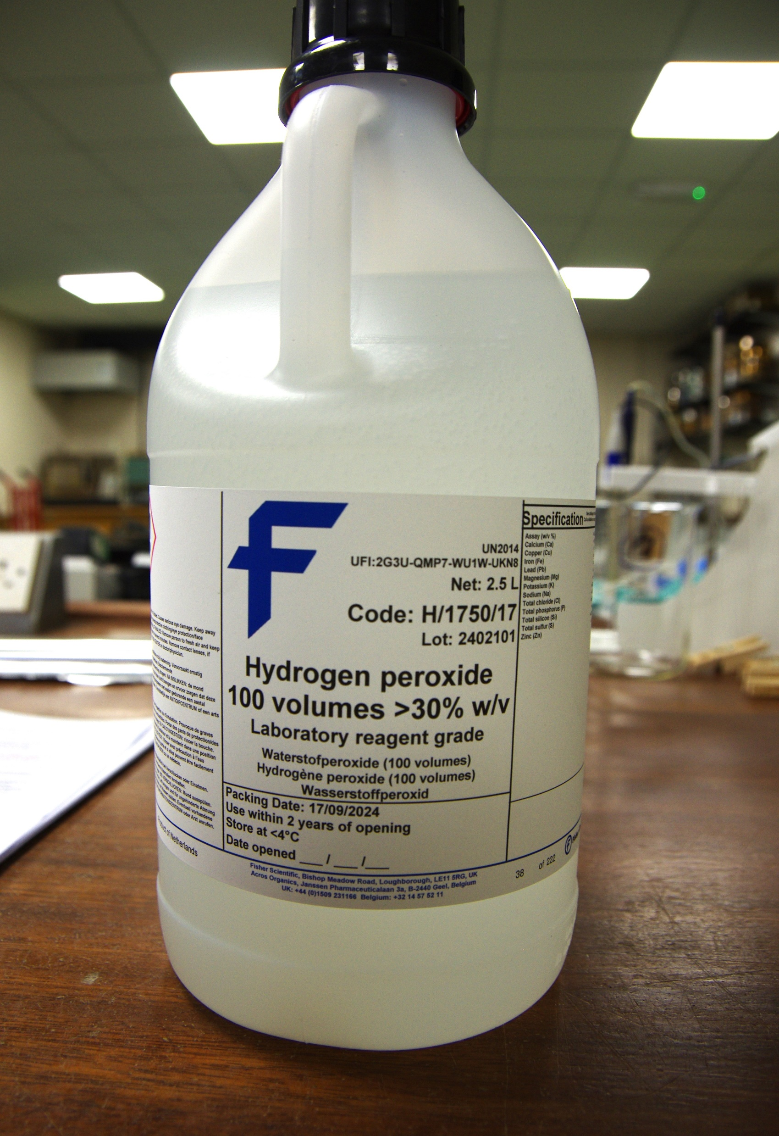
Identified method.
Use of sugar/water solution to separate ‘flots’, followed by immersion in a water/ bicarbonate of soda solution to deflocculate the soil of aggregates (Ross, A. & Duffy, R. 2000).
Sugar solution increases the specific gravity of the heavy fraction. Charcoal should float to the top (Kidder, T. R.,1997).
Our fall-back method if a safer method was not identified would involve using a diluted Hydrogen peroxide (H₂ O₂), solution.

Slide 4
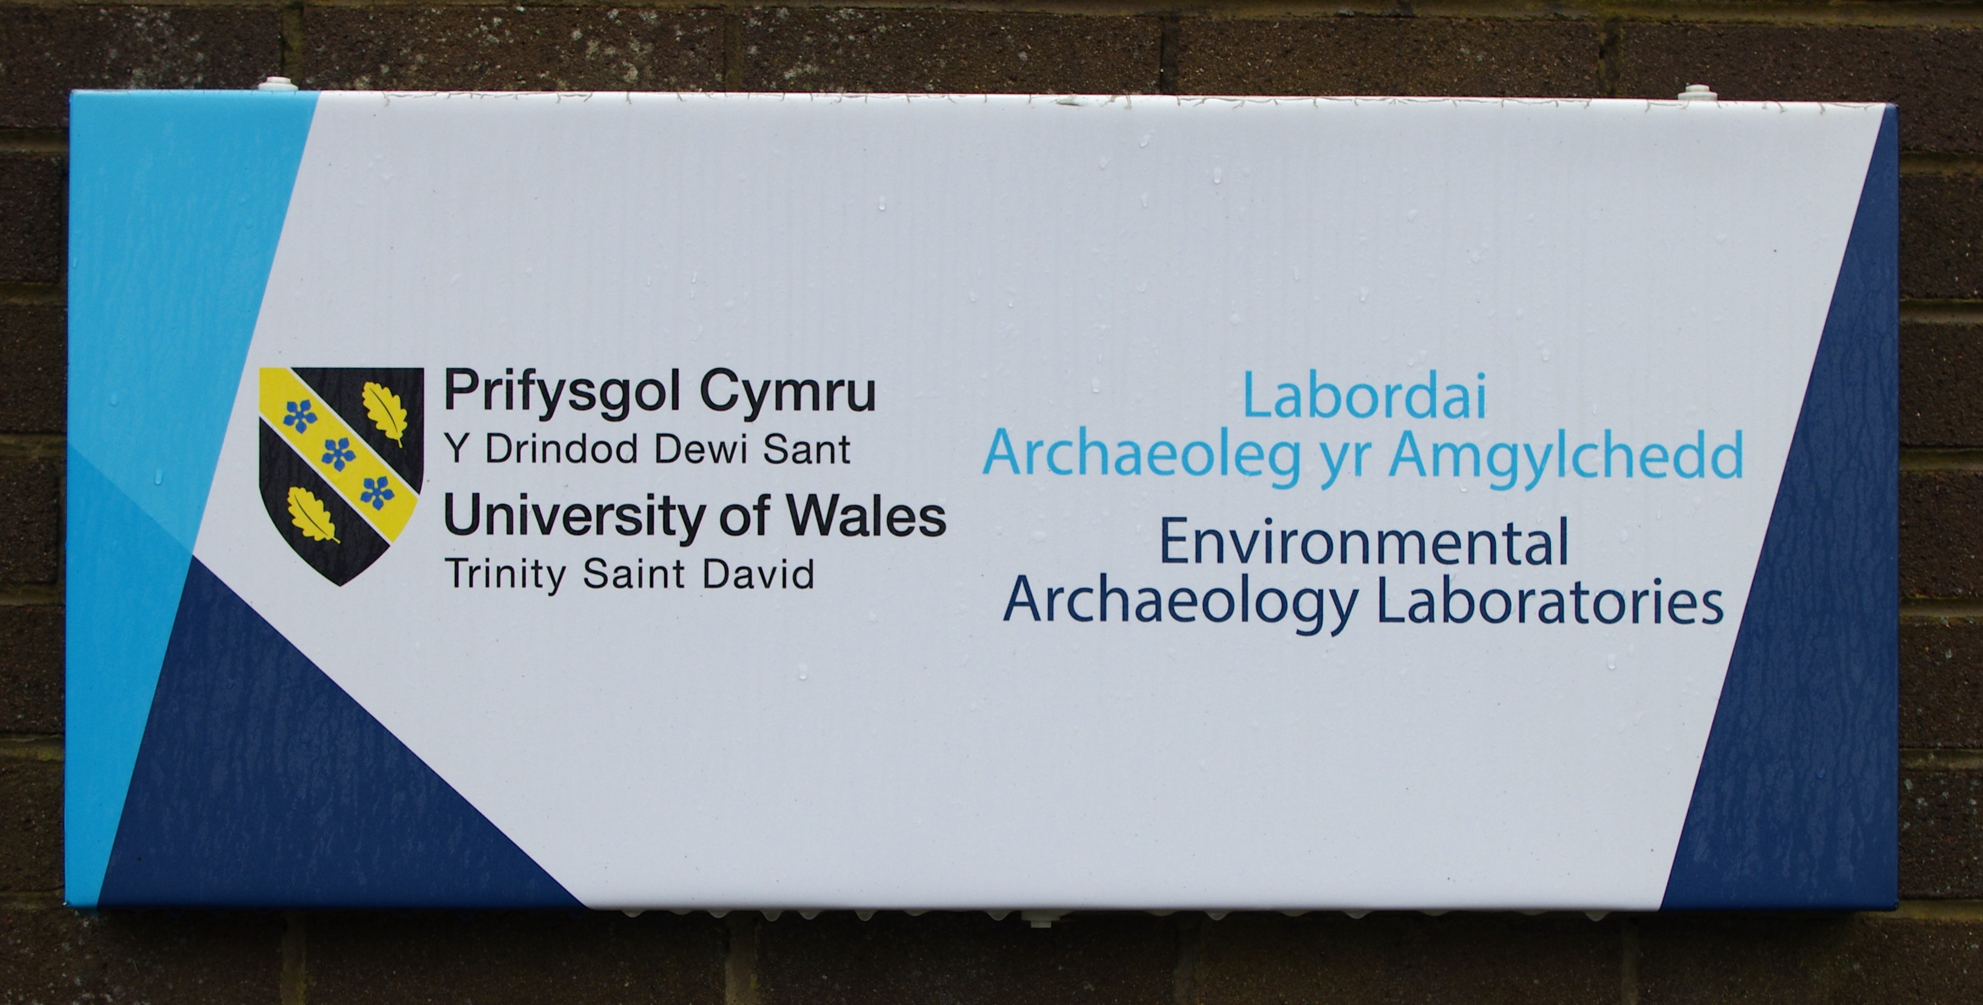
Experiment.
Use the afore mentioned solutions on samples from a sediment core drilled during the course of an archaeological investigation at Skaill near Skara Brae, on the Island of Orkney by Professor Martin Bates (Bates, 2025 ( c) ).
Use of the Laboratory facilities under the guidance of the Lab. Manager Dr Rod Bale.
Use of the Laboratory facilities under the guidance of the Lab Manager Dr Rod Bale

Slide 5
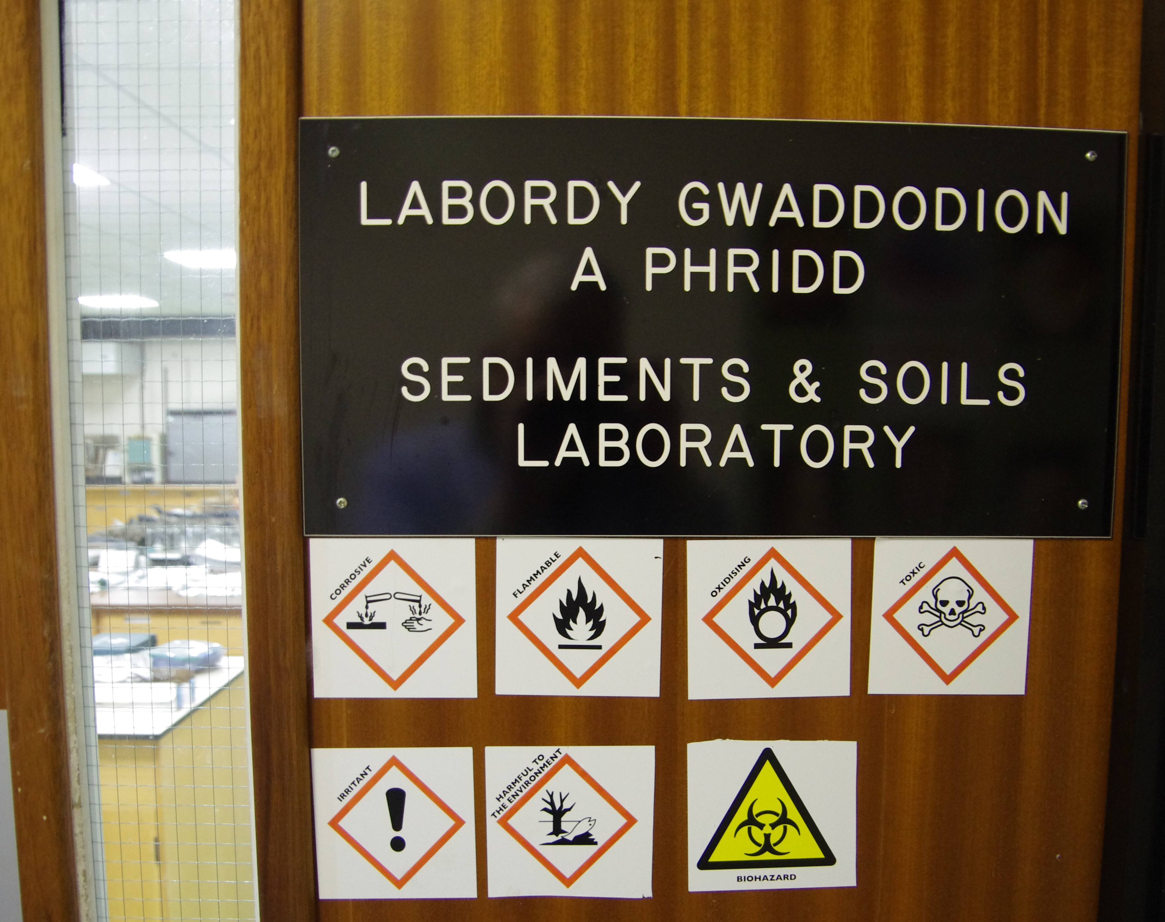
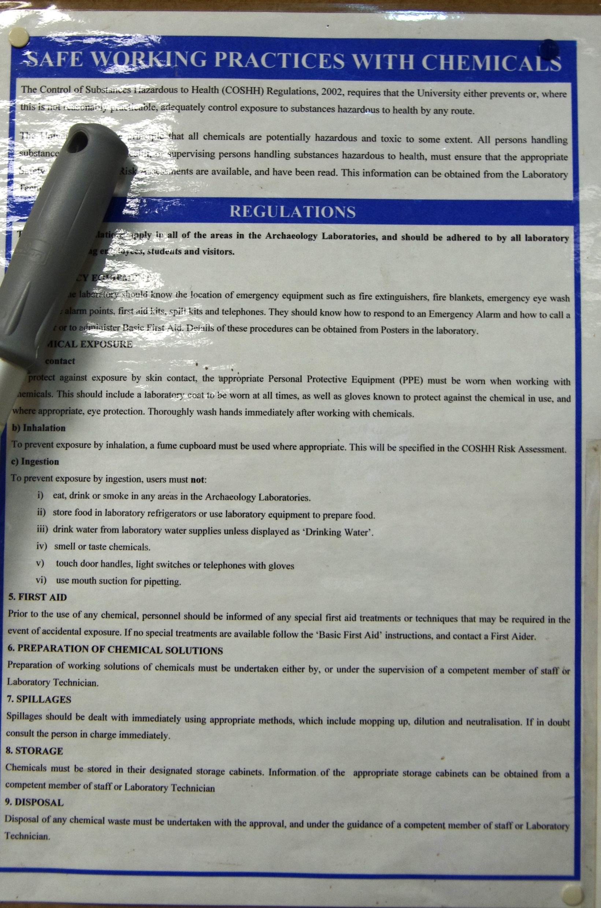
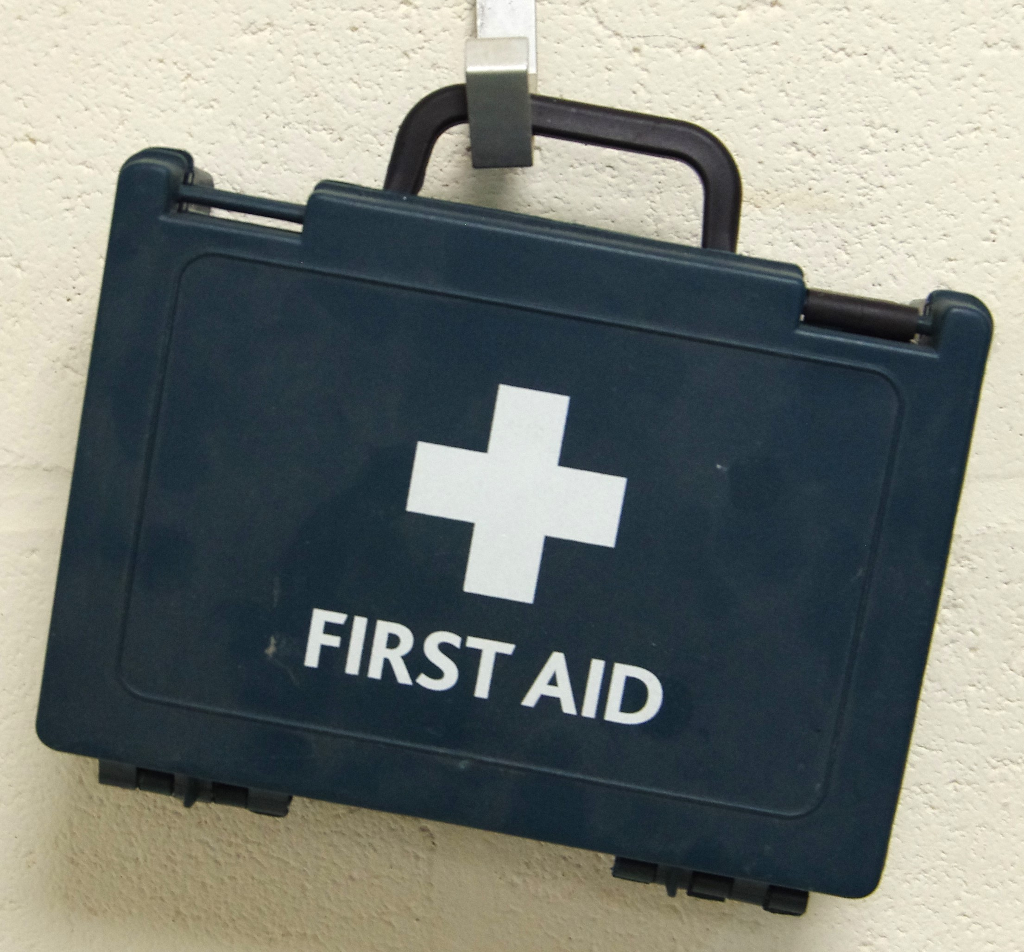
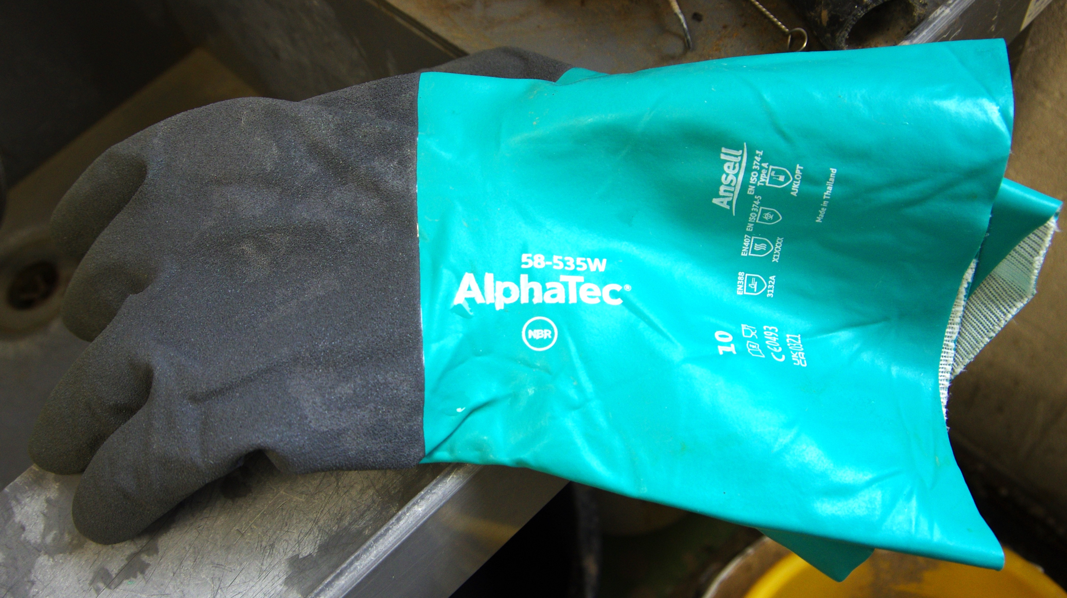
Considerations.
Active laboratory environment.
Expensive laboratory equipment.
Dangerous/toxic chemicals in storage and in use.
Health & safety procedures.
Laboratory Risk Assessment.
Identify locations of First Aid equipment.
Wear protective clothing when conducting the experiments.

Slide 6
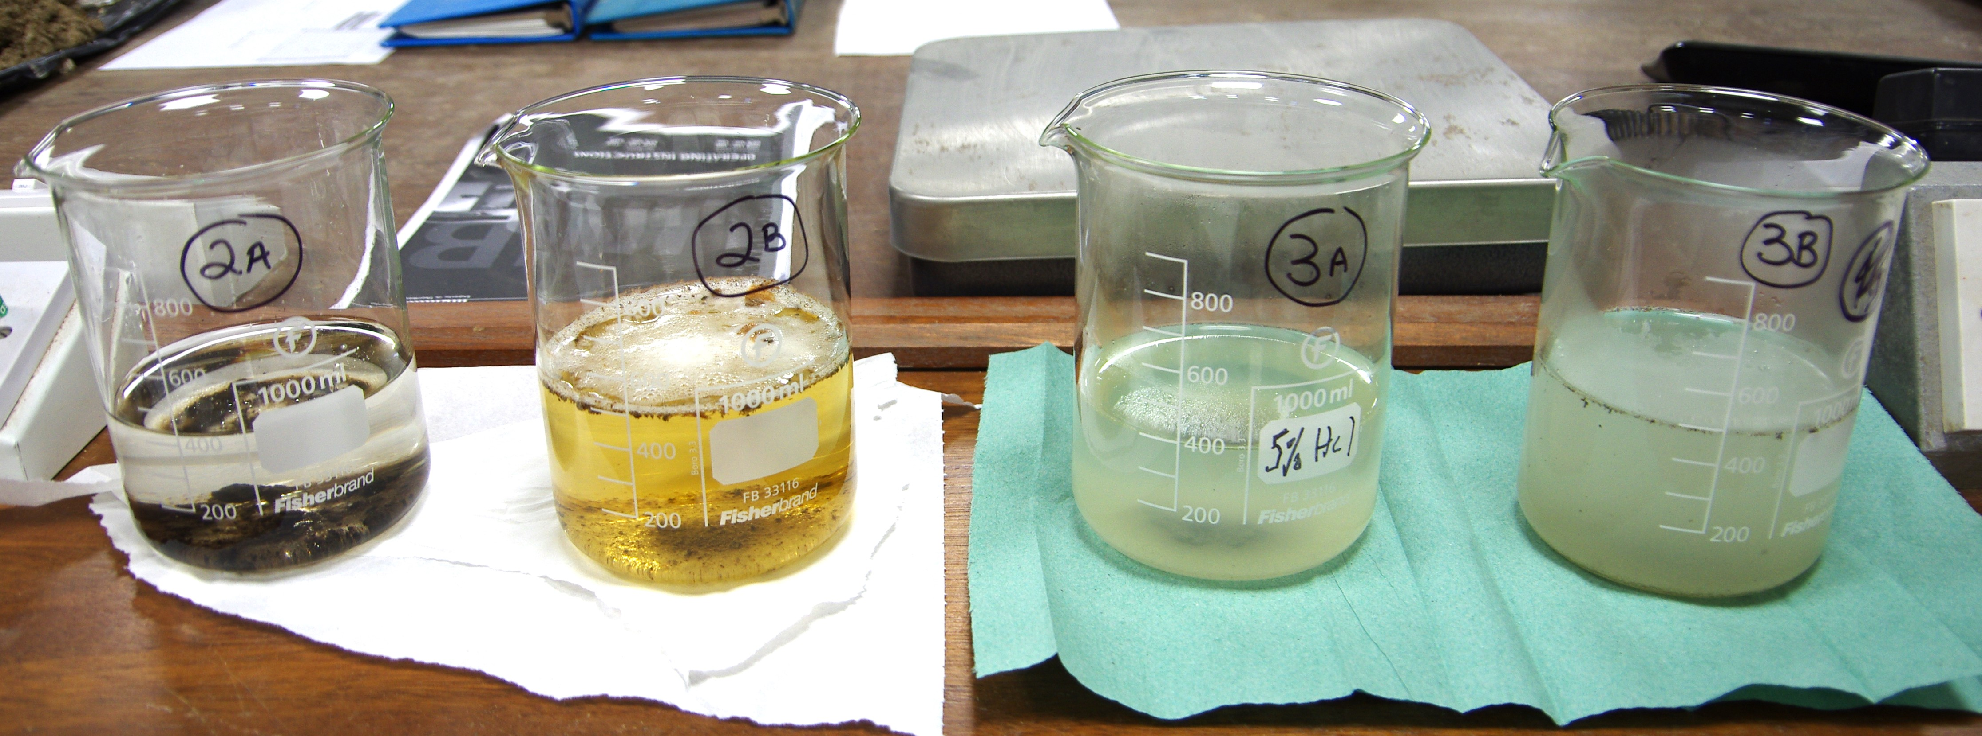
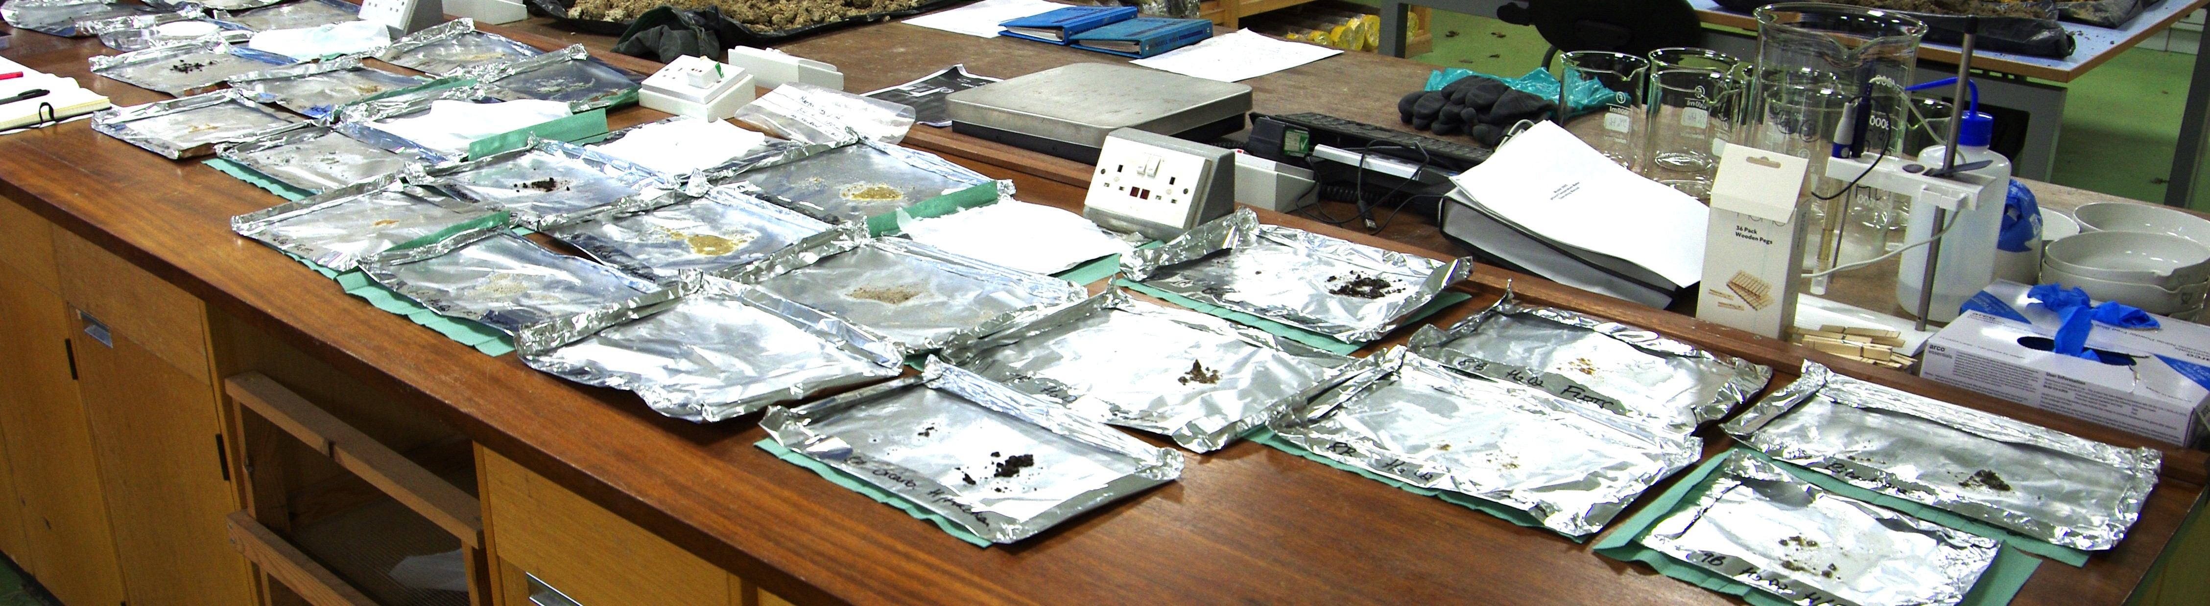

Slide 7
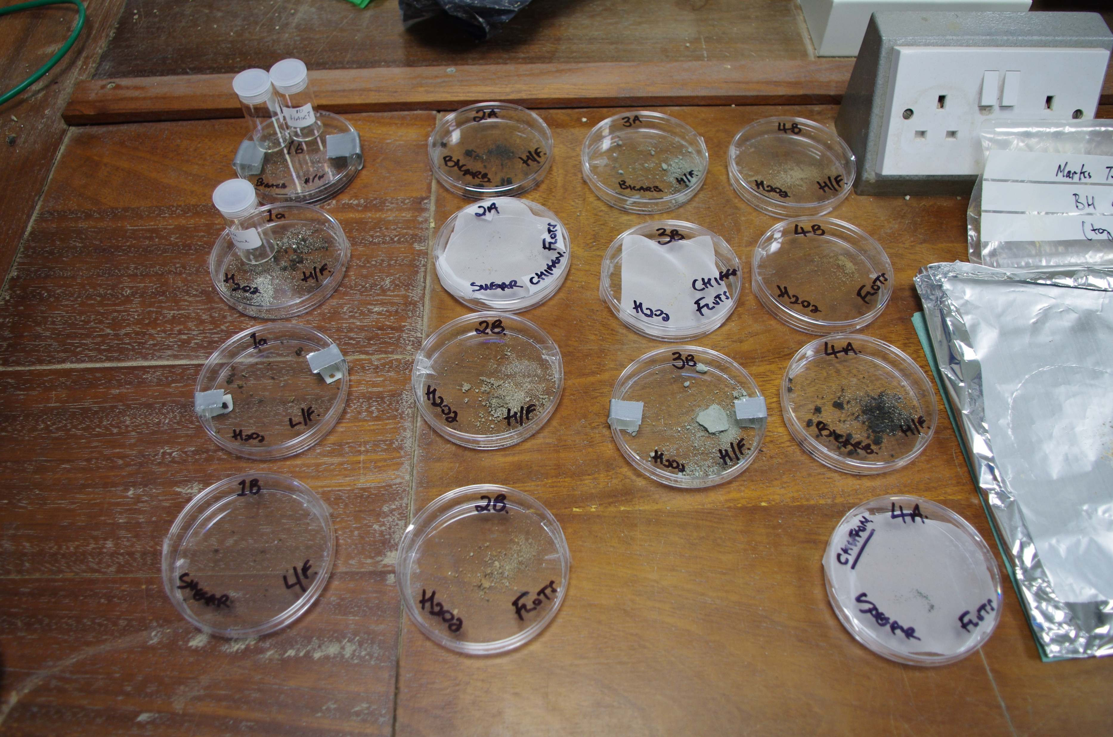
Every step of each procedure in noted in my notebook and on a spreadsheet.
Photographs are taken of each stage of the procedure.
When dry the samples are transferred to petri-dishes for further examination and storage.

Slide 8
Results.
Sugar solution did not work very well on the peat/clay soil from the core. It works better with sandy sediment.
Bicarbonate of soda solution provided slightly better deflocculation..
Hydrogen peroxide solution worked well in each case.
Next stage.
Currently utilising distilled malt vinegar and a solution of water and sodium hexametaphosphate.

Slide 9
What have I learnt from this experience?
The protocols of working within a laboratory environment and in particular the use of dangerous chemicals.
There is a huge amount of literature dealing with soil analysis, and there is much more to consider. Such as looking at how other industries conduct soil deflocculation.
It was an enjoyable experience which has provided a huge insight on the various scientific techniques used by archaeologists to reconstruct past environments.
My very brief involvement has made me eager to learn more and possibly carry on further with this experiment.

Slide 10
Bibliography.
Arranz-Otaegui, A. (2017). Evaluating the impact of water flotation and the state of the wood in archaeological wood charcoal remains: Implications for the reconstruction of past vegetation and identification of firewood gathering strategies at Tell Qarassa North (south Syria). Quaternary International, 457, 60–73. https://doi.org/10.1016/j.quaint.2016.06.030
Ascough, P.L. et al. (2010). “Alkali Extraction of Archaeological and Geological Charcoal: Evidence for Diagenetic Degradation and Formation of Humic Acids.” Journal of Archaeological Science, 38 (1). Pp.69-78. Available at: https://www.academia.edu/57609730/Alkali_extraction_of_archaeological_and_geological_charcoal_evidence_for_diagenetic_degradation_and_formation_of_humic_acids?email_work_card=view-paper (Accessed: 17 January 2025).
Banning, E. (2020). Archaeological Soils, Sediment and Geoarchaeology. [video]. Available at: https://www.youtube.com/watch?v=cwLTiYgvuK0 (Accessed: 14 January 2025).
Bates, M., (2025). Conversation with Gareth Jenkins on 9 January.
Bates, CR, Bates, M & Dawson, S. (2022). 'The Rising Tides Project, Orkney' Archaeology Scotland, vol. 44, pp. 26-28.
Bergslien, E. (2012). An Introduction to Forensic Geoscience. Willey- Blackwell.

Slide 11
Chiou, K.L., Cook, A.G. and Hastorf, C.A. (2013) ‘Flotation versus dry sieving archaeobotanical remains: A case history from the Middle Horizon southern coast of Peru’, Journal of field archaeology, 38(1), pp. 38–53. Available at: https://doi.org/10.1179/0093469012Z.00000000035. (Accessed: 11 January 2025).
Cobb, J. E. & Faulkner, C. H. (1978). “The Owl Hollow Project Laboratory Flotation Device.” In SEAC Newsletter Vol. 20. No.1.
Courty, M.A. Marie-A., Goldberg, P. and Macphail, R. (1989) Soils and micromorphology in archaeology. Cambridge: Cambridge University Press.
Cuenca‐García, C. (2019) ‘Soil geochemical methods in archaeo‐geophysics: Exploring a combined approach at sites in Scotland’, Archaeological prospection, 26(1), pp. 57–72. Available at: https://doi.org/10.1002/arp.1723. (Accessed: 28 January 2025).
Čufar, K. (2010). Recovery techniques for waterlogged archaeological sediments: a comparison of different treatment methods for samples from Neolithic Lake shore settlements. Vegetation History and Archaeobotany.
Decaix, A. and Douché, C. (2022). Introduction to Archaeobotany (Part 2). [video]. Available at: https://www.youtube.com/watch?v=fo-Q8Xxm4sE (Accessed: 14 January 2025).

Slide 12
Fairbairn, A. (2005). “Simple bucket flotation and wet-sieving in the wet tropics.” Palaeoworks Technical Papers 4. Available at: https://core.ac.uk/works/51741969/?t=e1c86db4ec1e63f31518692691bc29cd-51741969 (Accessed: 11 January 2025).
Gumerman, G. & Umemoto, B. S. (1987). “The Siphon Technique: An Addition to the Flotation Process.” American Antiquity, Vol. 52. No.2, pp. 330-336. Cambridge University Press. Available at: https://www.jstor.org/stable/281784 (Accessed: 9 January 2025).
Harrison, S. (2020) ‘David Griffiths, Jane Harrison and Michael Athanson, Beside the Ocean: Coastal Landscapes at the Bay of Skaill, Marwick and Birsay Bay, Orkney: Archaeological Research 2003–2018’, Scottish Archaeological Journal. UK: Edinburgh University Press, pp. 126–128. Available at: https://doi.org/10.3366/saj.2020.0129. (Accessed: 28 January 2025).
Hastorf, C.A. and Popper, V.S. (1988) Current paleoethnobotany : analytical methods and cultural interpretations of archaeological plant remains. Chicago, Ill. ; University of Chicago Press.
Hunter, A.A. and Gassner, B.R. (1998) ‘Evaluation of the Flote-Tech Machine-Assisted Flotation System’, American antiquity, 63(1), pp. 143–156. Available at: https://doi.org/10.2307/2694781 (Accessed: 12 January 2025).

Slide 13
Kabukcu, C. (2018). Wood Charcoal Analysis in Archaeology. Environmental Archaeology: Current Theoretical and Methodological Approaches, 133–154. https://doi.org/10.1007/978-3-319-75082-8 (Accessed: 17 January 2025).
Kabukcu, C. (2022). Highway to Science Introduction to wood charcoal analysis in archaeology. [video]. Available at: https://www.youtube.com/watch?v=EI8y6Xl_prc (Accessed: 14 January 2025).
Kidder, T.R. (1997) ‘Sugar Reflotation: An Alternative Method for Sorting Flotation-derived Heavy Fraction Samples’, Journal of field archaeology, 24(1), pp. 39–45. Available at: https://doi.org/10.1179/jfa.1997.24.1.39. (Accessed: 12 January 2025).
Langgut, D., Lev-Yadun, S., 2024. Archaeobotany: Wood and Charcoal Remains. In: Nikita, In E., Rehren, T. (Eds.), Encyclopedia of Archaeology, 2nd Edition, vol. 2, pp. 674–686, London: Academic Press. Available at: https://www.academia.edu/121001944/Archaeobotany_Wood_and_Charcoal_Remains_Langgut_and_Lev_Yadun_2024_In_Encyclopedia_of_Archaeology_2nd_Edition_ARC2_?nav_from=7d398d94-61a2-454e-8cfd-61a672d4fa8d (Accessed: 13 January 2025).
Latkova, M and Hajnalova, M., (2014). Plant macro-remains from the palaeochannel sediments, trench B 2012. In Poláček, L. (ed.). Mikulčice river archaeology. New interdisciplinary research into bridge No. 1. Brno : The Institute of Archaeology of the Academy of Sciences of the Czech Republic, Brno, 2014. s. 93-112. Available at: https://www.academia.edu/11778918/Plant_macro_remains_from_the_palaeochannel_sediments_trench_B_2012 (Accessed: 13 January 2025).

Slide 14
Mas, B. (2019). Flotación Manual - Bucket Flotation: to recover archaeological remians. Available at: https://www.youtube.com/watch?v=CubTMey6ED4 (Accessed:14 January 2025).
Macphail, R. and Goldberg, P. (2018) Applied soils and micromorphology in archaeology. Cambridge, United Kingdom ; Cambridge University Press.
Monnier, G.F. (2018) ‘A review of infrared spectroscopy in microarchaeology: Methods, applications, and recent trends’, Journal of archaeological science, reports, 18, pp. 806–823. Available at: https://doi.org/10.1016/j.jasrep.2017.12.029. (Accessed: 16 January 2025).
Monteiro, P. M. (2013). “Wood charcoal analysis of Mesolithic Archaeological contexts from Portugal: State of the art.” In Revista Arkeogazte/Aldizkaria N.º 3, año 2013. urtea 3.zbk. Monographic: Archaeology and environment, there and back again. Available at: https://www.academia.edu/5183073/Wood_charcoal_analysis_of_Mesolithic_Archaeological_contexts_from_Portugal_State_of_the_art (Accessed: 13 January 2025).
Nguyen, Q. & Nguyen, D & Rouw, S. (2022). Portable Hybrid Flotation Tank. Northern Illinois University, USA. Available at: https://www.niu.edu/ceet/_files/senior-design/2022/abstracts/team-42-abstract-sp-2022.pdf (Accessed: 19 January 2025).
O’Connor, T. and Evans, J.G. (2005) Environmental archaeology : principles and methods. 2nd ed. rev. & updated. Stroud: Sutton.
Panagiotis, T. K. & Goldberg, P. (2019). Reconstructing Archaeological Sites: Understanding the Geoarchaeological Matrix. Willey Blackwell.

Slide 15
Pearsall, D. M. (2016). Paleoethnobotany: A Handbook of Procedures. 3rd Ed. Routledge.
Ramenofsky, A.F. et al. (1986) ‘A New Technique for Separating Flotation Samples’, American Antiquity, 51(1), pp. 66–72. Available at: https://doi.org/10.2307/280394. (Accessed: 12 January 2025).
Rebollo, N. et al. (2008) ‘Structural Characterization of Charcoal Exposed to High and Low pH: Implications for 14C Sample Preparation and Charcoal Preservation’. Available at: https://doi.org/10.1017/S0033822200033592. (Accessed: 16 January 2025).
Rising Tide Orkney https://www.abdn.ac.uk/staffpages/uploads/arc007/Rising%20Tide%20Project%20Information%20June%2009.pdf
Ross, A. and Duffy, R. (2000) ‘Fine mesh screening of midden material and the recovery of fish bone: The development of flotation and deflocculation techniques for an efficient and effective procedure’, Geoarchaeology, 15(1), pp. 21–41. Available at: https://doi.org/10.1002/(SICI)1520-6548(200001)15:1<21::AID-GEA2>3.0.CO;2-L. (Accessed: 11 January 2025).
Shelton, C.P. and White, C.E. (2010) ‘The Hand-Pump Flotation System: A New Method for Archaeobotanical Recovery’, Journal of field archaeology, 35(3), pp. 316–326. Available at: https://doi.org/10.1179/009346910X12707321358838. (Accessed: 11 January 2025).

Slide 16
Stevenson, J. & Haberle, S., (2018). Macro Charcoal Analysis: A modified technique by the Department of Archaeology and Natural History. Palaeoworks Technical Papers 5. Australian National University. Available at: https://d1wqtxts1xzle7.cloudfront.net/82292238/paltr05-libre.pdf?1647556057=&response-content-disposition=inline%3B+filename%3D (Accessed: 10 January 2025).
Struever, S. (1968). “Flotation Techniques for the Recovery of Small-Scale Archaeological Remains.” American Antiquity, Vol.33, No. 3, pp. 353-362. Cambridge University Press. Available at: https://www.jstor.org/stable/278703 (Accessed: 12 January 2025).
Tolar, T. et al. (2010) ‘Recovery techniques for waterlogged archaeological sediments: a comparison of different treatment methods for samples from Neolithic lake shore settlements’, Vegetation history and archaeobotany, 19(1), pp. 53–67. Available at: https://doi.org/10.1007/s00334-009-0221-y. (Accessed: 15 January 2025).
Tsakiridou, M., Cunningham, L. and Hardiman, M. (2021) ‘Toward a standardized procedure for charcoal analysis’, Quaternary research, 99, pp. 329–340. Available at: https://doi.org/10.1017/qua.2020.56. (Accessed: 10 January 2025).
VanDerwarker, A.M. et al. (2016) ‘New World Paleoethnobotany in the New Millennium (2000–2013)’, Journal of archaeological research, 24(2), pp. 125–177. Available at: https://doi.org/10.1007/s10814-015-9089-9. (Accessed: 18 January 2025).

Slide 17
Veal, R. J., O’Donnell, L., McParland, L. (2011). Measuring burn temperatures from charcoal using the reflectance method, first results from an Irish Bronze Age cremation site. Available at: https://www.academia.edu/75274239/_PDF_Measuring_burn_temperatures_from_charcoal_using_the (Accessed: 19 January 2025).
Veal, R. J. (2014). Protocols for the Collection, Identification and Interpretation of Archaeological Charcoal and Wood. Technical Report, University of Cambridge. Available at: https://www.academia.edu/18712282/Charcoal_and_Wood_Field_Collection_Protocols (Accessed: 9 January 2025).
Weiner, S. (2010). Microarchaeology: Beyond the Visible Archaeological Record. Cambridge University Press.
Wilkinson, K. and Stevens, C. (2003) Environmental archaeology : approaches, techniques & applications. Stroud: Tempus.

