Slide 1
ECGE 4001Q
Academic Study Skills for Students
Assessment 2
Trudi Davies (1402946)
20th January 2020

Slide 2


Assessment Question
Explain how to reference within a body of the text (in-text citation) and reference list:
  Books
  Journal articles
  Government legislation
  Websites
Wikimedia Commons (2011)
Getty Images (2018)

Slide 3
Referencing Academic Texts
What is a reference?
‘Referencing is the process of acknowledging the sources you have used in writing your assignment.’
(Pears and Shields, 2013, p.1)
Why do we need to use references?
  Courtesy to the original author
  Helps other readers in finding sources
  Helps you if you need to find the source again
  Avoids plagiarism
  Gives readers confidence in your written academic work
(Cottrell, 2013, p.179)

Slide 4
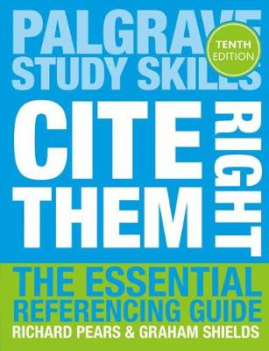
Books
In text citation for a book should include these points:
Author(s) surname
Year of publication
Page number(s) if required, if it is a direct quote
Example: (Pears and Shields, 2016)
Main reference list for a book:
Author(s) surname followed by initial of first name
Year of publication
Title of the book (in italics)
Place of publication
Publisher
Example: Pears, R. and Shields, G. (2016) Cite Them Right: The Essential Referencing Guide, 10th edn. London: Palgrave Macmillan.
(Pears and Shields, 2016)

Slide 5
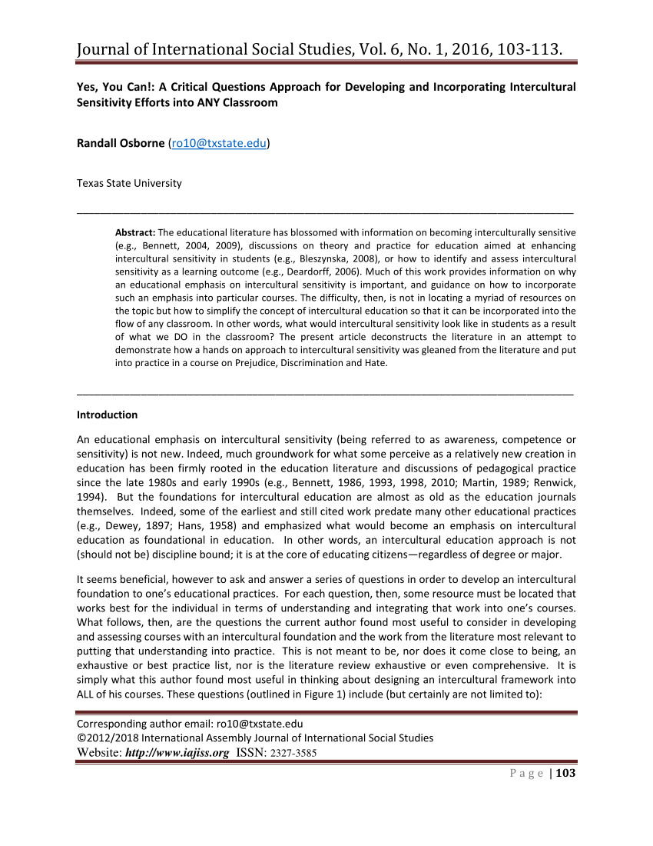
Journals
In text citation for a journal:
Author(s) surname
year of publication
Example: (Osborne, 2016)
Main reference list for a journal:
Author(s) surname followed by initial of first name
Year of publication
Article title in quotation marks
The journal title to be in italics
Volume number, issue number in brackets
Page(s) of journal
Examples:
Library copy:
Osborne, R. (2016) ‘Yes, you can!: A Critical Questions Approach for Developing and Incorporating Intercultural Sensitivity Efforts into Any Classroom’, Journal of International Social Studies, 6(1), pp.103-113.
On-line version:
Osborne, R. (2016) ‘Yes, you can!: A Critical Questions Approach for Developing and Incorporating Intercultural Sensitivity Efforts into Any Classroom’, Journal of International Social Studies. Available at: https://files.eric.ed.gov/fulltext/EJ1149354.pdf (Accessed: 13 January 2020).

Slide 6
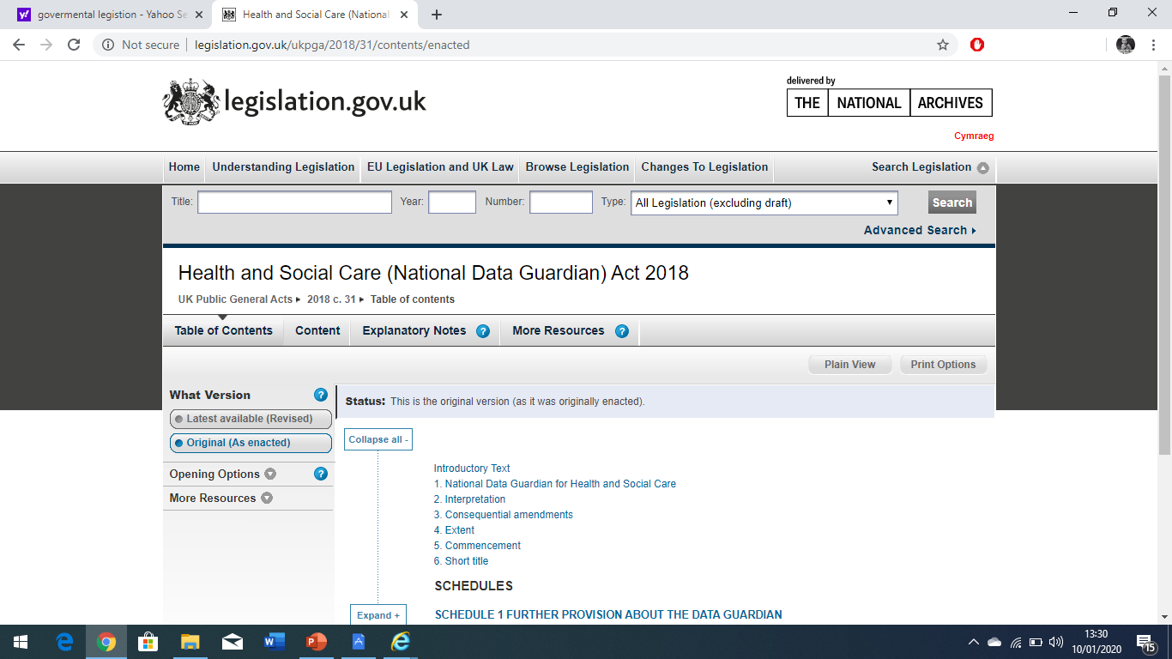
Government Legislation
In-text citation of a Government legislation document/Act:
The name of the legislation/Act
The date
Example: (Health and Social Care Act, 2018)
Main reference list for Government legislation document/Act:
Name of legislation/Act (in Italics)
Year
Chapter
If legislation is on-line, include ‘available at: +URL’
Date the information was accessed
Example: Health and Social Care Act 2018,c.31. Available at: http://www.legislation.gov.uk/ukpga/2018/31/contents (Accessed:14 January 2020).

Slide 7
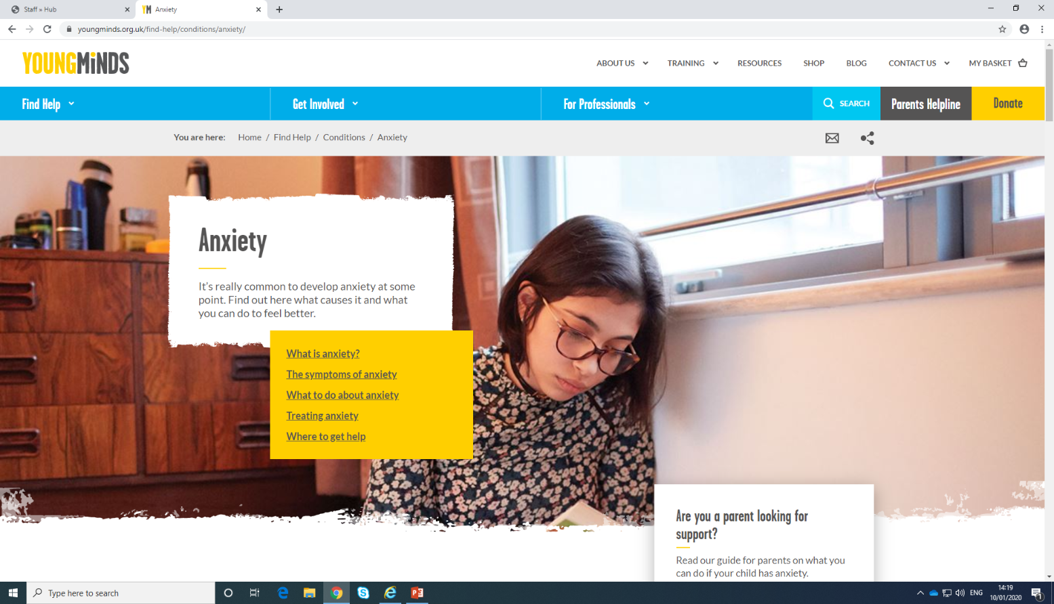
Websites
In-text citation for a website:
Name of website
Date
Example: (Young Minds, 2019)
Main reference list for a website:
Name of website
Date
Title in italics
Link to get it from available at
Accessed date
Example: Young Minds (2019) Anxiety. Available at: https://youngminds.org.uk/findhelp/conditions/anxiety/ (Accessed: 14 January 2020).
(Young Minds, 2019)

Slide 8

Conclusion
Referencing is important because:
  Your work looks more professional
  Helps you find good resources
  Proves that you have read!
  The reader can trace your resources
  It’s a way of keeping note of what you have read
Direct Quote
Alphabetical order of authors
Different ways of referencing
Lectures on Moodle
(The Spectator, 2019)

Slide 9
Reference list
Cottrell, S. (2013) The Study Skills Handbook, 4th edn. London: Palgrave Macmillan.
Cottrell, S. and Morris, N. (2012) Study Skills Connected: Using Technology To Support Your Studies. London: Palgrave Macmillan.
Getty Images (2018) Read Up With Our Favorite End-of-Year Books [Online]. Available at: https://www.wired.com/story/favorite-books-q4-2018/ (Accessed: 13 January 2020).
Health and Social Care Act 2018,C31. Available at: http://www.legislation.gov.uk/ukpga/2018/31/contents (Accessed: 14 January 2020).
Osborne, R. (2016) ‘Yes ,you can! A Critical Questions Approach for Developing and Incorporating Intercultural Sensitivity Efforts into Any Classroom’, Journal of International Social Studies, 6(1), pp.103-113.
Pears, R. and Shields, G. (2013) Cite Them Right: The Essential Referencing Guide, 9th edn. London: Palgrave Macmillan.
Pears, R. and Shields, G. (2016) Cite Them Right: The Essential Referencing Guide, 10th edn. London: Palgrave Macmillan.
The Spectator (2019) Why do we write dedications in books? [Online]. Available at: https://spectator.imgix.net/content/uploads/2019/09/Anthony-Quinn.jpg?auto=compress,enhance,format&crop=faces,entropy,edges&fit=crop&w=820&h=55 (Accessed: 13 January 2020).
Wikimedia Commons (2011) Magnifying glass with focus on glass [Online]. Available at: https://commons.wikimedia.org/wiki/File:Magnifying_glass_with_focus_on_glass.png (Accessed: 13 January 2020).
Young Minds (2019) Anxiety. Available at: https://youngminds.org.uk/findhelp/conditions/anxiety/ (Accessed: 14 January 2020).

Slide 10
Any Questions?

