Slide 1
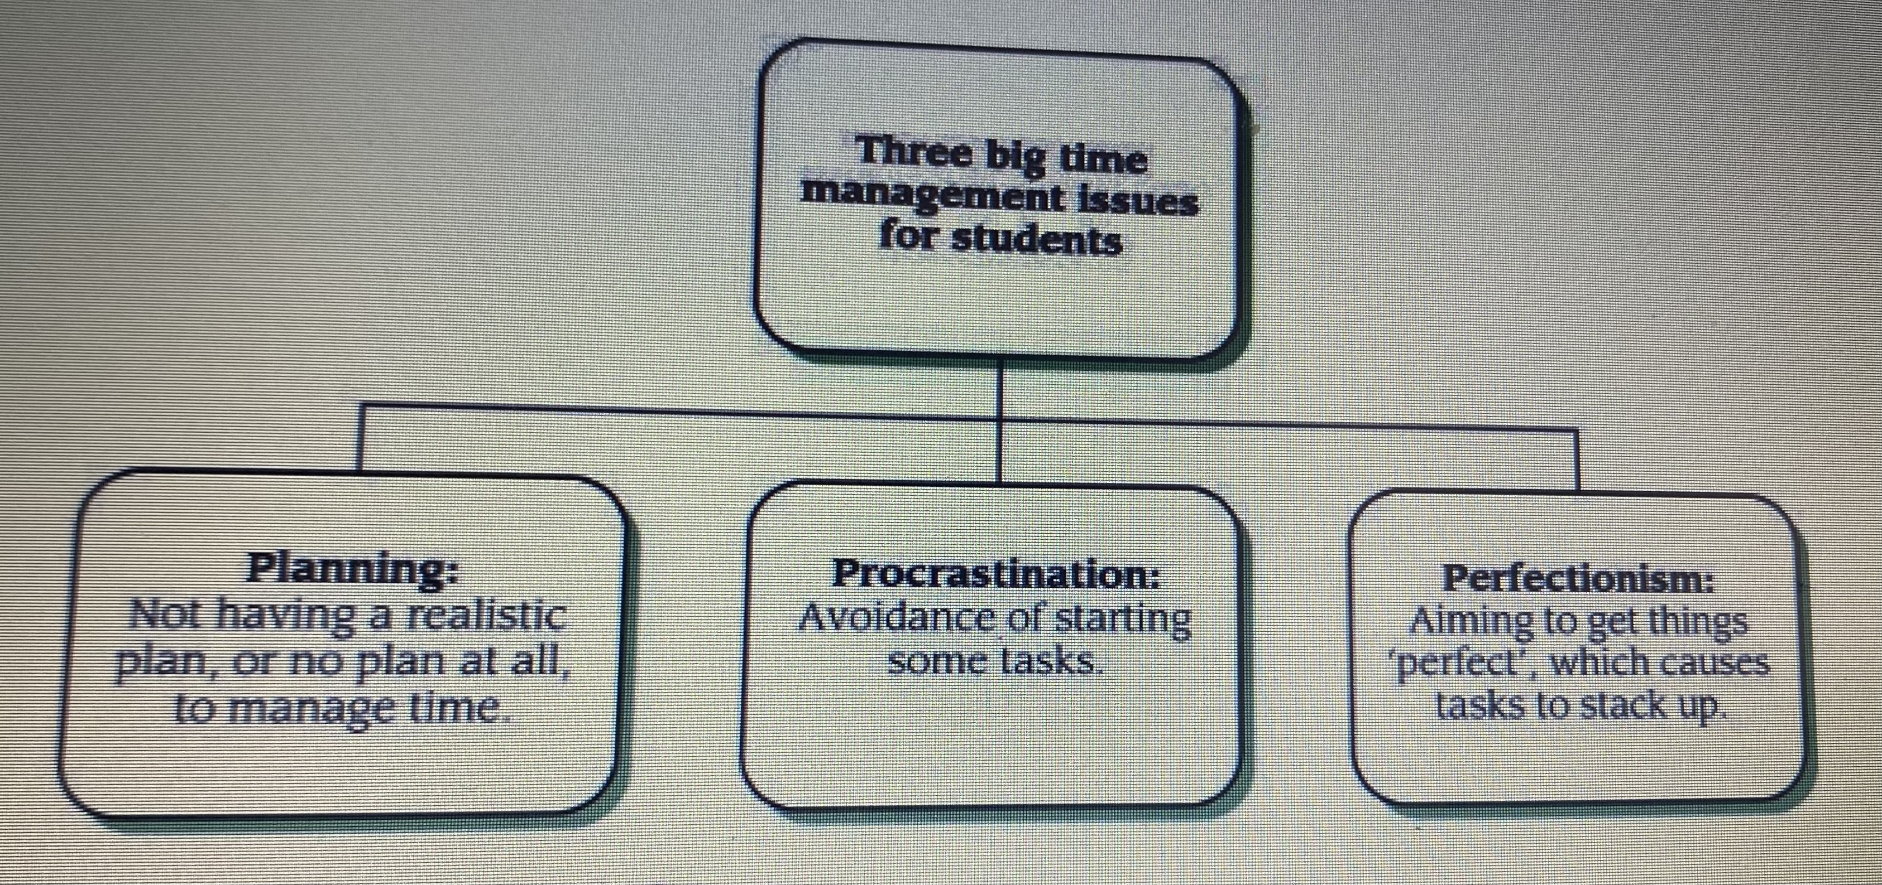
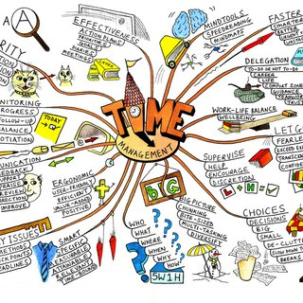
WELCOME
Academic Study Skills
During the presentation we will be identifying and discussing some essential skills to support our academic journey.
Referencing
(Pears and Shields 2022, p.1) describe referencing as the way we give credit to the work of others. Therefore, avoiding plagiarism.
Note Taking
Effective note taking is an essential skill that can be used throughout a lifetime. A skill that can be transferred and adapted to suit various settings.
There are many ways of note taking, finding a way that works for you is important as this will accentuate the relevant information that you need to recall.
Cottrell, (2019) P.213 states 'The way that you make notes can have a significant effect on your ability to find, recall and apply information in practical contexts, such as in exams, the workplace, the lab or studio'.
Figure 8.1: Three time management issues (Moore et al, 2010, p.135).
Conclusion
As we come to the end of the poster/presentation, it is evident that effective use of study skills will support further academic development. Continuing to develop these skills will be key to future successes.
Thank you for joining.
Time Management
As illustrated in the image above (see figure 8.1) (Moore et al.2010,p.135) outlines the three main issues of time management. They promote planning as being a key element to succeed in an academic journey.
Figure 2. (Quigley,2010) A mind map for "Time management", showing colourful illustrations and text to support the memory.

Slide 2
Reference List
Academic Resource Centre at Harvard University. (2023) Perfectionism.
Available at: https://www.academicresourcecentreharvard.edu/perfectionism (Accessed: September 2023)
Cottrell,S. (2017) Critical Thinking Skills. 3rd edn. London: Red Globe Press.
Cottrell,S. (2019) The study skills handbook. 5th edn. London: Red Globe Press.
Dorwart,L. (2023) 'Perfectionism' Verywell Health. Available at: https://verywellhealth.com/perfectionism
(Accessed: September 2023)
Le Cunff,A.(2022) 'The science of note-taking', Ness Labs. Available at: https://nesslabs.com/note-taking
(Accessed: September 2023)
Moore,S.et al. (2010) The ultimate study skills handbook. Maidenhead,England: Open University Press
Pears,R. and Shields,G. (2022) Cite them right: the essential referencing guide.12th edn. New York: Bloomsbury Academic.
Quigley,A.(2010) A mind map for time management. Available at : https://www.researchgate.net (Accessed: September 2023)
Shatz,I. (2023) 'Procrastination theories: The psychological frameworks for explaining procrastination', Solving procrastination.
Available at: https://www.solvingprocrastination.com (Accessed: September 2023)
Steel,P. (2011) 'Procrastination and the perfectionism myth', Psychology Today [Online], January 2011.
Available at: https://www.psycologytoday.com (Accessed: September 2023)

