Slide 1

M&S
Transforming for the Future
It's amazing what a penny can do. 'Don't ask the price, it’s a penny' was the slogan Michael Marks used when he opened his first bazaar in Leeds in 1884. It couldn’t be any simpler and both his idea and hard work soon paid off. Spencer in 1894 that the we all know really started to take shape.

Slide 2
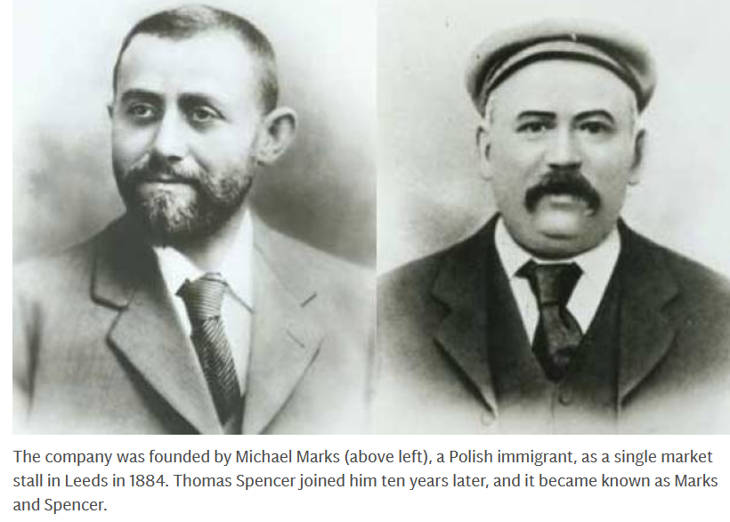
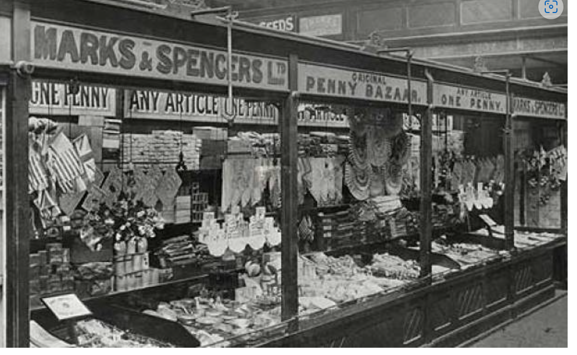
Marks and Spencer Group PLC a Public Limited Company is a United Kingdom-based retail company, which is focused on own label businesses, including food, clothing and home and, bank and services in the United Kingdom and internationally, and prides itself on quality.
Founded in 1884 by Michael Marks as a stalls in Leeds, it was when Thomas Spencer joined him 10 years later it became known as Marks and Spencer, (Guardian.com, 2008).
Up until recently Steve Rowe was CEO and began the fix the basics and never the same again campaign in Transforming and shaping a new future for the Company . It was to be a 5yr plan,but has had to move faster because of current challenges and lessoned from the pandemic. The New CEO Stuart Machin will continue to drive these changes forward, (Marks and Spencer, corporate,2022).
(Guardian.com,2008)
(Guardian.com,2008)

Slide 3
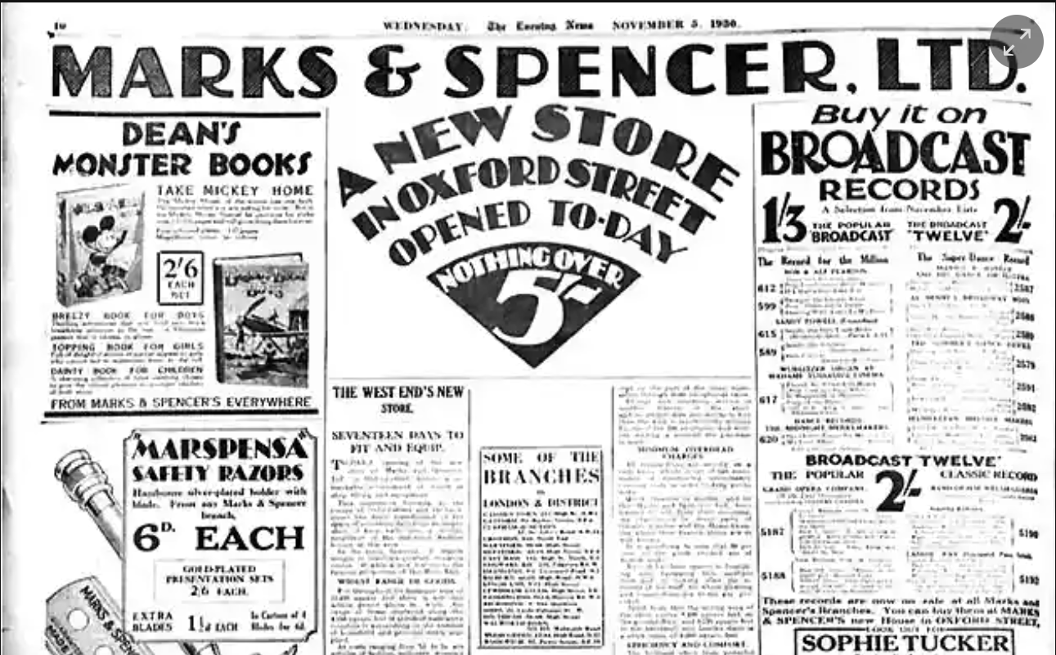
M&S currently has
65,000 employees
1487 Stores Globally
780 in Uk and 430 internationally
Has been around for 139 years
The company has well established a mostly trustworthy reputation for it’s quality in their products and customer focus, (Marks and Spencer, 2023).
(Guardian.com,2008).

Slide 4

Current Market Position
2019 loses place in ftse 100
Seen shares drop by 45% in the last 3 years, (Middleton,2019).
From profits of 1 Billion in 2007-08 dropping to £523 million in 201819 (Middleton,2019).
Figures dropping again in 2019-20 and 2020-20, (Middleton,2019).
Figures for 2021-2022 were better raising to £522.9 million a 29.7% increase (Marksandspencer,2023).

Slide 5

There have been many contributors towards M&S struggles
Political, economic, technological and more, some key issues many organisations not just M&S have been challenged with.
Brexit
pandemic
Rising energy costs
Financial losses
Omni channel
On lines sales
Underperforming stores
Outdated technology
Significant changes are being made throughout the organisation New leadership and restructuring of management
Up-Dating Technology
Closing unperforming stores
These are just a few examples of the Significant transformation the company is going through and many changes been brought in sooner from things they have learnt since the pandemic, (MarkandSpencer,2022).

Slide 6

Shaping the Future
Looking at the Store Rotation change in more depth
Whilst there are store closures taking place there are also new stores opening
With underperforming stores closing, new sustainable stores opening, more foodhalls opening , and refurbishing of stores there’s a significant amount being invested to reshape the future of stores, to allow the organisation to grow and shape a better more sustainable and up to date competitor in an firecly competitive market.
(MarksandSpencer,2022)

Slide 7

References
Guardian.com 2008 The history of Marks and Spencer available at: https://www.guardian.com/business/gallery/2008/jul/09/marksandspencer-history
Accessed (29/01/2023)
M&S Corporate,2022 online Building a store estate that’s sustainable in every way Available at: https://corporate.marksandspencer.com/stuart-machin-building-store-estate-thats-sustainable-every-way
Accessed (26/01/2023).
M&S Corporate, 2023 About us Available at: https://www.corporate.marksandspencer.com/about-us
Accessed (26/01/2023).
M&S Corporate, 2023 Our year in Review Available at: https://www.corporate.marksandspencer.com/investors/our-performance-updates/2022-annual-report
Accessed (26/01/2023)
Middleton,J 2019 M&S is demoted from FTSE 100 for the first time since index was created 35 years ago Available at: https://www.daily.mail.co.uk/news/article-7423589/m-s-demoted-FTSE-100-time-index.html
Accessed (26/01/2023)
5.

