Slide 1
MSc Data and Artificial Intelligence
Research Methods and Professional Development
Research Proposal:
Evaluating Machine Learning Models for Financial Fraud Detection: A Framework for Practical Model Selection
Lecturer Dr Mohamed Ben Farah
Student Marin Karakolev ID 2029731

Slide 2
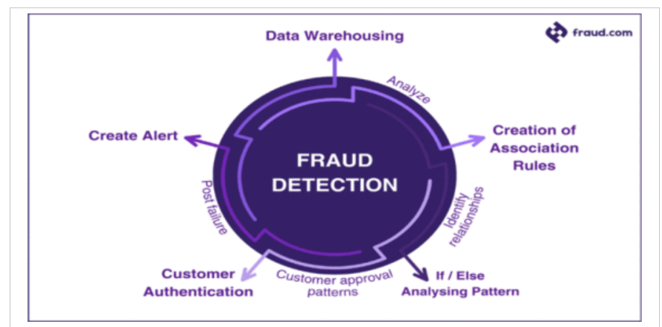
Research Context / Background
Background
Digital banking and online payments continue to grow rapidly.
Financial fraud causes significant financial losses worldwide.
Fraud detection systems need to deliver accurate results with minimal delay.
Conventional rule-based approaches often have difficulty adapting to emerging fraud patterns.
Current Development
Increasing adoption of Machine Learning (ML).
Growth of ensemble and boosting methods.
Interest in explainable and deployable AI solutions.

Slide 3

Research Problem
Problem Statement
Fraudulent transactions constitute only a small proportion of the overall financial transaction data.
This creates two major challenges:
• Class imbalance
• Difficulty detecting rare fraud cases
Many studies report high accuracy but still fail to identify a significant proportion of fraudulent transactions.
Literature Support
• Class imbalance remains a major challenge
• Strong performance does not always translate to real-world deployment

Slide 4

Research Aim and Objectives
Research Aim
To evaluate traditional machine learning models used to detect financial fraud and develop a practical framework for selecting models based on predictive performance, interpretability, computational efficiency and deployment suitability.
Objectives
Review current ML approaches for fraud detection.
Compare Logistic different ML models.
Evaluate model performance using appropriate metrics.
Assess suitability for real-world deployment.
Identify strengths and limitations of each model.
Develop a practical model selection framework.

Slide 5

Literature Review Summary
Key Findings from Literature
• Logistic Regression is simple and interpretable.
• Decision Trees are easy to understand but may overfit.
• Random Forest improves robustness and prediction accuracy.
• XGBoost often achieves the strongest predictive performance.
• SMOTE and resampling techniques help address class imbalance.
Common Theme
Ensemble and boosting methods generally outperform single classifiers.

Slide 6
Research Gap
What is Missing?
Current studies mainly focus on:
• Accuracy improvements
• Single-dataset evaluation
• Benchmark comparisons
Less attention is given to:
• Practical deployment
• Model interpretability
• Computational cost
• Balance between performance and usability
Gap
There is limited research comparing traditional ML models while considering both predictive performance and real-world suitability.

Slide 7
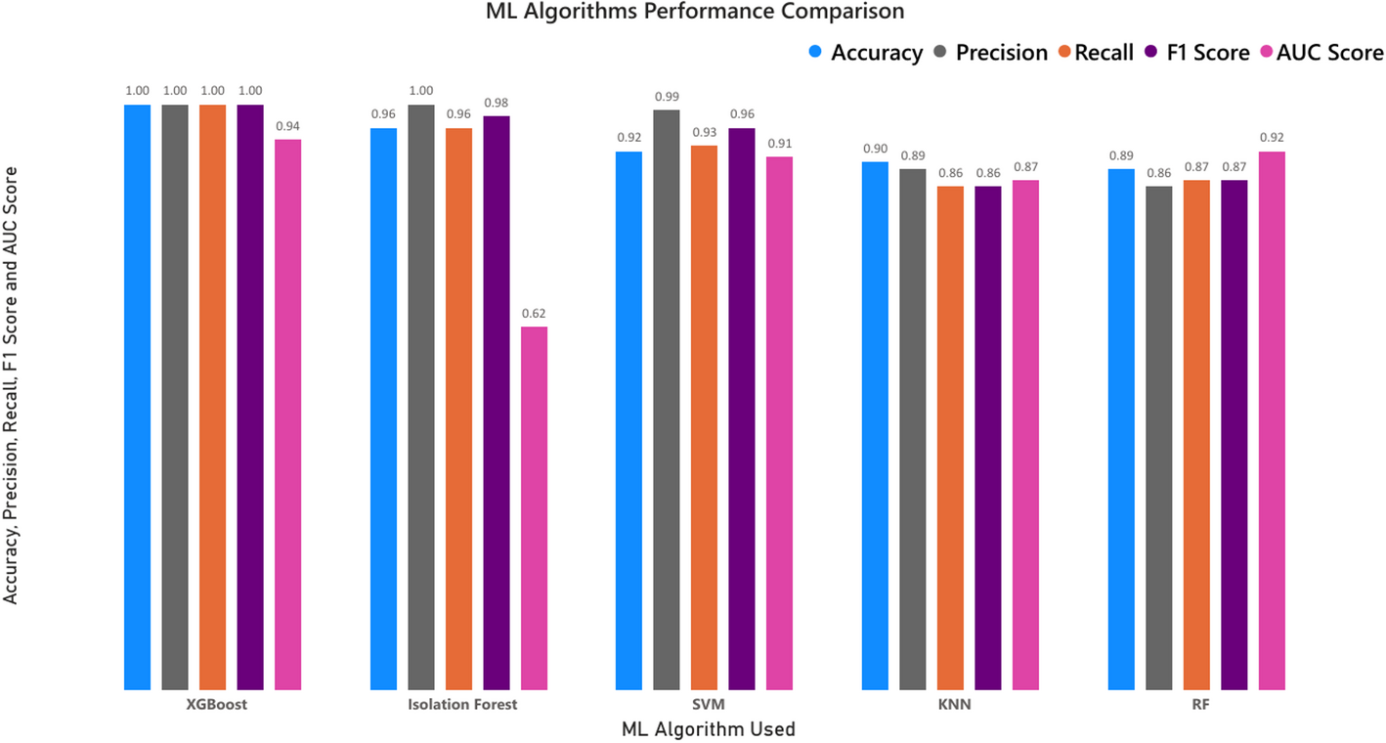
Research Methodology
Research Design
Comparative quantitative study
Dataset
PaySim Financial Fraud Dataset
Selected Models
XGBoost
Isolation Forest
SVM
KNN
RF
Development Process
Data Collection
↓
Preprocessing
↓
Model Training
↓
Evaluation
↓
Comparison

Slide 8
Data Collection and Evaluation
Data Preprocessing
• Data cleaning
• Handling class imbalance
• Feature selection
• Train-test split
Evaluation Metrics
• Precision
• Recall
• F1-score
• ROC-AUC
Why not Accuracy?
Because fraud cases are rare and accuracy can be misleading.

Slide 9
Project Planning and Resources
Resources Project Plan
Software:
• Python
• Scikit-learn
• Pandas
• NumPy
Hardware:
• Standard personal computer
Week | Activity
1-2 | Literature Review
3 | Dataset Preparation
4-5 | Data Preprocessing
6-7 | Model Training
8 | Model Evaluation
9 | Results Analysis
10 | Final Report

Slide 10

Impact and Limitations
Potential Impact
• Improved fraud detection
• Reduced financial losses
• Better decision-making
• Support for real-time monitoring systems
Limitations
• Single dataset
• Results may not generalise to all financial environments
• Limited computational resources
• Fraud patterns change over time

Slide 11
Conclusion
ML is widely used in fraud detection.
Ensemble methods often achieve the strongest predictive performance.
Practical deployment factors are often overlooked.
This research proposes a broader evaluation approach that considers performance, interpretability and computational efficiency together.
The outcome will be a practical framework to support fraud detection model selection.

Slide 12
Thank You
Questions?

Slide 13
References
‌ [1]
S. Panigrahi and V. L. N. Gorle, “Applications of Machine Learning and Deep Learning Algorithms in Financial Fraud Detection: A Review,” Computational Economics, Oct. 2025, doi: https://doi.org/10.1007/s10614-025-11089-7.
[2]
N. J. Sarna et al., “AI Driven Fraud Detection Models in Financial Networks: A Review,” IEEE Access, pp. 1–1, 2025, doi: https://doi.org/10.1109/access.2025.3596060.
[3]
S. Thivaios, G. Kostopoulos, A. Stefani, and S. Kotsiantis, “A Survey of Machine Learning and Deep Learning for Financial Fraud Detection: Architectures, Data Modalities, and Real-World Deployment Challenges,” Algorithms, vol. 19, no. 5, p. 354, May 2026, doi: https://doi.org/10.3390/a19050354.
‌ [4]
H. S. AlSagri, “Hybrid Machine Learning based Multi-Stage Framework for Detection of Credit Card Anomalies and Fraud,” IEEE Access, pp. 1–1, 2025, doi: https://doi.org/10.1109/access.2025.3565612.
‌ [5]
S. A. Ajagbe, Simphiwe Majola, and Pragasen Mudali, “Comparative analysis of machine learning algorithms for money laundering detection,” Discover Artificial Intelligence, vol. 5, no. 1, Jul. 2025, doi: https://doi.org/10.1007/s44163-025-00397-4.
‌ [6]
S. Georgiev, M. Markova, V. Mihova, and V. Todorov, “Modeling and Optimization of Deep and Machine Learning Methods for Credit Card Fraud Risk Management,” Mathematics, vol. 14, no. 9, p. 1496, Apr. 2026, doi: https://doi.org/10.3390/math14091496.

