Slide 1


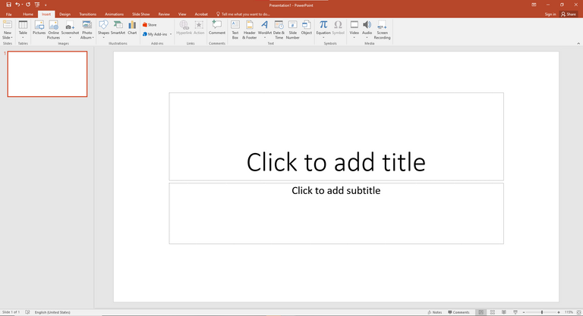

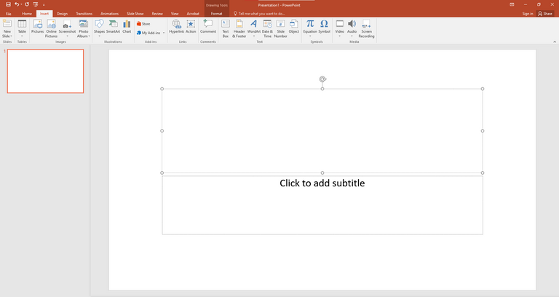
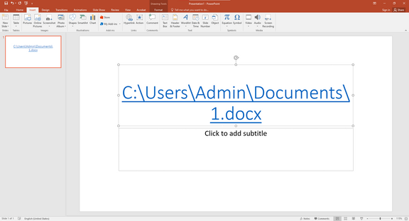




How to Insert a Hyperlink in PowerPoint
What is PowerPoint?
How is it Used?
PowerPoint hyperlinks can guide the viewers to other slides, web pages, or access external files (e.g., pdfs, excel sheets, videos, etc.) (Kuroll, 2022).. As an example, you can hyperlink a word, such as Click Here, to open one of your company web pages, or make a button a link in another part of your presentation. It is a particularly helpful feature in professional or educational presentations which need to be interactive and offer the ability to access references fast.
Microsoft PowerPoint is a presentation software which enables one to create slideshows of text, images, charts and multimedia (Das et al., 2025). It is common in the workplaces, schools, and professional meetings, where the visual and effective communication of ideas is possible. PowerPoint assists in the presentation of structured information in interactive and engaging slides by the presenter.
What is a Hyperlink?
A hyperlink is a text, picture, or object that can be clicked on to open up another slide, document, web address, or e-mail address. It enables you to interrelate various resources to one another thus ensuring easy navigation among your audiences. The hyperlinks tend to be blue and are underlined though you can customise them
Steps to Insert a Hyperlink in PowerPoint
Conclusion
Why is it Important in PowerPoint?
1.Mark the text, picture or object to be clickable.
2.Click on the insert tab on the top menu.
3.Select the option of a Link or Hyperlink (chain icon).
4.Select what you would like to be associated with:
5.Webpage: Type the Webpage URL into the address box.
6.Slide: Choose the option, Place in This Document and choose the slide you want to use.
7.File: Open and choose the document that you want to open.
8.Email: E-mail Address can be used to establish a mail.
9.Click OK to apply.
10. Check the hyperlink by the Ctrl +Click in presentation mode.
Enhanced communication, time-saving, and engaging your audience Hyperlinks will turn a simple PowerPoint into an interactive tool that will improve communication and save time. This is a simple but powerful feature that should be mastered to make professional well-connected presentations.
Interactive and professional presentation is promoted with the help of hyperlinks. They assist in saving time in the delivery process, prevent the manual switch between programs, and design the flow in a more seamless manner. Hyperlinks also bring liveliness to your presentation - you can have non-linear presentation where you can skip around the slides or resources depending on the interest of the audience (Haines, 2023). Hyperlinks are used in work environments to link to the policies, documents, or training material within a short time.
References
  Das, S., Malik, A., Tripathy, S.K. and Sahoo, M. (2025). How to Improve the Quality of PowerPoint Presentation to Achieve Maximum Learning. Research and reviews in pediatrics., 26(2), pp.31–36. doi:https://doi.org/10.4103/rrp.rrp_10_24.
  Haines, N.D. (2023). Conducting with Multimedia in Live Performance.
  Kuroll, A. (2022). A system for the automated creation of book-like documents from lecture slides. Tuwien.at. [online] doi:https://doi.org/10.34726/hss.2022.91345.

