Slide 1
Welcome
Group Members
Academic Skills Group Presentation
Elena Nicoleta Oprea 2024786
Ivana Desevova 2027510
Mihaela Daniela Simcea 2028830
Asen Metodiev Asenov 2028526

Slide 2
Introduction
Different Organisations have different strategies for their business. Having a better understanding of a business requires conducting research at different scales. In the ever-dynamic business world, organisations need to keep on bringing changes in the products and services (Taylor, 2020). To make the changes optimum, understanding the needs and demands of the consumers is extremely important. There are multiple ways of knowing about the preferences and choices of the consumers. This presentation aims to discuss about difference research methods and data types and apply some of the methods in the context of ASDA, a leading retailer chain of the UK
Notes:
Different Organisations have different strategies for their business. Having a better understanding of a business requires conducting research at different scales. In the ever dynamic business world, organisations need to keep on bringing changes in the products and services (Taylor, 2020). To make the changes optimum, understanding the needs and demands of the consumers is extremely important. There are multiple ways of knowing about the preferences and choices of the consumers. This presentation aims to discuss about difference research methods and data types and apply some of the methods in the context of ASDA, a leading retailer chain of the UK

Slide 3
Data Collection Methods
Quantitative Method
Qualitative Method
Data can be described numerically
Data is understood through complex implications and analysis
Before jumping to the details of ASDA and its products and services, understanding the data collection method is essential. The data collection will be done using bot qualitative and quantitative methods.
Quantitative Method: Data that fall under the competitive method can be understood easily due to their numerical value. For instance, the number or percentage of a people liking a service can be an example of quantitative data (Welman, Kruger and Mitchell, 2016). Quantitative data can easily be collected through questionnaires, surveys, interviews, etc.
Qualitative Data: Unlike quantitative data, qualitative data is non-numeric in nature. The results from qualitative data need to be derived by understanding the context and all the complexities related to the case. For instance, if the majority answers that they are not satisfied with a specific product, finding out the reason or understanding the implication will fall under qualitative data analysis (Welman, Kruger and Mitchell, 2016).
For the analysis of ASDA, the team will rely heavily on quantitative analysis that will be collected through primary data. However, qualitative data will be derived from the numeric data received from the primary research.
Notes:
Before jumping to the details of ASDA and its products and services, understanding the data collection method is essential. The data collection will be done using bot qualitative and quantitative methods.
Quantitative Method: Data that fall under the competitive method can be understood easily due to their numerical value. For instance, the number or percentage of a people liking a service can be an example of quantitative data (Welman, Kruger and Mitchell, 2016). Quantitative data can easily be collected through questionnaires, surveys, interviews, etc.
Qualitative Data: Unlike quantitative data, qualitative data is non-numeric in nature. The results from qualitative data need to be derived by understanding the context and all the complexities related to the case. For instance, if the majority answers that they are not satisfied with a specific product, finding out the reason or understanding the implication will fall under qualitative data analysis (Welman, Kruger and Mitchell, 2016).
For the analysis of ASDA, the team will rely heavily on quantitative analysis that will be collected through primary data. However, qualitative data will be derived from the numeric data received from the primary research.

Slide 4
Research Methodology
Secondary Research
Primary Research
Will be done through internet research and will be sued to assess current situation of ASDA
Will be done though online surveys and for understanding future plans
For conducting the research related to ASDA, both primary and secondary methods of research will be done, and the primary & secondary data will be used to understand the current situation of ASDA while making recommendations for future improvements. There should be no confusion regarding using Internet as the source of Secondary data as it is the most accessible source and is also a vast sea of information (Hazary, 2021). However, many researchers might debate about the efficiency of online surveys as a tool for collecting primary data. Due to the pandemic, conducting research by physically being present is very risky and inappropriate for the moment. Besides, many respondents would not be comfortable giving interview for a simple research work. Considering the existing situation, online surveys looked like the best option to collect primary data about customer experience and expectations from ASDA.
Notes:
For conducting the research related to ASDA, both primary and secondary methods of research will be done and the primary & secondary data will be used to understand the current situation of ASDA while making recommendations for future improvements. There should be no confusion regarding using Internet as the source of Secondary data as it is the most accessible source and is also a vast sea of information (Hazary, 2021). However, many researchers might debate about the efficiency of online surveys as a tool for collecting primary data. Due to the pandemic, conducting research by physically being present is very risky and inappropriate for the moment. Besides, many respondents would not be comfortable giving interview for a simple research work. Considering the existing situation, online surveys looked like the best option to collect primary data about customer experience and expectations from ASDA.

Slide 5

Details About
ASDA was founded on February 19, 1949.
ASDA is the third-largest Retail Chain of the United Kingdom in terms of Revenue.
It is a British Supermarkets Chain, headquartered in Leeds of England.
ASDA held the position of the largest supermarket chain in UK from 2003 to 2014.
ASDA serves in 632 locations as of January 2021.
ASDA boasts a big employee base of 165,000 employees
ASDA also provides clothing, mobile and financial services
ASDA also provides medical services through their Pharmacy
Notes:
ASDA is a British supermarket chain which is headquartered in the Leeds of England. In terms of market share, ASDA stands in the third place in UK, just after TESCO and Sainsbury (Statista - The Statistics Portal, 2021). Since 1949, ASDA has been serving its customers. With the progression of time, ASDA made its way to different parts of UK, currently serving in more than 600 locations globally. The employee base of ASDA is also very impressive, having more than 165,000 employees across different fields. The retail chain does not only specialise in selling groceries and other daily necessities. ASDA has its focus on multiple fields including the mobile sector and financial sector (Asda.com - Online Food Shopping, George, & more, 2021). To sum up the details of ASDA:
ASDA was founded on February 19, 1949.
ASDA is the third-largest Retail Chain of the United Kingdom in terms of Revenue.
It is a British Supermarkets Chain, headquartered in Leeds of England.
ASDA held the position of the largest supermarket chain in UK from 2003 to 2014.
ASDA serves in 632 locations as of January 2021.
ASDA boasts a big employee base of 165,000 employees.
ASDA also provides clothing, mobile and financial services.
ASDA also provides medical services through their Pharmacy.

Slide 6
Products Offered by ASDA
As a retail supermarket, it is obvious that ASDA will offer different kinds of products. However, not all of the products belong to different brands. Some of the products are manufactured by ASDA. The products that are sold by ASDA have been discussed below:
Health and Beauty Products: Unfortunately for ASDA, they do not offer any product made by themselves under this section. However, ASDA does offer a vast array of products related to dental care, skin care, women toiletries, sun care & travel, bath shower and caps, vegan health & beauty, etc. The products that ASDA offers under all of the categories mentioned belong to other brands. In essence, ASDA functions like any other retail store in this regard (ASDA Services, 2021). Having a vast collection of daily essential makes ASDA one of the most suitable hsopping places for the people of UK.
Fresh Food & Bakery: ASDA has a string grip over this product segment. Under ASDA there are multiple food production facilities that provides consumers with fresh beef steaks, bacon and chili jalapeno, triple chili burgers, mozzarella pearls with pesto, spinach and feta parcels, sweet potato falafels, corn with feta, etc. the list of products can go one for a few minutes. ASDA caters a lot of dairy products and meat products for competing against Tesco, Sainsbury and other supermarket chains. The products produced by ASDA have fair demand in the market and are also considered top quality. The prices of everyday products range between 1-5 pounds, making them affordable for the mass consumers. ASDA has a function named ‘low Price Lock’ that helps them keep the price of products as low as possible (Asda.com - Online Food Shopping, George, & more, 2021).
Vegan and Plant-based Products: Under this category, ASDA does not have many products of its own as well. Products such as sauce for vegans, oils for vegans, plant-based sauces, vegan meat, etc. are sold under this category. The plant-based sweet potato is a divine offering for vegan people from ASDA. ASDA ensures an inclusive environment for the consumers (Taylor, 2020).
Laundry and Household Products: ASDA has no laundry and household products of its own. That is why, it sells the products of other brands, just like most other retail stores.
Health and Beauty Products
Fresh Food & Bakery
Vegan and Plant-based
Laundry and Household
Notes:
As a retail supermarket, it is obvious that ASDA will offer different kinds of products. However, not all of the products belong to different brands. Some of the products are manufactured by ASDA. The products that are sold by ASDA have been discussed below:
Health and Beauty Products: Unfortunately for ASDA, they do not offer any product made by themselves under this section. However, ASDA does offer a vast array of products related to dental care, skin care, women toiletries, sun care & travel, bath shower and caps, vegan health & beauty, etc. The products that ASDA offers under all of the categories mentioned belong to other brands. In essence, ASDA functions like any other retail store in this regard (ASDA Services, 2021). Having a vast collection of daily essential makes ASDA one of the most suitable hsopping places for the people of UK.
Fresh Food & Bakery: ASDA has a string grip over this product segment. Under ASDA there are multiple food production facilities that provides consumers with fresh beef steaks, bacon and chili jalapeno, triple chili burgers, mozzarella pearls with pesto, spinach and feta parcels, sweet potato falafels, corn with feta, etc. the list of products can go one for a few minutes. ASDA caters a lot of dairy products and meat products for competing against Tesco, Sainsbury and other supermarket chains. The products produced by ASDA have fair demand in the market and are also considered top quality. The prices of everyday products range between 1-5 pounds, making them affordable for the mass consumers. ASDA has a function named ‘low Price Lock’ that helps them keep the price of products as low as possible (Asda.com - Online Food Shopping, George, & more, 2021).
Vegan and Plant-based Products: Under this category, ASDA does not have many products of its own as well. Products such as sauce for vegans, oils for vegans, plant-based sauces, vegan meat, etc. are sold under this category. The plant-based sweet potato is a divine offering for vegan people from ASDA. ASDA ensures an inclusive environment for the consumers (Taylor, 2020).
Laundry and Household Products: ASDA has no laundry and household products of its own. That is why, it sells the products of other brands, just like most other retail stores.

Slide 7
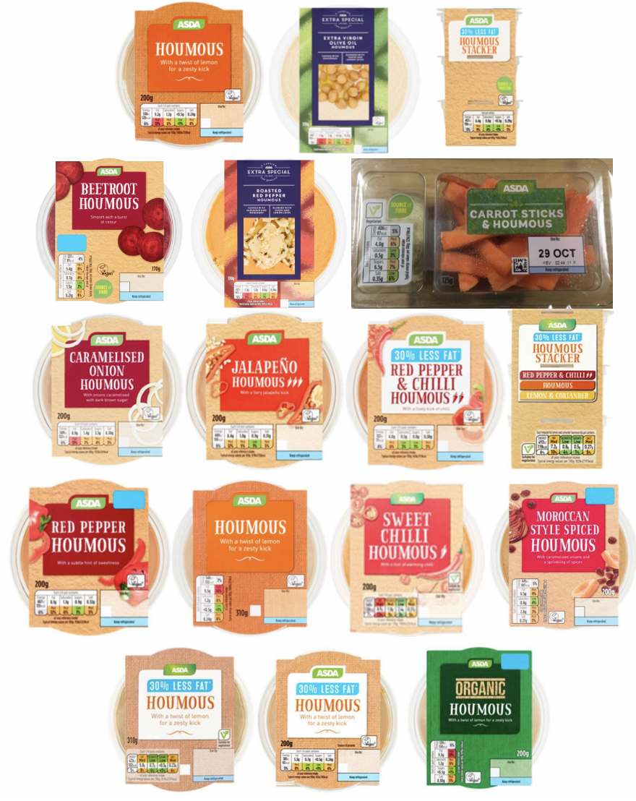
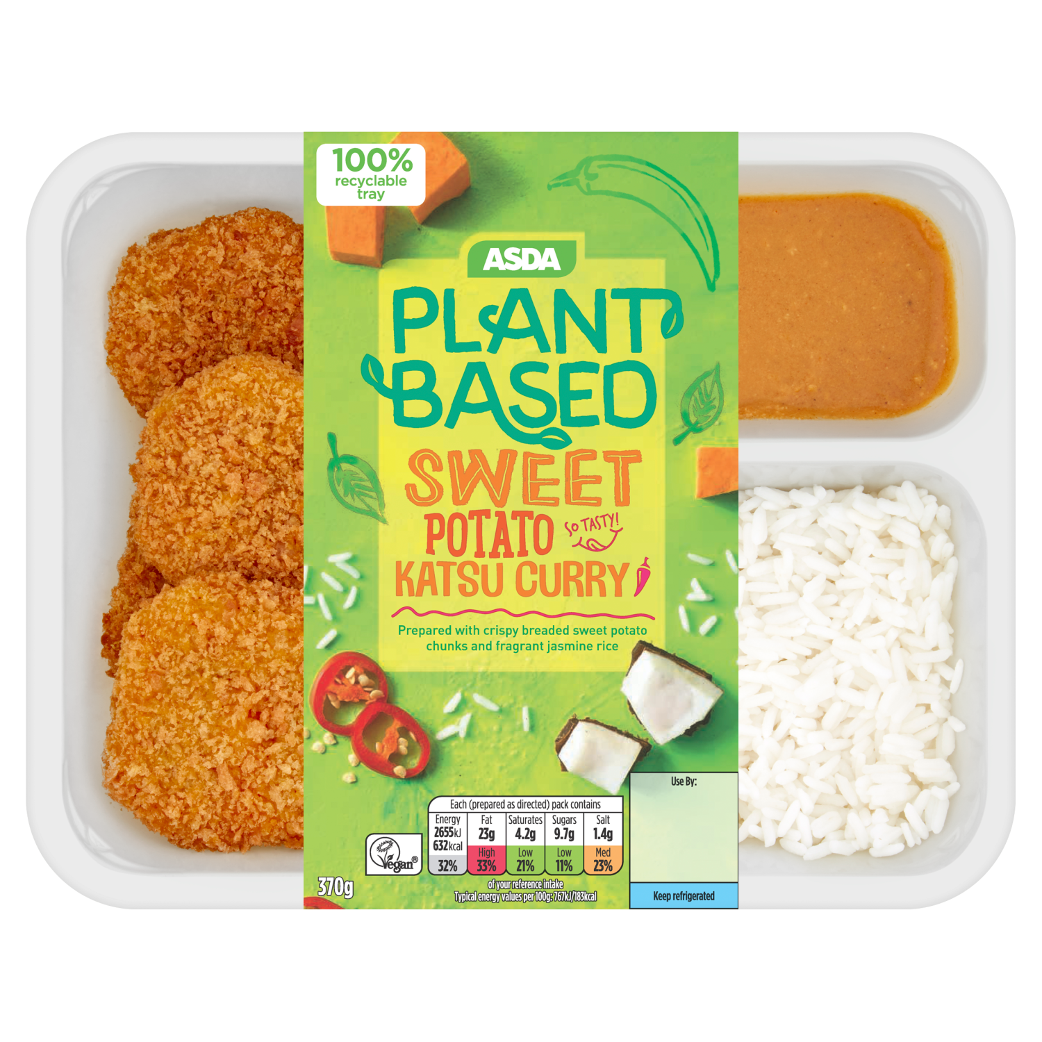
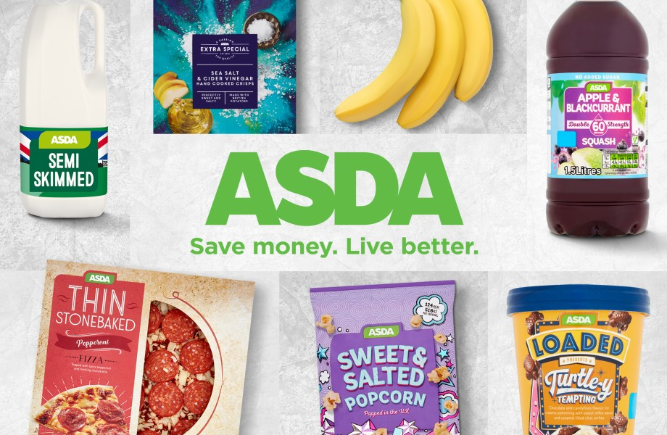
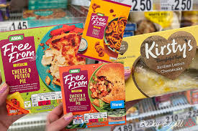
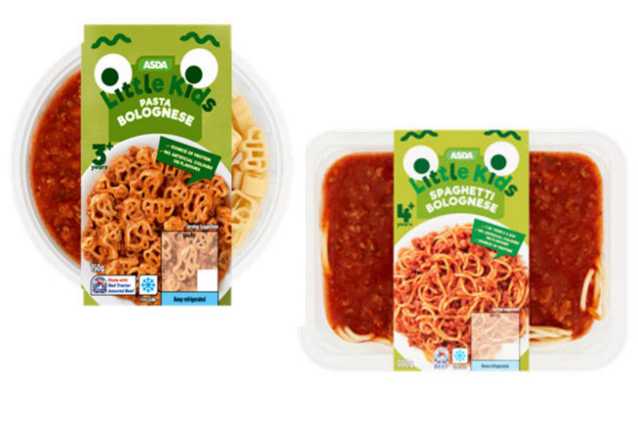
Products Offered by ASDA
These are just a few examples of the products that are produced by ASDA under different manufacturing facilities spread all around the UK. ASDA tries to be inclusive by offering vegan products for the vegans (Asda.com - Online Food Shopping, George, & more, 2021). The wide range of products by ASDA makes it one of the leading supermarket brands in the UK and helps it compete against the likes of
Notes:
These are just a few examples of the products that are produced by ASDA under different manufacturing facilities spread all around the UK. ASDA tries to be inclusive by offering vegan products for the vegans (Asda.com - Online Food Shopping, George, & more, 2021). The wide range of products by ASDA makes it one of the leading supermarket brands in the UK and helps it compete against the likes of

Slide 8
Services by ASDA
ASDA does not stop with the products. To make the experience more integrated and comfortable for the consumers, ASDA comes with a few other services for the customers. Most of the services can be availed at any outlet of ASDA.
ASDA Café: It is very hard to find a person who does not enjoy a great cup of coffee or a scrumptious slice of Pizza after a long shopping session. To satisfy the cravings of delicious items and hot (and cold) beverages, ASDA café is present in most outlets of ASDA. Items such a fish fingers, pizza, ice cream, coffee, etc. are available in the cafes of ASDA (In-Store Services l ASDA, 2021).
ASDA Money: ASDA money is the name of the financial services offered by ASDA. While the nomenclature might sound lazy, the services are great. ASDA money is basically a general insurance service that provides car insurance, pet insurance, travel money, small loans, home insurance, breakdown cover, etc. the Pet insurance of ASDA money makes it a unique service for people who own pet. The services under ASDA money need more advertisement for maximum reach (ASDA Services, 2021).
Pharmacy: Medicines are an integral part of life, especially for the older population. To make it easier for consumers to get all the services they need under one roof, ASDA has its own pharmacy. The pharmacies accept NHS and private prescriptions. There is also a pharmacist in the ASDA pharmacies present in the outlets. The pharmacists help the customers with the medicines or offers alternatives if the prescribed ones are not available (In-Store Services l ASDA, 2021). ASDA pharmacy also offer pneumonia jab for 25 pounds, which is a bargain considering the price of the jab in hospitals.
ASDA Optician: The choice to offer optical treatment for consumers is a rather odd one considering the core business of ASDA. But ASDA always tries to differentiate itself from the competitors by offering something they are not offering actively. The service started back in 2000 when ASDA was not as big as it is today. Now, the Optician services are available in 138 outlets of ASDA spread around the UK and Northern Ireland. ASDA Optician does not only provide with diagnosis or care for eyes, but all relevant products for eye-care and great spectacle frames. ASDA Optician also offers contact lenses for the customers (In-Store Services l ASDA, 2021).
ASDA Money
Opticians
ASDA Cafe
Pharmacy
Notes:
ASDA does not stop with the products. To make the experience more integrated and comfortable for the consumers, ASDA comes with a few other services for the customers. Most of the services can be availed at any outlet of ASDA.
ASDA Café: It is very hard to find a person who does not enjoy a great cup of coffee or a scrumptious slice of Pizza after a long shopping session. To satisfy the cravings of delicious items and hot (and cold) beverages, ASDA café is present in most outlets of ASDA. Items such a fish fingers, pizza, ice cream, coffee, etc. are available in the cafes of ASDA (In-Store Services l ASDA, 2021).
ASDA Money: ASDA money is the name of the financial services offered by ASDA. While the nomenclature might sound lazy, the services are great. ASDA money is basically a general insurance service that provides car insurance, pet insurance, travel money, small loans, home insurance, breakdown cover, etc. the Pet insurance of ASDA money makes it a unique service for people who own pet. The services under ASDA money need more advertisement for maximum reach (ASDA Services, 2021).
Pharmacy: Medicines are an integral part of life, especially for the older population. To make it easier for consumers to get all the services they need under one roof, ASDA has its own pharmacy. The pharmacies accept NHS and private prescriptions. There is also a pharmacist in the ASDA pharmacies present in the outlets. The pharmacists help the customers with the medicines or offers alternatives if the prescribed ones are not available (In-Store Services l ASDA, 2021). ASDA pharmacy also offer pneumonia jab for 25 pounds, which is a bargain considering the price of the jab in hospitals.
ASDA Optician: The choice to offer optical treatment for consumers is a rather odd one considering the core business of ASDA. But ASDA always tries to differentiate itself from the competitors by offering something they are not offering actively. The service started back in 2000 when ASDA was not as big as it is today. Now, the Optician services are available in 138 outlets of ASDA spread around the UK and Northern Ireland. ASDA Optician does not only provide with diagnosis or care for eyes, but all relevant products for eye-care and great spectacle frames. ASDA Optician also offers contact lenses for the customers (In-Store Services l ASDA, 2021).

Slide 9

Activities of ASDA During Covid-19 Pandemic
Online Delivery System
Safety Protocols
Assistance to Suppliers
Community Services
Even on the New Years Eve of 2019, the world did not know what was going to devour it in a few days. Currently, the death toll due to Covid has crossed the four million mark globally. In different ways, the pandemic has damaged the global economy. Currently, the unemployment rate in UK is around 4.8%, which was 3.8% on December 2019 (Statista - The Statistics Portal, 2021). Retail stores such as TESCO, ASDA, LIDL, Sainsbury and Morrisons had to face the initial wave of consumers rushing to buy essentials such as toilet papers and cleaning agents when the pandemic first started. After 1.5 years of the initial outbreak, the situations are still not very normal (Debnath, 2020). During this time, ASDA has been playing its part in ensuring that the shopping process is safe for the consumers and the employees as well. The following activities have been seen from ASDA since the March of 2020.
Safety Protocols: Since the very beginning of the pandemic, ASDA has been maintaining health protocols with great caution. It is mandatory for the consumers and staffs to wear masks at all times within the premises of the outlet. If any consumer behaves like a ‘Karen’ and decides to not wear a mask, ASDA holds full rights to refuse service to such consumers. Although face coverings or masks are not mandatory in Wales, the authority encourages people, to wear masks for their own safety (Debnath, 2020). Apart from face coverings, the stores are disinfected by the employees' multiple times a day and hand sanitizers are kept in different aisles and counters so that consumers and employees can use them to keep themselves sanitized. Cashless payment is encouraged to reduce the spread of germs. The ‘Scan and Go’ app makes it easier to make payments. The process is faster and safer. The employees are provided with paid period for the time they have to be isolated.
Online Delivery System: During the second quarter of 2021, the online sales of ASDA increased by 3.8% compared to its previous quarter. Since the inception of the pandemic, ASDA has been encouraging the consumers to shop online so that the transmission of virus stays at minimum. While it endorses online sales, it becomes difficult to deliver to multiple places and multiple orders within a limited time. For that purpose, ASDA ensures the option to order and pickup the delivery so that the consumers do not have to go into the shop. This greatly reduces the traffic within the shop.
Community Services: In the end, it is all about doing for the community during the time of need. ASDA has maintained its CSR activities quite well during this time of crisis. ASDA has provided 250,000 pieces of medical grade face masks to care homes to protect the workers and the residents. The Trussle Trust and FareShare got 5 million pounds as donation from ASDA during the initial lockdowns. Both of the organisations are partners of ASDA. The back of store donation scheme of ASDA has provided with 1.2 million meals since March 1 of 2020 (Corporate ASDA, 2021).
Assistance to Suppliers: Suppliers are one of the most essential partners of any retail player. ASDA has been very quick with bill payments to the farmers even though ASDA was facing crisis. George, the clothing sector of ASDA, has taken around 95% of the orders as planned to support the suppliers. Even for the amount of products ASDA count not take from the suppliers, they paid percentage of the whole amount to reduce losses of the suppliers (Corporate ASDA, 2021).
Notes:
Even on the New Years Eve of 2019, the world did not know what was going to devour it in a few days. Currently, the death toll due to Covid has crossed the four million mark globally. In different ways, the pandemic has damaged the global economy. Currently, the unemployment rate in UK is around 4.8%, which was 3.8% on December 2019 (Statista - The Statistics Portal, 2021). Retail stores such as TESCO, ASDA, LIDL, Sainsbury and Morrisons had to face the initial wave of consumers rushing to buy essentials such as toilet papers and cleaning agents when the pandemic first started. After 1.5 years of the initial outbreak, the situations are still not very normal (Debnath, 2020). During this time, ASDA has been playing its part in ensuring that the shopping process is safe for the consumers and the employees as well. The following activities have been seen from ASDA since the March of 2020.
Safety Protocols: Since the very beginning of the pandemic, ASDA has been maintaining health protocols with great caution. It is mandatory for the consumers and staffs to wear masks at all times within the premises of the outlet. If any consumer behaves like a ‘Karen’ and decides to not wear a mask, ASDA holds full rights to refuse service to such consumers. Although face coverings or masks are not mandatory in Wales, the authority encourages people, to wear masks for their own safety (Debnath, 2020). Apart from face coverings, the stores are disinfected by the employees multiple times a day and hand sanitizers are kept in different aisles and counters so that consumers and employees can use them to keep themselves sanitized. Cashless payment is encouraged to reduce the spread of germs. The ‘Scan and Go’ app makes it easier to make payments. The process is faster and safer. The employees are provided with paid period for the time they have to be isolated.
Online Delivery System: During the second quarter of 2021, the online sales of ASDA increased by 3.8% compared to its previous quarter. Since the inception of the pandemic, ASDA has been encouraging the consumers to shop online so that the transmission of virus stays at minimum. While it endorses online sales, it becomes difficult to deliver to multiple places and multiple orders within a limited time. For that purpose, ASDA ensures the option to order and pickup the delivery so that the consumers do not have to go into the shop. This greatly reduces the traffic within the shop.
Community Services: In the end, it is all about doing for the community during the time of need. ASDA has maintained its CSR activities quite well during this time of crisis. ASDA has provided 250,000 pieces of medical grade face masks to care homes to protect the workers and the residents. The Trussle Trust and FareShare got 5 million pounds as donation from ASDA during the initial lockdowns. Both of the organisations are partners of ASDA. The back of store donation scheme of ASDA has provided with 1.2 million meals since March 1 of 2020 (Corporate ASDA, 2021).
Assistance to Suppliers: Suppliers are one of the most essential partners of any retail player. ASDA has been very quick with bill payments to the farmers even though ASDA was facing crisis. George, the clothing sector of ASDA, has taken around 95% of the orders as planned to support the suppliers. Even for the amount of products ASDA count not take from the suppliers, they paid percentage of the whole amount to reduce losses of the suppliers (Corporate ASDA, 2021).

Slide 10
Results of Primary Research
The secondary data gave a very detailed look at the current condition of ASDA. A brief idea of the products and services of ASDA has been made clear and the activities of the company during Covid has also been highlighted efficiently. But there is always scope for improvement and the same goes for ASDA (Taylor, 2020). An online survey consisting of a few questions were given to 100 respondents. Luckily, all of the respondents answered to the questions. While the questions were simple, they gave a detailed insight of their expectations from ASDA.
Notes:
The secondary data gave a very detailed look at the current condition of ASDA. A brief idea of the products and services of ASDA has been made clear and the activities of the company during Covid has also been highlighted efficiently. But there is always scope for improvement and the same goes for ASDA (Taylor, 2020). An online survey consisting of a few questions were given to 100 respondents. Luckily, all of the respondents answered to the questions. While the questions were simple, they gave a detailed insight of their expectations from ASDA.

Slide 11
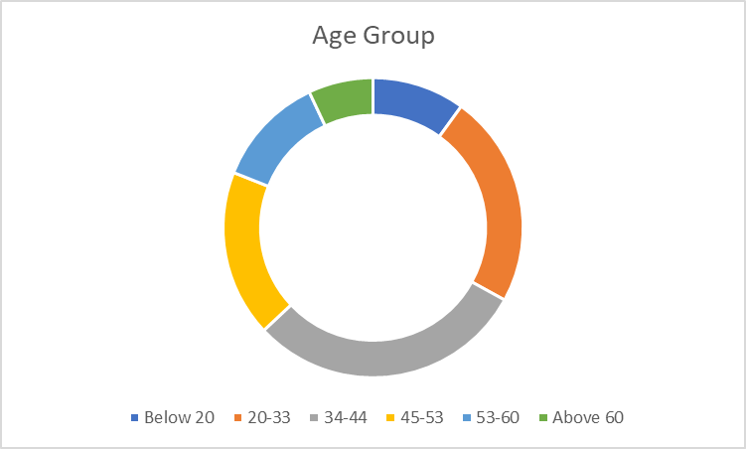
Which Age Group do You Belong to?
After the name was asked, the first question of the questionnaire was regarding which age group they belonged to. Most of the respondents belonged to the age group of 20-33 and 34-44, which means most were Gen Zs and Millennials. The answers gives an idea of which group of people do most of the shopping for their homes. The people of the age group below 20 and above 60 are considerably low.
Notes:
After the name was asked, the first question of the questionnaire was regarding which age group they belonged to. Most of the respondents belonged to the age group of 20-33 and 34-44, which means most were Gen Zs and Millennials. The answers gives an idea of which group of people do most of the shopping for their homes. The people of the age group below 20 and above 60 are considerably low.

Slide 12
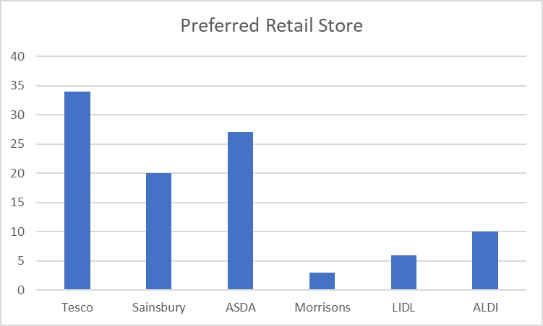
What is Your Preferred Retail Store?
The respondents were asked about which retail supermarket chain they preferred the most. Not so surprisingly, TESCO got the highest vote. TESCO is much bigger than ASDA and covers more locations, making it a popular choice. However, the second highest choice is ASDA, which is a great sign. The reason behind asking this question is very simple. If the preferred destination is TESCO or any other retail store, the answers of those respondents will give a better idea of what they expect from ASDA.
Notes:
The respondents were asked about which retail supermarket chain they preferred the most. Not so surprisingly, TESCO got the highest vote. TESCO is much bigger than ASDA and covers more locations, making it a popular choice. However, the second highest choice is ASDA, which is a great sign. The reason behind asking this question is very simple. If the preferred destination is TESCO or any other retail store, the answers of those respondents will give a better idea of what they expect from ASDA.

Slide 13
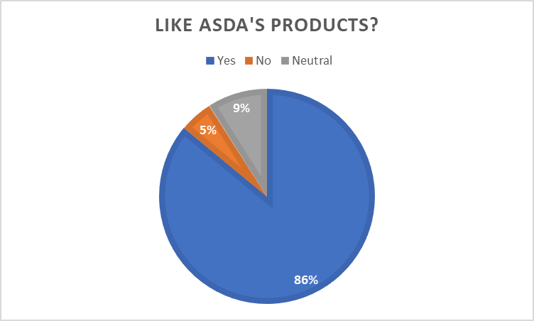
Do You Like the Products Produced by ASDA
As discussed before, ASDA has its own line of products, most of which are food and dairy items. The items have been quite a hit and the answers to the question says it all. 86% of the 100 respondents replied that they liked the products produced by ASDA. In the additional comment box of the survey, many respondents even signified that they absolutely loved the meat and dairy products and relied a lot of those. A lot of the respondents also claimed that the food products produced by ASDA was the only reason they preferred ASDA over other stores.
Notes:
As discussed before, ASDA has its own line of products, most of which are food and dairy items. The items have been quite a hit and the answers to the question says it all. 86% of the 100 respondents replied that they liked the products produced by ASDA. In the additional comment box of the survey, many respondents even signified that they absolutely loved the meat and dairy products and relied a lot of those. A lot of the respondents also claimed that the food products produced by ASDA was the only reason they preferred ASDA over other stores.

Slide 14
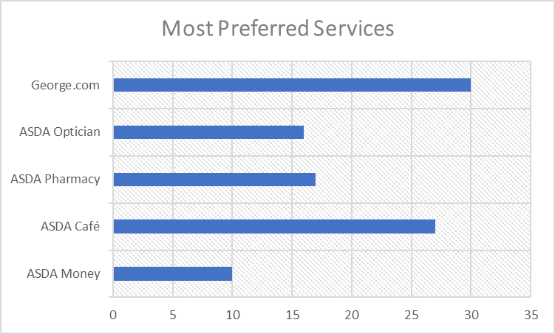
Which Age Group do You Belong to?
The ‘Groceries’ option was not kept in the question because it would be the most obvious answer and would not give any useful information. Among all the additional services provided by ASDA, George.com has the highest appeal among the consumers. The clothing line of ASDA is indeed very rich and the responses further validate the claim. The second most preferred service is ASDA cafe. The placement of the café within the premises of ASDA outlet makes it a great spot for gaining attention of the consumers.
Notes:
The ‘Groceries’ option was not kept in the question because it would be the most obvious answer and would not give any useful information. Among all the additional services provided by ASDA, George.com has the highest appeal among the consumers. The clothing line of ASDA is indeed very rich and the responses further validate the claim. The second most preferred service is ASDA cafe. The placement of the café within the premises of ASDA outlet makes it a great spot for gaining attention of the consumers.

Slide 15
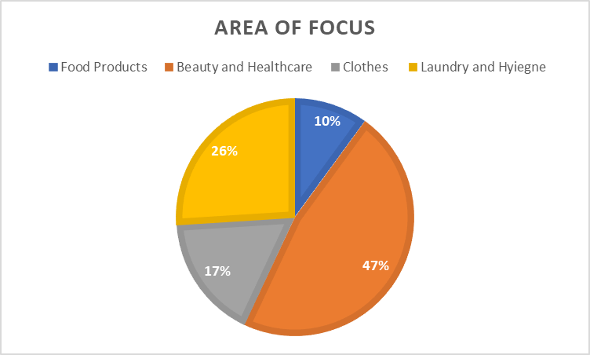
Which Product Segment Should ASDA Work On?
This question was the most important of all the questions asked till now. The respondents were asked about their thoughts on which product segment ASDA should focus on next. Not so surprisingly, only 10% voted for food products and 17% voted for clothes. Considering the huge arsenal of food products ASDA already produces and an established brand just for clothes, ASDA does not need to focus on these two segments. The beauty and healthcare product segment got almost half of all the votes, meaning people are expecting good beauty and healthcare products such as toothpaste, toiletries, toilet cleaners, glass cleaners, lotion, face powder, etc., from ASDA.
Notes:
This question was the most important of all the questions asked till now. The respondents were asked about their thoughts on which product segment ASDA should focus on next. Not so surprisingly, only 10% voted for food products and 17% voted for clothes. Considering the huge arsenal of food products ASDA already produces and an established brand just for clothes, ASDA does not need to focus on these two segments. The beauty and healthcare product segment got almost half of all the votes, meaning people are expecting good beauty and healthcare products such as toothpaste, toiletries, toilet cleaners, glass cleaners, lotion, face powder, etc., from ASDA.

Slide 16
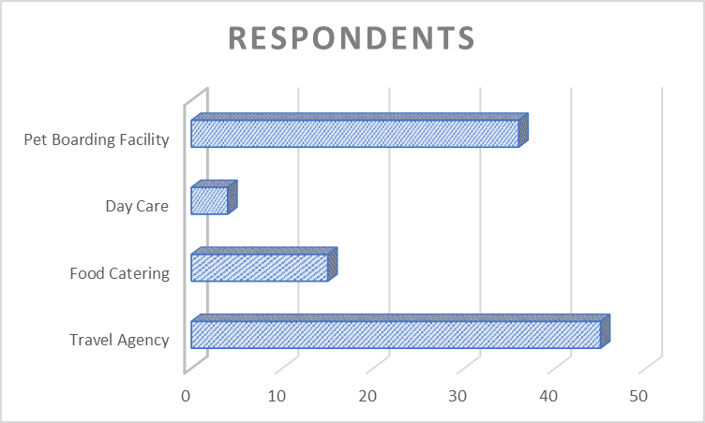
Which New Services do You Expect from ASDA?
The respondents were asked about their preference regarding new services they expect from ASDA. Most of the votes went to pet boarding facilities and travel agency idea. Food catering did not get much of an exposure because of ASDA already having ready to eat food products or already processed items.
Notes:
The respondents were asked about their preference regarding new services they expect from ASDA. Most of the votes went to pet boarding facilities and travel agency idea. Food catering did not get much of an exposure because of ASDA already having ready to eat food products or already processed items.

Slide 17
Plans for the Future
More Focus on ASDA Money
Production of Beauty and Healthcare Products
ASDA Travels
ASDA Pet Utopia
Considering the answers from the primary research and the capabilities of ASDA, there are four suggestions that ASDA can follow to meet the consumer needs more efficiently and to capture a broader part of the market.
Production of Beauty and Healthcare Products: ASDA is already well-established in the field of food products. Customers are expecting similar level of dedication towards beauty products such as face cream, face powder, lotion, face wash, hair gel, hair spray, etc. Focusing on multiple products at once will not bring in good results. ASDA can start with focusing on beauty products and then slowly move to healthcare products after the initial success.
More Focus on ASDA Money: ASDA money is a revolutionary offering from a retail chain. However, most people do not have much idea about the insurance services of ASDA. As it is a retail chain, people really do not connect it well with financial services,. ASDA has to invest heavily in advertisement efforts so that consumers get a better idea regarding ASDA Money. While making the ad campaigns, it must be kept in mind that the brand value of ASDA as a retail store does not get diluted or lowered.
ASDA Pet Utopia: In UK alone, there are 51 million pets. At times, single people look for good places where they can keep their pets while at work or on a vacation. Creating a pet boarding facility is a great way of accommodating the pets. Especially the owners of cats and dogs will get benefitted from this endeavor.
ASDA Travels: If ASDA can bring ASDA Money, ASDA travels is not a far-fetched idea. With a travel agency on hand, ASDA can truly become the one-stop destination for all the needs of the customers. The project is ambitious and will not kick off during the pandemic. But the planning can start now so that ASDA can implement the plans later after the pandemic wanes.
Notes:
Considering the answers from the primary research and the capabilities of ASDA, there are four suggestions that ASDA can follow to meet the consumer needs more efficiently and to capture a broader part of the market.
Production of Beauty and Healthcare Products: ASDA is already well-established in the field of food products. Customers are expecting similar level of dedication towards beauty products such as face cream, face powder, lotion, face wash, hair gel, hair spray, etc. Focusing on multiple products at once will not bring in good results. ASDA can start with focusing on beauty products and then slowly move to healthcare products after the initial success.
More Focus on ASDA Money: ASDA money is a revolutionary offering from a retail chain. However, most people do not have much idea about the insurance services of ASDA. As it is a retail chain, people really do not connect it well with financial services,. ASDA has to invest heavily in advertisement efforts so that consumers get a better idea regarding ASDA Money. While making the ad campaigns, it must be kept in mind that the brand value of ASDA as a retail store does not get diluted or lowered.
ASDA Pet Utopia: In UK alone, there are 51 million pets. At times, single people look for good places where they can keep their pets while at work or on a vacation. Creating a pet boarding facility is a great way of accommodating the pets. Especially the owners of cats and dogs will get benefitted from this endeavor.
ASDA Travels: If ASDA can bring ASDA Money, ASDA travels is not a far-fetched idea. With a travel agency on hand, ASDA can truly become the one-stop destination for all the needs of the customers. The project is ambitious and will not kick off during the pandemic. But the planning can start now so that ASDA can implement the plans later after the pandemic wanes.

Slide 18
Conclusion
ASDA is a renowned retail chain of the UK and has a firm market position. With a little bit of focus on new service ideas such as travel agency & pet boarding facilities and with focus on the production of beauty & healthcare products, ASDA can capture a greater chunk of the market.
Notes:
ASDA is a renowned retail chain of the UK and has a firm market position. With a little bit of focus on new service ideas such as travel agency & pet boarding facilities and with focus on the production of beauty & healthcare products, ASDA can capture a greater chunk of the market.

Slide 19
References
Asdaonlineservice.tumblr.com. 2021. ASDA Services. [online] Available at: <https://asdaonlineservice.tumblr.com/> [Accessed 17 July 2021].
Asda.com. 2021. Asda.com - Online Food Shopping, George, & more. [online] Available at: <https://www.asda.com/> [Accessed 17 July 2021].
ASDA.com. 2021. Corporate ASDA. [online] Available at: <https://corporate.asda.com/20200309/steps-we-have-taken-in-response-to-the-coronavirus-outbreak> [Accessed 17 July 2021].
Debnath, S., 2020. Impact of COVID-19 on Consumer Purchase Behaviour in Retail Sector - Study Based in UK. SSRN Electronic Journal, 4(2), pp.122-134.
Hazary, F., 2021. Primary vs Secondary Research Methods: 15 Key Differences. [online] Formpl.us. Available at: <https://www.formpl.us/blog/primary-secondary-research> [Accessed 17 July 2021].
Asda.com. 2021. In-Store Services l ASDA. [online] Available at: <https://www.asda.com/about/instore> [Accessed 17 July 2021].
Statista. 2021. Statista - The Statistics Portal. [online] Available at: <https://www.statista.com/> [Accessed 17 July 2021].
Taylor, F., 2020. The Principles of Scientific Management. La Vergne: Neeland Media LLC.
Welman, J., Kruger, F. and Mitchell, B., 2016. Research methodology. 10th ed. Cape Town: Oxford University Press.
Notes:
Asdaonlineservice.tumblr.com. 2021. ASDA Services. [online] Available at: <https://asdaonlineservice.tumblr.com/> [Accessed 17 July 2021].
Asda.com. 2021. Asda.com - Online Food Shopping, George, & more. [online] Available at: <https://www.asda.com/> [Accessed 17 July 2021].
ASDA.com. 2021. Corporate ASDA. [online] Available at: <https://corporate.asda.com/20200309/steps-we-have-taken-in-response-to-the-coronavirus-outbreak> [Accessed 17 July 2021].
Debnath, S., 2020. Impact of COVID-19 on Consumer Purchase Behaviour in Retail Sector - Study Based in UK. SSRN Electronic Journal, 4(2), pp.122-134.
Hazary, F., 2021. Primary vs Secondary Research Methods: 15 Key Differences. [online] Formpl.us. Available at: <https://www.formpl.us/blog/primary-secondary-research> [Accessed 17 July 2021].
Asda.com. 2021. In-Store Services l ASDA. [online] Available at: <https://www.asda.com/about/instore> [Accessed 17 July 2021].
Statista. 2021. Statista - The Statistics Portal. [online] Available at: <https://www.statista.com/> [Accessed 17 July 2021].
Taylor, F., 2020. The Principles of Scientific Management. La Vergne: Neeland Media LLC.
Welman, J., Kruger, F. and Mitchell, B., 2016. Research methodology. 10th ed. Cape Town: Oxford University Press.

Slide 20
THANK YOU

