Slide 1
Issues and Processes affecting Transport Planning in the UK-
Application of Regulation & law to Logistics Industry
Topic 3 – In Vehicle Monitoring Systems and Driver Hours
Transport and Professional Competence (M4X01279)
Dunstan Thompson and Abdal Miah

Slide 2
Contents
Background – law regarding drivers, commercial vehicles, fleets & safety and efficiency. Application of technology for monitoring and optimizing and controlling?
Transport Regulatory Overview- EU, AETR, GB, NI DfT & Agencies
Key Regulations in EU/UK
Drivers Hours Regulations
Tachograph Technologies
Monitoring technology enablers
Use by Operators for Fleet & Driver Management
Future Outlook
Conclusions
Appendices
  Sources

Slide 3
1 Background
Governments Regulate drivers, vehicles, road, air, sea transport and issue licences and permits and enforce compliance with these regulations.
Why do Governments Regulate?
  Safety - e.g. Drivers hours and vehicle standards
  Efficiency & Sustainability – optimum use of infrastructure and
  Raise revenue – licences & taxes on transport raise significant revenue
Road Vehicle Based Monitoring Technology has developed over the last 50 years from simple manual recording through analogue tachographs to integrated intelligent and digital tachographs and fleet management systems. These are increasingly used for enforcement of regulation and also by logistics companies for optimising efficiency, service levels and safety.

Slide 4
2 Transport Law & Regulations and Agencies
In UK Transport Regulations derive mainly from EU & UK law - however there are also international conventions for sea /air transport which not focus today
In UK the overall planning, regulation and enforcement is organised by the Department for Transport or DfT The DfT,s Mission Statement is :-
  “We work with our agencies and partners to support the transport network that helps the UK’s businesses and gets people and goods travelling around the country. We plan and invest in transport infrastructure to keep the UK on the move.”
The DfT supports about 22 non-departmental bodies, Tribunals, Public Corporations and 4 Executive Agencies which carry out the day-to-day work. Most Relevant for Commercial Road Transport are
  Driver & Vehicle Standards Agency (DVSA)– Defines the standards for Drivers & Vehicles
  Driver & Vehicle Licensing Agency (DVLA) - Licences Drivers & Vehicles (also Instructor, MOT centres ...)
  Vehicle Certification Agency – Type Approval for new vehicle models in UK
  Traffic Commissioner – Licences Commercial Transport

Slide 5
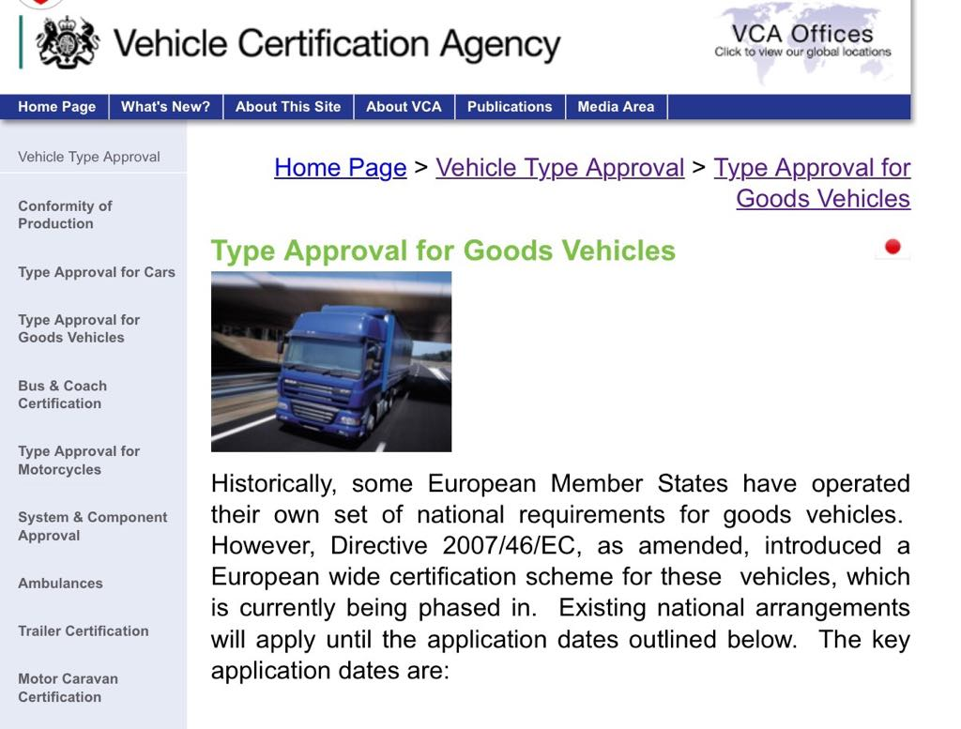
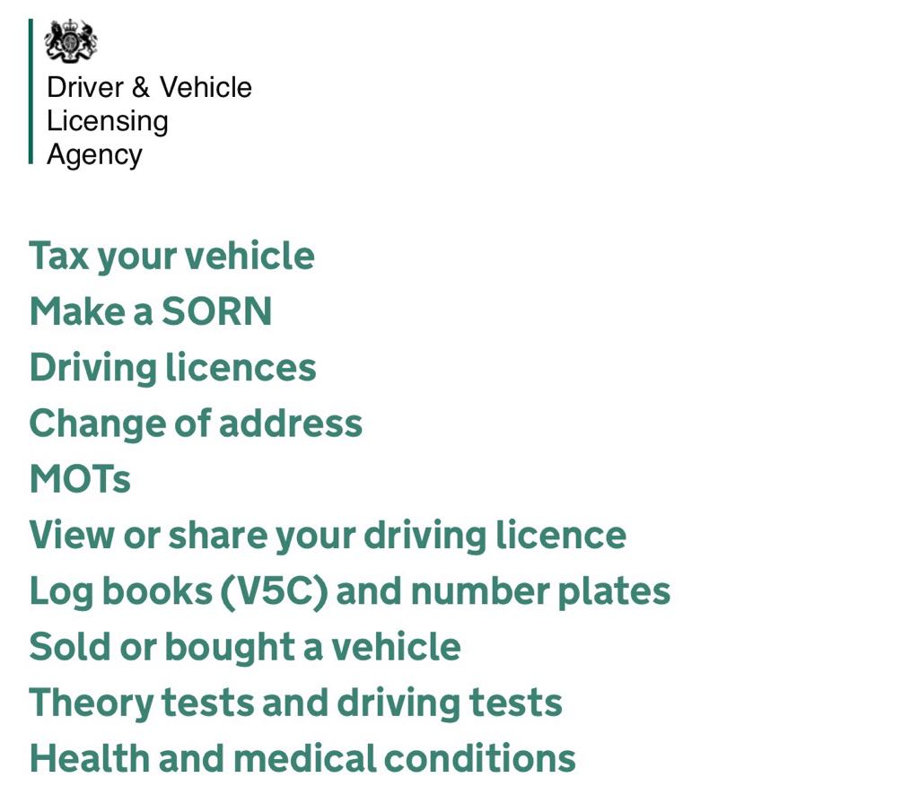
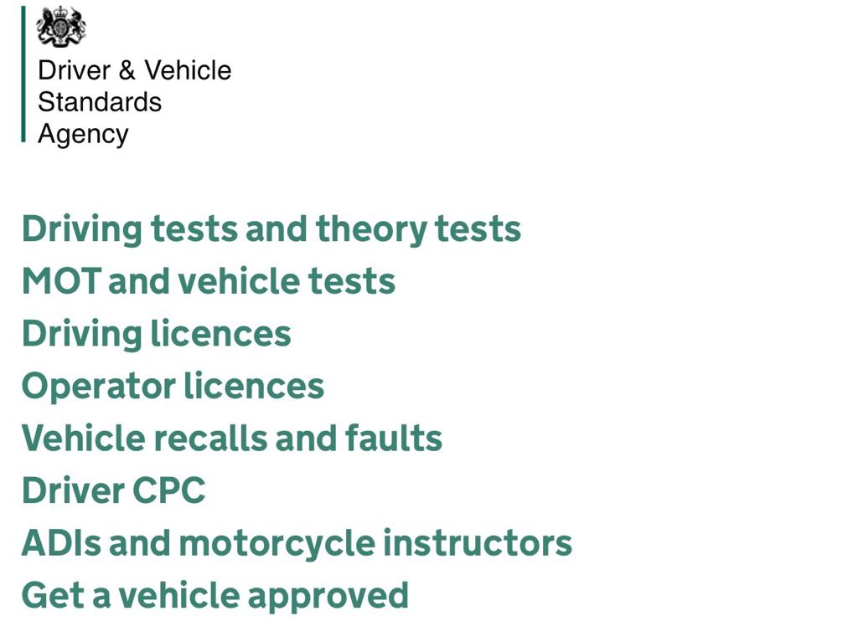
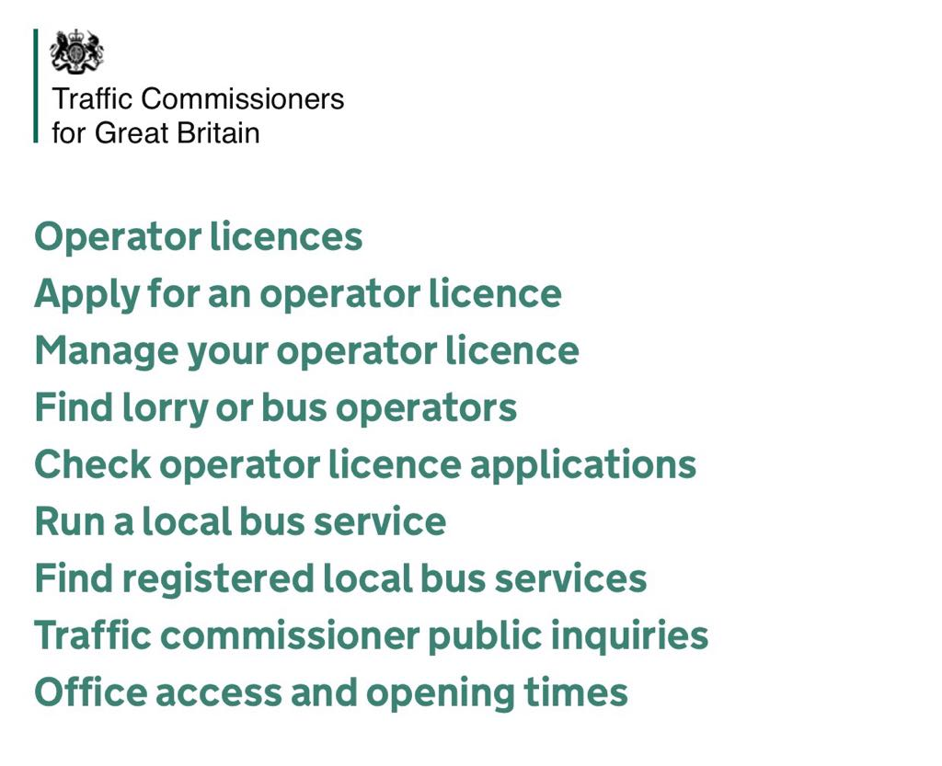

Slide 6
3 Key laws and Regulations in UK for Transport Logistics
Type Approval – for manufacturers / importers of vehicles
  Road Vehicle (Construction and Use) Act 1986 as amended
  Road Vehicle (Lighting Regulations) Act 1989 as amended
“MOT” Regular safety inspection and safety standards for vehicles
  Brakes, Conspicuity, Speed limiters, Tachographs etc.
Commercial Drivers Licencing
  Vocational, HGV, PSV
  Certification of Professional Competence (CPC) – 5 yearly refresher training for commercial drivers - 35hours
Operator licences (O licence) - Issued by Traffic Commissioners
  Legal authority to operate goods vehicles in Great Britain.
  Ensures systems and processes in place to comply with regulations

Slide 7
4.1 Commercial Drivers Hours – Evolution of Regulations
- 20% of all accidents are caused by fatigue
  UK Road and Rail Traffic act 1933 recognised dangers of driver fatigue
  UK Transport Act 1968 introduced drivers hours legislation.
  Increasing accidents due to fatigue in the 50s and 60s led to the EU making Tachographs compulsory in EU from 1975 for commercial vehicles over 3.5 Tons
  UK introduces (analogue) Tachograph “spy in the cab” 1979 as UK held to be in breach of EU rules
  EEC Regulation 3821/1985 - (analogue) tachographs mandatory throughout EEC
  EU Reg EC 561 in year 2006- requires digital tachograph on all commercial vehicles
  “GV262”-This is the UK interpretation of EU EC 561/2006
  AETR “European agreement concerning work of crews engaged in international transport” extends EU rules to various non EU countries
  GB Rules (dating back to 1968 act) now only apply for limited operations not covered by EU legislation
Need to be clear which regulations a driver is driving under!

Slide 8
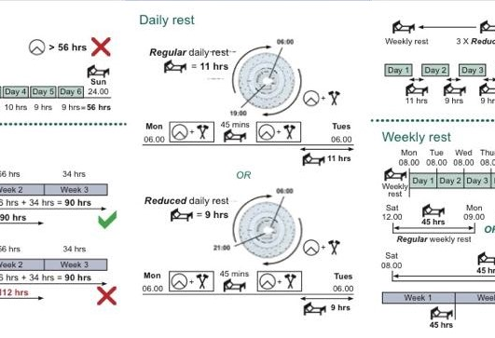
4.2 Drivers Hours Regulations Outline (EU)
Rules on Drivers Hours (HGV)
  Max. 9 hours/day
  10 hours/day allowed twice a week
  Max. 56 hours/week
  Max 90 hours/2weeks
Rules on Breaks
  Min. 11 hours rest / day
  45 hours unbroken rest / week
  45 mins rest after 4.5 hours driving
Different rules apply for PSV vehicles and for Vehicles under GB rules (limited operations.)
THIS IS BUT A FEW – ACTUAL RULES ARE QUITE COMPLEX!

Slide 9
5 Digital Tachograph Technologies
Digital Tachographs introduced in EU from 2006 consist of 3 parts
  Monitoring system on vehicle captures information such as-
    Driver Hours
    Driver activity
    Distance travelled
    Speed
    Identity and Number of Drivers and driver hours data
  Vehicle Unit (VU)– this records the information for that vehicle regardless of driver.
  Individual Driver’s Smart Card based Tacho Card (Issued by DVLA)
This information is recorded from speed sensors in the gearbox, odometer readings, engine speed
Information on driver’s “smart card” must be downloaded every 28 days to be checked for infringements.
Information on the vehicle’s VU must be assessed every 90 days.

Slide 10
6 Monitoring Technology Enablers
Four Technology Advances are driving the ability to use vehicle monitoring data for purposes other than driver’s hours;-
  Digital Monitoring Technology – can capture and store many more data points about vehicle, driver, journey and perhaps load than in past.
  Mobile communications enables information to be shared in real time.
  GPS based location tracking enables accurate real time tracking
  Internet / Web based Applications allow data to be shared and analysed remotely and efficiently.

Slide 11
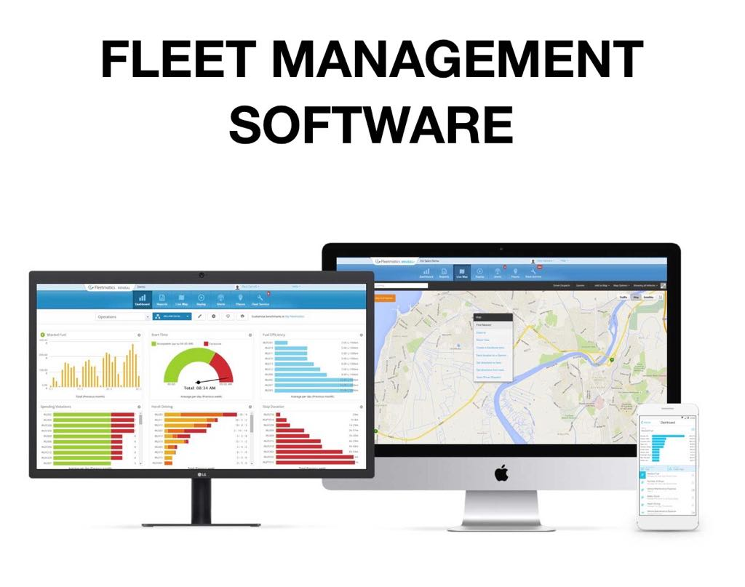
7 Use of Vehicle Monitoring by Transport Operators for Fleet & Driver Management
Businesses are increasingly using sophisticated “Fleet management systems” that are used to monitor driver behaviour providing feedback that allows them to grade and alert drivers to reduce risk, make savings on fuel and to ensure compliance etc. Specifically the collection and analysis of such data allows Operators to
Increase Operational efficiency – reduce Maintenance & Fuel costs by encouraging more economical driving habits
Increase “uptime” of vehicles and drivers due to better visibility & scheduling
Improve Service Levels to customers by allowing accurate delivery timings and real time tracking.
Reduce Infringement / Penalty costs by safer driving resulting from providing visibility of driver behaviour to management AND providing real time alerts in the cab.
Allow Real time “incident monitoring” to enable management to react to unplanned events etc.

Slide 12
8 Future Outlook
Decreasing costs of electronics and IT leading to more and more data being collected.
  Video recording of all trips? All engine details? All Load details?
Mobile communications becoming more ubiquitous & lower latency, higher capacity, enable more and more monitoring and automated driving
“AI”, Analytics etc. may lead to more and more innovative means of optimising use of transport assets. (Roads, vehicles, drivers)
Drones and driverless vehicles.
Internet of Things (IoT) – tracking of small objects and connectivity
Smart Cities – everything-online 24/7.

Slide 13
9 Conclusions
Governments regulate transport including commercial transport to promote safety, efficiency/environment and to raise revenue.
Regulations in UK are made by “Primary Legislation” in Acts of Parliament drafted by DfT and from EU laws.
Day to day regulations and enforcement is delegated to “Executive Agencies” and similar government bodies. (DVSA, DVLA etc.)
In-cab monitoring began in 1970ies to ensure drivers hours compliance.
Since 2006 Digital Tachographs compulsory in EU for Commercial vehicles.
Advances in technology now driving rapid development of applications using real time data from Commercial vehicles for Business Uses to improve business efficiency, service levels and safety.
As DfT agencies seek to promote safety, efficiency and sustainability, they will increasingly make use of ‘Digital’ technology

Slide 14
Appendix – Information Sources
https://www.optac.info/uk/introduction-to-tachographs/#one
https://www.gov.uk/government/organisations/department-for-transport/about
https://www.teletracnavman.co.uk
Vehicle Certification Agency- “Type approval for HGV’s”-http://www.dft.gov.uk/vca/vehicletype/type-approval-for-go.asp
DVSA Strategy 2017-2022 3,3 Digital data strategy- https://www.gov.uk/government/publications/dvsa-strategy-2017-to-2022/helping-you-stay-safe-on-britains-roads-dvsas-strategy-for-2017-to-2022

