Slide 1
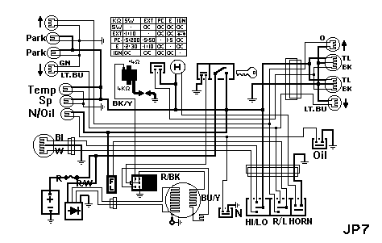
Engineering Science
Electronics
Level : Foundation
Lecturer :Tim Tudor
Email : timothy.tudor@smu.ac.uk
Year : 2011

Slide 2
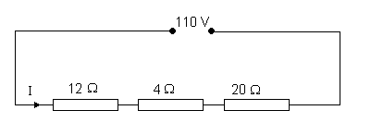
Topic 1 – DC Theory
Some Questions
Calculate the current flowing in the circuit below and the voltage drop over the middle resistor.
(3.056 A and 12.22 V)

Slide 3

Topic 1 – DC Theory
Some Questions
Calculate the total resistance of the circuit shown.
Determine the current, total power dissipated and the voltage drop over each resistor.
(0.333 A, 16.7W , 33.3 V and 16.67 V)

Slide 4
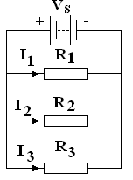
Topic 1 – DC Theory
Resistors in parallel
Consider 3 resistors in parallel as shown.
The voltage across each is the supply voltage V.
The current flowing in each is given by Ohms' Law
I₁= V/R₁ I₂= V/R₂ I₃= V/R₃

Slide 5
Topic 1 – DC Theory
Resistors in parallel
The current is divided according to the resistance.
If the resistors were all the same, the same current would flow in each.
The total current drawn from the supply is
I = I₁ + I₂ + I₃
I = V/R₁ + V/R₂ + V/R₃
I = V(1/R₁ + 1/R₂ + 1/R₃)

Slide 6
Topic 1 – DC Theory
Resistors in parallel
If the same current was drawn from the supply by a single resistor R_{T} the current would be
I = V/R_{T}
Comparing the two equations
V/R_{T} = I = V(1/R₁ + 1/R₂ + 1/R₃)

Slide 7
Topic 1 – DC Theory
Resistors in parallel
In general for resistors in parallel

Slide 8
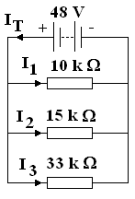
Topic 1 – DC Theory
Resistors in parallel
Calculate the total resistance and all the currents in the circuit below

Slide 9
Topic 1 – DC Theory
Resistors in parallel
I_{T} = 48 / 5.077 x 10³ = 9.455 x 10⁻³ A
I₁ = 48/10 x 10³ = 4.800 x 10⁻³ A
I₂ = 48/15 x 10³ = 3.200 x 10⁻³ A
I₃ = 48/33 x 10³ = 1.455 x 10⁻³ A
Check total = 4.8 + 3.2 +1.455 = 9.455 mA

Slide 10
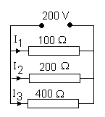
Topic 1 – DC Theory
Some Questions
Calculate the total resistance for the circuit shown. Determine the total current drawn from the
supply.

Slide 11
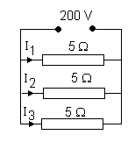
Topic 1 – DC Theory
Some Questions
Calculate the total resistance for the circuit shown. Determine the current in each resistor and
the total current drawn from the supply.
(1.66Ω, 40 A, 120 A)

