Slide 1
LCLM4006:
Enterprise and Entrepreneurship
Legal Format of Enterprises &
Building a Founding Team
Teaching Team
Deji Olagboye
Doreen Dai
Fouziya Farheen
Simon Chatterton
Sujeewa Herath
Chung Lai Johnny Wan (Module Lead)

Slide 2
LCLM4006: Enterprise & Entrepreneurship
Recap of previous session….
We
Explained the entrepreneurial process.
Explained the business planning process by learning about business plans.
Explored your business ideas and worked on your overview through a practical activity.

Slide 3
LCLM4006: Enterprise & Entrepreneurship
Assessment brief & support
Before we start our today’s sessions
Let’s have a look at the assessment brief and the assessment template
Do you have any questions?
Video explanation: Assessment Explanation

Slide 4
LCLM4006: Enterprise & Entrepreneurship
In today’s session….
We will:
Explore & explain the different legal formats of UK small businesses
Have a practical activity
Understand the importance of a founding team

Slide 5
Ownership structures and legal forms of SMEs
LCLM4006: Enterprise & Entrepreneurship
Businesses not only vary in size and industry but also in their ownership
Different from country to country. In the United Kingdom the 3 most common legal forms of SMEs are
Limited Company
Sole Trader
Partnerships

Slide 6
LCLM4006: Enterprise & Entrepreneurship
Limited Company-LTD
The company is registered as a separate legal entity from the individuals who owns it.
Owners are not liable for the debts of the company (with some exceptions-fraud for example etc).
Limited companies can be owned and operated by one person (director/ shareholder).
Must have at least one director/ shareholder. Directors are legally responsible for running the company and making sure all the company’s accounts and reports are properly prepared.
There is no restriction on how many directors a limited corporation may have; anyone who is 16 years of age or older may serve as a director.

Slide 7
LCLM4006: Enterprise & Entrepreneurship
Limited Company-LTD
Limited companies must choose a trading name & it must usually end in either ‘Limited’ or ‘Ltd’. For example: Vasilios Ltd or Vasilios Limited.
The trading name must be checked against the Companies House database.
Company House must approve the trading name of the company since it cannot be the same as another legally existing UK-based company.
Any limited company can be a company either ‘limited by shares’ or ‘limited by guarantee’.
Most limited companies are ‘limited by shares and each shareholder has a number of shares- John 25%- Mary 75%. The lower value of a single share could be £1.

Slide 8
LCLM4006: Enterprise & Entrepreneurship
Limited Company-LTD
Shareholders own the company by owning its shares and are often referred to as 'members'. Directors on the other hand, manage the business and its operations.
Shareholders must vote and agree for any changes to the company. An individual can be the director and shareholder at the same time .

Slide 9
LCLM4006: Enterprise & Entrepreneurship
Limited Company-LTD
Advantages
Disadvantages
Complicated to set up.
Complex accounts.
Accountancy costs.
Public records.
Ownership- if there are more than one shareholders then they have a say of how the company operates.
Tax efficient.
Limited liability- separate entity in the eyes of the law.
Professional status.
Company pension.

Slide 10
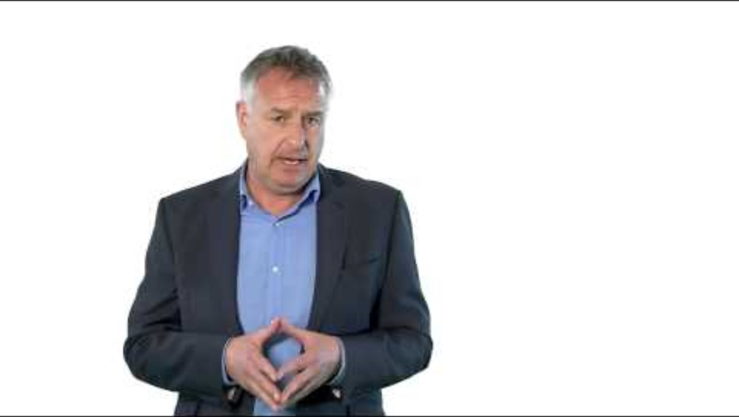
Limited company- LTD
LCLM4006: Enterprise & Entrepreneurship
Let's watch a video…………..
Video link: https://www.youtube.com/watch?v=iQmtT7BKlik

Slide 11
Sole Trader
LCLM4006: Enterprise & Entrepreneurship
A firm that is owned and operated by one person/self-employment.
Receives the profits and incurs any losses. Sole traders are personally liable for any debts of the firm.
Sole traders register and pay tax through the self-assessment process & they must file a tax return every year.
Sole trader must keep and declare all financial records.
Do not need to register their name and can trade under their own name or any other name they wish.
Sole traders can have employees. i.e. be an employer

Slide 12
Sole Trader
LCLM4006: Enterprise & Entrepreneurship
Advantages
Disadvantages
Easy and inexpensive to create.
Complete authority over all business activities.
It is the least regulated form of business ownership.
Tax on business profits- owner must file an annual self-assessment tax return every year.
The owner has unlimited liability (can get insurance but still liable).
Raising funding can be challenging.
Retaining high-calibre employees can be difficult.
One person has the full control.

Slide 13

Sole Trader
LCLM4006: Enterprise & Entrepreneurship
Let's watch a video…………..
Video link: https://www.youtube.com/watch?v=oDGfs_PVhYU

Slide 14
Partnerships
LCLM4006: Enterprise & Entrepreneurship
In a partnership, the partners personally share responsibility, for example for any losses, stock, equipment etc.
Partners share the firm’s profits, and each partner pays tax on their share.
A partner does not have to be an actual person. For example, a limited company counts as a ‘legal person’ and can also be a partner.
Two or more people set up a partnership together (lawyers, doctors).
Depending on the type of partnership, some partners might have limited liability while other that involved in the day-to-day operation, share the liability.

Slide 15
Partnerships
LCLM4006: Enterprise & Entrepreneurship
Ordinary Partnership
Both partners personally share responsibility for the firm.
Limited partnership
one ‘general partner’ and one ‘limited partner’. General and limited partners have different responsibilities and levels of liability for any debts the firm can’t pay. All partners pay tax on their share of the profits.
Limited liability partnership (LLP)
You can set up (‘incorporate’) a limited liability partnership (LLP) to run a business with 2 or more members. A member can be a person or a company, known as a ‘corporate member’.
Each member pays tax on their share of the profits, as in an ‘ordinary’ business partnership, but isn’t personally liable for any debts the business can’t pay.

Slide 16

Do you have any ……
LCLM4006: Enterprise & Entrepreneurship

Slide 17
LCLM4006:
Enterprise and Entrepreneurship
Social Enterprise

Slide 18
Social Enterprise
LCLM4006: Enterprise & Entrepreneurship
Social enterprises are companies that their primary focus is on addressing a social or environmental cause for the benefit of others.
Not for profit but for social impact. No shareholders or owners. Any surplus of funding or profit is reinvested to address the cause or is kept aside for future use.
Rely on volunteering, grants and donations to survive but also many social enterprises sell products and services.
Can be set in many forms: charitable incorporated organisation (CIO) or community interest company (CIC).

Slide 19
Social Enterprise
LCLM4006: Enterprise & Entrepreneurship
Let’s look in class few examples of Social Enterprises:
British Heart Foundation: https://www.bhf.org.uk/
Cancer UK: https://www.cancerresearchuk.org/
Oxfam: https://www.oxfam.org.uk/

Slide 20
How to start a Social Enterprises
LCLM4006: Enterprise & Entrepreneurship
https://www.gov.uk/set-up-a-social-enterprise

Slide 21
Community Interest Company-CIC
LCLM4006: Enterprise & Entrepreneurship
Community interest companies (CICs) were introduced in the UK in 2005
Have company directors who cannot be paid for being a director, but can be paid for other roles in the company
Less difficult to run than a registered charity and have to submit accounts to Companies House and complete a short annual return called a CIC34
Pay corporation tax on surplus generated

Slide 22
Community Interest Company-CIC
LCLM4006: Enterprise & Entrepreneurship
CICs are social enterprises whose primary focus is on addressing a social or environmental cause for the benefit of others.
Not for profit but for social impact. No shareholders or owners. Any surplus of funding or profit is reinvested to address the cause or is kept aside to develop the organisation.
Typically generate income though producing products and delivering services for or by a specific community. Eg bike repair workshop run by ex-offenders, a bakery run by people with a learning disability.

Slide 23
Community Interest Company Examples
LCLM4006: Enterprise & Entrepreneurship
Hills Café in High Wycombe
Big Issue
Little Fish Theatre Company in London
Onion Collective | social enterprise in Somerset

Slide 24
Charitable Incorporated Organisation-CIOs
LCLM4006: Enterprise & Entrepreneurship
The Charitable Incorporated Organisation format is for a registered charity which also trade and so needs to also be a registered company.
The CIO was created in response to requests from charities for a new legal form that could provide some of the benefits of being a company, but without some of the burdens. The CIO was first introduced in the Charities Act 2006.
For example, a charity which delivers contracts (e.g. social care provision) for their local authority.
The charity trustees are also company directors.

Slide 25
Legal Format of Social Enterprises
LCLM4006: Enterprise & Entrepreneurship
https://www.gov.uk/guidance/charity-types-how-to-choose-a-structure

Slide 26
CIC & CIO
LCLM4006: Enterprise & Entrepreneurship
https://www.gov.uk/government/publications/community-interest-companies-how-to-form-a-cic/community-interest-companies-guidance-chapters
https://www.gov.uk/setting-up-charity/register-your-charity

Slide 27
Sustainability and Community Support
Sustainability Ideas (BBC)
Sustainability Ideas (British Business Bank)
Community Support Ideas (Forbes)
Include at least one element in your business plan

Slide 28
Practical Activity- 30 minutes
LCLM4006: Enterprise & Entrepreneurship
Please write down what legal format would choose and why for your own idea.
A lot of information on how to set up a company can be found on the government website below:
https://www.gov.uk/set-up-business
If anyone is interested to start a Social Enterprise, then a lot of information on how to set up a social enterprise can be found on the government website below:
https://www.gov.uk/set-up-a-social-enterprise

Slide 29
Legal Format
Open your MS Word document
Add a new heading Legal Format
Describe the legal format
Briefly explain your choice
Add some references to support your ideas

Slide 30
How to search books and journal articles?
Module Reading List
UWTSD Library
Google Scholar
Readings in some Moodle tiles

Slide 31
How to cite?
Harvard Referencing Style
UWTSD Cite Them Right
Cite Them Right - Harvard

Slide 32
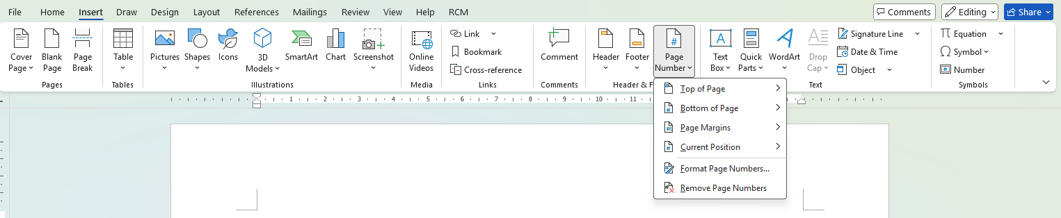
How to add page number?
Insert => Page Number

Slide 33
Do you have any ……
LCLM4006: Enterprise & Entrepreneurship

Slide 34
One-to-One Academic Support by Johnny Wan
Who can join? All students taking LCLM4006 who need academic support
What can you get? Johnny will answer any questions you have
How long would it be? 30 minutes
Where to join? MS Teams or in-person
How to book? Email: c.wan@uwtsd.ac.uk (Johnny Wan)

Slide 35
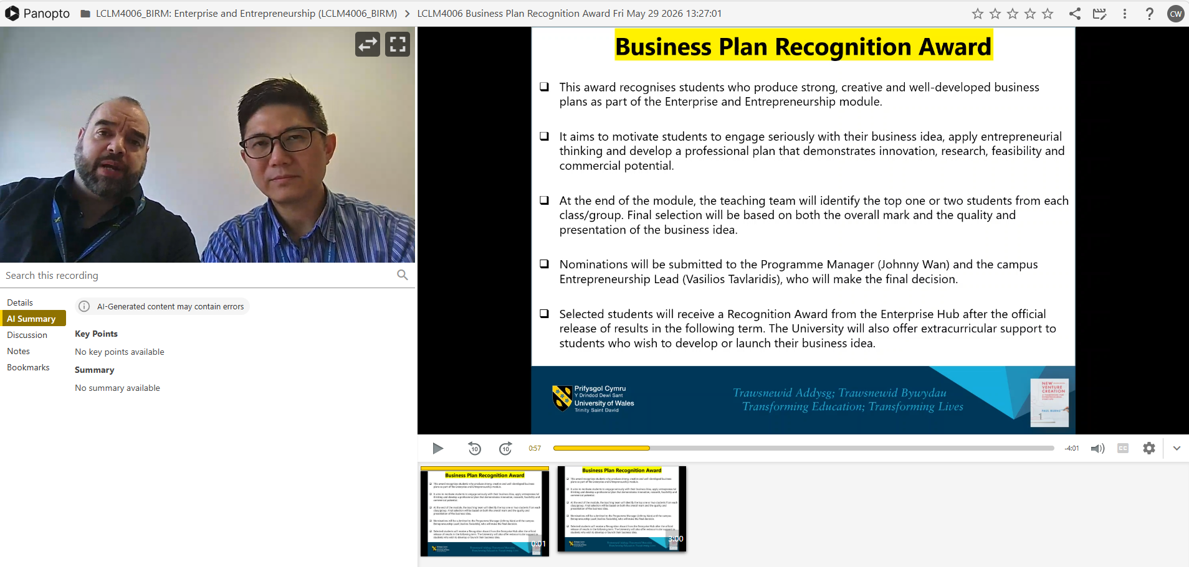
Business Plan Recognition Award
Panopto Video

Slide 36
LCLM4006:
Enterprise and Entrepreneurship
Founding Team

Slide 37
Founding Team
LCLM4006: Enterprise & Entrepreneurship
Having the right founding team/ employees is vitally important to the success of any startup.
As the owner of the startup, you cannot do everything…
The larger the firms becomes the more you must rely on your team..
The company should be able to run smoothly even if the owner is not present-Assign roles even if it is difficult.

Slide 38
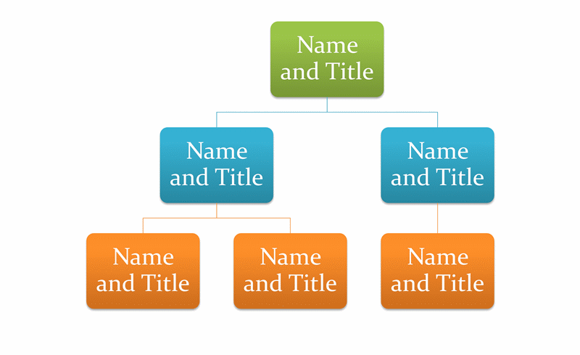
Practical Activity- 20 minutes
LCLM4006: Enterprise & Entrepreneurship
Write down the employee management structure
of your company idea.
Add a new heading Management Structure.
Please create a management diagram and briefly describe it.

Slide 39
Do you have any ……
LCLM4006: Enterprise & Entrepreneurship

Slide 40

Next week…..
We will learn about
Entrepreneurial Marketing-Defining customers, target market & marketing strategies

Slide 41
References
Barrow, Barrow, P., & Brown, R. (2012). The business plan workbook (7th ed.). Kogan Page.
Mariotti, S., & Glackin, C., (2017). Entrepreneurship: Starting and Operating A Small Business, 4th Edition, Pearson.

