Slide 1
Bmns4006 –Introduction to Research and evidence-based Practice
Student Number : 1816836
Module Leader : Jaymie Phillips

Slide 2
Learning outcomes
At the end of the presentation :
Brief history of infection Control
Be able to identify the meaning of infection control and prevention.
Reasons why cleanliness is important in health care settings.
Aspect of Fundamental care through infection control.
Relevant Legislations
Infection and Chain of infection.
Identify some appropriate infection control measures to minimise or reduced the risk of infection and cross infection.

Slide 3
Learning outcomes
The importance of Hand Hygiene
The 5 moments for hand hygiene at the point of care

Slide 4
Brief History
18th Century
Originated in Scotland
100 years later on
1858 Florence Nightingale
The discoveries of Pasteur, Koch and Lister and the beginning of the ‘Bacteriological Era’
Streptococcal, staphylococcal and then Gram-negative bacilli as a cause of hospital infection became a focus of attention, as did antibiotic-resistant organisms.

Slide 5
Infection Control
Preventing the spread of infection, there are two aspects of infection control
1. Curtailing the spread of infection or an organism
2. Managing the risks so as to prevent infection
Infection Control features is important in all health care setting, this makes the multi-disciplinary and multi- professional function.
National Health Service (2021) and Mayhall (2004).

Slide 6
Preventing the spread of infection
      Through :
      1. Risk Management
2. Hand Washing
3. Using PPE
4. Isolation
Loveday et al (2014)

Slide 7
reasons why cleanliness is important in health care settings
Almost all healthcare settings provide a reservoir of micro-organisms which may provide of infection.
In Wales approximately 6.4 % patients in hospitals will have an infection anytime (Humphreys et al, 2008).
Health care infection contribute to deaths annually by 1500 (Humphreys et al,2008)

Slide 8
reasons why cleanliness is important in health care settings
In England health care infection costs the NHS 1 Billon annually (Plowman et al, 2000).
Study shows that patients usually complaints the standard of cleanliness and poor standard of care (Francis Report, 2013)

Slide 9
Infection Control – Fundamental of care
Aspect 3: Ensuring the safety and practice indicators
1. Service Users
2. Equipment
(Welsh Assembly Government, 2003, p19 in Feo et al, 2018)

Slide 10
cleaning materials and barriers to effective cleaning
Cleaning Materials should be appropriate.
Suitable protective clothing
Mops and buckets – Cleaned
Colour coded cleaning equipment
BARRIERS:
1. Damaged equipment
2. Avoid unnecessary clutter
3. Manufacturers Guidance
(Loveday, 2014)

Slide 11
RELEVANT LEGISLATION
      COSHH – 2004
      Infection Control – ACT Health
      Occupiers Liability Act 1957
      Public Health (Infectious Diseases) Regulations (1988)
      Health and Social Act 2008
      COSHH | Health & Safety Adviser - Email Capture (safety-adviser.co.uk)
      Health and Safety at Work Act, 1974
      Occupiers Liability Act, 1957
      Public Health (Infectious Diseases) Regulations (1988).

Slide 12
Infection
Is define as the deposition and multiplication of bacteria and other micro-organisms in tissues or on surfaces of the body with associated hosts or reactions.
                (Ayliffe and English, 2003)

Slide 13
FOUR MAIN GROUPS OF Micro-organisms
Bacteria
Viruses
Protozoa
Fungi
(Loveday, 2014)

Slide 14
Chain Of Infection (Miller, 2018)
Infectious organisms
Reservoir
Route of Transmission
Means of Entry
Means of Exit
Susceptible Host

Slide 15
Source of infection
Endogenous Infection
Exogenous Infection
(Miller, 2018)

Slide 16
Cross Infection
Cross infection are the results of :
                Direct Contact
                Indirect Contact
                Vehicles
                Vectors
                Airborne transmissions
( Boncea et al, 2021)

Slide 17
Hand Hygiene
Importance:
              The hands of health care staff is a major factor in the spread of infection.
              Transmission of infections agents from one patient to another can lead to health care infections or death.
              Practicing effective hand washing significantly reduce the carriage of infectious agents.
              (World Health Organization, 2009)

Slide 18
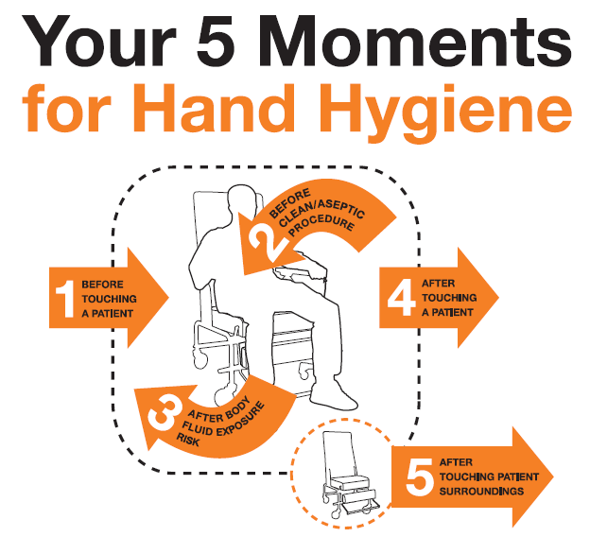
5 moments for hand hygiene at the point of care
WHO | WHO guidelines on hand hygiene in health care

Slide 19
Conclusion
The importance of infection control in health care settings are undeniably significant and nurses play a vital role and these includes:
                Nurses should be aware who cleans what, when and why.
                Nurses should familiarize on the decontamination policy issued by the infection control team, ensuring that appropriate decontamination of equipment takes place.
                Report inadequate standards and defects in equipment that might impact cleaning
                Cleaning standards should be monitored not only by nurses but supervisors, infection control teams and outside agencies.
                (Choi et al, 2021)

Slide 20
Action Plan
All health care staff should be equipped with training skills and knowledge about infection control.
A management plan should be on placed for emergency and incidents that may occurs.
All health care setting should designate a trained staff as an infection control specialists.
The ability of all staff to have a good team working within work place.
Availability of all cleaning products should be in placed and lock away.
Encouraged proper documentation of cleaning on all materials used and unused within working place.
SMART (Reuben andJennings,2019)

Slide 21
References
Ayliffe, G. and English, M. (2003). Hospital Infection from Miasmas to MRSA, Cambridge, Cambridge University Press.
Boncea,E., Expert, P., Honeyford,K., Kinderlerer, A., Mitchell, C., Cooke, G., Mercuri, L. and Costelloe, C. (2021). Association between intrahospital transfer and hospital-acquired infection in the elderly: a retrospective case–control study in a UK hospital network, BM, 1(10), pp 1 – 10.
Choi, U., MiKwon, Y., JeongKang, H., HoonSong, J., Yeoun, H., SookKim, M., HoonKahm, S.,YoungKwon, J., HoonKim, S., -HwaLeeg, S., HyunChoi, J. and Lee, J. (2021). Surveillance of the infection prevention and control practices of healthcare workers by an infection control surveillance-working group and a team of infection control coordinators during the COVID-19 pandemic, Journal of infection and public health, https://doi.org/10.1016/j.jiph.2021.01.012.
COSHH (2004). Retrieved on 14.03.2021 from COSHH Health & Safety Adviser - Email Capture (safety-adviser.co.uk)

Slide 22
References
Feo, R., Kitson, A., and Conroy, F. (2018). How fundamental aspects of nursing care are defined in the literature: A scoping review, Journal Of Clinical Nursing, 27 (11), pp 2189 – 2229.
Food Hygiene (England) Regulations (2006). Retrieved on 14.03.2021 from Food hygiene regulations 2006, England, UK, regulations, EU food hygiene laws, safety, legislation
Food Hygiene Wales Regulations (2005). Retrieved on 14.03.2021 from The Food Hygiene (Wales) Regulations 2005 (legislation.gov.uk)
Forder, A. (2007). A brief history of infection control – past and present. South African Medical Journal, 97 (11), pp 1161 – 1164.
Health and Safety at Work Act, 1974. Retrieved on 14.03.2021 from Health and Safety at Work Act, 1974
Humphreys, H., Newcombe, R. G., Enstone, J., Smyth, T.M., McIlvenny, G., Fitzpatrick, F., Fry, C. and Spencer, C. (2008). Four Country Healthcare Associated Infection Prevalence Survey 2006: risk factor analysis, Journal of Hospital Infection, 69 (3), pp 249-257.

Slide 23
References
Loveday, H.P.., Wilson, A. J., Pratt, R.J., Golsorkhi, M., Tingle, A., Bak, A., Browne, J., Prieto, J. and Wilcox, M. (2014). epic3: National Evidence-Based Guidelines for Preventing Healthcare-Associated Infections in NHS Hospitals in England, Journal of Hospital Infection, 86, (1), pp S1-S70
Mayhall, G. (2004). Hospital epidemiology and infection control, China, Lippincott Williams and Wilkins Publishing.
Miller, C. (2018). Infection Control and management of hazardous materials, St Louis, Missouri, Elsevier Publishing Press.
National Health Service (2021). Infection Control. Retrieved on 14.03.2021 from Coronavirus » Infection prevention and control (IPC) (england.nhs.uk)
Nursing and Midwifery Council (NMC) (2021). The Francis Report (2013). Retrieved on 26.02.2021 from https://www.nmc.org.uk/about-us/policy/position-statements/francis-report/
Occupiers Liability Act 1957.Retrievd on 14.03.2021 from Occupiers Liability Act, 1957

Slide 24
references
Official Feed and Food Controls (England) Regulations (2006). Retrieved on 14.03.2021 from Brexit - GOV.UK (www.gov.uk)
Plowman, R. (2000). The socioeconomic burden of hospital acquired infection, Europe's journal on infectious disease surveillance, epidemiology, prevention and control, 5(4), p 1.
Public Health (Infectious Diseases) Regulations (1988). Retrieved on 14.03.2021 from Public Health (Infectious Diseases) Regulations (1988).
Reuben, D. and Jennings, L. (2019). Putting Goal‐Oriented Patient Care Into Practice, Journal of the American Geriatrics Society, 67(7), pp 1342-1344.
World Health Organization (WHO) (2009). WHO Patient and Safety: WHO Guidelines on hand hygiene in health care. Retrieved on 15.03.2021 from WHO | WHO guidelines on hand hygiene in health care

Slide 25
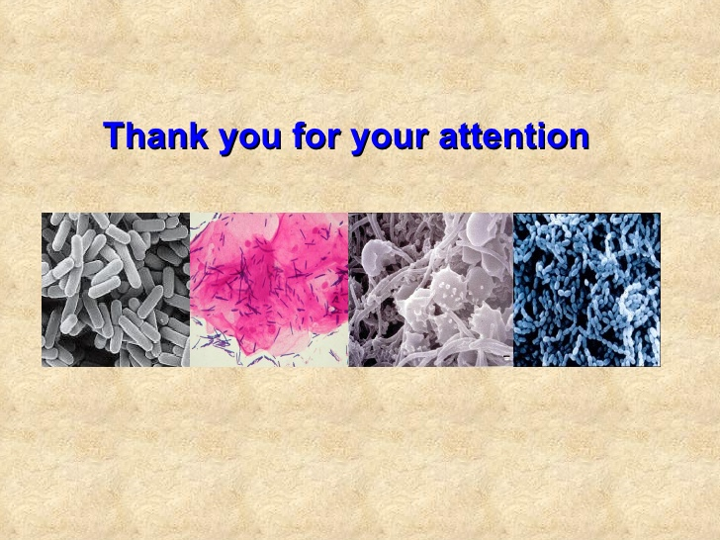
Questions

