Slide 1
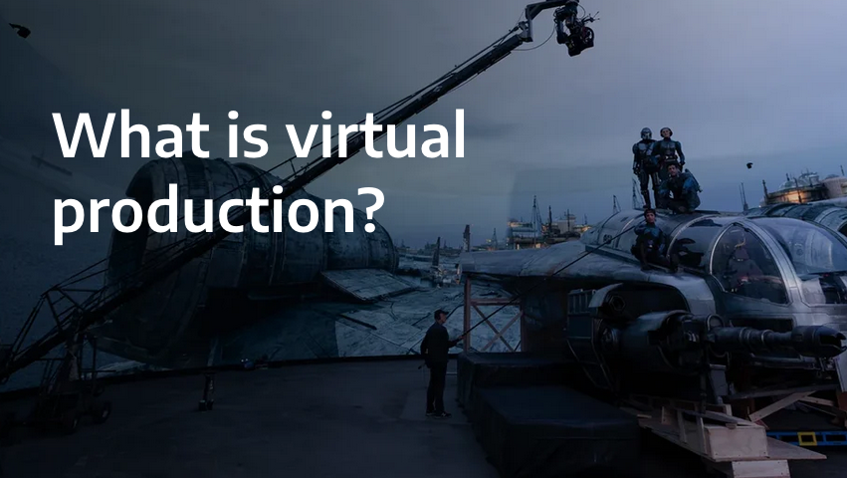

Slide 2
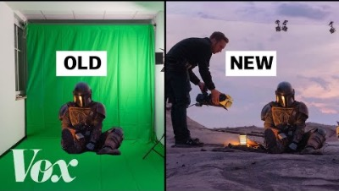

Slide 3
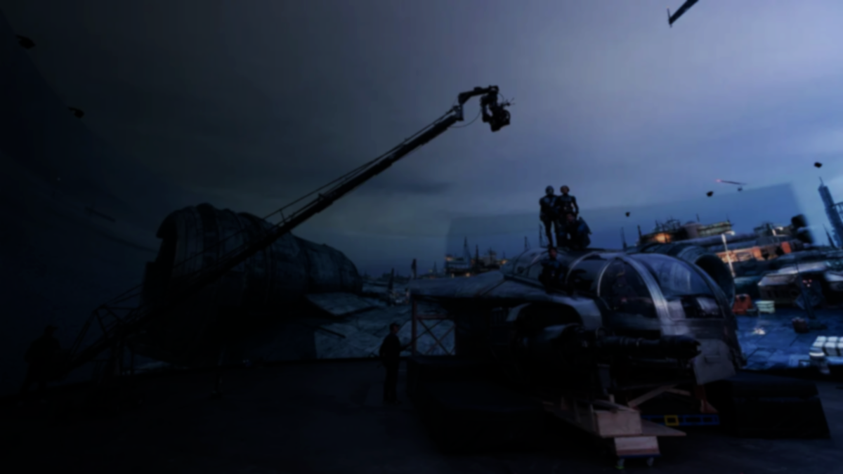
What is virtual production?
Virtual production allows real-world and digital platforms to converge using a game engine to create virtual sets and environments during filmmaking. Virtual production allows for more flexibility and creativity in filmmaking, as it eliminates the need for physically building every set or flying crew to physical locations. It also allows for some of the filmmaking processes to
take place virtually, allowing people to work remotely.
Notes:
Virtual production is one of the most important innovations since digital cameras replaced traditional film stock. It is being used for all kinds of content creation and it’s changing production processes forever. Let's take a look at some of the ways virtual production has been used in recent years and how real-time production is affecting the production pipeline.

Slide 4
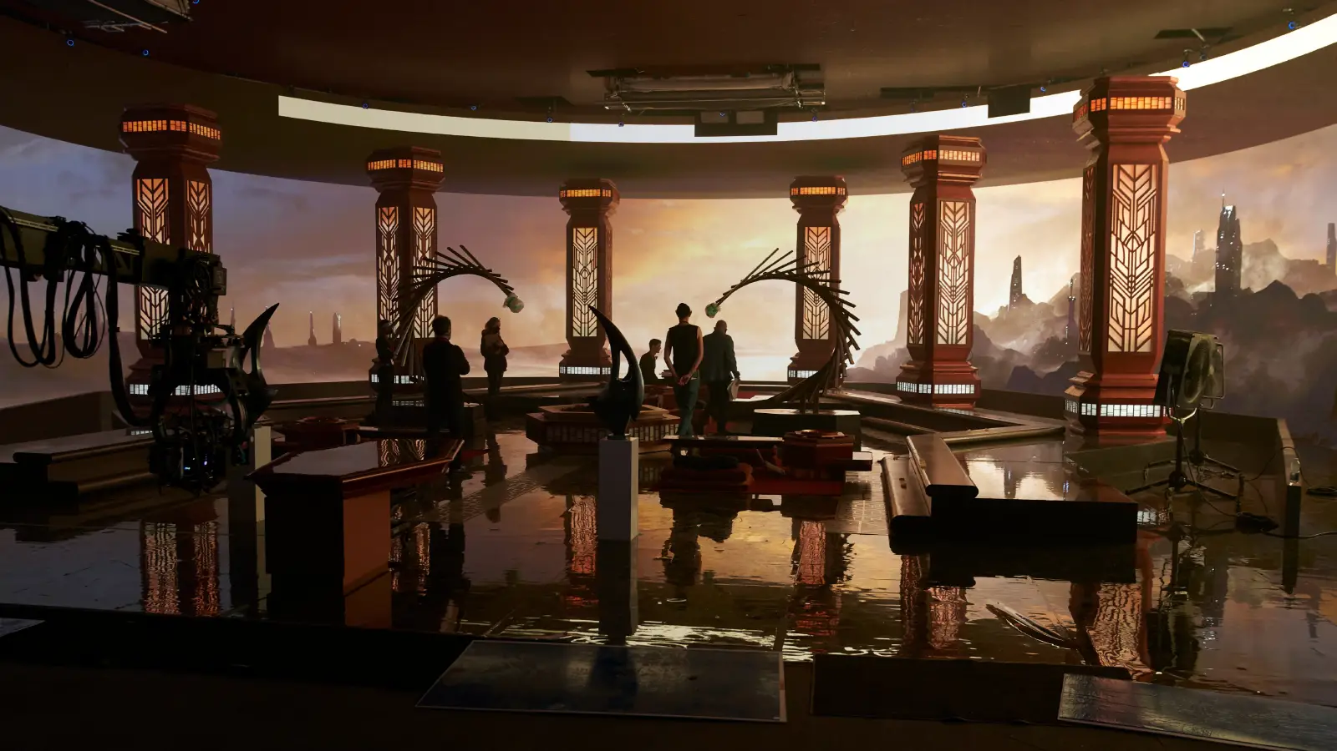
Examples of virtual production include world capture (location/set scanning and digitization), visualization (previs, techvis, postvis), performance capture (mocap, volumetric capture), simulcam (on-set visualization), and in-camera visual effects (ICVFX).
Notes:
Virtual production is one of the most important innovations since digital cameras replaced traditional film stock. It is being used for all kinds of content creation and it’s changing production processes forever. Let's take a look at some of the ways virtual production has been used in recent years and how real-time production is affecting the production pipeline.

Slide 5
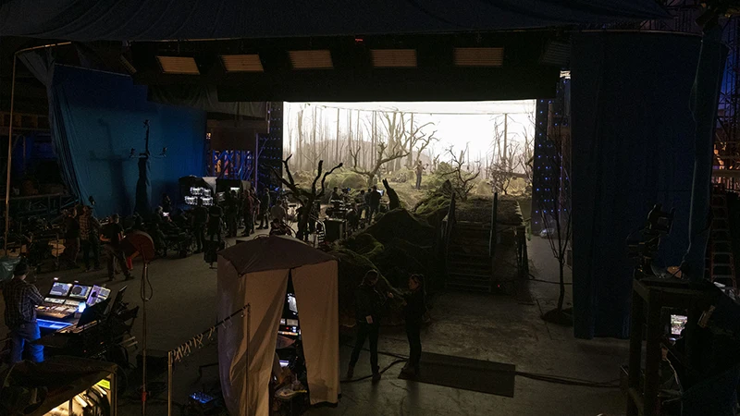
When a live-action camera moves, the virtual environment on the LED wall shifts perspective as well, using gaming technologies to navigate a virtual landscape. The unison of movement between camera and imagery is called parallax, creating the illusion of a single
physical location.
Live camera
tracking translates accurate
camera movements into the
rendering platforms where
they are realized in real-time.
Notes:
Virtual production is one of the most important innovations since digital cameras replaced traditional film stock. It is being used for all kinds of content creation and it’s changing production processes forever. Let's take a look at some of the ways virtual production has been used in recent years and how real-time production is affecting the production pipeline.

Slide 6
Virtual production is not new, it’s just been democratised. -Deepak Chetty
Chetty says there are more
opportunities than ever for
individuals to create incredible
content on their computers at
home. They now have the
power and tools to create
visuals that may have
previously required a large
crew and a million-dollar
budget.
Notes:
Virtual production is one of the most important innovations since digital cameras replaced traditional film stock. It is being used for all kinds of content creation and it’s changing production processes forever. Let's take a look at some of the ways virtual production has been used in recent years and how real-time production is affecting the production pipeline.

Slide 7
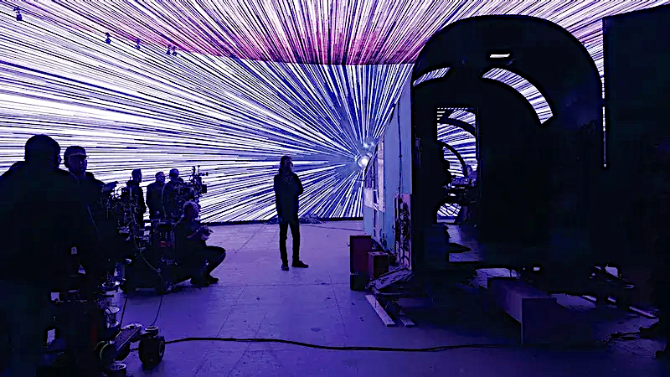
What is The Volume in virtual production?
Virtual production has led to a new stage known as The Volume, a modular fixture made up of thousands of LED lights used to display video content from a game engine, curving around actors and smaller sets.
Initially intended for indoor/outdoor advertising, entertainment venues, and broadcast use, LED panels are now employed on film sets to create volumes (backdrops) for motion picture cinematography.
Notes:
Virtual production is one of the most important innovations since digital cameras replaced traditional film stock. It is being used for all kinds of content creation and it’s changing production processes forever. Let's take a look at some of the ways virtual production has been used in recent years and how real-time production is affecting the production pipeline.

Slide 8
The automation of the Volume stage means that production times and set-ups are being greatly reduced or even circumvented. A tool called Stage Manager allows presets for locations, camera angles, and lighting set-ups that would normally take hours to establish on set. This can all be done via switchboard, allowing for instant set-up changes and tracking scenes and version numbers, all operating as multi-user sessions in separate virtual workspaces.
Notes:
Virtual production is one of the most important innovations since digital cameras replaced traditional film stock. It is being used for all kinds of content creation and it’s changing production processes forever. Let's take a look at some of the ways virtual production has been used in recent years and how real-time production is affecting the production pipeline.

Slide 9
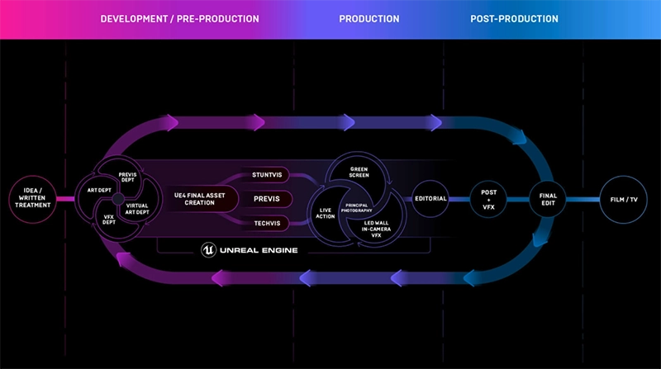
What are virtual production workflows?
The narrative options tools like Unreal Engine or Unity offer are changing technologies. The advent of the virtual design process has also introduced new asset departments and virtual art departments, requiring the diverse skills of a real-time 3D artist.
Notes:
Virtual production is one of the most important innovations since digital cameras replaced traditional film stock. It is being used for all kinds of content creation and it’s changing production processes forever. Let's take a look at some of the ways virtual production has been used in recent years and how real-time production is affecting the production pipeline.

Slide 10
Notes:
Virtual production is one of the most important innovations since digital cameras replaced traditional film stock. It is being used for all kinds of content creation and it’s changing production processes forever. Let's take a look at some of the ways virtual production has been used in recent years and how real-time production is affecting the production pipeline.

Slide 11
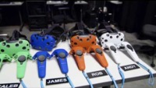
The emphasis is not so much on the technology but on how it is affecting content creation, changing workflows, and enhancing collaboration.
Along with the LED wall process, virtual production can include elements of chroma key effects, performance capture, and rear projection. Complete virtual production was used in the 2019 photorealistic remake of
The Lion King.
Notes:
Virtual production is one of the most important innovations since digital cameras replaced traditional film stock. It is being used for all kinds of content creation and it’s changing production processes forever. Let's take a look at some of the ways virtual production has been used in recent years and how real-time production is affecting the production pipeline.

Slide 12
The emphasis is not so much on the technology but on how it is affecting content creation, changing workflows, and enhancing collaboration.
Along with the LED wall process, virtual production can include elements of chroma key effects, performance capture, and rear projection. Complete virtual production was used in the 2019 photorealistic remake of
The Lion King.
Notes:
Virtual production is one of the most important innovations since digital cameras replaced traditional film stock. It is being used for all kinds of content creation and it’s changing production processes forever. Let's take a look at some of the ways virtual production has been used in recent years and how real-time production is affecting the production pipeline.

Slide 13


Slide 14
Real time tools like Unity or Unreal Engine create collaborative on-set experiences that allow filmmakers to work differently.
Pre-vis has evolved as collaboration in real-time. It now encompasses post-vis, tech-vis, motion capture volumes, spaces, virtual prototyping, photogrammetry, and virtual LED screens producing LED stage volumes. These virtual production tools are also being used for concept design, proof of concept, and animatics.
Notes:
Virtual production is one of the most important innovations since digital cameras replaced traditional film stock. It is being used for all kinds of content creation and it’s changing production processes forever. Let's take a look at some of the ways virtual production has been used in recent years and how real-time production is affecting the production pipeline.

Slide 15
Whereas pre-vis breathes life into characters through animation, virtual production entails rendering and lighting on set and the focus is on the shot. Render times have been sped up to the point where set lighting can be done on location. This means the pipelines have been changed, and production and VFX pipelines occur concurrently.
Notes:
Virtual production is one of the most important innovations since digital cameras replaced traditional film stock. It is being used for all kinds of content creation and it’s changing production processes forever. Let's take a look at some of the ways virtual production has been used in recent years and how real-time production is affecting the production pipeline.

Slide 16
Adapting to virtual production innovation
While some traditional VFX artists have embraced the benefits of virtual production, others are having a hard time moving into live-action production on set. They are used to working in isolation in a dark room and not in the dynamic atmosphere of a set.
In the case of a colorist, they have to work with 3 da Vinci resolves operating live over 40 monitors and four cameras in real-time. Notes also need to be resolved in real-time by up to 10 people, requiring teams of operators to work on these while filming. Tools are being developed to capture notes from all departments so they can be dealt with efficiently.
Notes:
Virtual production is one of the most important innovations since digital cameras replaced traditional film stock. It is being used for all kinds of content creation and it’s changing production processes forever. Let's take a look at some of the ways virtual production has been used in recent years and how real-time production is affecting the production pipeline.

Slide 17
Studios are wrapping their heads around how to re-use virtual assets for future productions.
Worldbuilding allows for a multitude of locations that can be re-textured and re-purposed for different productions. As asset libraries grow, studios and creators can choose to further monetize their assets by selling them on Unreal Marketplace.
Art departments now have to consider lighting in virtual production pipelines. Directors of Photography (DPs) are brought in to work with virtual crews for pre-lights, choosing frames and sequences. Then a tech visit is done on the assets so they know what the DP wants and what it’s going to look like on the shoot day.
Notes:
Virtual production is one of the most important innovations since digital cameras replaced traditional film stock. It is being used for all kinds of content creation and it’s changing production processes forever. Let's take a look at some of the ways virtual production has been used in recent years and how real-time production is affecting the production pipeline.

Slide 18
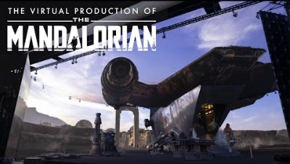
Case study: How virtual production was used in The Mandalorian
Notes:
Virtual production is one of the most important innovations since digital cameras replaced traditional film stock. It is being used for all kinds of content creation and it’s changing production processes forever. Let's take a look at some of the ways virtual production has been used in recent years and how real-time production is affecting the production pipeline.

Slide 19
In 1999 George Lucas was the first mainstream director to use high-definition digital cameras for Star Wars: Episode 1 The Phantom Menace. Since then, they have become the industry norm. The Star Wars franchise continues its legacy of VFX innovation with Industrial Light and Magic’s use of the Volume stage to produce high-end effects that enhance dynamic storytelling within a familiar universe that has been a part of popular culture for over 40 years.
In the making of The Mandalorian, immersive LED stages were used to create virtual three-dimensional environments that allowed director Jon Favreau to collaboratively create effects in-camera rather than in post-production. VFX artists were brought into the stage to collaborate with Favreau, the DOP, art departments, etc on the shoot. https://www.youtube.com/watch?v=zhfB-3KvG2A
Notes:
Virtual production is one of the most important innovations since digital cameras replaced traditional film stock. It is being used for all kinds of content creation and it’s changing production processes forever. Let's take a look at some of the ways virtual production has been used in recent years and how real-time production is affecting the production pipeline.

