Slide 1
Hospitality & Guest Services
in the Hospitality Industry
[BMET4001]
Who are our Consumers?

Slide 2

Today’s content
Different Types of Guests
Understanding and Appreciation of our Guests’ Needs and Wants
Service Expectations
Market Segments

Slide 3
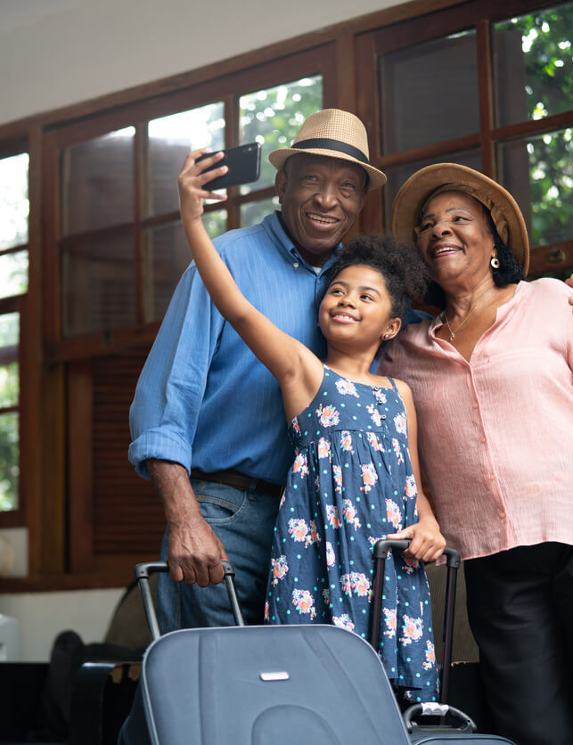
Week 3
Who are our Consumers?

Slide 4

Group Discussion
Who are the different type of consumer/guests in the events and tourism industry?
Notes:
Business guests
Leisure/ vacation
Families
locals

Slide 5

Consumers
People travel for many different reasons:
Business (conference/meetings)
Vacation
Leisure
Other purposes
Recent statistics indicate that approximately 41% of lodging guests travel for business
The remaining 59% of guests travel for pleasure
(Hayes, Ninemeier and Miller, 2020)

Slide 6
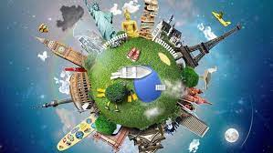

An Interesting Detail
A customer is someone whose relationship with the property is based only upon the exchange of money for products and services provided.
The tactic of treating visitors as guests rather than customers helps establish the positive guest-service philosophy that is critical to a hospitsality success.
(Hayes, Ninemeier and Miller, 2020)

Slide 7

Consumers
How do we know what guest services need to provide to those guests?
By knowing their needs and wants
Task:
Think about this when you go on holiday:
5 things you NEED and 5 things you WANT
Notes:
This is an interesting one because more often than not what people ‘need’ is actually just what they ‘want’
Get them to type it in the chat

Slide 8
Wants versus Needs
Needs
Wants
A need is something needed to survive
Needs are limited
Asked For Needs: Some needs are very easy to identify, especially when someone asks for something.
A want is something that people desire to have that they may not be able to obtain.
Wants are unlimited
Notes:
This gets us thinking that actually, we are aiming to enhance/ fulfil customer wants to make their experience more memorable as what they need is just what we should be doing anyway!

Slide 9
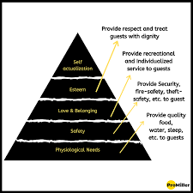
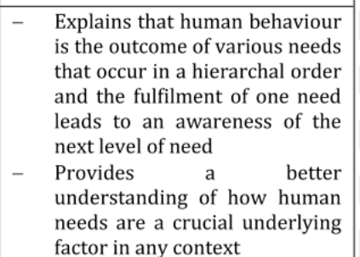
Lets apply Maslow (1943)..
Notes:
Maslow human needs is a critical factor in better understanding how human need are a in understanding crucial can be applied in an attempt to look into the various theoretical concepts/ theories that help to understand what motivates individuals

Slide 10
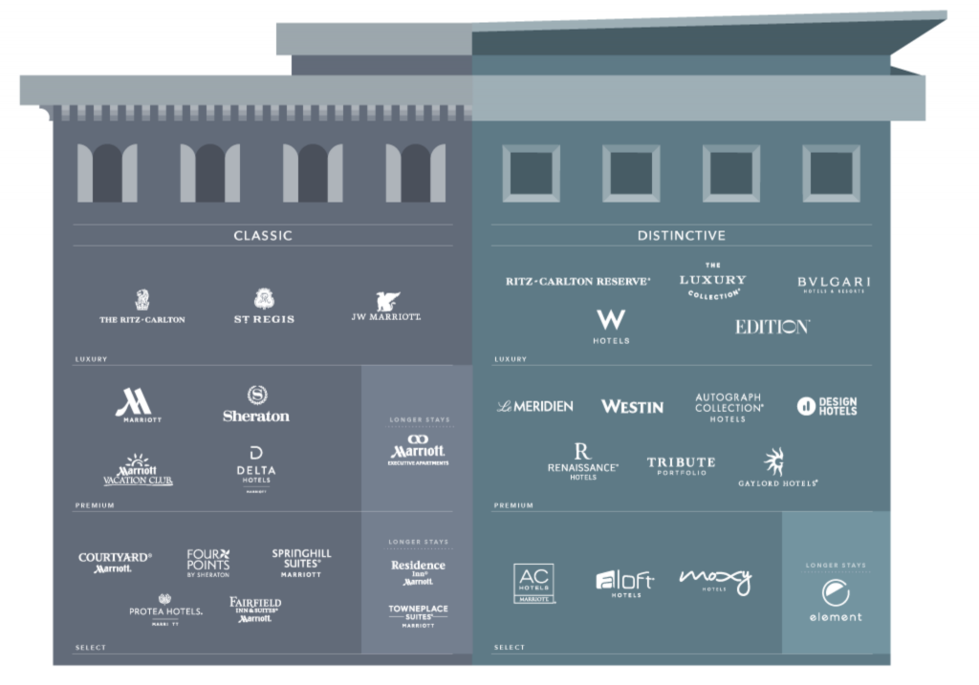
Case Study: Marriott International
Marriott International’s 30 sub-brands cater to different guest types and their diverse needs
Notes:
This can be used to highlight how all the different brand will appeal to different consumers due to their different expectations.

Slide 11


Case Study: Moxy Hotels
What type of consumer can we find at a Moxy Hotel?
What Guest Services does this brand have on offer?
Notes:
-Watch the video first, then let students answer the questions
-Answer: Millennials or younger
-Refer to the guest services on offer and shown in video
-Interesting fact: Moxy hotel rooms are specifically built/designed to be very small to “force” guests to go to the communal areas instead

Slide 12
Task – compare the different guest expectations
Leisure Guests
Business Guests
Locals
What is the expectations of the different guest types?
What specific facilities might the different guests want?
Find some specific examples from the tourism and events industry of how they meet these expectations
(
Notes:
Give 15 mins
Put into 3 break out room (one for each type of customer)
Get them to make notes on a document on the following question above.
Then share back as a whole group
Things we are looking for:
Business guests will be looking for good Wi-Fi, desk in room, early breakfast option, ample plug sockets in the room, free parking, potential loyalty scheme for a discount rate due to staying in hotels very often, potential access to different conference rooms for meetings
Leisure guests – late checkout, later breakfast time, extra facilities like swimming pool/spa, location near tourist sites or link to these sites, Pet friendly?, Childcare options?, maybe room service?, family friendly facilities/ restaurants
Locals – unique dishes or local produce on the menu in restaurants, discounts, events/wedding facilites

Slide 13
Group Discussion
How can a holiday resort enhance the customer experience?
Notes:
Ask for some discussion here
Does any have an example to share when they think their customer experience has been enhanced or if they work in hotel/hospitality have they actively done this

Slide 14
Group Discussion
How can an event enhance the customer experience?
Notes:
Ask for some discussion here
Does any have an example to share when they think their customer experience has been enhanced or if they work in hotel/hospitality have they actively done this

Slide 15
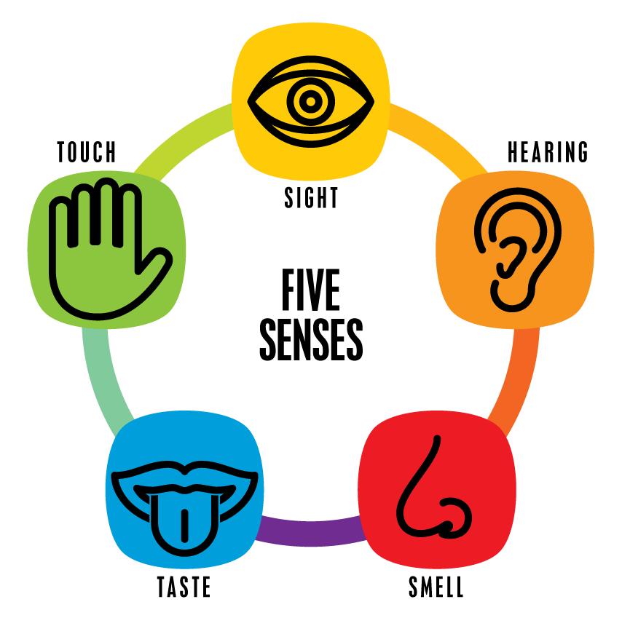
Group Discussion
Can you think of any examples of how the 5 senses can be used for the tourism and event?
Notes:
Prompt – e.g. sight = bright lobby, clean room
Taste – quality of the food, breakfast etc
More examples to follow on next slide

Slide 16
The Five Senses
Sight - Think visuals on Hotel websites, colours in branding and logos.
Sound - According to Juslin and Västfjäll (2008), listening to sounds such as music and noise has a significant effect on our moods and emotions because it can cause our brain to release dopamine.
Think songs that bring back good memories, childhood films, lobby music etc
Smell - Think the smell of popcorn, smell of bread, smell of hotel toiletries.
The Taj Hotels use a certain Jasmin scent in all their hotels specially made to enhance the scent in India
Touch – Your skin is the largest organ in the human body (National Georgraphic, 2017).
In Disney touch of water is integral part of experience. In hotels it may be the fixtures and furnishings of your room, lobby or restaurant
Taste – There are 10,000 taste buds in the human mouth, lots of opportunities to provide tastes in settings to enhance guest quality service.
Think Hilton cookies, or the different cuisines on offer throughout Disney parks.
(Hospitality Insights, N.D)
Notes:
Some more example to share with the groups about how we can use the five senses to enhance the customer experience

Slide 17
Six Steps to Deliver Quality Guest Service
Consider the guests being served
Determine what the guest desires
Develop procedures to deliver what guests want
Train and empower staff
Implement revised systems
Evaluate and modify service delivery systems
Notes:
Further ways to enhance experience and increase quality

Slide 18

Meeting and Exceeding Guest Expectations – How?
Appealing to all 5 senses to enhance the customer experience
Build relationships and connect emotionally (Emotional Intelligence)
Go the extra mile (WOW Factor)
Research the purpose of a guest’s stay and prepare their room accordingly

Slide 19
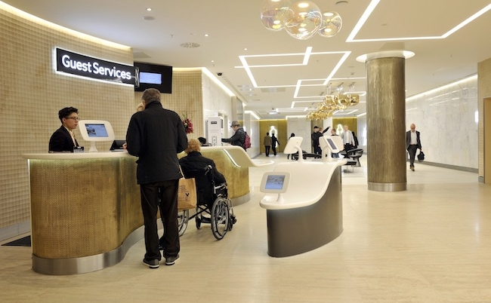
Part 2:
Changing Guest Services
Notes:
Take a break now – if you feel appropriate

Slide 20
Group Discussion
Can you think of any emerging trends or changes affecting the hospitality industry?
Notes:
Think about use of technology e.g. computer check in, robots serving food, the use of different AI
Sustainability – changing in use of chemicals, water consumption, energy consumption in hotels
Covid 19- I think still hygiene has improved as a result of the pandemic

Slide 21

Understanding the Factors Driving Hotel Trends
Emerging technology:
e.g. Artificial Intelligence (AI), robotics and virtual reality
Lifestyle changes:
e.g. Increased interest in sustainable business practices
Covid-19 Pandemic:
e.g. Increased emphasis on safety and hygiene
Notes:
-Technology is a key driver of trends in most industries

Slide 22
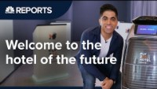
Case Study: Alibaba’s Keyless & Cashless Hotel
Notes:
Watch the video
Q: Which technologies are being used in this hotel? Discuss them with students

Slide 23
Group Discussion
What are the benefits of using AI or robotics in the hospitality industry ? (list examples)
What are your top concerns with these new technologies?
Notes:
Benefits:
Robots cannot phone in sick so less likely to be ‘short staff’
Makes the process more efficient and productive
Cost saving in the long term due to less ongoing wages to pay
Concerns:
Are robots taking our jobs?
What if the technology fails?
Will the technology become quickly outdated?

Slide 24
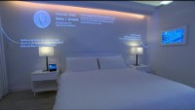
Smart Hotels
Notes:
Ask students - does this entice you?
Are you excited about the future of hotels?

Slide 25
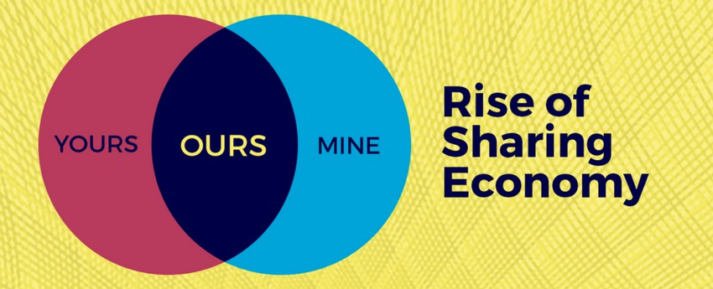

Case Study: Airbnb
“Today, homes are designed around the idea of privacy and separation. What if homes were designed to be shared from the ground up?”
~Joe Gebbia, Airbnb Co-Founder

Slide 26
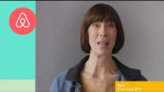
Case Study: Airbnb
Notes:
Facts and figures:
81,000 cities
191 countries
5+ million listings
IPO in late 2020

Slide 27
Group Discussion
Why do you think Airbnb has been successful?

Slide 28
Why Airbnb is so successful
‘Live like a local’
Flexibility
More space for less money
Amenities
Interaction with hosts

Slide 29
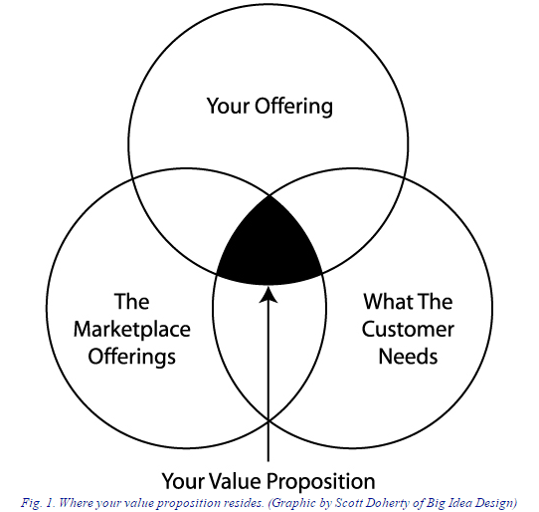
Tourism and Events must promote their Unique Value Proposition
Notes:
OR USP = Unique selling point
Need to stand out from the competition in order to remain competitive

Slide 30

Any Questions?

Slide 31
Assignment 1 – Presentation?
Are you ready?
Do you know what you need to do?
Can you access your individual link?
Do you know how to upload your slides as PDF?
Notes:
Double check here
Answer any questions
Make sure you have shared the recording that walks through how to share screen and record presentation

Slide 32
Assignment 1: Presentation
Please use the following structure:
Title Page (Student name/ID, Module Name/Code, Lecturer’s name, date, title)
Content table
Introduction of the hotel brand (including basic facts like how many hotel locations, when it was founded etc.)
Main content (including a presentation of the guest services, customer base, service expectations offered by your chosen hotel brand etc.)
Explanation of the role and function of guest services in general & how hotels can meet these (to test your knowledge about was learned up until that point in the module) and the importance of hospitality
Summary/Conclusion
Reference List

Slide 33

Today we learned about…
Different types of consumers
What is the expectations of the different consumers?
How can we enhance the customer experience?
How is the customer needs changing?
Impact of technology within the industry

Slide 34
References
Be As You Are SP (2018) Moxy – Meet Moxy Hotels [video]. Available at: https://www.youtube.com/watch?v=emUXNr4_oLw (Accessed: 8th September 2023).
Hayes, D. K., Ninemeier, J. D. and Miller, A. A. (2020) Hotel Operations Management, 3rd Ed. Uttar Pradesh: Pearson India Education Services.
Hospitality Insights (N.D) The five senses of hotel marketing. Available at: https://hospitalityinsights.ehl.edu/five-senses-hotel-marketing (Accessed: 8th September 2023 ).
Macdonald, S. (2021) 7 Ways to Create a Great Customer Experience Strategy [blog]. Available at: https://www.superoffice.com/blog/customer-experience-strategy/ (Accessed: 8th September 2023).
Miao, C., Humphrey, R. H. and Qian, S. (2021) ‘Emotional intelligence and job performance in the hospitality industry: a meta-analytic review’, International Journal of Contemporary Hospitality Management, Vol. 33(8).
Petersen, L. (2019) Uncontrollable variable that affect the hospitality industry. Available at: https://smallbusiness.chron.com/uncontrollable-variables-affect-hospitality-industry-38795.html (Accessed: 8th September 2023)
Solomon, M. (2019) Heart of hospitality. New York: SELECT Books INC.
TEDx Talks (2013) What’s next in service for the hospitality industry, a culture of care: Jan Smith at TEDxTemecula [video]. Available at: https://www.youtube.com/watch?v=rlNdbqkglvg (Accessed: 26th September 2022).

Slide 35
I look forward to seeing you next week.
If you have any questions in the meantime, please send an email from your student account c.joyner@uwtsd.ac.uk

