Slide 1



PRESENTATION
Student Name: Valentin Victor Zlate
Student ID : 2022008
Course name: Managing People
Subject name : Role of HR of ZARA

Slide 2

Introduction
People management is a process of setting various policies for hiring the new candidates, trying to train the candidates with proper training, and manage the employees to maintain a proper work culture. The human resource professionals have to look after the environment of the company, which helps to preserve a fruitful and healthy work culture such that the employees can bring out the best services for the business
Notes:
Introduction
People management is a process of setting various policies for hiring the new candidates, trying to train the candidates with proper training, and manage the employees to maintain a proper work culture. The human resource professionals have to look after the environment of the company, which helps to preserve a fruitful and healthy work culture such that the employees can bring out the best services for the business (Sharma et al., 2020 p. 190). The HRM managers help to develop the goals and objectives of the business, try to achieve those goals by delegating tasks to the employees, and can be able to retain the positions in the global market.

Slide 3


Overview of the business
The chosen business for the present project is Zara which belongs to the retail industry and manufactures different products related to fashions, makeup, and different accessories. Zara was established in 1975 having its headquarters in Spain
The founders of the Zara clothing company were Amancio Ortega and Rosalia Mera and the current revenues of the company are 19,586 million Euros.
Notes:
Overview of the business
The chosen business for the present project is Zara, which belongs to the retail industry and manufactures different products related to fashions, makeup, and different accessories. Zara was established in 1975 having its headquarters in Spain (Zara.com. 2022). The company has expanded its services and has 2007 stores all over the world. The founders of the Zara clothing company were Amancio Ortega and Rosalia Mera and the current revenues of the company are 19,586 million Euros. The human resources professionals try to maintain a proper work culture, which helps to expand the services of the company all over the world.

Slide 4
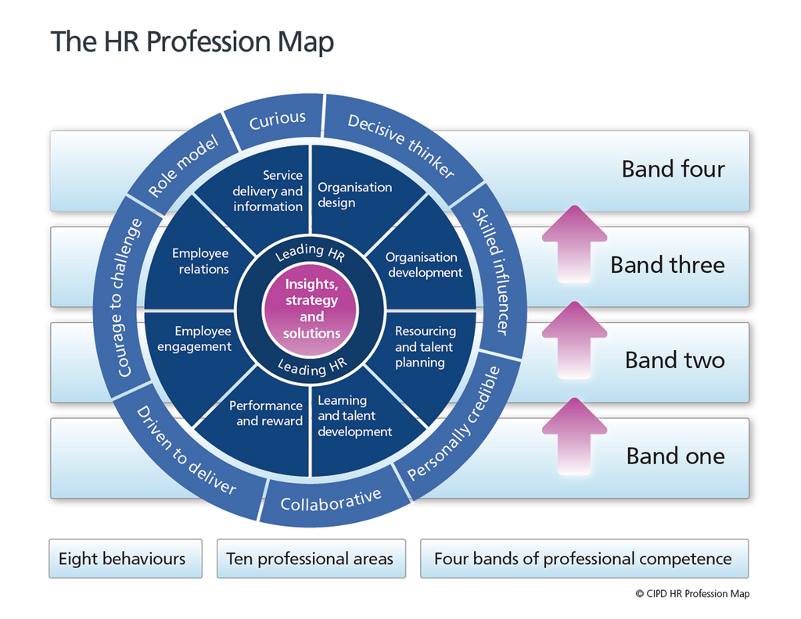
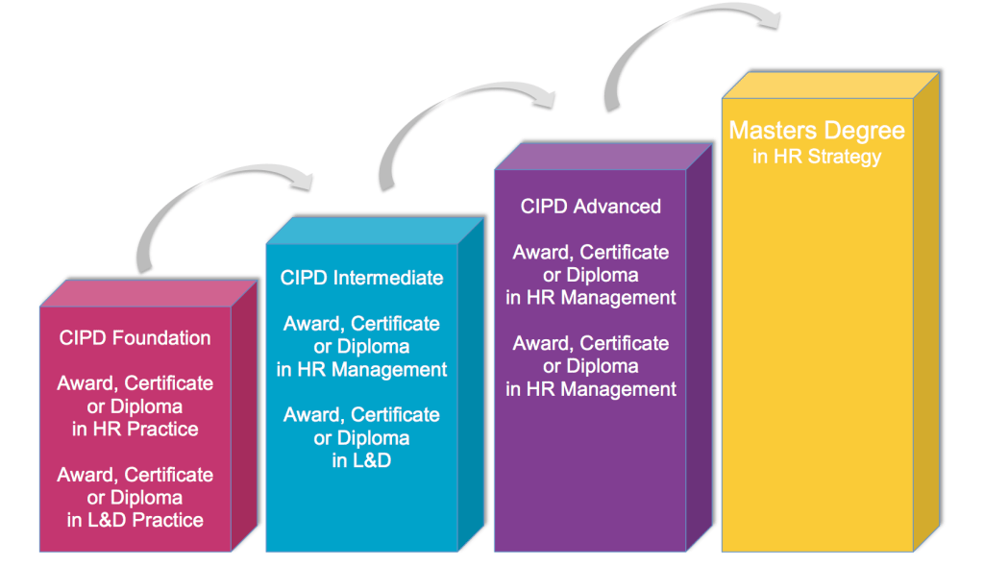
The Role of an H.R professional to the current CIPD Profession Map
The HR professionals try to administer the benefits to the employees and try to provide proper training
The role of the human resource professionals is to manage the lifestyle of the employees through proper recruitmen and hiring.
The management department has to maintain certain policies within the work culture such that a fruitful and wealthy work culture
Notes:
(Source: CIPD People Profession. 2022)
The role of the human resource professionals is to manage the lifestyle of the employees through proper recruitment, hiring, and providing proper training to the employees and fire the employees in any situation. The HR professionals try to administer the benefits to the employees and try to provide proper training to the employees as they are able to bring out the best performances for the company. A strong relationship must be maintained between the employees and management such that employees can communicate their problems and can be solved accordingly. The management department has to maintain certain policies within the work culture such that a fruitful and wealthy work culture must be maintained for the betterment of the company. Proper training must be provided to the hired candidates such that they are able to bring out the best performances with the involvement of new and advanced skills (Sokolov et al., 2018). The purpose of the human resource professionals in the CIPD Professional Map is to increase the core knowledge about the background of the company and try to improve the core behaviours of the employees.
The human resources professional tries to maintain the principles, work on the evidence, and focus on the outcome of the company such that it can achieve the targeted goals and objectives of the company. The Human Resources department of the Zara Company is to recruit the appropriate candidates who are eligible for the specific job role and tries towards bring out the best performances to the company. Since the world is moving at a great pace with the help of technological skills and tools, the companies are also involving the technical skills within the structure of the company. With the involvement of the technical skills, new and advanced software is being involved within the company. Therefore, proper training is scheduled for the employees to get used to the creative and innovative ideas for the betterment of the company. The recruitment process depends on the human resources department only such that the appropriate candidates are to be selected under certain rounds of interviews. If the candidates cannot able to give their respective work according to the stipulated time, then the human resources department can hire the employees. The HR professionals must look after the finances of the company and tries to allocate the finances to the places where it is needed for development. The Human resources department of Zara Company is trying to expand its services all over the world by attracting customers by providing nice behaviours from the employees.

Slide 5
Evolution of HR and recruitment
Evolution of HR and recruitment
The concept of HR professionals evolved with the various stages of the industrial revolution,
scientific management, and human relations. The Human Resources professionals mainly
focus on the recruitment process of the company and overview the financial sector of the
company
The skills
and techniques of the company are upgraded by involving the various new and advanced
software in the company.

Slide 6


How the firm executes its Recruitment and Selection process
The main aim of the Human Resources department is to recruit the best employees for the business such that they can be able to accomplish the targeted goals and objectives in the global market.
The HR professionals have to bring out the potentiality of the candidates such that they can be able to provide the finest performances
The HR professionals try to develop proper behaviours of the employees to impress the customers
Notes:
Describe how the firm executes its Recruitment and Selection process
The main aim of the Human Resources department is to recruit the best employees for the business such that they can be able to accomplish the targeted goals and objectives in the global market. The HR professionals have to bring out the potentiality of the candidates such that they can be able to provide the finest performances for the company. A strong relationship must be maintained between the employees and management such that employees can communicate their problems and can be solved accordingly. Proper training must be given to the employees as the workers of the respective organization can get to know about the innovative and highly developed software that is involved in the company, which reduces the cost of production in the company. Zara Company is a retailer industry and manufactures the fashion products for the customers. The HR professionals try to develop proper behaviours of the employees to impress the customers with their activities. The respective organization also provides attractive discounts and offers to attract more customers to increase the revenues of the company. The human resource department of the Zara Company tries to employ those employees who are hard-working in nature and can readily accept the changes and tries to cope with the changed environment of the company (Poon et al., 2020).
The HR professionals of the respective company try to increase the revenues in the global market by recruiting the appropriate candidate for the company through certain interview rounds. The company is also trying to involve certain creative and innovative skills which try to attract the customers and be able to increase the revenues in the global market. The recruitment process depends on the human resources department only such that the appropriate candidates are to be selected under certain rounds of interviews. The main duty of the HR department is to select the candidates properly for the company who can bring out the best products and services for the company. The candidates are to be properly trained in the training and try to select the best candidates and increase the revenues in the global market (Hauff., 2021 p. 1930). A strong relationship must be maintained within the company such that the employees can easily communicate their problems and tries to resolve the conflicts in an effective manner.

Slide 7

How the strategies used in process beginning OF HRM
The concept of HR professionals evolved with the various stages of the industrial revolution, scientific management, and human relations. HR Professionals of ZARA mainly focus on advanced software of the company
The HR department of the Zara Company introduced various rules and regulations to maintain a disciplined environment in the company.
The aim of the HR department is to find the potential of the candidates who are hard working and flexible
Notes:
Evolution of HR and recruitment
The concept of HR professionals evolved with the various stages of the industrial revolution, scientific management, and human relations. The Human Resources professionals mainly focus on the recruitment process of the company and overview the financial sector of the company. The company tries to achieve its targeted goals and objectives and tries to retain its position in the global market. The HR department of the Zara Company introduced various rules and regulations to maintain a disciplined environment in the company. A fruitful and wealthy work culture environment has to be created so that the employees are able to do work according to the needs and demands of the company (Lopez-Cabrales et al., 2020). The skills and techniques of the company are upgraded by involving the various new and advanced software in the company. Proper training is also needed for the employees to increase the revenues in the company. The aim of the HR department is to find the potential of the candidates who are hard working and flexible in nature and can adapt to any situation in the global market.

Slide 8
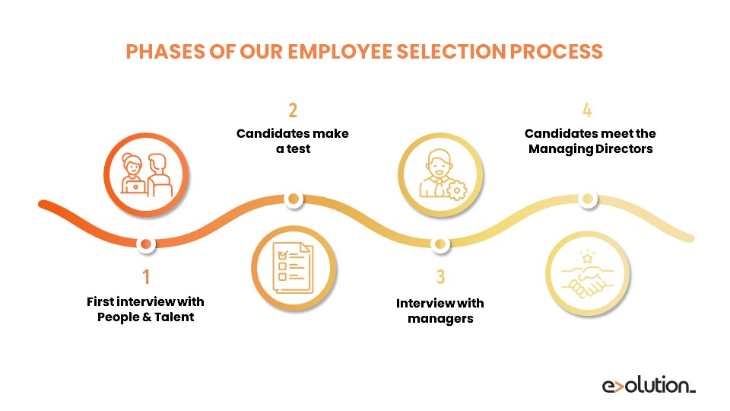
How the strategies used in the firm’s recruitment and selection beginning OF HRM
The concept of HR professionals evolved with the various stages of the industrial revolution, scientific management, and human relations.
The Human Resources professionals mainly focus on the recruitment process of the company and overview the financial sector
Notes:
People management is a process of setting various policies for hiring the new candidates and trying to train the candidates with proper training and manage the employees to maintain a proper work culture (Sheth., 2020 p. 163). In addition to the new and advanced techniques are also involved within the company, which helps to achieve the goals and objectives of the company. The Human Resources department of the Zara Company is to recruit the appropriate candidates who are eligible for the specific job role and can be able to achieve the goals according to the demands of the customers.

Slide 9
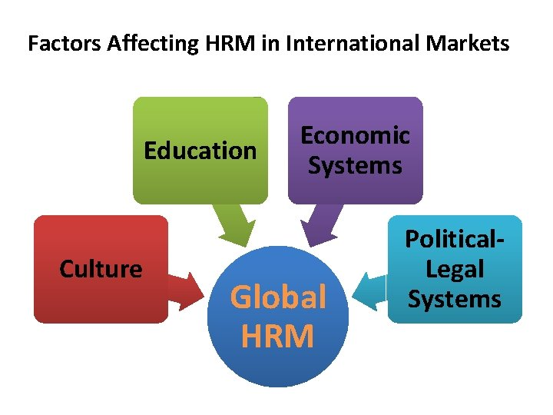
HRM has been affected
HRM ZARA it has been affected of COVID-19,as it was hard to hire new people and they lost income and staff.
ZARA has been affected also of Brexit from UK as they will need more papers and rules when they hire new staff as new law of UK GOV
ZARA it was affected like almost every company with the world inflation as prices goes up very much and they need to make sure they can keep the track with new regulation.

Slide 10

Conclusion
Lastly, it can be concluded that HR professionals are responsible for recruiting the best candidates for the company such that the business can bring out the best services and products in the global market.
Notes:
Conclusion
Lastly, it can be concluded that HR professionals are responsible for recruiting the best candidates for the company such that the business can bring out the best services and products in the global market. The main motive of the HR professionals is to bring out the potential of the candidates as they can be able to provide the finest performances for the

Slide 11



