Slide 1

Collaborative Learning - The Advantages, Disadvantages and the Role of Collaboration in International Business Contexts
By Cezar Stelica

Slide 2

Introduction
Collaborative Learning consists of learners working collaboratively in a group to identify and resolve issues, develop knowledge, and reflect together.
It is becoming increasingly important as businesses have continued to grow because of globalisation (O’Donnell & Hmelo-Silver, 2013).
In this presentation I will discuss the advantages, disadvantages and implications of Collaborative Learning in a Professional International Business context.

Slide 3
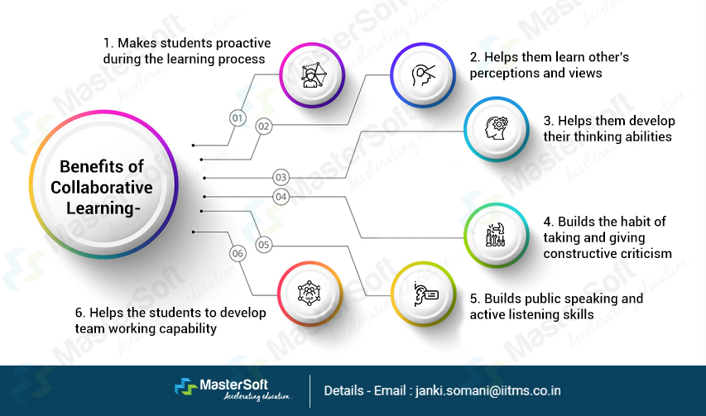
Benefits of Collaborative Learning
A primary benefit of Collaborative Learning is that groups develop deeper learning and critical thinking through collaborative problem solving. In addition, groups inherently foster motivation and positive engagement with learning.
Collaborative Learning also promotes both the development of communication skills and the development of language skills. It is an incredibly beneficial platform for scaffolding by peers and providing support to other learners, particularly in environments that are culturally and linguistically diverse in nature (Cheng & Dörnyei, 2007).
Participating in Collaborative Learning enables learners to actively engage and learn rather than simply passively receive knowledge.

Slide 4

Collaborative Learning in a Professional Environment
Participating in Collaborative Learning helps develop many of the skills that employers expect in Global Professional Industries. Teamwork, negotiation and communication are all vital skills that employers are looking for today.
Participating in Collaborative Learning also promotes the development of Cross-Cultural Competency, which is a key asset for multinational corporations (Clark et al., 2007).
In addition, Collaborative Learning promotes collaborative ownership of both the learning process and the solution. As such, Collaborative Learning mimics the way that individuals work together to achieve organisational goals in the workplace.

Slide 5

Challenges and Limitations of Collaborative Learning
As many team's experience issues with unequal contributions, this can create a lack of equity within the team, which decreases team cohesion and can ultimately impact a team's ability to achieve its goals (Cantwell & Andrews, 2002).
There are barriers to participation created by cultural and linguistic differences. These barriers may also negatively influence the confidence and ability of group members to fully participate in the group.
Many group dynamic barriers may cause anxiety and conflict because of collaboration.
In addition, group members often require a structure to work together, and instructors must provide clear roles for group members and monitor group members regularly to ensure everyone is progressing (Brown, 1994).

Slide 6
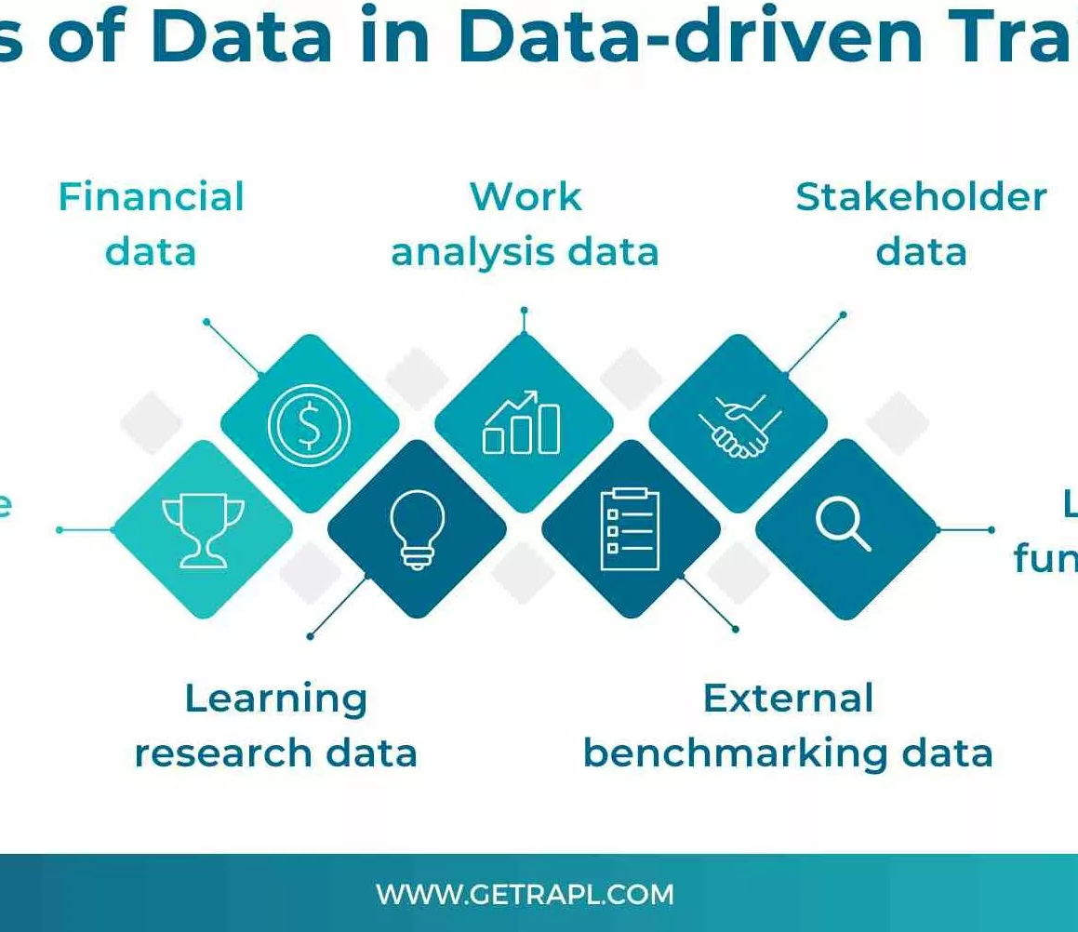
Insights from Recent Research
As evidenced in recent studies, Collaborative Learning helps students increase performance, as well as enhance the level of student engagement and interaction (Qureshi et al., 2023).
Studies have shown that Collaborative Learning has been successful in a variety of areas, including Technical Fields (programming) (Sekhar & Goud, 2024).
Today's studies have continued to emphasise the importance of having well-defined goals, accountability, and providing a supportive group structure when using Collaborative Learning (O’Donnell & Hmelo-Silver, 2013).

Slide 7
References
Boud, D., Cohen, R., & Sampson, J. (1999). Peer learning and assessment. Assessment & Evaluation in Higher Education, 24(4), 413–426.
Brown, H. D. (1994). Teaching by principles: An interactive approach to language pedagogy. Prentice Hall.
Cantwell, R. H., & Andrews, B. (2002). Cognitive and psychological factors underlying secondary students’ feelings towards group work. Educational Psychology, 22(1), 75–91.
Chen, H.-C. (2008). Cooperative learning on second/foreign language education: Theory and practice. Acad J Kang Ning, 10, 197–216.
Chen, R. Y., & Hird, B. (2006). Group work in the EFL classroom in China: A closer look. RELC Journal, 37(1), 91–103.
Cheng, H. F., & Dörnyei, Z. (2007). The use of motivational strategies in language instruction. Innovation in Language Learning and Teaching, 1(1), 153–174.
Clark, J., Baker, T., & Li, M. S. (2007). Student success: Bridging the gap for Chinese students in collaborative learning. ISANA International Conference.
O’Donnell, A. M., & Hmelo-Silver, C. E. (2013). Introduction: What is collaborative learning? In International Handbook of Collaborative Learning (p. 15). Routledge.
Qureshi, M. A., Khaskheli, A., Qureshi, J. A., Raza, S. A., & Yousufi, S. Q. (2023). Factors affecting students’ learning... Interactive Learning Environments, 31(4), 2371–2391.
Sekhar, P. R., & Goud, S. (2024). Collaborative learning techniques in Python programming. Journal of Engineering Education Transformations, 243–249.

