Slide 1


CAREERS SERVICE
HERE TO HELP YOU REALISE A CAREER

Slide 2

CAREERS SERVICE
HERE TO HELP YOU REALISE A CAREER
STUDENT SERVICES
University life is an amazing opportunity to learn new things and discover yourself, but it can come with some challenges. Our Student Hwb services offer a professional support service providing high quality information, advice, guidance, practical and emotional support to enable all students to reach their full potential. The Student Hwb is a collection of practical professional services designed to enable and support all our students to reach their full potential. Through our services, students can access high-quality information, advice, guidance, opportunities, and support on wellbeing support, money support, learning support, careers and safeguarding.
CAREERS SERVICE
DISABILITY SUPPORT
FAITH & SPIRITUALITY
LEARNING SUPPORT
LIBRARY & LEARNING RESCOURCES
MONEY SUPPORT
REPORTING TO THE UNIVERSITY
STUDENT AMBASSADORS
STUDENT HWB
STUDENTS UNION
WELLBEING

Slide 3
What do we do?
CAREERS SERVICE
HERE TO HELP YOU REALISE A CAREER
We offer one-to-one support for in both English and Welsh.
Our services are available to students and graduates for up to three years after graduation.
We provide confidential and personalised Careers Information, Education, Advice, and Guidance.
Enjoy flexible services offered both in person and online via Microsoft Teams.
Careers events and workshops to enhance your employability.
We are open all year round, except for Bank Holidays and university closure days.

Slide 4
How can we help?
CAREERS SERVICE
HERE TO HELP YOU REALISE A CAREER
CV’s, Applications, Cover letters, etc
Job searching tips
Interview practice
Gaining relevant work experience
Postgraduate study
Signposting to other resources
Support in looking for training/education
Exploring your options
Impartial advice and guidance
Advice with self-employment
Job fairs
Access to ‘MyCareer’

Slide 5
MY CAREER
CAREERS SERVICE
HERE TO HELP YOU REALISE A CAREER

Slide 6
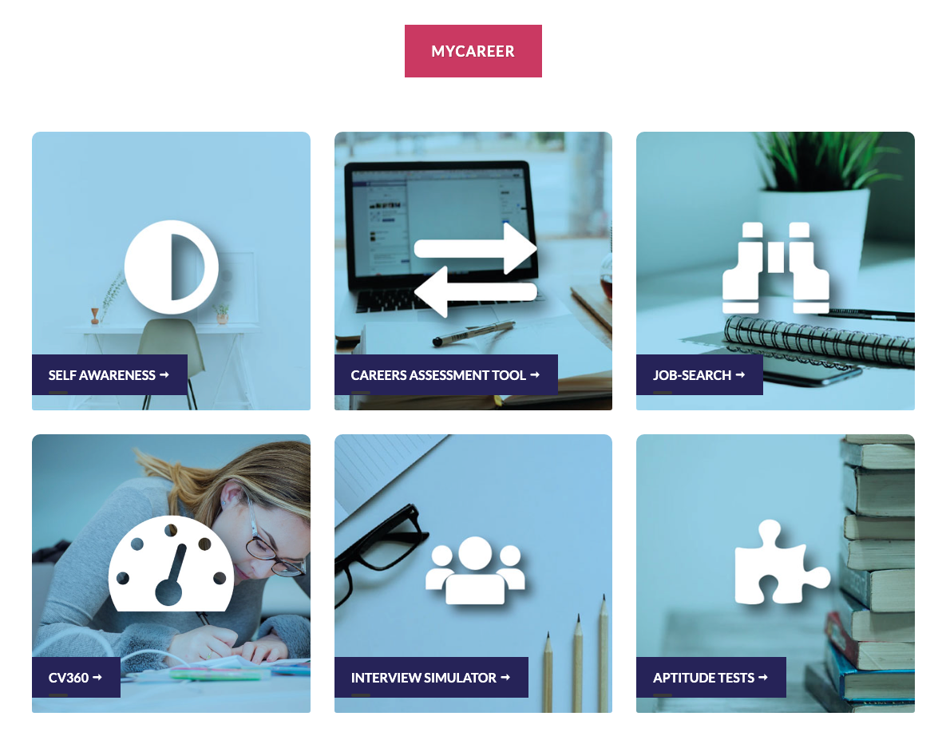
CAREERS SERVICE
HERE TO HELP YOU REALISE A CAREER
As a UWTSD Student you have 24/7 access to our online Careers Service platform, MyCareer. Through this platform you can access Careers information, Career planners, self assessments, CV360 checker and MUCH more. You can continue to use this platform for up to three years after graduation.

Slide 7
HOW TO ACCESS MYCAREER….
GO TO THE CAREERS PAGE OF THE WEBSITE
SCROLL DOWN AND CLICK ‘MYCAREER’
CLICK STUDENT/STAFF
LOG IN WITH YOUR UNIVERISTY EMAIL AND PASSWORD

Slide 8
CAREERS SERVICE
HERE TO HELP YOU REALISE A CAREER
MyCareer Employer Tool - What It Offers Students
Overview:
The Abintegro platform connects students, universities, and employers to support career development and employability.

Slide 9
CAREERS SERVICE
HERE TO HELP YOU REALISE A CAREER
Key Benefits for Students:
  Browse employer profiles, internships, placements, and job vacancies.
  Build professional CVs and portfolios, complete employability assessments, and plan personal development goals.
  Use AI-powered tools to rehearse interviews and receive feedback on communication skills.
  Explore detailed employer information to understand what different sectors and companies look for.
  All career tools, learning resources, and employer connections in one place, managed by their institution.

Slide 10
CAREERS SERVICE
HERE TO HELP YOU REALISE A CAREER
Why It Matters:
  Increases employability and confidence.
  Helps students understand and meet employer expectations.
  Makes career planning more proactive and personalised.
  Strengthens links between education and the world of work.

Slide 11
CAREERS SERVICE
HERE TO HELP YOU REALISE A CAREER
For technical support, contact careers@uwtsd.ac.uk

Slide 12
CV OVERVIEW
CAREERS SERVICE
CAREERS SERVICE
HERE TO HELP YOU REALISE A CAREER

Slide 18
CAREERS SERVICE
HERE TO HELP YOU REALISE A CAREER
Additional Tips to Strengthen Your CV
  Professional Development: Include any extra learning such as online courses, workshops, or training
  sessions you’ve completed.
  Design: Use simple fonts (like Arial or Calibri), avoid tables or graphics, and use clear headings so your
  CV works well with online application systems. You can make a CV look snazzy, but the content is the
  most important thing.
  Read through: Check spelling/grammar before submitting. Always give it a good read through to make
  sure it makes sense. Always write in British English.
  Cover Letters Matter: Always include a tailored cover letter – it helps introduce you and explain why
  you're right for the role.

Slide 19
CAREERS SERVICE
HERE TO HELP YOU REALISE A CAREER
When we meet next, the Careers Service can go through your CV with you and offer feedback. This will be a good opportunity to strengthen your CV and ensure it reflects your skills and experience as clearly as possible.
GOOD LUCK!

