Slide 1
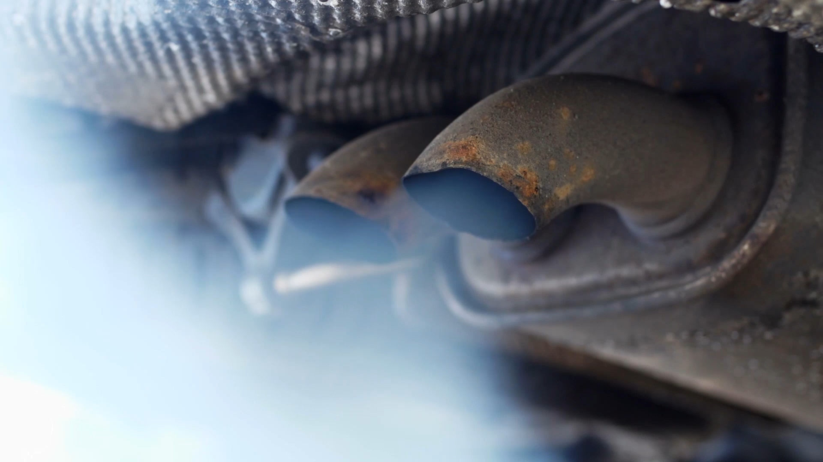
How to prevent corrosion in metals ?
Corina Chelu

Slide 2

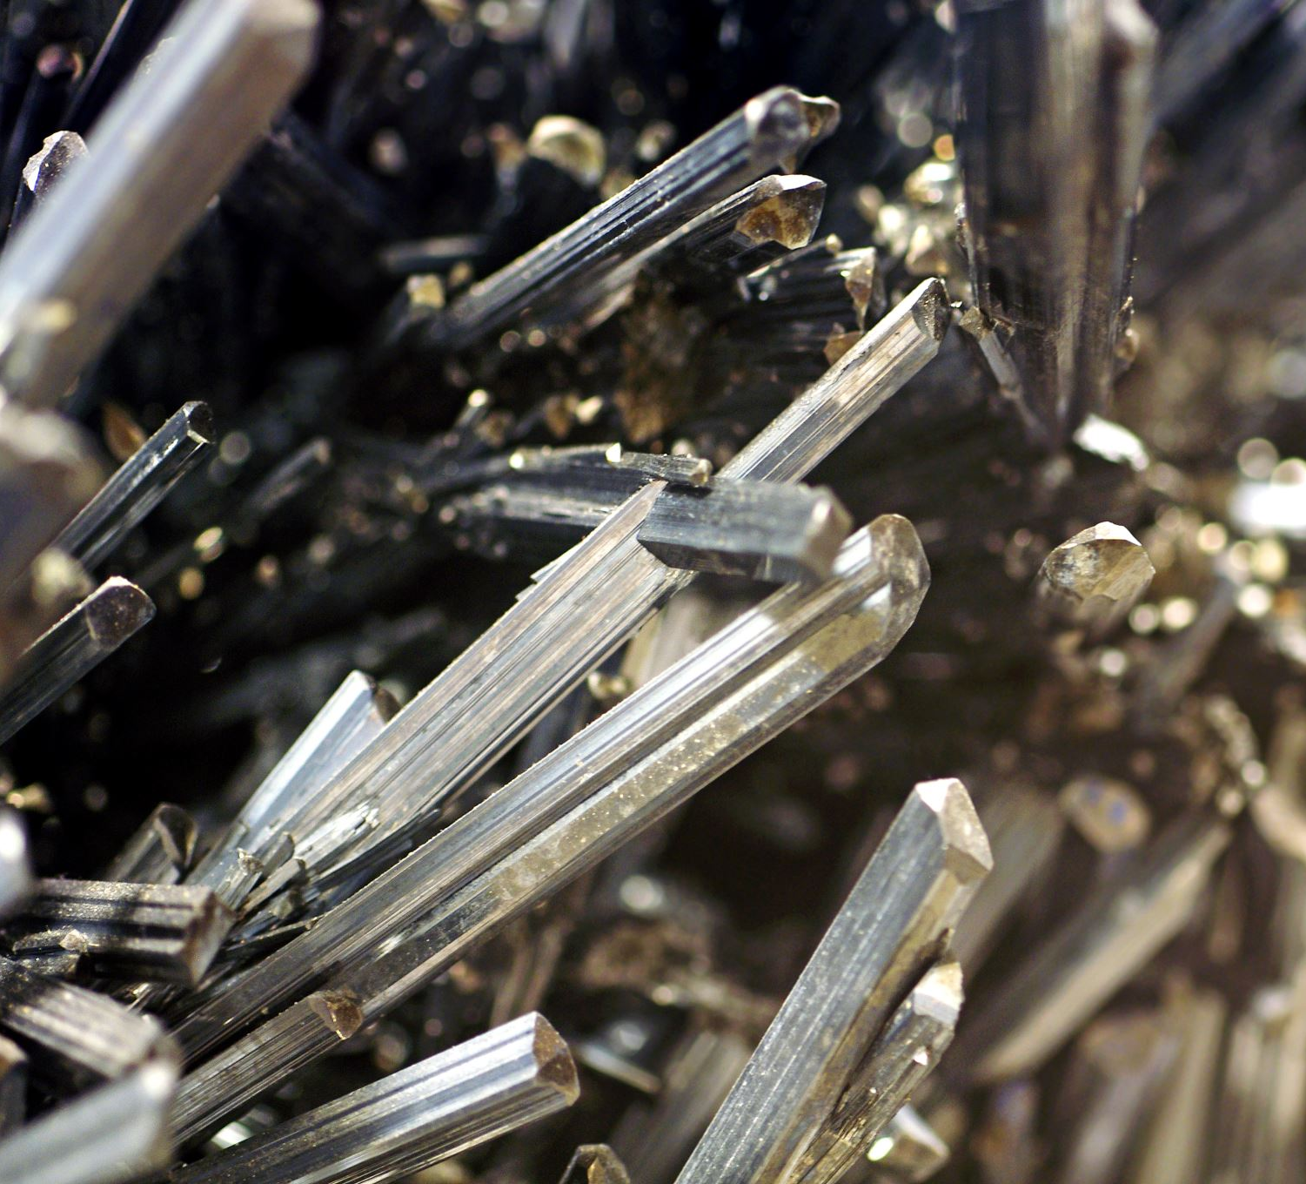
What is corrosion ?
Corrosion is a natural process where metals break down over time due to a chemical reaction with their environment.
The metal will lose shine and colored layer in the presence of air or water.

Slide 3
What is corrosion ?
Corrosion is a natural process where metals break down over time due to a chemical reaction with their environment.
The metal will lose shine and colored layer in the presence of air or water.

Slide 4
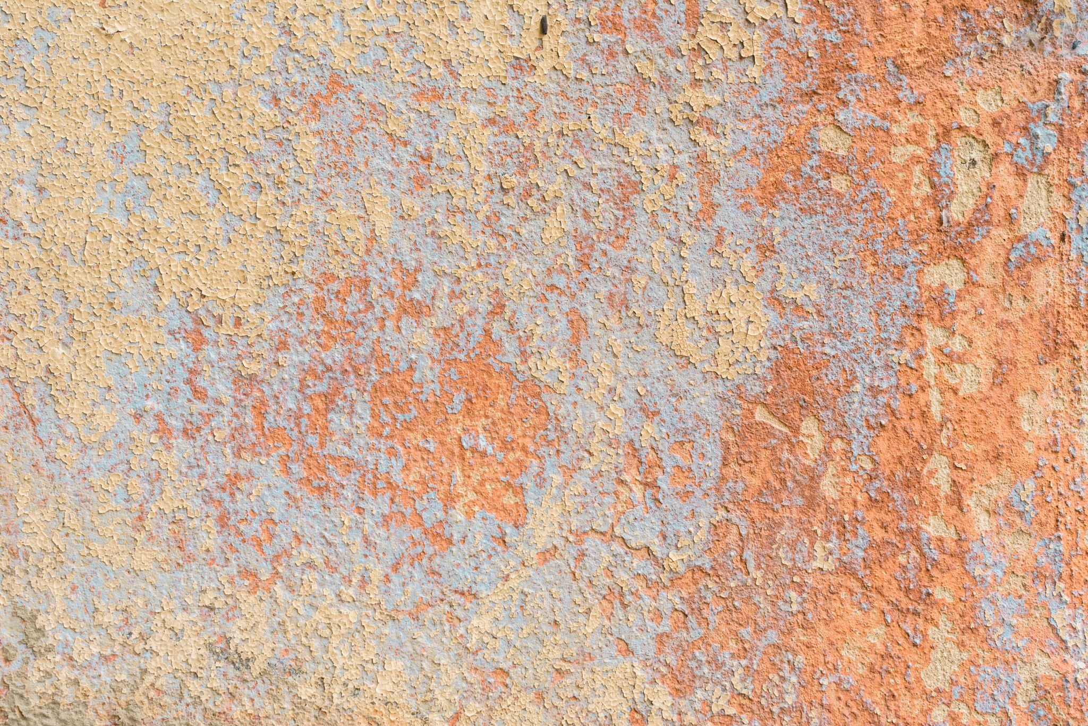

Slide 5
Types of corrosion

Slide 6
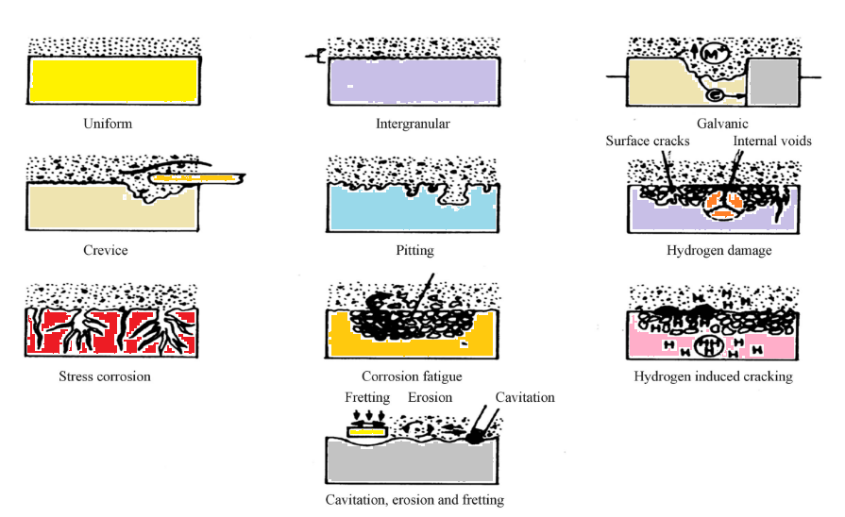

Slide 8
Ways to prevent corrosion
Painting
Alloying
Electroplating
Cathodic Protection (CP)
Galvanization
Enameling

Slide 9
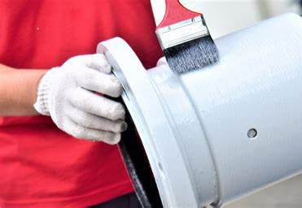
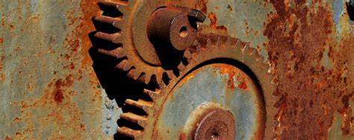
Ways to prevent corrosion
Painting
Alloying
Electroplating
Cathodic Protection (CP)
Galvanization
Enameling

Slide 10
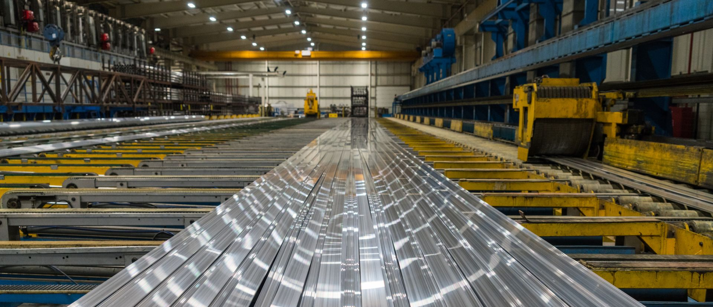
Ways to prevent corrosion
Painting
Alloying
Electroplating
Cathodic Protection (CP)
Galvanization
Enameling

Slide 11
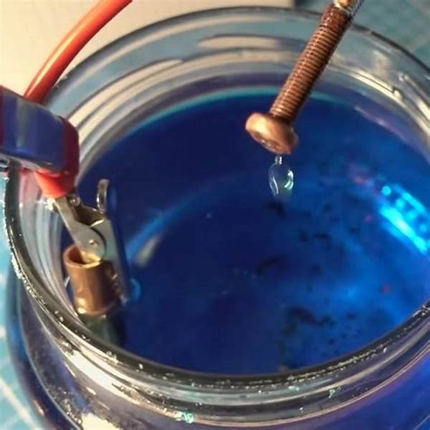
Ways to prevent corrosion
Painting
Alloying
Electroplating
Cathodic Protection (CP)
Galvanization
Enameling

Slide 12
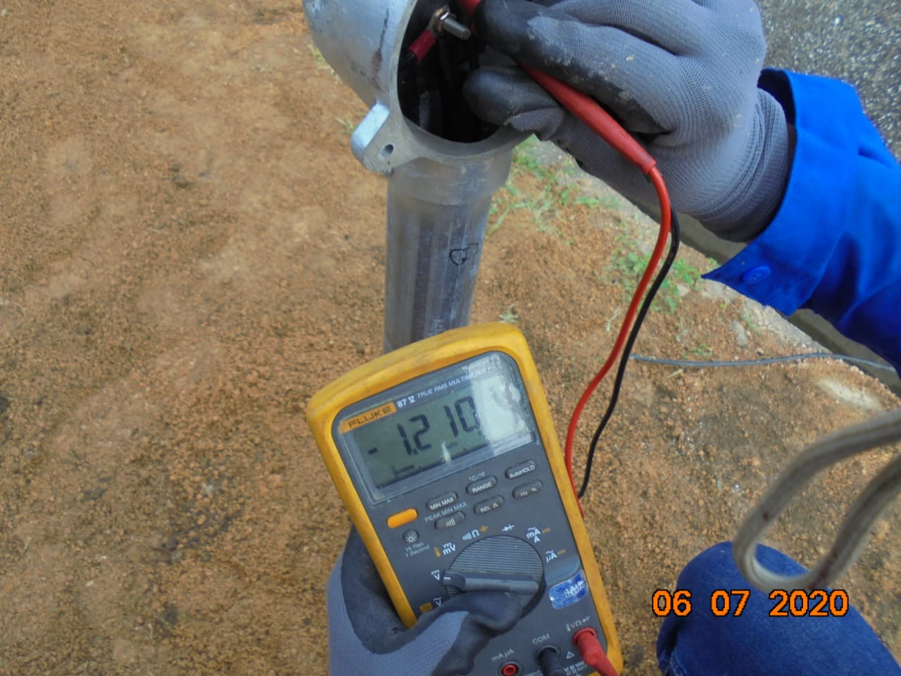
Ways to prevent corrosion
Painting
Alloying
Electroplating
Cathodic Protection (CP)
Galvanization
Enameling

Slide 13
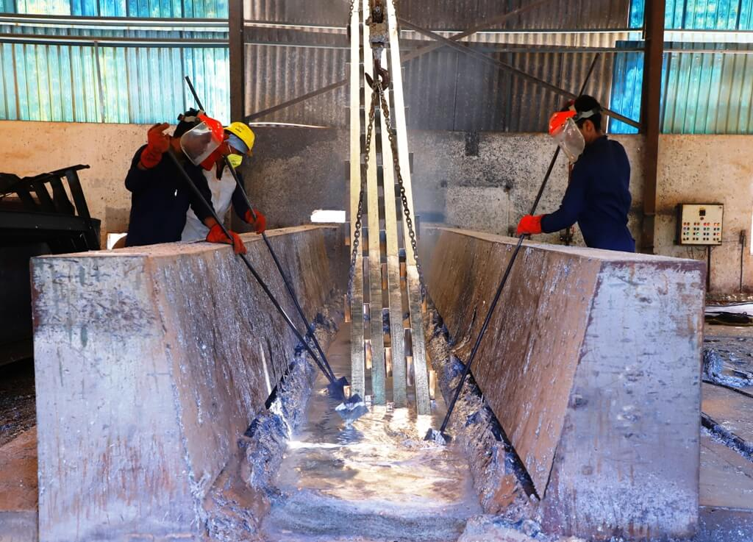
Ways to prevent corrosion
Painting
Alloying
Electroplating
Cathodic Protection (CP)
Galvanization
Enameling

Slide 14
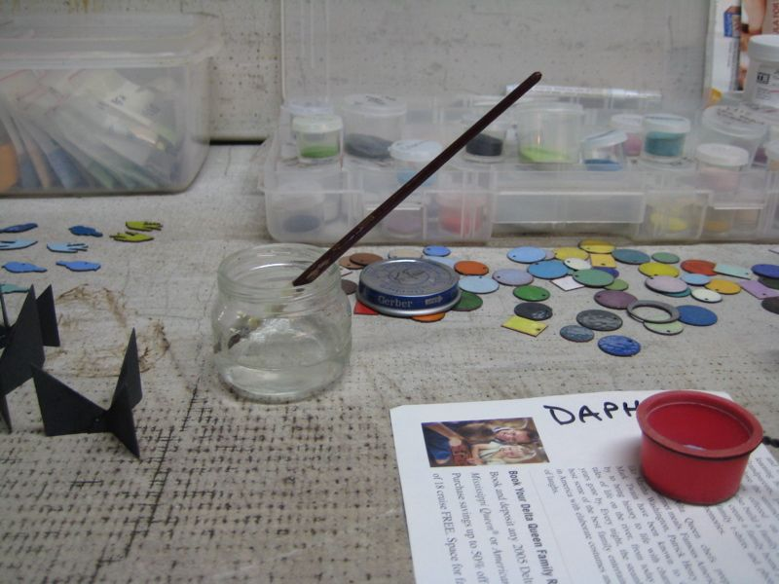
Ways to prevent corrosion
Painting
Alloying
Electroplating
Cathodic Protection (CP)
Galvanization
Enameling

Slide 15

Thank you !
Corina Chelu
Integrating Project

