Slide 1
Module Title: Operating Hotel Facilities
Module Code: BMIH4006
Assignment Title: Presentation
Assignment Type:Presentation
Module Leader: Natalie Brailsford
Student Name: Gabriela Giurgiu
Student ID: 2240417

Slide 2
Table of Contents
Introduction………………………………………………..3
Importance of health and safety regulations………...4
Essential safety and health practices…………...…(5-8)
Conclusion…………………………………………………9
References…………………………………………...……10

Slide 3
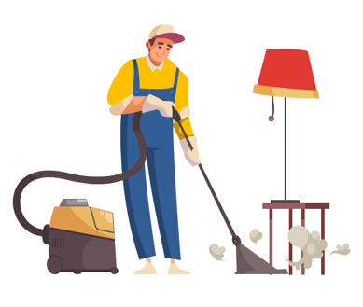
Introduction
Housekeepers should have strong customer service skills to become successful in their profession in the future.
This presentation will be constructed to provide and guide the housekeeping team of Premier Inn Whitley Bay Hotel.
Some major importance of following health and safety regulations will be highlighted briefly in this presentation.
(Casado, 2012)
Notes:
Component Three: Presentation
Introduction
Housekeepers should have strong customer service skills to become successful in their profession in the future. The work of housekeepers is directly linked with the approval of guests in a hotel. This presentation will be constructed to provide and guide the housekeeping team of Premier Inn Whitley Bay Hotel about essential safety and health practices. This presentation will be based on the previous health and safety guide for educating the team members about their housekeeping services more effectively. Some major importance of following health and safety regulations will be highlighted briefly in this presentation.

Slide 4
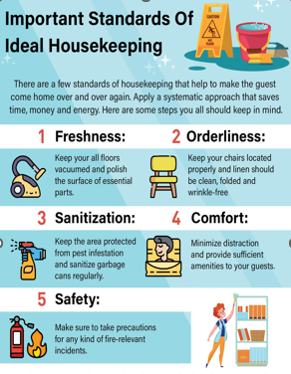
Importance of health and safety regulations
Guest satisfaction: To enhance the level of guest satisfaction housekeepers of a hotel should follow the health and safety regulations.
Brand recognition: Satisfied customers are the backbone of every business to make proper brand value in the market.
Employee well-being: Effective health and safety guidelines highly ensure a safe working environment.
(Sharma et al., 2019)
Notes:
Importance of health and safety regulations
Guest satisfaction: To enhance the level of guest satisfaction housekeepers of a hotel should follow the health and safety regulations. This should ensure that all of the guests would get hygienic and clean accommodation services in the hotel. In hotel businesses, consumer satisfaction plays a vital role as the whole business runs based on the service that they provide towards their consumers (Casado, 2012). Positive guest reviews and feedback would be very effective for making proper brand recognition within the market in the hospitality industry.
Brand recognition: Satisfied customers are the backbone of every business to make proper brand value in the market. Better consumer service by the housekeeper highly influences the guests and makes them provide positive feedback about the company. Thus, to gain proper brand value and brand recognition a hotel business should heavily follow health and safety regulations within their daily life business activities.
Employee well-being: Effective health and safety guidelines highly ensure a safe working environment by reducing the chances of injuries and accidents. The physical as well as mental health of every staff and consumer within a hotel business is highly regulated by these regulations effectively (Raghubalan and Raghubalan, 2016). Thus, for fostering an effective and healthy workforce health and safety regulations are very important for hotel businesses.

Slide 5
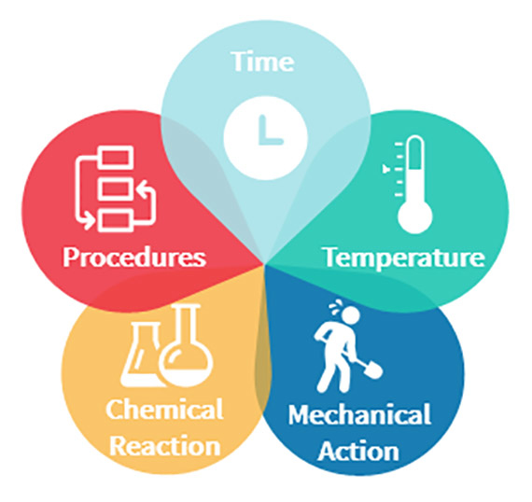
Essential safety and health practices
Precautions
Fire safety: Fire safety is one of the essential safety measures that should be taken by every hotel business.
Electrical safety: Every housekeeper should be highly aware of electrical safety guidelines and follow them.
Chemical handling and storage: The usage of chemicals and storing them safely are the core functions of every housekeeper in a hotel.
(Vallen and Vallen, 2012)
Notes:
Essential safety and health practices
Precautions
Fire safety: Fire safety is one of the essential safety measures that should be taken by every hotel business. Conducting fire drills and ensuring that every staff is aware of evacuation procedures is highly recommended for every hotel business. Along with proper maintenance of smoke detectors and keeping away flammable objects from future conflicts is highly recommended for housekeepers.
Electrical safety: Every housekeeper should be highly aware of electrical safety guidelines and follow them. Starting with the inspection of all electrical equipment and using GFCI tools to avoid watermarks on electrical appliances would be the major role of every housekeeper to avoid such electrical emergencies (Tesone, 2010).
Chemical handling and storage: The usage of chemicals and storing them safely are the core functions of every housekeeper in a hotel. Labelling every chemical product with accurate product names and storing them with proper safety measures is highly recommended for every housekeeping staff in a hotel business.

Slide 6
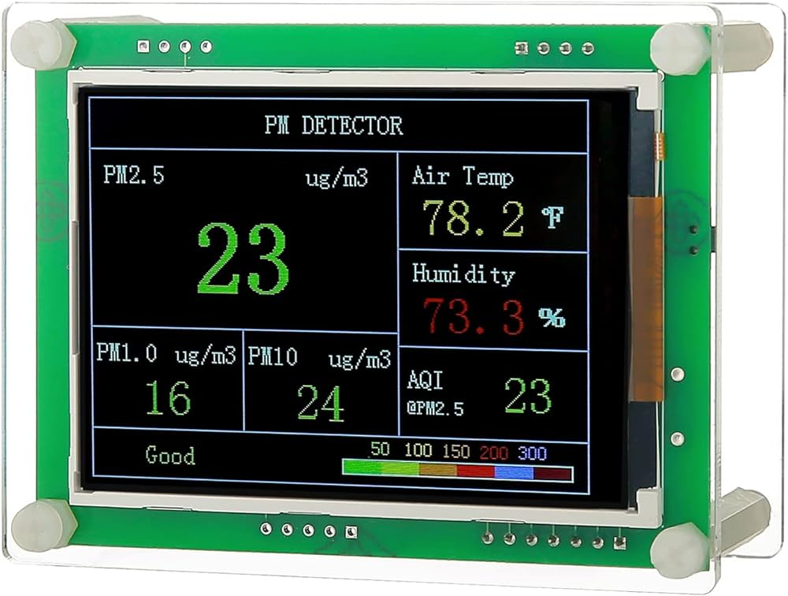
CONTD…
Procedures
Air quality check and ventilation: Checking the air quality and ventilation system of rooms daily is one of the healthier habits.
Waste management: Properly managing waste is one of the current trends in the global market.
Sanitisation: Starting with bathroom sanitisation and room sanitisation is one of the best ways to maintain health and safety regulations.
(Tesone, 2010)
Notes:
Procedures
Air quality check and ventilation: Checking the air quality and ventilation system of rooms daily is one of the healthier habits for housekeepers. It plays a vital role in ensuring safe and healthy room services to the guests easily. Thus, this process is highly recommended for every housekeeper to follow in every hotel business.
Waste management: Properly managing waste is one of the current trends in the global market. Meanwhile, within a hotel, it is one of the essential routines for every housekeeper to manage waste daily. By following proper waste management tactics, a hotel should maintain their health and hygiene properly and enhance consumer services accordingly (Fallon and Rutherford, 2010).
Sanitisation: Starting with bathroom sanitisation and room sanitisation is one of the best ways to maintain health and safety regulations. Thorough cleaning and sanitising the whole room along with the bathroom are one of the essential steps that should be used by every housekeeping staff effectively in a hotel.

Slide 7
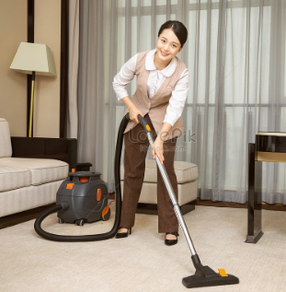
CONTD…
Required equipment
Rubber gloves: Rubber gloves are one of the essential equipment that is used in hotels by housekeepers while cleaning rooms.
Bucket and mop: Mops can be used for wet surfaces after washing the floor to avoid slipping.
Vacuum cleaner: Vacuum clear is heavily used in various hotel businesses to clean rooms.
(Casado, 2012)
Notes:
Required equipment
Rubber gloves: Rubber gloves are one of the essential equipment that is used in hotels by housekeepers while cleaning rooms. It plays a vital role in protecting skin from various chemicals, germs and allergens. Replacing gloves after a certain period is very necessary for avoiding such conflicts on safety (Vallen and Vallen, 2012).
Bucket and mop: Mops can be used for wet surfaces after washing the floor to avoid slipping. Buckets can be used to prevent spills and avoid overloading within a room in a hotel. Those are the crucial equipment that is heavily used by housekeepers in their daily life business activities.
Vacuum cleaner: Vacuum clear is heavily used in various hotel businesses to clean rooms. Tripping hazards can be easily prevented by using vacuum cleaners for cleaning. Thus, proper maintenance of vacuum cleaners is highly recommended for every housekeeper for a better cleaning service (Wood, 2013).

Slide 8
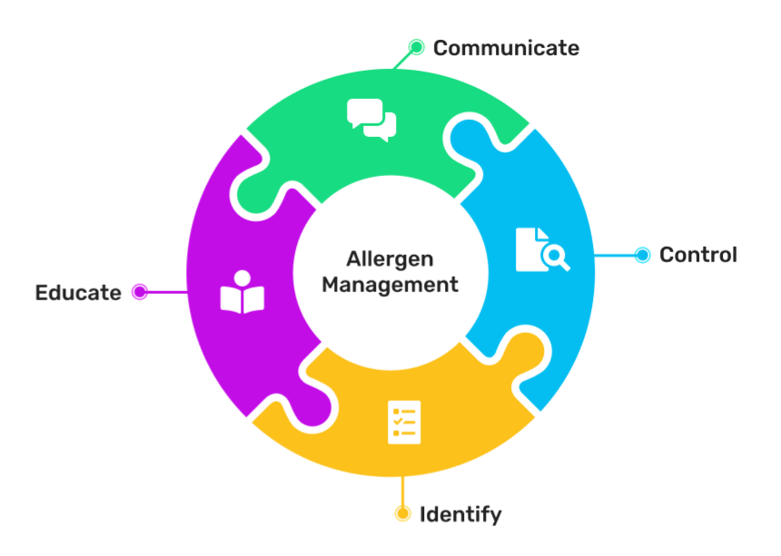
CONTD…
Hazard mitigation tactics
Electrical hazards: Keeping electrical tools away from water and using GFCI outlets would help avoid such risks due to electrical equipment.
Sharp objects: Broken glasses, needles, blades, knives and other sharp objects would be one of the major reasons for hazards.
Allergens: Dust, moulds, pet dander and some other particles would be listed as the essential reasons for allergic reactions.
(Sharma et al., 2019)
Notes:
Hazard mitigation tactics
Electrical hazards: Some floor scrubbers and other electrical items such as vacuum cleaners could be listed as the major reasons for electrical hazards. Proper inspection of electrical equipment in a regular manner would be one of the best solutions for avoiding such electrical hazards. Besides that, keeping electrical tools away from water and using GFCI outlets would help avoid such risks due to electrical equipment (Ferdinand and Kitchin, 2017).
Sharp objects: Broken glasses, needles, blades, knives and other sharp objects would be one of the major reasons for hazards due to sharp objects. Sturdy gloves and handling with care of sharp objects while cleaning rooms in hotels are highly recommended for housekeepers to mitigate such hazards due to sharp objects (Sharma et al., 2019).
Allergens: Dust, moulds, pet dander and some other particles would be listed as the essential reasons for allergic reactions. Proper cleaning is very necessary to avoid such allergic reactions (Elliott, 2023). The usage of HEPA filters within vacuum cleaners would be one of the best solutions for removing such dust and other dangerous small particles from rooms easily.

Slide 9
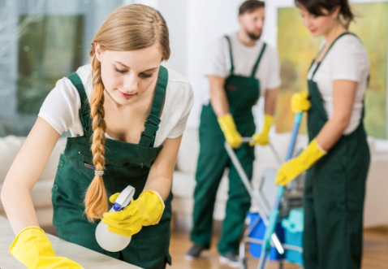
Conclusion
The whole presentation has been constructed to train the team members in housekeeping based on the health and safety guide.
Some effective processes such as waste management and sanitisation and their impotence have been introduced.
Some probable hazards and their probable solutions have been mentioned in this training presentation.
(Vallen and Vallen, 2012)
Notes:
Conclusion
The whole presentation has been constructed to train the team members in housekeeping based on the health and safety guide. Some essential importance of following health and safety regulations by housekeepers have been highlighted in this presentation briefly. Some precautions for preventing such accidents and injuries in hotels by housekeeping staff such as fire safety and electrical safety have been mentioned in this presentation. After that, some effective processes such as waste management and sanitisation and their impotence have been introduced in this training presentation. Some required equipment and tools such as buckets, mops, vacuum cleaners and so on and their effectiveness has been highlighted in this training presentation. Some probable hazards and their probable solutions have been mentioned in this training presentation.

Slide 10
References
Casado, M. (2012) Housekeeping Management. London: Wiley.
Elliott, C., (2023). Daily Hotel Housekeeping May Be History. Here’s Who Will Pay For It. [Online] Available at: https://www.forbes.com/sites/christopherelliott/2021/06/30/daily-hotel-housekeeping-may-be-history-heres-who-will-pay-for-it/ [Accessed 01 02 2024].
Fallon, M. & Rutherford, D. (2010) Hotel Management and Operations. London: Pearson.
Ferdinand, N. and Kitchin, P. (2017) Events Management - An International Approach. 2nd ed. London: SAGE Publications Ltd.
Notes:
References
Casado, M. (2012) Housekeeping Management. London: Wiley.
Elliott, C., (2023). Daily Hotel Housekeeping May Be History. Here’s Who Will Pay For It. [Online] Available at: https://www.forbes.com/sites/christopherelliott/2021/06/30/daily-hotel-housekeeping-may-be-history-heres-who-will-pay-for-it/ [Accessed 01 02 2024].
Fallon, M. & Rutherford, D. (2010) Hotel Management and Operations. London: Pearson.
Ferdinand, N. and Kitchin, P. (2017) Events Management - An International Approach. 2nd ed. London: SAGE Publications Ltd.
Sharma, N., Chaudhary, N. and Singh, V. (2019) Management Techniques for Employee Engagement in Contemporary Organizations. Hershey, Pennsylvania: IGI Global.
Tesone, D. (2010) Principles of Management for The Hospitality Industry. 1st ed. London: Routledge.
Vallen, G. & Vallen, J. (2012) Managing Hotel Operations. London: Pearson.
Wood, R. (2013) Key Concepts in Hospitality Management. London: Sage.

