Slide 1

CIM Certificate in Professional Marketing
Digital Marketing

Slide 2
Digital in Action
LO 6 Apply the key principles involved in monitoring and measuring digital marketing effectiveness

Slide 3
Task
Read web analytics insights into the customer journey – Highlight key points, considering what we have covered in the module, and be prepared to discuss in class

Slide 4
Objectives
REACH
  Provide information
ACT
  Generate leads
CONVERT
  Get people to register
  Purchase online (instantly)
  Build brand values or change attitudes
  Order placement
ENGAGE
  Deliver customer service
  Seek reviews
Remember:
D –Differentiate
R – Remind/reassure
I – Inform
P – Persuade

Slide 5
Objectives Using the 5S Model
S | Detail | SMART
Sell | No of new clients needed | Increase web sales by 30% within 12 months
Serve | How can we improve our offering for our customers | Develop Chat function within 6 months
Speak | What information can we provide | Offer 24/7 chat now facility to answer questions by potential buyers within 6 months of website lauch.
Save | Increase efficiency, save costs and identify areas of improvement | Create and launch mobile app, saving time for mobile customers and increasing online conversions by June 2019.
Sizzle | Wow factor! | Developing AR function to offer 360 tours, integrating into website by clearing 2019

Slide 6
What do we measure?
And
Why?

Slide 7
Measurement and Control
REACH
Awareness
Visitor numbers
Followers/Fans
ACT
How the audience interacts
Bounce Rates
Dwell Time/Pages visited
ENGAGE
Bookings
Reviews
Recommendations
WOM/content sharing
CONVERT
Achieve conversion goals
Sales/repeat bookings
Downloads

Slide 8
Purpose of measurement
ROMI/LTV
  Life Time Value “ Estimated value of a customer considering past, current and future revenue”
Strategy/decisions
Improvements
Marketing mix decisions
Marketing productivity

Slide 9
5M’s – Managing social interactions
The 5Ms are another useful framework for reviewing strategy implementation, they are:
1. Monitoring. Reviewing the method of social listening and deriving insights from these.
2. Mapping. Finding relationships between an individual customer or grouped segments using different social platforms, e.g. Facebook and Twitter or email marketing.
3. Management. Processes for implementing and reviewing strategy. More detail on campaign management would be helpful here.
4. Middleware. The software tools and APIs used to monitor and gather insight.
5. Measurement. The measures used to assess social marketing effectiveness and ROI.

Slide 10
Engagement
Customer Engagement:
  Repeated interactions that strengthen the emotional, psychological or physical investment a customer has in a brand
  CHALLENGED BY
Media fragmentation:
  Describes a trend to increasing choice and consumption of a range of media in terms of different channels such as web and mobile and also within channels eg tv channels, radio stations, more websites

Slide 11
Forrester (2007) has developed a framework to measure online engagement through the customer lifecycle and away from a brands own site:
  Involvement: website visits, time spent, pages viewed
  Interaction: comments, reviews
  Intimacy: sentiment tracking on third party sites including blogs and reviews
  Influence: advocacy indicated by such measures as likelihood to recommend to a friend

Slide 12
Consider how we measure….paid, earned and owned media
Paid
  Paid search
  Display ads
  Affiliate marketing
Earned
  WOM
  Social networks
  Editorial
Owned
  Website
  Blogs
  Mobile apps

Slide 13
Platforms
Google analytics
Buffer
Hootsuite
Meltwater
Hotjar
Others?

Slide 14

Measuring digital campaigns

Slide 15
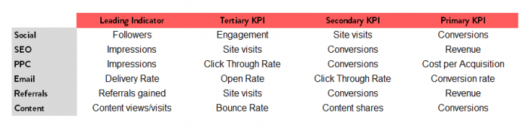
KPI’s
Source: www.smartinsights.com

Slide 16
Question?
What metrics do you currently have in place to measure your digital marketing activity?
Check it out with www.similarweb.com and www.socialmention.com

Slide 17
For example….
Website activity to measure the effectiveness of SEO?
Offline activity to drive people to your website? Unique visitors? number of visits? Duration and repeat visits
Click through rates from display advertising?
Social metrics – followers, comments, likes, retweets, mentions, channel views, subscribers
Use of # or other key words
Downloads of app?
Entry into competitions
Sentiment analysis – positive/negative views

Slide 18
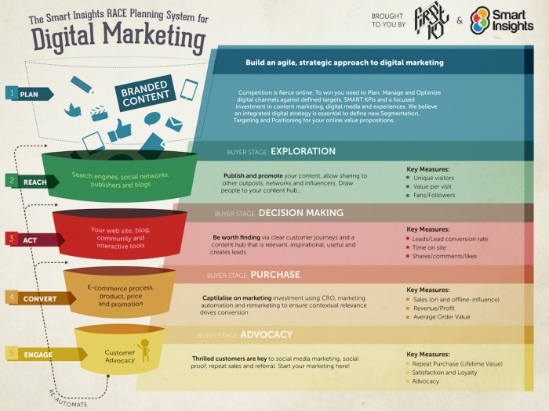

Slide 19
Personas
https://buffer.com/library/marketing-personas-beginners-guide

Slide 20
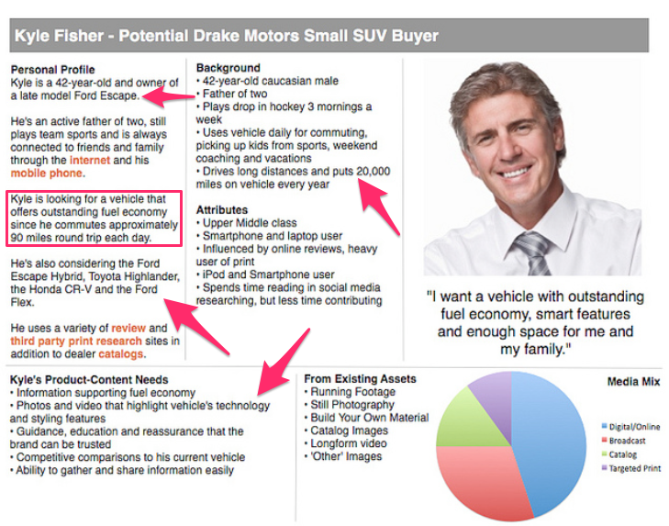
Source: https://www.quicksprout.com/customer-persona/

Slide 21
Example
Information on this marketing profile such as the customer’s name, age, and race.
Kyle has two kids and enjoys playing hockey. - These factors impact his need for an SUV.
Since Kyle has children, he can’t buy a coupe. Plus, safety is important to a family man. Since SUVs are larger, he might feel safer driving his kids in a full-size vehicle.

Slide 22
The fact that he plays hockey means he needs room in his car for big, heavy, and bulky equipment, so an SUV makes the most sense.
More detailed info includes:
The number of miles he drives to work each day, which is why fuel economy is important to him. The profile also includes some recreational activities he uses his car for such as family vacations, coaching, and driving his kids to and from their sporting events.
How could this be different to another 42 year old male from the same area and what impact might that have?

Slide 23
Task
Create a customer persons for 1 segment of your market
How might you tailor your marketing campaigns to this segment based on the knowledge you have from your persona

Slide 24
Assignment hint and tips

Slide 25
Examiner Report

Slide 26
General
Follow required format
Check command words
Link to the scenario
Keep to word count and check marks allocated!
All answers in 1 document word/PDF and uploaded to the digital platform
Link the tasks – do not repeat

Slide 27
Check out…
https://www.hotjar.com/blog/
https://www.hotjar.com/blog/user-personas/

