Slide 1
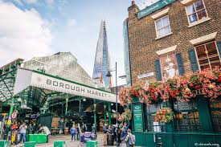
HPAN5041/6041 Economic Anthropology and Past Societies
Modes of production (2): Modern Capitalism
Understanding the Market
Here, we return to the concept of modes of production and focus in on the capitalist mode of production, examining "the market" in theory and in practice and studying how the market allocates resources and how value, price and profit come into play. We'll also ask, anthropologically, what's going on?

Slide 2
Understanding the market
Simple markets and everyday definitions
Uses of the word “market”
What is “the free market”?
Creating a world market – massive demographic change and new inequalities

Slide 3
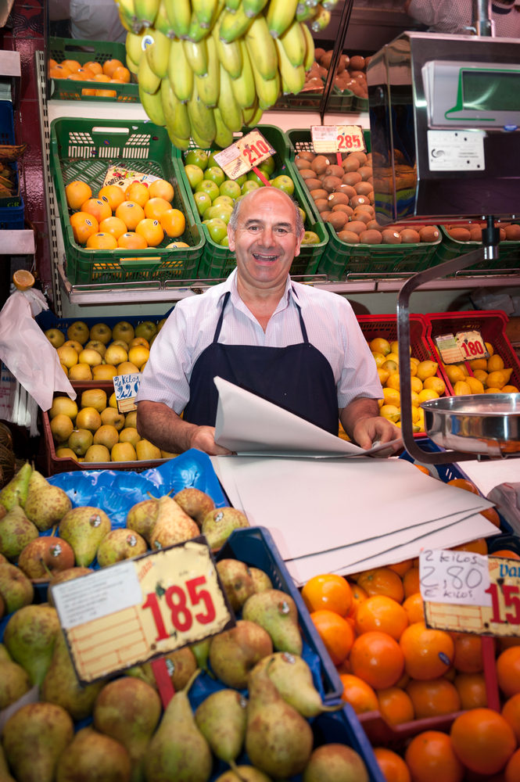
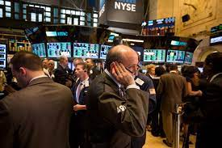
“Market”: different meanings?
Simple markets and everyday definitions
Uses of the word “market”
Market Traders on the New York Stock Exchange A different kind of market trader

Slide 4
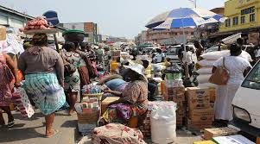
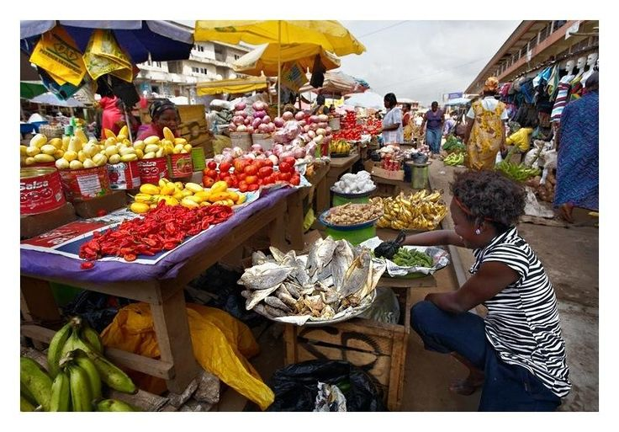
Other images of “the market”
Kumasi market, Ghana

Slide 5
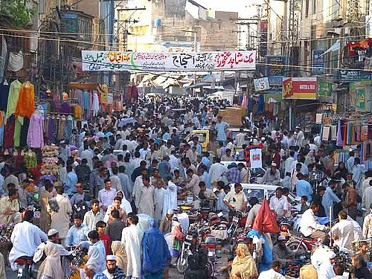
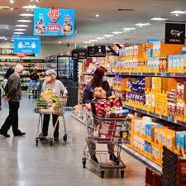
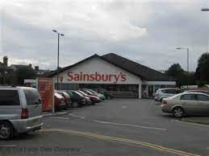
Raja Bazaar, Rawalpindi
“Supermarkets”

Slide 6

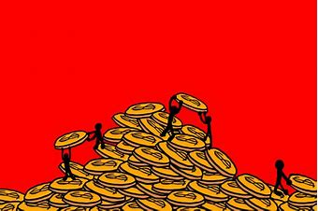
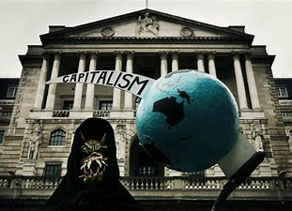
What is “the free market”?
Capitalism
Cash/money economy
Commodity exchange
Alienation

Slide 7
1. How free is a “free market”?
- regulation
2. How does the free market/capitalism compare with other economic models?
Traditional societies (pre-capitalist economic formations):
- reciprocity/gift-based
- feudalism: rise of traders/merchants/bankers/towns
- mercantilism becomes mature capitalism
Planned or command economies: USSR, E Europe, China etc.

Slide 8
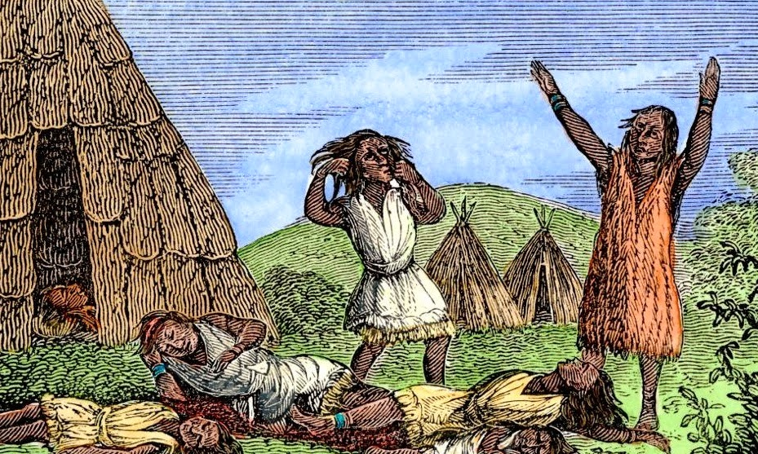
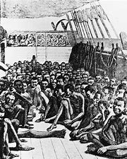
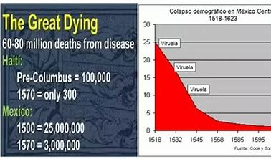
Creating a world market – massive demographic change and new inequalities

Slide 9
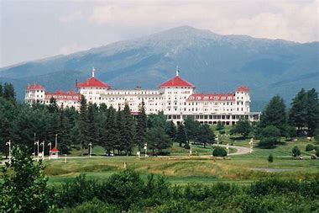
Political economy since 1945:
- The “post-war consensus” 1944-1970s
After the New Deal and WWII
The Bretton Woods Agreement 1944: a Keynesian consensus: W Europe, N America, Japan etc.
1971 turning point
- Vietnam war costs
- Oil price shocks

Slide 10

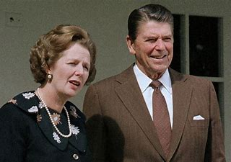
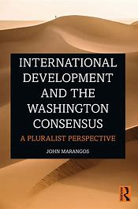
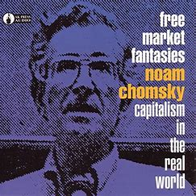
Political economy since 1945:
- The Washington Consensus/Neo-Liberalism 1980-2007
New crises: * The Crash 2007/8 * Covid-19

Slide 11
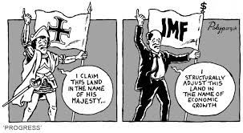
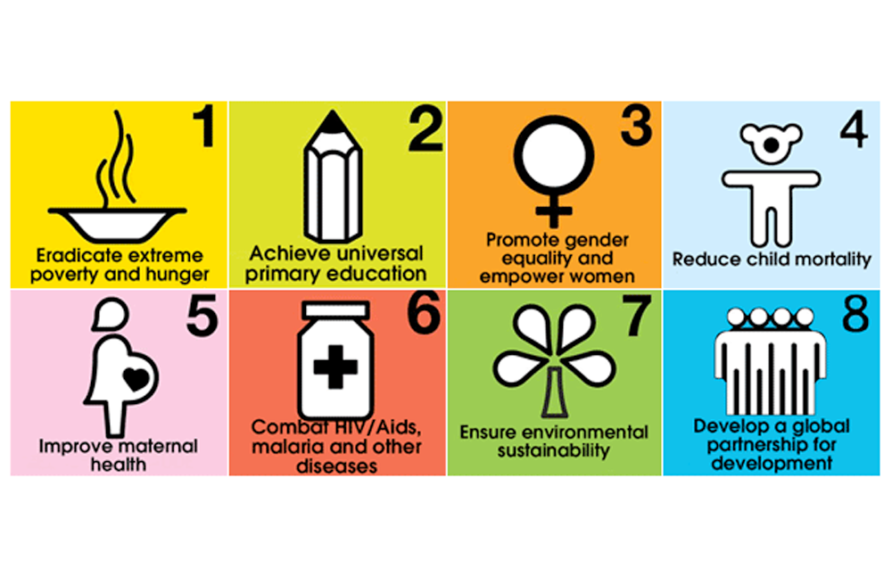
The results of the Washington Consensus – and the emergence of “Human Development” at the UN

Slide 12
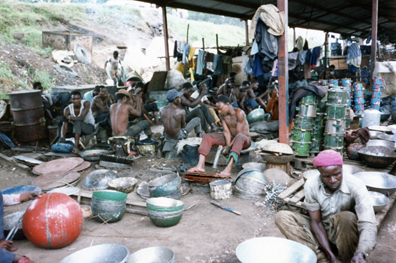
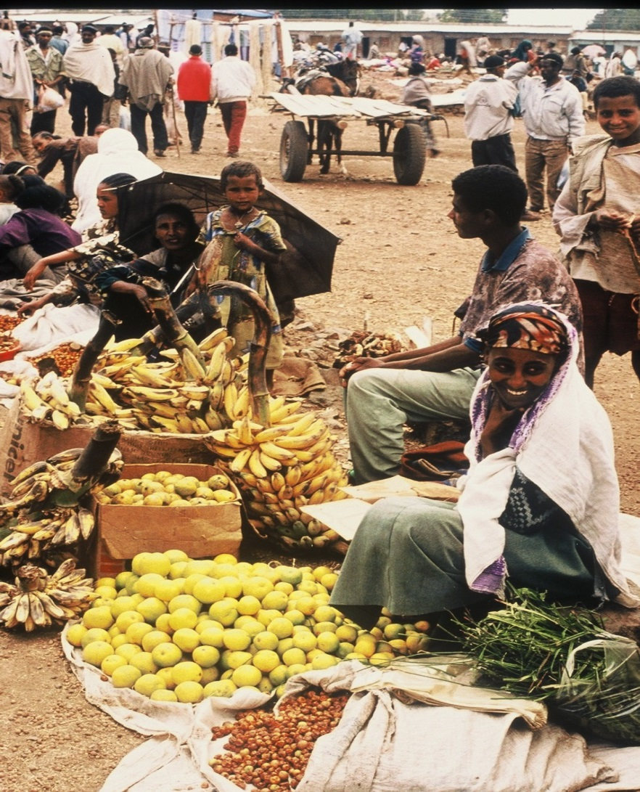
The informal sector economy:
Theories of micro-enterprise

Slide 13
The informal sector economy

Slide 14
The informal sector economy

Slide 15
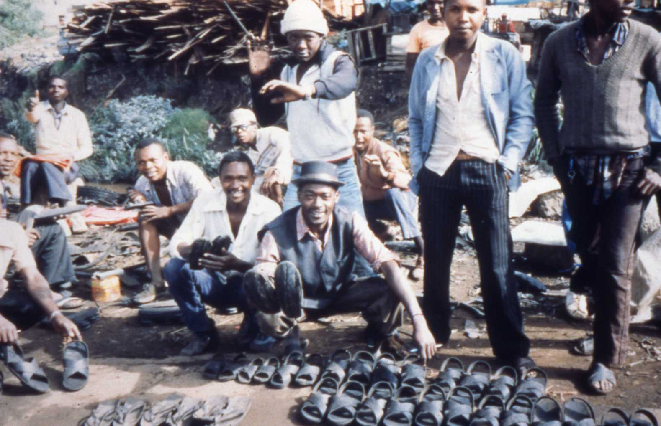
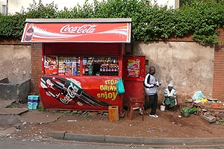
Informal sector traders

