Slide 1

BMHN4001
Health, Exercise and Society
Lifecourse Epidemiology: Understanding the Early Origins of Disease

Slide 2

By the end of this lecture you should be able to:
Recognise that some of the major chronic diseases of adulthood begin in childhood, including cardiovascular and metabolic disease.
Describe the pathogenesis of atherosclerosis in young people
Take a life-course perspective and consider the context of why we wish to promote good health-related fitness in infants, children, adolescents and young people.

Slide 3
Pathogenesis of atherosclerosis video
https://www.youtube.com/watch?v=g3kDdg8r6NY

Slide 4
Atherogenesis from childhood to adulthood
The ‘fatty streak’ Consists of macrophages, smooth muscle cells and
T-lymphocytes and can be found in the aorta shortly after birth.
Found in the coronary arteries at about 15 years of age.
They cause little or no obstruction to blood flow and no
clinical manifestations.
The fibrous plaque By the age of 25, more advance lesions can be found in
the coronary arteries in populations where there is a high
incidence of coronary artery disease. If this lesion progresses
it can compromise blood supply. Comprised of more smc’s
and lipid deposition.
The advanced lesion Occur with increasing frequency with age. The lipid-rich core
becomes larger and calcifies. The plaque can develop cracks
(fissures) and eventually rupture leading to a thrombotic event
and a myocardial infarction.

Slide 5
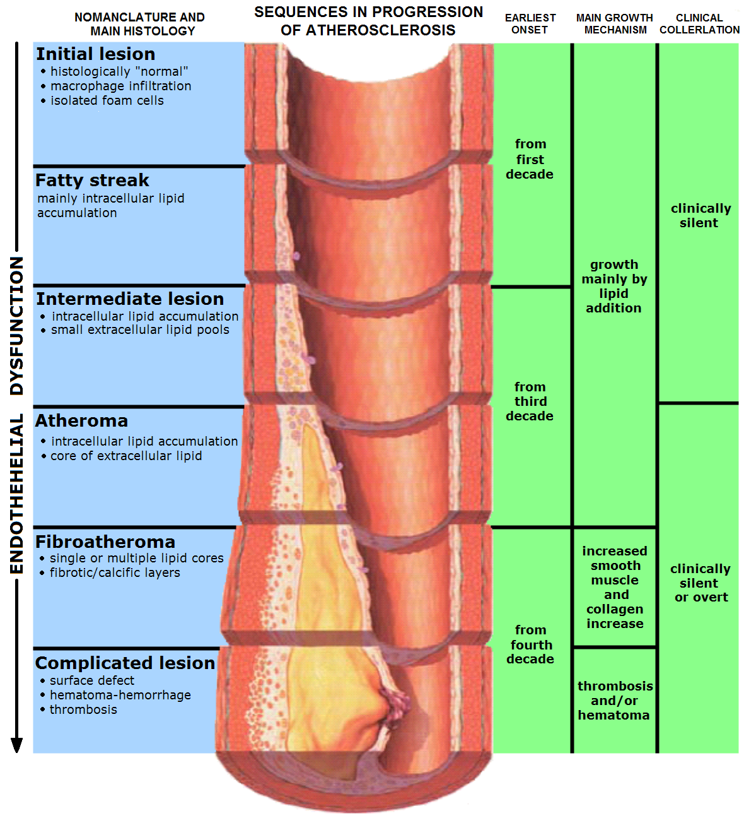

Slide 6
PAEDIATRIC ORIGINS OF CAD
International atherosclerosis project
4737 autopsies of males and females aged 10-39 years
‘fatty streak’ present by the age of 10 in most aortas

Slide 7
Autopsies of Young Soldiers Killed in Action
USA soldiers from Korean and Vietnam wars:
  77% of 300 soldiers (mean age 22 years) killed in Korea had atherosclerotic lesions of the coronary arteries ranging from minimal eccentric thickening to complete occlusions of one or more coronary branch.
  12% had occlusions >50%
  Enos et al. JAMA July 16, 1955, pp 912-914.

Slide 8
Vietnam Conflict
In Vietnam, 47% of 105 fatalities (average age 22.1 years, range 18-37 years) had coronary lesions in one or more of their coronary arteries.

Slide 9
The Bogalusa (Louisiana) Heart Study
A large-scale epidemiological study of risk factors for CAD from birth through to the age of 26 in a biracial US population.
From 1973 to 1983, 8000 children were examined.
From 1978 to ~1986, 88 autopsies were conducted on children and young adults aged 3 to 26 years (35 were participants in Bogalusa Heart Study).
90% of deaths were due to accidents, homicides or suicides
Evidence of early CAD was present in many of the autopsied arteries.

Slide 10
Pathobiological Determinants of Atherosclerosis in Youth, PDAY
Collaboration of pathologists and scientists in the USA participating in a multi-centre study investigating the natural history of atherosclerosis in childhood and young adulthood and to determine its association with risk factors for adult coronary heart disease.
The Pathobiological Determinants of Atherosclerosis in Youth (PDAY) study began in 1985 involving 15 medical centres. The PDAY Research Group collected arteries, blood, tissue, and data from more than 3000 young persons who died between 15 and 34 years of age of external causes (accidents, homicides, suicides).

Slide 11
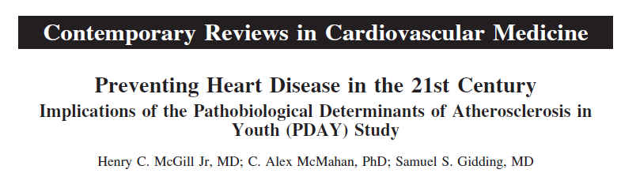
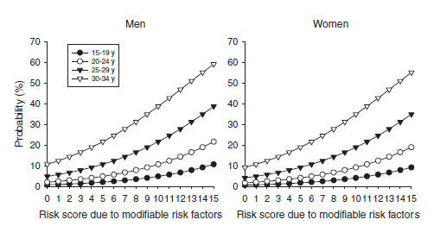
Pathobiological Determinants of Atherosclerosis in Youth, PDAY
Main findings
113 publications up to year 2009
Non HDL-cholesterol, hypertension, raised blood glucose, obesity and smoking were all associated with the extent of fatty streaks and raised lesions.
Obesity accelerates the progression of the fatty streak
Estimated probability of advanced
atherosclerotic lesions in the coronary
arteries according to PDAY risk score

Slide 12
What are the major risk factors for CVD?
Major risk factors for CVD:
  Age
  Sex
  Family history
  High total and LDL-cholesterol
  Smoking
  Low physical activity/cardiorespiratory fitness
  Low HDL-cholesterol and high triglycerides
  High blood pressure
  Insulin resistance, diabetes mellitus and hyperglycaemia
  Obesity (abdominal)

Slide 13
Health and the Life-Course

Slide 14
Inequities in Child Health
“Health inequities result from unequal distribution of power, prestige and resources among groups in society” (Marmot, 2007).
“Because the physical and mental development of young children is still under way and they depend on others to ensure their health, they are particularly susceptible to socioeconomic inequities that lead to marked differentials in morbidity and mortality” (WHO, 2010).

Slide 15
Examples of Health Inequalities in Children
  Children from lower SES families are typically:
    More likely to die in infancy
      Despite a reduction in infant mortality in the UK the inequality between lowest and highest SES families has widened (17% in 2004-6, 13% in 1997-9).
    More likely to be born small as babies
    Paradoxically, more likely to be overweight or obese
    More likely to have cerebral palsy
    More likely to experience intentional or non-intentional serious injury
    More likely to have social or behavioural problems

Slide 16
Examples of Health Inequalities in Behaviour
  Children from lower SES families are typically:
    More likely to be consuming an unhealthy diet
    Possibly more likely to be sedentary, especially girls
    Have at least one parent who is overweight or smokes – leads to inter-generational transmission
    Less likely to be breastfed and to have continued breastfeeding (up to 6 months)

Slide 17
A Life-Course Perspective
What is a life-course perspective?
  It is a lens through which we can view health and the determinants of health and seek to understand, explain and improve health across populations.
  It is an alternative to the reductionist perspective or reductionism.
It suggests that a complex interplay of biological, behavioural, psychological and social factors contribute to health and disease across a person’s life span.

Slide 18
Clarifying Terms
Life span:
  Length of time a species is capable of living or the length of an individual’s life.
Life cycle:
  Regular, predictable series of life stages or reproductive cycle.
Life course:
  Age-graded developmental trajectories shaped by contexts (environments).

Slide 19
Life Course Concepts – ‘T2E2’
Timeline:
  Health is cumulative and longitudinal i.e. developed over a lifetime.
Timing:
  Health and health trajectories are particularly affected during critical or sensitive periods.
Environment:
  The broader environment (biologic, social, physical and economic) affects health and development.
Equity:
  Health inequality reflects more than genetics and personal choice.

Slide 20
The Life-Course Approach and Time
A life-course approach recognises the role of time in shaping health outcomes & incorporates time into models that explain health outcomes.
Based largely on:
  Barker’s hypothesis
    Foetal programming hypothesis; Developmental Origins of Health and Disease (DOHaD);
  Critical periods
  Birth cohorts
  Epigenetics

Slide 21
CVD and the Life-course
Poor living conditions in childhood and the social class of parents have a strong impact on cardiovascular health.
In middle-age, traditional risk factors impact on CVD risk but this can be counteracted by education, living and material conditions that make healthy behaviours affordable and facilitate health seeking.
In later life, access to good health care, social and family support, and a sense of control over life impact on cardiovascular health.

Slide 22
Social Stratification and Differential Vulnerability
Four life-course models (Pollitt, Rose and Kaufman, 2005) describe why low childhood socioeconomic status impacts negatively on adult CVD:
  Latent effects model: adverse life experiences during “sensitive periods”.
  Pathway model: early life events place an individual onto a certain “life trajectory”.
  Social mobility model: “social mobility across the life-course impacts adult health”.
  Cumulative life-course model: “psychosocial and physiological experiences and environments during early and later life accumulate to influence adult disease risk”*
  * Most favoured model.

Slide 23
Birth Cohort Studies
Study individuals from birth (or soon after) through life to ascertain how life events ‘effect’ a wide variety of health and social outcomes.
The Millennium Cohort Study (MCS) is a multi-disciplinary research project following the lives of around 19,000 children born in the UK in 2000-01.
Most recent of Britain’s world-renowned national longitudinal birth cohort studies.
MCS is following children through their early childhood years and plans to follow them into adulthood. It collects information on the children’s siblings and parents.
MCS’s field of enquiry covers such diverse topics as parenting; childcare; school choice; child behaviour and cognitive development; child and parental health; parents’ employment and education; income and poverty; housing, neighbourhood and residential mobility; and social capital and ethnicity.
Data are freely available to researchers
http://www.cls.ioe.ac.uk/page.aspx?sitesectionid=851&sitesectiontitle=Welcome+to+the+Millenium+Cohort+Study

Slide 24
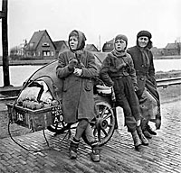
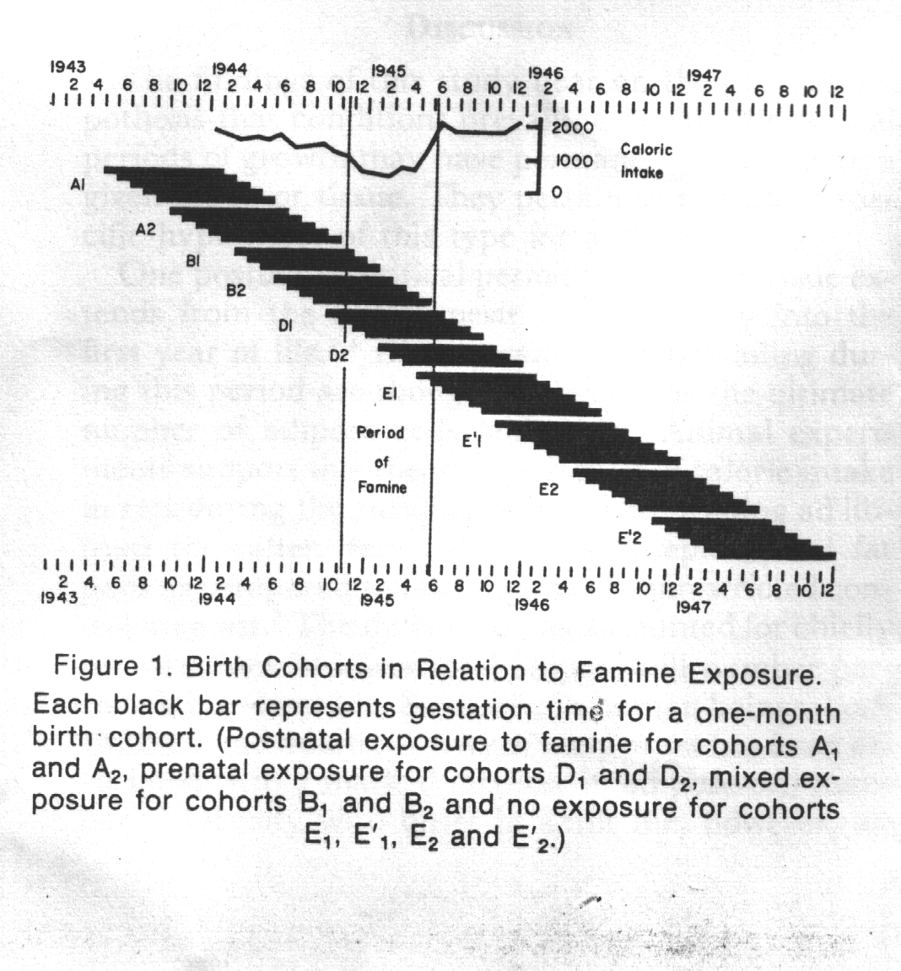
Design of the Dutch Famine (1944-45) Study examining the impact of famine on obesity

Slide 25
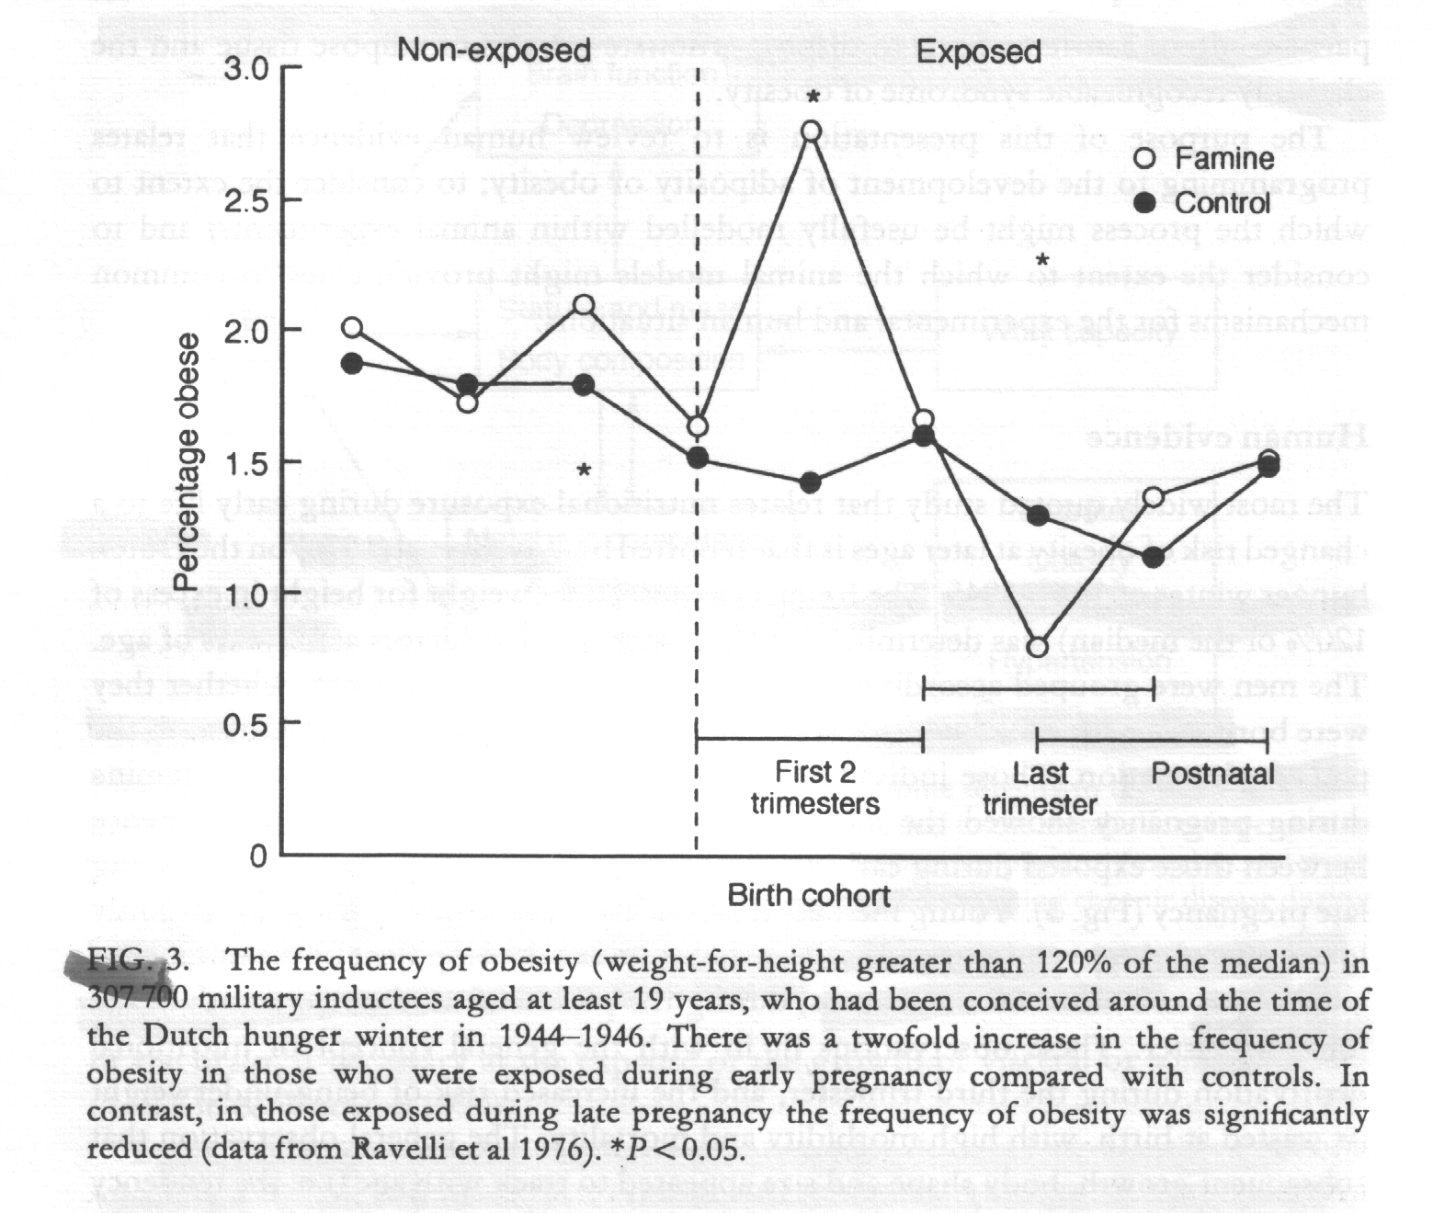
Frequency of obesity amongst subjects in the Dutch Famine Study
Epigenetics – the influence
of environmental factors
such as diet and chemical
exposure on genes – whether
they are switched ‘on’ or ‘off’.
People who were exposed to
the famine have been found to
have undergone epigenetic
changes that increase their
risk of obesity, cardiovascular
disease and other chronic
conditions.

Slide 26
Birth weight and later health outcomes
Many published studies that have considered the association between birth weight and later health.
First study performed by David Barker from Southampton University, using birth records in the UK
Referred to as “Barker’s Hypothesis”, “Foetal Programming” or “Intrauterine Development”
Fairly consistent findings...low birth weight and rapid weight gain in early years associated with greater risk of CVD.

Slide 28

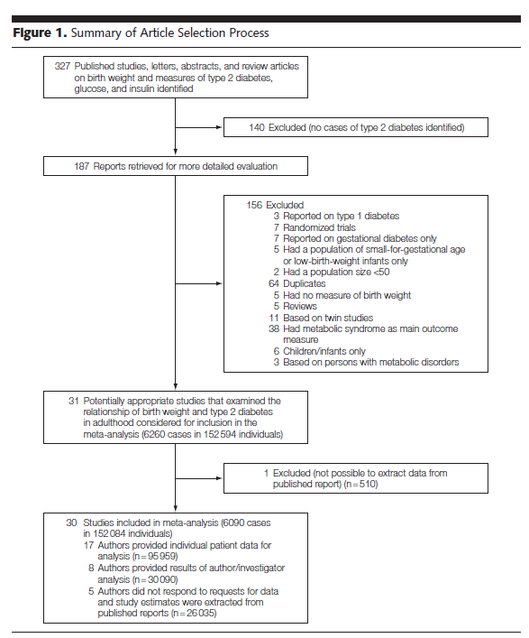

Slide 29
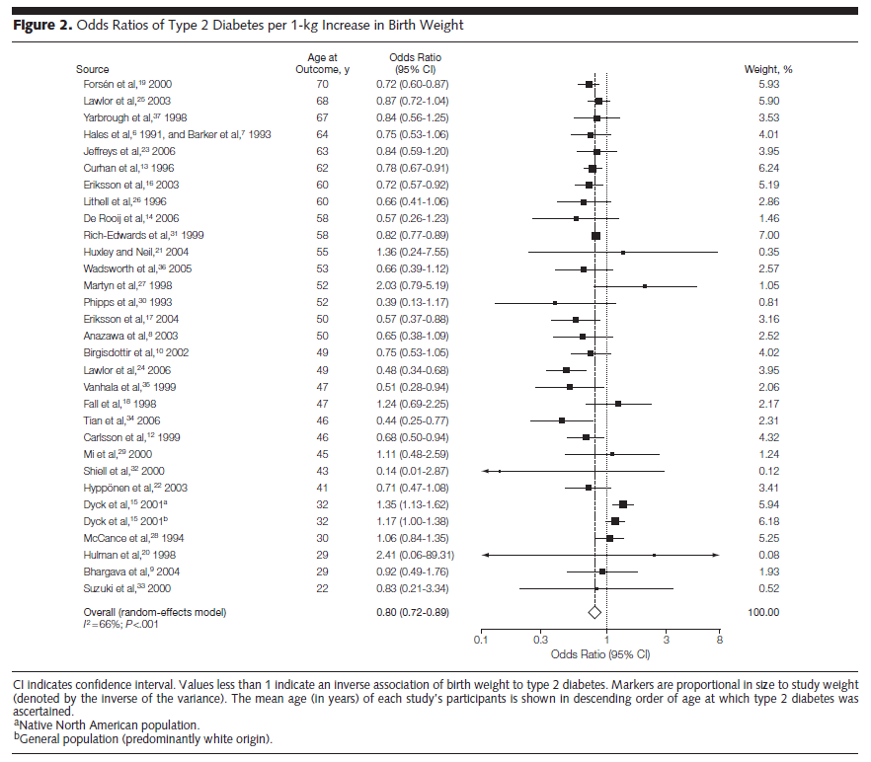

Slide 30
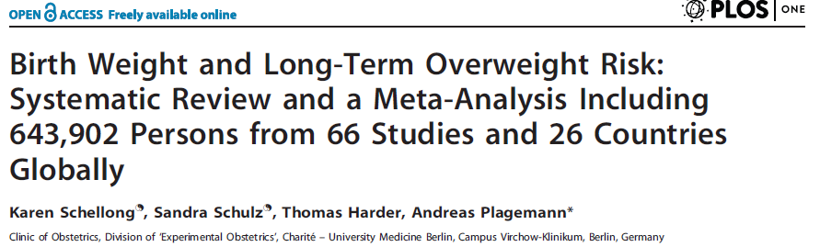
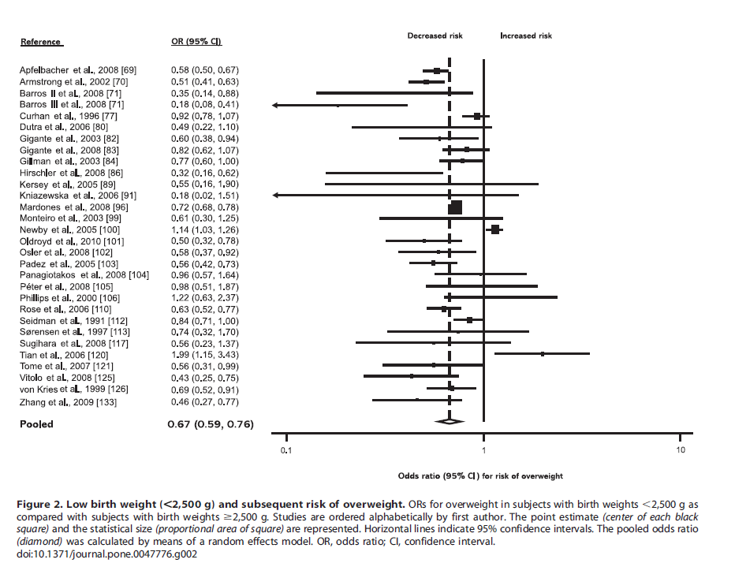
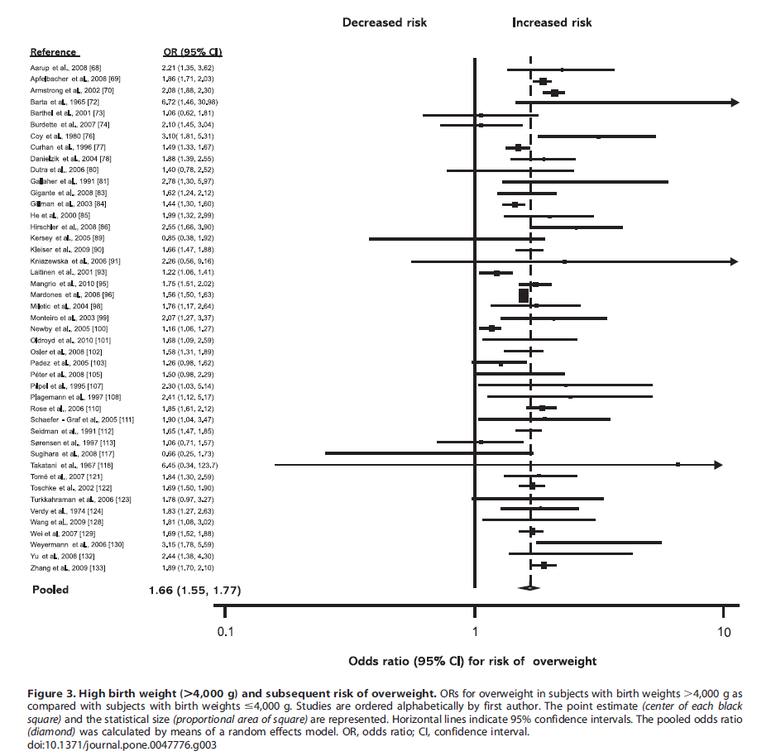
Low birth weight (<2.5kg)
High birth weight (>4.0kg)

Slide 31
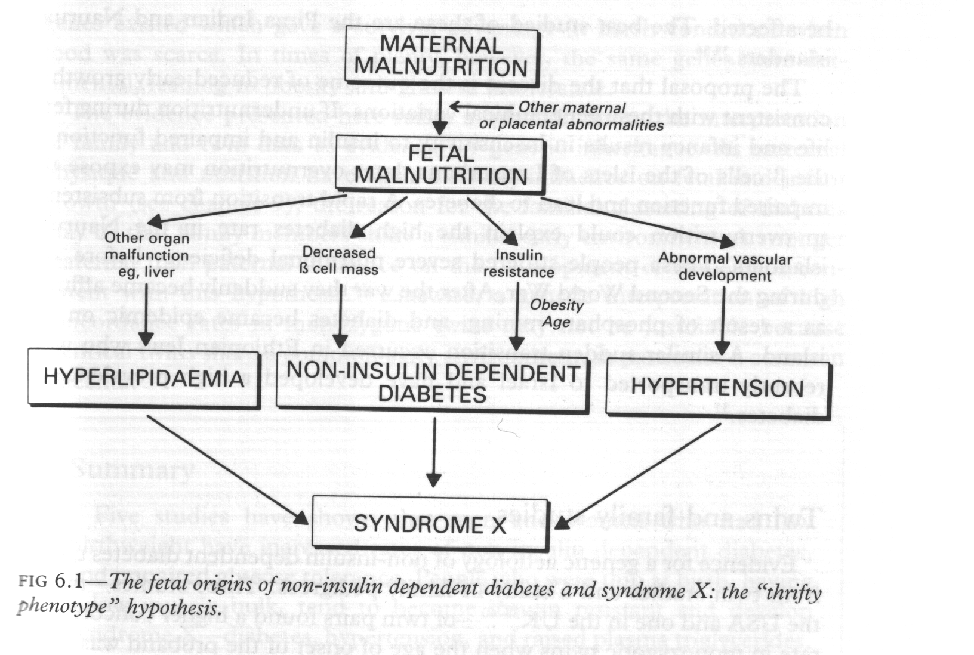
Possible link between maternal malnutrition, obesity, type 2 diabetes & CVD

Slide 32
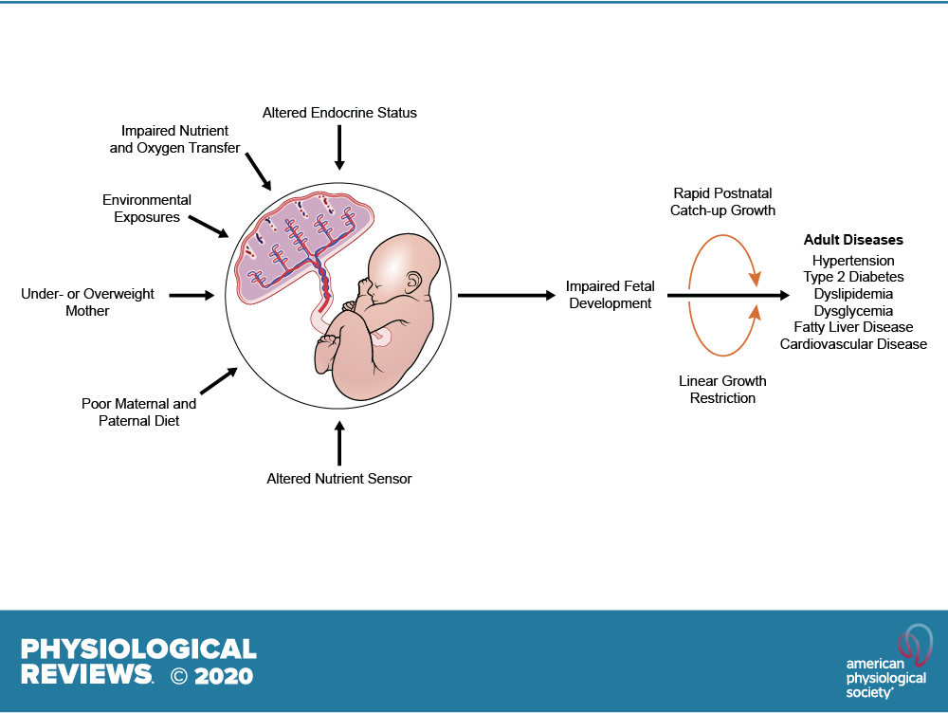
DOI: (10.1152/physrev.00002.2020)

Slide 33
DOI: (10.1152/physrev.00002.2020)

Slide 35
Case study:
A 70 year old man with cardiovascular disease (CVD) smokes, has high blood pressure, obesity and high cholesterol.
Why does he have CVD?

Slide 36
If you said because he smokes, has high blood pressure, obesity and high cholesterol you have adopted a reductionist explanation that focuses on biology and behaviour

Slide 37
Case study
(Health Equity and Lifecourse Explanation)
A 70 year old man with CVD smokes, has high blood pressure, obesity and high cholesterol.
Why does he have CVD?
Because...
  His mother was financially poor & consumed a poor diet before he was born; he was born of low birth weight; his father was unemployed and the family experienced poverty and poor living conditions; he was not vaccinated and experienced measles and mumps in late adolescence; he rapidly gained weight during adolescence and became obese as a young adult; he was bullied at school and had many extended absences as a consequence; he has no educational qualifications and a manual job that he dislikes and causes a high level of stress because he has no control; he marries and has a child but divorces soon after because he loses his job – this causes more stress; he starts to smoke and drink alcohol excessively and gains weight; he is forced to live in poor quality rented accommodation and experiences social isolation ....
How could this man’s CVD have been prevented?

Slide 38
Case study:
A 70 year old man from the same neighbourhood and who attended the same school as the previous man has no identifiable disease and is remarkably fit and healthy.
Why the difference in outcome?
Because...
  His parents were both highly educated and had professional well-paid jobs – household income was in the top 10% for the country; the timing of his birth was planned such that the mother was able to take 12 months off work to breastfeed and ‘bond’ with her son; she was normal weight, physically active and consuming a healthy diet before and during the pregnancy; the family home was owned, detached and close to greenspace; he was born of average birth weight, was fully vaccinated as a child and has remained of normal weight throughout his life; he enjoyed school and participated in many sporting and extracurricular activities; he left school with 10 GCSE’s graded A-C and went on to graduate with a Masters degree in engineering; he worked as an engineer for several years before establishing his own engineering consultancy which is doing very well; managing his own business can be stressful but he gets great job satisfaction because he is in control and employs several very capable people to help run the business; he owns property in Spain and is now spending more time there than in the UK; his hobbies include wine tasting, music and walking
What factors contribute to this man’s good health?

Slide 39
In summary
Atherosclerosis appears to begin in childhood with the fatty streak and is related to lipids, obesity, hypertension, poor diet, lack of activity and smoking.
There are marked inequalities in health in our society and the societies of other countries.
The life-course approach suggests that from birth or before, our health is determined by a multitude of social, environment, behavioural and physiological factors. This is highly relevant when planning health improvement/disease reduction programmes.

