Slide 1
Student Name: Razia Begum
Student ID: 2322783
Lecturer’s Name: Rebecca Stewart
Module Code: LCLM 4004
Module Name: Problem Solving and Decision-Making
Component 1: Green Haven Florists

Slide 2
An Overview of my presentation
Good Afternoon ladies and gents. My name is Razia Begum and in my presentation I will be discussing
  Green Havan Florists and the nature and scope of the problems
  The 5W2H model that summarises these issues.
  Application of the PESTEL framework.
  The Cause-and-Effect model.
  A summary of the key findings.

Slide 3
An overview of Green Havan Florists
Owners: Liam and Priya Patel
Location: Norwich, UK
Known for selling: Bespoke floral arrangements
Main problem: Decline in sales and food traffic due to rising costs and online competition

Slide 4
The problems Green Haven Florists are facing
Green Haven Florists root problem is the 30% decline in in-store sales.
The reasons that are contributing to this decline in sales.
The Internal problems are:
Outdated website and weak online presence
Limited digital marketing efforts
Struggle to adapt the business model and delivery options
The external problems are:
Increased competition from online flower retailers and new local florists
Rising flower and material costs due to inflation and supply chain issues
Decline in high street foot traffic

Slide 5
Root Problem is that they are losing money
What? | Where? | When? | Who? | Why? | How? | How much?
What effect is it having? | Where is the problem occurring? | When was the problem first noticed? | Who is impacted by the problem? | Why is the problem happening? | How serious is the problem? | How much money is being lost?
Decrease in revenue and foot traffic | At the Green Haven Florits shop in Norwich | Over the past 12 months | Liam and Priya Patel, the business owners | Due to rising costs and competition from online florists | Very serious threatening business sustainability | Around a 30% decline in in-store sales

Slide 6
The PESTEL Framework
The PESTEL Framework is:
  P - Political
  E - Economic
  S - Social
  T - Technological
  E - Environmental
  L - Legal
  We use it to analyse external factors that can affect a business
  Schuetz , Mair, and Schrefl (2018)
  ULUBEYLİ, (2019)

Slide 7
PESTEL Framework
Here is the tabular PESTLE analysis of Olive Tree Bistro.
Political Factors | Economic Factors | Social Factors | Technological Factors | Legal Factors | Environmental Factors
Import regulations affecting the costs of flowers Government support small, local businesses may be limited | Rising inflation increasing flower and material prices Reduced consumer spending due to higher living costs | Customers prefer convenience and online shopping Growing demand for eco-friendly and sustainable products | Outdated website reduces online sales potential Competitors using social media and digital marketing effectively | Must comply with trading and consumer protection laws Regulation on imported flowers and sustainability claims | Higher costs for biodegradable and eco-friendly materials Supply issues due to climate impact on flower production

Slide 8
The Cause-and-Effect model
The Cause-and-Effect Model is a model that shows the relationship between a problem and its effects
  Why is it used?
  To identify and understand the root causes of a problem
  Where/how is it used?
  In businesses to show causes and effects often in a fishbone diagram
  What are the benefits of this model?
  Helps find the main cause of problems
  Makes problem solving easier
  What are the criticisms of this model?
  Can make the problem look to simple
  Needs correct information to work well
  Sturmberg, and Marcum (2024)
  Arif and MacNeil (2023)

Slide 9
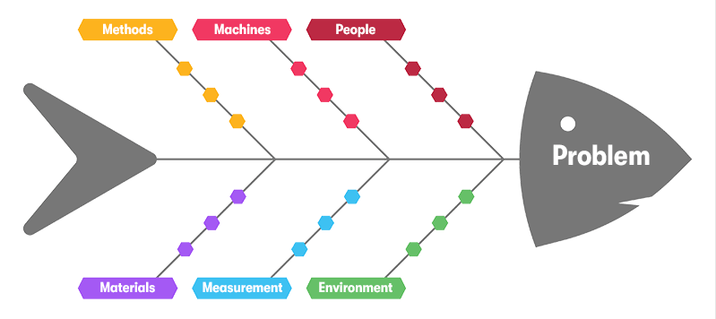
Methods:
Relying mostly on word of mouth and occasional social media posts
Limited online ordering and delivery options
Machines:
Outdated website and digital tools
People:
Liam and Priya struggling to keep up with digital marketing trends
Small team managing all operations
Materials:
Expensive biodegradable wrapping and locally sourced flowers
Measurement:
30% decline in in-store sales over the past 12 months
Kang Yang, and Patterson (2021)
Environmental:
Reduced high street activity and more online shopping trends

Slide 10
A summary of the Key Findings
Green Haven Florists is losing money due to a 30% drop in sales caused by rising costs and strong online competition
External factors like inflations online shopping trends and higher eco-friendly costs are affecting the business's success
The main causes include outdated marketing methods, lack of technology high materials costs and reduced local foot traffic
The business needs to modernize, update its website use stronger digital marketing and offer more online and delivery options to survive

Slide 11

Reference List:
ULUBEYLİ, S. et al. (2019) ‘Strategic Factors Affecting Green Building Industry: A Macro-Environmental Analysis Using PESTEL Framework’, Sakarya Üniversitesi Fen Bilimleri Enstitüsü Dergisi, 23(6), pp. 1042–1055. Available at: https://doi.org/10.16984/saufenbilder.474824
Schuetz, C.G., Mair, E. and Schrefl, M. (2018) ‘PESTEL Modeler: Strategy Analysis Using MetaEdit+, iStar 2.0, and Semantic Technologies’, in 2018 IEEE 22nd International Enterprise Distributed Object Computing Workshop (EDOCW). IEEE, pp. 216–219. Available at: https://doi.org/10.1109/EDOCW.2018.00040.
Sturmberg, J.P. and Marcum, J.A. (2024) ‘From cause and effect to causes and effects’, Journal of evaluation in clinical practice, 30(2), pp. 296–308. Available at: https://doi.org/10.1111/jep.13814.
Arif, S. and MacNeil, M.A. (2023) ‘Applying the structural causal model framework for observational causal inference in ecology’, Ecological monographs, 93(1). Available at: https://doi.org/10.1002/ecm.1554.
Kang, Y., Yang, S. and Patterson, P. (2021) ‘Modern Cause and Effect Model by Factors of Root Cause for Accident Prevention in Small to Medium Sized Enterprises’, Safety and health at work, 12(4), pp. 505–510.

Slide 12
Thank you for listening

Slide 13


