Slide 1
UCM L4 LitDE: Assignment 2
Self-evaluation
Support deck for Task 1.

Slide 2
Contents
Overview
Belbin Team Role Theory.
Myers–Briggs Type Indicator.
Gardner’s Theory of Multiple Intelligences.
Color Personality Test.
Optional: Level-Up tools.
Conclusion

Slide 3
1. Overview: Self-evaluation
The following slides provide links to online self-evaluation questionnaires.
The questionnaire results will help you to understand yourself.
The process of completing the online questionnaires, reflecting on the results and reflecting on yourself i.e. your view/perspective, your feelings, attitude and behaviour will help you to understand who you are as a unique individual.
They will also help you to discover your innate strengths, weaknesses and support you to develop yourself to become the next best version of who you would like to be in the world.

Slide 4
2. Belbin Team Role Theory
Dr Meredith Belbin and his research team at Henley Management College revealed individuals displayed traits and fulfil different Team Roles.
A Team Role came to be defined as “A tendency to behave, contribute and interrelate with others in a particular way.”
It was found that the most Successful Teams contain a mixture of Team roles.
Each team role is associated with typical behavioural, interpersonal strengths and characteristic weaknesses. Belbin called the weaknesses of team-roles “allowable”.
Belbin identified 9 team roles and he categorised those roles into 3 groups:
People Oriented (Communicators) - Co-ordinator, Team-worker and Resource Investigator
Thought Oriented (Planners, Designers) - Plant, Monitor Evaluator and Specialist
Action Oriented (Implementers) - Shaper, Implementer and Completer Finisher.
(1) http://www.belbin.com/rte.asp?id=8

Slide 5
Belbin Team Role Theory
Belbin identified 9 team roles, and he categorised those roles into 3 groups:
People Oriented (Communicators):
  A Co-ordinator, a Team-worker and a Resource Investigator.
Thought Oriented (Planners, Designers):
  A Plant, Monitor Evaluator and Specialist.
Action Oriented (Implementers) - Shaper, Implementer and Completer Finisher.
Let’s find out which role you would be best at in a Team and which one most reflects your qualities and strengths.
(1) http://www.belbin.com/rte.asp?id=8

Slide 6
Belbin Team Role Test
Belbin’s Self-Perception Inventory questionnaire is a professional tool that is carried out by a trained professional and costs to complete. The following test is based on Belbin’s Self-Perception Inventory questionnaire
Complete the following Team Role test: http://www.123test.com/team-roles-test/.
  For further information you can review Belbin’s 9 Team roles here: http://www.belbin.com/about/belbin-team-roles/ or on the following slides.

Slide 7
Bg: Action Oriented Roles:
1. Shaper (SH)
Shapers are people who challenge the team to improve. They are dynamic and usually extroverted people who enjoy stimulating others, questioning norms, and finding the best approaches to problems. Shapers often see obstacles as exciting challenges and they tend to have the courage to push on when others feel like quitting. Their potential weaknesses may be that they’re argumentative, and that they may offend people’s feelings.
2. Implementer (IMP)
Implementers are the people who get things done. They turn the team’s ideas and concepts into practical actions and plans. They are typically conservative, disciplined people who work systematically and efficiently and are very well organized. These are the people who you can count on to get the job done. On the downside, Implementers may be inflexible and somewhat resistant to change.
3. Completer Finisher (CF)
Completer–Finishers are the people who see that projects are completed thoroughly. They ensure there have been no errors or omissions and they pay attention to the smallest of details. They are very concerned with deadlines and will push the team to make sure the job is completed on time. They are described as perfectionists who are orderly, conscientious, and anxious. However, a Completer-Finisher may worry unnecessarily and find it hard to delegate.

Slide 8
Bg: People Oriented Roles:
4. Coordinator (CO)
Coordinators are the ones who take on the traditional team–leader role and have also been referred to as the chairmen. They guide the team to what they perceive are the objectives. They are often excellent listeners and they are naturally able to recognize the value that each team members brings to the table. They are calm and good-natured and delegate tasks very effectively. Their potential weaknesses are that they may delegate away too much personal responsibility, and may tend to be manipulative.
5. Team Worker (TW)
Team Workers are the people who provide support and make sure the team is working together. These people fill the role of negotiators within the team and they are diplomatic, and perceptive. These tend to be popular people who are very capable in their own right but who prioritize team cohesion and helping people getting along. Their weaknesses may be a tendency to be indecisive, and maintain uncommitted positions during discussions and decision-making.
6. Resource Investigator (RI)
Resource Investigators are innovative and curious. They explore available options, develop contacts, and negotiate for resources on behalf of the team. They identify and work with external stakeholders to help the team accomplish its objective. They are outgoing and are often extroverted, meaning that others are often receptive to them and their ideas. On the downside, they may lose enthusiasm quickly, and are often overly optimistic.

Slide 9
Bg: Thought Oriented Roles:
7. Plant (PL)
The Plant is the creative innovator who comes up with new ideas and approaches. They thrive on praise but criticism is especially hard for them to deal with. Plants are often introverted and prefer to work apart from the team. Because their ideas are so novel, they can be impractical at times. They may also be poor communicators and can tend to ignore given parameters and constraints.
8. Monitor – Evaluator (ME)
Monitor-Evaluators are best at analyzing and evaluating ideas that other people (often Plants) come up with. These people are shrewd and objective and they carefully weigh the pros and cons of all the options before coming to a decision. Monitor-Evaluators are critical thinkers and very strategic in their approach. They are often perceived as detached or unemotional. Sometimes they are poor motivators who react to events rather than instigating them
9. Specialist (SP)
Specialists are people who have specialized knowledge that is needed to get the job done. They pride themselves on their skills and abilities, and they work to maintain their professional status. Their job within the team is to be an expert in the area, and they commit themselves fully to their field of expertise. This may limit their contribution, and lead to a preoccupation with technicalities at the expense of the bigger picture.

Slide 10
Bg: Belbin Team Role Theory
Balance is key:
Whilst some Team Roles were more “high profile” and some team members shouted more loudly than others, each of the behaviours are EQUALLY essential in getting the team successfully from start to finish. The key to the most successful Teams was BALANCE.
For example, Meredith Belbin found that a team with no Plant struggled to come up with the initial spark of an idea with which to push forward. However, once too many Plants were in the team, bad ideas concealed good ones and non-starters were given too much airtime.
Strengths and allowable weaknesses
As well as the strength or contribution they provided, each Team Role was also found to have an “allowable weakness”: a flipside of the behavioural characteristics, which is allowable in the team because of the strength which goes with it. For example, the unorthodox Plant could be forgetful or scatty. Teamworkers, concerned with the welfare and morale of the team, found it difficult to make decisions. Shapers risked becoming aggressive and bad-humoured in their attempts to get things done.
How do I find out my Team Role preferences?
To find out which of the 9 Belbin Team Roles you have an affinity towards, and which ones you don’t, you need to complete a Belbin Self-Perception Inventory. This slide deck provides a quick test to help you identify which role you might affiliate with and is based on Belbin Self-Perception Inventory questionnaire: http://www.123test.com/team-roles-test/.

Slide 11
BTRT Activity:
If you haven’t already done so (from the previous slide), complete the following Team Role test that is based on Belbin’s Self-Perception Inventory questionnaire: http://www.123test.com/team-roles-test/.

Slide 12
3. Myers-Briggs Type Indicator (MBTI)
The Myers–Briggs Type Indicator (MBTI) is an introspective self-report questionnaire designed to indicate psychological preferences in how people perceive the world and make decisions.
It can help you to identify your strength character traits, to help you know how you can best contribute to a team.
The MBTI was constructed by Katharine Cook Briggs and her daughter Isabel Briggs Myers.
The underlying assumption of the MBTI is that we all have specific preferences in the way we interpret our experiences, and these preferences underlie our interests, needs, values, and motivation.
It is based on the typological theory proposed by Carl Jung who had speculated that there are four principal psychological functions by which humans experience the world: sensation, intuition, feeling, and thinking – and that one of these four functions is dominant for a person most of the time.

Slide 13
MBTI types
The four categories are:
  Introversion/Extraversion;
  Sensing/Intuition;
  Thinking/Feeling;
  Judging/Perceiving.
Each person is said to have one preferred quality from each category, producing 16 unique types / roles.
The MBTI instrument analyses for preferences, creating 16 different personality types that can be used to identify suitable careers.

Slide 14
Activity:
MBTI Self-Discovery Survey (MBTi)
To discover your MBTI role, try a similar and simplified version of the Myers-Briggs MBTi questionnaire to identify your Strengths and Positive Characteristics. Choose from one of the tests below:
https://www.truity.com/test/type-finder-personality-test-new.
https://personalitymax.com/personality-test/.
  For more information about the test and the personality types please click-here.
Note: For more information about the Myers Briggs Type assessment and/or to learn more about the official Myers Briggs Type Indicator, please click-here.

Slide 15
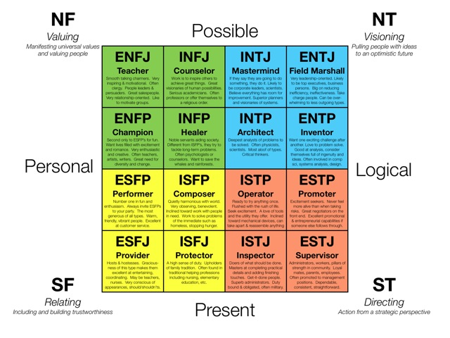
The 16 roles / personality types:
Ref: (1)

Slide 16
Multiple Intelligence Theory
Howard Gardner's theory of multiple intelligences proposes that people are not born with all of the intelligence they will ever have.
This theory challenged the traditional notion that there is one single type of intelligence, sometimes known as “g” for general intelligence, that only focuses on cognitive abilities.
To broaden this notion of intelligence, Gardner introduced eight different types of intelligences consisting of: Logical/Mathematical, Linguistic, Musical, Spatial, Bodily-Kinesthetic, Naturalist, Interpersonal, and Intrapersonal.
Gardner suggests that there may be other intelligences such as spiritual intelligence, existential intelligence, and moral intelligence. (2)

Slide 17
Gardner’s Theory of Multiple Intelligences
Gardner’s research states that we have multiple intelligences and whereas we ALL posses ALL aspects, individuals differ in the strength of each intelligence. Each of us has a unique ‘intelligence profile’.
In his book ‘Frames of Mind: The Theory of Multiple Intelligences (1983), Gardner’s proposed multiple intelligences (below), that we posses to varying and different degrees.
Intelligence | Capability and perception
Linguistic | words and language
Logical-Mathematical | logic and numbers
Musical | music, sound, rhythm
Bodily-Kinesthetic | body movement control
Spatial-Visual | images and space
Interpersonal | other people's feelings
Intrapersonal | self-awareness

Slide 18
Types of Intelligence
Gardner identified the following types of Intelligence:
  Naturalist (nature intelligence)
  Musical (sound intelligence)
  Logical-mathematical (number/reasoning intelligence)
  Existential (life intelligence)
  Interpersonal (people intelligence)
  Bodily-kinesthetic (body intelligence)
  Linguistic (word intelligence)
  Intra-personal (self intelligence).

Slide 19
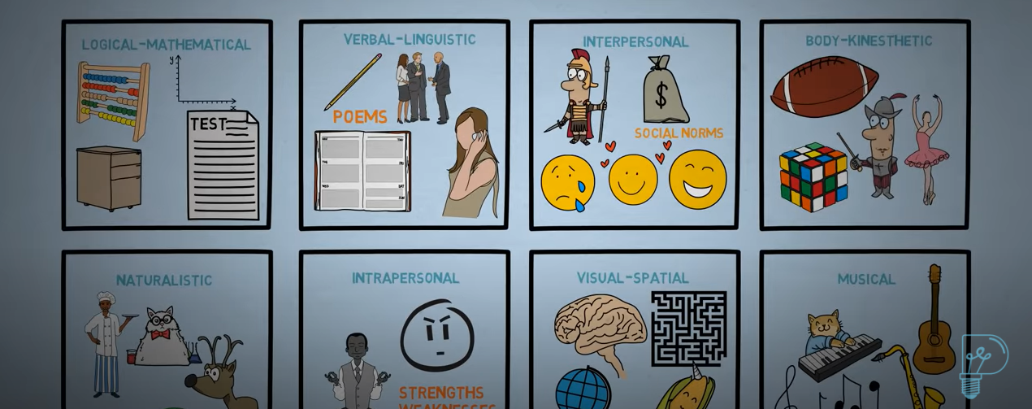

Video: Theory of Multiple Intelligences Explained
Click here or below to watch a short video that explains Garnder’s theory of Multiple intelligences.

Slide 20
Activity: Multiple intelligence
Learning about multiple intelligences can help you better understand your self, your strengths and identify well suited career paths or areas of interest for personal study or hobbies.
Complete the Multiple intelligence survey below to learn more:
https://mypersonality.info/multiple-intelligences/ also located here: https://personalitymax.com/multiple-intelligences/.

Slide 21

Activity: Color Personality Test
To discover your strengths and weaknesses, to enhance your self-discovery and/or to highlight your skills at interviews, try the Color Personality test below.
Click on the following link to complete the Color Personality questionnaire.
CC: https://www.google.com/url?sa=i&url=https%3A%2F%2Fwww.needpix.com%2Fphoto%2Fdownload%2F1215520%2Fcreativity-abstract-alive-multicolored-colors-the-background-colorful-colored-graphics&psig=AOvVaw29nnxfGqAmEUPjxmpXqdtN&ust=1606474689038000&source=images&cd=vfe&ved=2ahUKEwjPz9vahqDtAhUPgFwKHcEAD_4QjRx6BAgAEAc

Slide 22
Level-Up: Additional discovery tools
To discover more about your behaviour and group fit, try the short DISC personality type test.
  If interested, for more information about DISC, please click here.
To discover more about your Strengths, try the VIA Character Strengths questionnaire:
http://www.viacharacter.org/www/Character-Strengths-Survey.

Slide 23
Conclusion
This slide deck contains questionnaires to aid and support your self-evaluation & discovery.
They will never be 100% accurate of course, but they are tried and tested methods that can be very useful to help you learn about who you are and to discover your gifts & potential.
Along with your own self-reflection, they can help you to learn about who you are as a unique individual.
The above tests are similar and simplified versions of professional self-discovery tools. They are useful to help you to enhance your self-awareness, self-esteem, self-confidence, self-actualisation & if needed (e.g. at interview) self-promotion.
If you are aware of or come across other tools that you would like to use, please feel free to do so.
Use the results from these tools to answer Assignment 2.

Slide 25
Archive.

Slide 26
Bu: Original
Myers-Briggs MBTi questionnaire
https://personalitymax.com/personality-test/.
  For more information about the test and the personality types please click-here.

Slide 27
Bg/Background reading
: Belbin Team Role Theory
Ever wondered why some teams just seem to work and others don’t?
In the 1970s, Dr Meredith Belbin and his research team at Henley Management College set about observing teams, with a view to finding out where and how these differences come about.
They wanted to control the dynamics of teams to discover if – and how – problems could be pre-empted and avoided. As the research progressed, the research revealed that the difference between success and failure for a team was not dependent on factors such as intellect, but more on behaviour.
The research team began to identify separate clusters of behaviour, each of which formed a distinct team contribution or “Team Role”. (1)
A ‘Team Role’ came to be defined as: “A tendency to behave, contribute and interrelate with others in a particular way.”
It was found that different individuals displayed different Team Roles to varying degrees.
(1) http://www.belbin.com/rte.asp?id=8

Slide 28
Personal Strengths identification
Belbin’s Teams role test: https://www.123test.com/team-roles-test/
Myers-Briggs Type Inventory: https://mypersonality.info/basic-vs-pro/personality-type-test.

Slide 29
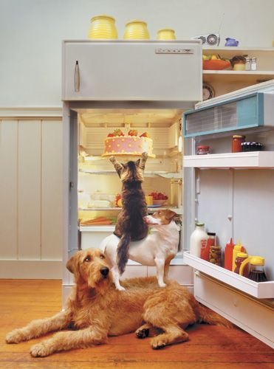
Teamwork =

Slide 30
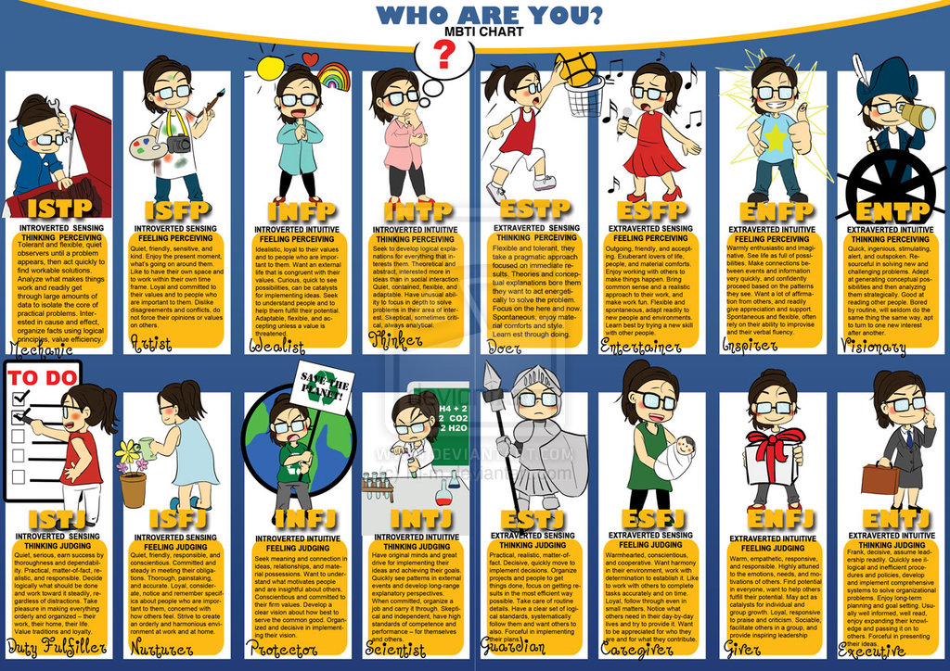
CLICK IMAGE.
Ref: (1)

