Slide 1
Definition of an Explosion
The phenomenon of an explosion can be defined as the rapid decomposition of a chemical system with the evolution of heat and gas.
In the vast majority of chemical explosions, the decomposition takes the form of combustion (an exothermic oxidation reaction) which produces some form of visible manifestation such as flame and/or smoke.

Slide 2
Definition of an Explosive
An explosive is a chemical substance capable of causing an explosion.
The definition of an explosive is as simple as that, although the chemistry behind it quite complex. Ratio of fuel to oxidizer, density of loading, particle size, crystal habit, degree of confinement, critical diameter, hygroscopicity, and strength of external stimulus are just some of the many variables to consider.

Slide 3
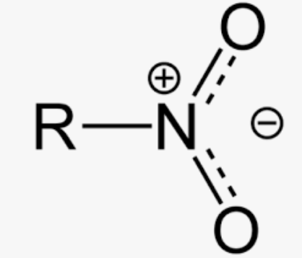
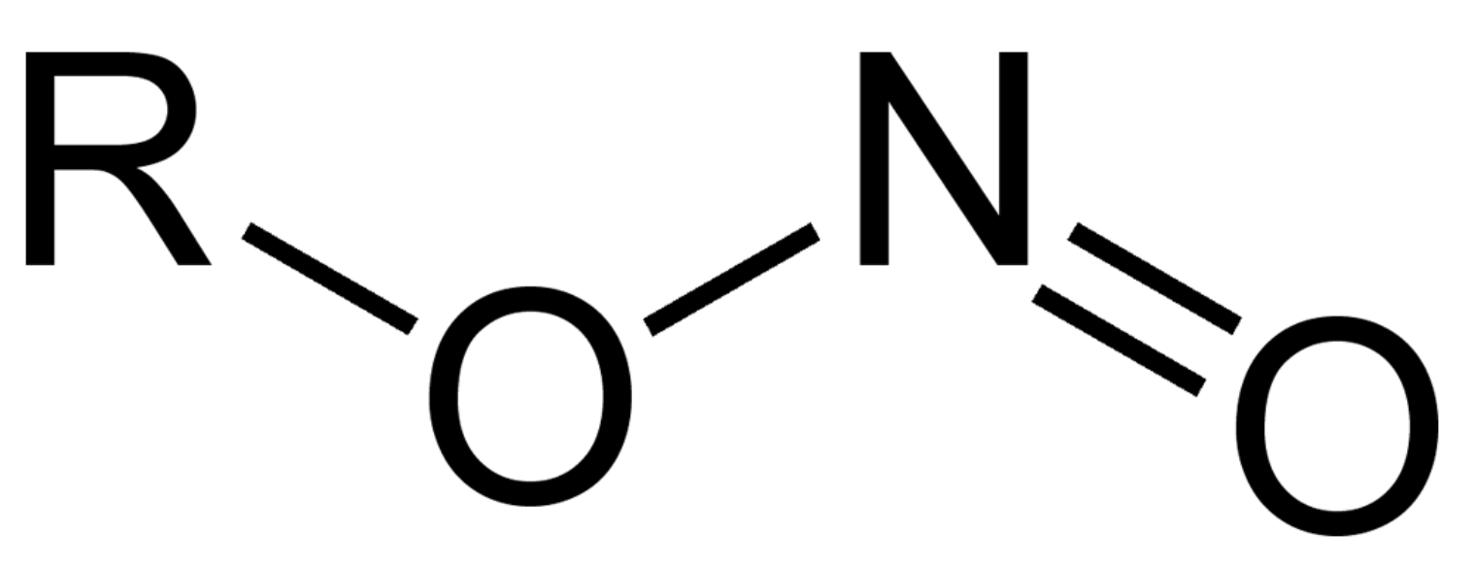
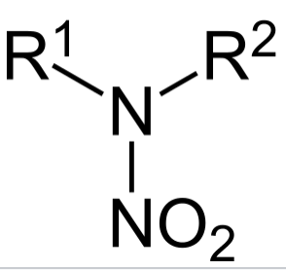
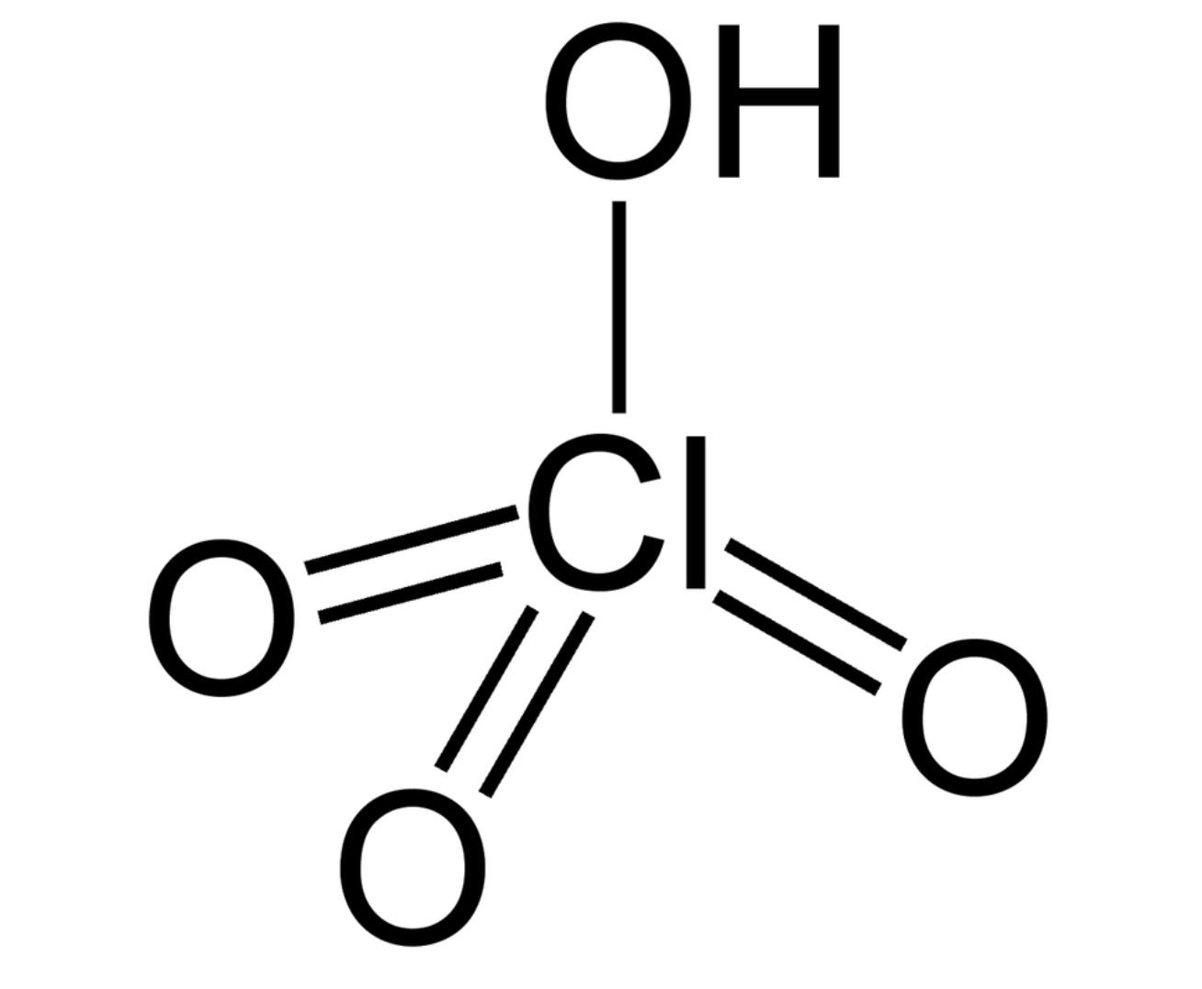
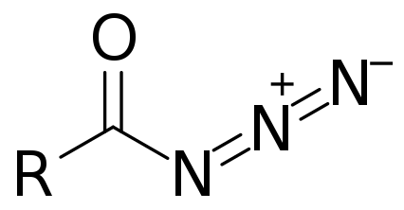

Classification of Explosives
Explosives may be classified from the viewpoint of their chemistry and use. From the chemical viewpoint we distinguish between individual substances and mixtures. The former are divided into:
• nitro compounds;
• nitrate esters;
• nitramines;
• derivatives of chloric and perchloric acids;
• azides;
• various compounds capable of producing an explosion, for example fulminates, peroxides and ozonides.

Slide 4
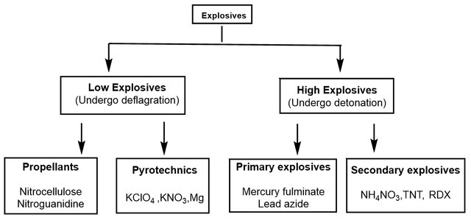
Types of Explosives

Slide 5
A further breakdown of terminology
Energetic Material
Propellants
Explosives
Pyrotechnics
Primary
Secondary
Tertiary
Gun
Rocket
Colour and Light
Smoke and Sound
Heat Compositions

Slide 6
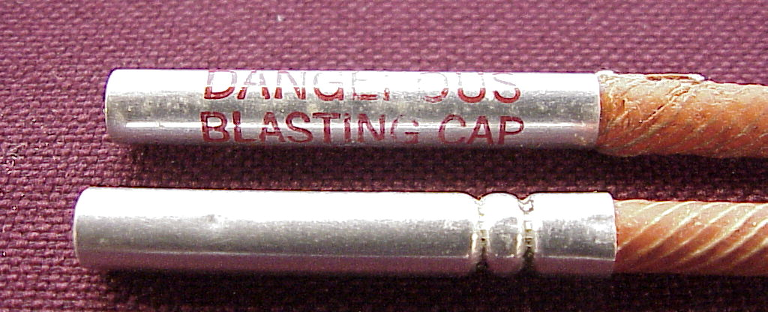
Primary Explosives
Explosives which are readily initiated by a small stimulus are known as primary explosives. They can deflagrate or detonate. Primary explosives are most often used to initiate reactions whereby their chemistry produces a shock wave (or burn rate) of sufficient magnitude to deflagrate/detonate a less sensitive explosive.
Lead azide, mercury fulminate, TATP
Notes:
Explosives which are readily initiated by a small stimulus are known as primary explosives. They can deflagrate or detonate. Primary explosives are most often used to initiate reactions whereby their chemistry produces a shock wave (or burn rate) of sufficient magnitude to deflagrate/detonate a less sensitive explosive. Ignition for the majority of primary explosives is via inter-crystalline friction, which generates hotspots to overcome activation energy. If the energy created by the hot spots exceeds the activation energy of the primary explosive then deflagration/detonation will proceed with the formation of explosive products and a release of energy. If not, the hot spots will gradually die out, with no reaction occurring. Generally speaking, primary explosives have a detonation wave analogous to secondary explosives but are much more sensitive to friction and heat. This characteristic makes them essential to the function of a detonator or blasting cap. Examples of primary explosives are lead styphnate, mercury fulminate, lead azide, DDNP, tetracene and TATP, all which have been used as detonators in HME compositions.
Primary explosives are normally prepared in the form of crystalline or powdery material with low bulk density and large specific area. This isn’t ideal for reliable use and as such a degree of compaction is required. However, higher densities are harder to ignite, or may only burn without detonation, due to a phenomenon called ‘dead pressing’. Mercury fulminate, DDNP and peroxide-based primary explosives are dead-pressed very easily, causing reliability (and safety!) issues during manufacture and performance.
Hot Spot Ignition Mechanisms for Explosives. John E. Field. Acc. Chem. Res. 15th April 1992, 25, 489 – 496.

Slide 7
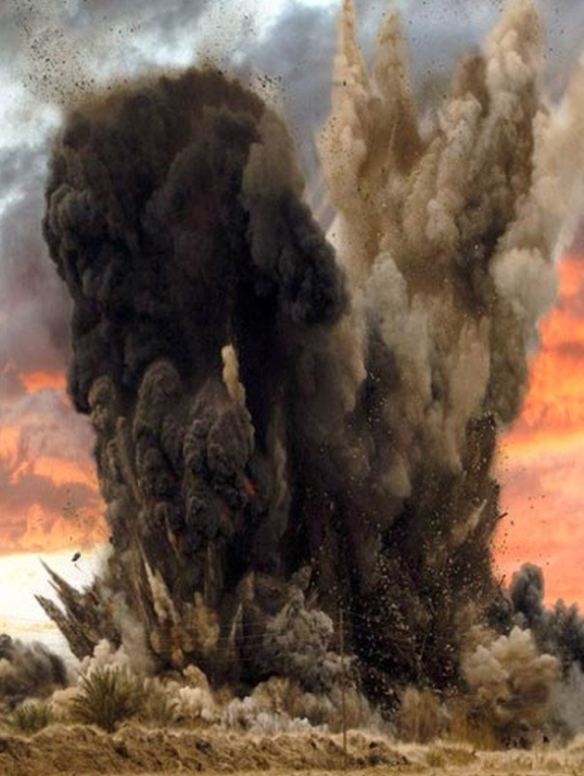
Secondary Explosives
Those explosives which require a large stimulus (that being the impingement of a shock wave to bring about detonation) are known as secondary explosives. They will generally require a primary explosive to provide that shock to detonation.
NG, TNT, RDX, HMX, TATB, PETN
Notes:
Those explosives which require a large stimulus (that being the impingement of a shock wave to bring about detonation) are known as secondary explosives. They will generally require a primary explosive to provide that shock to detonation. Ignition of secondary explosives is primarily through the adiabatic compression of small gas spaces between crystals. Secondary explosives are relatively insensitive to heat, kinetic shock, electrostatic discharge and friction, making them safe enough in routine handling, moulding and transport. Some secondary explosives, such as PETN, are slightly more sensitive and have a very high detonation velocity. Explosives such as PETN are often used as booster charges for tertiary explosives. Their stable characteristic means that on their own, secondary explosives are not able to be reliably detonated without an external explosive force. Examples of secondary explosives are nitroglycerine, HMX, RDX, TNT and tetryl.

Slide 8
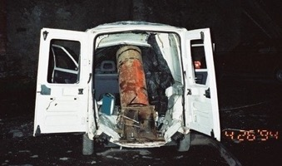
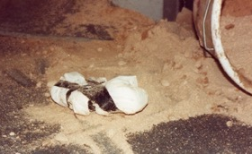
Tertiary Explosives
Tertiary explosives are very stable and require a ‘boost’ from a secondary and more powerful explosive composition to detonate.
Ammonium nitrate, NTO, guanidine nitrate, nitroguanidine and hydrogen peroxide (at 98%+ w/w) are commonly recognised tertiary explosives.

Slide 9
The distinction between burning and detonation
Burning | Detonation
All explosives burn when initiated by flame. | Most explosives are capable of detonation if sufficient stimulus is applied.
Burning is slow compared to detonation (burning rates lie between 0.001 ms⁻¹ and 500 ms⁻¹) | Detonation is much faster than burning with velocities of detonation anything between 1800 ms⁻¹ and 9000 ms⁻¹ for solid explosives.
Burning is a surface reaction where the burn rate increases with ambient pressure. | Detonation is not a surface phenomenon; it is a shockwave mechanism. Detonation proceeds radially from the point of initiation within the charge. The surface of the explosive is merely the boundary at which the wave ceases to be self-supporting. The velocity of detonation is independent of ambient pressure.
The burning rate is not normally affected by the strength of the container. | When detonation occurs within a container the velocity is affected by the strength and thickness of the container.
Damage to inert surfaces is limited to distortion or bursting. | Due to the sudden and extreme pressure created by a detonation, inert surfaces are damaged by distortion, perforation, shattering, denting and deep erosion.
The linear burning rate is independent of the size of the burning charge. There is no critical diameter so to speak. | The velocity of detonation of an explosive charge is dependent on charge diameter. If the diameter of the explosive falls is below a certain diameter at point of detonation, or below a certain critical diameter during propagation, then the detonation wave will not progress.
Burning is not (usually) initiated by an explosive shock but by direct heat or flame. Burning may convert to detonation if the velocity of the flame front exceeds the velocity of sound in the material being burned. | Detonation is initiated by shock or transition from burning. It does not usually revert to burning; if propagation fails then the charge remains chemically unchanged.
Granular explosives which are wet cannot generally be ignited. | Granular explosives can, with adequate shock, be detonated.
Burning does not create shock phenomena, but noise and air blast may occur when cumulative pressure is vented into the atmosphere. | Detonation creates a report, which is caused by the shockwave emerging from the charge into the surrounding air.
Burning can take place with temperatures between 600 and 1200 ºC, dependent upon conditions. | Detonation can realize temperatures as high 7000 ºC.
In a burning system the gases flow in the opposite direction to the burning front | The product gases of a detonation follow on behind the shock wave in the same direction as the shock wave

Slide 10
Blast Injuries to you: Categories
Primary injury
  Caused by blast wave → over pressure
Secondary injury
  Caused by flying debris → shrapnel wounds
Tertiary injury
  Caused by blast wind → forceful impact
Quaternary injury
  Caused by other vectors → heat, radiation

Slide 11
Blast Injuries: Primary
Blunt trauma from over pressure wave
  Unique to high-order explosives
  Results from the impact of the over-pressurization wave with body surfaces
  Blunt force injuries
  Produces barotrauma

Slide 12
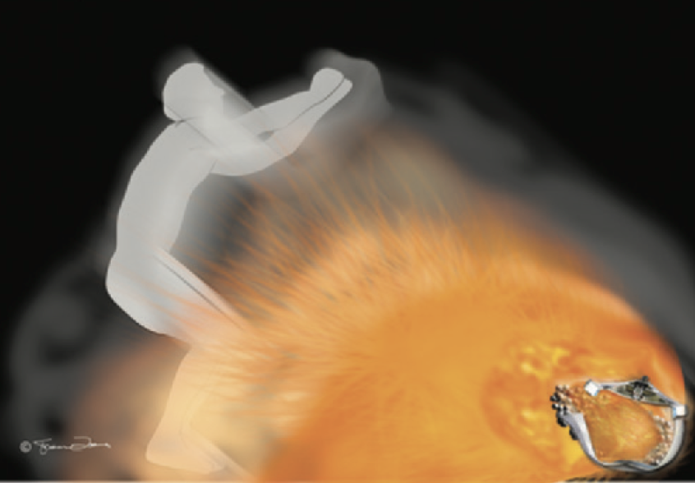
Blast Injuries: Primary

Slide 13
Blast Injuries: Primary
Most common injuries:
  Blast lung—pulmonary barotraumas
  Traumatic brain injury (TBI), concussion
  Tympanic membrane (eardrum) rupture
  Middle ear damage
  Abdominal hemorrhage
  Abdominal organ perforation

Slide 14
Blast Injuries: Secondary
The most common cause of death in a blast event is secondary blast injuries. These injuries are caused by flying debris generated by the explosion. Terrorists often add screws, nails, and other sharp objects to bombs to increase injuries.

Slide 15
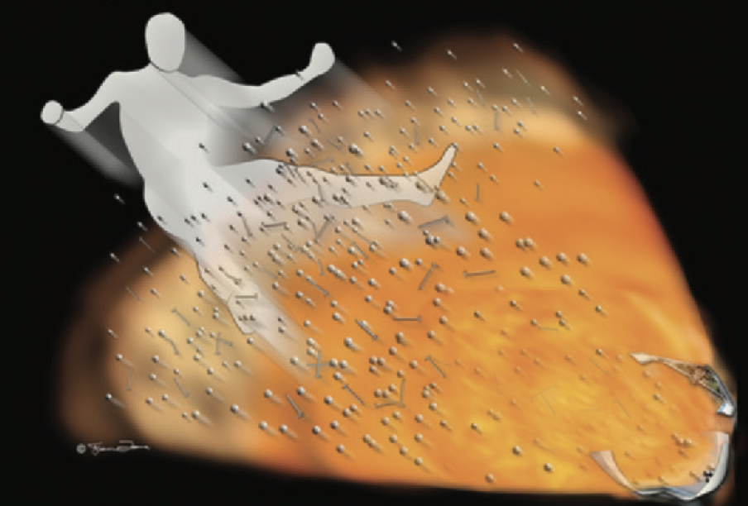
Blast Injuries - Secondary

Slide 16
Blast Injuries: Secondary
The most common types of secondary blast injuries are:
  Trauma to the head, neck, chest, abdomen, and extremities in the form of penetrating and blunt trauma
  Fractures
  Traumatic amputations
  Soft tissue injuries

Slide 17
Blast Injuries: Secondary
Penetrating trauma (shrapnel wounds)
  Foreign bodies follow unpredictable paths through body
  May have only mild external signs
  Have a low threshold for imaging studies (plain radiographs, computed tomograms)
  Consider all wounds contaminated

Slide 18
Blast Injuries: Tertiary
Tertiary injuries result from individuals being thrown by the blast wind.
The most common types of tertiary blast injuries are:
  Head injuries
  Skull fractures
  Bone fractures
Treatment for most tertiary blast injuries follows established protocols for that specific injury.

Slide 19
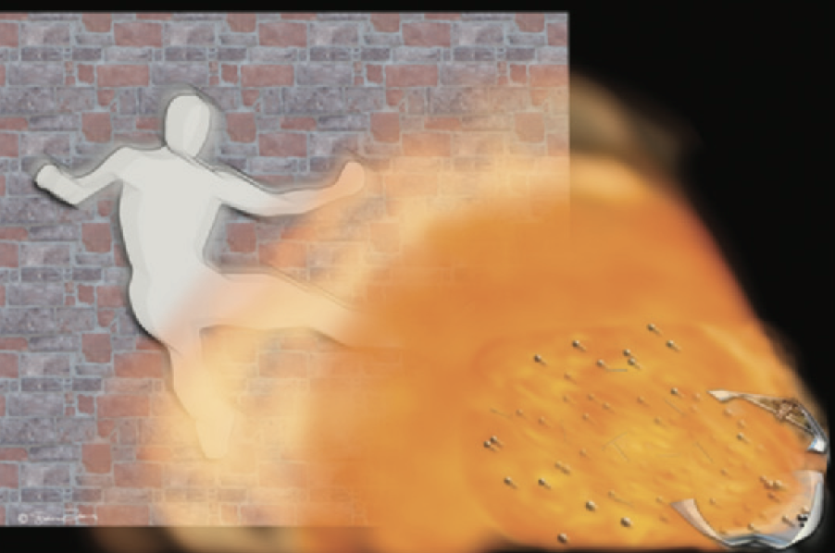
Blast Injuries - Tertiary

Slide 20
Blast Injuries: Quaternary
All explosion-related injuries, illnesses, or diseases not due to primary, secondary, or tertiary mechanisms are considered quaternary blast injuries. This includes exacerbation or complications of existing conditions.

Slide 21
Start sensitive and build from there!
Match, Paper, Wood, Coal.
You wouldn’t hold a Swan Vesta under a lump of best Welsh anthracite steam coal and hope it would light? Would you?
You’d build the fire from paper, kindling, wood and then coal.

Slide 22
Primary and Secondary Explosives
C_{(s)}, CO_{(g)}
H₂O_{(g)}, CO_{2(g)}
O_{2(g)}
EGDN
NG
TNT

Slide 23
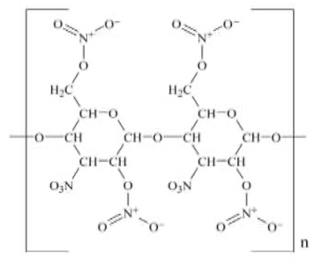
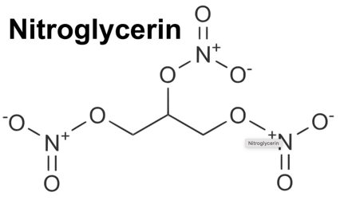
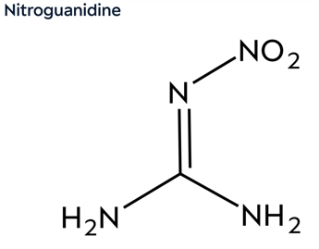
Propellants
Nitrocellulose
NC = Nitrocullulose
NG = Nitroglycerine
NQ = Nitroguanidine
Nitroglycerine
NC/NG
Double Base
NG
Force Constant
NC/NG/NQ
(Triple Base
NC
(14.14%)
Single Base
Nitroguanidine
NQ
(54.4% N)
-30
-24
0
+3.5
Oxygen Balance

Slide 24
Ignition / Detonation Train Design

Slide 25
To fully understand explosive chemistry, it is important first to define deflagrations and detonations and highlight the characteristics that distinguish these two types of combustion waves. Deflagration and detonation are differentiated from usual combustion by their power output, velocities of propagation (some mms⁻¹ for combustion, several hundred ms⁻¹ for deflagration and several thousand ms⁻¹ for detonation), and the source of oxygen that they use.
Reaction Type | Reaction rate | Power Output | Oxygen Source | Example
Combustion | Slow (mms⁻¹) | 100 Wcm⁻³ | Atmosphere | Burning Wood
Deflagration | Subsonic (+100ms⁻¹) | 100 Wcm⁻³ | Within compound | Confined black powder
Detonation | Supersonic (+330ms⁻¹) | 1000 Wcm⁻³ | Within compound | TNT

Slide 26
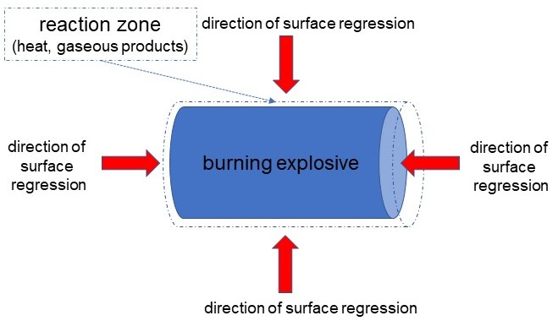
What is deflagration
Deflagration is a rapid burning where convection plays an important role (the transfer of heat between areas of different temperature). The term is often used to describe the burning of an explosive which has failed to detonate.
Notes:
The propagation of an explosion reaction through a deflagrating explosive is based on thermal reactions. A deflagrating explosive will ignite when subjected to an external stimulus such as flame, spark, shock, friction or high temperatures. Burning begins on or just above its surface, essentially receding layer by layer as one would imagine when sucking a hard boiled sweet. The rate at which the surface of the explosive burns is known as the linear burning rate, which is governed by Equation 1, where r is the linear burning rate coefficient in mms⁻¹, P is the pressure at the surface of the explosive at a given instant in Nmm⁻², β is the burning rate coefficient and α is the burning rate index.
$$r= βP^{∝}$$
Equation 1: Linear Burning Rate
In a deflagration reaction, the temperature of each layer of the explosive is brought to the ignition point as it recedes, with heat being radiated and conducted from the reaction zone into the solid material. The rate at which the surface recedes depends on the rate of heat transfer into the explosive, which itself is dependent upon the pressure at the surface of the composition as Equation 1 demonstrates. As such, the rate of surface regression can increase hugely if the explosive is confined (completely enclosed), since the gaseous products of combustion cannot escape - pressure increases; the reaction zone is narrowed; heat flow into the explosive increases; the explosive burns faster. Within a few milliseconds the process become self-propagating. To represent this in numbers, the linear burn rate of pine wood at atmospheric pressure is in the order of 0.02 mms⁻¹. Similarly, the linear burn rate of an unconfined gun propellant under the same conditions is typically 5 mms⁻¹. However, if this same propellant is then confined in the breech mechanism of an artillery piece then the linear burn rate can increase to 400 mms⁻¹.
Ultimately, the rate of deflagration in explosives can reach a situation where the rate of burning approaches and exceeds the velocity of sound for that material under the current conditions. If the rate of deflagration reaches values in excess of 1000 – 1800 ms⁻¹ then the reaction is classed as a ‘low order’ detonation.

Slide 27
What is detonation
A detonation is defined as an extremely fast explosive decomposition, in which an exothermic reaction wave maintains a shock front in the explosive material.
Notes:
The velocity of that shock front can be in the region of 1800 – 9000 ms⁻¹, dependent upon the explosive. Unlike a deflagration, the rate at which the material decomposes is NOT governed by the rate of heat transfer but by the velocity at which the explosive material will propagate the shockwave. Detonation can take place via two specific mechanisms:
Burning to detonation;
Shock to detonation.
The rapid and violent form of combustion called detonation differs from other forms in that all the important energy transfer is by mass flow in strong compression waves, with negligible contributions from other processes (such as heat conduction) which are so important in flames. The leading part of a detonation front is a strong shock wave propagating into the explosive. This shock heats the material by com­pressing it, thus triggering chemical reactions, and a balance is attained such that the chemical reaction supports the shock wave propagation. In this process material is consumed much faster than in a flame, making detonation easily distinguishable from other combustion processes. The very rapid energy conversion in explosives is the property that makes them useful. The most easily measured characteristic property of a detonation is the velocity at which the front propagates into the explosive. The front of a detonation wave initiated at one end of a large-diameter stick of explosive is found to approach a nearly plane shape and a constant velocity of propagation. Thus, it seems reasonable to assume that a limiting velocity exists, and within that limit a chemical reaction takes place which produces a steady propagating zone in the explosive.

Slide 28

Transition to detonation
Explosive in advance of the combustion zone can become compressed by thermal expansion. A pressure wave propagates through the unburned material.
This wave can increase in intensity until it is capable of initiating the explosive in advance of the combustion front. It may be travelling at the speed of sound in the material.
Reaction
zone
Shock
zone
Unreacted explosive
The material is now detonating.
Detonation Wave Video

Slide 29
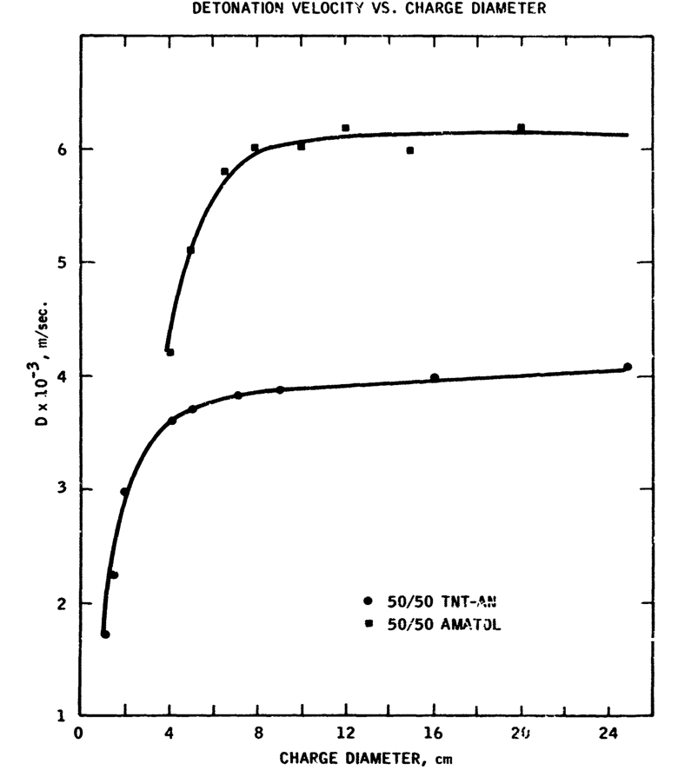
Charge Diameter and DDT

Slide 30
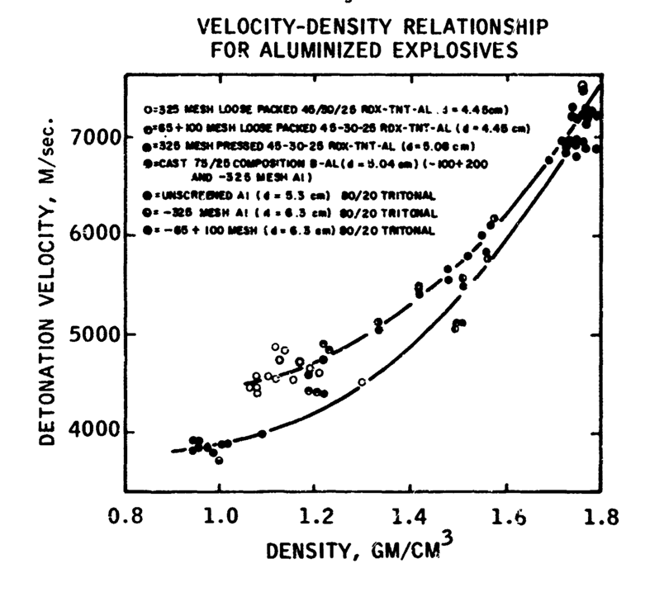
Density and DDT
80/20 TRITONAL

Slide 31
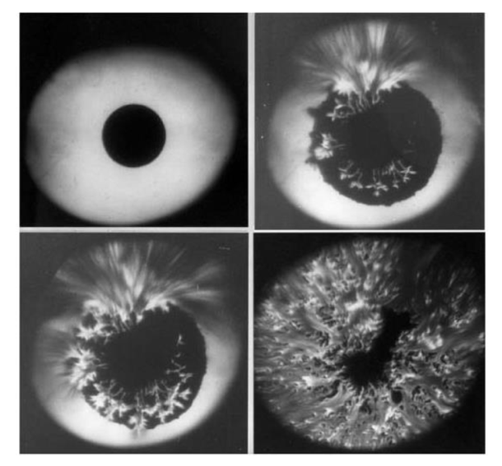
How Does Detonation Occur?
Hot-Spot Formation
  Where energy is concentrated in excess of the ignition temperature/threshold – linking/quenching.
  Cracks, voids, impurities etc as small as 0.1-10𝜇m
  Time duration - 10𝜇s to 1ms
  1. Bubble collapse
  2. Friction
  3. Shear band formation
  4. Crystal fracture
  5. Visco-plastic work
  6. Electrical discharge
Notes:
Those hot-spots which are in proximity to one another link together possibly as a result of pressure pulses travelling between the hot-spots as a result of the production of product gases. Hot-spots which are more widely spaced tend to be quenched.

Slide 32
Primary Explosive – Hot Spots
Ignition for the majority* of primary explosives is via inter-crystalline friction or adiabatic heating, which generate hotspots to overcome activation energy. [*ESD/flame/direct heating]
If the energy created by the hot spots exceeds the activation energy of the primary explosive then deflagration/detonation will proceed with the formation of explosive products and a release of energy.
If not, the hot spots will gradually die out, with no reaction occurring.

Slide 33
Secondary Explosive – Hot Spots
Ignition for the majority of secondary explosives is through the adiabatic compression of small gas spaces between crystals.
If the heat energy created by the hot spots exceeds the ignition temperature of the explosive, then deflagration/detonation will proceed with the formation of explosive products and a release of energy.
If heat can dissipate then the hot spot gradually dies out, with no reaction occurring.

Slide 34
Burning to Detonation
Self-propagating deflagrations are intrinsically unstable and tend to accelerate continuously. Under appropriate conditions, a deflagration will accelerate to a high supersonic velocity and then undergo an abrupt transition to a detonation wave.
Burning to detonation occurs when the pressure at the burning surface accelerates the flame front beyond the velocity of sound of the explosive material under its current conditions. This would be akin to an aircraft exceeding the speed of sound in air, the point at which the sonic boom is heard.
So, we progress from a deflagration to a detonation, suggesting that there will be a delay to the onset. The delay to onset of detonation is dependent upon the nature of the explosive, charge density and conditions of confinement.

Slide 35
Shock to detonation
In a shock to detonation (or direct initiation) there is no requirement to precede with a flame front through a burning process. Instead, a high velocity shock wave generated by the ignition source is responsible for the detonation formation process.
Notes:
In a shock to detonation (or direct initiation) there is no requirement to precede with a flame front through a burning process. Instead, a high velocity shock wave generated by the ignition source is responsible for the detonation formation process. As the shock wave travels into the explosive, particle compression and adiabatic heating occurs at the shock front. Adiabatic heating and compression liberate energy as the explosive decomposes, thereby accelerating the shock wave further. At some point (or not) the velocity of the shock wave will exceed the velocity of sound in the explosive material and detonation will occur. Obviously, the shock wave will be required to travel a distance along the explosive (mm or cm even) before it becomes self-propagating, but unlike a burn to detonation, the delay is in microseconds. If the conditions are not met, again for which there are many variables such as initial shock velocity, charge diameter and loading density, a detonation may not occur, leaving the explosive chemically unchanged. So, in terms of OME there can be many occurrences where explosive charges:
high order (where the conditions to sustain the velocity of the required shock wave are met);
low order (where the explosive is consumed but the shock front is unable to achieve its peak velocity leading to a less violent explosion);
partial (where the shock wave is only able to sustain the appropriate detonation velocity through part of the explosive, leaving part of it chemically unchanged and still visible at the explosion site).

Slide 36
Deflagration to Detonation Transition
If the explosive is sufficiently energetic, and if the heat of combustion is not lost to the environment, the rate of propagation may accelerate, and the pressure wave in advance of the combustion zone may increase in intensity.
In some cases, the pressure may rise sufficiently to cause reaction in advance of the thermal stimulus, and acceleration of the rate occurs.
If the propagation rate increases to the speed of sound in the material, the process is now a detonation – the fastest process that can be achieved in that system.
DDT – deflagration to detonation transition.

Slide 37
What is a primary explosive?
Explosives which are readily initiated by a small stimulus are known as primary explosives. They can deflagrate or detonate. Primary explosives are most often used to initiate reactions whereby their chemistry produces a shock wave (or burn rate) of sufficient magnitude to deflagrate/detonate a less sensitive explosive.
Primary explosives are normally prepared in the form of crystalline or powdery material with low bulk density and large specific area. This isn’t ideal for reliable use and as such a degree of compaction is required. However, higher densities are harder to ignite, or may only burn without detonation, due to a phenomenon called ‘dead pressing’. Mercury fulminate, DDNP and peroxide-based primary explosives are dead-pressed very easily, causing reliability (and safety!) issues during manufacture and performance.
Figure of Insensitiveness – The Rotter Impact Test (pg 63 JA).

Slide 38
Primary Explosives

Slide 39
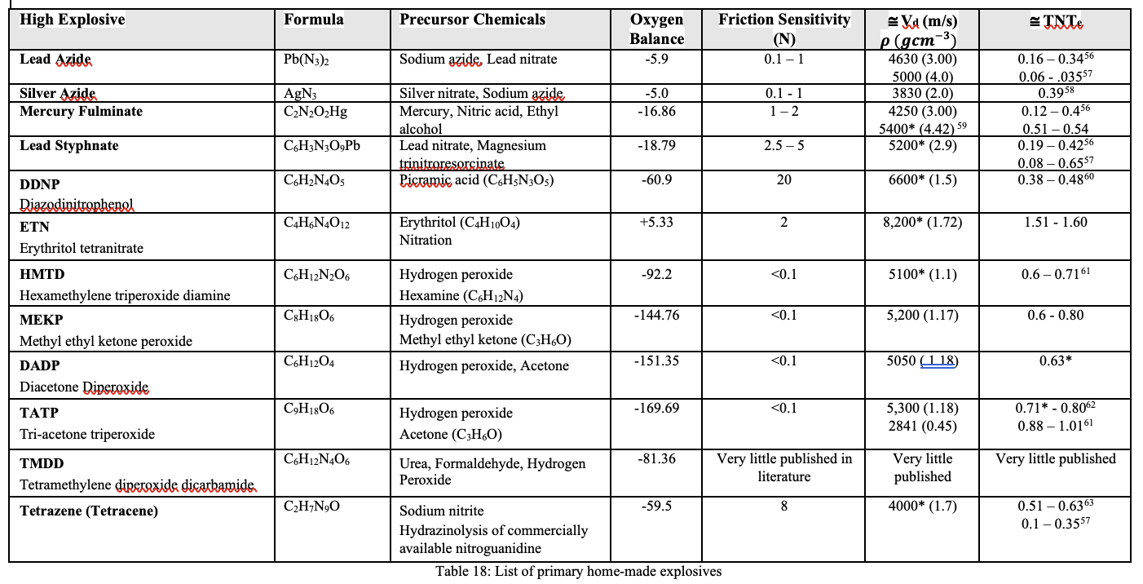
A list of primary explosives

Slide 40
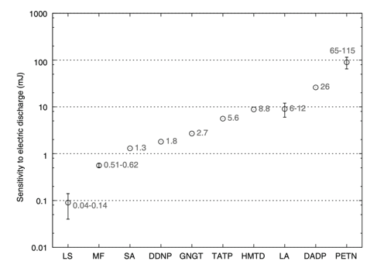
Electrostatic Sensitivity of Primary Explosives

Slide 41
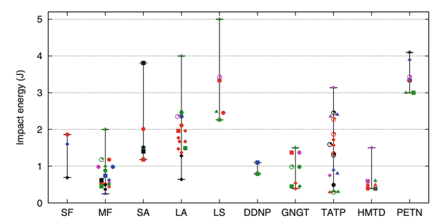
Impact Sensitivity
Diazo-Di-Nitro-Phenol

Slide 42
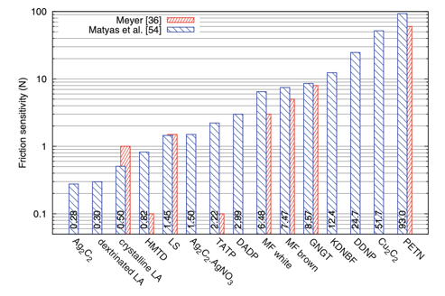
Friction Sensitivity of Primary Explosives

Slide 43
Secondary Explosive
Less sensitive than primary explosive (FOI >50)
On functioning, the energy of the explosive –
  Disrupts the warhead’s case
  Affects the environment in a manner governed by the environment and by the position of the munition.
If the requirement is for fragmentation, then the material and the geometry of the case are selected to give the required fragment characteristics.
If the requirement is for blast, then the case may be made light to require less energy for disruption.

Slide 44
Factors Affecting Detonation (1)
So what factors affect the efficiency of detonation?
Initiating stimulus
  Generally for secondary explosives an impinging shock wave from initiation train
  Must be strong enough to decompose explosive
Confinement
  A detonation wave is curved and suffers from lateral energy losses
  Confinement can reduce these losses by maintaining energy behind the wave
Energy
Energy
Un-confined
Energy losses balance energy generation
Detonation failure
Confined
Detonation wave progresses without energy losses

Slide 45
Factors Affecting Detonation (2)
Density
  Increased density gives improved energy concentration available to support shock wave
  The higher the density (absolute and %TMD) The faster the V of D and the higher the detonation pressure

Slide 46
Factors Affecting Detonation (3)
Charge diameter (cylindrical geometry)
  The V of D will increase as the diameter of the explosive charge increases up to a limiting value as edge effects are minimised
  The detonation wave is convex
    The larger the charge the flatter the angle of curvature
  The V of D diminishes from the axis of the charge to its surface due to
    Energy losses from the system
    More pronounced the smaller the charge
  If the diameter is reduced
    A point will be reached where surface effects create instability
    The detonation wave fails
  This is known as the critical diameter and is a characteristic of an explosive

Slide 47

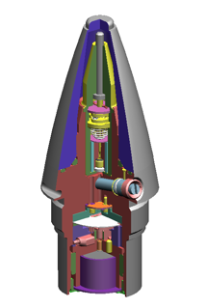
So, what’s this all about? A Typical Shell
Cap:- Ingniferous input,
percussion or electric,
Lead styphnate based
Additives :-
Graphite in the electric cap.
Lead Oxide
Calcium silicide
Barium Nitrate
Tetrazine in the percussion cap
Booster pellet:-
Formerly CE (tetryl)
Now RX 3601 or similar
RDX/TNT/Wax filling
LDNR Stab sensitive
Detonator
Booster
Gunpowder G20 in
the primer body. Vents
Through holes and lights
Propellant.
Boron based delay.
Switch in / out
First Fire layer (or layers)
Usefully fine gunpowder
Either pressed onto the cap or
in magazine in the primer
or both.
Granular propellant:-
double base, 7 hole granule.
With de-coppering agent
In line / out of line
Stemming and
detonator
LDNR = Lead dinitro resorcinate

Slide 48
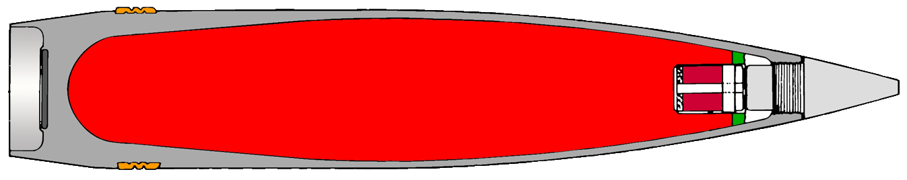
HE Munition
Main Filling
RDX/TNT/wax
melt/cast
Booster
RDX/wax
pressed
Detonator
lead azide
155mm L15
43 kg, 11.4 kg HE

Slide 49
Explosive Munitions
The required effects include :
Blast – generation of large quantity of hot gas which expands rapidly (initially supersonically) in air to produce a shock wave with shattering effect, and high speed gas flow to move objects.
Fragmentation – rapid expansion of a metallic casing with consequent fracturing and production of high velocity fragments.
Rapid acceleration of a fragment in a specific direction (directed energy) – Shaped Charge, EFP, HESH
Kinetic Energy (sub-hydrodynamic, hydrodynamic) – Long Rod

Slide 50
Outline Structure of Munition
Examples :
lead azide
RDX/wax
RDX/TNT
lead styphnate
tetryl
RDX/TNT/aluminium
RDX/polyurethane

Slide 51
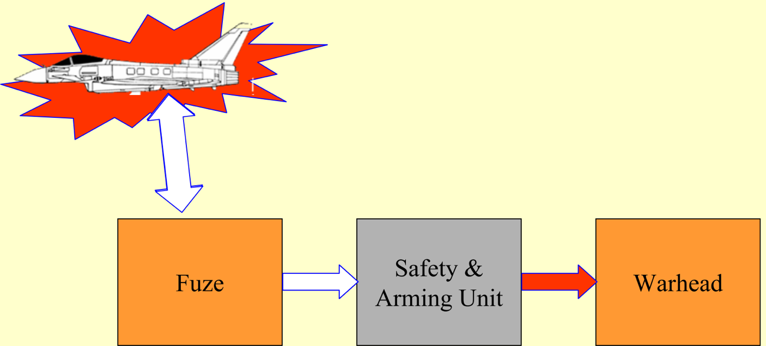
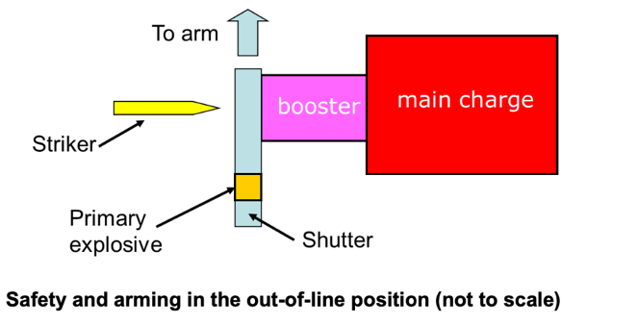

Slide 52
Explosive Munitions
The required effects include :
Blast – generation of large quantity of hot gas which expands rapidly (initially supersonically) in air to produce a shock wave with shattering effect, and high speed gas to move objects.
Fragmentation – rapid expansion of a metallic casing with consequent fracturing and production of high velocity fragments
Shaped Charge (SC) and Explosively Formed Projectile (EFP) – production of a high velocity jet of metal which penetrated deeply into the target, and formation of a high velocity fragment in a specified direction.

Slide 53
Target Defeat Mechanisms - Summary
ANTI-PERSONNEL
ANTI-STRUCTURE
ANTI-ARMOUR
Blast - HE
Blast - External
HESH
KE - shell fragment
Blast - Internal
Shaped Charge - HEAT
KE - bullet
Tandem Warhead
KE - APFSDS

Slide 54
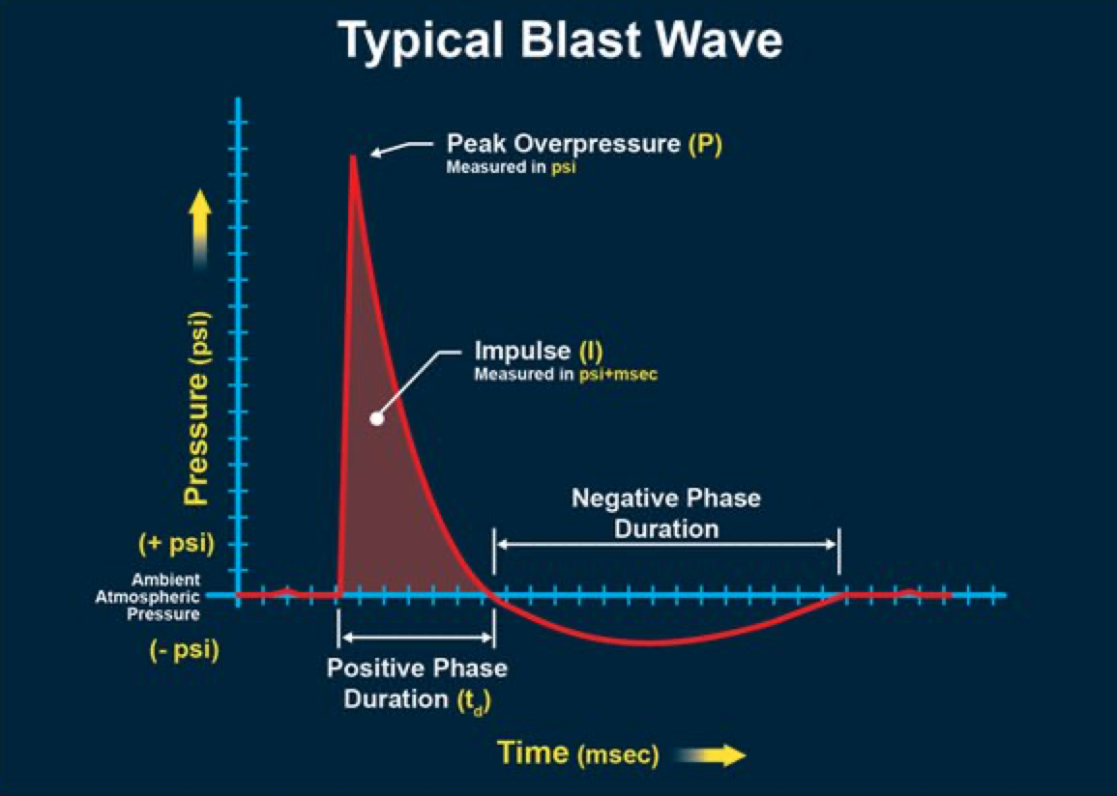



$$μs$$
The nature and formation of blast waves
m$s$
m$s$ – several s
Notes:
The two main parameters of the blast wave are the peak overpressure at a given distance (Pmax) and the impulse. The latter involves both the overpressure and the time during which it exists at a given distance. This time depends on the profile and velocity of the wave.

Slide 55
Effects from Underwater Explosion
gas bubble
plumes
air blast
wave
surface wave
surface
oscillating
and
migrating
gas bubble
shock
front
bubble pulse
HE charge
bottom
reflected
shock wave
bottom

Slide 57
Propellant Thermodynamics
There are 3 key aspects to propellant thermodynamics:
Specific Energy (F)
Calorimetric Value (Q) and Flame Temperature (T_{o})
Oxygen Balance (Ω)

Slide 58
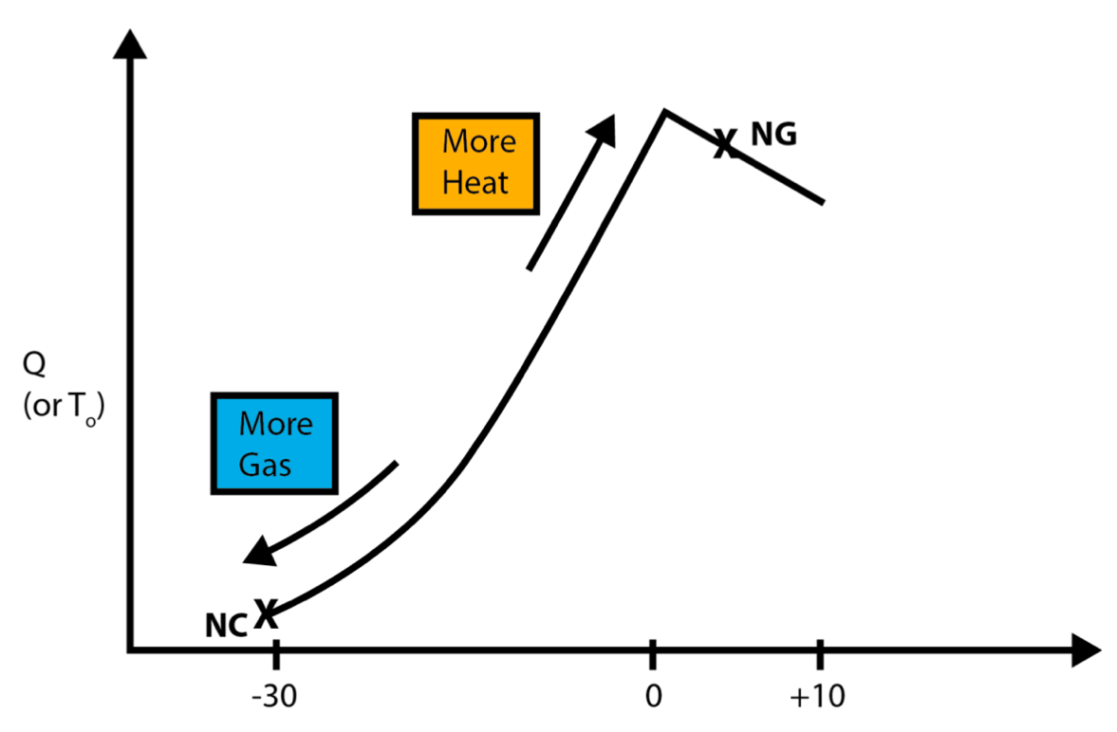
O₂
Energetic compounds in gun propellants
CO₂ H₂O
Oxygen Balance Ω
Notes:
All the major ingredients of propellants are essentially organic in nature, and are composed of carbon, hydrogen, nitrogen and oxygen. Thus, the atomic composition of the propellant can, like that of its constituents, be represented by the general formula CaHbNcOd. This implies that 'd’ moles of oxygen atoms are available to oxidise the fuel elements present, namely 'a' moles of carbon atoms and ‘b’ moles of hydrogen atoms, more or less completely to oxides of carbon and to water respectively. The dominant term in the thermochemistry Equation is Hf (products). In fact, if small quantities of methane, ammonia, nitrogen dioxide etc. are ignored, this term comprises:
pHf (CO) + qHf (CO2) + rHf (H2) + sHf (H2O) (liq) + tHf (N2) where p, q, r, s and t are the numbers of moles of CO, CO2, H2, H2O and N2 that
make up the composition of the products. The ratios p:q and r:s vary with propellant composition and are chiefly dependent on the oxygen balance. If the oxygen balance is high, these ratios will be smaller, and vice versa. The heats of formation of CO2 and H2O are considerably higher than those of CO and H2 respectively. Hence a high oxygen content increases the value of Q

Slide 64
Propellant Additives

Slide 65
Stabilisers
Nitrocellulose and nitro-glycerine are nitrate esters and decompose slowly at normal temperatures to form oxides of nitrogen, mainly nitrogen dioxide (NO2). If these oxides are not chemically removed from the system as they are formed, they catalyse further decomposition, eventually leading to auto ignition and shortening the storage life of the propellant. The desirable properties of such a stabiliser are as follows:
Capacity to absorb oxides of nitrogen;
Ability to neutralise acids;
Ability to dissolve in the propellant matrix; and
Inertness to NC or NG before and after reaction with the decomposition products
Notes:
NC in all types of conventional gun propellant undergoes slow degradation at normal propellant storage temperatures as a result of the loss of nitrate ester groups. Such reactions lead ultimately to stabiliser depletion (see below) and hence to autocatalytic decomposition and potential auto ignition of the propellant. The onset of autocatalysis therefore defines the "chemical safe life" of the propellant but before this is reached the NC will have degraded to a point where both the ballistic and the mechanical performance of the propellant are severely compromised. The shelf life is therefore more usually determined not by stabiliser depletion but by the deterioration of physico-mechanical properties or ballistic performance which can render the propellant unsafe to handle or unreliable in use. "Physico-mechanical life" is strongly influenced by the degradation of NC, the reduction in its average molecular weight causing increased grain brittleness. The "ballistic life" of a propellant is also affected by the reduction in NC molecular weight with age but other factors such as surface moderant migration and changes in volatile content are often more important in this case.
The one additive common to all conventional gun propellants is the stabiliser. NC and NG are nitrate esters and decompose slowly at normal temperatures to form oxides of nitrogen, mainly nitrogen dioxide, NO2. If these oxides are not chemically removed from the system as they are formed they catalyse further decomposition, eventually leading to the shortening of storage life of the propellant and in extremis to auto ignition.

Slide 66
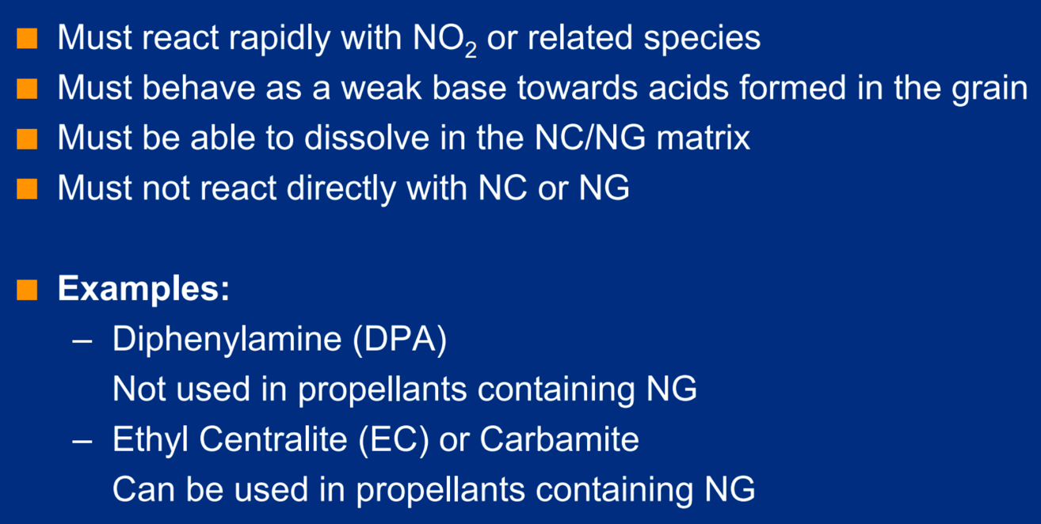
Requirements of a Stabiliser

Slide 68
Notes:
A coolant, in this connection is a substance that absorbs heat when it decomposes during combustion. The original stabiliser, mineral jelly, doubled in this role and so does carbamite. Dinitrotoluene represents 10% by mass of the artillery propellants NH and FNH and this accounts for the conveniently low flame temperatures of these compositions. Dinitrotoluene also imparts a moisture-repellent quality to propellants. The liquid plasticisers such as dibutyl phthalate, diethyl phthalate and glycerol triacetate double as coolants and are sometimes referred to as coolant-plasticisers.

Slide 69
De-coppering Agents
In a large gun the driving band of the shell becomes partially molten during its passage along the bore and leaves a deposit of copper there. If this deposit is allowed to accumulate it eventually affects the ballistic performance of the gun. To counter this a de-coppering agent is used with the propellant. This can be done in one of two ways. Firstly, the propellant composition can contain compounds of lead or tin, or secondly a piece of lead or tin foil can be juxtaposed to the propellant in the cartridge. In either case the metallic element combines with the copper deposit and forms a brittle alloy, which is removed by friction when the next projectile is fired.

Slide 70
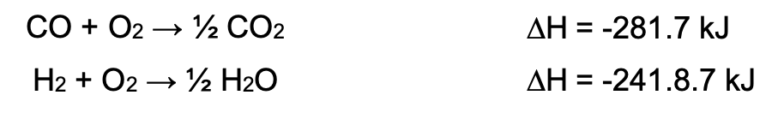
Flash Inhibitors
The flash from a gun can be regarded as comprising two portions:
Muzzle glow - red in colour and probably due to incandescent particles in the hot gases from the propellant.
Secondary flash - a much larger flame, usually of considerable light intensity, occurring for some distance in front of the muzzle. This is due to the burning of the gases hydrogen and carbon monoxide after admixture with oxygen from the air.
Flash can be reduced by addition of metallic salts, especially by those of potassium, such as potassium sulphate or nitrate, and potassium cryolite. Sodium cryolite can also be used. However………..
Notes:
The predominant mechanism of the reaction is probably the breaking of one of the chain reactions that occur in the oxidation of hydrogen, by radical removal processes. This theory is supported by the fact that potassium hydroxide, which is formed from the original potassium salt additive under the influence of the high in bore temperature, has been found to be a more effective flash-inhibiting additive than any potassium salt. Another mechanism for the reduction of muzzle flash by potassium salts is the inhibition of the water-gas shift reaction (CO + H2O ↔ CO2 + H2) that normally occurs as the propellant gases cool producing flammable hydrogen. However, the addition of such salts may increase the amount of smoke. Another method is to decrease the calorimetric value of the propellant by the addition of coolants such as dinitrotoluene. Experiments have shown that the gases from the ‘cooler’ propellants contain more methane than those from the ‘hotter’ propellants, and methane is less easily flammable than hydrogen. This may explain why the comparatively ‘cool’ single-base propellants (NH and FNH) give relatively little flash although the calculated compositions of their muzzle gases show a greater proportion of CO + H2 than for the ‘hotter’ double-base propellants.

Slide 71
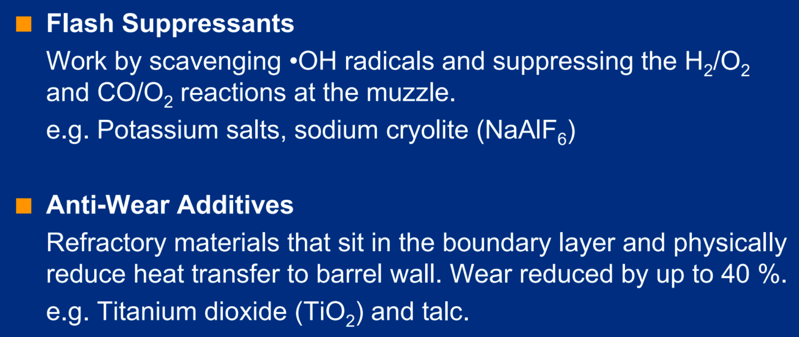
Flash Inhibitors and Anti-Wear Additives

Slide 72
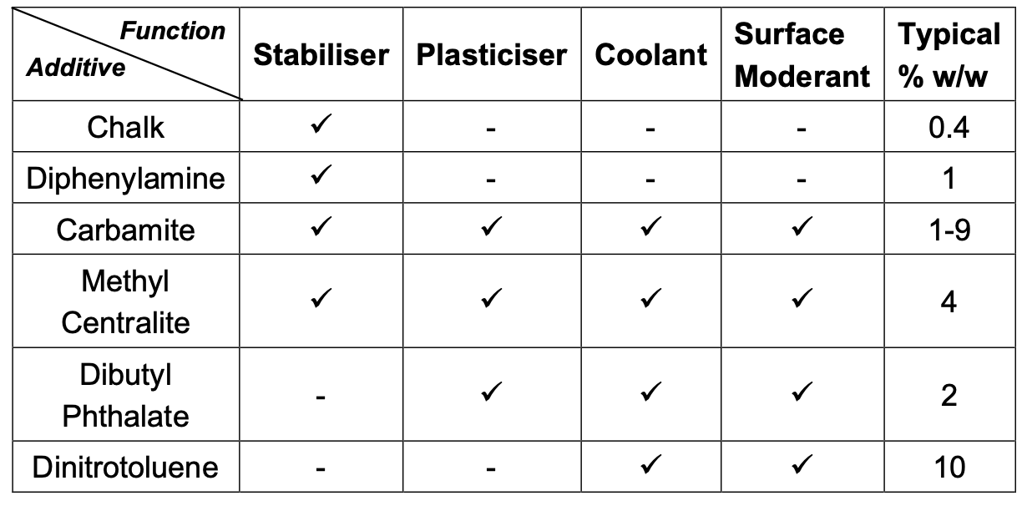
Possible functions of gun propellant additives

Slide 73
Summary – Gun Propellants
Propellant | Constituent | Q (Jg⁻¹) | Flame Temperature (T_{o}) K | Force Constant (Jg-¹)
Single Base | NC | 3100 - 3700 | 2500 - 3000 | 920 - 1075
Double Base | NC+NG | 4300 - 5200 | 2600 - 3600 | 1075 - 1175
Triple Base | NC+NG+NQ | 3200 - 3700 | 2400 - 3300 | 1000 - 1100
Multi-Base, High Energy or Nitramine | NC+NG+NQ+RDX (NTO etc) |  | 2900 - 3200 | 1100 - 1250
LOVA | HMX/RDX+Binder+ Plasticiser | 3410 | 2853 | 1100 - 1300
HAN | HAN, Nitrate salt of amine, water |  | 2730 | 970 - 1000

