Slide 1

How do we use technology to collaborate at UWTSD?
Mirabela Mutcu
Digital Skills & Research Methods

Slide 2
Introduction
This presentation will focus on planning a research which to answer the following question:
“Which digital tool is most commonly used for collaboration at UWTSD”
Therefore, there will be a set of primary research carried out using questionnaires and then the results will be compared with other data accumulated from secondary research

Slide 3

What are the digital tools used in collaboration?
In the current era the digitality is one of the main source that is used by people to communicate when at distance.
According to statistics, for academic purposes the most commonly used source for collaboration are google classrooms and Microsoft teams. However, for written messages only, the most common one is Outlook Emails (Hosey, 2020).

Slide 4
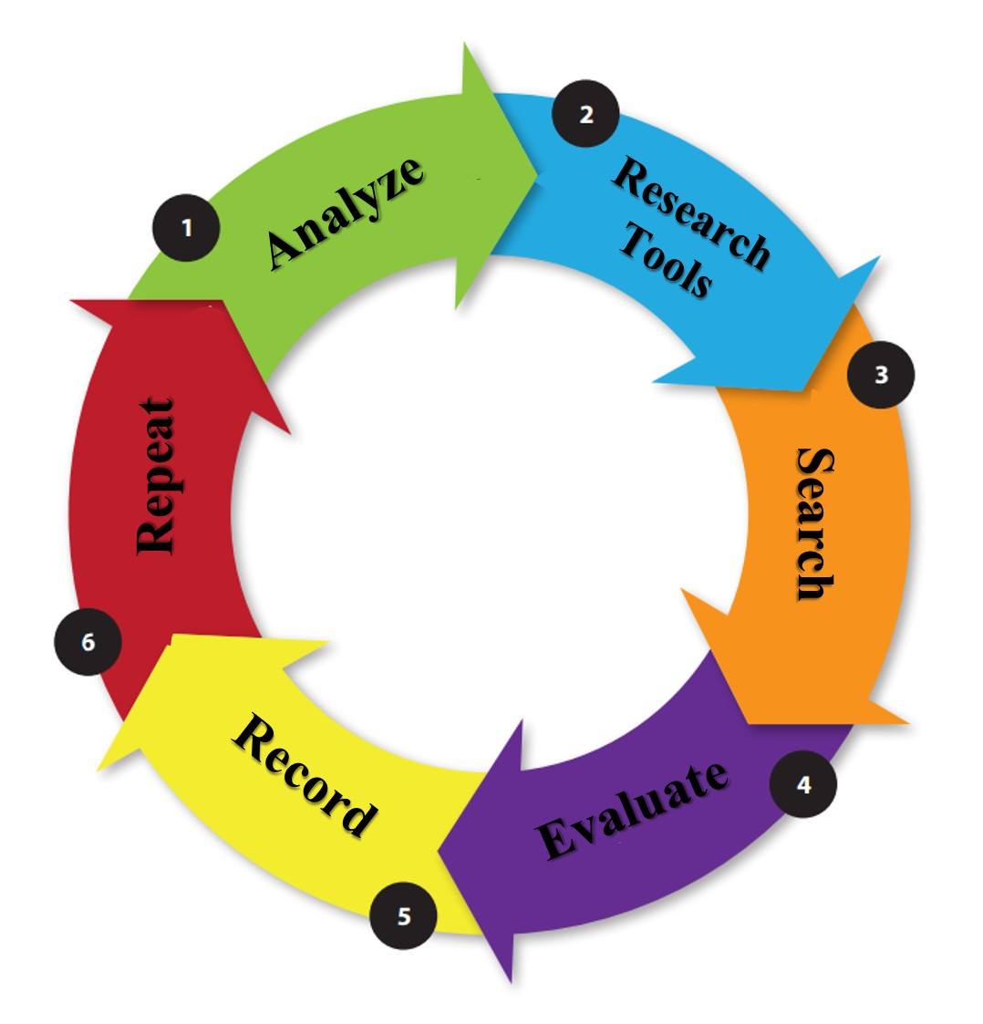
Research Process
As it has been mentioned in the introduction the research will be carried out using questionnaires. The questionnaire will include a set of fivequestions which to be addressed to the colleagues from my class.
The six questions include:
  What tool are you usually using to collaborate with your lecturer?
  What tool are you using to collaborate with your colleagues?
  Do you prefer in-person collaboration or using digitality?
  Which tool that you have used for academic collaboration you consider as most effective?
  Which tool that you have used in the past you consider as being least effective? Why?

Slide 5

The Hypothesis
Personally, the hypothesis of this research is the following
“The effectiveness of a digital tool is increasing the performance and motivation of students in learning”.

Slide 6

Secondary research
Throughout the secondary research other sources from the internet are going to be used to investigate what types of digital tools are used in other areas most commonly and compare different preferences.
To accumulate this information, different research papers that have been already carried out by other authors will be investigated.

Slide 7

Conclusion
Overall, the research is going to be very much based on complex information regarding what digital tools are used, why, and what their importance is in the learning of students.
By following the plan mentioned, a lot of information which to be processes is going to be accumulated.

Slide 8
Reference list
Beiske, B. (2007), Research Methods: Uses and Limitations of Questionnaires. 1st Edition. GRIN Verlag.
Hosey, M. (2020) Tools for digital communication with Students and Families. (online) available on: https://www.teachbetter.com/blog/tools-for-digital-communication-with-students-and-families/ last accessed on: 13th April 2022

