Slide 1

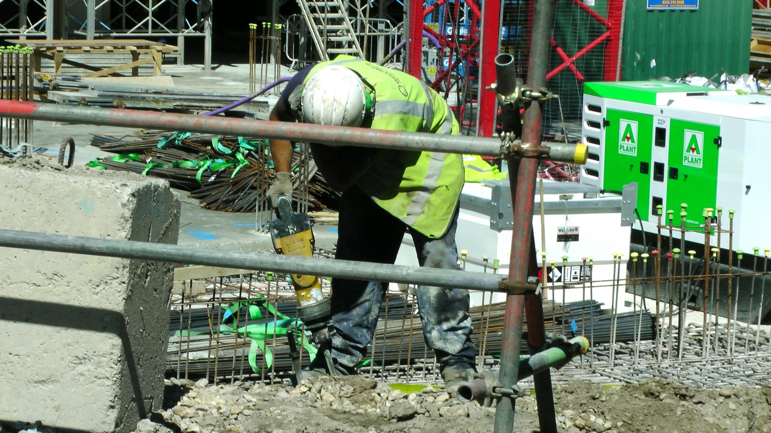
Unlocking the Potential of Careers in the Construction Industry
Ramatoulie Baldeh 2022866 {2022866’student.uwtsd.ac.uk}
Introduction:
Welcome to the dynamic and diverse realm of the construction and built environment sector, where dreams take shape and vision becomes reality! As a trainee project manager with a local housing developer, I've been entrusted with an exciting mission: to craft a comprehensive and engaging poster for school-aged students, igniting their curiosity about careers within the construction industry. Our goal is to provide these young minds with a gateway to envision themselves as future leaders in roles such as Quantity Surveyors, Project Managers, Architects, or Civil Engineers.
Architects:
•Architects are the artists of construction, painting the canvas of space with creative designs and functionality.
•They take the dreams and desires of clients and transform them into tangible blueprints, seamlessly blending aesthetics, and utility.
•Architects give life to the vision, ensuring that every structure they create stands as a testament to their creative genius.
Understanding Construction Project Management.
Imagine the construction industry as a grand tapestry, with each thread woven by experts in their respective fields, coming together to create marvels of design and functionality. The foundation of every successful construction project rests on the principles of project management. In the form of mind map, we'll delve into the intricate web of responsibilities and collaborative efforts that bring these ambitious projects to fruition.
Civil Engineers:
•Civil Engineers are the guardians of structural integrity and technical excellence.
•They hold the keys to technical expertise and safety standards, assuring that each project is built with precision and adheres to stringent safety codes.
•Their role is pivotal in translating architectural visions into safe, sturdy, and functional structure.
Building a Comprehensive Gantt Chart
Imagine a construction project as an intricate puzzle, where each piece must align perfectly to reveal the full picture. A Gantt chart serves as the blueprint for this puzzle, providing a visual roadmap that guides the construction journey. Let's dive deeper into each stage:
Project Managers (PMs):
•As the masterminds behind the operation, Project Managers assume the role of captain, steering the ship to success.
•Their responsibilities encompass every aspect of a project, from goal setting and planning to budget management, quality control, risk assessment, and stakeholder engagement.
•They are the driving force that orchestrates resources, ensuring that timelines are met, and projects stay on course.
•Their leadership and problem-solving skills are the cornerstone of a project's triumph.
Construction project - Designing Buildings
- Quantity Surveyors (QS):
•Quantity Surveyors are the financial custodians of the construction world, guarding the treasure chest with vigilance.
•Their role revolves around cost control, meticulous budget management, and precise estimation of expenses.
•Their acute financial acumen guarantees that projects remain financially sound and within the defined budgetary constraints.

Slide 2
Reference Lister
Smith, J. (2019). Occupational Health and Safety in Construction: A Comprehensive Review.
Johnson, A. (2020). Risk Assessment and Hazard Control in Construction Projects.
Green, S. (2018). Fall Hazards in Construction: Causes, Prevention, and Regulatory Compliance.
Wilson, P. (2021). Chemical Hazards in Construction: Identification and Mitigation.
Brown, R. (2017). Electrical Safety in Construction: Best Practices and Training
Construction project - Designing Buildings

