Slide 1
FLYing Start
Leah Hooper

Slide 2
Meaning of poverty
Poverty
Stereo typical view – card board boxes, no food, ripped clothes , Brazilian shanty towns.
In reality 14Million people live below the poverty (Less than £15,000 a year household income) child poverty action group.
NHS Scotland - direct link between poverty and children’s educational results.
Effects on learners:
Learners unable to see themselves as positive learners
Unhealthy living conditions -

Slide 3
General information
Introduced in Wales 2007
Delivered by local authorities within certain areas.
Flying start teams decide which areas need the help.
Geographically tested not based on household income.
Offers enhanced health visiting – significantly reduce caseloads and pressures.
Being delivered to over 37,000 children under 4.
25% of children under 4 in deprived areas wales.

Slide 4
How is an area chosen?
Geographically tested.
Not a universal programme.
County’s broken up into smaller areas and targeting is based on the most deprived areas.
Based on number of free school meals / income benefits in that area.
Lower super output areas.
Sometimes an outreach project can be offered for those outside the flying start areas.

Slide 5
Out reach element
Not all children in need live in the flying start areas.
No access to other support before school age.
Local authorise determine who is eligible.
5% of budget to fund the out reach element of flying start.
Dependent on whether or not there is sufficient numbers within the flying start area.
(Welsh Govt 2018)

Slide 6
What is on offer?
Free quality part time childcare for 2-3 year olds
Enhanced health visiting
Parenting support programmes
Speech, language and communication provision.
Communities of interest targeted
Flying start teams have the freedom to decide which areas would benefit most.
Out reach element – targets more children
(Welsh Govt 2018)

Slide 7
Flying start funding.
£628 Million in revenue funding. (Welsh Govt 2018)
£62.5 Million capital funding to develop infrastructure. (Welsh Govt 2018)
5% of budget goes on out reach element if there is room for additional pupils in Flying Start areas. (Welsh Govt 2018)
allocations of funding for Flying Start were consistent with the intention of the programme to focus on the issues facing children and their families in the most deprived areas of Wales. (Welsh Assembly 2010)
Issues surrounding eligibility – numbers gone up budget barely increased. (Welsh Assembly 2010)

Slide 8
how is it monitored
Wave 1(2015), Wave 2(2016) & Wave 3(2017.
Arad Research
2013 impact report.
Interim Evaluation of Flying Start 2010
Comparisons between flying start families and those from non flying start areas.

Slide 9
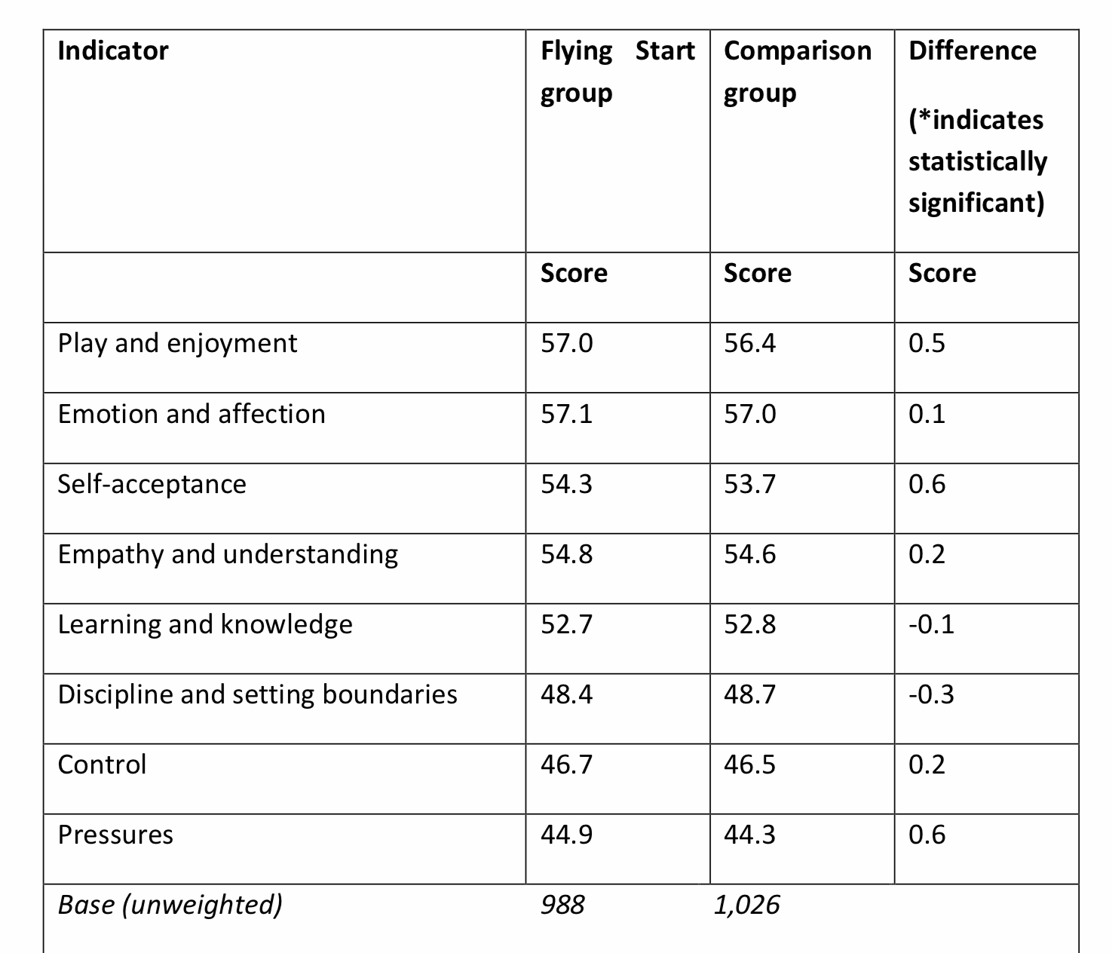
Welsh Assembly (2013)

Slide 10
Is it successful?
Increasing engagement in wider services.
Increased accessibility to services
Building relationships with hard to reach families
Report states two main reasons for flying starts success.
The role of home visits
The personalised nature of service delivery.
-Welsh Assembly 2010.

Slide 11
Children and Young people and education Committee
February 2018 flying start programme is a vital source of support for children that can benefit from it.
Most children that need the help are based outside the geographical areas that are defined as deprived.
Highly unlikely that the small proportion of flying start funding available for families reaches the children who need it most.

Slide 12
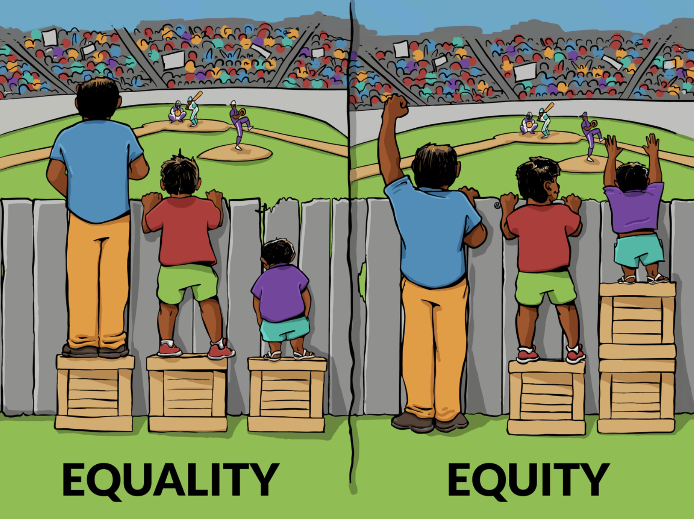
Conclusion
Overall seen as successful in reducing the gap between poverty and attainment.
Cannot be said for sure but certainly encourages children to do well in school from the offset.
By helping those in deprived areas with education it gives them the same chance of attainment as those who are in wealthier areas with a stable home life.

Slide 13
Reference list
Egan, D. (2013) Poverty and low educational achievement in Wales: student, family and community intervention. Jospeh Rowntree Foundation. (Available on https://www.jrf.org.uk/sites/default/files/jrf/migrated/files/wales-education-poverty-summary.pdf
) (accessed on 7th February 2019)
Family Point Cymru. (2017) Pembrokeshire Flying Start. (Available on https://familypoint.cymru/pembrokeshire/flying-start-pembrokeshire/ ) (Accessed on 2nd February 2019)
Glyn, E. et al. (2018) Qualative Research with Flying start: Wave 3. Arad Research. Welsh Assembly. Cardiff. (Available on https://gov.wales/docs/caecd/research/2018/180718-qualitative-research-flying-start-families-wave-3-en.pdf)
Illustrating Equality Vs Equity. (2016) (Available on http://interactioninstitute.org/illustrating-equality-vs-equity/ ) Accessed on 15th February 2019)
Knibbs, S. et al. (2013) National Evaluation of Flying Start. Welsh Government Social Research. Welsh Government. Cardiff. (Available on https://dera.ioe.ac.uk/19094/1/131205-national-evaluation-flying-start-impact-report-en.pdf ) (Accessed on 5th February 2019)
McCrindle, L. & White, G. (2010). Interim evaluation of Flying Start. Welsh Assembly. Cardiff. (Available on http://www.assembly.wales/Meeting%20Agenda%20Documents/Interim%20Evaluation%20of%20Flying%20Start%20(PDF,%20768KB)-12102010-198330/100715interimevaluationen-English.pdf) (Accessed on 31st January 2019)
Thomas, S. (2018) Is the welsh government give a “Flying Start” to all children who need it? Senedd Research. Welsh Assembly. (Available on https://seneddresearch.blog/2018/05/21/is-the-welsh-government-giving-a-flying-start-to-all-children-who-need-it/ ) (Accessed on January 31st 2019)
White, J. (2018). Poverty affects education attainment. NHS Scotland. Scotland. (Available on http://www.healthscotland.scot/news/2018/july/poverty-affects-educational-attainment ) (Accessed on 31st January 2019)

