Slide 1
Hydro Power
By
Andrew Thorn

Slide 2
Introduction
Hydro power is an established technology which accounted for 16% of global electricity production in 2010
The energy of the water is either in the form of potential energy (reservoirs) or kinetic energy (rivers)
In both cases electricity is generated by passing the water through large water turbines

Slide 3
Introduction
There are two main types of hydropower plant systems: dams and run of river (ROR) schemes
RORs use a very small reservoir (pondage) or none at all, while dams have a large reservoir
As ROR systems do not impound a large volume of water their environmental impact is generally small

Slide 4
Hydropower
The main economic advantages of hydropower are low operating, minimal impact on the atmosphere, quick response to sudden changes in electricity demand, and long plant life (40 years or more)
However, the capital cost of construction of dams is high and the payback period is very long
There are also serious social and environmental issues to be considered when deciding about new hydroelectric scheme, including displacement of population, sedimentation, changes in water quality, impact on fish and flooding

Slide 5
Power Output from a Dam
Consider a turbine situated at a vertical distance h (called the head) below the surface of the water in a reservoir
The power output P is the product of the efficiency η, the potential energy per unit volume pgh, and the volume of water flowing per second (Q_{i})

Slide 6
Example
Estimate the power output of a dam with a head of 50m and volume flow rate of 20m/s
Assume η = 1, p = 1000kg m³ g = 10 m/s
P = npgh Q
P = 1000 x 10 x 50 x 20 = 10 MW

Slide 7
Volume flow rate using a weir
For power extraction from a stream it is important to be able to measure the volume flow rate of water
One particular method diverts the stream through a straight-sided channel containing an artificial barrier called a weir

Slide 8
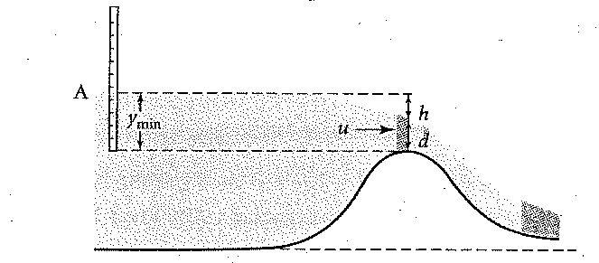
Flow over a Broad Crest Weir

Slide 9
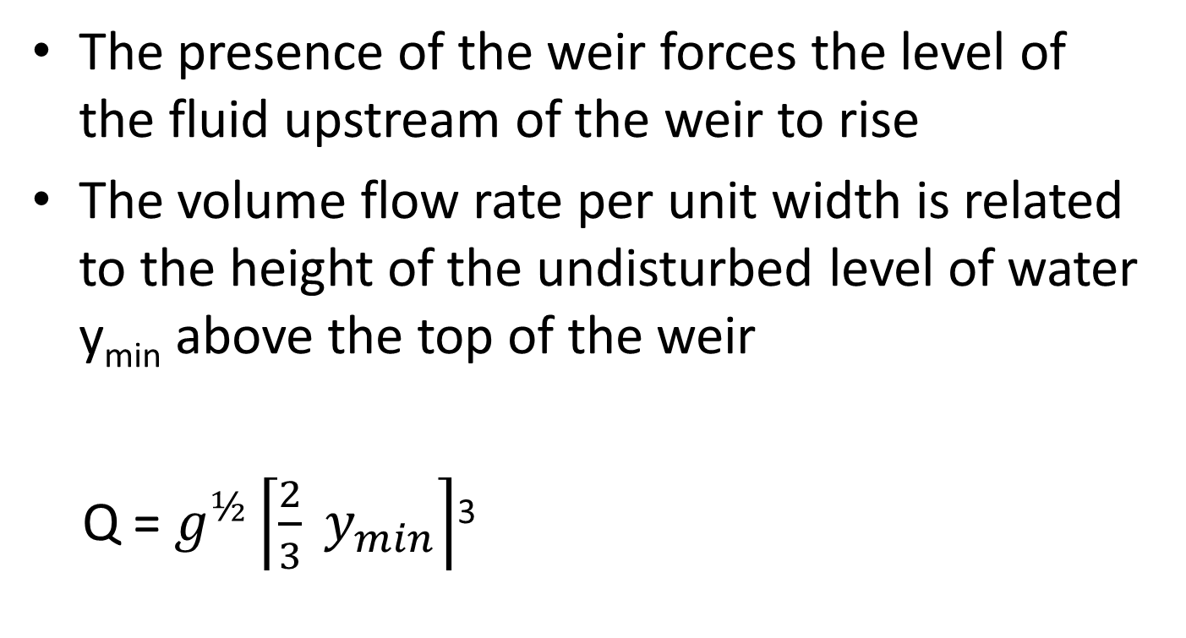
Volume flow rate using a weir
The presence of the weir forces the level of the fluid upstream of the weir to rise
The volume flow rate per unit width is related to the height of the undisturbed level of water y_{min} above the top of the weir
Q = $g^{½}\left\lceil \frac{2}{3} y_{min}\right\rceil$³

Slide 10
Water Turbines
When water flow through a water wheel the water between the blades is almost stationary
Hence the force exerted on a blade is essentially due to the difference in pressure across the blade
In a water turbine, however, the water is fast moving and the turbine extracts kinetic energy from the water

Slide 11
Water Turbines
Two basic designs; impulse and reaction turbines
In an impulse turbine, the blades are fixed to a rotating wheel and each blade rotates in air, apart from when the blade is in line with a high speed jet of water
In a reaction turbine, however, the blades are fully immersed in water and the thrust on the moving blades is due to a combination of reaction and impulse force

Slide 12
Water Turbines
To calculate the maximum power output from a Pelton wheel, we consider a jet moving with velocity (u) and the cup moving with velocity U_{C}
Relative to the cup, the velocity of the incident jet is (U - U_{C}) and the velocity of the reflected jet is - (U - U_{C})
Hence the total change in the velocity of the jet relative to the cup is -2 (U - U_{C})

Slide 13
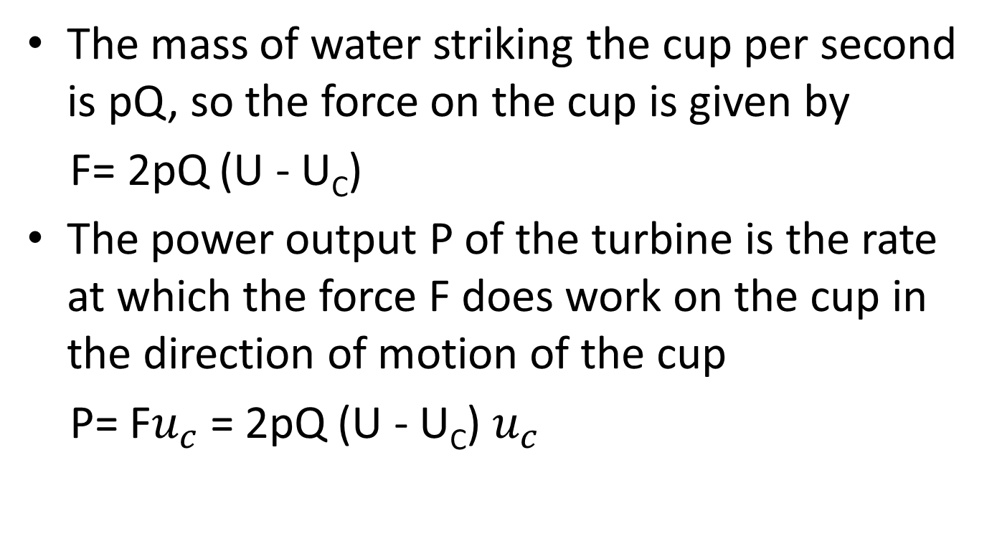
Water Turbines
The mass of water striking the cup per second is pQ, so the force on the cup is given by
F= 2pQ (U - U_{C})
The power output P of the turbine is the rate at which the force F does work on the cup in the direction of motion of the cup
P= F$u_{c}$ = 2pQ (U - U_{C}) $u_{c}$

Slide 14
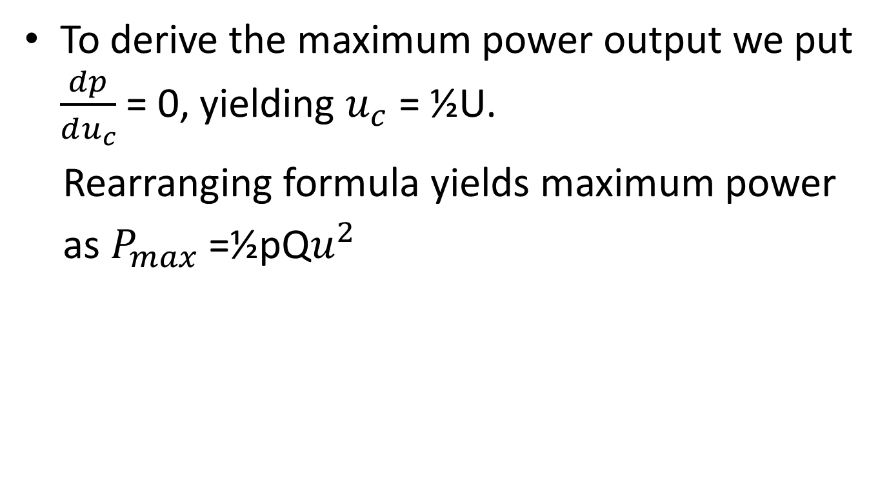
Water Turbines
To derive the maximum power output we put $\frac{dp}{du_{c}}$ = 0, yielding $u_{c}$ = ½U.
Rearranging formula yields maximum power
as $P_{max}$ =½pQ$u^{2}$

Slide 15
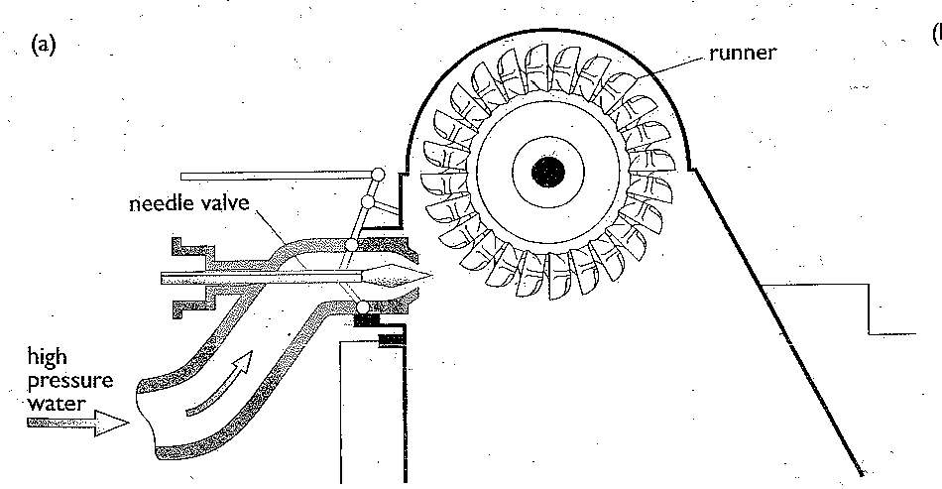
Pelton Wheel Turbine

Slide 16
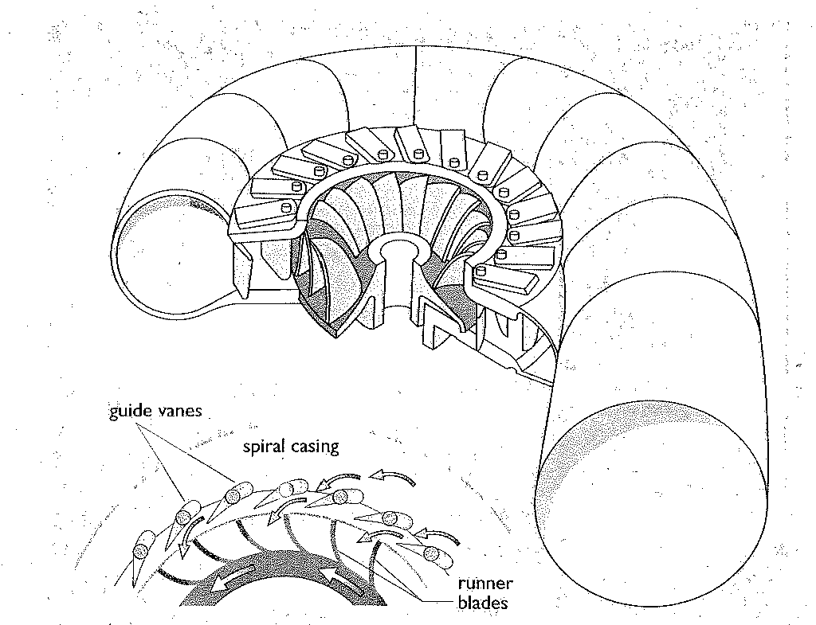
Francis Turbine

Slide 17
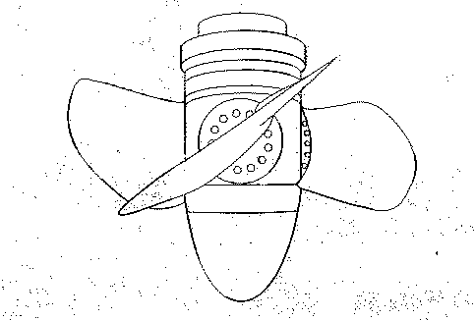
Kaplan Turbine

Slide 18
Water Turbines
The most common designs of reaction turbines are the Francis Turbine and Kaplan Turbine
In a Francis Turbine the runner is a spiral annulus whereas in the Kaplan Turbine it is propeller shaped
In both designs the kinetic energy of the water leaving the runner is small compared with the incident kinetic energy

Slide 19
Power, Head and Flow Rate
Resource estimates must take into account energy losses
In any real system the water will lose some energy due to frictional drag and turbulence, and the effective head will thus be less than the actual head
These flow losses very greatly from system to system: in some cases the effective head is no more than 75% of the actual height difference

Slide 20
Power, Head and Flow Rate
Efficiency- the ratio of output to input power is always less than 100%
Output power becomes
P = 1000 x η x Q x g x H
H = effective head
η = turbo generator efficiency

Slide 21
Types of Water Wheel
Undershot
Overshot
Breastshot

Slide 22
Undershot Water Wheel
Is driven by the pressure of water against its lower blades which dip into the flowing stream
The advantage is that it can be used in almost any stream or channel
However, it becomes very inefficient if the water backs up due to flooding, impeding the motion of the wheel

Slide 23
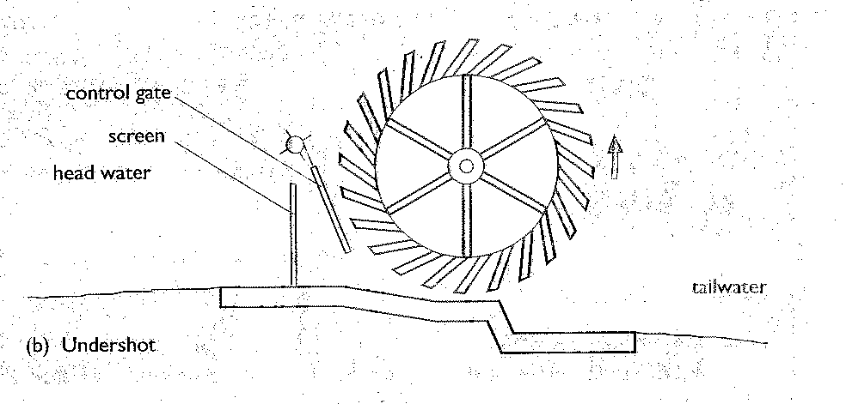
Undershot Water Wheel

Slide 24
Overshot Water Wheels
Is driven by water falling from above on blades with closed sides, effectively buckets
Overshot wheels don’t suffer the flooding problem, but need a ‘head’ at least as high as the diameter of the wheel making them unsuitable for streams and rivers with gentle gradients

Slide 25
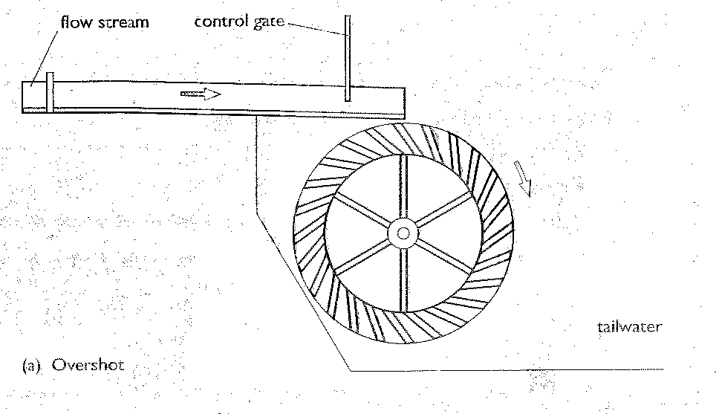
Overshot Water Wheels

Slide 26
Breastshot Water Wheel
The water is channelled between parallel breast walls and strikes the paddles at about the level of the wheel axle
It has the advantage of overcoming the flooding problem without requiring the high head

Slide 27
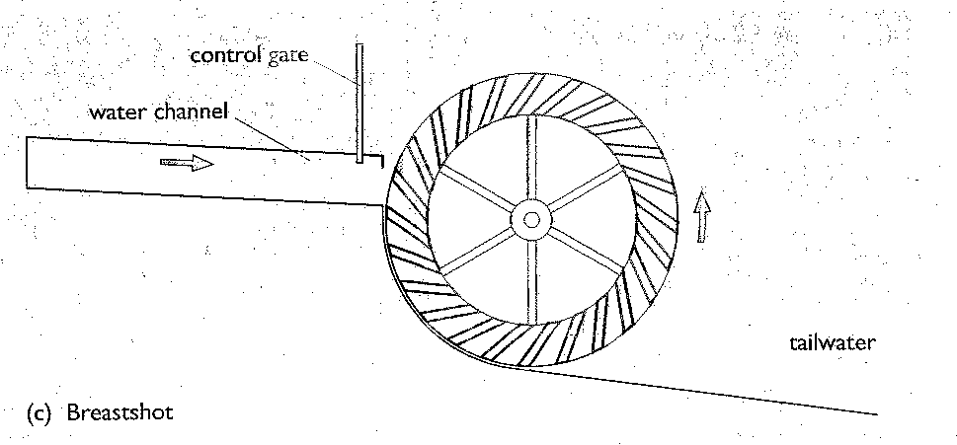
Breastshot Water Wheel

Slide 28
Maximising Efficiency
Maintaining exactly the right speed and direction of the incoming water relative to the runner blades is important
The output power can be reduced by reducing the water flow, and in Francis Turbine this is done by turning the guide vanes
This changes the angle at which the water hits the moving blades and the efficiency falls

Slide 29
Maximising Efficiency
A rather different cause of less than 100% efficiency is that the water flowing out carries away kinetic energy
A partial remedy is to flare the draft tube. If the tube become larger, but the volume flow stays the same, the actual speed of the water must decrease, reducing the energy loss

Slide 30
Propellers
In the ‘propeller’ or axial flow turbine the area through which the water enters is as large as it can be
Axial-flow turbines are therefore suitable for very large volume flows and have become usual where the head is only a few metres
They have the advantage over radial-flow turbines that it is technically simpler to improve the efficiency by varying the angle of the blades when the power demand changes

Slide 31
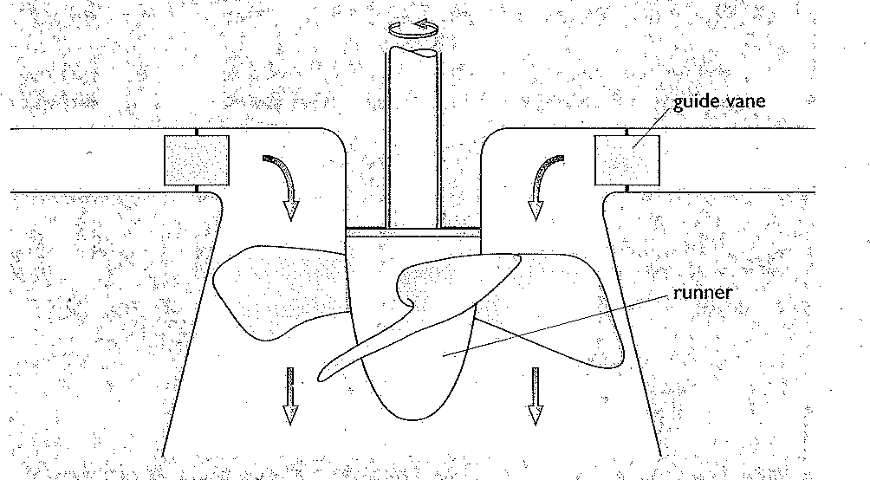
Propellers

Slide 32
Propellers
As the entering water is swirling round an important feature is that the optimum blade speed is now appreciably greater than the water speed- as much as twice as fast
The allows a rapid rate of rotation even with relatively low water speeds

Slide 33
Turgo Turbine
The double cups are replaced by single, shallower ones, with the water entering on one side and leaving on the other
The water enters as a jet, striking the cups in turn, so this is still an impulse turbine
However, its ability to handle a larger volume of water than a Pelton Wheel of the same diameter gives it an advantage for power generation at medium heads

Slide 34
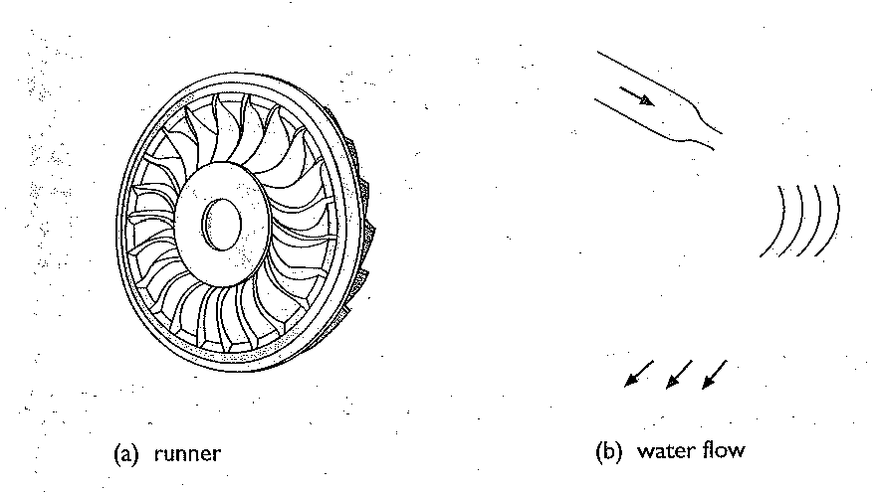
Turgo Turbine

Slide 35
Cross-Flow Turbine
The cross-flow turbine is yet another impulse type, but the water enters in a flat sheet rather than round jet
It flows across the blades, around the central shaft, and across the blades on the opposite side as it leaves
Cross-flow turbines are often used instead of Francis turbines in small-scale plants with output below 100 kW

Slide 36
Cross-Flow Turbine
Can be constructed without sophisticated engineering facilities and are therefore suitable for remote communities

Slide 37
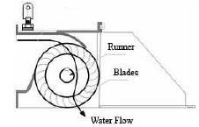
Cross Flow Turbine

Slide 38
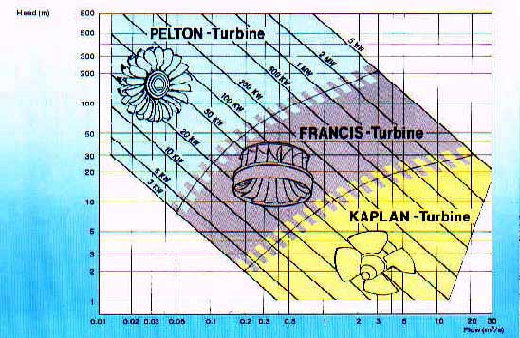
Range of Application

Slide 39
Ranges of Application
In general Pelton Wheels are most suitable for high heads, propellers for low heads and Francis Turbines for the immediate range
But the effective head is not the only factor determining the most appropriate type for a given situation
The available power also matters

Slide 40
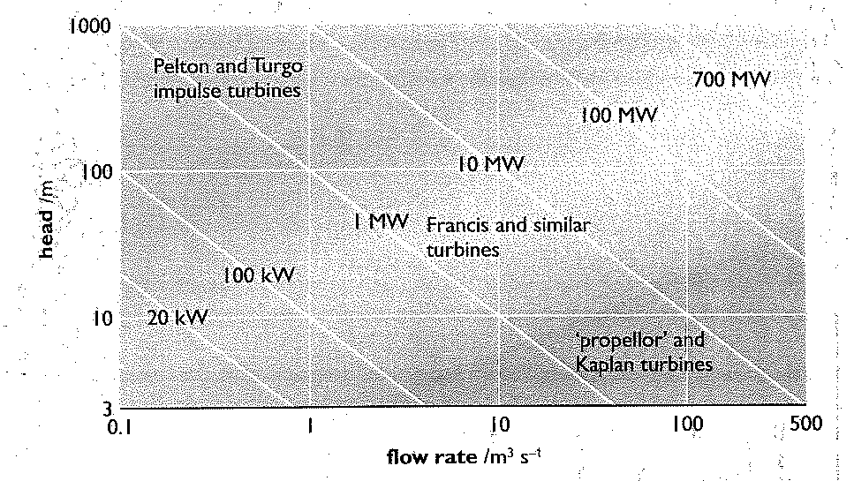
Range of Applications

Slide 41
Specific Speed
One factor missing from the diagram is the rate of rotation (n) of the turbine, and this can take very different values
The specific speed (N_{S}) takes n into account, allowing a more detailed assessment

Slide 42
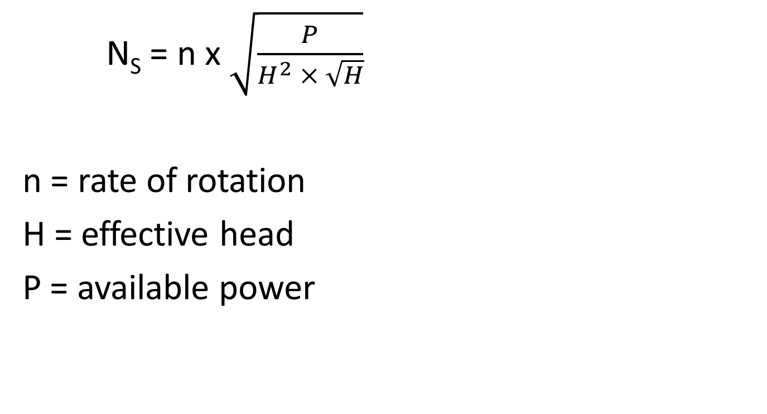
Specific Speed
N_{S} = n x $\sqrt{\frac{P}{H^{2} × \sqrt{H}}}$
n = rate of rotation
H = effective head
P = available power

Slide 43
Specific Speed
Once the effective head H and the available water power P have been estimated for a particular site, the specific speeds at different possible rates of rotation can be calculated
The point of this is that each type of turbine, regardless of size operates best within a certain range of values of N
Other factors such as cost, simplicity in manufacture and ease of maintenance also influence final choice

Slide 44
Specific Speeds
Type of Turbine | Range of Specific Speeds
Francis | 70 - 500
‘Propeller’ or Kaplan | 350 - 100
Pelton, Turgo, Cross-flow | 10 - 80

Slide 45
Assessing Small Scale Installations
It is clear that in order to estimate the input power P_{o} we have to measure the flow rate Q and the available vertical fall H (head)
For example with Q= 40 l/s and H= 20m, the maximum available at source is 8kW

Slide 46
Measurement of Head
For nearly vertical falls trigonometric methods are suitable
For more gently sloping sites, the use of level and pole is simple
Note that power input to the turbine depends not on the geometric head H_{t} as measured this way, but on the available head H_{a}

Slide 47
Measurement of Head
H_{a} = H_{t} – H_{f}
H_{f} allows for friction losses in the pipe and channels leading from the source to the turbine
By choosing the right pipework it is possible to keep H_{f} < H_{f} /3, but H_{f} increases proportionally in relation to the total length of the pipe
So the best sites for hydro-power have steep slopes

Slide 48
Measurement of Flow rate Q
The flow through the turbine produces the power, and this flow will usually be less than the flow in the stream
However, the flow in the stream varies with time, for example between drought and flood periods
For power generation we usually want to know the minimum flow, since a turbine matched to this will produce power all the year without overcapacity of machinery

Slide 49
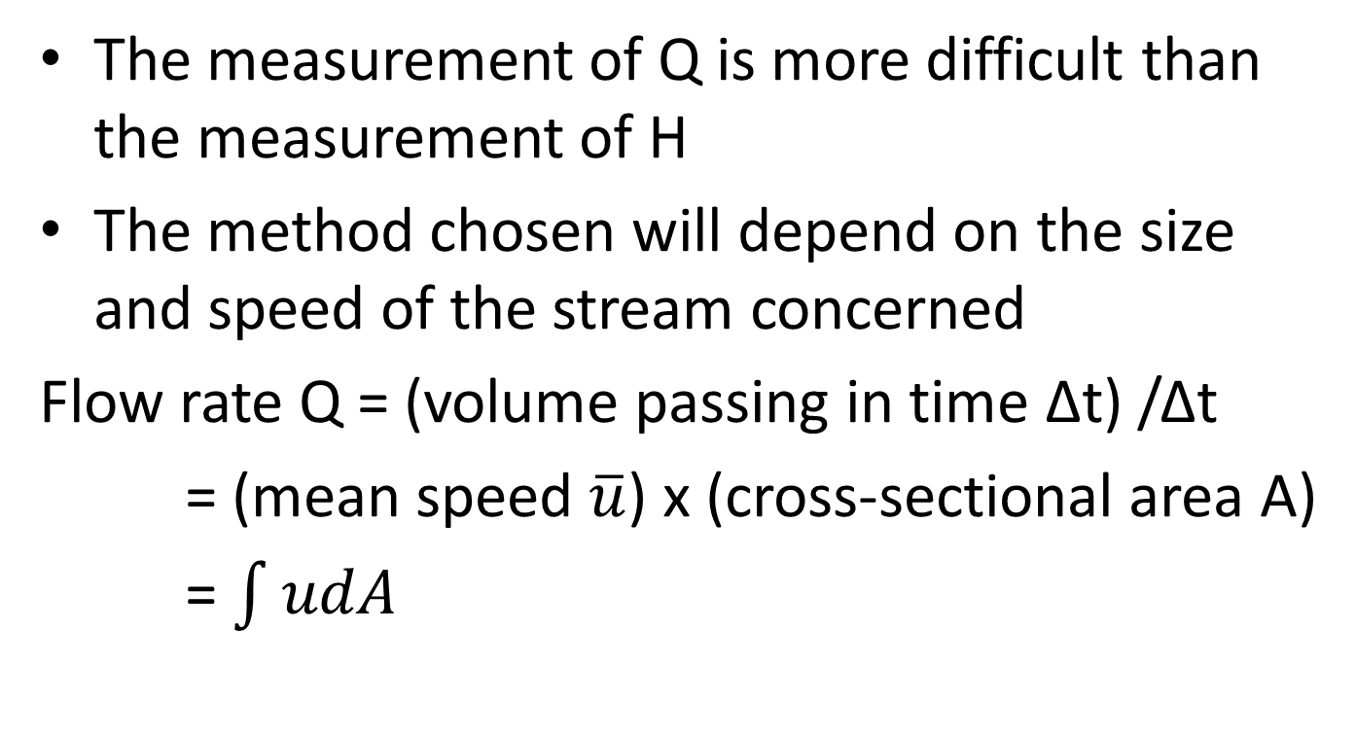
Measurement of Flow rate Q
The measurement of Q is more difficult than the measurement of H
The method chosen will depend on the size and speed of the stream concerned
Flow rate Q = (volume passing in time Δt) /Δt
= (mean speed $\overline{u}$) x (cross-sectional area A)
= $\int{udA}$

Slide 50
Measurement of Flow rate Q
M = stream wise velocity
In addition, if the water falls freely over a ledge or weir, then the height of the flow at the ledge relates to the flow rate

Slide 51
Basic Method
The whole stream is either stopped by a dam or diverted into containing volume
In either case it is possible to measure the flow rate from the volume trapped
This method makes no assumption about the flow, is accurate and is ideal for small flows, such as those at very smooth waterfall

Slide 52
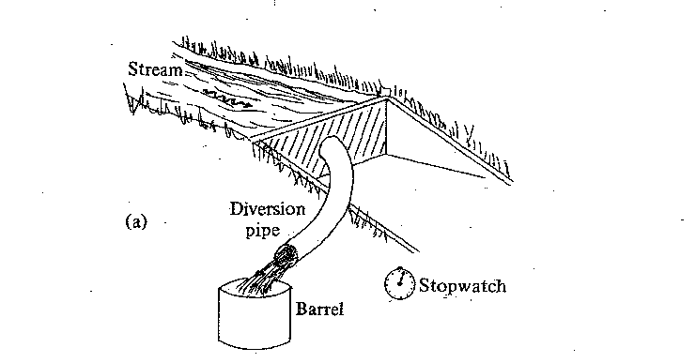
Basic Method

Slide 53
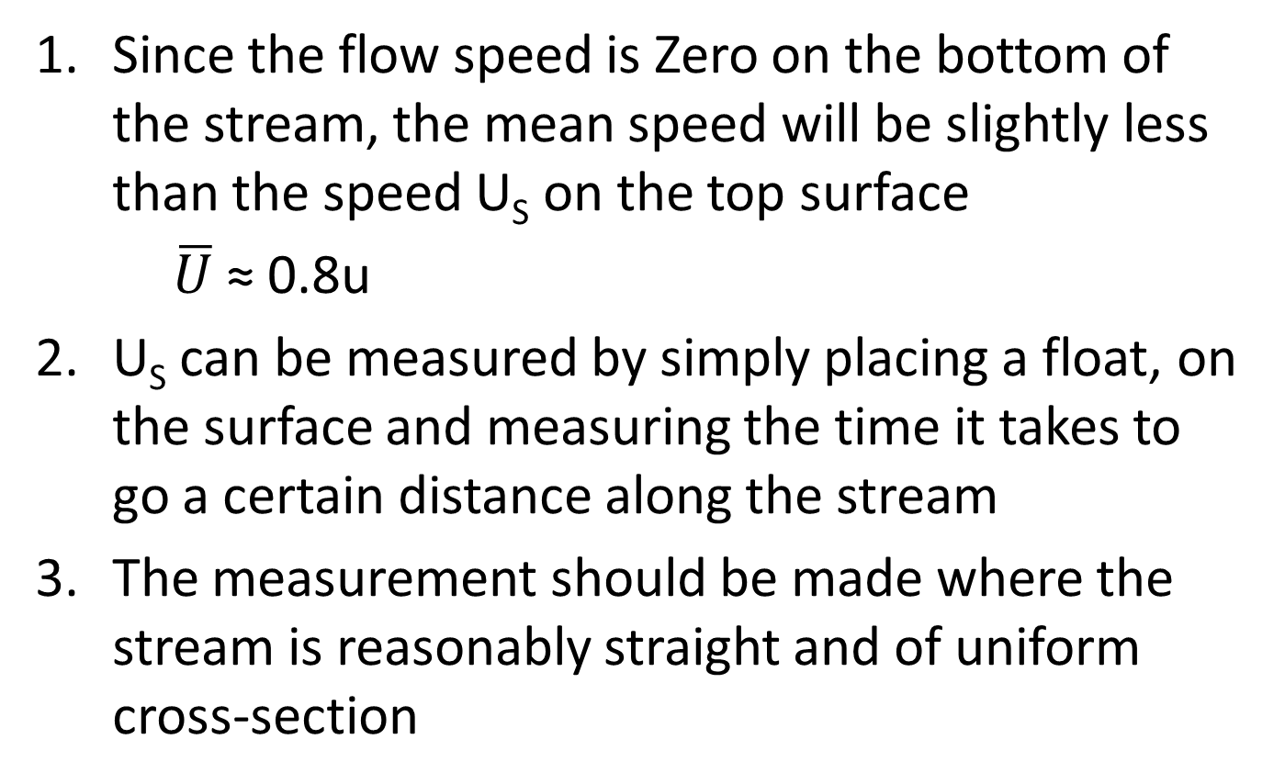
Refined Method
Since the flow speed is Zero on the bottom of the stream, the mean speed will be slightly less than the speed U_{S} on the top surface
$\overline{U}$ ≈ 0.8u
U_{S} can be measured by simply placing a float, on the surface and measuring the time it takes to go a certain distance along the stream
The measurement should be made where the stream is reasonably straight and of uniform cross-section

Slide 54
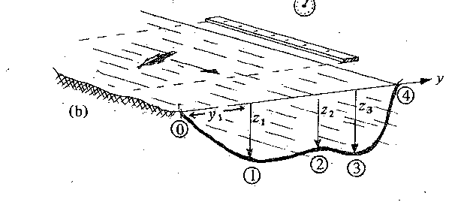
Refined Method

Slide 55
Sophisticated Method
Most accurate method
The forward speed is measured with a small flow meter at the points on a two-dimensional grid extending across the stream

Slide 56
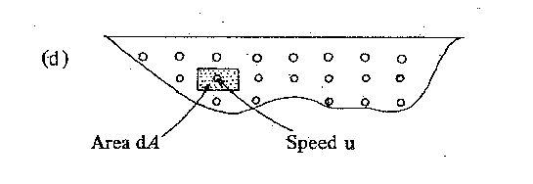
Sophisticated Method

Slide 57
Weir Method
If Q is to be measured throughout the year for the same stream, measurement can be made by building a dam with a specially shaped calibration notch
The height of flow through the notch gives a measure of the flow
The system is calibrated against a laboratory model having the same form of notch

Slide 58
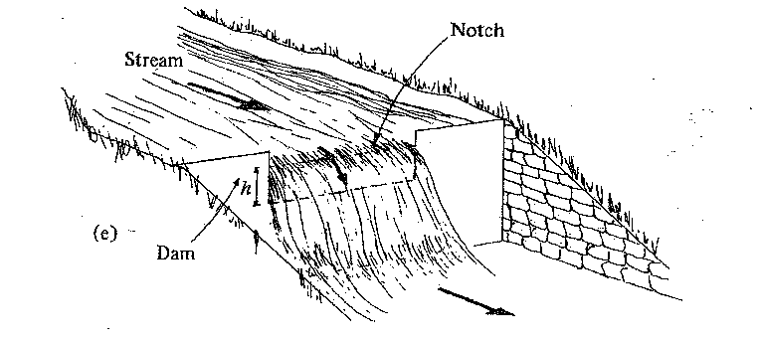
Weir Method

Slide 59
Impulse Turbines
The potential energy of the water in the reservoir is changed into kinetic energy of one or more jets
Each jet then hits a series of buckets or ‘cups’ placed on the perimeter of a vertical wheel
The resulting deflection of the fluid constitutes a change in momentum of the fluid

Slide 60
Impulse Turbines
The cup has exerted a force on the fluid, and therefore the fluid has likewise exerted a force on the cup
This tangential force applied to the wheel causes it to rotate

Slide 61
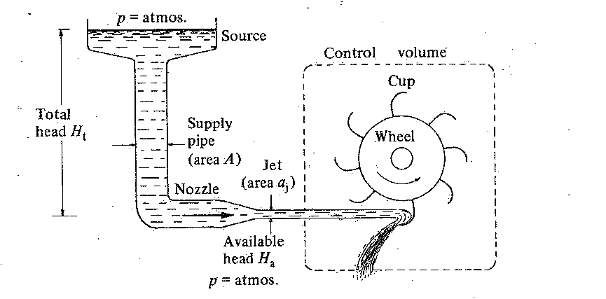
Impulse Turbines

Slide 62
Impulse Turbines
The next slide shows a jet, of density ρ and volume flow rate Q, hitting a cup
The cup moves to the right with steady speed U_{C} and the input jet speed is U_{i}

Slide 63
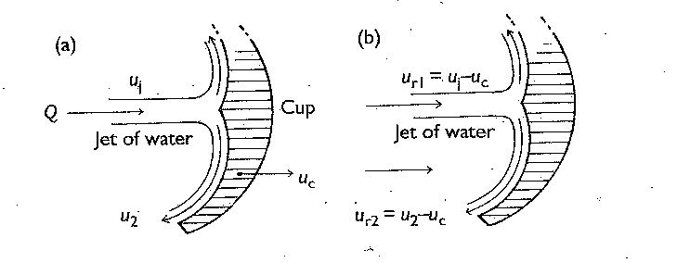
Impulse Turbines

Slide 64
Impulse Turbines
The frame of the cup has a relative jet speed (U₂ - U_{i}), but since the polished cup is smooth, friction is negligible, so the jet is deflected smoothly through almost 180°C with no loss in speed U₂ – U_{i}

Slide 65
Impulse Turbine (forces)
Thus in the frame of the cup, the change in momentum per unit time, and hence the force F experienced by the cup is F= 2ρ Q_{i} (U₂ – U_{i})
The force is the direction of the jet
The power P, transferred to the single cup is P = Fu_{C} = 2ρ Q_{i} (U₂ – U_{i})U_{C}
Q = flow through the jet

Slide 66
Impulse Turbine (forces)
The design of a Pelton Wheel aims for ideal performance
For instance, nozzles are adjusted so that the water jets hit the moving cups perpendicularly at the optimum relative speed for maximum momentum transfer
The ideal cannot be achieved in practice, because an incoming jet would be disturbed by the reflected jet and by the next cup revolving into place

Slide 67
Impulse Turbines (forces)
To overcome these difficulties notches in the top of the cups gave the jets better access to the turbine cups
The shape of the cups incorporated a central splitter section so that the water jets were reflected away from the incoming water

Slide 68
Impulse Turbines
(Jet Velocity and Nozzle Size)
Bernoulli’s theorem implies that, in the absence of friction in the pipe, U_{i}² = 2g H_{t}
Pipe friction can be allowed for by replacing the total head H_{t} by the available head H_{a} defined by U_{i}² = 2g H_{a}

Slide 69
Impulse Turbines
(Jet Velocity and Nozzle Size)
In practice the size of the pipes is chosen so that U_{i} is independent of the nozzle area
If there are n nozzles, each of area a, then the total flow from all jets is Q= na u_{i} = n Q_{i}

Slide 70
Impulse Turbines
(Jet Velocity and Nozzle Size)
In any impulse turbine system it is vital that the maximum available head H_{a} is obtained between the turbine and reservoir
The output power is proportional to the total jet cross-sectional area A= na
However, a is limited by the size of cup, so if a is to be increased a larger turbine is needed
It is usually easier to increase the number of nozzles n than to increase the overall size of the turbine, but the arrangement becomes unworkably complicated for n ≥ 4

Slide 71
Impulse Turbines
(Jet Velocity and Nozzle Size)
The total flow Q through the turbine cannot be more than the flow in the stream Q_{stream}
na_{i} ≤ Q_{Stream} /(2g H_{a})^{½}

Slide 72
Impulse Turbines
(Angular velocity and Turbine Size)
The nozzle size has fixed the size of the cups, but not the overall size of the wheel
The latter is determined by geometric constraints, and also by the required rotational speed
For electrical generation, the output variable, e.g. voltage, frequency and efficiency, depend on the angular speed of the generator

Slide 73
Impulse Turbines
(Angular velocity and Turbine Size)
Most electric generators have greatest efficiency at large rotational frequency, commonly 1500rpm
If the wheel has radius R and turns at angular velocity ω and P= Fr_{ω}
Thus for a given output power the larger the wheel the smaller its angular velocity

Slide 74
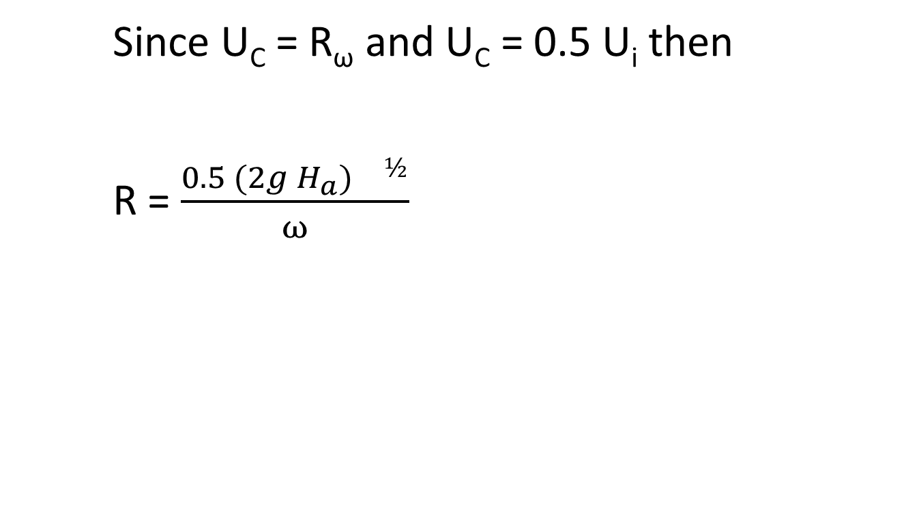
Impulse Turbines
(Angular velocity and Turbine Size)
Since U_{C} = R_{ω} and U_{C} = 0.5 U_{i} then
R = $\frac{0.5 (2g H_{a}){}^{½}}{ω}$

Slide 75
Reaction Turbines
If you are required to have the same power from a lower head, we have to maintain a greater flow Q through the turbine
This can be expressed in terms of the shape number τ which is a non-dimensional measure on the operating conditions
In order to maintain the same ω and P with a lower H we require a turbine with larger τ

Slide 76
Reaction Turbines
One way of doing this is to increase the number of nozzles on a Pelton Wheel
However, the pipework becomes unduly complicated if n > 4, and the efficiency decreases because the many jets of water interfere with each other
To have a larger flow through the turbine, it is necessary to make a significant change in the design

Slide 77
Hydroelectric Systems
Most modern hydro-power systems are used to drive electric generators, although some special purpose mechanical systems are still useful, such as the hydraulic ram pump
A complete hydroelectric system must include the water source, the pipe (penstock), flow control, the turbine, the electric generator, fine control of the generator and wiring for electricity distribution

Slide 78
Hydroelectric Systems
The dam or weir ensures a steady supply of water to the system without fluctuations, and enables energy storage in the reservoir
The supply pipe (penstock) is a major cost. If it is thin-walled, short and of small diameter D, it will be cheaper
In particular the diameter cannot be decreased because of the head loss H_{f}

Slide 79
Hydroelectric Systems
Therefore if the pipe diameter is too small, almost all the power will be lost in the pipe.
The greater cost of a bigger pipe has to be compared with the continued loss of power by using a smaller pipe
A compromise is to make H_{f} ≤ 0.1 H_{t}

Slide 80
Hydroelectric Systems
The material of the pipe is required to be both smooth (to reduce friction losses) and strong to withstand the static pressures, and larger ‘Water hammer’ pressures that arise when the flow is turned suddenly on or off
For small installations, PVC plastic is suitable for the main length of the pipe, perhaps with a short steel section at the bottom to withstand the larger pressures

Slide 81
Hydroelectric Systems
A screen is needed at the top of the supply pipe to intercept the rubbish before it blocks the pipe
This screen has to be regularly checked and cleared of debris
A settling chamber is essential to deposit suspended material before the water goes down the pipe

Slide 82
Hydroelectric Systems
The turbine speed is designed to be suitable for the electric generator, with generation usually at about 400v AC
Larger systems usually have a specially built generator running from the same shaft as the turbine, which minimises power losses between the turbine and the generator
Small systems generally use off-the-shelf generators or induction motors operated as generators

Slide 83
Hydroelectric Systems
If the turbine speed is not large enough to match the generator, then gearing is used
A V-belt is a common gearing mechanism, which unfortunately may give power losses of 10-20% in very small systems

Slide 84
Power Regulation and Control
With any hydro installation feeding electricity into a utility transmission grid, it is important that the voltage and frequency of the output match that of the rest of the grid
Although the primary generation is always at a relatively low voltage, the AC voltage can easily be increased by transformers, both to match the grid voltage and to minimise I² R losses in transmission

Slide 85
Power Regulation and Control
It is important that the voltage and frequency be controlled to maintain common grid standards and consumer requirements
This is done traditionally by mechanical feedback systems which control the flow through the turbine, so that it maintains constant frequency (‘Speed’)
With a Pelton Wheel, a spear valve is made to move in and out of the nozzle, thus regulating Q

Slide 86
Power Regulation and Control
Stand-alone, autonomous, hydro-electric systems intended to supply electricity to a village or farm also require some regulation, but the devices they are required to run, such as lights and small electric motors can generally tolerate variations in voltage and frequency to ± 10%
Moreover the currents involved are easily switched by power electronic devices, such as thyristors

Slide 87
Power Regulation and Control
With an electronic load control system major variations in output are accomplished by manually switching nozzles completely in or out, or by manually controlling the total flow through the turbine
Finer control is achieved by an electronic feed forward control which shares the output of the generator between the mainloads and a ballast heating circuit which can tolerate a varying or intermittent supply

Slide 88
System Efficiency
Even though the efficiency of each individual step is large, there is still a substantial energy loss in passing from the original power P_{O} of the stream to the electrical output P_{e} from the generator
Further losses occur in the distribution and use of the electricity

Slide 89
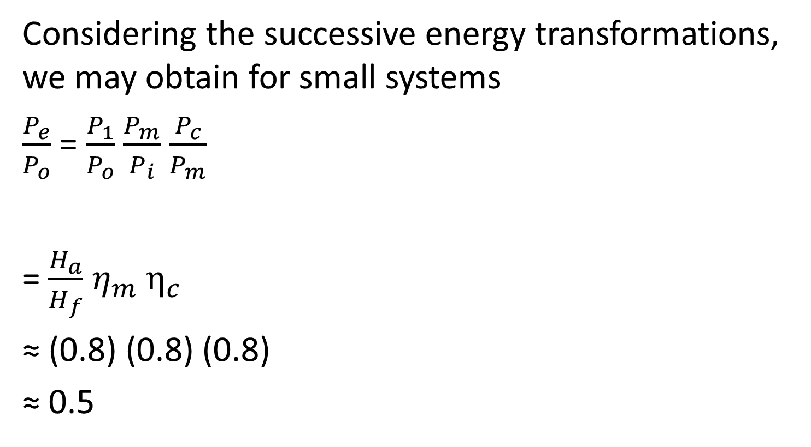
System Efficiency
Considering the successive energy transformations, we may obtain for small systems
$\frac{P_{e}}{P_{o}}$ = $\frac{P_{1}}{P_{o}}$ $\frac{P_{m}}{P_{i}}$ $\frac{P_{c}}{P_{m}}$
= $\frac{H_{a}}{H_{f}}$ $η_{m}$ $η_{c}$
≈ (0.8) (0.8) (0.8)
≈ 0.5

Slide 90
Hydraulic Ram Pump
The momentum of the stream flow is used to pump some of the water to a considerably higher level
For example, stream falling 2m below can be made to pump 10% of its flow to a height 12m above
This is clearly a useful way of filling a header tank for piped water, especially rural areas.

Slide 91
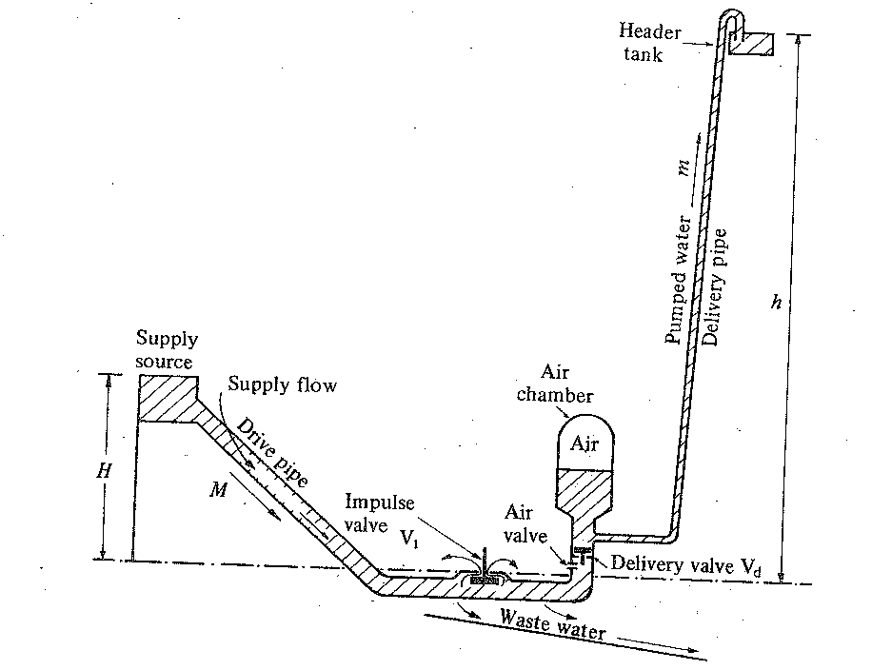
Hydraulic Ram Pump

Slide 92
Hydraulic Ram Pump
The water supply flows down a strong, inclined pipe called the ‘drive pipe’
The potential energy MgH of the supply water is first converted into kinetic energy and subsequently into potential energy mgh
The kinetic energy is obtained by a mass of water M falling through a head H, and out through the impulse valve V₁

Slide 93
Operation of Hydraulic Ram Pump
The speed of flow increases under the influence of the supply head so a significant dynamic pressure arises for the flow through the valve
The static pressure acting on the underside of the impulse valve overcomes the weight of the valve, so it closes rapidly
Consequently the water at the bottom becomes compressed by the force of the water still coming down the pipe

Slide 94
Operation of Hydraulic Ram Pump
The pressure in the supply pipe rises rapidly, forcing open the delivery valve V_{d} and discharging a mass of water m into the delivery section
The air in the air chamber is compressed by the incoming water, but its compressibility cushions the pressure rise in the delivery pipe
The combined pressure of air and water forces the mass m up the delivery pipe

Slide 95
Operation of Hydraulic Ram Pump
As soon as the momentum of the supply column is exhausted the delivery valve closes, and the water contained in the drive pipe recoils towards the supply
This recoil removes the pressure acting on the underside of the impulse valve, which there upon falls and again allows the escape of water

Slide 96
Operation of Hydraulic Ram Pump
Simultaneously, the recoil causes the small air charging valve to open, admitting a small amount of air into the impact chamber of the ram. This air is carried along with the water into the air chamber to compensate for that absorbed by the water
The whole cycle repeats indefinitely at a rate which is usually set to be about 1Hz

