Slide 1
BASIL’S BAKERY
Digital Transformation and Online Ordering Challenges
Problem Solving and Decision Making
Individual Presentation
Student Name: Iacob Badarau
Student ID: 2537668
Module Code: LCLM4004
Academic Year: 2026–2027

Slide 2
BUSINESS BACKGROUND & DIGITAL CHALLENGES
Why is Basil's Bakery in need of change?
Business Background
Independent organic bakery opened in Coventry in 2015.
Sells freshly baked bread, cakes and pastries.
In 2023-2025, sales were around 25% lower than in 2019.
Current Challenges
No online ordering available: Customers do not have the option to use online ordering.
There are restricted pre-orders: If a busy period occurs, telephone orders can be missed.
Lower convenience: Customers may have less choice of their products.
Limited adoption of technology: Small businesses may not have the resources to adopt technologies (OECD, 2021).
Customer expectation change: With the increasing competition in the market, there is a growing need for businesses to adjust their services (Bharadwaj et al., 2013).
Main Issue
The bakery may find that limited digital services can hinder efforts to attract and retain customers.

Slide 3
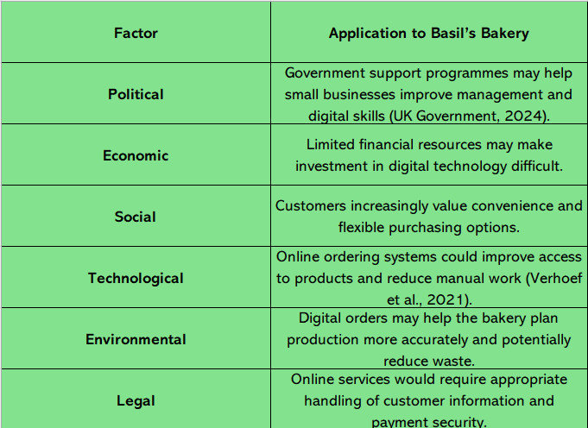
PESTEL ANALYSIS
Understanding External Influences
Key Findings
Convenience in ordering is a means provided when customers' expectations change.
There are opportunities to enhance accessibility and customer experience (Bharadwaj et al., 2013) through digital technology.
Digital investment may be challenging due to a lack of financial resources (OECD, 2021).
There are government support programmes that could be used by small businesses to build up their management skills (UK Government, 2024).
Advantage
Helps identify external opportunities and challenges.
Limitation
Does not describe digital issues within the bakery.
PESTEL is a strategic tool that is used to consider external factors that can impact the business.
It takes into account the Political, Economic, Social, Technological, Environmental and Legal factors.
The external environment can be a facade that helps to give an explanation to Basil's Bakery's digital development (Verhoef et al., 2021).

Slide 4
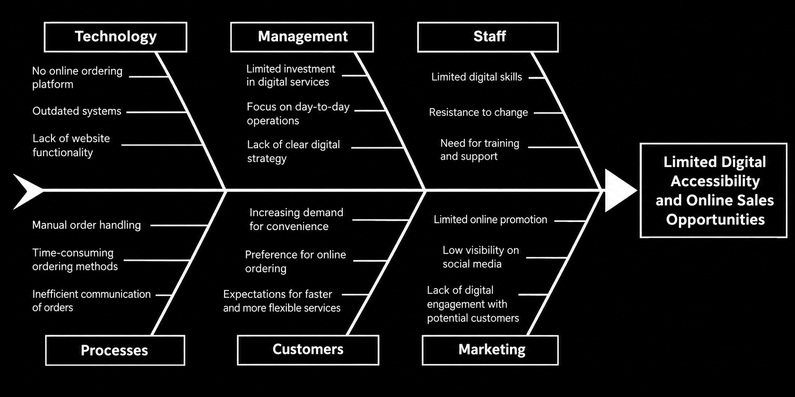
FISHBONE DIAGRAM
Understanding the reasons for low digital service uptake
Fishbone Diagram is a visual problem-solving approach to arrange solutions to a particular problem and it encourages businesses to consider multiple factors instead of a single explanation.
Main Problem - Restricted Digital Accessibility and Online Sales Channel.
Advantage - Offers plausible explanations in a logical fashion.
Limitation - Does not substantiate without evidence which causes have the most impact.

Slide 5

FISHBONE ANALYSIS- KEY FINDINGS
Technology: There is no restriction to purchase in terms of an online ordering platform (Bharadwaj et al., 2013).
Management: Delaying digital improvements may be due to limited investment (Rogers, 2018).
Staff training: Staff might need training to ensure that they become confident in the new systems (Davis, 1989).
Processes: Manual order handling can cause delays and add to workloads.
Customers: They have different expectations, and convenience may drive increased demand.
Marketing: Limited online promotion may limit opportunity to reach potential customers (Nyström, 2022).
What’s stopping the bakery?
Digital development requires a synergy of technology, employees and management (Verhoef et al., 2021).

Slide 6
ANALYSIS OF DIGITAL CHALLENGES
What are the best first steps to take for improvement?
Priority
Start with a simple online pre-ordering system and then gradually add other online services.
Online Pre-Orders: Give customers the opportunity to place an order before and pick up products at a convenient time.
Digital Marketing: Enhance social media presence to market products and market to customers (Nyström, 2022).
Staff Training: Offer hands-on assistance to staff members when they are learning about new technology (Davis, 1989).
Customer experience: Make buying things with digital services easier, but retain personal customer service (Philip et al., 2021).
Low-cost Solutions: Start with low-cost technology, rather than invest more money (OECD, 2021).
Performance monitoring: Analyse customer comments, online order and waiting time to track progress.

Slide 7
FINDINGS & CONCLUSION
Creating Digital Improvements at Basil's Bakery
Findings
Customers have less convenient ordering experiences due to limited digital services.
PESTEL identifies the changing expectations of the customers and opportunities for digital development (OECD, 2021).
Fishbone points out potential investment and staff skills and manual ordering impediments.
Technology improvements are not enough; there is a need for changes in daily working practices, too (Verhoef et al., 2021).
Conclusion & Recommendations
Be slow to introduce: start with a simple online pre-order system for collection.
Enhance visibility: Market products using social media and engage customers (Nyström, 2022).
Support staff: Give basic training prior to the new technology (Davis, 1989).
Monitor progress: Evaluate customer feedback and track improvements in waiting times.
The longer-term goal is to make ordering easier, attract more customers and support business growth (Rogers, 2018).

Slide 8
References
Bharadwaj, A., El Sawy, O.A., Pavlou, P.A. and Venkatraman, N.V., 2013. Digital business strategy: Toward a next generation of insights. MIS quarterly, 37(2), pp.471-482.
Davis, F.D., 1989. Perceived usefulness, perceived ease of use, and user acceptance of information technology. MIS quarterly, pp.319-340.
Department for Business and Trade (2024) Small Business Survey 2023. Available at https://www.gov.uk/government/collections/small-business-survey-reports (Accessed: 8 October 2026).
Philip, K., Hermawan, K. and Iwan, S., 2021. Marketing 5.0: Technology for humanity.
Nyström, J., 2022. Developing a digital marketing strategy for a small B2B company–pitfalls to avoid and learning experiences.
OECD (2021) The Digital Transformation of SMEs. Paris: OECD Publishing. Available at https://www.oecd.org/en/publications/the-digital-transformation-of-smes_bdb9256a-en.html (Accessed: 8 October 2026).
Rogers, D.L., 2018. The digital transformation playbook. Tantor Media, Incorporated.
UK Government (2024) Help to Grow: Management. Available at https://www.gov.uk/business-finance-support/help-to-grow-management-uk (Accessed: 8 October 2026).
Verhoef, P.C., Broekhuizen, T., Bart, Y., Bhattacharya, A., Dong, J.Q., Fabian, N. and Haenlein, M., 2021. Digital transformation: A multidisciplinary reflection and research agenda. Journal of business research, 122, pp.889-901.

