Slide 1


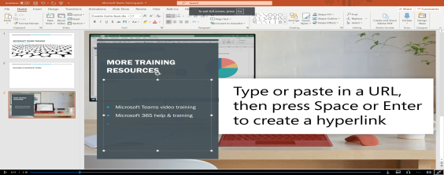
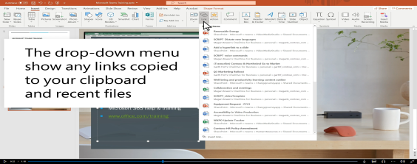
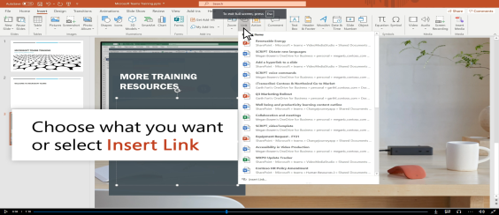
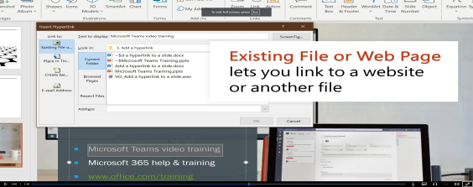
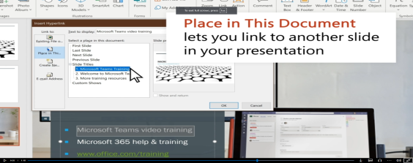
How to Insert Hyperlink into a PowerPoint Presentation
Mario Gramon
2416241
Step by Step how to insert a Hyperlink:
Select text or Object:
On these text and 3 objects (image, shape and graphic) can be changed into a hyperlink.
2. How to find the Hyperlink Menu:
You can find this by tapping the insert on the toolbar button and choose “Link” from the drop list.
3. Choose what Link you want to use:
In the hyperlink box, you will see a lot of options:
Existing File or Web Page using an URL to an external document or a website by copying this in the correct field.
Place in this Document or Create a document, you can click to view another slide, or you can use hyperlink to a new document that can be built right on the site that you opened.
4. Choose the Destination:
Choose the URL source , file to the one that would like to link.
5. Click OK:
Click “OK” to insert the hyperlink, now you should
Press CTRL+Click left mouse to test if the link works
If it works you don’t have to do anything
If it is possible that your link don’t work, you should
do this from beginning.
Reference:
1. Add a hyperlink to a slide (Microsoft, 2024) https://support.microsoft.com/en-gb/office/add-hyperlinks-to-slides-6f37e08a-43a8-40fe-a1d3-3adf6c592fa9 (Accessed:20 November 2024
Notes:
1

