Slide 1
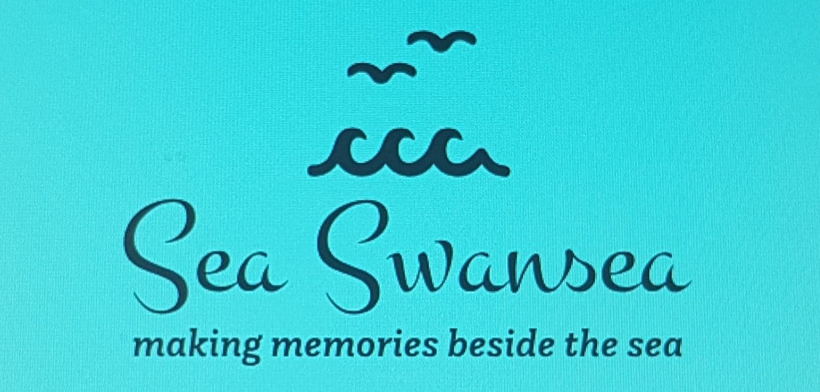
THE COMMUNICATIONS MIX
Caitlin James-Deane and Samantha Winkley

Slide 2
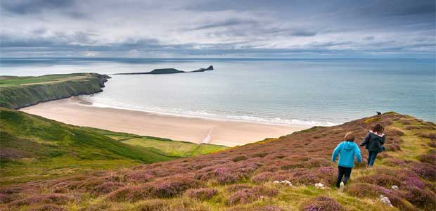
Target Market
Families with children
Three day break Itinerary
Day 1 Check in 12:00 | Activities: Mumbles 12:30-14:30 Oystermouth Castle 15:00-17:00 Dinner: Denny’s American Diner 17:30 Accommodation: 1 night at Village Hotel Swansea Transport: Briggs coaches all 3 days
Day 2 | Activities: LC2 waterpark 10:00-12:00 Guided walk around Rhossili Bay coast, cliffs and the Worm’s Head 14:00-16:00 Dinner: Worm’s Head Hotel 17:00 Accommodation: Worm’s Head Hotel
Day 3 | Activities: Family surfing lesson and free time at the beach 10:00-12:00 Lunch: Worms Head Hotel 12:30 Accommodation Check Out: 13:30
Coastline big unique selling point
Major factors of the holiday - Rhossili beach, Mumbles and Gower
Incorporating Swansea’s other adventures, events and activity
Seasonal adaptations - Christmas, Easter, Bonfire night
Work alongside Visit Wales’ year of the sea to promote tourism
Other opportunities/Wet weather alternatives: Plantasia, Marina boat trip, hotel indoor pool, bowling, waterfront museum, Wales National Airshow, cafe play Mumbles, Swansea Grand theatre.
(Google images)

Slide 3
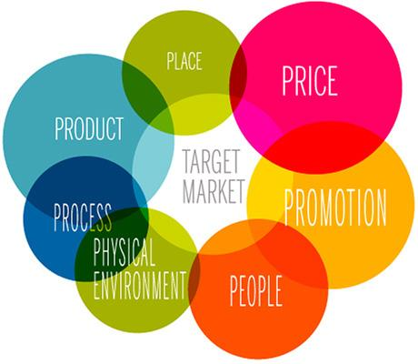
AN INTRODUCTION TO INTEGRATED MARKETING COMMUNICATIONS (IMC)
It ensures that all forms of communications and messages are carefully linked together.
It means integrating all the promotional tools, so that they work together in harmony.
Promotion is one of the Ps in the marketing mix. Promotions has its own mix of communications tools.
All of these communications tools work better if they work together in harmony rather than in isolation.
There are other levels of integration such as Horizontal, Vertical, Internal, External and Data integration.
Notes:
“Integrated Marketing Communications is a simple concept. It ensures that all forms of communications and messages are carefully linked together.
At its most basic level, Integrated Marketing Communications, or IMC, as we’ll call it, means integrating all the promotional tools, so that they work together in harmony.
Promotion is one of the Ps in the marketing mix. Promotions has its own mix of communications tools.
All of these communications tools work better if they work together in harmony rather than in isolation. Their sum is greater than their parts – providing they speak consistently with one voice all the time, every time.
This is enhanced when integration goes beyond just the basic communications tools. There are other levels of integration such as Horizontal, Vertical, Internal, External and Data integration. “
- Multimedia Marketing .com (2018), ‘Integrated Marketing Communications’, [Online]. Available: http://multimediamarketing.com/mkc/marketingcommunications/, [2018, April 17].

Slide 4



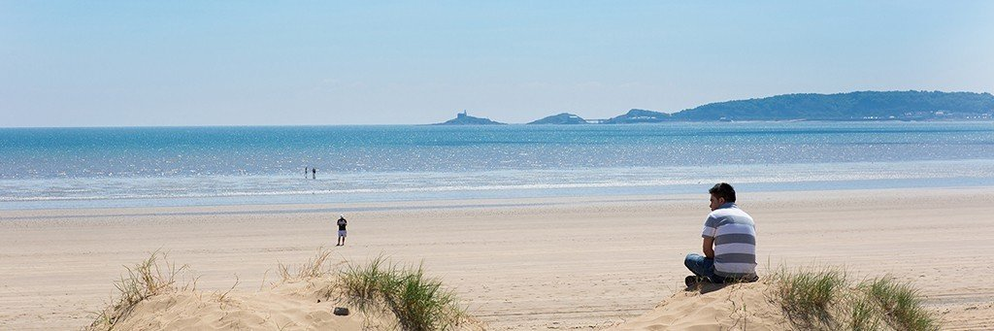
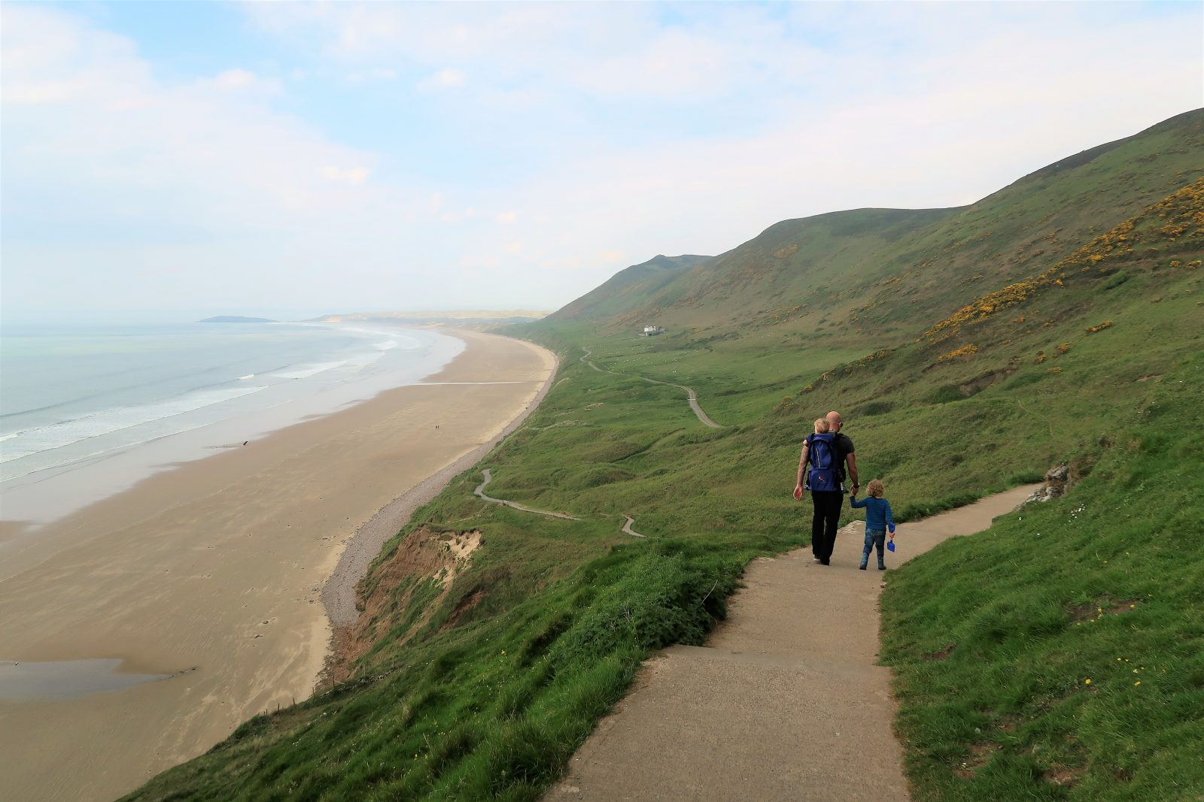

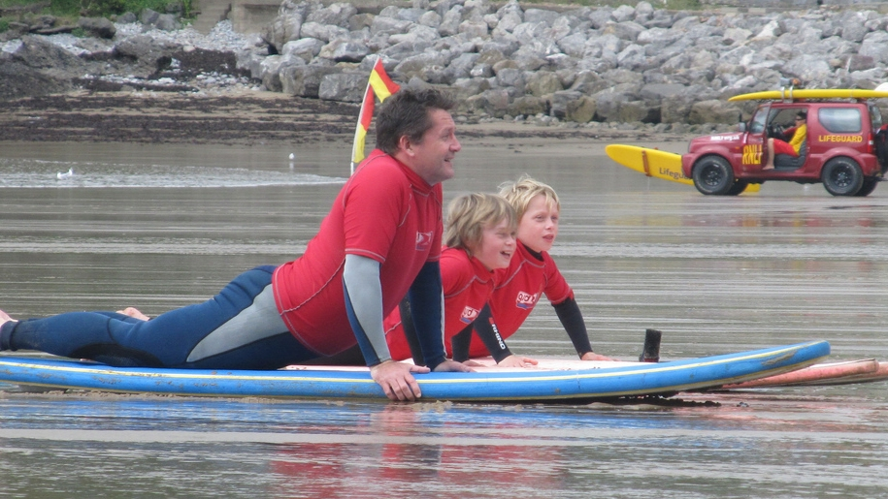
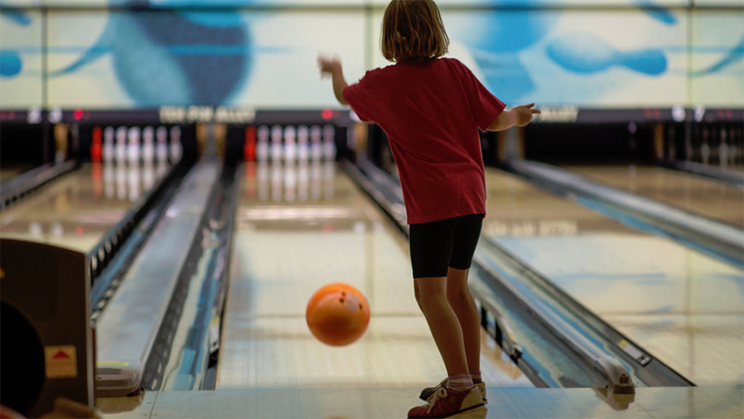
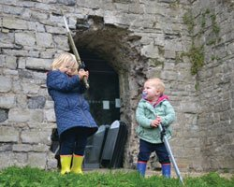
Sea Swansea
Discover the Gower coastline with our help
Sometimes the most breathtaking moments are found where you would least expect it
#SeaSwansea
Sea Swansea is a family fun break agency. We specialise in creating short holidays in Swansea and the Gower Peninsula for families that are packed with fun and engaging activities. Our aim is to give you the best experiences and help you create memories with your family that will last forever.
Sea Swansea 41 minutes ago
Swansea has a lot to offer families, making memories by the sea and creating bonding experiences to remember forever. Come to #SeaSwansea for yourself.
New challenges for all ages
Sea Swansea 4 hours ago
Booking your break with Sea Swansea is easy through our website online booking system, or you can just message us today or call 01234567890. We look forward to hearing from you
Easy to use 24/7 online booking system through our website
Check in date
Adults Children
Number of rooms
Sea Swansea Yesterday
Want to get the kids out for a weekend break but the Great British weather isn't cooperating? Rain or shine, round up your tribe and come to #SeaSwansea any time!
Too wet and windy? The competition is on at Tenpin Swansea
Events at Oystermouth Castle are always a hit
Sea Swansea 3 May at 14:55
Wanting to treat yourself and your family to a fun weekend break? To be in with a chance to *WIN* a break with Sea Swansea and surprise them to an adventure full of fun activities just like our page, like this status and share using the hashtag #SeaSwansea!
(Google Images)

Slide 5

Reasons for using social media to target family market?
Social media will lead to real relationship building
Users are receptive to your messages.
Social media ads allow targeting and retargeting.
You can respond to problems immediately.
A strong social media presence builds brand loyalty.
It’s free
Notes:
Social media will lead to real relationship building - you can read their tweets and status updates to get insights into their daily lives (and maybe adjust your marketing strategy as a result). What products are they buying and why? What are they doing on the weekend? What kind of posts do they love to share, and from what websites? You can also use social media as a tool for connecting with complementary, non-competing businesses, thought leaders and tastemakers in your space, as well as journalists who cover your industry
Users are receptive to your messages. People view Twitter and Facebook as social networks, not marketing machines. As a result, they’re less likely to see what you post as an advertisement and will be more likely to hear what you have to say
Social media ads allow targeting and retargeting. One of the reasons social media is important is because of the highly customizable nature of social media ads. Facebook ads, for example, allow you to target users by things like location, education level, industry and even purchase history and the pages they’ve liked. You also have to the option to install a Facebook pixel on your site and use it to retarget the users who visit you
You can respond to problems immediately. If there’s a problem with your product or service, you want to know about it right away. With the feedback you get in the process of social media marketing, you’ll be the first to know when there are issues – and you can take steps to resolve them right away.
A strong social media presence builds brand loyalty. A report published by Texas Tech University found that brands with active social media profiles have more loyal customers. when you’re engaging and interacting on social media) you become less like a corporation and more like what you truly are — a unified group of people who share a vision.
It’s free
Reference: The Content Factory (2018), ‘Why social media marketing is important for any business’. Available: https://www.contentfac.com/9-reasons-social-media-marketing-should-top-your-to-do-list/, [07/05/2018].

Slide 6
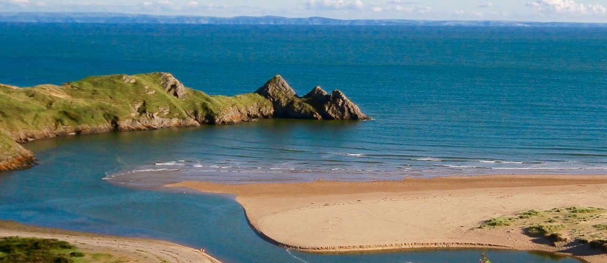
Cost to us £375.60
Package price to customers £565
Average 3 families per week = £ 29,484 annual profit
Annual marketing budget £2,948.40
Mid market price bracket
Subsidise incentives
Website costs
Charity events to network and build relationships
Bank majority of marketing budget for future developments including TV adverts in London, Midlands and other parts of Wales with a wider reach

Slide 7

COMPETITORS MARKETING
Radio and newspaper advertisements:
We won’t use newspaper or radio as It is easier to generalise families via these methods - ie stereotype families and not target changing family structures. Less personalisation via these methods.
Advertisements that target family needs:
Specific marketing targeting different needs within the family. Ie Thomas Cook offers hotel packages that include free childcare
Notes:
We found that a lot of tour operator competitors chose to advertise via radio and newspaper advertisements. However, research shows that these methods of advertisement are a lot less personal than methods such as social media. It is easier to generalise using these methods and stereotype families and their needs. As these methods also cost money, it would not be cost effective.
We also found that a lot of competitors offered specialist extras to fit different individual’s needs. For example Thomas Cook offers hotel packages that include free childcare - therefore appealing to a larger audience and offering a free benefit to families. This is a strategy we would also incorporate on our tours, whereby we would free child services during these evenings. This is a strategy we feel is very beneficial in attracting a wide range of people and so we have adapted this into our itinerary.

Slide 8
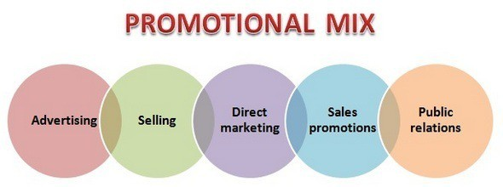
Marketing Techniques in response to the
Personal
No TV, newspaper or radio coverage - for now! Impersonal, costly and not very effective
follow up email week after leaving, return customer discounts in email, another 9 months on, build relationship
Down season sales promotions (book early/last minute bookings to fill up) - short term incentives Groupon, expedia, booking.com
Provide incentive for journalists in return for content and coverage. Use this technique with current popular bloggers and social media “stars”.. Especially ones that are popular with families/kids/mothers
Leaflets.. won’t use these - costly and only 2% response rate..

Slide 9
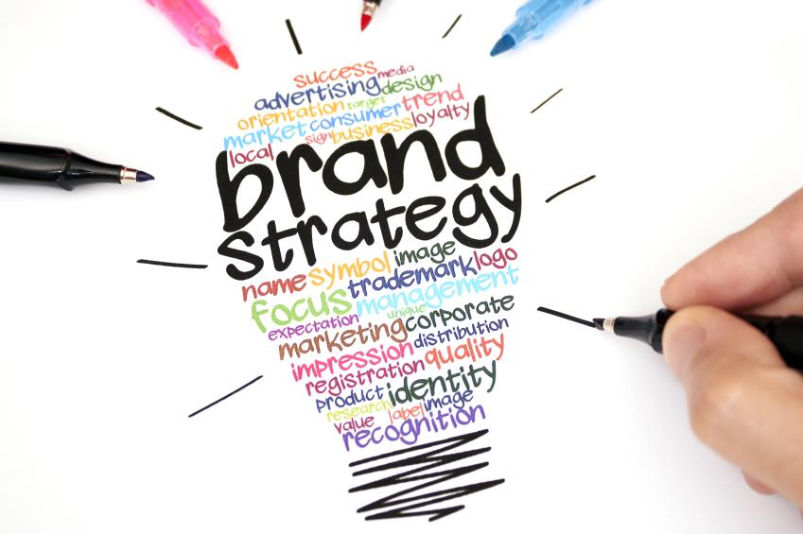
WHY CHOOSE OUR BRAND?
How we will compete with competitors?
Exceptional experiences and a personal touch
How we stand out?
There are few operators that offer package deals in the Swansea area therefore we are offering what few companies can. Also targeting different family groups
How will they recognise us / brand identity?
Unique and colourful brand logo. Blue relating to the seaside theme.
‘Making Memories by the Sea’ = want to be perceived as a family friendly tour operator offering seaside holidays.
Notes:
How we will compete with competitors?
Exceptional experiences and a personal touch
How we stand out?
From our research there are few operators that offer package deals in the Swansea area therefore we are offering what dew companies can. Also targeting different family groups - grandparents, single parents, young parents etc
How will they recognise us / brand identity?
Unique and colourful brand logo. Blue relating to the seaside theme.
‘Making Memories by the Sea’ = want to be perceived as a family friendly tour operator offering seaside holidays.

Slide 10
References
Multimedia Marketing .com (2018), ‘Integrated Marketing Communications’, [Online]. Available: http://multimediamarketing.com/mkc/marketingcommunications/, [2018, April 17].
The Content Factory (2018), ‘Why social media marketing is important for any business’. Available: https://www.contentfac.com/9-reasons-social-media-marketing-should-top-your-to-do-list/, [07/05/2018].

