Slide 1

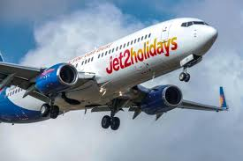
Explaining the internal operations and external environment of Jet2 Holidays
Sameena Hassan (2023264). Yasmin Saleem (2220775) and Hira Shahzad

Slide 2
Overview of Jet 2 Holidays
Jet 2 is a package holiday provider that sells its holiday packages through various different channels. Travel agents and can also be purchased via telephone though their contact centre whom are based in Leeds, United Kingdom.
Jet2 Holidays was discovered in 2003
Jet2 Holidays is a low budget airline
Operates to over 70 different destinations
A range of leisure destinations from its base airports at Leeds Bradford International Airport, and Belfast, Birmingham, East Midlands, Edinburgh, Glasgow, Manchester, London Stansted, New Bristol, and Newcastle airports.

Slide 3
Organisational structure of Jet2 Holidays
Their organisational structure is operations, maintenance, marketing and their finance divisions.
Have been rapidly expanding since the year 2000. As jet2 has been known to expand quickly, this has meant that their operational costs and revenue has also increased. In 2015, Jet 2 Holidays made a 15% rise in revenue and overall revenue increase was 47 Million.

Slide 4
Background organisation structure, size and its functions
Size of jet 2 - Jet2 Holidays is the UK’s 3rd largest airline, flying from 12 UK airports to more than 65 destinations across Europe, the Mediterranean and the Canary Islands. Since our first flight in 2003, we've grown our fleet, and in Summer 2023, we operated 119 planes.
Functions of Jet 2 Holidays – offering a variety of functions which includes managing your own booking online whilst adding your own extras and having the control t manage your own booking whilst keeping in touch with all the latest updates and information with flights and regulations which we must be aware of beforehand.
Jet2 focuses on safety, sustainability, and providing excellent customer engagement and service. Jet2 Holidays thrives to provide generous baggage allowance, holiday packages, and a loyalty program which benefits their customers, ensuring a pleasant and rewarding travel experience for everyone to make it memorable.

Slide 5
The internal and external environment influencing the organisation
internal environment in order to assess its resources, competencies, and competitive advantages. Performing an internal analysis allows you to identify the strengths and weaknesses of your organization (Mirkovic 2020). Jet2's mission is 'to be the UK's leading and best leisure travel business' (Jet2 plc, 2021). Performing an internal analysis will allow a sustainable competitive advantage to be created and established for Jet2.

Slide 6
External continued..
External - they can expand upon their current target demographic to access and attract a new younger audience. They will be able to do this by promoting their services on a variety of social media platforms following their reconditioning of the website. The aim of this is to make it more modern and accessible to ensure that their number of purchases and returning customers remains high to and that they continue to be of the top companies in the low-cost UK airline industry.
However, although there are a great number of positives to the recommendations suggested some negative impacts can be established. It may be difficult for Jet2 to make drastic changes to their demographic and website, due to the fact that the market is highly competitive, and it will be extremely easy for customers to substitute to alternative airlines. To overcome this, Jet2 must ensure that they continue to offer unique services, such as their VIP Plus Scheme, as well as the introduction of brand ambassadors via social media.
This will give Jet2 an advantageous edge over competitors, enhancing their brand reputation and hopefully leading to an increase in sales and market share.

Slide 7
PESTEL analysis on Jet 2
Political – less disposable income to spend on holidays. However the political economy in the Uk is always changing with the recent changes in laws and regulations however is stable for majority members of public travelling and providers such as Jet2 do update customers with any legal change.
Economic – UK experienced inflation of 1.8% in 2020, 1.9% in 2021,2022 and 2023. Due to the inflation, consumers had to pay more to ensure all costs were covered of travelling.
Social – further to the emphasis that society have to save money and seeking new adventures, the society has become more sensitive and require everything to be perfect regarding their holiday to prevent any mishap.
Technology – the use of technology has been proven to benefited the economy and business as this allows to use social marketing to increase sales.
Legal – airline must uphold specific service and quality criteria to comply with the regulation.
Environmental- passengers heightened sensitivitiy to climate change has contributed, passengers increasing awareness, aeroplanes may need to adopt ecogically friendly operations (Levens,2020).

Slide 8
SWOT analysis of Jet2
Strengths = 2nd largest British tour operator providing over 1million customers with holiday packages a year, ATOL protected and transport provided to and from the airport to your hotel. The brand is reputated and recognised everywhere in the world.
Weakness= competitors such as TUI are providing other services other than holiday packages such as flight only and wedding packages. The labour costs has impacted the structure due to the large number of employees causing
Opportunities = companies are provided with the opportunity to expand their aviation sector as this continues to increase due to rising demand for travel, priority is time management given a rise in aviation sector.
Threats = concerns of brexit impacting, competition with rivals. Following the travel sector are impacted by the cost increases.

Slide 9
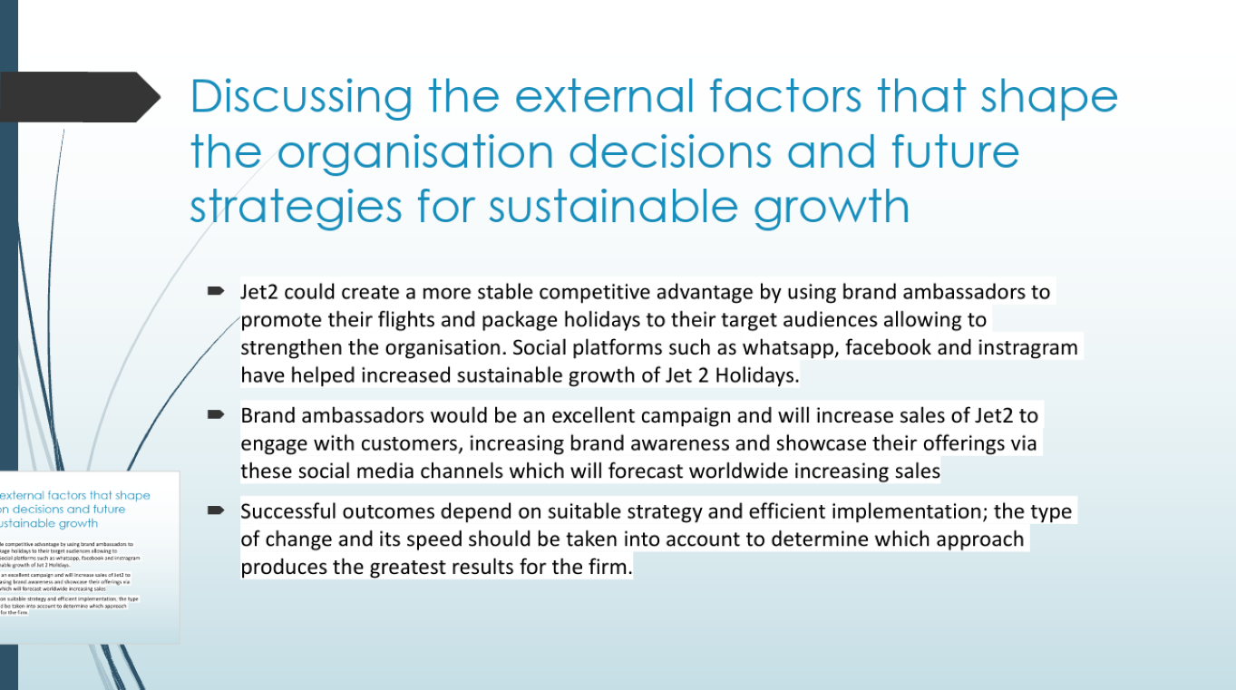
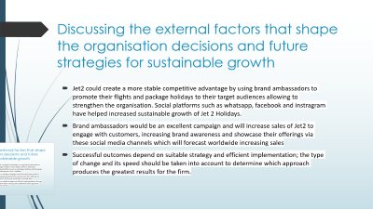
Discussing the external factors that shape the organisation decisions and future strategies for sustainable growth
Jet2 could create a more stable competitive advantage by using brand ambassadors to promote their flights and package holidays to their target audiences allowing to strengthen the organisation. Social platforms such as whatsapp, facebook and instragram have helped increased sustainable growth of Jet 2 Holidays.
Brand ambassadors would be an excellent campaign and will increase sales of Jet2 to engage with customers, increasing brand awareness and showcase their offerings via these social media channels which will forecast worldwide increasing sales
Successful outcomes depend on suitable strategy and efficient implementation; the type of change and its speed should be taken into account to determine which approach produces the greatest results for the firm.

Slide 10
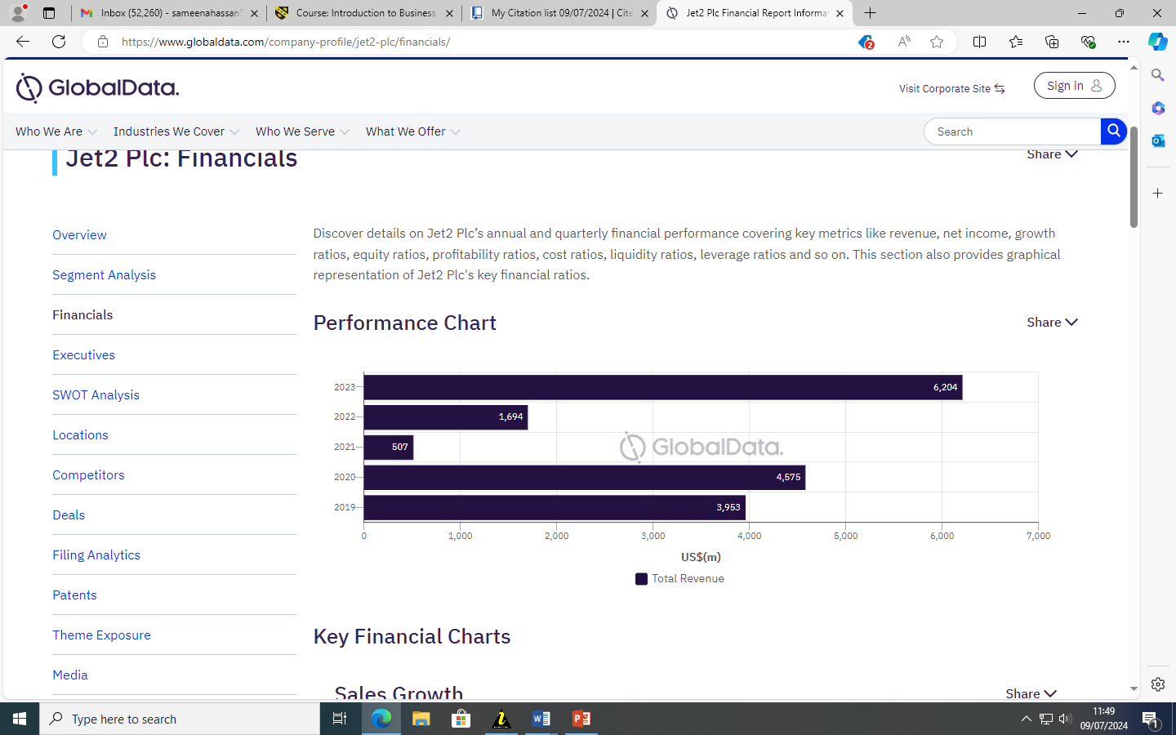
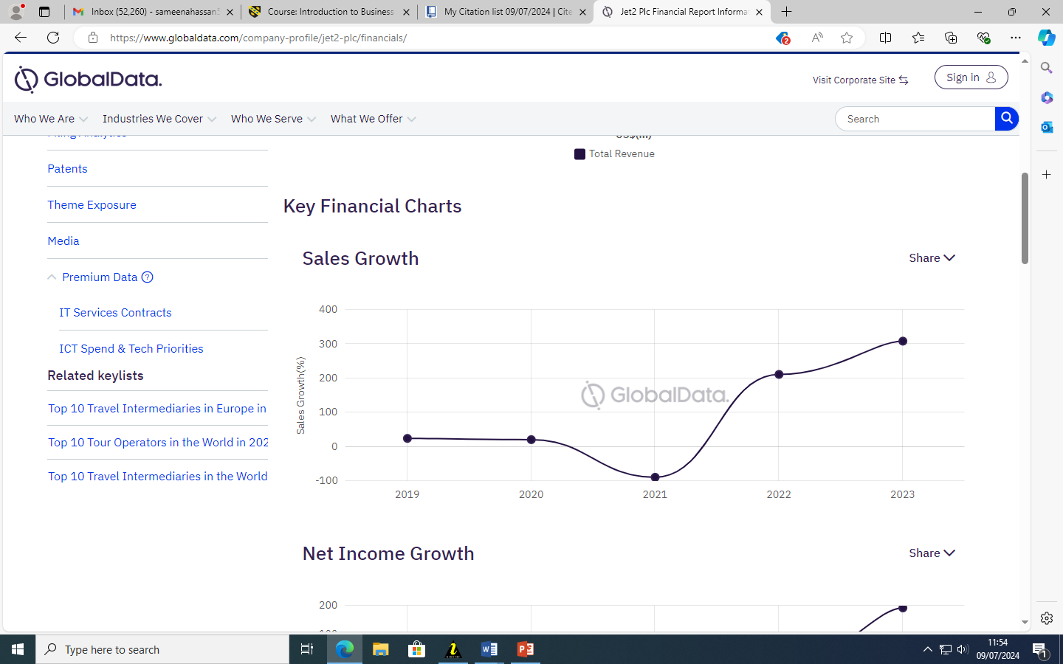
Financial side of Jet2

Slide 11
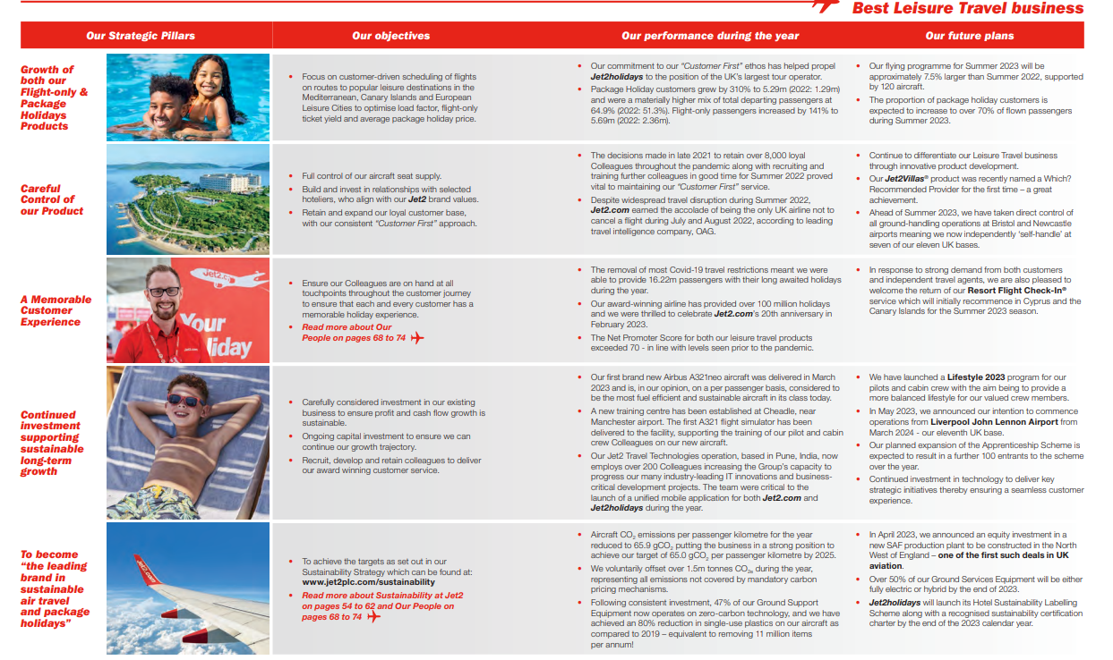

Slide 12
Conclusion
To conclude, following the review of Jet2's current strategic position and their internal and external environment in which they operate, it can be seen that they are in a very secure position and have the resources to grow through there use of promotions and development. Therefore, Jet2 can increase their current ranking and attract a wider target audience which will ultimately improve their brand loyalty and overall market revenue.

Slide 13
referencing
(corporate.easyjet.com, 2022).
(Travel Trade Association)(Walker, 2019).
(www.globaldata.com, 2022)
Pestel - (Brezonakova, Badanik and Davies, 2021).

