Slide 1
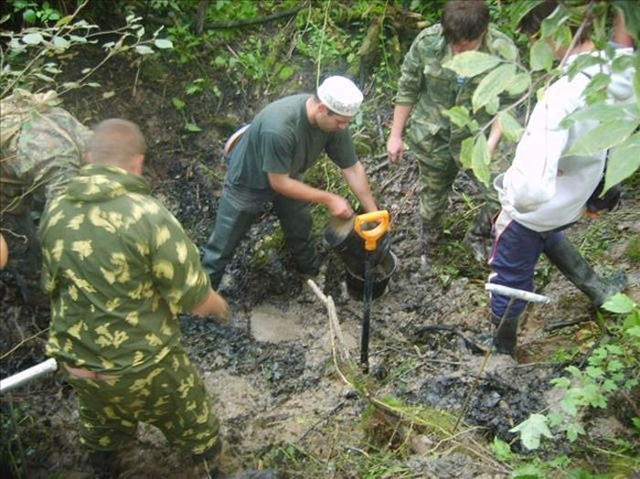
Export and exploitation
global capitalism & battlefield heritage

Slide 2
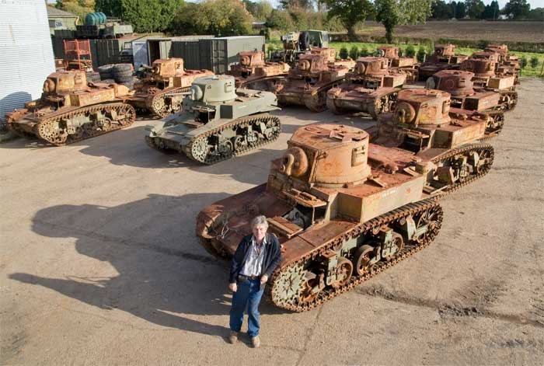
16 M3 ‘Stuart’
Imported to UK 2008

Slide 3
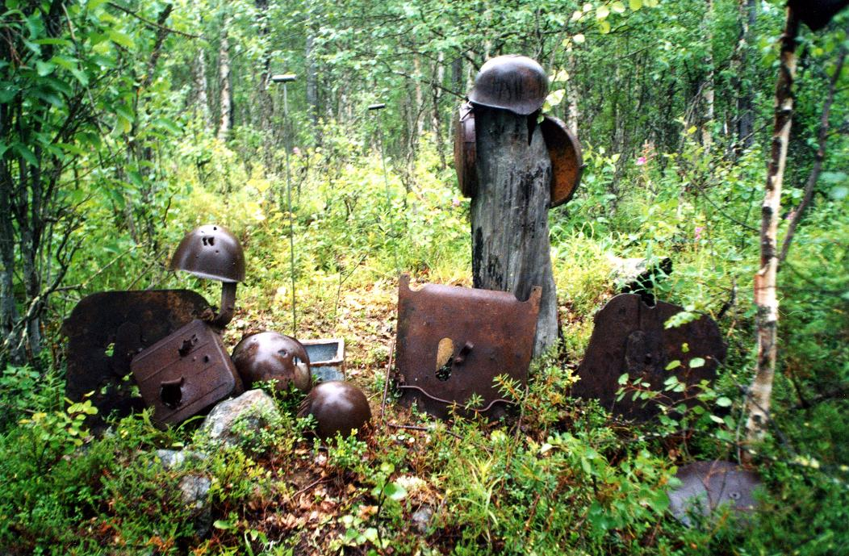

Slide 4
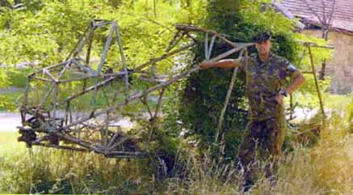
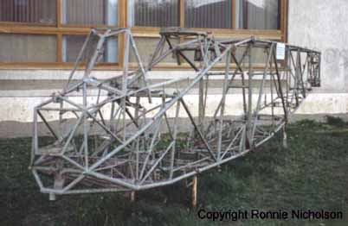
DFS 230
Drvar Bosnia 2001

Slide 5
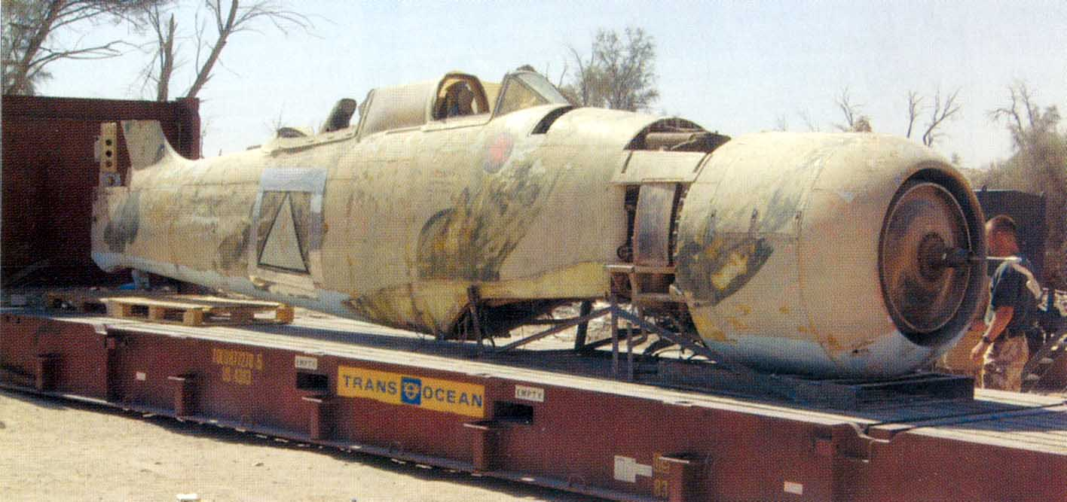
Hawker Fury T-20
Iraq 2004

Slide 6
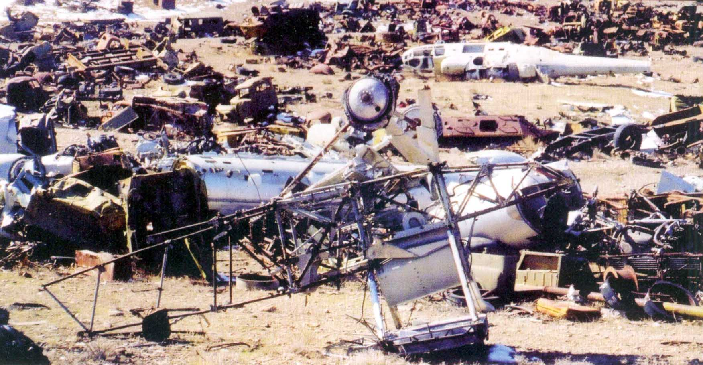
Hawker Hind
Kabul Afghanistan 2004

Slide 7
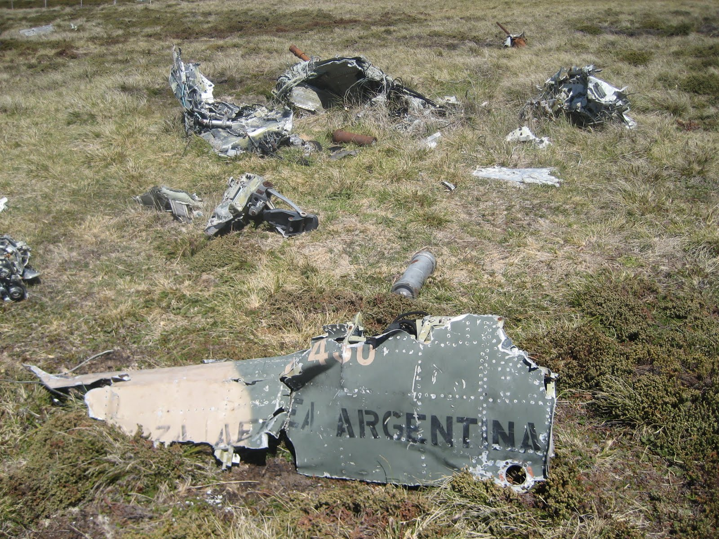
Falkland Islands / Islas Malvinas

Slide 8
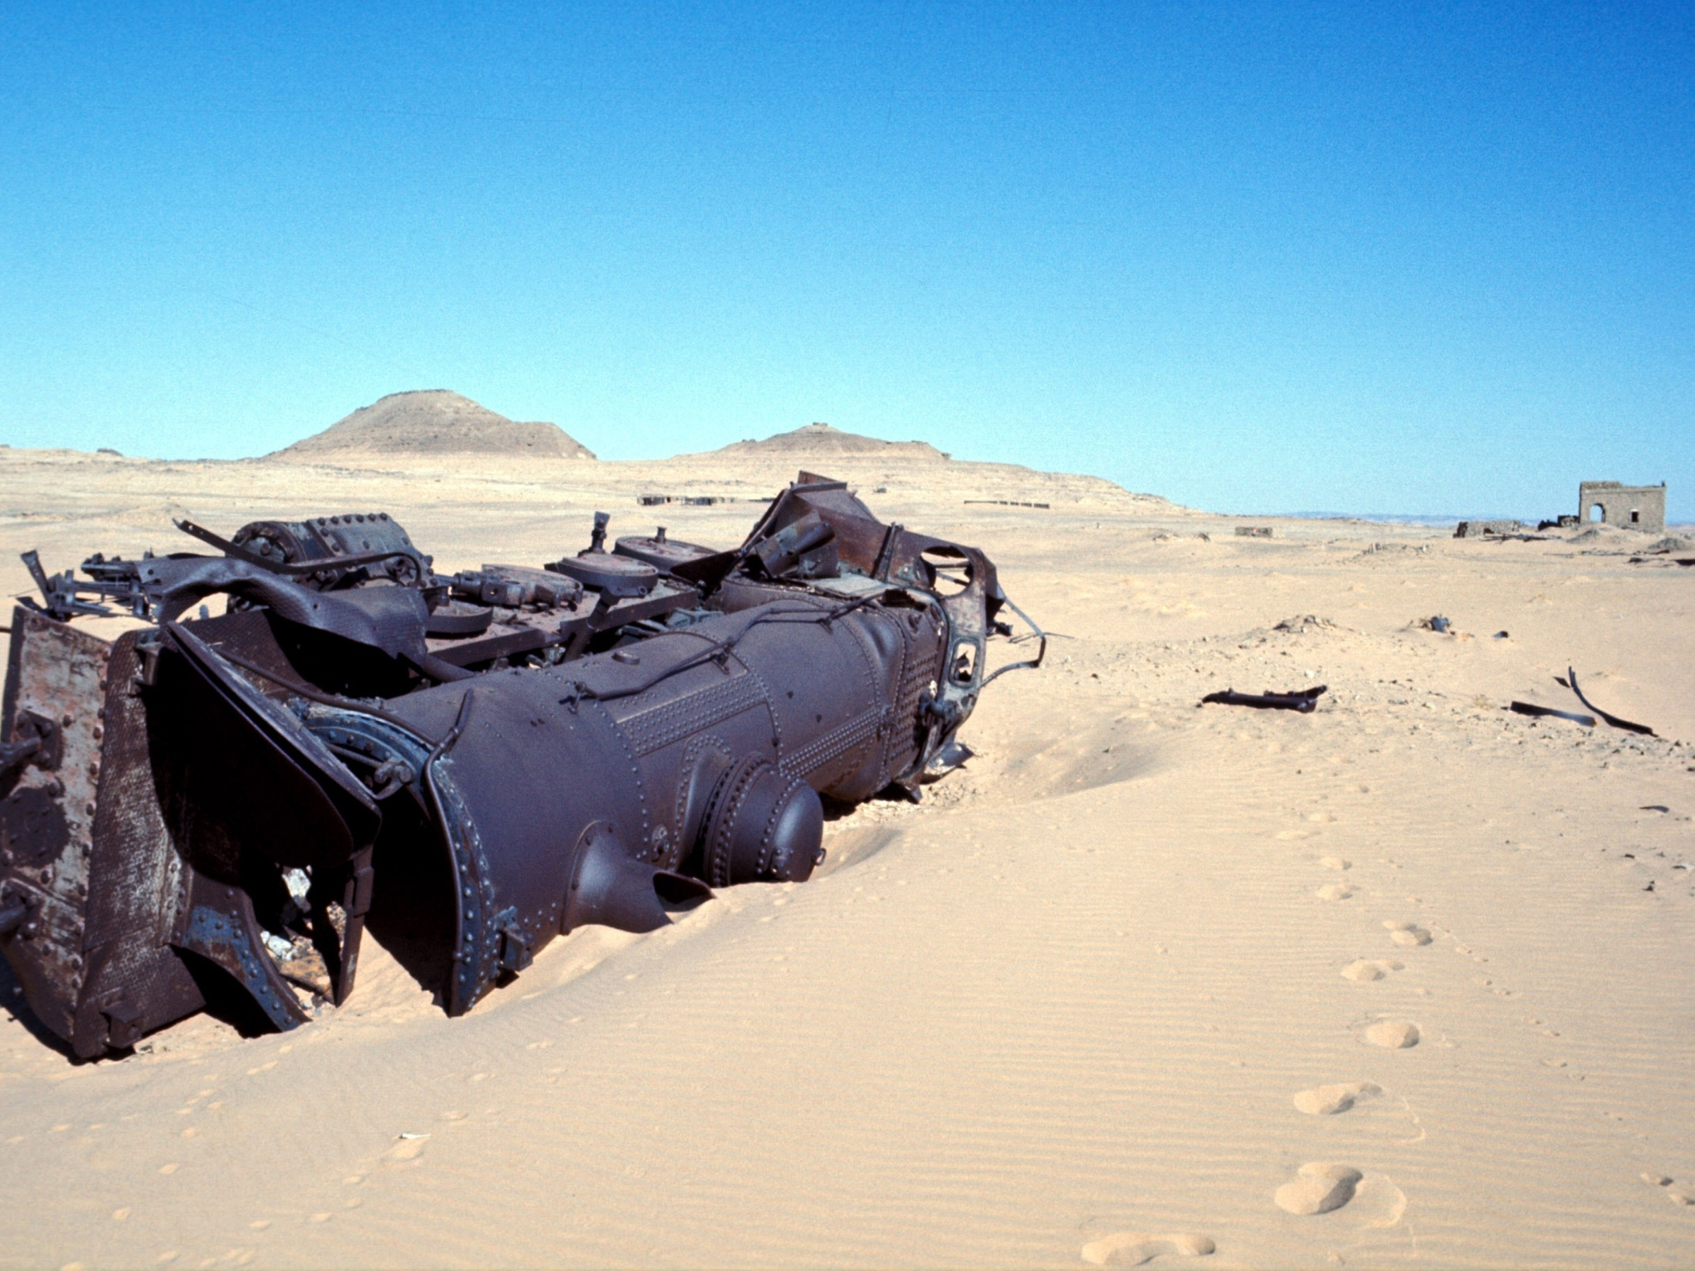
WW1 Turkish steam engine wreck – Jordan (Hejaz Railway, a 1,320-kilometre narrow-gauge line linking Damascus and Medina)
Attacked and destroyed by T.E.Lawrence in 1917

Slide 9
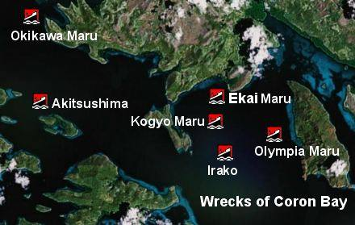

Slide 10
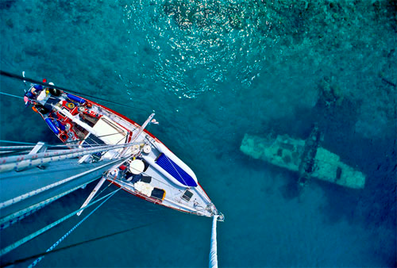

Slide 11
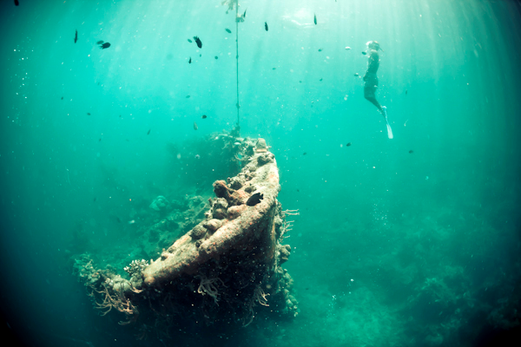

Slide 12
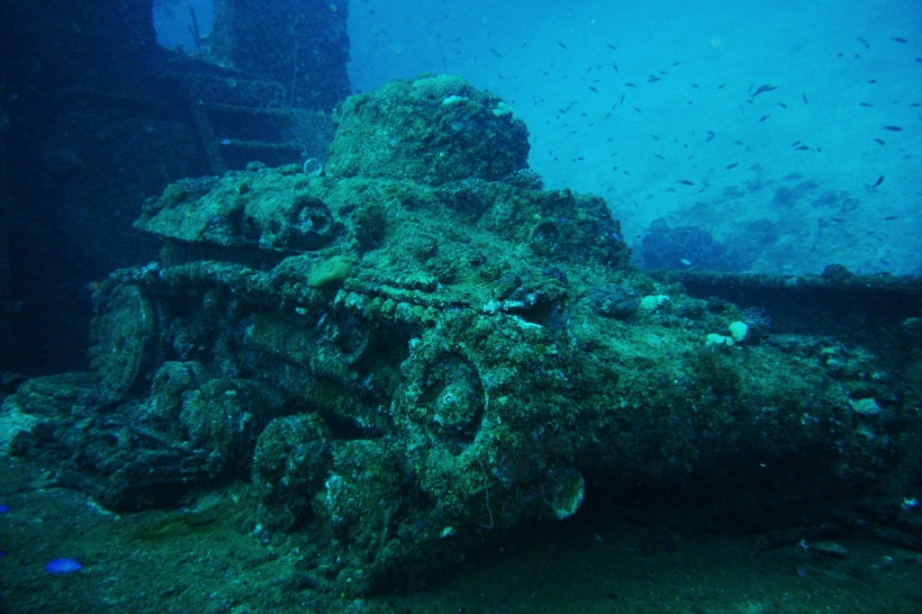

Slide 13


Slide 14


Slide 15


Slide 16
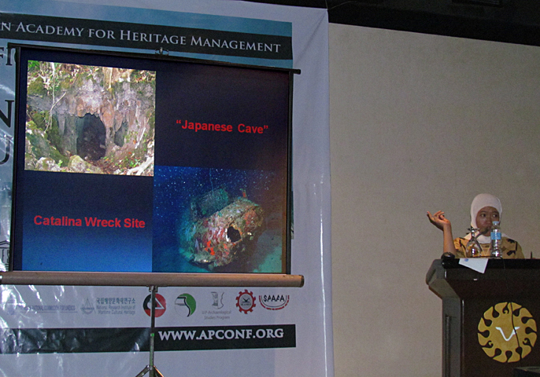

Slide 17


Slide 18
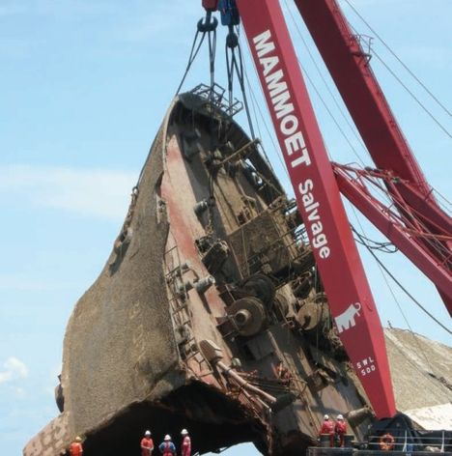

Slide 19
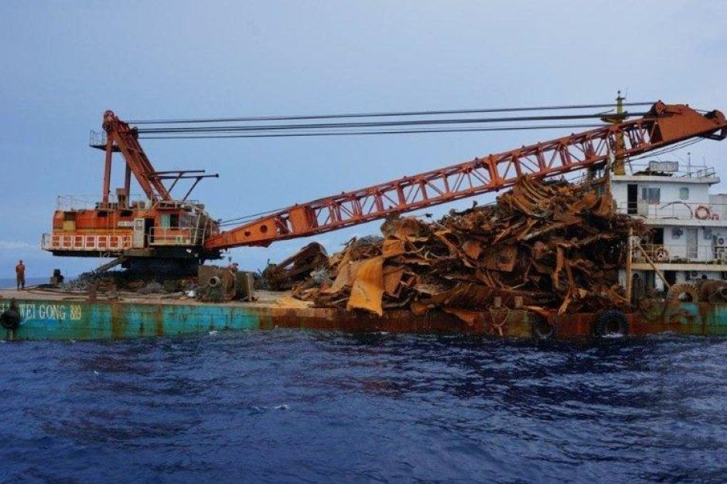
Scavenging Dutch WW2 submarine O-16 - October 2013
According to IHS Maritime 360, the “HAI WEI GONG 889”, although manned by Chinese nationals, is operated by a Malaysian company, Rei Management Sdn. Bhd

Slide 20
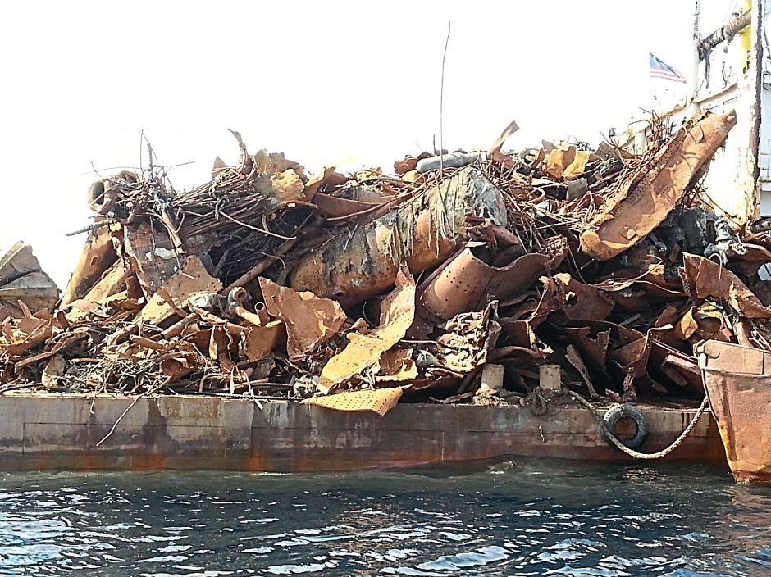

Slide 21
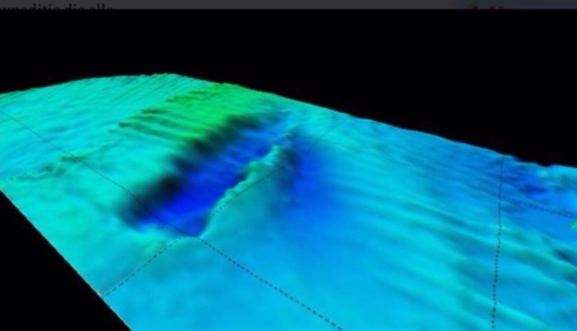
Java Sea – 2015 - The footprint of a the Dutch WW2 submarine O-16 on the sea bottom - note the tracks of the demolishing / scavenging machines

Slide 22
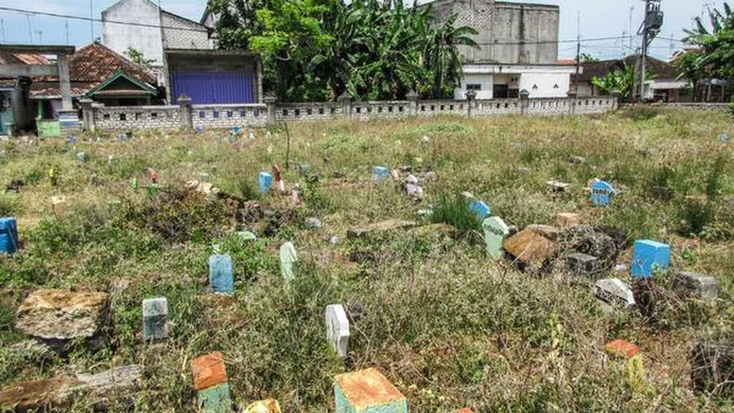
The human remains are located in at least four places: Brondong city cemetery, two mass graves somewhere in the harbour area and the city’s garbage dump where the remains are unrecoverable - Indonesia

Slide 23

Tourists look at Khmer Rouge victims' skulls on display at the former Khmer Rouge extermination camp, Choeung Ek, Phnom Penh, Cambodia (2004)

Slide 24
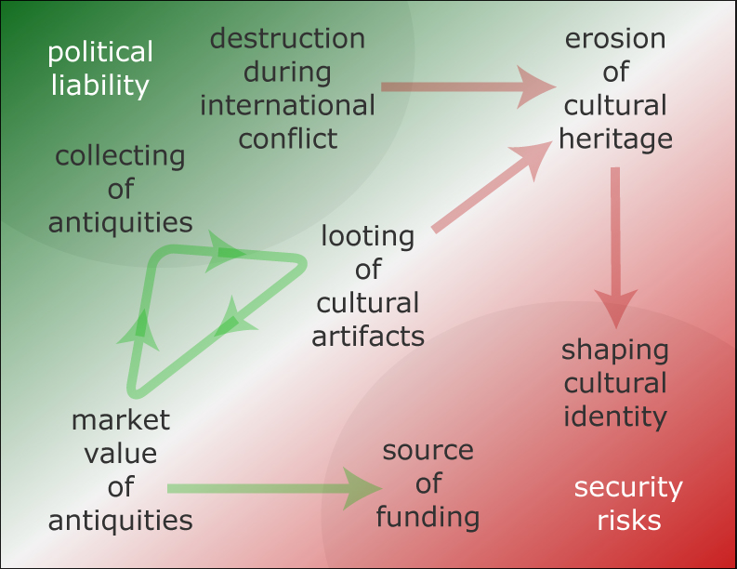
Erik Nemeth, "Cultural Security: The Evolving Role of Art in International Security"
Terrorism and Political Violence, 19:1, 19-42, 2007

Slide 25
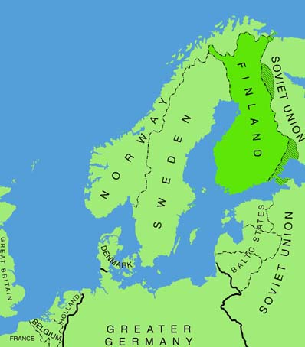
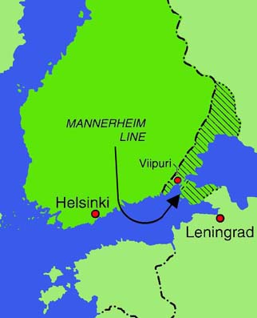
Karelia
(ceded to Russia following the Winter War, 1939-40)

Slide 26

Big Kaleyarvi Lake
Republic of Karelia

Slide 27
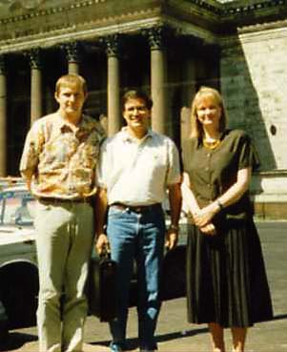
Marja Dmietriev (r)
Vladimir Prytkov (l)
& Gary Villiard (c)
St.Isac Cathedral
St. Petersburgh
June 1994

Slide 28

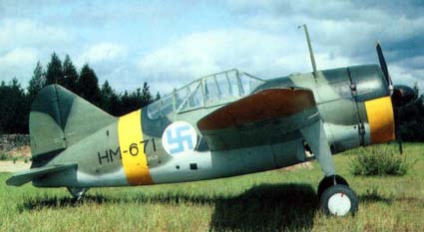
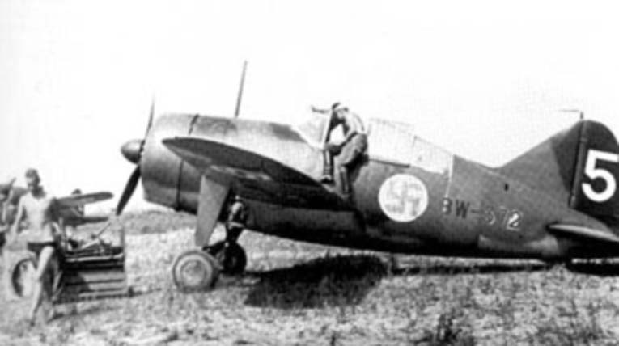
Brewster Model 329 BW-372

Slide 29
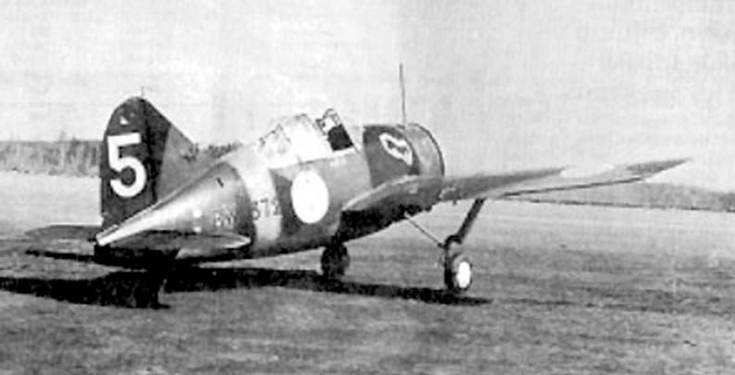
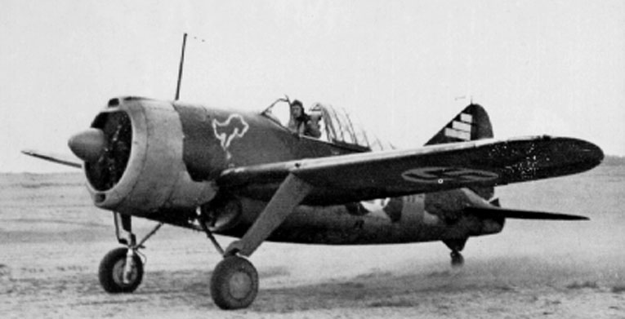
Brewster Model 329
BW-372 2/LeLv 24
Tiiksjärvi airfield,
October 1941
Pilot is Sgt. P. Koskela who on
24th January 1942 survived a
‘Taran’ attack in this aircraft

Slide 30
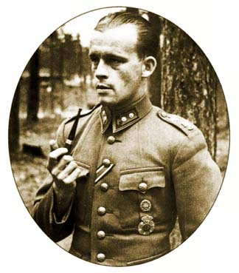
1Lt. Lauri Pekuri
August 1942
18.5 kills
314 combat sorties
2/LeLv 24
1939 - Feb 43
1/LeLv 34
Feb 43 - June 44
25th June 1944
shot down - P.o.W
Jan 1946
returned to Finland

Slide 31
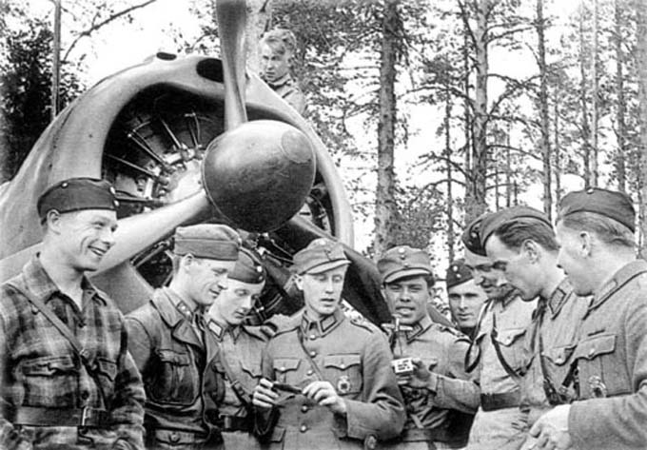

Slide 32
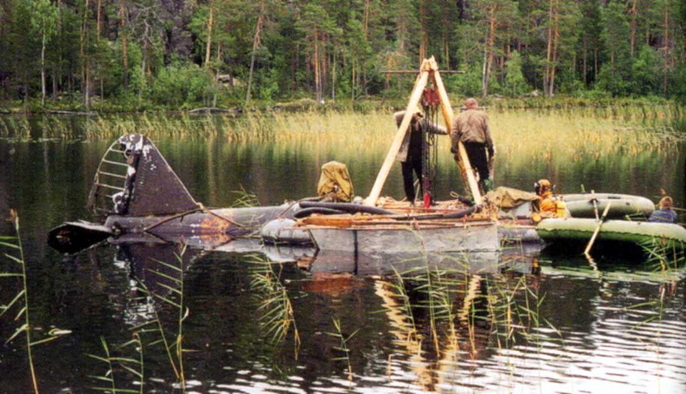
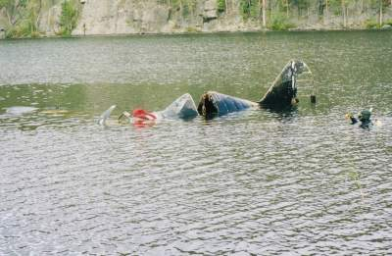
Brewster Buffalo BW-372
September 1998

Slide 33
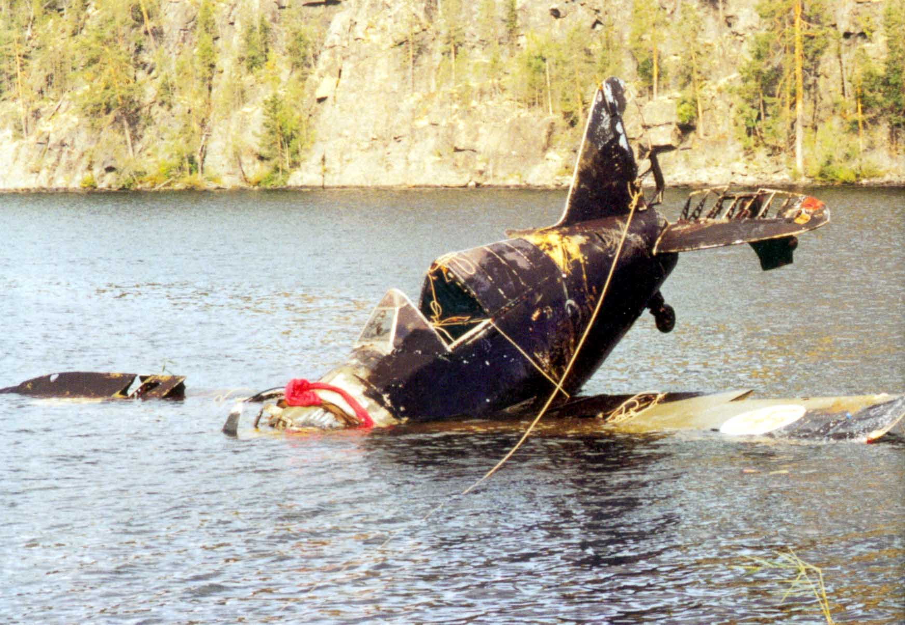

Slide 34
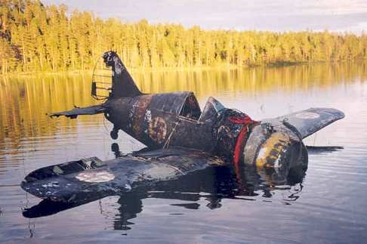

Slide 35
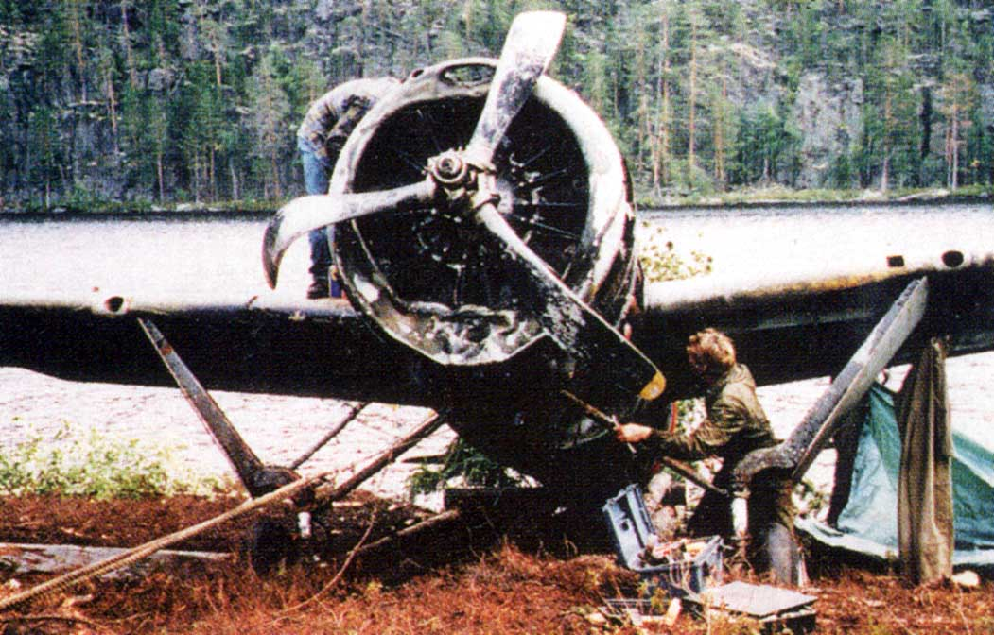

Slide 36
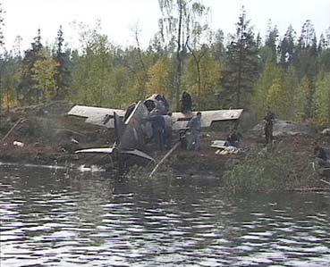
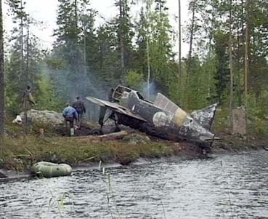
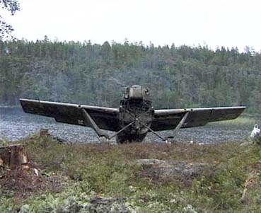
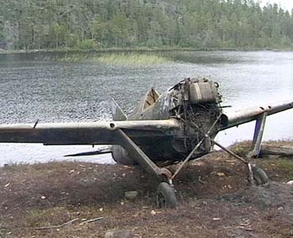

Slide 37
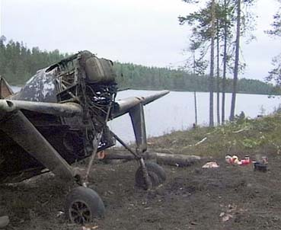
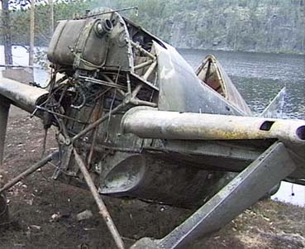
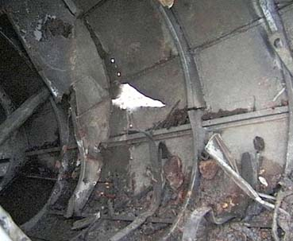
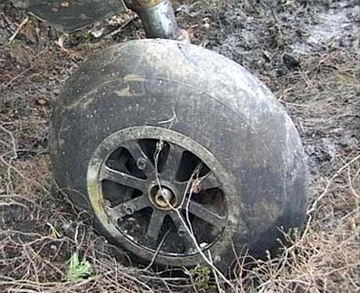

Slide 38
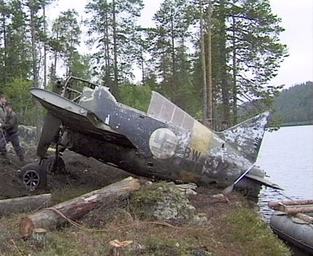

Slide 39
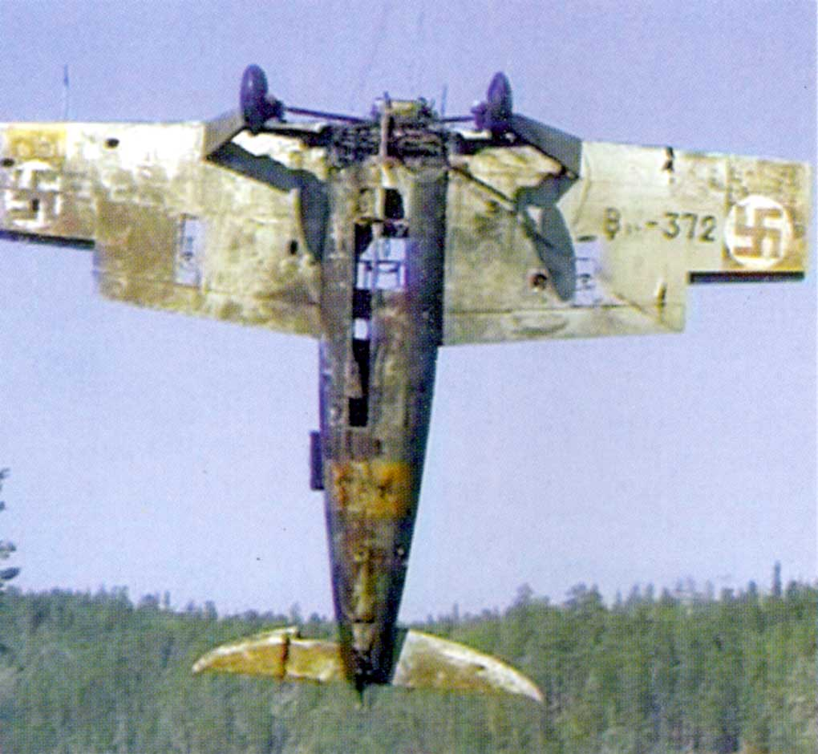
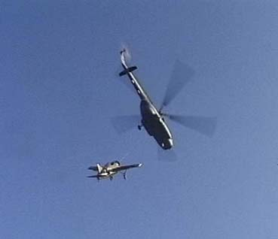
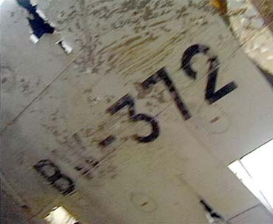

Slide 40
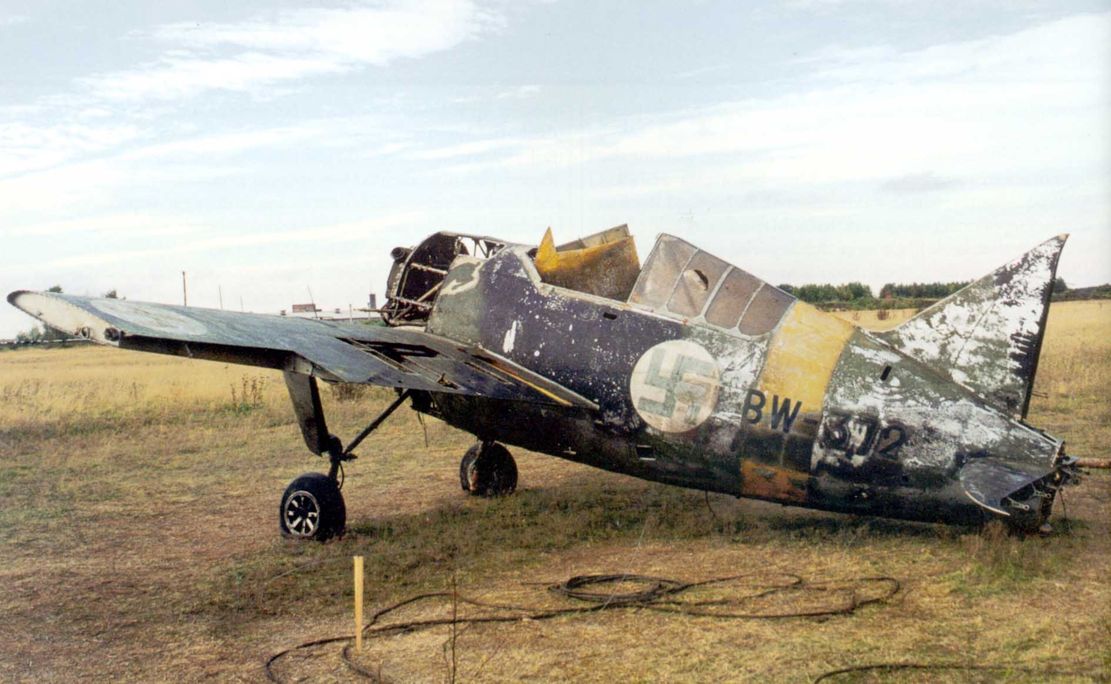
Segezha airfield
Russia 1999

Slide 41
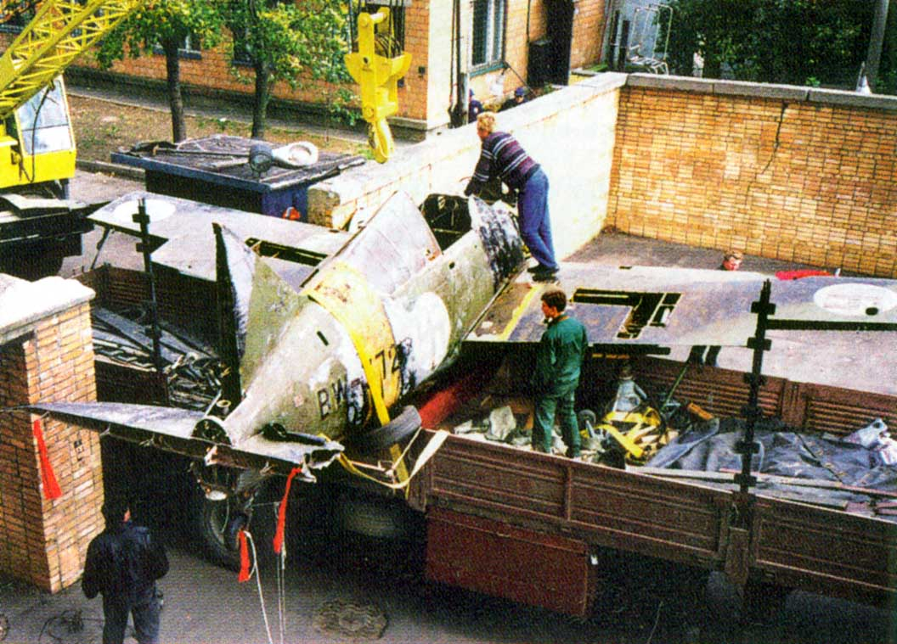

Slide 42
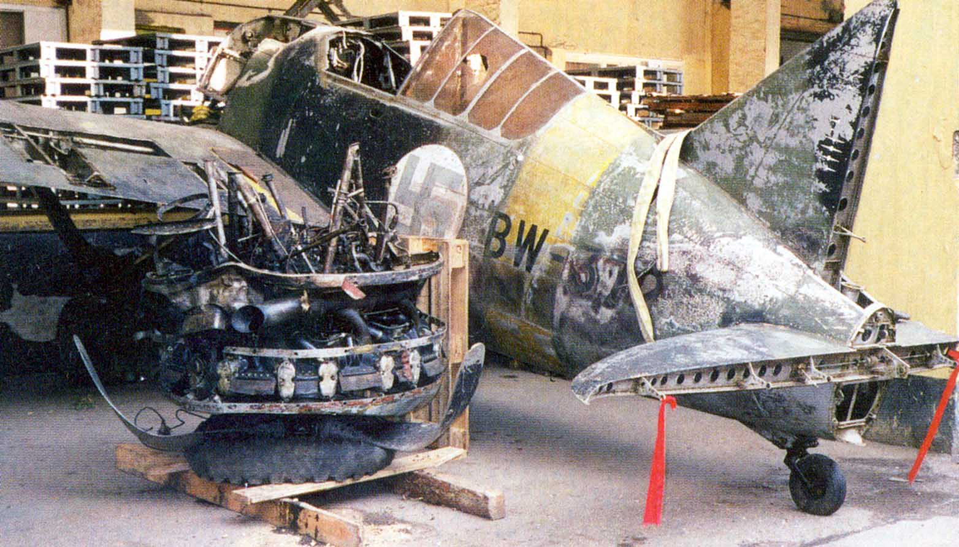

Slide 43
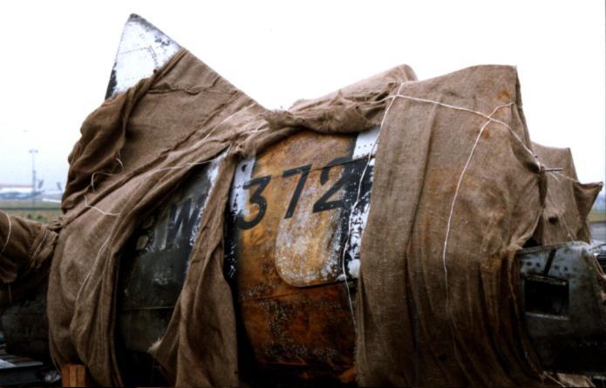
Brewster Buffalo BW-372
Shannon airport 2000

Slide 44

August 2004, BW-372 was acquired by the Museum of Naval Aviation in Pensacola, Florida

Slide 45

Suomen Ilmavoimamuseo
(Finnish Air Force Museum), Helsinki

