Slide 1
Master of Business Administration
Human Capital Management
Recruitment and performance management

Slide 2
What is recruitment?
Recruitment
  The process of attracting individuals in sufficient numbers with the right skills and at appropriate times to apply for open positions within the organization.
  Actively soliciting applications from potential employees – separate activity from selection.

Slide 3
Recruitment adverts
UK costs of more than £1 billion each year – includes:
  Local newspapers
  National newspapers
  Trade and professional journals
(Taylor, 2014)

Slide 4
Recruitment adverts
Factors to consider:
  Style and wording
  Wide trawl or wide nets
  Precise or vague information
  Corporate image

Slide 5
Recruitment Process
Is there a vacancy?
If yes, should the job be done in the same way? Or is it a new position?
Design or update job description and person specification
Seek authorisation to recruit and choose selection methods
Advertise in appropriate media e.g. company website, newspaper, agencies

Slide 6
Job analysis
Concerned with systematically collecting information about an existing job, which activities are performed, what the expected outcomes of the tasks are, and what skills are needed.

Slide 7

Job description
Sets out basic details of the job: primary purpose, reporting relations, main activities or tasks carried out and any special requirements. Will usually include:
  Job title
  Grade/rate of pay
  Main location
  Responsible to
  Responsible for
  Main purpose of the job
  Responsibilities/duties
  Working conditions

Slide 8
Person specification
States necessary and desirable criteria for selection. Will usually include details of:
  Skills, aptitude, knowledge and experience
  Qualifications – only those necessary to do the job – unless candidates are recruited on the basis of future potential
  Personal qualities relevant to the job, such as ability to work as part of a team.

Slide 9
Internal recruitment
Job Posting: The process of announcing job openings to employees – job information should be made available to all employees.
Employee Referrals
Promotions from within
Lateral transfers
Rehiring former employees

Slide 10
External recruitment
Internet
Several options are available:
  Employer websites
  Job sites linked to newspapers and journals
  Job sites operated by employment agencies
  Social media

Slide 11
External recruitment
External agencies
  Government and voluntary agents - Services are often free of charge, but the quality of candidates can be questionable
  Advertising and recruitment consultants - More expensive, but can help employers attract the most suitable candidates
  Temporary employment agencies
  Head-hunters and permanent employment agents

Slide 12
Education liaison
More than 400,000 students graduate each year from UK universities.
The majority have the ability to make a real difference to an organization’s future performance.
Graduate recruiters generally search for the same types of people and use the same recruitment and selection tools to identify them.

Slide 13
Concept of ‘Fit’
Recruitment & selection decisions can seek to create:
Supplementary fit: when an individual possesses characteristics that are similar to others in the organisation, and embellishes the fit.
Complementary fit: when a person’s characteristics add what is lacking in an organisation

Slide 14
What criteria should recruitment and selection be based on?
CIPD says selection processes should be based only on:
  Experience
  Qualification
  Ability to do the job
  Ability to make valuable contributions to the organisation’s effectiveness.
  Potential for development.
Compare with your experiences?

Slide 15
Factors influencing the choice of selection methods
Available budget
Time-scale for appointment
The accuracy required
The type, specialism and level of post to be filled
Previous custom and practice
The abilities of the staff involved in the process

Slide 16
Evaluating recruitment and selection
Success – getting the right person, at the right time and at the right cost.
How – cost per applicant, total applicants, time taken to fill the role, number of qualified applicants.

Slide 17
Performance Management – Performance Appraisals

Slide 18
What is ‘performance’?
Boxall and Purcell
  Performance is a function of ability, motivation and opportunity, as shown in the formula:
  Performance = ƒ(Ability x Motivation x Opportunity to Participate).
In other words P = a mixture of an individual’s knowledge, skills and actions combined with the available organisational resources and support.

Slide 19
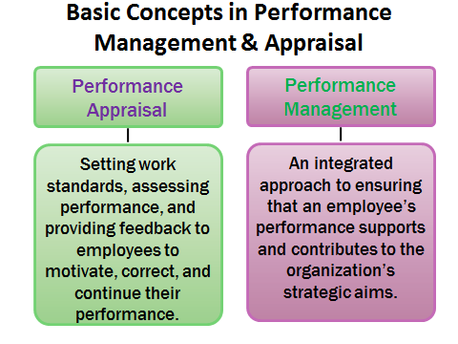

Slide 20
Performance management
cycle
Goals and objective
Corporate level
Divisional level
Team level
Agreement
Individual and team performance criteria agreed with line management
Review Feed back Report (appraisal)
Comparison between expected and actual performance
Agreed Action Plan
Include self development plans
Performance
Monitoring
Feedback
Coaching

Slide 21
Reasons for Performance Management?
Improve motivation and morale
Clarify performance expectations, communicate goals
Control behaviours, set norms and values
Improve communication
Encourage employee growth and development
Identify training/development needs
Provide a systematic basis for (reward-focused) decisions on pay, promotion, discipline, transfer, termination

Slide 22
What is appraised …
Appraising the person: Assessment of traits or attributes such as loyalty, stability, decisiveness...;
Appraising behaviour: measuring application of competences associated with effective performance; rating key job-related behaviours;
Evaluating performance against set objectives: not always easy.

Slide 23
Managing Poor Performance
IRS Survey with 139 organisations (300,000 staff)
  Four-fifths had experienced underperformance to some extent while one in 10 had experienced it to a considerable extent
  Only 8 percent of respondents felt that their efforts to deal with poor performance had been successful
  Two-thirds of them did not consider that managers at their organization were capable of managing it
(Armstrong, 2009)

Slide 24
Ethical Principles
Employees are positively inclined towards PM systems that tie in with pay rise, promotion, training and development, or other incentives.
The element of justice is however important in the performance management process.
It is essential that the process is perceived as fair if it is to bring about employee commitment.

Slide 25
Traditional Systems - Annual Appraisal
Interviews held with employees to carry out a review of their performance. Three stages:
  Around 2 weeks prior, the employee may be given a self assessment form, which provides a measured way of assessing the key points of the job. These will have been established through a process of job analysis. The employee is asked to consider in an objective way and assess their own performance.
  Manager also has a form which is completed in advance of meeting. It is important that the manager assesses the employee in the light of valid and verifiable information.
  The two then meet to reach an agreement over the degree to which the employee has met the required standards.

Slide 26
Critical Incident Technique
Unusual events that denote superior or inferior employee performance in some part of the job.

Slide 27
Essay Evaluation
An approach to performance appraisal that requires the rater to compose a statement describing employee behavior.

Slide 28
Management By Objective (MBO)
Rating performance on the basis of employee achievement of goals set by mutual agreement of employee and manager.

Slide 29
Problems with Performance Appraisals
Validity & Reliability
  Halo: the appraiser notes desirable traits and allows these to spread to all other attributes.
  Horn: reverse and results in lower assessment than might otherwise be expected.
  Subjectivity: the closeness of the relationship between appraiser and appraise.
  Recency: only events that happened recently are remembered and measured.

Slide 30
Current trends in performance appraisal
More and more leading companies (Adobe, Microsoft, Deloitte, Accenture, General Electric, etc) are abandoning traditional performance appraisals:
Ratings and rankings
Annual objectives
Links to pay
In favour of:
Weekly check-ins with line manager
Coaching and mentoring
Focus on development instead of reward
Feedforward instead of feedback

Slide 31
References/Further Reading
ACAS (2010) How to Manage Performance. Advisory Booklet. London: ACAS
Armstrong, M. (2009) Armstrong’s handbook of performance management: an evidence-based guide to delivering high performance. 4th ed. London: Kogan Page.
Armstrong, M. (2015) Armstrong’s handbook of performance management. London: Kogan Page
Armstrong, M. and BARON, A. (2004) Managing performance: performance management in action. London: Chartered Institute of Personnel and Development
Blumberg, M. & Pringle, C. D. 1982. The missing opportunity in organizational research: Some implications for a theory of work performance. Academy of Management Review 7, 560-569.
CIPD (2009) Performance Management In Action: Current Trends and Practice. Research report. London: CIPD
CIPD (2014) Performance Management – An overview. Factsheet. London: CIPD
Cockerill, T. and MESTER, B. (2006) How to develop high performance. People Management. Vol 12, No 7, 6 April. pp52–53.
Hutchinson, S. (2013). Performance Management: Theory and Practice. London:CIPD
Ibeogu, H. and Ozturen, A. (2015). Perception of Justice in Performance Appraisal and Effect on Satisfaction: Empirical Findings from Northern Cyprus Banks. Procedia Economics and Finance, 23, 964-969.
Locke, E. A., & Latham, G. P. (1990). A theory of goal setting and task performance. Upper Saddle River, NJ: Prentice Hall.
Marchington, M., Wilkinson, A., Donnelly, R. and Kynighou, A. (2016). Human Resource Management at Work. 6th ed London: CIPD.
McCloy RA, Campel JP, Cudeck R (1994). A confirmatory test of a model performance determininents. J. Appl. Psychol., 79: 493-854.
Prather, T, (2010). The Perception of Fairness of Performance Appraisals. ETD Archive. Paper 373.
Purcell, J. and Hutchinson, S (2007) Rewarding work: the vital role of line managers, CIPD.

Slide 32
References
Mueller-Carmen, M., Croucher, R. and Leigh, S. (2008). Human Resource Management- A case study approach. London: CIPD.
Smith, M. and Gregg, M. and Andrews, D. (1989), Selection and Assessment: A New Appraisal, London: Pitman.
Taylor, S. (2014), Resourcing and Talent Management (6th edition), London: CIPD.

Slide 33
Objectives
Students should be able to:
Explain disciplinary, dismissal and redundancy procedures - the legal requirements and what constitutes best practice
Evaluate the evidence on how these matters are handled in organisations.
Understand the different causes of redundancies

Slide 34
Employee dismissal
Dismissal of an employee occurs when:
The employer terminates the contract, either with or without giving notice
A fixed term contract ends and is not renewed
Constructive dismissal – when an employee is forced to leave their job because of the employer’s conduct
  (e.g. not being paid, forced to work night shifts when not in contract, allowing bullying and harassment by colleagues).
According to ACAS, the most common reasons for dismissal are misconduct, inability to do the job and redundancy.

Slide 35
What is redundancy?
Legal Definition: Sect 139(1) Employment Act 1996 describes redundancy as a form of dismissal which often occurs due to some known reasons….
Redundancy is classed as a dismissal of employees which may have occurred not necessarily as a fault of the employee or employer.

Slide 36
Reasons For Redundancy
Business or plant closure
Business relocation
Employer no longer need an existing particular kind of work, possibly in a particular location
Introduction of new technology- Machine take over of human services
Lack of business funding

Slide 37
Redundancies also commonplace in successful firms…
Way of streamlining, cost-cutting e.g. making employees redundant then re-engaging them through employment agency
Employer can decide fewer employees needed for same amount of work
Re-train surviving employees to undertake existing jobs
Also used to increase control of behaviours e.g. if absence rates used as primary criterion for selection

Slide 38
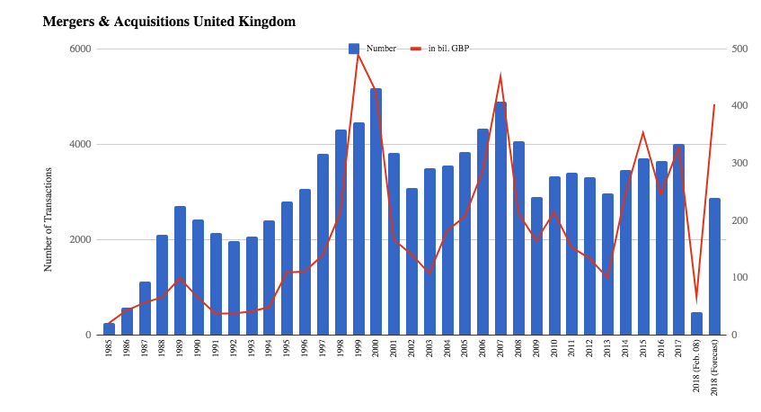
Redundancies are the usual result of Mergers
Number of mergers in UK
Point of mergers – often financial (economies of scale, saving on labour costs) ➔ redundancies
Can also be strategic (expansion of business activities, new markets, increase market share, market leadership, acquire knowledge, technology, control of supply chain, etc.)

Slide 39
Impact of recession
When economy growing – approx. 400,000 redundancies p/a
In 2009 there were 939,000
In 2012, it was 595,000
2008-2013 3 million people made redundant
= > 10% of workforce

Slide 40
Why is legal definition important?
Employers are obliged to adhere to legal redundancy procedures
Entitlement to redundancy payments
Different procedural approach to dismissal
Must meet ET standards of ‘reasonableness’

Slide 41
Steps
Step 1
  Provide affected employees with written notification of the changes that are proposed.
Step 2
  Discuss the operational changes with affected employees (and their representatives).
Step 3
  Listen to affected employees, consider what they have to say and respond.

Slide 42
What is a reasonable procedure?
Have steps been taken to minimise the number of redundancies or avoid altogether?
Either:
Longer Term: Steps to prevent situation arising in first place (HR Planning, Flexible work practices and early retirement)
Short Term: Steps to take once redundancy becomes inevitable (compulsory and voluntary redundancy)

Slide 43
Long-term approaches
Effective HR planning
Flexible working
Early retirement schemes

Slide 44
HR Planning
If downturn or change in business processes can be foreseen (big ‘if’)
Can reduce the number of new recruits
Focus on retraining existing employees for new roles

Slide 45
Maximising Flexibility
Seek applications for staff to work flexibly
Employ multi-skilling employees
Subcontracting peripheral tasks/use of agency workers

Slide 46
Early retirement
Offer employees incentive to retire early but do not compel them to have a premature retirement
Offer should be made to all employees and not target specific employees e.g. an aged or older employee
Attractive for employees (can draw pension and still work)

Slide 47
Short-term approaches
Long-term approaches may still fail to prevent redundancies
So, first step usually = ask for volunteers
Asking employees who would like to be considered for redundancy
Select those to be made redundant
Pitfalls of asking for volunteers?

Slide 48
Short-term approaches
Good approach but can be very expensive:
Long-serving employees entitled to most payment
Loss of best talent
Other pitfalls of asking for volunteers:
Too many applicants
Those not selected become demotivated
How to avoid this?

Slide 49
Short-term approaches
- Target particular grades or departments
Target individuals with poorer performance and longer service (early retirement options?)
Don’t raise false hopes – establish criteria e.g. employees with good performance, long-service and valuable skills won’t be selected.

Slide 50
Short-term approaches
Only advertise vacant posts internally & only fill with employees at risk of redundancy
Cut staff costs by:
  Reducing overtime
  Cutting hours
  Pay freeze or pay cut
  These should be negotiated with staff reps!
Cut other costs (rent etc)

Slide 51
Selecting people for redundancy
Lifo –but age discrimination? DON’T USE ALONE
Matrix approach
  Scoring according to criteria (e.g. competence, performance, attendance, conduct, qualifications, attitude)
  Must be able to provide objective evidence!

Slide 52
Help for redundant employees
Not much law on this except you must give employees reasonable time off to find another job.
But most large organisations offer practical assistance with job search and counselling.
Counsellors must be trained professionals.

Slide 53
Redundancy payments
Straightforward rules for calculating – based on age and number of years of service
But maximum payment employers obliged to make (for 20 years service) = only £13,500
Therefore most organisations go beyond statutory minimum

Slide 54
Disciplinary procedures
Most large and medium-sized organisations now have formal disciplinary procedures.

Slide 55
ACAS Discipline and grievance - Code of Practice
Employers should have their own written disciplinary procedures which they must follow.
Employees and managers should be made aware of this policy.
The employee should be informed, in writing, of the alleged offence.
There should be a meeting with the employee and employer to discuss the alleged offence. The employee is allowed to be represented at this meeting by a trade union representative or colleague.
The employee should have the opportunity to appeal against any sanction.

Slide 56
Disciplinary procedures
Follow company policies already in place
Assess the nature of the infraction
Compare how other employees have been treated
Review the history of the employee
Don’t:
Discipline employees in public areas
React with anger or threatening comments

Slide 57
Disciplinary procedures
Why?
Manage conflict before it escalates
Protect employees by providing greater fairness and consistency in management decision-making
Establish expected standards of performance & behaviour
Defense in litigation cases

Slide 58
Implementing the procedures
Most of the responsibility falls on line managers:
- Need training on legal aspects and soft skills for resolving disputes, mediation
HR:
Advising line managers
Ensuring consistency across the organisation – but line managers also need flexibility for different individuals

Slide 59
Further reading
CIPD factsheets on dismissal and discipline and grievance procedures
ACAS website
Gilmore and Williams (2013) Human Resource Management (ch.9 and ch.13)
Jones and Saundry (2011) The practice of discipline: evaluating the relationship between managers and HR professionals, Human Resource Management Journal
Taylor, S. (2014) Resourcing and Talent Management, CIPD

