Slide 1






Starting Your Business?
Financial Recording keeping
Tax returns
VAT -
Class 2 and class 4 insurance
Income tax
See- www.gov.uk

Slide 2
Being in Business
Deciding what to sell
Do to have the skills / attributes / resources for the product
Do to have the skills / attributes / resources for the business
Planning and running your business
Training Needs Analysis

Slide 3
Deciding What you are?
Sole Trader – unlimited company
Partnership – unlimited company
Limited Company - Register with Companies House

Slide 4
Types of Business
Difficult in raising funds as not assets can be used as collateral – assume personal unlimited liability
Sole trader – one owner
Partnership – two or more owners
Limited company
a private company whose owners are legally responsible for its debts only to the amount they invest.

Slide 5
Limited Company
A limited company is an organisation that you can set up to run your business - it’s responsible in its own right for everything it does and its finances are separate to your personal finances.
Any profit it makes is owned by the company, after it pays Corporation Tax.
The company can then share its profits.
Ownership
Every limited company has ‘members’ - the people or organisations who own shares in the company.
Directors are responsible for running the company. Directors often own shares, but they don’t have to.
Legal responsibilities???
There are many legal responsibilities involved with running and managing a limited company (beyond the scope of this lecture)

Slide 6
Limited Liability
Example
A company limited by shares issues 100 shares valued at £1 each when it’s set up. Its 2 shareholders own 50 shares each and have both paid in full for 25 of these.
If the company goes bust, the maximum the shareholders have to pay towards its outstanding bills is £50 - the value of the remaining 25 shares that they’ve each not paid for.

Slide 7
Business Wales
Tel: 03000 603000
Loans
Grants
Business Support
Marketing
IT
Skills and Training (BOSS – Business On-line Support Service)

Slide 8
Keeping Records
Keep a copy of your financial returns for a least 22 months after the end of the relevant tax year.

Slide 9
Tax returns
Self –assessment – submit on-line after the end of tax year (5th April before the next 31st January)
Accountant – easier but costs!
a good accountant can save you a fortune!
Deduct allowable expenses

Slide 10

Value Added Tax
20% of income will be paid in VAT.
Claim back VAT on goods bought.
In the service industry we pay a lot of VAT!

Slide 11
Paying VAT
The company must register for VAT if you expect its takings to be more than £83,000 a year.
Self assessment – set payment or monthly submission.
PAYE if the company pays you a salary

Slide 12
Class1, 2, 3, 4 National Insurance
Pays for the State Pension and Benefits etc
Self-employed National Insurance rates. You usually pay 2 types of National Insurance if you're self-employed: Class 2 if your profits are £5,965 or more a year. Class 4 if your profits are £8,060 or more a year.
Class 2 - £2.80 a week
Class 4 - 9% on profits £8,060 – 43,000
2% on profits over £43,000
Pay through self-assessment

Slide 13
National Insurance
National Insurance class | Who pays
Class 1 | Employees earning more than £155 a week and under State Pension age - they’re automatically deducted by your employer
Class 1A or 1B | Employers pay these directly on their employee’s expenses or benefits
Class 2 | Self-employed people - you don’t have to pay if you earn less than £5,965 a year (but you can choose to pay voluntary contributions)
Class 3 | Voluntary contributions - you can pay them to fill or avoid gaps in your National Insurance record
Class 3A | Voluntary contribution - you may be able to top up your pension with a single lump sum if you’re due to retire before 6 April 2016
Class 4 | Self-employed people earning profits over £8,060 a year
Be aware of these require contributions if you employ anyone.
This is why many personal trainers are freelance

Slide 14
Your Wage
Expenses
VAT
National Insurance
Tax
PAYE
Income
Wage
You need to predict these before you know how much to charge

Slide 15
Ready to Start
You are an entrepreneur
  "An entrepreneur is a person who
  assumes the organisation, management
  and risks involved in a business venture."
Qualities you will need to be a successful
entrepreneur:
  Decision Maker
  Analytical Ability (problem solving skills)
  Good Interpersonal Skills
  High Drive (highly motivated)
  Risk Taker
What you need:
Personal skills
Business knowledge
A good idea!
Start-up money
Support
Good personal
credit history

Slide 16
Be Prepared
Investors and lenders?
  Many entrepreneurs are intuitive and rely on their experience, industry knowledge, and gut feelings to tell them whether a project “makes sense”
  BUT
  Most bankers are methodical, and won’t draw conclusions quickly- especially if they don’t have all the facts before them.
  Given that they don’t have your technical knowledge, they will want to see that you have thoroughly analysed and planned your project.
  Therefore
  A thought through and thorough business plan is key to your success.

Slide 17
Planning
Write a proposal and include your business plan as well as additional documentation such as:
  Market research
  Industry trends
  Other information supporting your
  project’s viability

Slide 18
First Steps
From a legal stand point | From a financial stand point | From an insurance stand point
Choose the form of business: Sole proprietor Partnership, or Limited company Register your business with UK GOV.co.uk | Get a business number Get financial advice – accountant, Bank | Buy business insurance Liability Disability Key people Business interruption Prepare to have employees

Slide 19
Your Business Plan
What is a business plan:
A business plan can help
you detail your goals, and serves as an operational
plan for achieving them
Everyone who is going
into business and who is
operating a business requires a business plan
a business plan?
It describes your business
It conveys your vision to potential investors
It explains your business goals
It raises potential problems and ways to solve them
It states the amount of capital required to finance your venture

Slide 20
Your Business Plan
What it should include:
  An executive summary
  A description of your company
  A description of your management team
  An overview of your marketing plan
  Human resources plan
  Financial planning
  Appendices that boost your credibility

Slide 21
What it should include:
  An executive summary
    The industry, products/services, competitive advantages, amount of financing required
  A description of your company
    Legal status, date company founded, mission, objectives and vision
  A description of your management team
    Roles, experience and competence, education

Slide 22
What it should include:
Overview of your
Marketing plan
  Is there a proven market for your products or services?
  Who are your competitors?
  What is your client profile?
  What will you offer that is better?
  How will you get them to switch?
4. Marketing Plan
Four sections should be detailed:
  Your product or services
    Why your products/services will sell?
  Your market potential
    Target clients, market size and penetration, demographic factors
  Overview of your competition
    Their strengths and weaknesses
  Marketing strategy
    Overview of your Marketing plan, media chosen, partners, etc.

Slide 23
What it should include:
Human resource plan
  Determine how you will recruit, retain and develop employees:
    HR Policy
    Subcontracting and outside professionals
    Organizational and development plan
Financial planning
  Forecasts, balance sheet, statement of income, cash flow budget
Appendices that boost your credibility
  Brief bios of your management team, market studies, client testimonials, etc.

Slide 24
Finding Financing
What lenders look for:
Proof of experience, skills, determination, and self-confidence to successfully carry out your project.
Your personal credit history – past performance can affect perception about how you will perform in the future.
Your business plan must be clear, structured, and short, but it must cover all elements of your business idea

Slide 25
Financial Planning
Personal investment money: Cash/collateral on your assets.
Proof that you have a long-term commitment to your project
Gift capital or love money:
Money loaned by loved one
and that will be repaid later.
Bankers consider this asset as “patient capital”
Investments from others:
Money you raise from
investors.
Bankers regard such investment highly
Proof that your idea is sound but can often diminish the degree of control you have over you own company

Slide 26
Types of Loan
Money loaned to you, not your business
Loan secured by your personal assets
Many banks offer this type of loan to start-up businesses or those with few assets (land, building or equipment)
Personal Loan
Short term, flexible financing that you manage yourself
Borrowing as much as you need up to a determined
amount
Secured by your inventory and accounts receivable, and your bank can require full repayment at any time
Operating Loan
- Also called
Line of Credit

Slide 27
Types of Loan
Term Loan
Long-term financing option for fixed assets such as equipment, land or building
Working capital
Loan
Long-term financing to cover projects such as Growth, Export, Marketing, e-Business, R&D, etc.
Help provide you the cash flow to fuel your growth
Complement your existing line of credit

Slide 28

Decide what you want to be?
Planning is never a waste of time

Slide 29




Marketing your Business

Slide 30
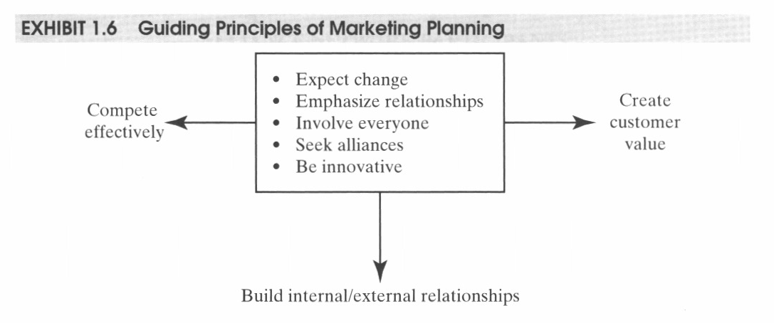
Developing a Marketing Strategy
Anticipating the needs and wants of customers.

Slide 31
The Marketing Challenge
five critical questions:
  What is unique about your business? What is the general need that your product or service aims to meet?
  Who is your target buyer? Who buys your product or service now, and who do you really want to sell to?
  Who are your competitors? How can your small business effectively compete in your chosen market?
  What positioning message do you want to communicate to your target buyers? How can you position your business or product to let people know about your product?
  What is your sales strategy? How will you get your product or service in the hands of your customers?

Slide 32
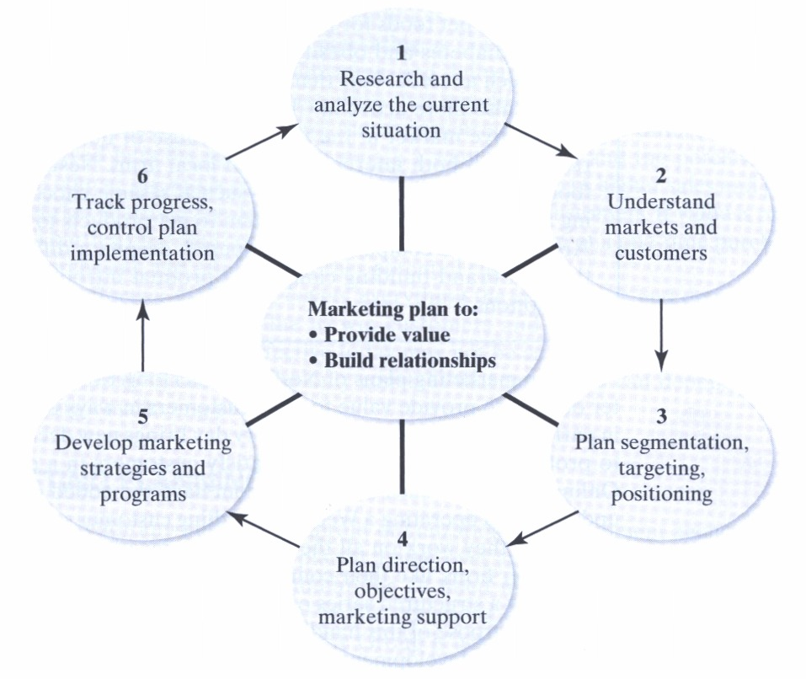

Slide 33

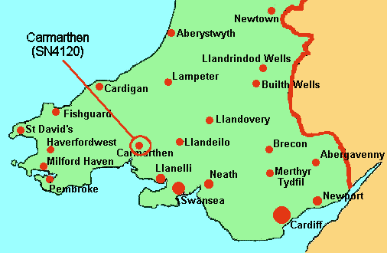
Set your Marketing Objectives
Market entry?
Market growth?
New products?
New customer demographics?

Slide 34
Your Brand
Describe your business by the products / services you deliver?
But
Customers view your business in terms of their satisfaction.
Customers view business by image
A range of other criteria – sustainability, charity work, ease of access etc

Slide 35
Know your Market
Knowledge of customers expectations
Qualifications and Competencies
Facilities
Operating procedures
Build relationships

Slide 36

SWOT Analysis
A situation analysis details the context for your marketing efforts by considering internal and external factors that could influence your marketing strategy.
  Strengths: assets or a resources that can be used to improve your business’ competitive position.
  Weaknesses: resources or capabilities that may cause your business to have a less competitive position.
  Opportunities: situations or conditions arising from a business’ strengths, or set of positive externalities.
  Threats: problems that focus on your weaknesses and which can create a potentially negative situation.

Slide 37
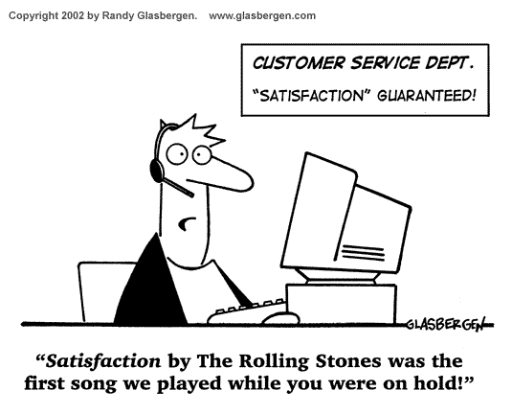
Service is the Key to Success
Give the customer what they want when they want it.
Give value for money – or at least the perception of it
Respond quickly
Be reliable
Educate your customers – give them more than what they expect!

Slide 38
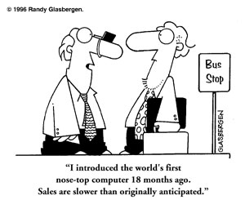
Innovation
Be unique but not too unique!
Compare your services to that of your competitors and focus on these.
Give the customer a reason to come to you.

Slide 39
Understand Your Customers
Defining your market, but you need to be realistic and your market needs to be well-defined to focus the strategy.
Who are your competitors, and who do they target?
Who is your perfect customer and client base?
What is your current customer base (in terms of age, sex, income, and geographic location)?
What habits do your customers and potential customers share? Where do they shop, what do they read, watch, listen to?
What prospective customers are you currently not reaching? How can you reach them?
What qualities do your customers value most about your product or service? Do they value selection, convenience, service, reliability, availability, or affordability?
What qualities about your product or service do you need to improve? How can they be adjusted to serve your customers better?

Slide 40
Market Entry
Research your competitors
  How many are there?
  What do they do well?
  What do they do poorly?
  What are their unique features?
Start with the thing you do best?
Start in a defined and controlled manner i.e test the market

Slide 41
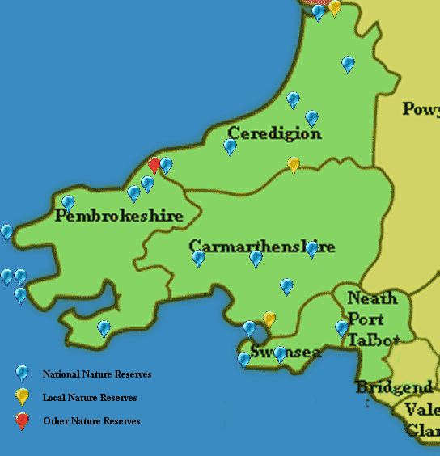
Your location
Direct competitors
Indirect competitors
Limited competition

Slide 42
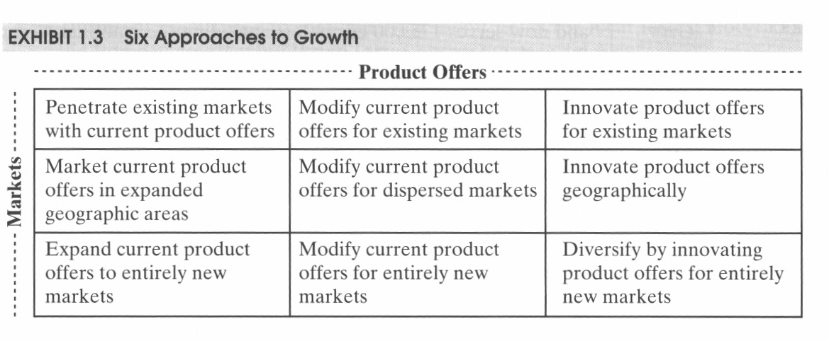
Growth

Slide 43
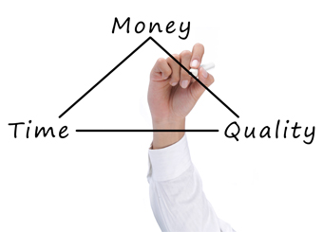
Financial planning
Amount v Income v Profits
Costs per customer
Is the Strategy cost effective?
Is the strategy time effective?

Slide 44
Marketing Activities
The market Mix – the 4 P’s
              Product
              Price
              Promotion
              Place
Internet
Events
Direct
Databases (buy one – create one)
Public relations

Slide 45
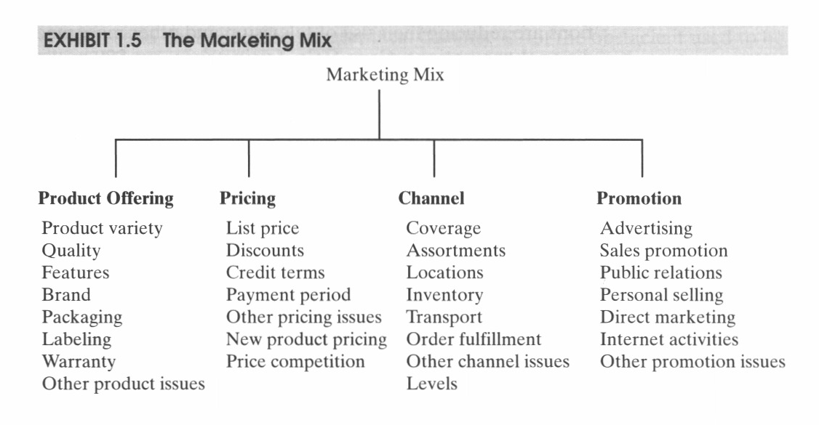
Marketing tools

Slide 46
Plan the Process
Executive summary
Current Marketing Situation
Objectives and issues
Target Market
Marketing Strategy
Marketing Activities
Financial planning
Implementation controls

Slide 47
Managing the Process
Did you achieve your marketing objective?
MONITOR
MEASURE
INPUT
CORRECT
SIGNOFF

Slide 48
Your Marketing?
Outline 4 ways you will market your business
Cost them.
Rationalise why the cost is worth the expense.

Slide 49

Financial Planning

Slide 50
Financial Planning
Write reports i.e spreadsheets for profit / loss
Always budget
Monitor your finances regularly
Cash flow
Manage Risk
Health Insurance
Legal protection
Maximise the return on your bank account
Consider all types of funding i.e. grants
Get professional Advice i.e. accountant

Slide 51
Things You Need to Know
Important Assumptions
Break-even Analysis
Projected profit/loss
Projected Cash flow
Projected Balance Sheet

Slide 52
Assumptions
Your best guess (research) about things that influence your business;
Market size
Price people are willing to pay
Your time
Interest rates

Slide 53
Break Even Analysis
Makes obvious how well the business is doing based on the actual income compared to the;
Fixed costs
Variable costs
Sales income

Slide 54
Fixed Costs
A cost to your business that remains stable over a period of time – a year.
Insurance
Rent
Interest on loans
Salaries / wages
Depreciation
Utility bills
Property Taxes
Membership of organisation
Consultants – web design etc

Slide 55
Variable Costs
Costs that vary on a regular basis, in relation to the activity of your business.
Consumable products
Travel expenses
VAT
Tax on profit
Credit card fees
Sub-contract wages

Slide 56
Profit and Loss
Determines the amount of business tax you will pay.
Allows you to determine the on-going viability of your business.
Allows you to see where you might reduces expenditure or enhance income.

Slide 57
 | April | May | June | July | August | September | October | November | December | January | February | March
Income
Massage
Fitness Programmes
Web consultation
Clothing
Equipment Sales
Nutrition supplement sales
Total Income | 0 | 0 | 0 | 0 | 0 | 0 | 0 | 0 | 0 | 0 | 0 | 0
cumulative Income | 0 | 0 | 0 | 0 | 0 | 0 | 0 | 0 | 0 | 0 | 0 | 0
Expenditure
Insurance | 100 | 100 | 100 | 100 | 100 | 100 | 100 | 100 | 100 | 100 | 100 | 100
Rent | 400 | 400 | 400 | 400 | 400 | 400 | 400 | 400 | 400 | 400 | 400 | 400
Interest on loans | 0 | 0 | 0 | 0 | 0 | 0 | 0 | 0 | 0 | 0 | 0 | 0
Wages | 1500 | 1500 | 1500 | 1500 | 1500 | 1500 | 1500 | 1500 | 1500 | 1500 | 1500 | 1500
Depreciation | 0 | 0 | 0 | 0 | 0 | 0 | 0 | 0 | 0 | 0 | 0 | 0
Electricity | 50 | 50 | 50 | 50 | 50 | 50 | 50 | 50 | 50 | 50 | 50 | 50
Water | 50 | 50 | 50 | 50 | 50 | 50 | 50 | 50 | 50 | 50 | 50 | 50
Business Rates | 120 | 120 | 120 | 120 | 120 | 120 | 120 | 120 | 120 | 120 | 120 | 120
REPs / BASES membership | 5 | 5 | 5 | 5 | 5 | 5 | 5 | 5 | 5 | 5 | 5 | 5
WEB site fees | 10 | 10 | 10 | 10 | 10 | 10 | 10 | 10 | 10 | 10 | 10 | 10
Consumables products | 100 | 0 | 0 | 0 | 0 | 0 | 0 | 0 | 50 | 25 | 0 | 0
Travel expenses | 50 | 50 | 50 | 50 | 75 | 50 | 0 | 25 | 50 | 50 | 50 | 50
Credit card fees | 0 | 0 | 0 | 0 | 0 | 0 | 0 | 0 | 0 | 0 | 0 | 0
Gym membership fees | 40 | 40 | 40 | 40 | 40 | 40 | 40 | 40 | 40 | 40 | 40 | 40
Total Expenditure | 2425 | 2325 | 2325 | 2325 | 2350 | 2325 | 2275 | 2300 | 2375 | 2350 | 2325 | 2325
cumulative expenditure | 2425 | 4750 | 7075 | 9400 | 11750 | 14075 | 16350 | 18650 | 21025 | 23375 | 25700 | 28025
Profit / Loss | -2425 | -4750 | -7075 | -9400 | -11750 | -14075 | -16350 | -18650 | -21025 | -23375 | -25700 | -28025

Slide 58
Cash Flow
The difference in cash available at the beginning of a period and the amount at the end.
Therefore the amount of cash available in the bank.
Account balance + (Actual income – Actual expenditure)

Slide 59
Cash Flow
The flow of cash in and out of the business
When completing profit and loss do you include the account when the service is provided or when you are paid?

Slide 60
Increasing Cash flow
Selling more goods or services,
Selling an asset,
Reducing costs
Increasing the selling price,
Collecting faster,
Paying slower,
Bringing in more equity,
Taking a loan.

Slide 61
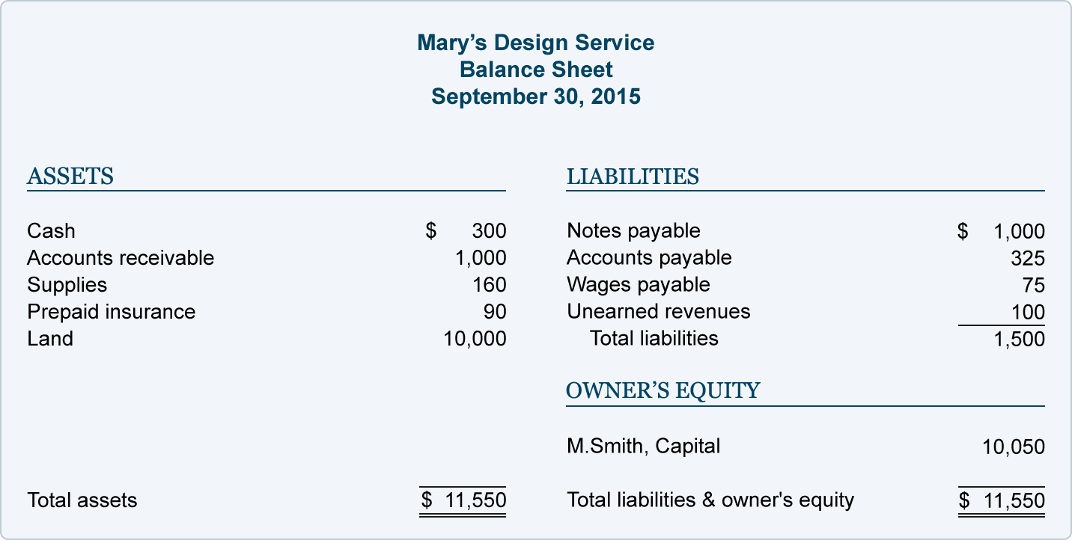
Balance Sheet
Similar to Profit and Loss but provides more of a summary statement allowing you to make decisions about which areas of your business need attention.
It also includes information about loans, assets, income owed etc

Slide 62
Final Advice
Only by keeping and monitoring your finances will you be able to succeed in business.
So
Complete Profit and loss accounts every week

