Slide 1
Operational Activities effecting motorsport
By Will Clent

Slide 2
Introduction
Motorsport chosen: British Touring Car Championship (BTCC)
The comparison of the 1993 Inline 4 cylinder from BMW Motorsport “Team Schnitzer” and the comparison of the 2017 West Surrey Racing 125i m sport
Difference in MPG & BHP
Difference in Co2 output
Comparison of Co2 per lap produced
Rules & Regulation of BTCC & how they have adapted to the on going environment issues
Global Manufacturing footprint for Production

Slide 3


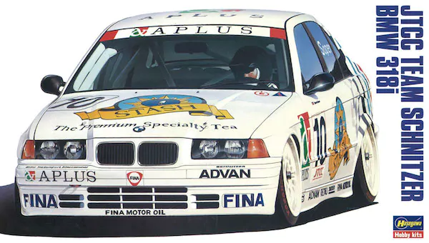
SHNITZER1993 BMW 318i E36
engine: s14b20
SHARES A LOT OF COMPONENTS WITH THE S14B25EVO3 (Last generation of e30 m3)
bHp – 290
INLINE 4 CYLIDER
Produces 232.93g/km

Slide 4
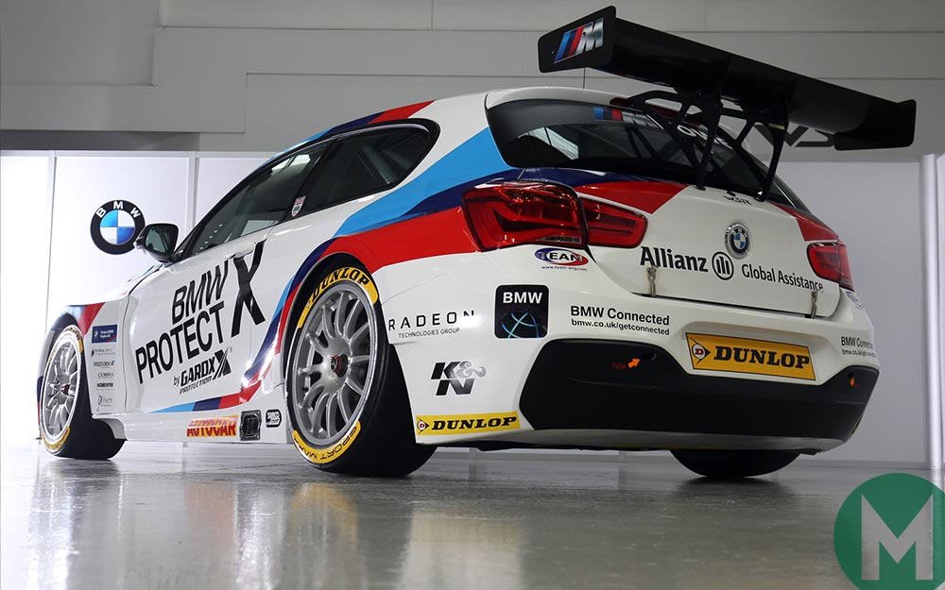
West Surrey Racing 2017 BMw 125i m sport
Engine: b48
Twin Turbo Inline 4 cylinder
Bhp: 360
Produces 188g p/km

Slide 5
comparison
Schnitzer 1993
Co2- 232.93gk/m
Co2 – x 5.1km (1 lap of Silverstone)
=1,187gk/m per lap
Built in Germany
Parts sourced from Germany
West surrey racing 2017
Co2 – 188g
Co2 – x 5.1
= 958g
Engine built in Birmingham
Chassis sourced from sa

Slide 6
Btcc Rules on emissions
There were no rules in 1993 regarding emissions
There were rules about noise which still applies today
No restrictions on exhaust fumes (no cats)
2015 emissions testing now mandatory
Has to have sport cat

Slide 7
IL4 BMW Motorsport
The main revolutionary factor separating the two generations of IL4’s mentioned is that over the years BMW have found it more efficient in terms economy and power to fit a turbo to their 4-cylinder engines.
the IL4 over 24 year made an excellent platform for the BMW Motorsports team to build on, as it become such a tunable, efficient and economic engine.

Slide 8
Global Manufacturing footprint for Production of BMW
1978 BMW opens manufacturing facility, first bmw factory to open outside of Germany.
85% of all 3 series get exported to USA, Taiwan, Japan, Singapore, New Zealand, Hong Kong, Australia, Sub-Saharan Africa and Canada
200,000 3 series unit get produced pa
Shipping to those 10 countries
5,500 cars per ship
Would need 36 separate ships
Each ship length is around six football pitches
The emissions from 15 of these mega-ships match those from all the cars in the world.

Slide 9
Global Manufacturing footprint for Production of BMW
This links to the bmw motorsports IL4 because the vehicles used go through the same building processes as the manufactured cars
Bmw motorsports is still contributing to the carbon problem globally it may have reduced its emissions over the years, but the process of making the vehicles counter acts any reductions in co2 they make from the cars/race cars.

