Slide 2

Scanning Networks &
Enumeration
Advanced Cybersecurity
(ACCB6000)
Applied Computing - WISA

Slide 3
So far, we discussed about Information security, the threats and attack vectors. In continuation to that, I hope you all have understood the hacking concepts and the reasons to stay ethical. Add more insight, we also discussed various security laws and standards. To conclude, we covered various “Risk” concepts like risk factors, cyber risk resilience in the process of enhancing security.
In continuation, we discussed Footprinting concepts focusing on different methodologies like Search Engines, Google Hacking Techniques etc. giving a walkthrough on Website Footprinting, Email Footprinting, Competitive Intelligence, Network Footprinting etc.
During the tutorials, under isolated lab environment we used different Footprinting tools to understand the countermeasures and pen testing attacks.
Previous sessions…
Understanding Information Security, Risks involved, assessing, managing and monitoring Risks, Cyber risk resilience
Purpose and role of Hackers, Penetration Testing, Various Laws and Standards
Understanding Footprinting and Reconnaissance Concepts, Methodology.
Using various Tools, Taking Countermeasures
Lab/ Tutorials
Download and Setup your Lab.
Coursework Description.
Activity 1, 2

Slide 4
During this week, with applied knowledge and understanding on Footprinting, let us focus on Network Scanning, different tools and methodologies used etc. We shall also understand the concept of Banner Grabbing and scanning Penetration testing. we shall move ahead focusing on enumeration concepts, its different tools and techniques etc
During the tutorials, under isolated lab environment you will be using different tools to scan a network and understand the outcomes.
Scanning and Enumeration
Network Scanning
Tools and Techniques
Banner Grabbing
Scanning – PenTesting
Enumeration
  Concepts
  Techniques
  Countermeasures
Lab/ Tutorials
Activity 3 – Scanning.

Slide 5

Scanning Networks
Like, Reconnaissance is the method of collecting information about a target system without alerting it, also known as Footprinting, it is the first step in any form of hacking.
It will help in understanding the target system and identify potential attack vectors & vulnerabilities
Network scanning is the next process which helps in identifying hosts, ports and services in the network.
Network scanning could be done using a set of procedures.
It is one of the components of intelligence gathering that can be used by attackers to gather information and create a profile of their targets.

Slide 6

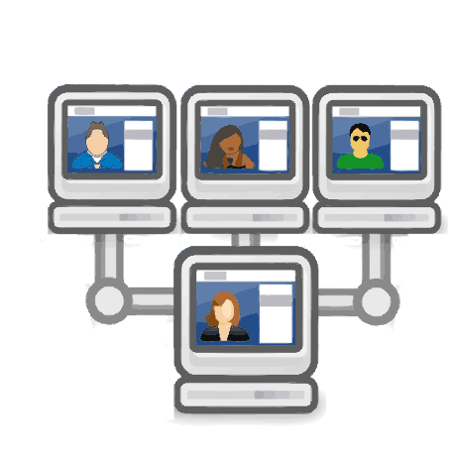


Scanning Networks
TCP/IP Probes
The main objectives of network scanning
Get Network Information
Find and Confirm Information
(live hosts, its IP Address and its open ports)
Host Information
(its Operating Systems & System Architecture)
Deep-dive
(Its services)
Discover Vulnerabilities in live hosts

Slide 7
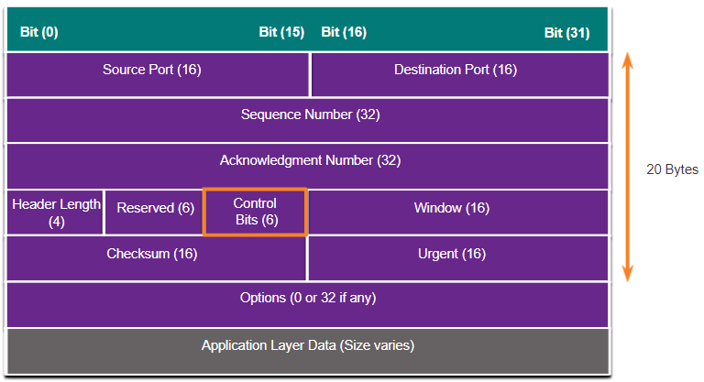










Scanning Networks – TCP Communication Flags
URG Urgent
ACK Acknowledgment
PSH - Push
RST- Reset
SYN - Synchronize
FIN - Finish
Data in the packet with this flag need to be processed immediately
Acknowledges the receipt of a packet
Sends all buffered data immediately
Resets a connection
Initiates a connection between hosts
No further transmissions
Earlier, we discussed about TCP Control Bits, As we know, TCP segment information appears immediately after the IP header.

Slide 8
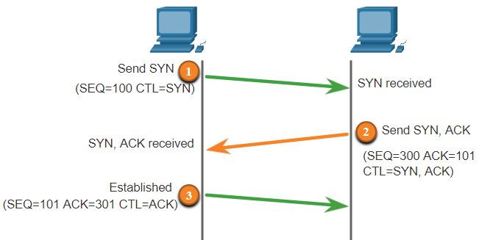
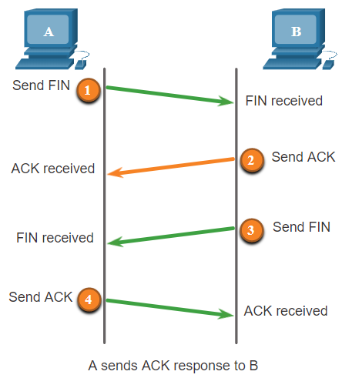
Scanning Networks – TCP Communication Flags
URG Urgent
ACK Acknowledgment
PSH - Push
RST- Reset
SYN - Synchronize
FIN - Finish
Data in the packet with this flag need to be processed immediately
Acknowledges the receipt of a packet
Sends all buffered data immediately
Resets a connection
Initiates a connection between hosts
No further transmissions
Attackers can also create fragmented packets to bypass security systems like firewalls, IDS/ IPS.
Packet Crafting Tools like NetScan Tools Pro, OSTINATO, LANforge FIRE etc can be used.
Colasoft Packet Builder enables the creation of custom network packets to audit networks for various attacks

Slide 9
Scanning Networks – IPv6
Structure of IPv6 is comparatively sophisticated and secured with more levels of addressing hierarchy.
Focusing on Traditional network scanning Techniques for IPv6 networks brings in complex situation due to its larger subnets.
So, scanning IPv6 networks involve more techniques rather than using the traditional network scanning tool, as most of the scanning tools do not support ping sweeps on IPv6 networks.
Need to look into the network traffic, recorded logs, header lines etc to get information about IPv6 addresses.
However, if successfully scanned, the IPv6 networks gives more privileges. Eg: Compromising One host in the subnet can help in probing all other hosts using “all hosts” and “link-local multicast addresses”

Slide 10
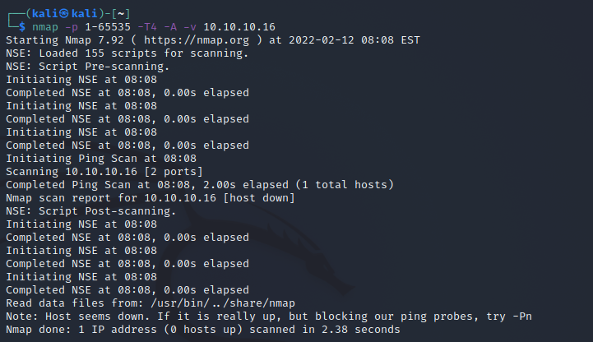
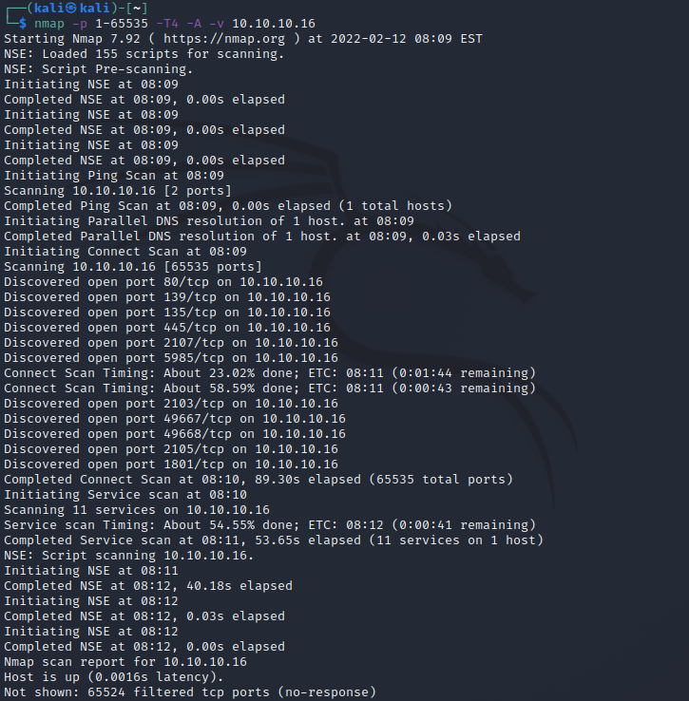
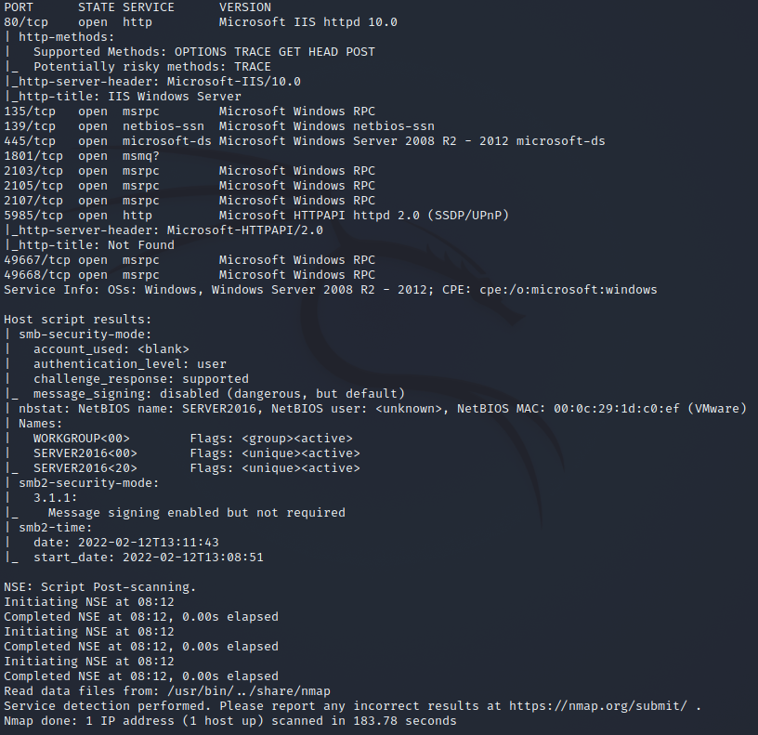
Scanning Networks: Tools
Many tools are available
NMAP
Purpose of Nmap is to gather Network inventory, managing service upgrade schedules, monitoring hosts, its service uptime etc.
Nmap can be also used to get live host, its services like application name, version, packet filters, firewalls, operating systems, its versions etc

Slide 11
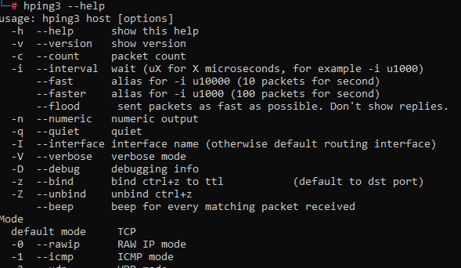
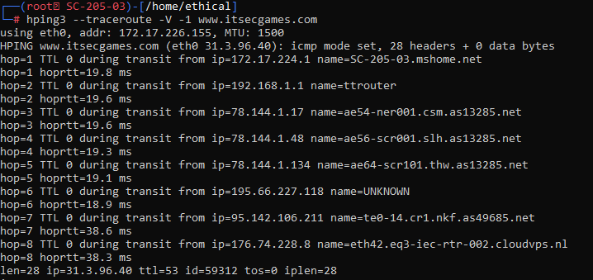
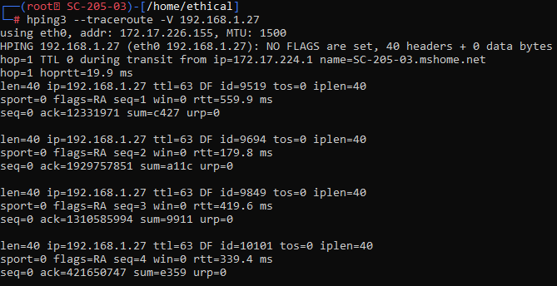
Scanning Networks: Tools
Hping3
It is a command line network scanning and packet crafting tool focusing on TCP/IP protocol
It can be used for
Auditing network security
Testing Firewall
manual path MTU discovery
Advanced traceroute,
Remote OS Fingerprinting
Remote uptime guessing
TCP/IP stacks auditing etc

Slide 12
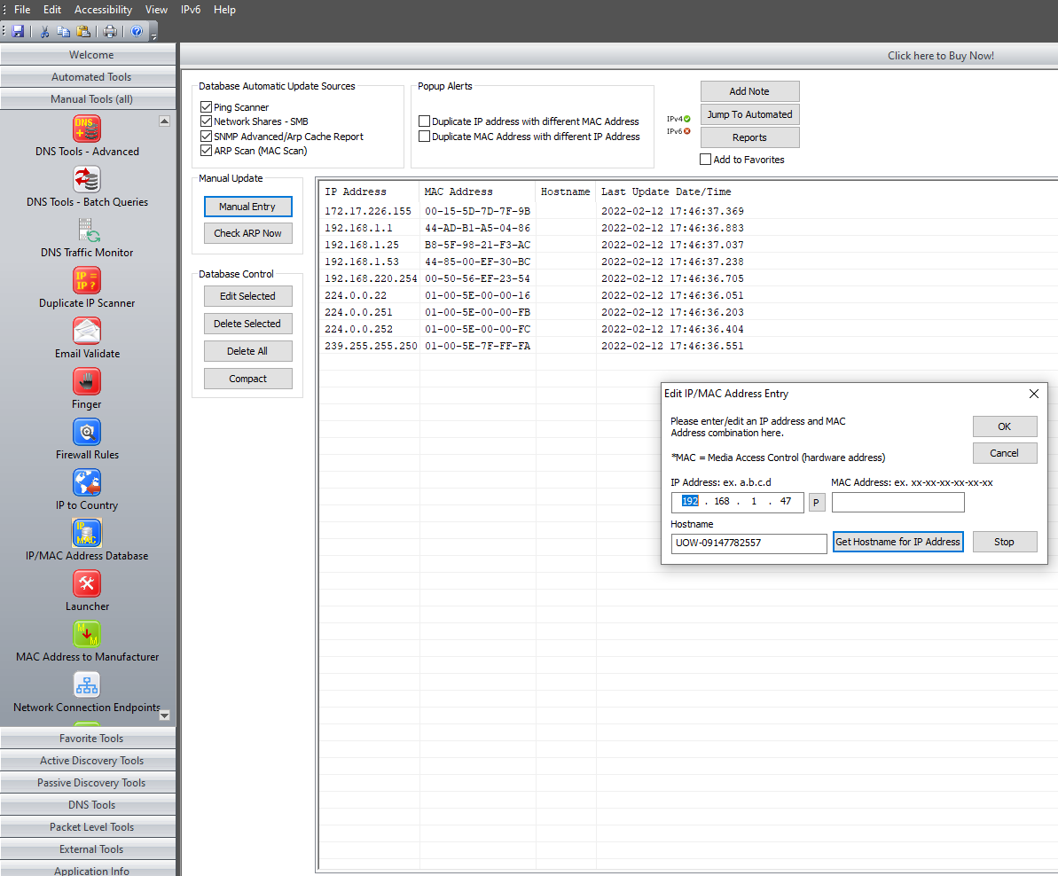
Scanning Networks: Tools
NetScanTools Pro
It helps in troubleshooting, diagnosing, monitoring, discovering devices
It lists IPv4, IPv6 Addresses, hostnames, domain names, email addresses, urls.
It does automatically or manually.

Slide 13
Scanning Networks - Techniques
Scanning
ICMP
TCP
UDP
Open TCP Scanning Methods
Stealth TCP Scanning Methods
3rd Party and Spoofed TCP Scanning Methods
TCP Connect/ Full Open Scan
Half-Open Scan
Inverse TCP Flag Scan
ACK Flag Probe Scan
Xmas Scan
FIN Scan
NULL Scan
IDLE/IP ID Header Scan
UDP Scanning

Slide 14



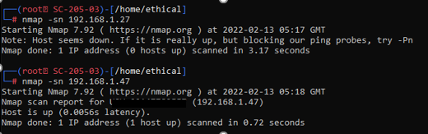

Scanning Networks – ICMP
ICMP Scanning – To check for live systems
  ICMP Scan will send ICMP ECHO requests to a particular host.
  If the system is LIVE, it will send back an ICMP ECHO reply
  Using an ICMP Scan, you may
    determine an active device.
    determine if Firewall is blocking ICMP
ICMP ECHO REQUEST
ICMP ECHO REPLY
<<

Slide 15


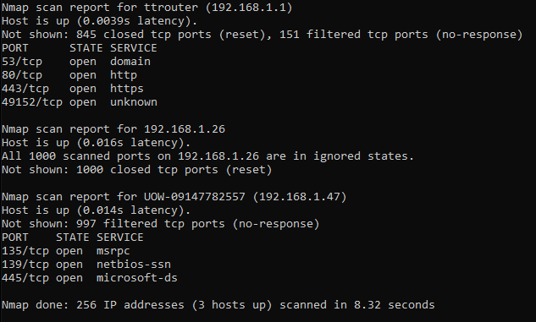


Scanning Networks – Ping Sweep
ICMP ECHO REQUEST
PING Sweep – To find live systems from a range of IP Addresses
  Ping Sweep will send ICMP ECHO requests to multiple host.
  If the system is LIVE, it will send back an ICMP ECHO reply
  You need to determine the subnet mask to find out the number of hosts that are found in the subnet.
  Mostly, Ping Sweeps are done to create an inventory of live systems in the subnet.
ICMP ECHO REPLY
<<

Slide 16
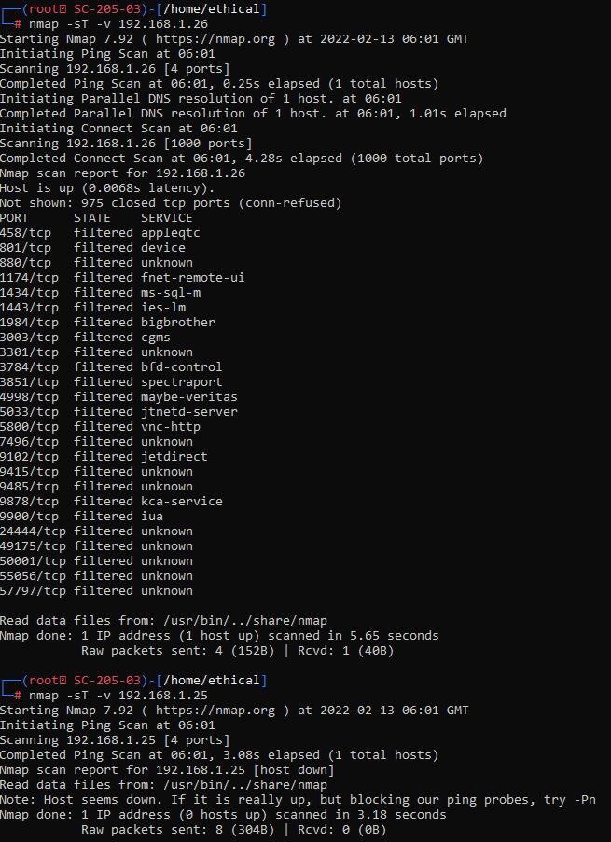



Scanning Networks – TCP Connect/ Full Open Scan
Full Open Scan can detect when a port is open after the three-way handshake
It establishes full connection and sends back RST Packets to bring down
  Does not require super user privileges.
SYN Packet + Port (n)
RST
ACK
SYN Packet + Port (n)
When a Port is closed?
SYN + ACK Packet
When a Port is Open?
RST
<<

Slide 17
Scanning Networks – Half Open Scan
The Attacker sends a single SYN packet to the target to app. port
Otherwise, Stealth Scan can reset the TCP Connection between the client and the server quickly before the three-way handshake, resulting in a half open connection.
This technique is used to bypass firewall rules, logging mechanism and hide under network traffic.
SYN (Port 80)
An open port: sends the SYN/ACK packet
RST
The Attacker sends back RST packet, stating the remote port is in CLOSED state
The Targets sends the RST packet to close the initiation before a connection is established
SYN (Port 80)
SYN + ACK Packet
When a Port is Open?
RST
<<
When a Port is closed?

Slide 18

Scanning Networks – Inverse TCP Flag Scan
Probe Pkt (FIN/URG/PSH/NULL)
Attackers send TCP probe packets with a TCP Flag (FIN, URG, PSH) set or with no flags.
No Response? → Port is Open
RST → Port is Closed
Probe Pkt (FIN/URG/PSH/NULL)
No Response
When a Port is Open?
When a Port is closed?
RST/ ACK
<<

Slide 19
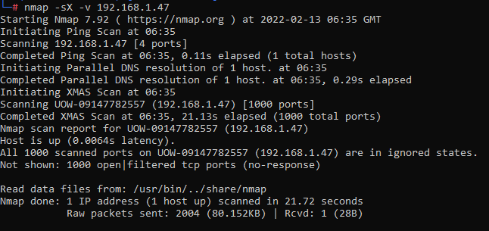
Scanning Networks – Xmas Scan
Attackers send TCP frame to a remote device with (FIN, URG, PSH) set.
Note: FIN scan works only with RFC 793-based TCP/IP implementation OS. It will not work with any of the current Windows version
FIN + URG + PSH
When a Port is Open?
No Response
FIN + URG + PSH
When a Port is closed?
RST/ ACK
<<

Slide 20
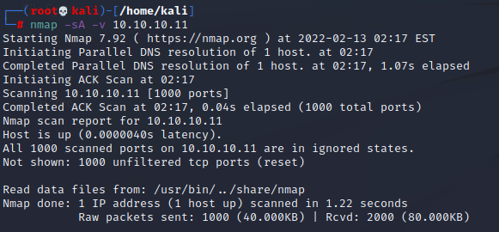
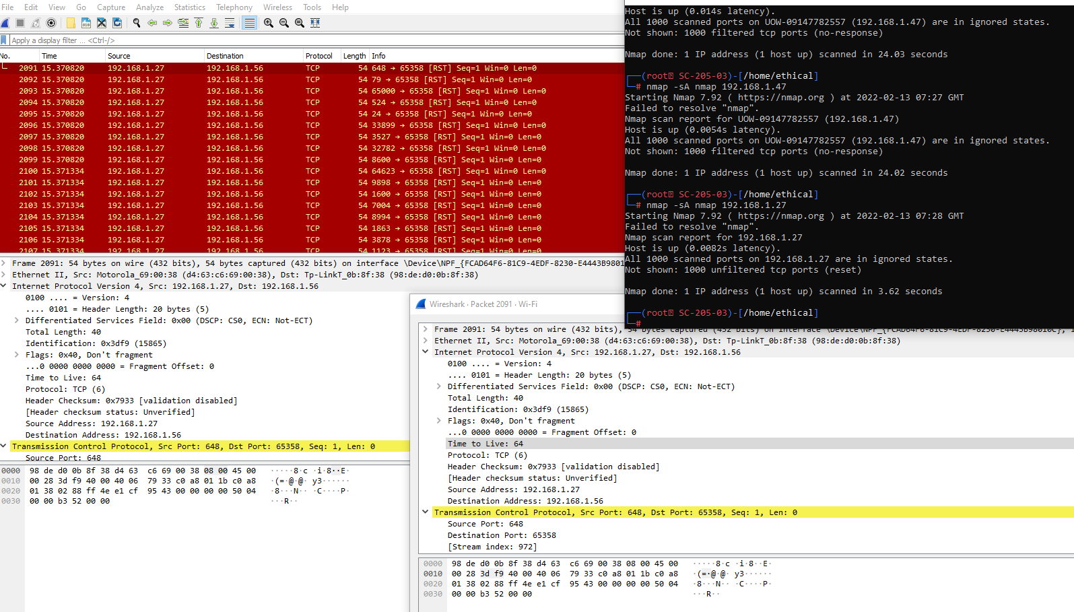
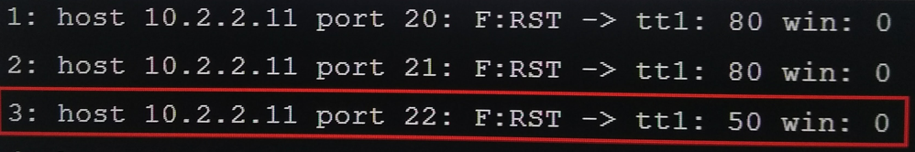
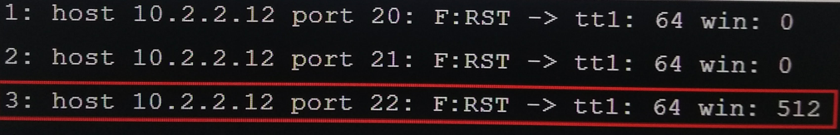
Scanning Networks – ACK Flag Probe Scan
Attackers send TCP probe pkts to remote devices with ACK Flag set.
Analyse the header information like TTL, Window Field of received RST packets to find out the open/closed ports
ACK Probe Pkts
Stateful Firewall
No Response
ACK Probe Pkts
No Firewall
RST/ ACK
<<

Slide 21




Scanning Networks – IDLE/ IPID Header Scan
It is a TCP port scan. However, it uses a spoofed source address to the target to find out the available services.
It is a complete blind scanning of a target.
Not expecting an SYN + ACK
SYN + ACK PKT
Victim
TARGET
SYN PKT to port 80 with victims IP as source
SYN + ACK PKT
RST IPID 12345
SYN + ACK PKT
RST IPID 12346
Thank you mate!!!
RST IPID 12347
If the port is closed, Target will send an RST instead of SYN + ACK, which will not trigger the Victim to send an RST and hence when the attacker is again sending an SYN+ACK, the IPID would be 12346
<<

Slide 22
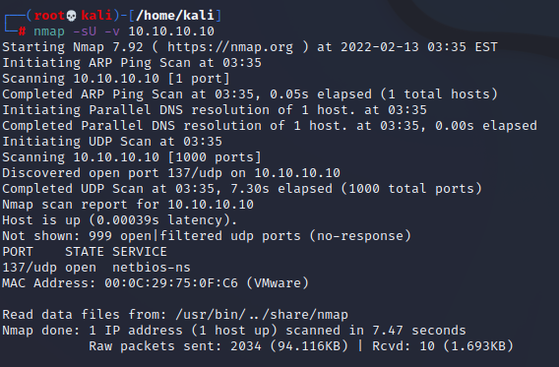
Scanning Networks – UDP Scan
For UDP, there is no 3-way Handshake. That means, the system won’t respond with a message to tell the port status.
If a UDP packet is sent to a port that is closed, the system will respond with ICMP port unreachable message
Generally, malicious applications, Trojan horses, Spywares use UDP Ports.
Is Port 1572 open for UDP?
ICMP unreachable message
No Response: Port is Open
<<

Slide 23
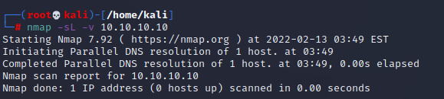
Scanning Networks – SSDP/ List Scan
SSDP: Simple Service Discovery Protocol working with Universal Plug and Play to detect devices.
This helps the attackers to launch Buffer Overflow or DoS attacks
Metasploits, or UPnP SSDP M-Search info discovery tool could be used to check the UPnP vulnerability.
List scan generates and prints the IP address and names without pinging them. A reverse DNS resolution could be carried out to identify the host names.

Slide 24
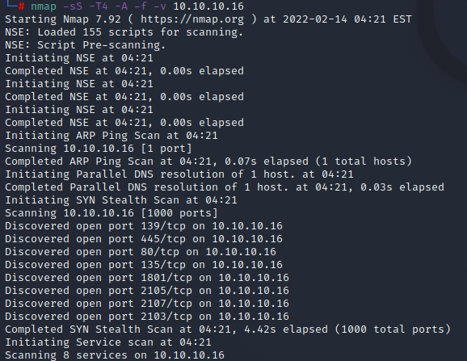



Scanning Networks – Firewalls!!!
SYN/FIN Small IP Fragments + Port (n)
In many cases, placing a Firewall/ IDS, IPS Systems may protect the network from scanning networks. However, there are various methods to overcome Firewalls and other protection mechanisms.
One way, is to fragment (divide into small packets) the probe packets.
TCP Header may be split into many small packets in order to avoid packet filtering mechanisms placed in the network.
Source Routing is another way, where the attacker decides on the route (specified route) to ignore the IDS/IPS/Firewalls.
RST/ ACK

Slide 25

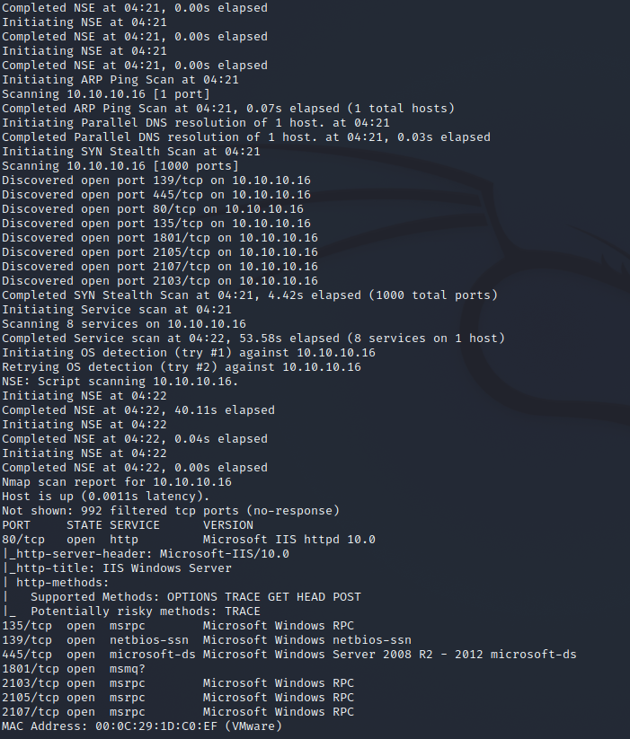
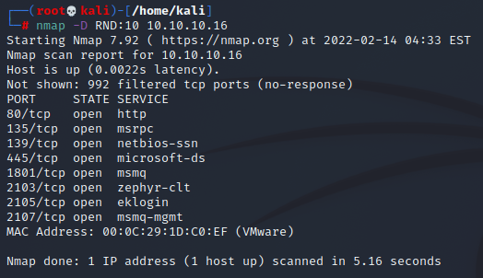
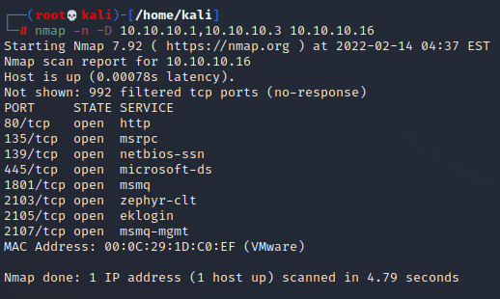
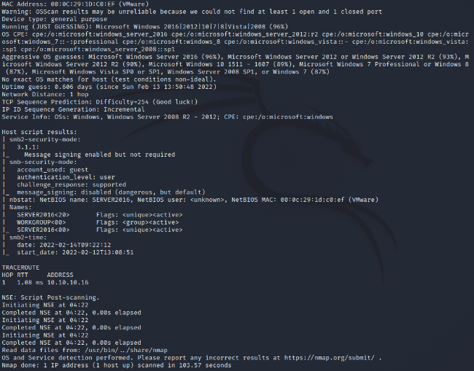
Scanning Networks – Firewalls!!!
In many cases, placing a Firewall/ IDS, IPS Systems may protect the network from scanning networks. However, there are various methods to overcome Firewalls and other protection mechanisms.
Generate/ Manually assign an IP address to bypass the firewall. This is known as IP Address decoy.
Change the source IP Address to make it look like an attack from a different source. This could bypass firewalls as 3-way handshake is not complete. This is IP Address Spoofing

Slide 26

Scanning Networks – Security Perspective
As a security professional, there is always ways to analyse the packets to identify these scans
Send a packet to the host. You will get a reply. Look at the TTL with the initial packet received. If the TTL is not same, it is a spoofed packet.
Send probe to the suspected host. Compare the IPID in its reply. If IPID value is not any nearest value to the packet examining, it is a spoofed traffic.
Target 10.0.0.25
Sending pkt using 10.0.0.5
TTL 13
IPID 2525
Sending pkt to 10.0.0.5
Victim 10.0.0.5
TTL 35
IP ID 4532

Slide 27
Scanning Networks – Security Perspective
As a security professional, there is always ways to analyse the packets to identify these scans
If an attacker is sending a spoofed TCP packet, he/she will not receive the SYN-ACK. (as it is spoofed with a different ip address and the SYN-ACK will reach the original spoofed address). This will limit the attackers from receiving any updates. If the received traffic continues even after a window size exhaustion, the packets are spoofed.
Target 10.0.0.25
Sending SYN pkt using 10.0.0.5
TTL 13
IPID 2525
Sending pkt to 10.0.0.5
With small window size
Victim 10.0.0.5

Slide 28
Scanning Networks - Countermeasures
Information is Wealth: Restrict sensitive information from public access
Firewalls: Always make sure firewalls/ IDS/ IPS are configured to identify and block probes. Use multiple firewalls.
Self-Test: Try to do TCP and UDP scan along with ICMP probes against your networks IP address to check the status of your network
Configurations & Updates: Have a look at routers and firewall configurations, firmware updates
Anti-Spoofing: Make sure, anti-scanning & anti-spoofing rules are effective
Block: Block unused ports
Filter: Filter all inbound and outbound lCMP messages. Use routers and firewalls to filter incoming packets and outgoing packets.
Encrypt all the traffic: Use Ipsec, TLS, SSH, HTTPS etc
IP-based authentication: It is not reliable. Use random initial sequence number to prevent IP Spoofing attacks based on seq. number spoofing.

Slide 29
Scanning Networks Proxys
An intermediary device helping in connecting with devices is a proxy server. Proxys help in hiding the actual source of scan and bypass security restrictions.
A Request is made for a resource via a Proxy Client
The Proxy Client connects to a Proxy server and passes the request
The Proxy server removes the user id’s and passes it to the next proxy server.
The process continues until the request reaches the resource.
From the source to the destination, the traffic is encrypted. It is decrypted when it reaches the destination.
Tools like Proxy Switcher is used to browse internet without disclosing the IP address.
CyberGhost VPN: Online Privacy, Anonymous Browsing, Access/Block censored contents etc
Tor, Burpsite, Proxifier etc…
Any Proxy’s you know? List out….
Page 4 of 4

Slide 30
Scanning Networks – Banner Grabbing
Active
Packets are crafted and sent to the target
Determine OS
Passive
Looking into the error messages.
Observing Packets. (Capture, analyse)
The Reponses were gathered, compared and analysed
Note: OS’es could have different responses because of their TCP/IP stack implementation
Information like Server Type, OS, Tools etc.
Other available details (.php uses apache server, Linux, .aspx uses IIS Server, Windows
On discussing about scanning the target for concrete information which would be very helpful in identifying their vulnerabilities, details on Open Ports, Applications etc is good to know. Adding to those information, finding out the running operating system adds more value to the gathered information.
Determining/ Identifying the target’s Operating System is Banner Grabbing.

Slide 31
Scanning Networks – Banner Grabbing
Countermeasures:
Set False banners.
Turn off Services that are not used/required
Hide file extensions.

Slide 32

Scanning Networks –
Map the Infrastructure
Logical/ Physical path.
  Intranet
  DMZ
  Intranet

Slide 33
Scanning Networks – Security Perspective!!!
As a Security Professional, look at your Network’s security.
Look for
  Live systems
  Open Ports
  Services Running
  System Banners
  Etc….
Act on
  Close all the unused ports
  Disable Services that are not used
  Hide Banners
  Fix configuration errors
  Check Firewall rules.
Page 1 of 2

Slide 34
Scanning Networks – Steps
HOST
Identify Host
Nmap, IP Scanner, NetScanTools etc
SCAN
Scan for open ports
Packet Fragmentation, IP address spoofing etc
BG
MAP
Bypass Security Infrastructure
Banner Grabbing
Craft packets and capture the response
Map the Target Network
Mapper, OpManager, NetBrain etc
Record/ Document the information

Slide 35

Enumeration
Like, Reconnaissance is the method of collecting information about a target system without alerting it, also known as Footprinting, it is the first step in any form of hacking that helps in understanding the target system and identify potential attack vectors & vulnerabilities followed by network scanning to identify hosts, ports and services in the network.
Enumeration is when you try and connect to the system and do deliberate actions to gather more information.
OH!!! NO----- NOT AGAIN!!!! How many stages are there to collect information?
Are you really tried? Are you in a hurry? Then this is not your

Slide 36
Enumeration
The main objectives of Enumeration
Use the earlier gathered information to look out the weak points to initiate system attack and gain access on the target system
Further get more information, but this time from an intranet environment.
Network Resources
Shared Folders
Routing Information
System/ Security Settings
Names, Users, Groups
Applications
SNMP, FQDN Information etc

Slide 37
Enumeration
As it is not the basic stages of gathering information, you also need to gain Domain Knowledge. Eg: The services and its ports etc
Let's check now:
DNS Zone Transfer Port and Protocol: _____________________________________
Lightweight Directory Access Protocol: ____________________________________
SNMP: ____________________________________
SNMP Trap: ________________________________
SMTP: ____________________________________
UDP 137: ____________________________________
TCP 139: ____________________________________

Slide 38


Enumeration
Communication using NetBIOS Name
NetBIOS
  What it is?
  Used to identify the network devices
  Uses TCP/IP
  Enumerate NetBIOS information to
  List the computers of the domain.
  List the shares on the hosts
  Look for Policies and Passwords
NetBIOS Name:
16 Digits
15 Digits – Device Name
1 Last Digit – Service/ Name Record Type

Slide 39
Enumeration
Communication using NetBIOS Name
NetBIOS
  What it is?
  Used to identify the network devices
  Uses TCP/IP
  Enumerate NetBIOS information to
  List the computers of the domain.
  List the shares on the hosts
  Look for Policies and Passwords
NetBIOS Name:
16 Digits
15 Digits – Device Name
1 Last Digit – Service/ Name Record Type
Name | NetBIOS Code | Type | Information
<host name> | <00> | UNIQUE | Hostname
<domain> | <00> | GROUP | Domain Name
<host name> | <03> | UNIQUE | Messenger Service for the computer
<user name> | <03> | UNIQUE | Messenger Service for the user logged in
<host name> | <20> | UNIQUE | Server services running
<domain> | <1D> | GROUP | Master Browser name for the subnet
<domain> | <1B> | UNIQUE | Domain Master browser name: identifies the primary domain controller (PDC) for that domain

Slide 40


Enumeration
SNMP Manager
Get Request
SNMP
  SNMP has Manager (NMS) and Agent (Each Network Device)
  SNMP Manager uses 2 passwords to access and configure its Agents.
    Read Community String: Public. View device Configuration
    Read/Write community String: Private. Edit Configuration
  Enumerating user accounts and devices on a Target System
    Gathers default community strings information and gets details like hosts, intermediate devices, shares, routing tables, ARP tables, network traffic etc.
  Community Strings are stored in MIB (Management Information Base) which needs to be matched. If not, an error message will be sent to the pre-configured SNMP Manager.
    MIB is a virtual database with information related to network objects (Scalar Objects – define a single object instance; Tabular Objects – Multiple related object instances are grouped) managed used SNMP
    MIB database is hierarchical, and they are addressed using Object Identifiers (OIDs). OIDs includes counter, string, address, access levels (not accessible, read-only, read-write), size restrictions, range information etc.
    SNMP uses the MIB’s hierarchical namespace containing Object Identifies (OIDs) to translate the OID numbers into a human-readable display.
UDP Port 161
Response
SNMP Agents

Slide 41
Enumeration
LDAP
Active Directory LD Services
Manageability
Security
Interoperability
  AD LDS is a hierarchical file-based directory store with directory information source and the service that makes the information available and usable
Application
Server Config
SSO
App-Specific Directory Info
Email Servers
Mailbox Information
Address Book
Windows User
Account Information
Privileges
Profiles
Policies
Network Devices
Config
QoS Policy
Security Policy
  Queries LDAP services and gets information like usernames, department details, address etc.
  Tools like LDAP Admi Tools, LDAP Search, Active Directory Explorer could be used to enumerated LDAP.

Slide 42
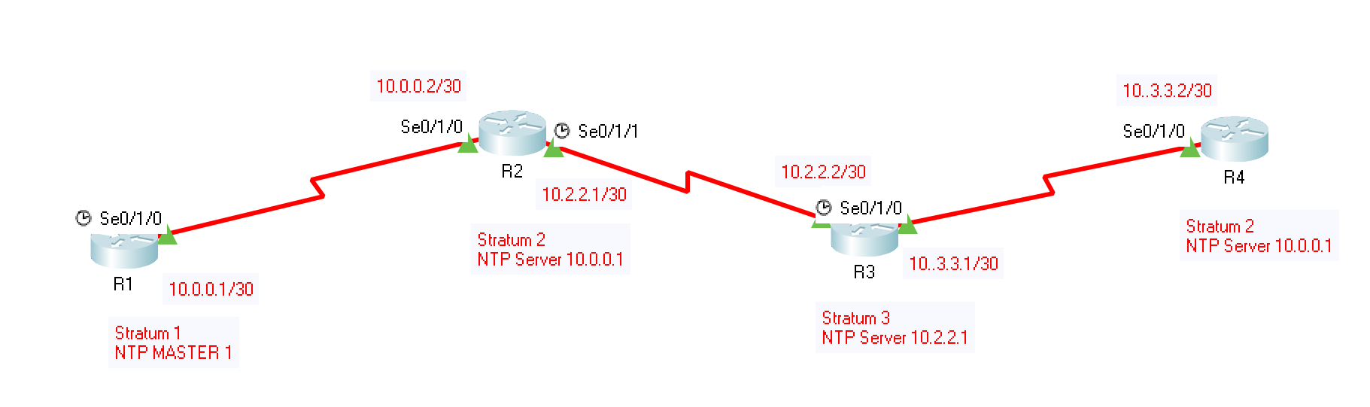
Enumeration
NTP
Network Time Protocol (NTP) is used to synchronize a set of network clocks in a distributed client/server architecture.
NTP is a UDP-based protocol that connects with servers on port 123. The client source port is dynamic. The Time zone in Cisco devices is UTC
NTP is based on a hierarchical concept of communication.
  At the top of the hierarchy are authoritative devices that operate as an NTP server with an atomic clock.
  The NTP client queries the NTP server for its time and then updates its time based on the response.
The NTP synchronization process is not fast, gaining an accuracy of tens of milliseconds requires hours or days of comparisons.
  Attacker targets NTP server to look for the connected hosts to it, IP Addresses, System Names and Operating Systems.
  Internal IP Address can also be obtained if NTP Server is located in DMZ

Slide 43
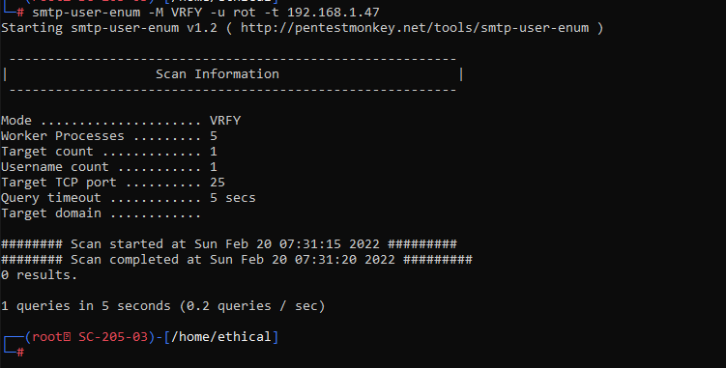
Enumeration
SMTP
Simple Mail Transfer Protocol (SMTP) is used to send emails.
SMTP has commands to validate users (vrfy), give actual deliver address and mailing lists (expn) and give the receivers details (rcpt to).
The response to valid users and invalid users defers in SMTP servers.
  Attacker uses telnet connection to get the list of valid users from an SMTP Server

Slide 44
Enumeration
DNS
Enumerating DNS is a process of finding out the DNS Server of the target.
Enumerating DNS can give an attacker information like DNS Server Names, usernames, IP Address, Host name, machine names etc.
DNS Zone Transfer enumeration is used to get a copy of entire zone file for the domain from DNS Server
IPsec
A scan for ISAKMP in UDP port (???) can indicate the presence of a VPN Gateway.
Using various available tools, attackers can get information like encrypting & hashing algorithms, authentication type, SA life duration etc.
VoIP
VoIP (SIP) uses UDP/TCP ports (???).
Using various available tools, attackers can get information like VoIP gateway/servers, IP-PBX Systems, client softwares/ VoIP Phones, user-extensions etc.
Later, these information may be used to attack the target.
RPC
By enumerating RPC endpoints, attackers gather information on vulnerable services on the ports.

Slide 45
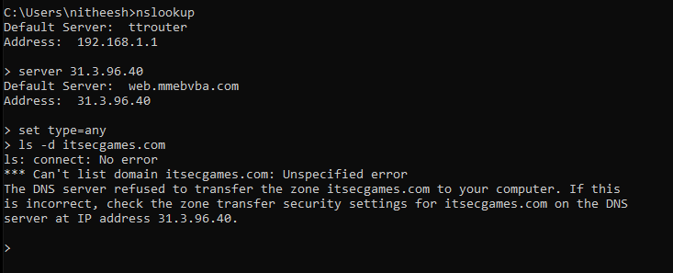
Enumeration - Countermeasures
SNMP
Turn Off SNMP Service
DNS
If not, change community string names
Upgrade to SNMP3
Implement Group Policy Security Option
Restrict access to null session pipes, null session shares, IPSec Filtering
Disable DNS Zone transfers to the untrusted hosts
Don’t publish private IP addresses in DNS Zone Files of Public DNS Server
Use DNS registration services that hides sensitive information
Use generic network admin contact for DNS Registrations
SMTP
Ignore emails from unknown recipients
Restrict mail responses
Disable Open relay feature
Limit no. of accepted connections

Slide 46
Enumeration - Countermeasures
LDAP
Encrypt LDAP traffic
SMB
Disable SMB protocol on Web & DNS Servers, Internet Facing servers, TCP Ports.
Enable account lockout
Restrict anonymous access

Slide 47
Enumeration – Steps
Network
Identify Network Range, Calculate Subnet Mask, Discover Host, Scan the Ports
Whois Lookup, Nmap etc
ENM
Start with NetBIOS Enumeration, SNMP Enumeration, LDAP Enumeration, NTP Enumeration, SMTP Enumeration, DNS Enumeration, Ipsec, VoIP, RPC
Doc
Document all the findings

Slide 48
Any Questions?
Advanced Cybersecurity
(ACCB6000)
Applied Computing - WISA

Slide 49
References
EC-Council CEH
Cisco Networking Academy
Tevel Cyber Corps
Certified Ethical Hacker (CEH) Version 10 Cert Guide, 3rd edition
Wikipedia
Other website sources given in this presentation
* The intension of usage is for Educational Purpose Only
Advanced Cybersecurity
(ACCB6000)
Applied Computing - WISA

