Slide 1

Week 3
Note taking, Harvard Referencing & Paraphrasing
Academic Skills for the Digital Era (BMSW4013)

Slide 2
Recap (Week 2)
What did we do last week?
Notes:
Do it as a group, individually, in smaller groups it doesn’t matter, the idea is to get them thinking about what they did last week. I like to use the SMART Boards if you have one.

Slide 3
Reflection (Week 2)
Take 10 minutes to reflect on last week and complete the reflection worksheet.
This will help you in the long term to complete Assignment 2.

Slide 4
Learning Objectives
By the end of this session, students will be able to:
Explain the purpose of academic note-taking and Harvard referencing within higher education
Identify the key components of Harvard referencing, including in-text citations and reference list entries
Apply Harvard referencing conventions to a range of academic sources relevant to the assignment topic
Paraphrase academic information in their own words while maintaining meaning and including appropriate in-text citation
Produce accurate in-text citations and reference list entries for selected sources at an appropriate first-year standard

Slide 5
Assignment 1
Academic Skills for the Digital Era (BMSW4013)

Slide 6
Assignment 1:
Evidence of Learning (E-Portfolio)
Component 1
Development of Academic Skills (500 words)
Component 2
Application of Academic Skills (1,000 words)
Component 3
Academic Poster: Communicating Academic Skills
Today’s lecture will help you with all 3 components.

Slide 7


How do you take notes in the class?
I will not write anything. Listening is more important
I will write down everything the Lecturer says. Having comprehensive notes are very important.

Slide 8
Note-Taking
“Notetaking is a strategy for making information meaningful… The act of taking notes is more important that the result.” (McPherson, 2018, p6)
The density/complexity of the information.
How fast the information is presented – a slower pace gives time to reflect on/review notes.
Several factors determine if note taking is effective:
The style (putting points in your own words is more useful that long verbatim notes)
How well the information is organized by the presenter.
How skilled you are at taking notes (do you capture the important points?)

Slide 9
Working Memory
Your Working Memory (WM) capacity is the amount of information you can ‘hold’ in one go. This varies between people.
Your working memory governs your ability to comprehend what you are reading or hearing, your ability to learn new words, your ability to reason, your ability to plan and organise yourself.
Some people have a high capacity WM, holding up to 10 pieces of information at a time.
Most have an average WM recalling up to 6 pieces of information at a time
Some will have a lower capacity WM holding 3 pieces of info at a time.

Slide 10

Note-Taking Essentials
Record notes accurately (source)
Date your notes (chronologically or lecturers)
Your notes have to be meaningful (from day 1 to months)
Personalise your notes (they have to make sense to you)

Slide 11

Note-Taking Styles
There are numerous methods but here are a few examples to get you going:
Underlining
Highlighting
Colour coding
Bullet points
Mind mapping
Boxes for important points

Slide 12
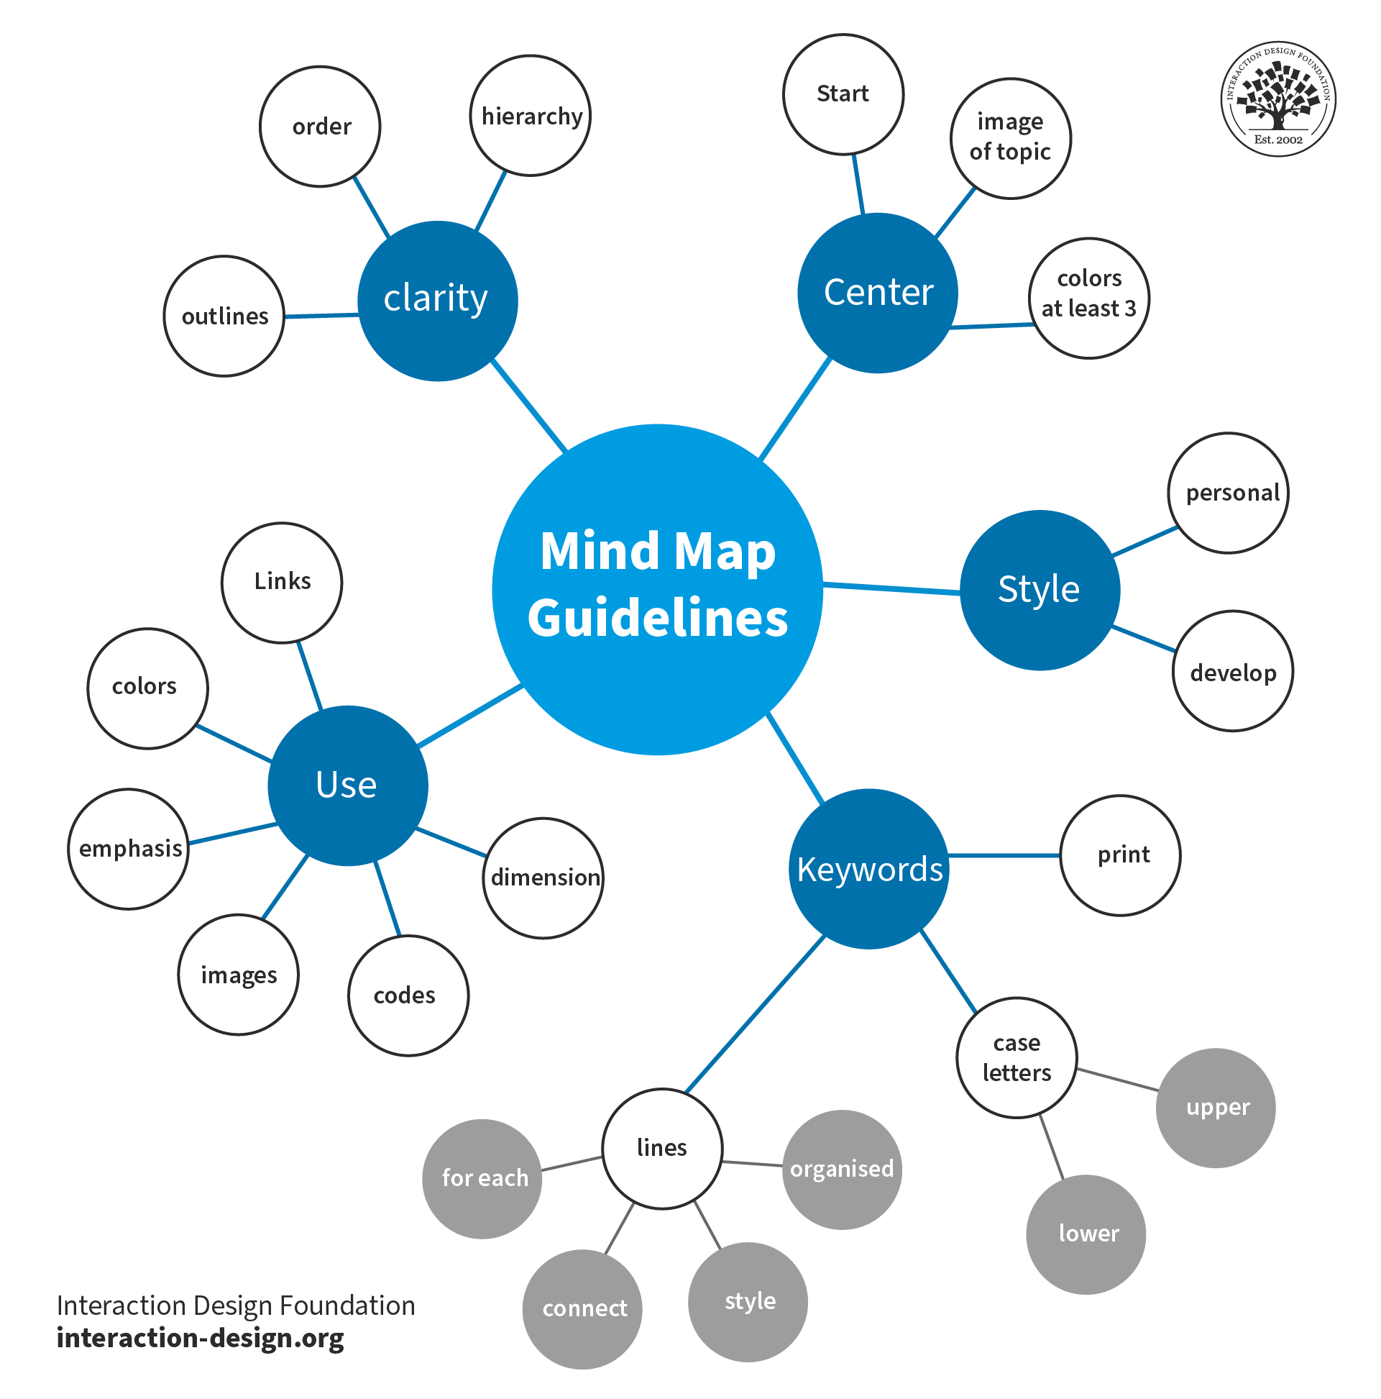
Mind-Mapping
Mind maps are graphic summaries of information that aid you as a notetaker to:
Organise,
Group your points of information,
Link your points of information.

Slide 13
Building a Mind Map
Health Care soft skills
Empathy
Communication
Positive attitude
Here is an example of a Mind Map. You could do one at the end of each week to help with the following weeks recap activity.
Notes:
Within the centre of the page, write the subject area, question, argument or idea.
Next stages is to listen or read information which may be related.

Slide 14
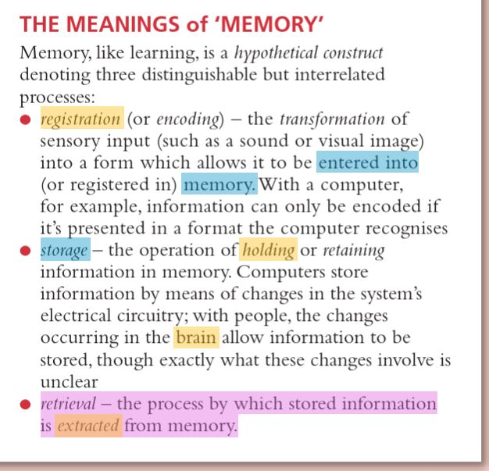
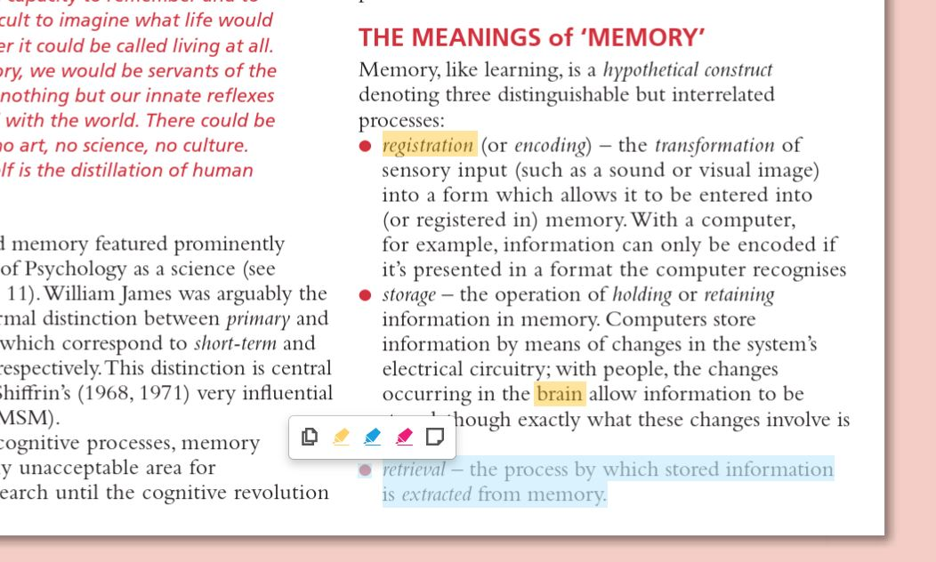
Highlighting
Highlighting refers to emphasising key words, phrases or data by means of underlining or circling, or using a coloured highlighter pen.
Many of the books available on the reading lists have a highlighter and note making tool.
Select just the key words that aid your understanding and make re-reading more rapid.
Left click and drag over the relevant text. Select a colour.

Slide 15
What is Harvard Referencing?
Harvard Referencing is a way of giving credit to the sources (books, websites, articles, etc.) that you use in your work.
Harvard Referencing helps show:
Where your information came from.
That you are not copying but using research properly.
Readers know where to find the original source if they want more information.
(Swales & Feak, 2012)

Slide 16
Harvard Referencing
Harvard Referencing has two parts:
In-text citation
This is a short note in your writing that shows who said something and when.
Example:
“Climate change is a global issue” (Smith, 2020).
Reference List
This is a full list at the end of your work with all the details about each source.
Example:
Smith, J. (2020) Understanding Climate Change. London: Oxford University Press
(Palgrave, 2016)

Slide 17
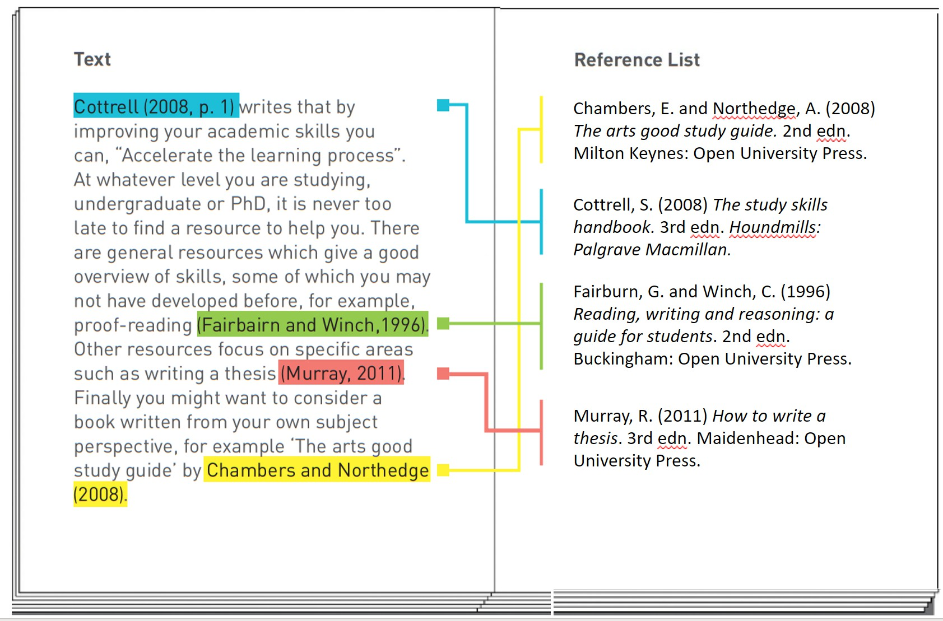
1. In-text citation
2. Full reference list
This work is licensed and adapted under a Creative Commons Attribution 4.0 International License. Attribution: Leeds Beckett University Library.

Slide 18
Why is Harvard Referencing Important?
Gives Credit – Shows who wrote the ideas or information you used.
Avoids Plagiarism – Helps you stay honest and not copy without saying where it's from.
Supports Your Work – Backs up your points with trusted sources.
Helps Others Find Sources – Makes it easy for others to check your research.
Meets Academic Rules – Most schools and universities expect it.
(Norton, 2009)

Slide 19
Example (Book)
In-text citation (Inside your writing)
Students today face many challenges such as distraction, information overload, and digital burnout, but also have opportunities like global learning and easy access to resources (Jones, 2022).
Is there another way we can introduce the citation?
Jones (2022) suggests students today face many challenges…
Reference list entry (at the end of your work)
Jones, M. (2022). Learning in the Digital Age: Challenges and Opportunities for Students. 6th edn. Academic Press.

Slide 20
Reference List: Book
WHO? Author's
WHEN? Date in round brackets.
WHAT? Title of book (in italics) and edition (if there is one.
surname and initial.
Jones, M. (2022)
Learning in the Digital Age: Challenges and Opportunities
for Students. 6th edn.
Bloomsbury Academic.
WHERE? Publisher
In-text citation: (Jones, 2022)

Slide 21
Example (Journal Article)
In-text citation (Inside your writing)
E-learning adoption in emerging economies presents both technical and cultural challenges, requiring strategic planning and support (Barikzai, Bharathi and Perdana, 2024).
Reference list entry (at the end of your work)
Barikzai, S., Bharathi, V. and Perdana, A. (2024) ‘Challenges and strategies in e-learning adoption in emerging economies: a scoping review’, Cogent Education, 11(1), pp.1–19. Available at: https://doi.org/10.1080/2331186X.2024.2400415

Slide 22
Reference List: Journal Article
WHO? Author's surname and initial.
WHEN? Date published in round brackets.
WHAT? Title of article in single quotations.
‘Challenges and strategies in e-learning
Barikzai, S., Bharathi, V. and Perdana, A. | (2024)
adoption in emerging economies: a scoping review’, |  |  |  | Cogent Education, 11(1), pp.1–19.
Available at: https://doi.org/10.1080/2331186X.2024.2400415
WHERE?
Journal Title in italics.
Volume, Issue and page range.
Available at: Insert DOI or URL
In-text citation: (Barikzai, Bharathi and Perdana, 2024)

Slide 23
Example (Website)
In-text citation (Inside your writing)
To succeed in the digital era, students need to develop digital literacy, time management skills, and resilience to stay focused online (Education Corner, 2023).
Reference list entry (at the end of your work)
Education Corner. (2023) How to succeed as a student in the digital age. Available at: https://www.educationcorner.com/succeed-in-digital-age.html (Accessed 18 September 2025).

Slide 24
Reference List: Web Page
WHO? Author's surname or corporate author.
WHEN? Date of publication
WHAT? Title of webpage in italics
Education Corner. (2023) How to succeed as a student in the digital age
Available at: https://www.educationcorner.com/succeed-in-digital-age.html (Accessed 18 September 2025).
WHERE? URL and
accessed date.
In-text citation: (Holford, 2022)

Slide 25
Harvard Referencing: Task
Last week we CRAAP tested 4 different sources related to the assignment question “What are the challenges and opportunities for students in the digital era, and how can they adapt to succeed?“
Your task now is to reference the sources from last week using the Harvard Referencing system.
To assist you, please refer to the Harvard Referencing Handbook (WHICH CAN BE FOUND IN MOODLE).

Slide 26
Harvard Referencing: Task
Digitalization of higher education: Students’ perspectives
The interplay among digital distraction, self-regulation of learning tendencies, and motivational influences: A transnational investigation
Digital distractions in the classroom among students: A cross-sectional study
Laptop multitasking hinders classroom learning for both users and nearby peers

Slide 27
Harvard Referencing: Task Answers
Digitalization of higher education: Students’ perspectives
Potočan, V., Nedelko, Z. and Rosi, M. (2025) ‘Digitalization of higher education: Students’ perspectives’, Education Sciences, 15(7), p.847. Available at: https://doi.org/10.3390/educsci15070847 (Accessed: Day Month Year).
2. The interplay among digital distraction, self-regulation of learning tendencies, and motivational influences: A transnational investigation
Flanigan, A.E., Brady, A.C., Akcaoglu, M., Dai, Y., Won, S., Daleiden, B.K. and Hartley, K. (2025) ‘The interplay among digital distraction, self-regulation of learning tendencies, and motivational influences: A transnational investigation’, The Internet and Higher Education, 67, p.101023. Available at: https://doi.org/10.1016/j.iheduc.2025.101023 (Accessed: Day Month Year).

Slide 28
Harvard Referencing: Task
3. Digital distractions in the classroom among students: A cross-sectional study
Thapa, P., Sharma, P., Goundar, S., Tsirkas, P., Valamontes, A. and Adamopoulos, I. (2025) Digital distractions in the classroom among students: A cross-sectional study. Preprint. Available at: https://doi.org/10.20944/preprints202502.1931.v1 (Accessed: Day Month Year).
4. Laptop multitasking hinders classroom learning for both users and nearby peers
Sana, F., Weston, T. and Cepeda, N.J. (2013) ‘Laptop multitasking hinders classroom learning for both users and nearby peers’, Computers & Education, 62, pp.24–31. Available at: https://doi.org/10.1016/j.compedu.2012.10.003 (Accessed: Day Month Year).

Slide 29
Read this paragraph:
“Many students use digital tools like tablets and laptops to help them study. These tools make it easier to take notes, find information, and stay organised. However, using technology also means students must learn how to avoid distractions and manage their time well.”
Now, without looking at it, try to tell it to the person next to you what it was about – but use your own words.

Slide 30
Paraphrasing
Paraphrasing means rewriting something in your keeping the same meaning.
own words while
You use paraphrasing when you read information from a book, website, or article and want to include it in your work without copying it exactly.
Why is paraphrasing important?
It shows you understand what you read.
It helps you avoid plagiarism (copying).
It makes your work sound more like you.
(Blake, 2011)

Slide 31
Paraphrasing – Example
"Online education offers students flexibility, allowing them to learn at their own pace and access resources from anywhere. However, it also requires a high level of self-discipline and time management skills to stay on track.“
Paraphrased Version:
"E-learning gives students the freedom to learn at their own speed and use resources from any location. But it also demands strong self-control and good time management to keep up with their studies."

Slide 32
Paraphrasing – Tips
Understand first – Read the text carefully and highlight key points.
Use synonyms – Replace words with similar meanings but be cautious.
Change structure – Rearrange sentences, switch from active to passive, etc.
Simplify or combine – Break long sentences or combine short ones.
Stay true to the meaning – Keep the original message and tone.
Use your own voice – Imagine explaining the idea in your own words.
(University of Leeds, 2020)

Slide 33
Paraphrasing – Activity
Original Text:
"Students today face many challenges such as managing their time effectively, dealing with distractions, and staying motivated while using technology. However, the digital era also offers opportunities, such as easy access to information, online learning platforms, and global connections that can enhance their education."
Task:
Author: Scott James
Date of publication: 2025
Name of book: Navigating Education in the Digital Age: Challenges and Opportunities for Students
Edition: 2nd
Place: London
Publisher: Routledge
Read the sentence above carefully
Paraphrase it in your own words
Add an in-text citation within your work
Include the full reference

Slide 34
Paraphrasing – Activity
Paraphrased Version:
In the digital age, students encounter challenges like staying focused, managing their time, and maintaining motivation while using technology. On the other hand, they also benefit from opportunities such as quick access to information, online learning tools, and the ability to connect with others worldwide, all of which can improve their educational experience (James, 2025).
Reference:
James, S. (2025) Navigating Education in the Digital Age: Challenges and Opportunities for Students. 2nd edn. London: Routledge.

Slide 35
As you become more familiar with Harvard Referencing and encounter a wider range of source types, you'll start to notice various nuances.
For example:
What if there’s more than one author?
What if no date is provided?
What if the author is unknown?
These situations are common—and knowing how to handle them correctly is important.
Where can you go for support?

Slide 36


Other Useful Resources

Slide 37
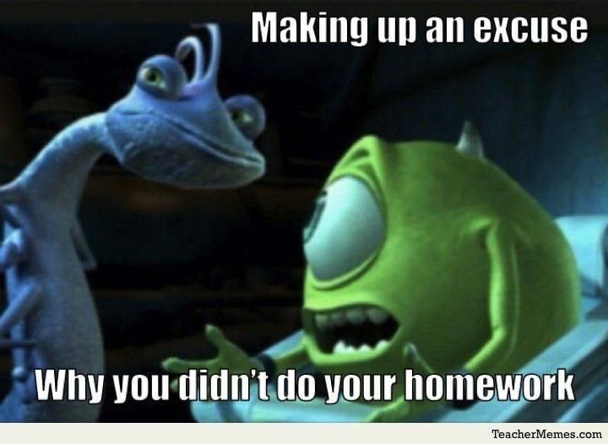
Tasks
Task: Complete Referencing: Unit 1 – Academic Integrity & Avoiding Plagiarism

Slide 38
Learning Objectives
By the end of this session, students will be able to:
Explain the purpose of academic note-taking and Harvard referencing within higher education
Identify the key components of Harvard referencing, including in-text citations and reference list entries
Apply Harvard referencing conventions to a range of academic sources relevant to the assignment topic
Paraphrase academic information in their own words while maintaining meaning and including appropriate in-text citation
Produce accurate in-text citations and reference list entries for selected sources at an appropriate first-year standard

Slide 39
Reference List
Blake, P. (2011) The Little Book of Writing: A Guide to Writing Well. Oxford: Oxford University Press.
Norton, B. (2009) The Harvard Referencing System. 2nd edn. London: Routledge.
Palgrave, M. (2016) Harvard Referencing Guide. 4th edn. London: Macmillan Education.
Swales, J.M. and Feak, C.B. (2012) Academic writing for graduate students: Essential tasks and skills. 3rd edn. Ann Arbor: University of Michigan Press.
University of Leeds (2020) Paraphrasing: Tips and Techniques. Available at: https://library.leeds.ac.uk/paraphrasing (Accessed 18 September 2025)

