Slide 1

Three Organisational Structure Designs: Adidas
Module Name | Understanding Organisational Structure and Culture
Module Code | LCBB4009
Assessment Name | Component 1: Practical: Individual presentation
Student Name | Anamaria Bardut-Cristurean Cristurean
Student Number | 2410281
Submission Date | Slide Submission: 24/07/2026 by 2PM Presentation: 25/07/2026

Slide 2

Presentation Outline
The concepts of organisational structure and its relevance in contemporary business organisations today are introduced.
Describes functional organisation structure based on practical Adidas business operations and departments in an effective way.
Describes divisional organisational structure in favour of Adidas products, markets, and strategic business development.
Notes:
The presentation also introduces organisational structure and how important it is for successful organisations. Three structural designs of organisations are analysed with Adidas as the chosen organisation. The pros and cons of these and their practical applications are highlighted and the effectiveness of them is compared and the most suitable organisational structure identified.

Slide 3

Organisational Structure
Organisational structure outlines the duties of employees, the power, the communication and the reporting dynamics in businesses (Costa, 2025).
Reporting between departments, between managers and employees, and between managers and employees is clearly shown in organisational charts.
Proper organisational structures enhance coordination, productivity, communication and performance of the organisation.
Notes:
Organizational structure defines the role of employees, reporting relationships, and communication of an organization. These relationships are graphically illustrated by organisational charts and explain the level of authority. Effective organisational structures enhance efficiency in operations, promote accountability, enhance coordination and facilitate effective decision making in all organisational activities.

Slide 4
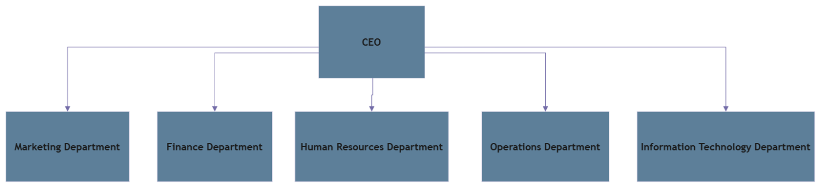
Functional Structure (Adidas)
Functional structure organises the employees based on specialised business functions and responsibilities effectively.
Adidas has several functional divisions such as marketing, finance, operations, human resources, and information technology (Galluccio and Agrell, 2022).
Specialisation enhances efficiency, specialisation, employee growth, and the overall consistency of business performance.
Departmental isolation can minimise interdepartmental communication and interdepartmental collaboration, interdepartmental flexibility and interdepartmental responsiveness
Notes:
The functional structure is used to categorise the employees based on specialised business departments. Adidas can enhance efficiency through clustering activities of similar nature giving employees an opportunity to become experts on their roles. Nevertheless, horizontal communication could slow down, decreasing team-work and organisational agility when working on complicated projects.

Slide 5
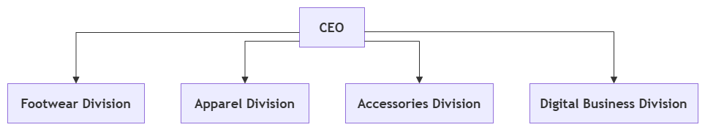
Divisional Structure (Adidas)
Divisional structure: This structure divides business operations based on products, markets or geographical locations.
Adidas operates footwear, apparel, accessories and digital business across separate operating segments.
Independent divisions enhance customer focus, innovation, strategic flexibility, and effectiveness of product development (Sergeev, 2023).
Divisional operations sometimes raise management expenses, redundancy of resources and organisational coordination issues.
Notes:
The divisional structure allows Adidas to deal with various product lines in isolation and still retain strategic focus. All the divisions are responsive to customer needs and market dynamics. Despite the increased flexibility, managing multiple divisions entails extra management resources and hence costs organisations as well as complexity in their coordination.

Slide 6
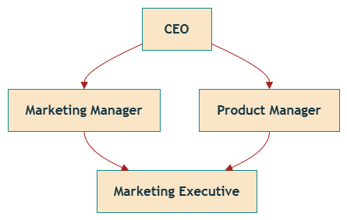
Matrix Structure (Adidas)
Matrix structure is a structure that integrates both the functional departments and the product or project management.
Functional managers and project managers who report to the same workers are found in different parts of the operations.
Adidas favors innovation by working on products and marketing efforts on a worldwide scale in teams.
On some occasions, dual reporting relationships cause confusion, conflict, slow decision making and difficulty in accountability (Song, Ro and Baek, 2026).
Notes:
The matrix structure brings together departmental expertise and project-based cooperation. Adidas has the advantage of establishing cross-functional teams, when launching new products and marketing campaigns on a global level. Despite these benefits of innovation and flexibility, dual reporting can be confusing, leading to communication problems and sometimes management conflict between supervisors.

Slide 7
Comparison of Organisational Structures
Functional structure provides efficiency based on specialised departments and a well-defined organisational responsibility (WANG, 2024).
Divisional structure improves market responsiveness using independent product-focused business divisions successfully today.
Collaboration in the form of collective expertise and cross-functional project management teams are strengthened by the matrix structure.
Notes:
Organisational structures offer various business benefits based on organisational goals. Functional structures enhance efficiency; divisional structures enhance customer responsiveness and matrix structures promote cooperation and creativity. International business operations in Adidas ensure greater organisational performance through the incorporation of organisational flexibility and organisational teamwork using divisional flexibility and matrix teamwork.

Slide 8

Conclusion
Organisational structures have a direct impact on communication, productivity, coordination and organisational performance in businesses.
The functional structure is efficient as it has specialised departments that carry out well-defined organisational functions.
Divisional and matrix are the structures that enhance innovation, flexibility, collaboration and strategic business responsiveness.
Notes:
An organisation structure is still the key to effective communication, coordination and organisational success. The various structures have different strengths following the business objectives. The advantages of adopting both the divisional and the matrix models are that Adidas would be flexible and thus be able to innovate and work internationally and ensure business competitiveness in the long run.

Slide 9
References
Costa, L., 2025. Influence of Corporate Culture on the Creation of Project Management Structures.
Galluccio, A. and Agrell, P.J., 2022. Industry 4.0 in focus: The adidas speedfactory. Université catholique de Louvain, pp.21-32.
Sergeev, M., 2023. Web3. 0 as an Adaptive Strategy in Crisis: The Case of Nike and Adidas (Master's thesis, Universidade Catolica Portuguesa (Portugal)).
Song, D.E., Ro, D. and Baek, H., 2026. Narratives, Networks, and the Evolution of Paracrises: Evidence From X (Twitter) Discourse on the Adidas SL72 Campaign. Journal of Contingencies and Crisis Management, 34(2), p.e70156.
WANG, X., 2024. The impact of organizational dynamic capability on collaborative innovation: A supply chain perspective

Slide 10
Thank You

