Slide 1
CSO REFRESHER TRAINING:
POWERS RELATING TO
CONFISCATION of ALCOHOL,
TOBACCO & DRUGS
CSO – February 2024
Curriculum updated

Slide 2
AIMS & OBJECTIVES:
AIM:
The aim of this session is for Community Support Officers to understand legislation surrounding the seizure of alcohol, tobacco and drugs from members of the public.
OBJECTIVES:
Understanding the meaning of ‘young person’
Describe what a ‘relevant place’ is
Understand the process of the power of search, detention, seizure and disposal of alcohol and tobacco.
Know the legislation surrounding the seizure and disposal of drugs.

Slide 3

ALCOHOL:

Slide 4
Paragraph 6 of Schedule 4 to the Police Reform Act 2002.
Power to Seize Alcohol From Young Persons In Relevant Place & require details:
Where a CSO reasonably suspects a young person to be in possession of what the CSO reasonably believes is alcohol in a relevant place
The CSO may require the young person to:
Surrender anything, they reasonably believe to be alcohol or a
container for alcohol (sealed or unsealed)
and power to dispose of alcohol surrendered.
AND state their name and address
Notes:
Came into force on August 1st 1997 and provided the Police with a power of confiscation where young persons are drinking in the street. It was designed to allow the Police to deal with situations where drinking causes a nuisance to others or may lead to further bad behaviour.
It did not create an offence for a young person to have an alcoholic drink in a public place and we are not under a duty to do so. Not meant to be used when not causing a problem e.g. family picnic
191(1) In this Act, 'alcohol' means spirits, wine, beer, cider or any other fermented, distilled or spirituous liquor, but does not include:-
(a) alcohol which is of a strength not exceeding 0.5% at the time of the sale or supply in question,
(b) perfume,
(c) flavouring essences recognised by the Commissioners of Customs and Excise as not being intended for consumption as or with dutiable alcoholic liquor,(d) the aromatic flavouring essence commonly known as Angostura bitters,
(e) alcohol which is, or is included in, a medicinal product,
(f) denatured alcohol,
(g) methyl alcohol,
(h) naphtha, or
(i) alcohol contained in liqueur confectionary.

Slide 5
MEANING OF ‘YOUNG PERSON’:
Where a CSO reasonably suspects that a person in a relevant place is in possession of alcohol and that either:
They are under 18 years old
They intend that an under 18-year-old person should consume the alcohol
(e.g. adult supplying to minors)
A person under 18 who is with them, or recently been with them has
consumed alcohol (adult accompanying)
A person who is
NOT YET 18
(Anyone is regarded as a ‘young person’ up to midnight of the day before their 18th birthday).
Notes:
If you suspect or believe that a person will supply it to u18s you can seize it, even if they are just ‘in company’ of the over 18s drinking alcohol.
If they are older than 18 and can prove it with I.D. still seize it as its most likely they will share it with the u18s.
Take it to the station and they can attend the next day with proof of I.D. and have it back. Or within 28 days.

Slide 6
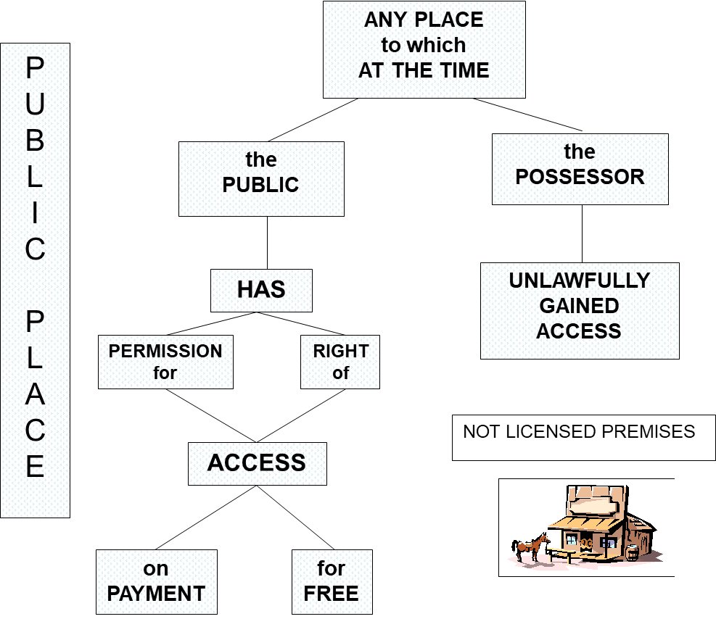
RELEVANT PLACE DEFINITION:
Notes:
If someone has access to it then it is a public place.
Get Licencing involved – Gwent Police has Licencing Officers who have specialist knowledge and work in partnership with the council.
This is easier to manage now that the challenge 25 system is in place in most off and on licenced premises.
Have to prove – Either bought it or given it
- Under 18
- Public place.
PSPOs – Public Space Protection Orders (designated no drinking zones) Usually on High Streets, there are signs in place.
There are some designated drinking areas e.g. Beer gardens.
U18s can consume alcohol in a private dwelling

Slide 7
SEIZURE OF ALCOHOL – Power of Search:
If a Community Support Officer reasonably believes:
that the person is in possession of alcohol and …
that person fails to surrender it
then they have the power to search the person for alcohol and
seize and dispose of any alcohol found.
It is an offence to fail to consent to be searched and CSOs must tell the person to be searched that it is an offence to refuse – can require name and address as this is an offence.
POWER TO SEARCH FOR ALCOHOL:
Paragraph 7A, Sch 4 Police Reform Act 2002

Slide 8
SEIZURE OF ALCOHOL: Seizure and disposal
POWER TO REQUIRE PERSONS UNDER 18 TO SURRENDER ALCOHOL:
Includes power to dispose of that alcohol
Paragraph 6 of schedule 4, to the Police Reform Act 2002
POWER TO REQUIRE PERSONS DRINKING ALCOHOL IN DESIGNATED PLACES TO SURRENDER ALCOHOL, includes power to dispose of that alcohol
Paragraph 5 of Schedule 4 to the Police Reform Act 2002.
Notes:
Two powers to seize alcohol…
* Under 18
* Drinking in a designated area

Slide 9
THE POWER OF DETENTION:
If the person concerned refuses to stop drinking and hand over the alcohol the CSO can require their Name and Address. If they fail to provide this, or they have reasonable grounds to suspect it is false, they commit an offence.
They can then either:
  Be detained for up to 30 minutes to await the arrival of a constable OR Accompany the CSO to the nearest police station.
  POWER TO REQUIRE NAME & ADDRESS:
  Paragraph 1A, sch 4, Police Reform Act 2002
  POWER TO DETAIN: On failure to provide details
  Paragraph 2, sch 4 Police Reform Act 2002
Notes:
It is not advisable to take the detained person to the nearest Police Station as you would be responsible for their safety.
They could trip or fall etc.

Slide 10
EXAMPLE OF MAKING A REQUEST:
“I have reason to suspect that you are under 18 years of age and you (are/or have been) drinking
alcohol…
You must stop drinking immediately (if applicable)
Please give me that can/bottle etc…
What is your name and address?”
Notes:
If they refuse details – use power of detention.
Make sure you take the bottle/can every time and in the first instance.
If sealed - seize and book into property
Unsealed – tip away appropriately
It can be given back if requested by parents or proved to be over 18.

Slide 11

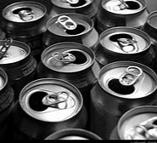

POWER TO SEIZE ALCOHOL IN DESIGNATED PUBLIC PLACE
A CSO who reasonably believes a person…
*Has been consuming
*Is consuming
*Intends to consume
Alcohol In a Designated Public Place…
Can require that person to
Hand over any alcohol or container for alcohol (sealed or unsealed)
Stop Drinking
AND
Notes:
PSPOs – Public Space Protection Orders (designated no drinking zones) Usually on High Streets, there are signs in place.
There are some designated drinking areas e.g. Beer gardens.
Council put these in place
Can seize alcohol from adults in these areas.

Slide 12
POINTS TO PROVE: Alcohol
That you were in uniform
The objective was to seize alcohol
The person was apparently under 18, or drinking in a designated area
That the person was drinking alcohol, or is intoxicated
That the person was in a street or public place

Slide 13
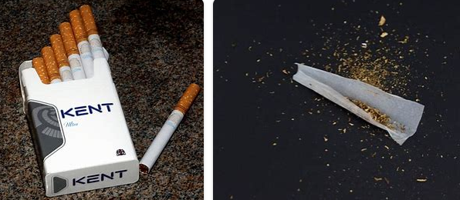
TOBACCO:

Slide 14
POWER TO SEIZE TOBACCO:
It is the duty of a CSO or Constable
TO SIEZE ANY…
TOBACCO
CIGARETTES
CIGARS
CIGARETTE PAPERS
In possession of a person apparently under 16
Who they find smoking in a
Public Place and dispose of it
Notes:
Up to and including 15 years 364 days!
It is now an offence to purchase cigarettes if your are under 18 years old.
It is illegal to SELL Tobacco products to u18s.

Slide 15

SEIZURE OF TOBACCO – Power of Search:
If a Community Support Officer reasonably believes:
that the person is in possession of tobacco and that person fails to surrender it…
then they have the power to search the person for the tobacco and
seize and dispose of any tobacco found.
It is an offence to fail to consent to be searched and CSOs must tell the person to be searched that it is an offence to refuse.
POWER TO SEARCH FOR TOBACCO:
Paragraph 7, schedule 4, Police Reform Act 2002

Slide 16
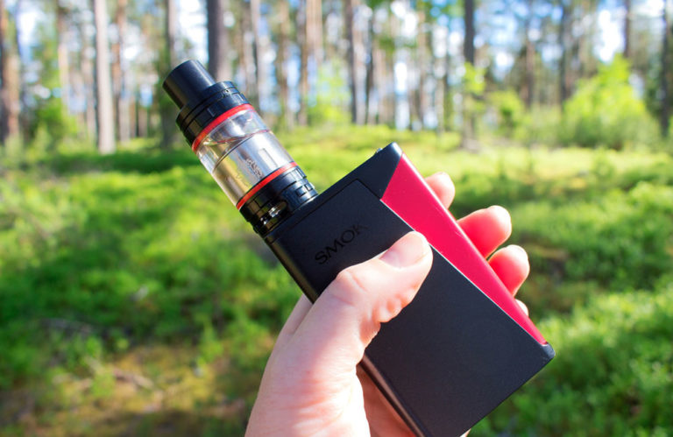

E-Cigs and Vapes.
Must be over 18 to buy a VAPE, E-CIG or VAPE JUICE
Possession of any of these products that contain nicotine is illegal for under 18s IN PUBLIC
Minors can possess nicotine-free vape pens
‘Alternative nicotine’ products are illegal
*Vape cartridges must not hold more than 2 millilitres of liquid or contain more than 20 millilitres of nicotine per ml*
*If seized must be stored in an outside storage unit (e.g. Bike store) due to risk of combustion*
Notes:
No specific power but would come under tobacco product.
If seized – contact parents and explain, possible ASB referral and that Adult can collect within 28 days from the station.

Slide 17
SEIZURE OF TOBACCO: Seizure and disposal
POWER TO SEIZE TOBACCO FROM A PERSON AGED 16 AND DISPOSE OF THAT TOBACCO:
Paragraph 7, schedule 4, Police Reform Act 2002
Notes:
If sealed – seize and book into property
Unsealed – put in the nearest bin.

Slide 18
THE POWER OF DETENTION: Tobacco
If the person concerned refuses to stop hand over the tobacco or cigarettes, the CSO can require their Name and Address. If they fail to provide this, or they have reasonable grounds to suspect it is false, they commit an offence.
They can then either:
  Be detained for up to 30 minutes to await the arrival of a constable OR Accompany the CSO to the nearest police station.
  POWER TO REQUIRE NAME & ADDRESS:
  Paragraph 1A, sch 4, Police Reform Act 2002
  POWER TO DETAIN: On failure to provide details
  Paragraph 2, sch 4 Police Reform Act 2002

Slide 19
POINTS TO PROVE:
That you were in uniform
The objective was to seize tobacco, cigarettes, cigars or cigarette papers
The person was apparently under 16
That the person was smoking
That the person was in a street or public place
Notes:
It is difficult to prove age for under 16s as they don’t have ID at that age, but you can SUSPECT that they are if they appear to be.

Slide 20
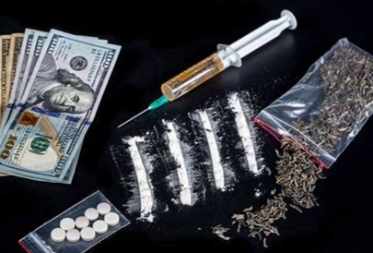
DRUGS:

Slide 21
DRUGS:
A CSO has the power to seize unconcealed drugs or drugs found when searching for alcohol, tobacco or dangerous items (under detention). The CSO must call for a PC and retain the drugs until the PC instructs them as to what to do with it.
If the CSO finds drugs or believes that the person is in possession of drugs, then they can require that person`s name and address.
The CSO may detain the person on failure to comply with the requirement to provide name and address or to confirm name and address.
POWER TO SEIZE DRUGS AND REQUIRE NAME AND ADDRESS FOR POSSESSION OF DRUGS:
Paragraph 7B, schedule 4, Police Reform Act 2002
Notes:
Power derived from Serious Organized Crime and Police Act 2005
**When searching for dangerous items to assist escape when detained**
Please don’t search for drugs, can’t do it as you don’t have the power.

Slide 22
POINTS TO PROVE:
That you found a controlled drug in persons possession
Circumstances of finding; that you were using your powers to search for alcohol, tobacco, or dangerous items to assist escape
That you reasonably believed the person was in unlawful possession of a controlled drug
That you requested the person's name and address
That the person refused to give you the name and address
That you made a note of the description of the suspect (using ADVOKATE)
Responsibilities:
Inform the person from whom the drugs were seized where to go for recovery of drugs if they maintain they were in lawful possession (proof will be required)
Request assistance of a police officer and comply with their instructions as to method of disposal
Notes:
If you are not sure – ASK!
Your team will support you- ward managers, Sgts, other CSOs or PC’s.

Slide 23

ANY QUESTIONS?
Notes:
Get a volunteer out front and seize alcohol or tobacco,
Get them into pairs to practice.
“I have reason to believe that you are under 18 and are drinking alcohol, stop drinking and hand over your bottle/can, what is your name and address please?

