Slide 1
Entrepreneurship
Tanzeela Asif
1708843
A business proposal for Nail Bar Business

Slide 2
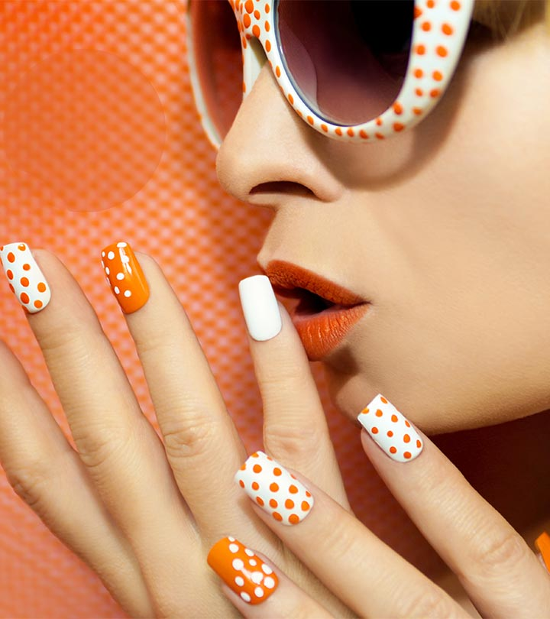
Celebrity Nail Studio

Slide 3
In the heart of city of London we will be opening ‘Celebrity Nail Studio’
We will make £10,000 multiply by 6 by the end of 3rd quarter of first year of our Nail bar business.
By adapting celebrity style in our nail art we can attract maximum number of customer and make good money

Slide 4
INTRODUCTION
An aim to generate lots of money is the encouragement behind starting a nail bar business in the dynamic city of London,
An innovative idea of saving people’s time and providing them with best services with the facility of premiere services of celebrity collection
By starting a well-structured business with the support of expert and educated employees
To kick start a nail bar business it needs lots of investments because nail care as a cosmetics business not just about art but hygiene and health aspects are also to be taken care of

Slide 5
BACKGROUND & TREND
Start of nail care trend in UK 2011 (Philby, 2013)
In 2013nail polish sales £244 million - lipstick reaches £242 million (Roy, 2016)
A break from Busy lifestyle – now become the part of grooming (Philby, 2013)
86% of women do not attend job interview without a manicure in United Kingdom (Styles, 2013)
An affordable luxury (Philby, 2013)

Slide 6
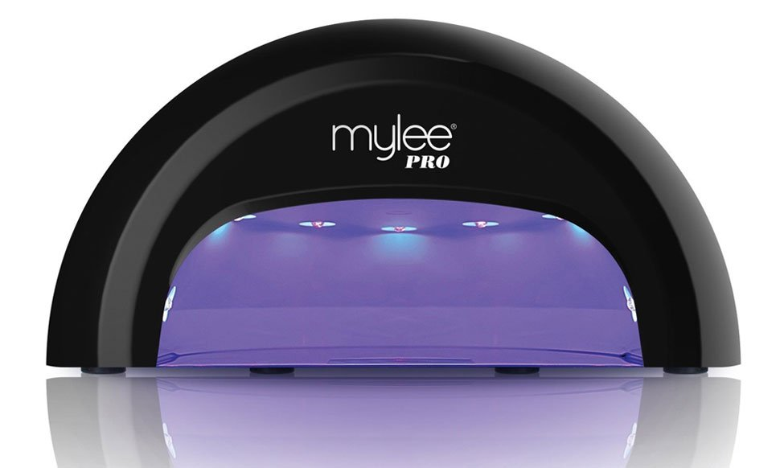
INITIAL BENEFIT STATEMENT
The LED technology and our LED nail polish collection with finest gel finish can cut your manicure & pedicure services time in half and make the nail colour and shine long lasting, plus you can select your favourite celebrity style from our premier collection in bar or online.
LED technology cure nails in just 30 seconds (Andrea, 2013)
Gel effect nail polish and LED lasts for more than 2 weeks
Celebrity style nail art

Slide 7
BUSINESS PLAN & SCALABILITY
In the middle of London city - the manicure and pedicure facility with well trained staff
Starting the business with £10,000 initially with 300 customer in introductory month the business will grow up to 1200 customer experience by the end of first quarter
By the end of 3rd quarter the company will generate £64000 operating profit with the opening of 2nd bar
The 2nd bar will add Rita Ora Jazzy collection
By the end of 3rd year of business company will reach it’s milestones of 6 Bars
£7.8 million profit

Slide 8
RISK ASSESSMENT
The on going trend is supporting the business to grow rapidly
Rising legal aspects after Vietnam's slavery cases in nail bars increases the hurdles to start new business
A Major threat to business is that it’s a life style trend
Monotony of collection will bore the clients so new celebrity collection will be added to at new opening bar
Keep on watching what competitors and changing needed in the business

Slide 9
FUTURE PLANS
Our own nail products
Our own manicure and pedicure kits
Move from services to products to expand the business

Slide 10
CONCLUSION
This was the Business plan to open and grow the nail bar saloon with the innovation of celebrity collection
The fastest technology to cure the nail saves a lot of time
The fast growing trend gives an ultimate edge to this business

Slide 11
ANY QUESTION?

Slide 12
REFERENCE LIST
Roy, S. (2016). InternatioNAILS-United Kingdom: Booming Growth -And a Few Growing Pains. [online] Nails Magazine. Available at: http://www.nailsmag.com/article/116167/internationails-united-kingdom-booming-growth-and-a-few-growing-pains [Accessed 08 Aug. 2018]
Philby, C. (2013). Manicure mania: The business that nailed the beauty boom. [online] The Independent. Available at: https://www.independent.co.uk/life-style/fashion/news/manicure-mania-the-business-that-nailed-the-beauty-boom-8644642.html [Accessed 13 Aug. 2018].
Andrea. (2013). What’s the difference between UV and LED Nail Lamps? [online] Chickettes. Available at: http://www.chickettes.com/whats-the-difference-between-uv-and-led-nail-lamps/ [Accessed 13 Aug. 2018].
Roy, S. (2016). InternatioNAILS-United Kingdom: Booming Growth -And a Few Growing Pains. [online] Nails Magazine. Available at: http://www.nailsmag.com/article/116167/internationails-united-kingdom-booming-growth-and-a-few-growing-pains [Accessed 08 Aug. 2018]

