Slide 1
Six Sigma Analyse Phase
By
Andrew Thorn

Slide 2
Analyse Phase Elements
Identify Sources of Variation
Graphical Analysis Tools
Review Analysis Methods
Process Analysis Methods

Slide 3
Analyse Phase
Allows the Project Team to target improvement opportunities by taking a closer look at the data
The baseline performance capability sets the stage for further refinements and analysis of the data
With the baseline sigma value established, the Project Team will select the appropriate graphical analysis tools and apply them to the data collected during the Measure Phase

Slide 4
Analyse Phase Objectives
State the definition and purpose of the basic methods for process analysis
Describe the application and use of the basic tools for graphical analysis
Describe the methods for verifying root cause(s)

Slide 5
Process Analysis Methods
Detailed Process Mapping: - looks for bottlenecks, disconnects and redundancies
Value Analysis: - assessing each task as value added, business value added or non-value added
Cycle Time Analysis: - contrasting actual work time with wait time

Slide 6
Detailed Process Mapping
Bottlenecks are tasks that constrain process throughput (work piles up here)
Disconnects are task dependencies that are violated due to misunderstandings or conflicting objectives
Redundancies are evident when different individuals (or departments) are completing the same tasks

Slide 7
Value Analysis
For a task to be considered Value Added, it must: -
Transform the item
Be something the customer would be willing to pay for
Be done correctly (first time)

Slide 8
Value Analysis
For a task to be considered Business Value Added, it must
Be required for legal purposes
Be required for outside audits
Required to support value added activities

Slide 9
Recognising Waste
All defects take additional space, time, materials, money, and manpower for detection, inspection analysis, and defect repair
As defect rate increases, hidden factories (waste) in a company or process tend to increase, and so do costs

Slide 10
Seven Wastes
Over production
Inventory
Transportation
Waiting
Motion
Over processing
Defects

Slide 11
Process Mapping and the
Hidden Factory
When mapping a process it is important to take time to understand what is actually occurring
During the study of the process, extra steps might be discovered that are not recorded as part of the existing process map.
This is a good time to conduct a “Value Analysis”

Slide 12
Value Analysis
Value added: - Any activity in a manufacturing or business process that changes the product form, fit, or function to meet customer specifications and directly impacts customer satisfaction. Work the customer is willing to pay for
Business-value added: - Any activity, when left out, does not directly impact the customer and does not effect customer satisfaction. These steps may be necessary to support value added steps
Non-value added: - Any activity, when left out, does not directly impact the customer and does not effect satisfaction

Slide 13
Cycle Time Analysis
Actual work time: - determines average (mean) time to complete each task
Wait time: - determines average (mean) time between tasks

Slide 14
Cycle Time Analysis Example

Slide 15
Process Analysis Synthesis
Combine value analysis with cycle time analysis to create a compelling case for change
Estimate value added work time by adding the average work time for only value added tasks
Compare value added work time to overall cycle time

Slide 16
Process Analysis Work Sheet
Add Figure P.13

Slide 17
Review Analysis Methods
This step allows team members to view the complete set of graphical analysis tools to determine how each tool might be used to reveal details about process performance and variation.

Slide 18
Graphical Analysis Tools
This set of tools produces a graphical representation of data based on a chosen set of procedures
Tools include: -
- Pareto Chart
- Trend/run chart
- Boxplot
- Histogram
- Scatter plot

Slide 19
Pareto Chart
Is based on Pareto’s Law: 20% of the causes contribute to 80% of the problems
It is a way to show the factors that contribute to a problem in descending order of importance
The vital few are isolated and displayed in a simple visual format
The Pareto Chart allows a team to focus on fixing the problems that have the greatest potential impact on improving the process

Slide 20
Trend/Run Chart
Are used to monitor process measures to see whether or not the long-range average is changing
They allow the Project Team to study observed performance data overtime to discern trends or patterns in the process

Slide 21
Boxplot
The boxplot is used in the analysis of variable data
It measures the differences in distribution between samples, offers a graphical summary of the values, and helps identify extreme values and unusual distributions

Slide 22
Interpreting Boxplots
20
10
0
3
1
4
5
1 2 3 4 5
2

Slide 23
Using Boxplots
Scale of data (days, counts, output)
Subgroups of data (steps, operations)
Whiskers show the lower and upper limits of variations
Median of the individual subgroups
The box represents 50% of the data

Slide 24
Histograms
A histogram is a frequency bar graph
It takes measurement data and displays its distribution
It shows the frequency with which data falls into specific categories
The histogram reveals the amount of variation any process has within it
Histograms allow for quick analysis of data normality, process centering, spread and slope

Slide 25
Scatter Plot
Allows the project team to identify and study possible relationships between two different variables
The position of the plotted points provides a visual representation showing the strength or weakness of the potential relationship

Slide 26
Scatter Plot
The direction and tightness of the plotted point cluster provide a clue to the strength of the relationship
In the plot, the plotted points resemble a straight line, indicating a strong positive relationship or “correlation” between these two variables
This means each positive movement on one axis creates an equal positive movement on the other

Slide 27
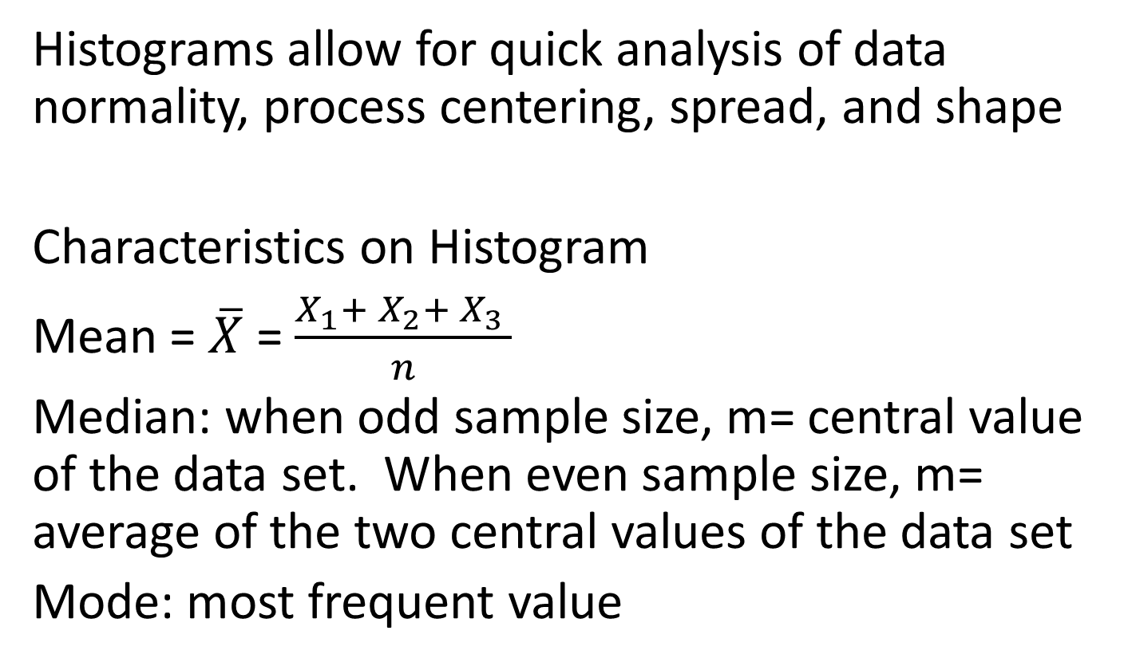
Using Histograms
Histograms allow for quick analysis of data normality, process centering, spread, and shape
Characteristics on Histogram
Mean = $\overline{X}$ = $\frac{X_{1}+ X_{2}+ X_{3} }{n}$
Median: when odd sample size, m= central value of the data set. When even sample size, m= average of the two central values of the data set
Mode: most frequent value

Slide 28
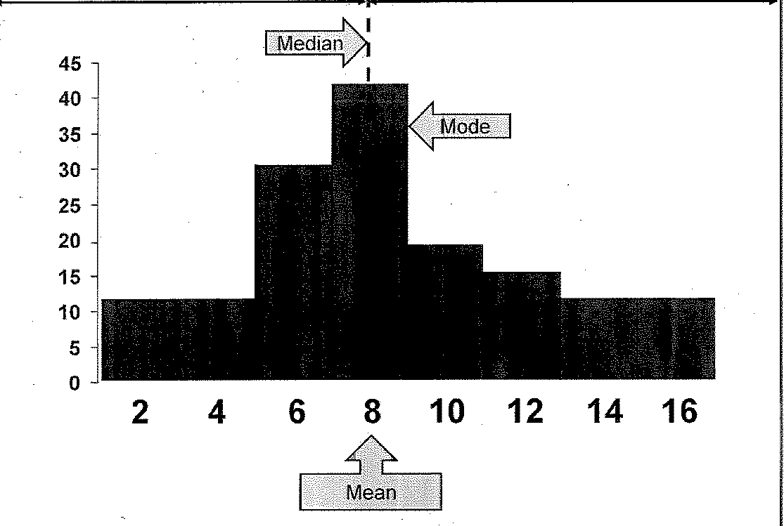
Using Histograms

Slide 29
Using Histograms
Symmetric: - if the time plot shows no special causes, data may come from a stable, predictable process
Biomodal: - this pattern appears when something thought to be one process is really two processes. That is, there are two different sets of conditions operating
Outliers: - one or more data points far away from the rest of the data

Slide 30
Using Histograms
Not symmetric: - a long tail on one side of the distribution is common when the property being measured is the time required to complete a job, wait time, or a count of problems. It can also occur when there is an unstable process
Flat: - a flat distribution occurs when a process drifts overtime. It can also appear when one process is really a mixture of many processes. For example, it can occur when many people use different procedures for the same job.

Slide 31
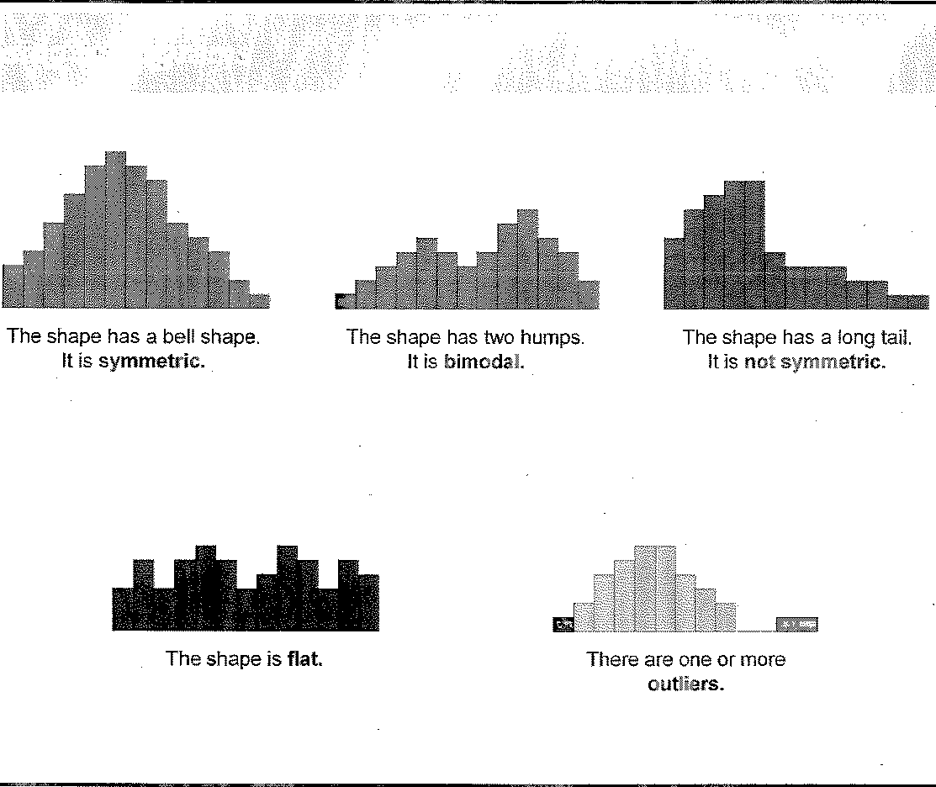
Using Histograms

Slide 32
Using Scatter Plots
Used to determine what happens to one variable when another variable changes value
Visually determines whether a potential relationship exists between an input and an outcome

Slide 33
Purpose of Scatter Plots
Used in 6-sigma to establish the nature of a relationship between a specific “X” variable (cause factor) and the respective “Y” (output/CTQ)
The appearance of the relationship doesn’t necessarily indicate a cause and effect relationship
The relationship might be coincidental, therefore the project team should investigate further before making conclusions

Slide 34
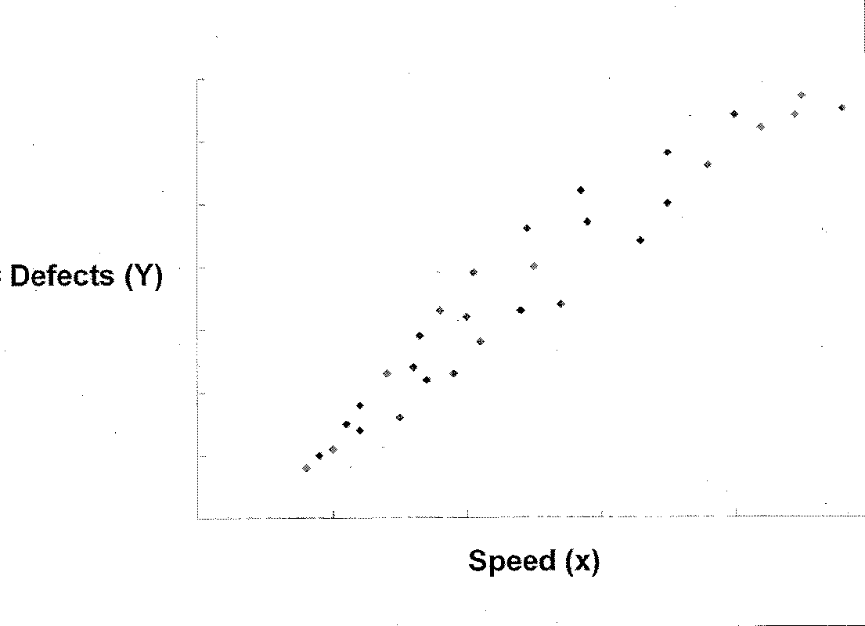
Scatter Plots

Slide 35
Scatter Plots Examples
Positive Correlation: - This is the relationship in which an increase in one attribute causes an increase in the other attribute
Negative Correlation: - An increase or decrease in one-factor matches the opposite effect in the other attributes

Slide 36
Using Scatter Plots
Non-Linear Effect: - A positive or negative correlation may exist up to a certain point, at which time, the relationship between the attributes reverses
No Correlation: - The points will be scattered on the diagram like a cloud, which indicates a change in one attribute has no effect on the other attribute

Slide 37
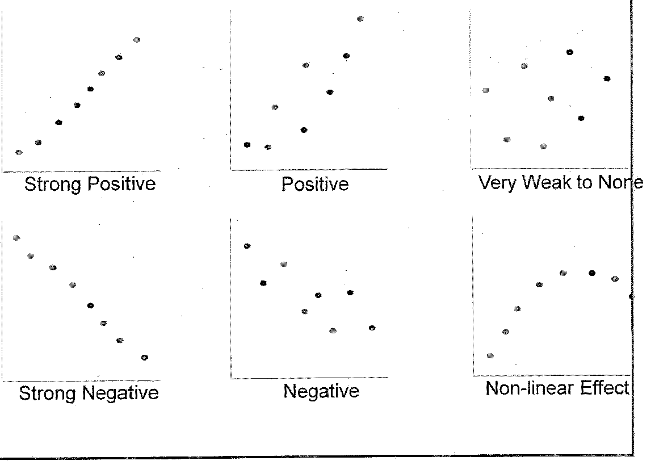
Scatter Plots

Slide 38
Using Trend/Run Chart
Use a Trend/Run Chart to display trends within observation points over a specified time period.
This chart is a simple time-ordered plot of data that can be used to test for the presence of special causes

Slide 39
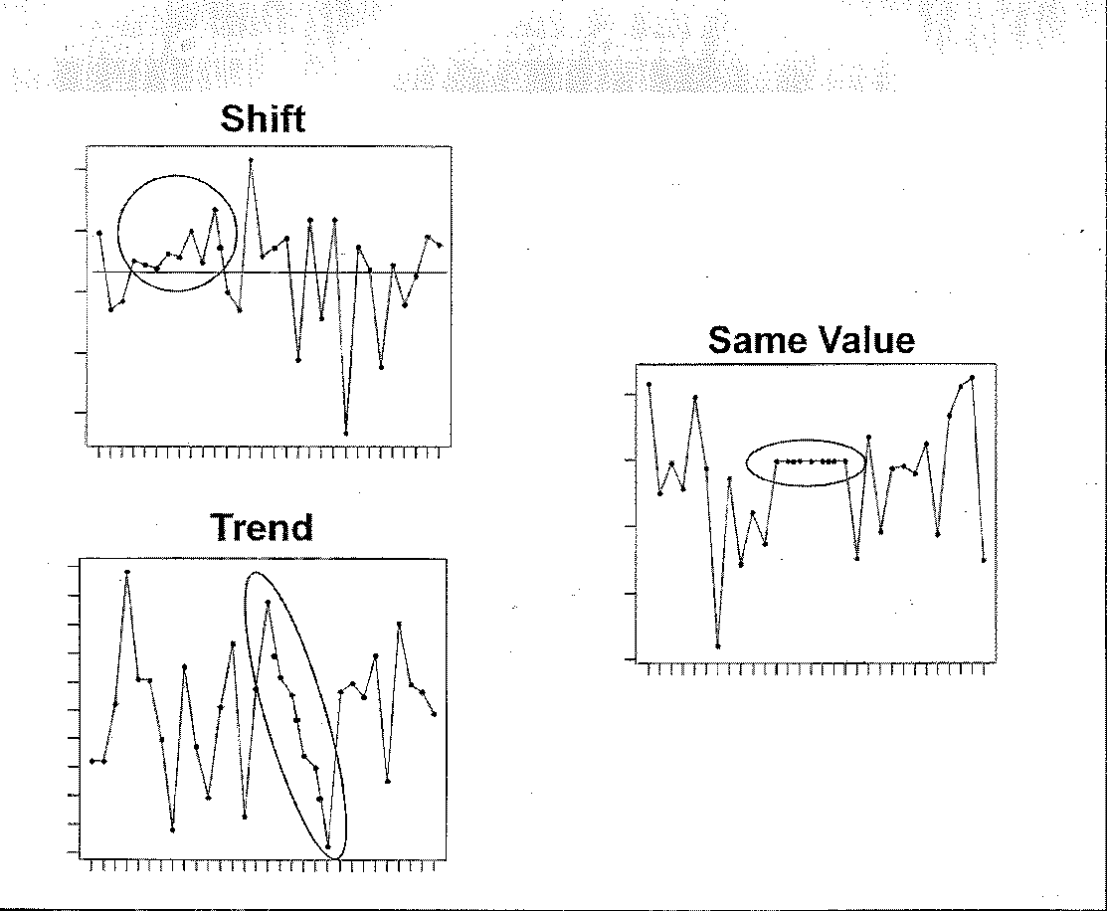
Using Trend/Run Charts

Slide 40
Identify Sources of Variation
After applying a graphical analysis tools to the data set, the project team is ready to identify sources of variation in their process
The purpose of the Analyse Phase is to target root causes that Project Teams validate and to verify them with observation, data, or experiments

Slide 41
Purpose of Identifying Sources of Variation
This step continues the process of narrowing and focusing that begun with project selection
The project team will use the results produced by graphical analysis to target specific sources of variation
The purpose of identifying sources of variation is to help narrow the work to be done in the improve phase

Slide 42
Verifying the Vital Few Causes
Develop a list of potential causes with possible explanations for the problem
Refined, rejected, or confirmed the causes using; process analysis and/or graphical data analysis
Selected the most important controllable causes- the vital few Xs

Slide 43
Verification Method
There are many methods available to verify that likely causes are indeed root causes
For example, by collecting additional defect data it can be determined whether, in fact, the root cause was the culprit
In some cases, this may be as easy as observation
Also, making the problem come and go is a critical aspect of verifying root cause

Slide 44
Guidelines for Root Cause Verification
Do not use opinions to verify causes
Do not assume that a specific cause is economically controllable
Check out potential causes thoroughly
Use the existing cause-and-effect diagram to document your processes of verifying the vital few causes

Slide 45
Guidelines for Root Cause Verification
Verification is a critical step in process improvement
Solutions require resources- time, people and materials
It is important to verify that a particular cause contributes to a problem
Solutions should address verified causes that have a significant impact on the effect
Additional data collection may be required

Slide 46
Guidelines for Root Cause Verification
A root cause is a verified cause that accounts for the problem
In complex systems, there may be more than one root cause. In those cases the improvements may need to address multiple root causes
It may take time to determine absolute sources of variation and how they may be separated to adequately address each root cause

Slide 47
Summary Analyse Phase
Apply the three most common process methods used to analyse collected data- process mapping, value analysis and cycle time analysis
Interpret the graphical analysis tools (Pareto, Trend/Run, Boxplot, Histogram, Scatter Plot) available to produce a visual indication of performance
Distinguish source of variation by utilising the process and graphical analysis data to identify root cause(s)

