Slide 1

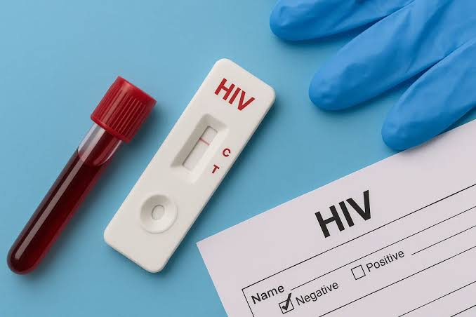


Factors Influencing HIV Testing Uptake and Early Diagnosis Among Adults in the United Kingdom: A Systematic Review
Student Name: Payalben Kaushikbhai Joshi Student ID:2530075 University email ID: 2530075@student.uwtsd.ac.uk Lecturer Name:Oluwadamilola Tayo Module Name : Practise Based Research Program Name: MSc in Public Health and Social Care in Practice
1. Introduction
Human immunodeficiency virus (HIV) remains an important public health concern in the United Kingdom because delayed diagnosis can increase the risk of serious illness, onward transmission and poorer health outcomes (Brown et al., 2018). HIV testing is essential for identifying infection early, enabling timely antiretroviral treatment and helping people living with HIV achieve a near-normal life expectancy (Boardman et al., 2024). HIV testing uptake is influenced by demographic characteristics, socioeconomic circumstances, perceived risk, stigma, cultural beliefs, awareness and access to healthcare services (Bell et al., 2021). This systematic review will examine the factors affecting HIV testing uptake and early diagnosis among UK adults, focusing on barriers, facilitators and opportunities to improve testing services.
2. Prevalence
In England, 928 adults were diagnosed late with HIV in 2024, accounting for 42% (928 out of 2,196) of adults with a reported CD4 count within 91 days of diagnosis (Gov.UK, 2026). In 2024, 50% of newly diagnosed Black African heterosexual adults in England were diagnosed late (285 out of 572), highlighting inequalities in early diagnosis (Gov.UK, 2026). Adults diagnosed late with HIV in England in 2023 were 10 times more likely to die within one year of diagnosis than those diagnosed promptly, demonstrating the importance of improving early testing and diagnosis (UK Parliament, 2025). In 2024, sexual health services in England tested approximately 1.32 million people for HIV, demonstrating the substantial role of these services in identifying infection and supporting access to treatment (BASHH, 2025).
3. Rationale for the Research
Despite improvements in HIV prevention, testing and treatment, late diagnosis remains a significant public health concern in the UK, making it important to identify factors that prevent adults from accessing timely testing (Palfreeman et al., 2020). Understanding demographic, socioeconomic and behavioural influences can help explain why some adults are less likely to accept an HIV test or seek testing when they are at risk (Endalamaw et al., 2016). HIV-related stigma, fear of a positive result, concerns about confidentiality, limited awareness and perceived low personal risk may discourage individuals from accessing testing services (Hedge et al., 2021). Existing testing approaches, including sexual health clinics, community-based testing and online self-testing, may reach different population groups unevenly, highlighting the need to examine barriers and facilitators across service settings (Adeniyi et al., 2026). This systematic review will synthesise evidence from UK studies to provide a combined understanding of individual, social and healthcare-related influences on testing uptake and early diagnosis (Clifton et al., 2016). The originality of this research lies in its integrated focus on demographic, socioeconomic and behavioural factors alongside service accessibility and early diagnosis outcomes among UK adults, helping to identify evidence gaps and priorities for future interventions (Adeniyi et al., 2026).
4. Research Aim, Objectives and Question
Research Aim: To systematically review and synthesise the evidence on factors influencing HIV testing uptake and early diagnosis among adults in the United Kingdom. Research Question: What factors influence HIV testing uptake and early diagnosis among adults in the United Kingdom? Research Objectives 1. To identify demographic, socioeconomic, and behavioural factors associated with HIV testing uptake among adults in the UK. 2. To examine barriers and facilitators affecting access to HIV testing services and early HIV diagnosis in the UK. 3. To evaluate the impact of identified factors on HIV testing uptake and early diagnosis outcomes among UK adults.
5. Research Impact
The findings may help identify adults and population groups who experience barriers to HIV testing, supporting more targeted and equitable testing strategies (Youssef et al., 2017). The review may inform public health campaigns that address HIV-related stigma, improve awareness and encourage people to seek testing without fear or embarrassment (Evans et al., 2016). Healthcare professionals, including nurses, sexual health practitioners and general practitioners, may use the findings to improve communication, offer testing appropriately and recognise factors associated with delayed diagnosis (Dalrymple et al., 2019). The findings may support improvements in access to testing through sexual health clinics, community services and online testing options, particularly for groups who face practical or social barriers (Sulat et al., 2018). Public health services and policymakers may use the evidence to inform HIV prevention programmes, testing policies and strategies aimed at reducing inequalities in diagnosis and access to treatment (Dalrymple et al., 2019).
Reference list
Adeniyi, T., Horwood, J., Doran, M., Piggott, K., Namurach, A.M., Harryman, L., Oldenbourg, E., Kiflu, M., Speare, N., Griffin, M. and Wilson, M., (2026). Barriers and facilitators to HIV testing among African and Caribbean heritage communities: a mixed methods study. Sexually Transmitted Infections, 102(1), pp.3-10. https://sti.bmj.com/content/102/1/3.abstract BASHH (British Association for Sexual Health and HIV) (2025), New UKHSA data release: HIV in the UK 2024. https://www.bashh.org/news/1695/new_ukhsa_data_release_hiv_in_the_uk_2024/ Bell, S., Doran, T., Martin, F. and Adamson, J., (2021). Journeys to HIV testing and diagnosis among adults aged 50+ years in England: a qualitative interview study. Journal of health services research & policy, 26(2), pp.85-94. https://journals.sagepub.com/doi/abs/10.1177/1355819620943242 Boardman, E., Boffito, M., Chadwick, D.R., Cheserem, E., Kabagambe, S., Kasadha, B. and Elliott, C., (2024). Tackling late HIV diagnosis: lessons from the UK in the COVID-19 era. International journal of STD & AIDS, 35(4), pp.244-253. https://journals.sagepub.com/doi/abs/10.1177/09564624231202287 Brown, A.E., Nash, S., Connor, N., Kirwan, P.D., Ogaz, D., Croxford, S., De Angelis, D. and Delpech, V.C., (2018). Towards elimination of HIV transmission, AIDS and HIV‐related deaths in the UK. HIV medicine, 19(8), pp.505-512. https://onlinelibrary.wiley.com/doi/abs/10.1111/hiv.12617 Clifton, S., Nardone, A., Field, N., Mercer, C.H., Tanton, C., Macdowall, W., Johnson, A.M. and Sonnenberg, P., (2016). HIV testing, risk perception, and behaviour in the British population. AIDS (London, England), 30(6), p.943. https://pmc.ncbi.nlm.nih.gov/articles/PMC4794135/ Dalrymple, J., McAloney-Kocaman, K., Flowers, P., McDaid, L.M. and Frankis, J.S., (2019). Age-related factors influence HIV testing within subpopulations: a cross-sectional survey of MSM within the Celtic nations. Sexually transmitted infections, 95(5), pp.351-357. https://sti.bmj.com/content/95/5/351.abstract Endalamaw, A., Gilks, C.F., Ambaw, F., Shiferaw, W.S. and Assefa, Y., (2024). Explaining inequity in knowledge, attitude, and services related to HIV/AIDS: a systematic review. BMC Public Health, 24(1), p.1815. https://link.springer.com/article/10.1186/s12889-024-19329-5 Evans, C., Turner, K., Suggs, L.S., Occa, A., Juma, A. and Blake, H., (2016). Developing a mHealth intervention to promote uptake of HIV testing among African communities in the UK: a qualitative study. BMC public health, 16(1), p.656. https://link.springer.com/article/10.1186/s12889-016-3278-4 Hedge, B., Devan, K., Catalan, J., Cheshire, A. and Ridge, D., (2021). HIV-related stigma in the UK then and now: to what extent are we on track to eliminate stigma? A qualitative investigation. BMC public health, 21(1), p.1022. https://link.springer.com/article/10.1186/s12889-021-11000-7 Gov.UK (2026), https://www.gov.uk/government/statistics/hiv-annual-data/hiv-testing-prep-new-hiv-diagnoses-and-care-outcomes-for-people-accessing-hiv-services-2025-report Palfreeman, A., Sullivan, A., Rayment, M., Waters, L., Buckley, A., Burns, F., Clutterbuck, D., Cormack, I., Croxford, S., Dean, G. and Delpech, V., (2020). British HIV association/British association for sexual health and HIV/British infection association adult HIV testing guidelines 2020. HIV medicine, 21(S6), pp.1-26. https://discovery.ucl.ac.uk/id/eprint/10120450/1/BBB%20HIV%20testing%20GL%20V15%20approved%20Sept20.pdf Sulat, J.S., Prabandari, Y.S., Sanusi, R., Hapsari, E.D. and Santoso, B., (2018). The impacts of community-based HIV testing and counselling on testing uptake: A systematic review. Journal of Health Research, 32(2), pp.152-163. https://www.emerald.com/jhr/article/32/2/152/223406 UK Parliament (2025), https://publications.parliament.uk/pa/cm5901/cmselect/cmwomeq/1249/report.html Youssef, E., Cooper, V., Delpech, V., Davies, K. and Wright, J., (2017). Barriers and facilitators to HIV testing in people age 50 and above: a systematic review. Clinical Medicine, 17(6), pp.508-520. https://www.sciencedirect.com/science/article/pii/S1470211824013113

