Slide 1
Interim Viva
Alexander Jenkins (2103347)
The Art of Fear:
Analysing the Techniques and Impact of Horror in Survival Horror Video Games

Slide 2
Project Aim: How survival horror video games create horror to keep the player immersed and on edge.
Objective One: What defines a survival horror game?
Objective Two: What instalments defined the survival horror genre?
Objective Three: To evaluate how horror is implemented in survival horror video games.
Objective Four: How survival horror video games keep the player immersed.

Slide 3
Interactive Horror Scene
Purpose is to display elements discussed in the dissertation
Horror setting set in the woods with a crashed spaceship

Slide 4
Literature Review
Level of Progress:
Background research for chosen project
Objective one complete
Started research for objective two
Started work on the horror scene

Slide 5
Background Research Prior to Starting Project
Making sure there was enough information on the topic
Deciding what to create for the practical project

Slide 6
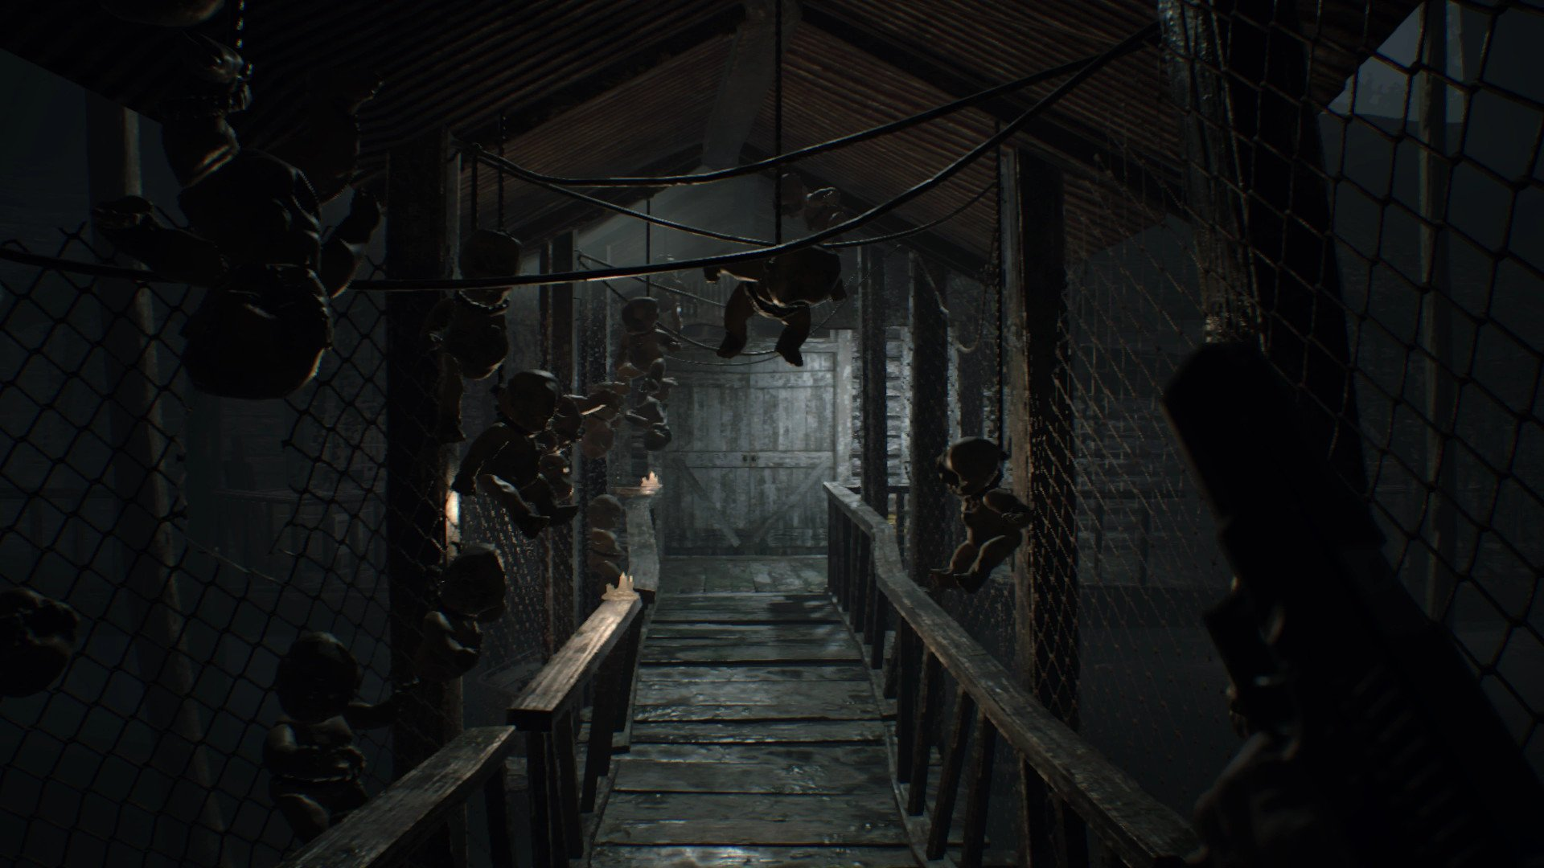
Findings for Objective One
Defining factors for a survival horror video game:
Need for survival
Scarce resources
Decision making
[1]

Slide 7
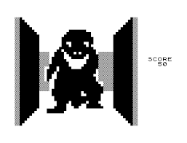
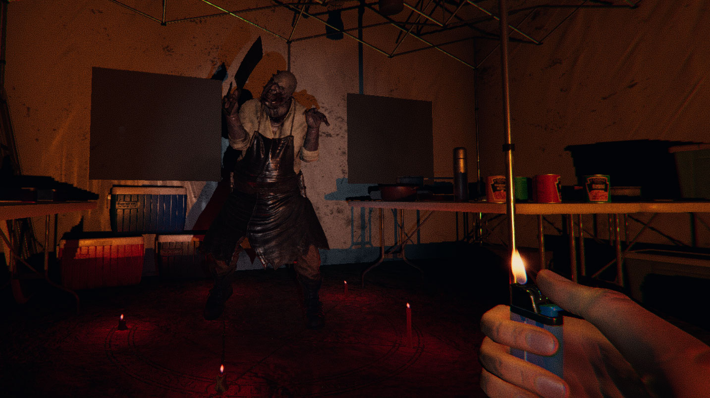
Findings for Objective Two
[3]
Defining games for the genre.
Resident Evil 1996 [2] coined the term
Goes as far back as 1980’s (3D Monster Maze [3])
VR and multiplayer survival horrors (Phasmophobia [4], The Outlast Trials [5])
[4]

Slide 8
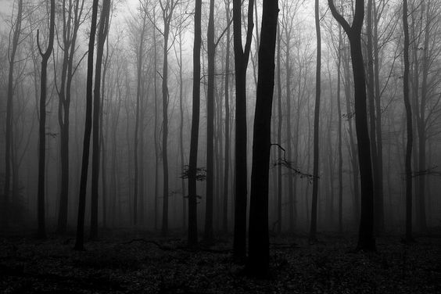
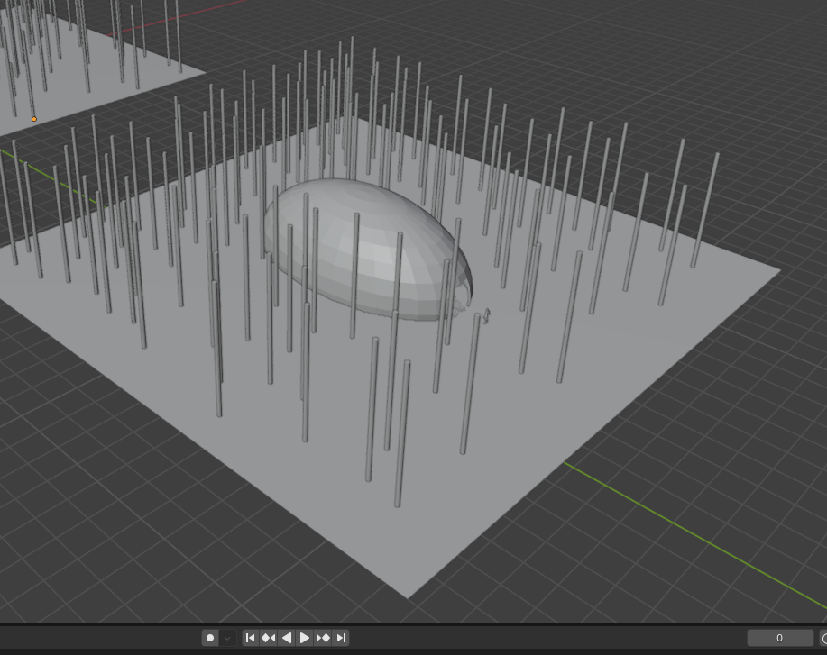
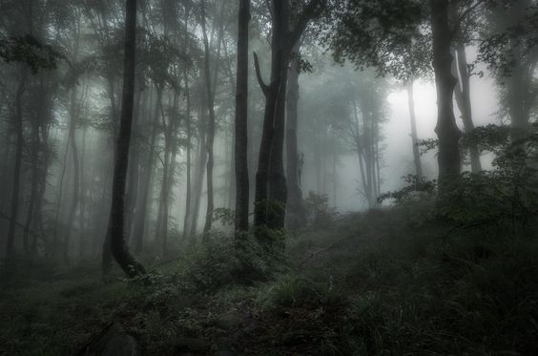
Horror Scene Research
Crash Site Woods
[6]
[7]

Slide 9
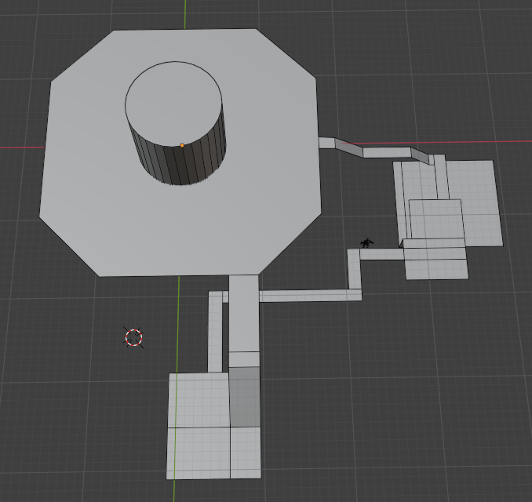
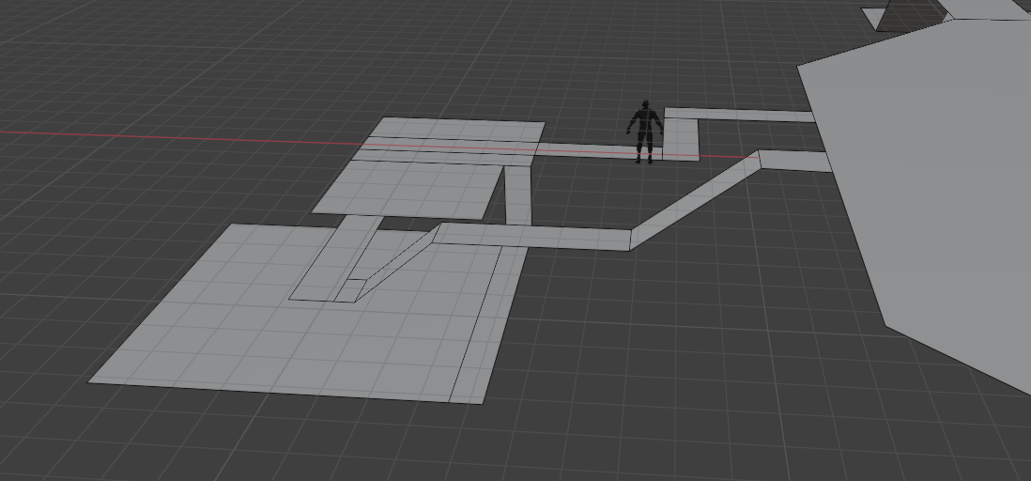
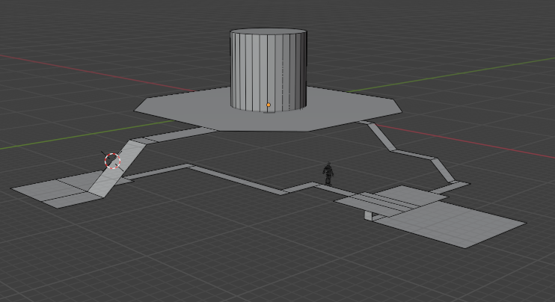
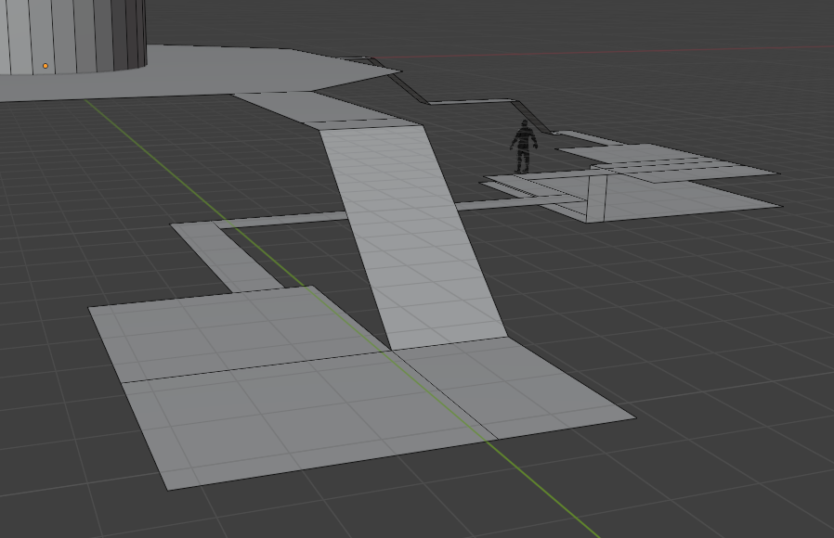
Horror Scene Research
Abandoned Factory

Slide 10
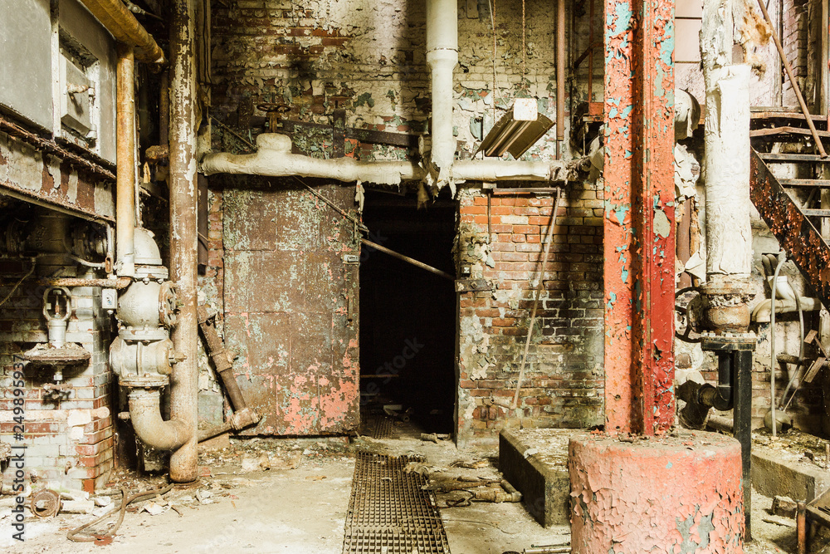
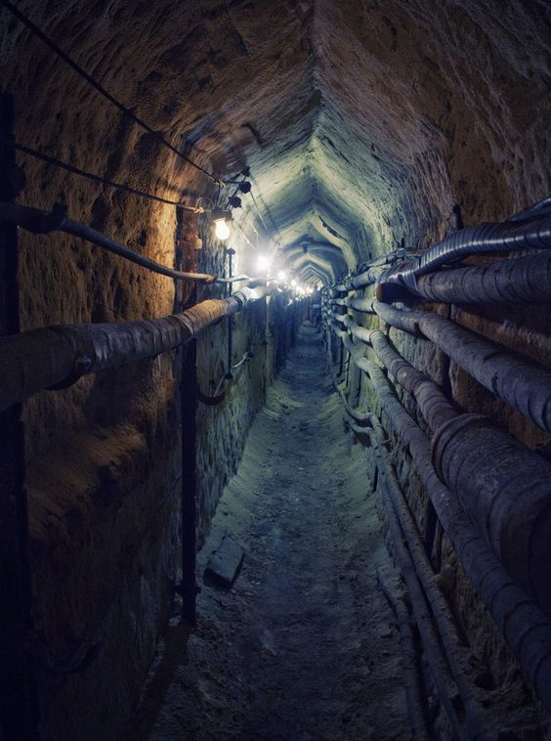
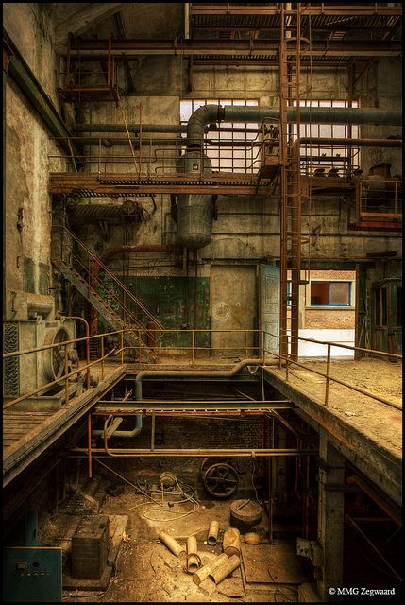
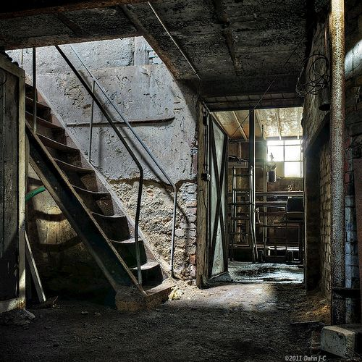
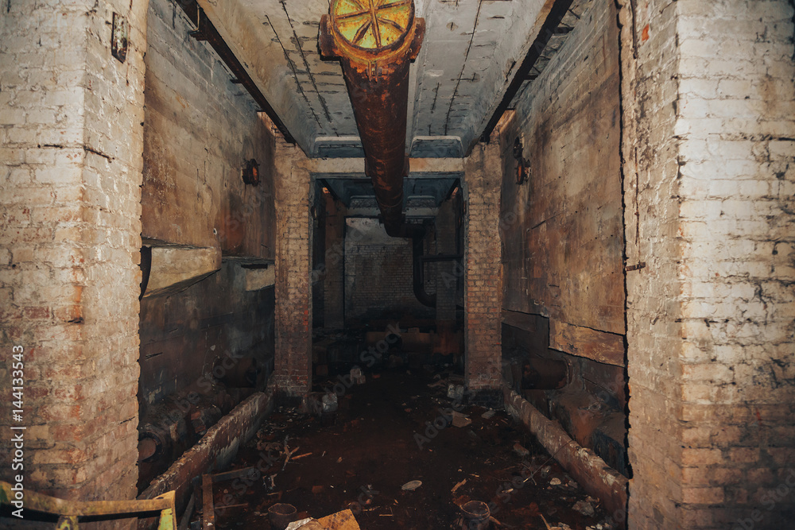
[8]
[11]
[12]
[9]
[10]

Slide 11
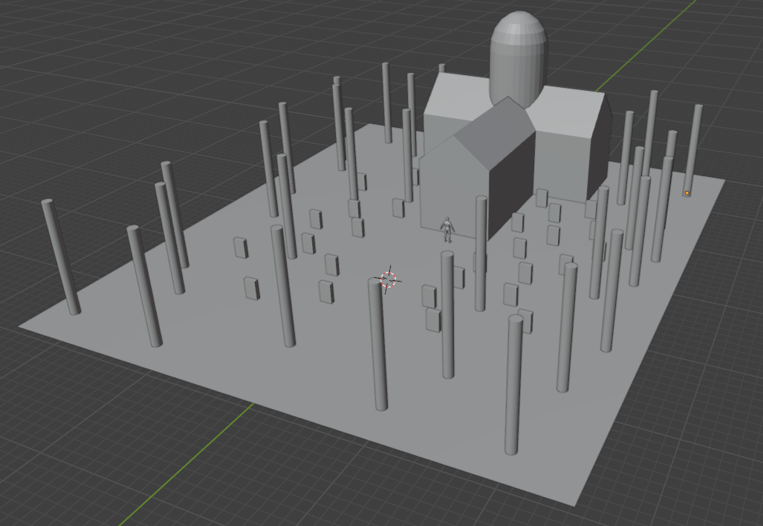
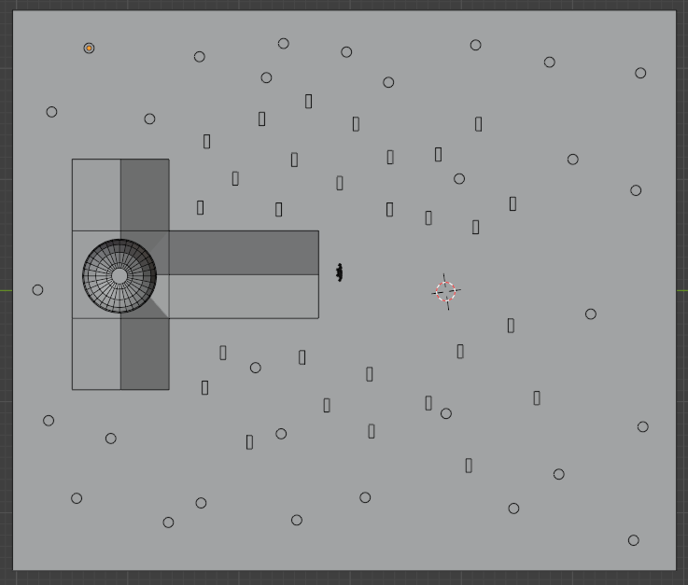
Horror Scene Research
Church

Slide 12
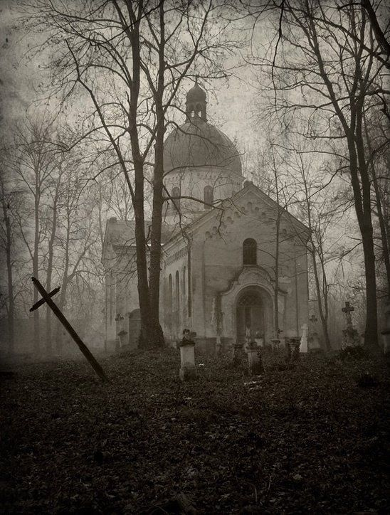
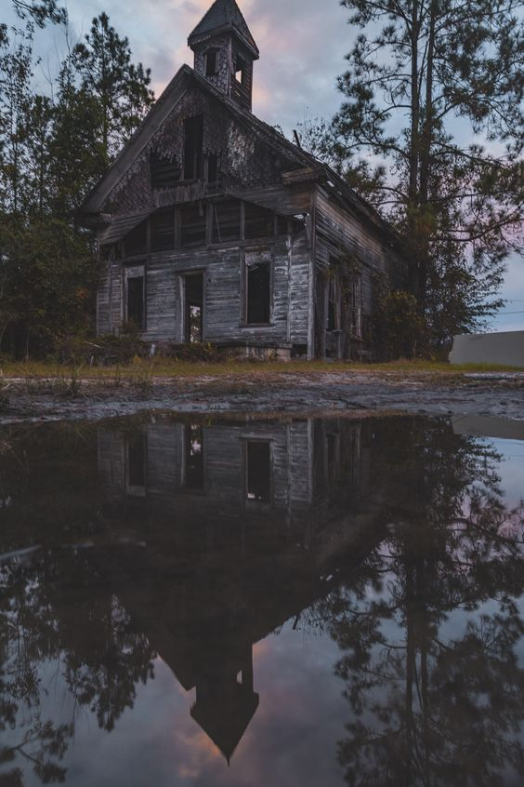
Horror Scene Research
Church
[13]
[14]

Slide 13
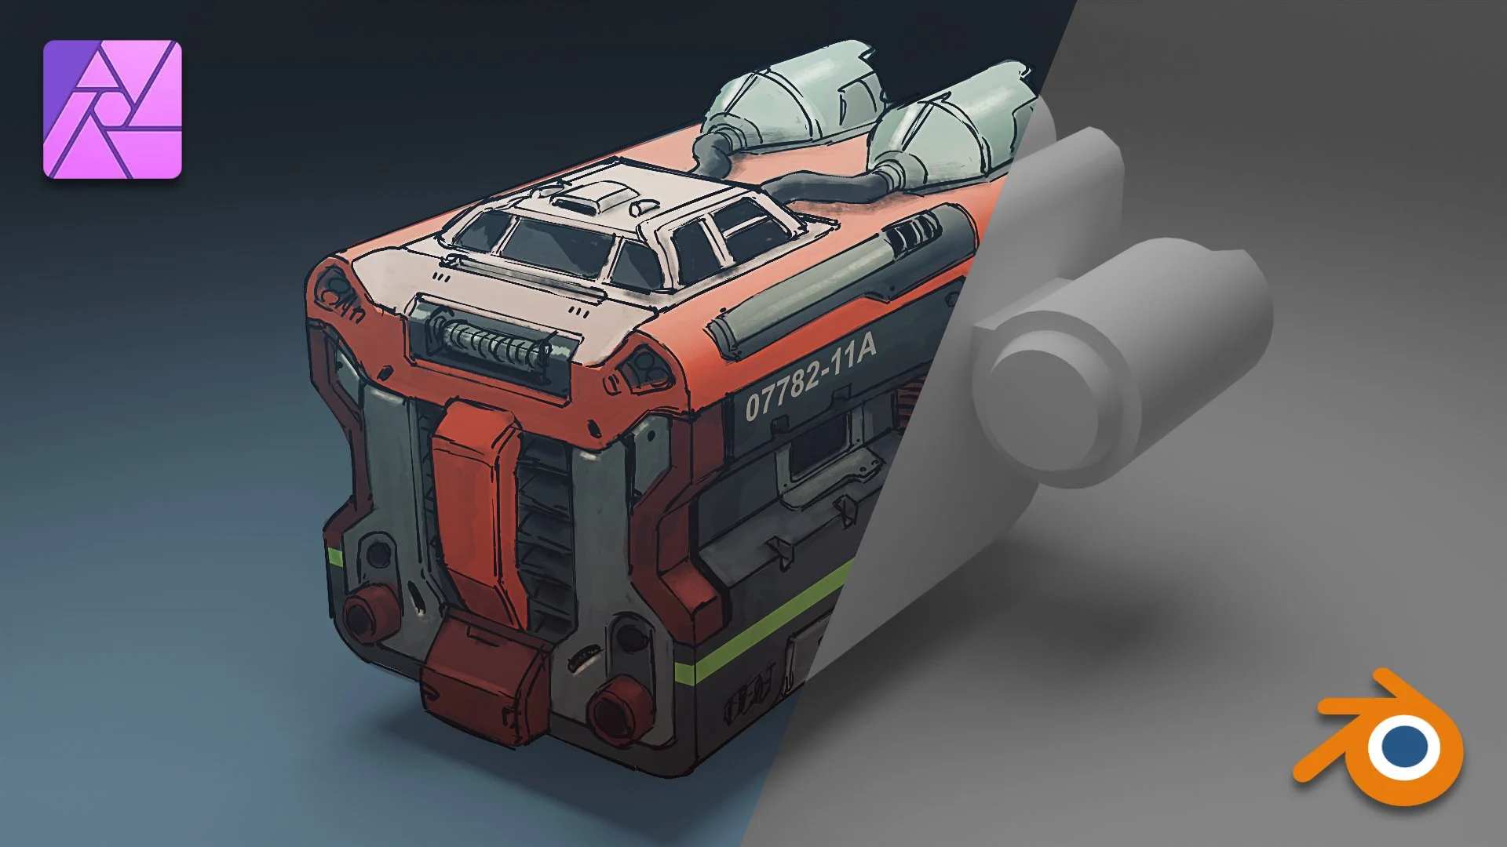
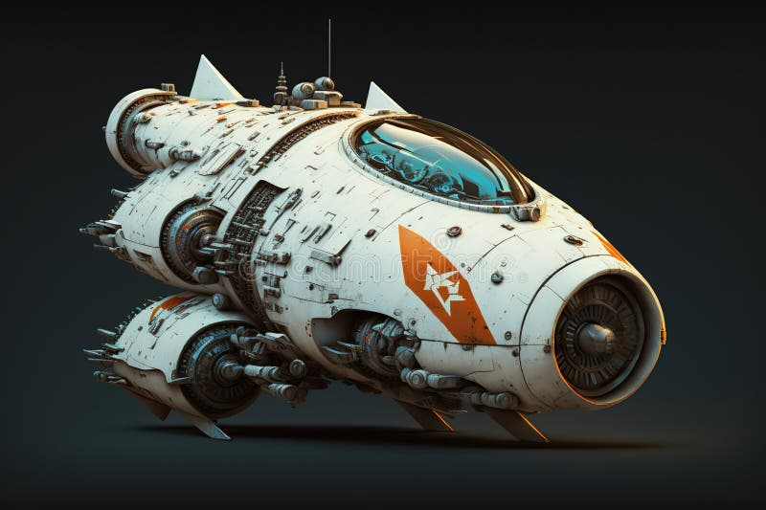
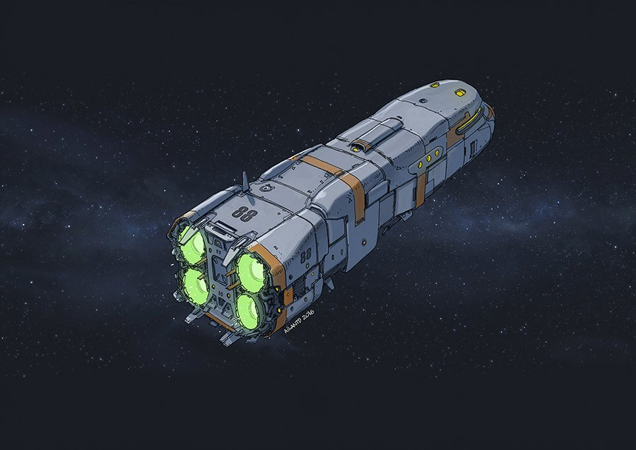
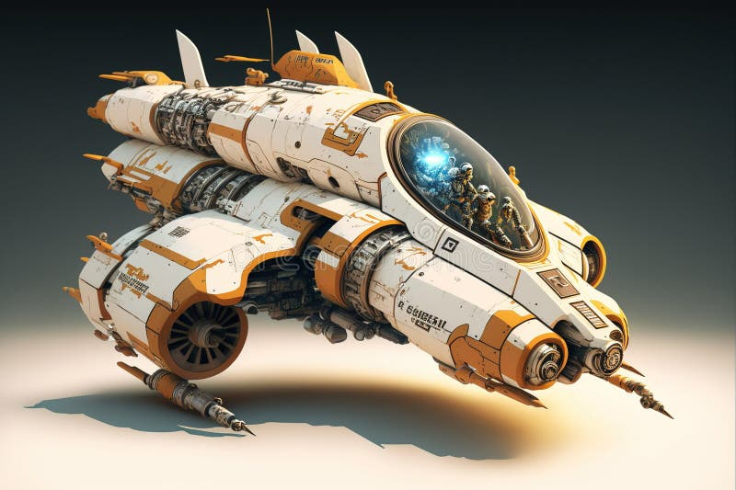
Horror Scene Research
Spaceship exterior Inspiration
[17]
[15]
[18]
[16]

Slide 14
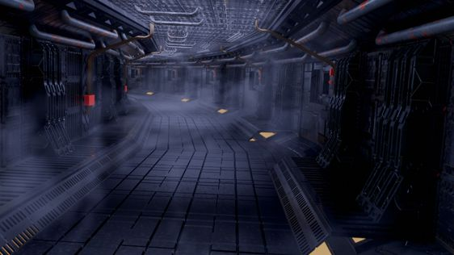
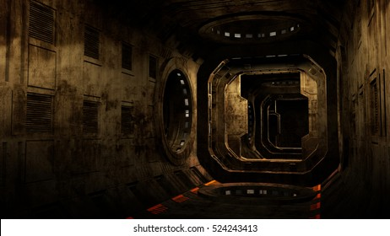
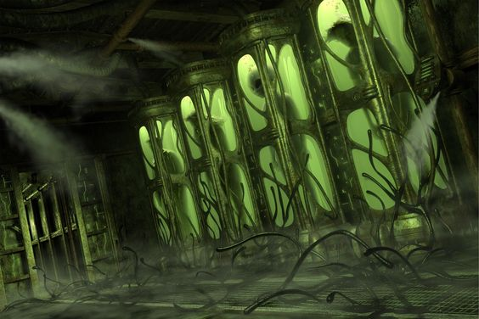
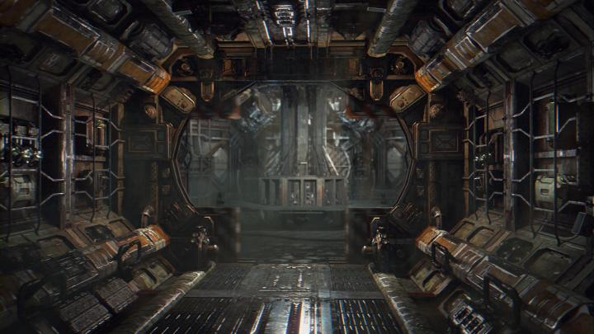
Horror Scene Research
Spaceship Interior Inspiration
[21]
[19]
[20]
[22]

Slide 15
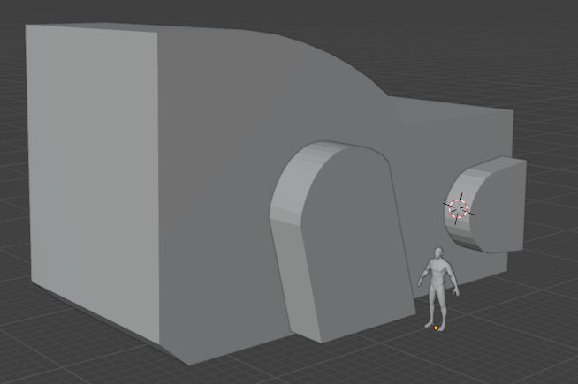
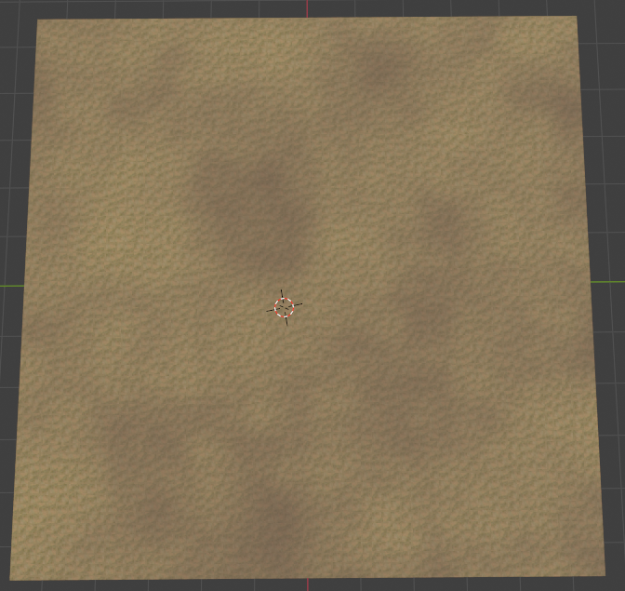
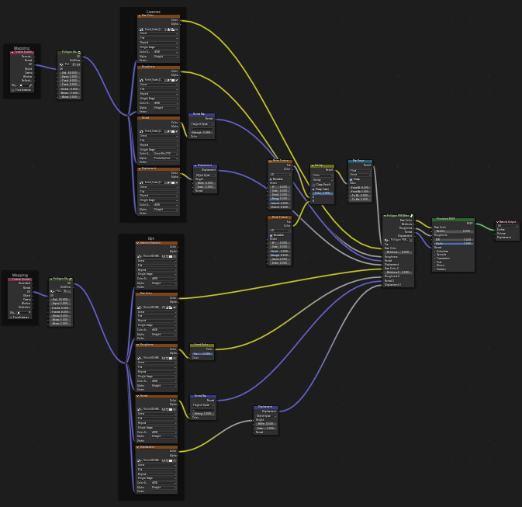
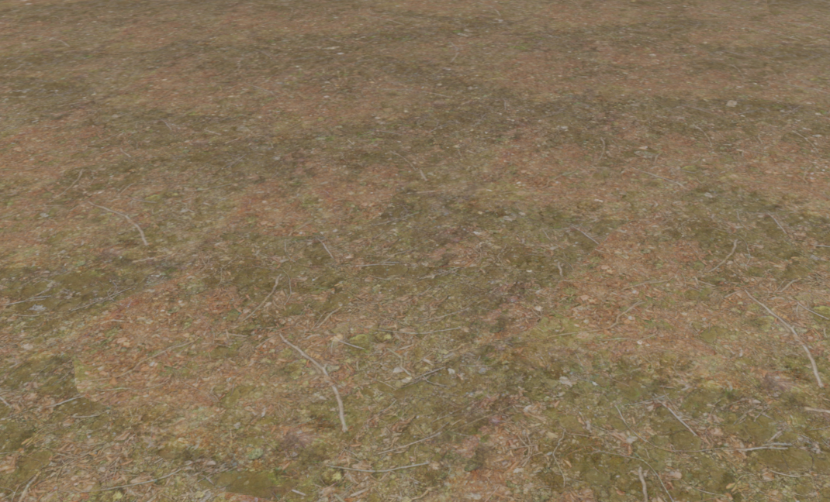
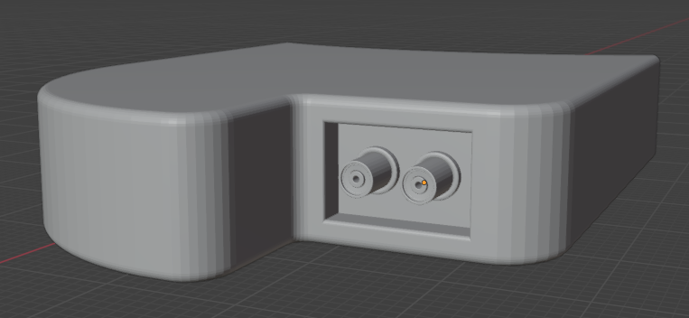
Horror Scene Progress
Spaceship Progress Ground Texture

Slide 16
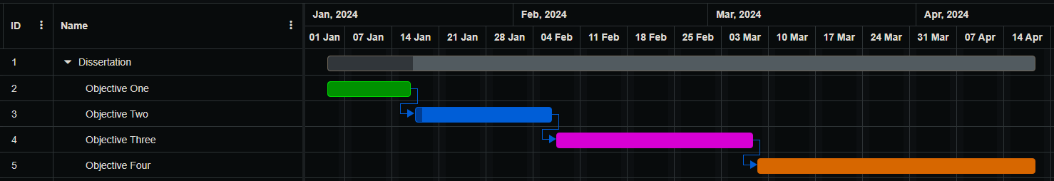
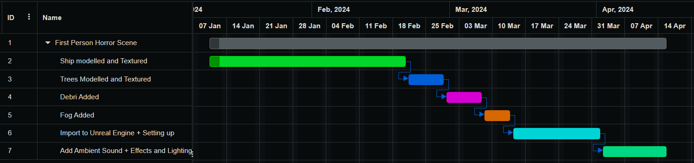
Gantt Chart Plan (Made with onlinegantt.com [23])

Slide 17
Plan for Future Research
Find research using resources found via the internet as well as books relating to the topic
Continue to work on the horror scene
Use the Gantt chart to stay on track

Slide 18
References
[1] Resident Evil 7: Biohazard. [Software], Capcom, 2017.
[2] Resident Evil. [Software], Capcom, 1996.
[3] 3D Monster Maze. [Software], Malcolm Evans, 1981.
[4] Phasmophobia. [Software], Kinetic Games, 2020.
[5] The Outlast Trials. [Software], Red Barrels, 2023.
[6] A. Khames, “creepy forest,” Flickr, Nov. 16, 2010. https://www.flickr.com/photos/16979519@N08/5198322063 (accessed Jan. 15, 2024).
[7] unxietly, “Pin by Dju_Dju on атмосферные фоны | Misty forest, Landscape photography, Dark forest aesthetic,” Pinterest. https://www.pinterest.co.uk/pin/111041947055344495/ (accessed Jan. 15, 2024).
[8] R. Wellen Photography, “Spooky Opening Metal Door Abandoned Factory Stock Photo 1315370900,” Shutterstock. https://www.shutterstock.com/image-photo/spooky-opening-metal-door-abandoned-factory-1315370900 (accessed Jan. 16, 2024).
[9] ZerberuZ1, “black factory basement | Education design, Travel art, Abandoned houses,” Pinterest. https://www.pinterest.co.uk/pin/416723771778372660/ (accessed Jan. 16, 2024).
[10] DedMityay, “Basement in old abandoned industrial production building or factory,...,” iStock, Nov. 01, 2017. https://www.istockphoto.com/photo/basement-in-old-abandoned-production-building-or-factory-gm868057284-144626739 (accessed Jan. 16, 2024).

Slide 19
References
[11] PurePhoto, “Minnesota | Urban decay photography, Abandoned, Scenery,” Pinterest. https://www.pinterest.co.uk/pin/512495632575622915/ (accessed Jan. 16, 2024).
[12] Martino, “Paperfactory C˜, France | Industrial architecture, Abandoned houses, Abandoned places,” Pinterest. https://www.pinterest.co.uk/pin/192810427786684836/ (accessed Jan. 16, 2024).
[13] preh1storic, “Church and graveyard in the mist,” Imgur. https://imgur.com/gallery/1z5gj1o (accessed Jan. 16, 2024).
[14] HazelPat <3, “A creepy church never gets old | Creepy houses, Eerie places, Church aesthetic,” Pinterest. https://www.pinterest.co.uk/pin/93168286034592460/ (accessed Jan. 16, 2024).
[15] BiancoBlue, “Wondrous Futuristic Small Sci-fi Space Racer with Engine for Space Racing. Stock Illustration - Illustration of travel, universe: 271165618,” Dreamstime. https://www.dreamstime.com/wondrous-high-speed-small-sci-fi-spaceship-racer-powerful-engine-interstellar-travel-space-exploration-beautiful-image271165618 (accessed Jan. 16, 2024).
[16] BiancoBlue, “Wondrous Futuristic Small Sci-fi Space Racer with Engine for Space Racing. Stock Illustration - Illustration of galactic, universe: 272095678,” Dreamstime. https://www.dreamstime.com/wondrous-high-speed-small-sci-fi-spaceship-racer-powerful-engine-interstellar-travel-space-exploration-beautiful-image272095678 (accessed Jan. 16, 2024).
[17] Greedy3D, “Spaceship Concept Art with Affinity Photo and Blender”. Skill Share. https://www.skillshare.com/en/classes/Spaceship-Concept-Art-with-Affinity-Photo-and-Blender/606431557 (accessed Jan. 16, 2024).

Slide 20
References
[18] Ailantd, “Some kind of small cargo and bus space ship. Commission work this one. #Spaceship” X. https://twitter.com/ailantd/status/755502219835957248 (accessed Jan. 16, 2024).
[19] Apex Infinity Games, “Abandoned Spaceship Interior 3d Illustration Stock Illustration 524243413,” Shutterstock. https://www.shutterstock.com/image-illustration/abandoned-spaceship-interior-3d-illustration-524243413 (accessed Jan. 17, 2024).
[20] Hong Kong Disneyland, “Spaceship interior, Alien spaceship, Alien concept art,” Pinterest. https://www.pinterest.co.uk/pin/379920918543071148/ (accessed Jan. 17, 2024).
[21] “ArtStation - 3D Old Spaceship Interior, Sebastian Pineda Rios | Spaceship interior, Out of this world, Backdrops,” Pinterest. https://www.pinterest.co.uk/pin/571816483949204449/ (accessed Jan. 17, 2024).
[22] NiZu, “‘Nostromo’ environment study | Spaceship interior, Sci fi concept art, Sci fi environment,” Pinterest. https://www.pinterest.co.uk/pin/640496378269608222/ (accessed Jan. 17, 2024).
[23] “Free Online Gantt Chart Software,” www.onlinegantt.com. https://www.onlinegantt.com/#/gantt.

Slide 21
Thank you for Listening!
Any questions?

