Slide 1
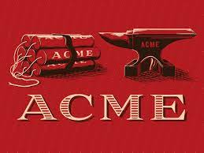
ACME Corporation
https://uowtsd-my.sharepoint.com/:v:/r/personal/2230423_student_uwtsd_ac_uk/Documents/Recording-20230428_074459.webm?csf=1&web=1&e=q8WGHk
Jatin pandey
Student id 2230423
HR management

Slide 2
Introduction
ACME employer has faced challenges related to worker engagement, which has had implications for the organization's overall performance and competitiveness.
Our recommendations include continuous learning and development, communication and collaboration skills development, diversity and inclusion skills development, change management skills development, employee engagement and well-being skills development.

Slide 3

Continuous Learning and Development
Continuous learning and development are important for HR expert s to stay up-to-date with the modern trends, laws, and regulations inside the HR industry.
HR professionals can take advantage of various training and improvement opportunities, such as seminars, workshops, webinars, and certifications.
According to a Shaban et al. (2020), continuous learning and development can improve the overall performance and effectiveness of HR expert and undoubtedly impact organizational performance.
HR specialists also can benefit from mentoring and training packages, which could enhance their management and problem-solving skills (Gupta & Bhatnagar, 2017).
By investing in continuous learning and development, HR professionals can stay current with best practices and improve their ability to support the organization's strategic goals.

Slide 4

Communication and Collaboration Skills Development
Effective communication and collaboration skills are important for HR specialist to build relationships with employees, managers, and other stakeholders in the organization.
HR professionals should expand their communication skills, such as active listening, empathy, and clear and concise writing, to ensure they are successfully y communicating with all parties involved (Green & Knippenberg, 2020).
HR professionals can enhance their communication and collaboration skills through various means, such as attending workshops, participating in team-building activities, and practicing active listening techniques (Wolfe et al., 2020).
By improving their communication and collaboration skills, HR professionals can effectively navigate workplace challenges and build strong relationships with all stakeholders.

Slide 5
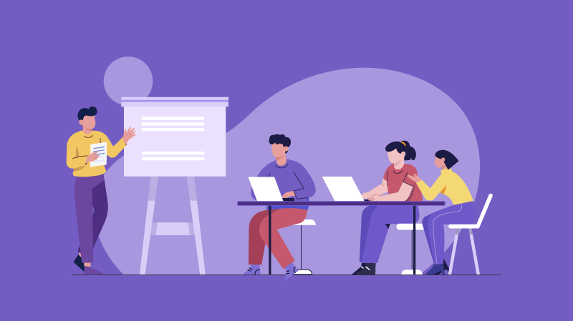
Diversity and Inclusion Skills Development
In today's globalized and diverse workplace, HR professionals need to develop their diversity and inclusion skills to ensure they are creating a welcoming and inclusive environment for all employees.
Diversity and inclusion skills include cultural competency, awareness of unconscious biases, and ability to foster diversity and inclusion initiatives (Wrench et al., 2019).
HR professionals should educate themselves on diversity and inclusion best practices and engage in ongoing learning and development to effectively support diverse employees and build an inclusive culture (Ely & Thomas, 2020).
Organizations with inclusive cultures can reap many benefits, including increased employee engagement, innovation, and overall organizational performance (Deloitte, 2017).

Slide 6
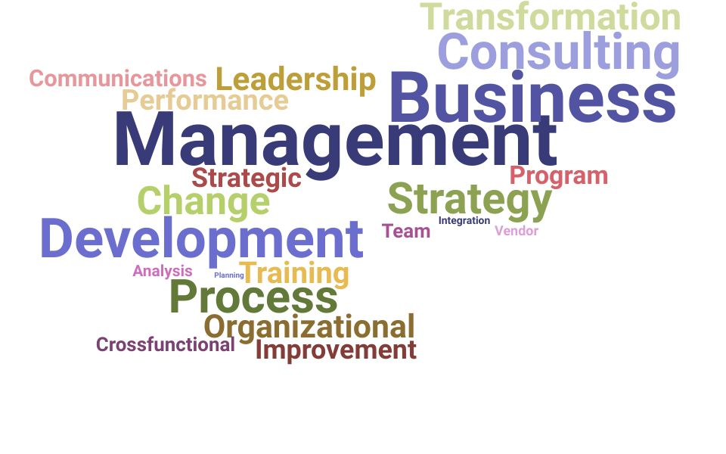
Change Management Skills Development
Change management skills include the ability to communicate change effectively, manage resistance to change, and create a change-ready culture (Prosci, 2019).
HR professionals can foster change management by creating a clear change management plan, providing transparent communication and support, and empowering employees to be part of the change process (SHRM, 2021).
Organizations that effectively manage change can experience smoother transitions, increased employee morale, and improved overall performance (Prosci, 2019).
HR professionals can develop their change management skills by attending change management training programs, seeking out mentorship from experienced change leaders, and actively participating in change initiatives within their organizations.

Slide 7
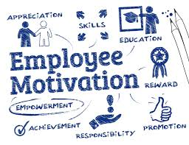
Employee Engagement and Well-being Skills Development
HR professionals should focus on developing employee engagement and well-being skills to create a positive workplace culture and improve employee retention.
Employee engagement and well-being skills include the ability to create meaningful work, provide recognition and feedback, and promote work-life balance (Gallup, 2021).
HR professionals can foster employee engagement and well-being by designing comprehensive well-being programs, implementing flexible work arrangements, and conducting regular employee surveys to gather feedback and make data-driven decisions (SHRM, 2021).
Organizations with high employee engagement and well-being tend to experience lower absenteeism, higher productivity, and increased customer satisfaction (Gallup, 2021).

Slide 8
Conclusion
HR professionals should develop their leadership and management skills to effectively manage their teams and drive organizational success.
HR professionals should develop their HR technology skills to effectively leverage technology to manage HR processes and improve efficiency.
Developing diversity and inclusion skills is crucial for HR professionals to create a more inclusive workplace culture.
Employee engagement and well-being skills development are important for HR professionals to support employee well-being and boost retention rates.
HR professionals can develop these skills through various methods such as training and development programs, seeking mentorship, and actively participating in change initiatives.
By investing in their own skills development, HR professionals can better support the organization's human capital and contribute to overall business success.

Slide 9
References
Gupta, V., & Bhatnagar, J. (2017). Mentoring and coaching as a development strategy for HR professionals. Human Resource Management Review, 27(3), 435-448.
Shaban, A., Buhari, M. F., Ali, M. A., & Jaafar, N. I. (2020). The impact of human resource development practices on organizational performance: Evidence from Malaysia. International Journal of Academic Research in Business and Social Sciences, 10(2), 68-81.
Green, M. T., & Knippenberg, D. V. (2020). Creating the context for effective communication in HRM. Human Resource Management Review, 30(3), 1-14.
Wolfe, K. J., Boyatzis, R. E., Gaskin, J., & Kolb, D. A. (2020). Exploring the relationship between emotional intelligence and coaching efficacy. Frontiers in Psychology, 11, 569.
Deloitte. (2017). The diversity and inclusion revolution: Eight powerful truths.
Ely, R. J., & Thomas, D. A. (2020). Making differences matter: A new paradigm for managing diversity. Harvard Business Review, 98(2), 74-85.
Wrench, J. S., McCroskey, J. C., Richmond, V. P., & Johnson, A. D. (2019). Understanding the communication skills and cultural competence of diverse groups of individuals: A review of existing literature and recommendations for future research. Journal of International and Intercultural Communication, 12(2), 111-136.

Slide 10
References
Gallup. (2021). Employee engagement.
Society for Human Resource Management. (2021). The business case for well-being.
World Health Organization. (2021). Mental health in the workplace.
Prosci. (2019). Change management: The definitive guide.
Society for Human Resource Management. (2021). Change management.

Slide 11


