Slide 1
Using Reflective Practice to Improve Wellbeing
The importance of reflective practice in relation to mental health
Jamie Davies - 1302337

Slide 2

Background
“Anxiety is a natural human response to stress or perceived danger” (Mental Health Foundation, 2023).
In some form, everyone will face it in their lives.
Reflective Practice has the potential to improve professional wellbeing by reducing anxiety.
(Freepik, 2023)

Slide 3
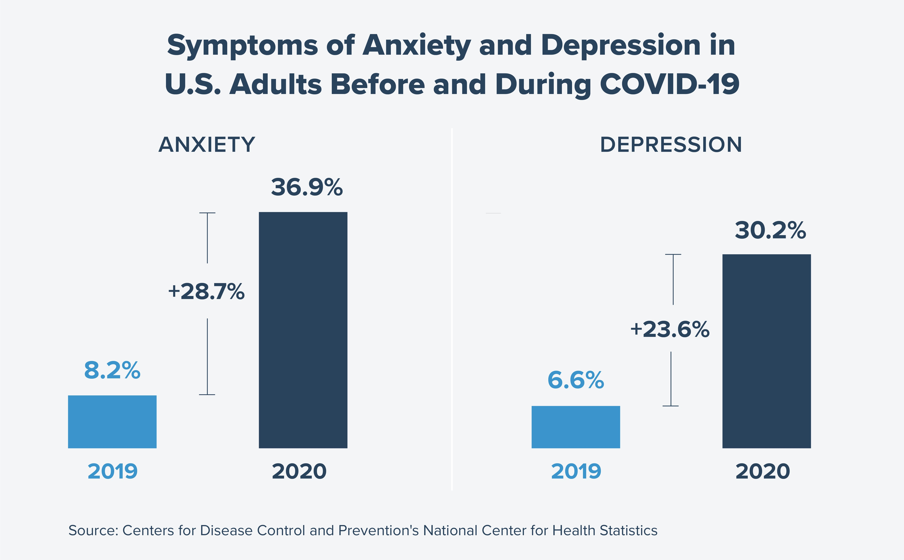
The Surge of Mental Health Problems
“32.5 million working days were lost to work-related ill health in 2019/20, with stress, anxiety and depression accounting for almost 18 million of these” (CIPD, 2023).
With the increased awareness of mental health problems, especially during the COVID-19 pandemic, wellbeing is paramount.
(Powaleny, 2021)

Slide 4
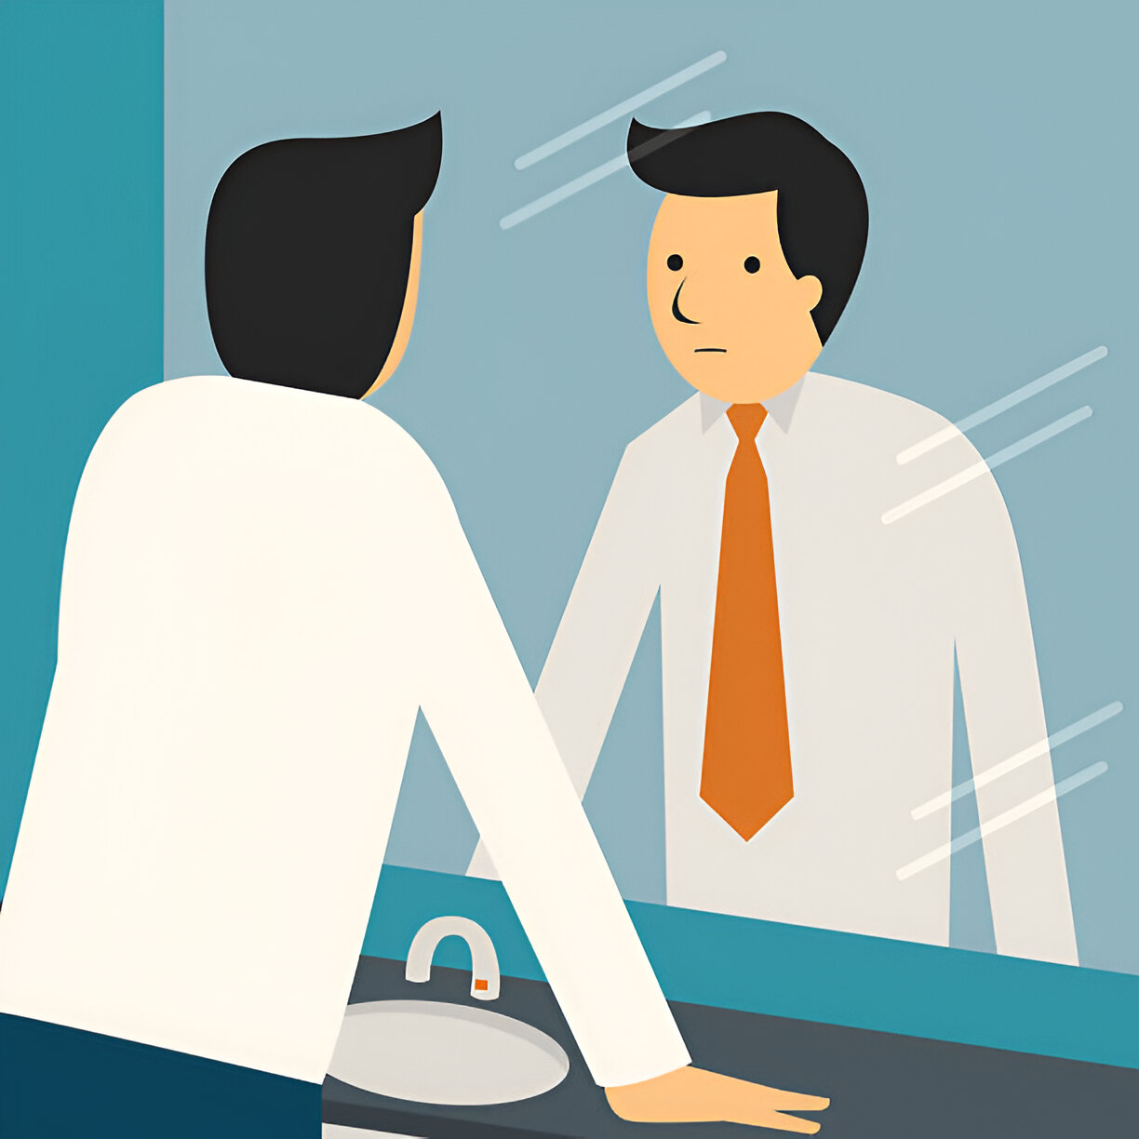
What is Reflection?
In Derinalp’s (2021) thesis, she stated that definition of reflection among scholars is still considered ‘elusive’.
Dating back to the 20th Century, Dewey (1910) believed that the process of reflection is a ‘consequence’.
Bassot (2020, p.6) believed it is developed “…through a process of thinking and looking at your practice in a ‘metaphorical mirror’”.
(iStock, 2023)

Slide 5
What does Reflection mean to me?
It is invoked thinking, to learn from an experience and make sense of any issues that were encountered.

Slide 6
What is Reflective Practice?
“Reflective practice is simply creating a habit, structure, or routine around examining experience” (Amulya, 2004, p. 2).
It is a process of continuous learning that we need to repeat to gain insight from experiences.
It enables self-growth by encouraging an individual to structuralise a reflection and promote critical thinking.

Slide 7
Using Reflective Models
I believe that the effective use of reflective practices can help alleviate stress and anxieties.
It creates a safe environment to reflect on what went well and what went not so well during experiences.
There are many reflective models that can be used as a framework for reflection.
I have chosen Gibbs Reflective Cycle because of its cyclical structure, with one of the stages addressing the feelings of an experience.

Slide 8
Revisited Gibbs’ Cycle
Description
Feelings
Emotions
Evaluation
Analysis
Conclusion
Action Plan
Emotions and feelings are not the same thing.
Wellbeing is essential to professional development.
“Reflective practice requires a particular set of skills and a certain frame of mind or attitude” (Clinical Excellence Commission, 2022, p.4).
(Galli and New, 2022, p.98)

Slide 9
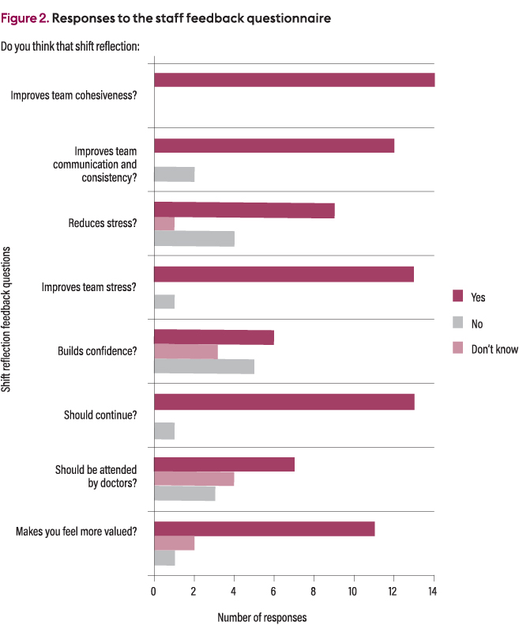
Reflective Practice can make a difference
A study by Ragoobar et al. (2021) showed promising results from using shift reflection with nurses.
Every question yielded mostly positive results, with 13 out of 14 nurses thinking that the reflective practice should continue.
(Ragoobar et al., 2021)

Slide 10
Outcomes
Positivity from past research regarding the use of reflective practice for professional wellbeing.
From experiencing workplace anxiety and the negative effect it has had on my professional performance.
I will incorporate reflective practice based on the revisited Gibbs’ Cycle.

Slide 11

Tyson Fury – Mental Health Ambassador
(GB News,2023)
“It’s down to the individual to know how to stand strong, but it requires a healthy state of mind to succeed. I want to do everything possible to be emotionally ready for these moments” (Tyson Fury, 2022, p.3).

Slide 12
Conclusion
Simplified, reflection is invoked thinking, to learn from an experience and make sense of any issues that were encountered.
Reflective Practice is the habit of structuring these reflections and encouraging self-growth through repetition and critical thinking.
Increased awareness of mental health, and personal experiences of workplace anxiety, have encouraged me to become more reflective.
I can use the Revisited Gibbs’ Reflective Cycle to detail my wellbeing before, during and after a task to improve my mental health and professional development.

Slide 13
References
Amulya, J. (2004) What is Reflective Practice? Massachusetts: Center for Reflective Community Practice. Available at: https://www.careinnovations.org/wp-content/uploads/what-is-reflective-practice65.pdf (Accessed: 14 November 2023).
Bassot, B. (2020) The Reflective Journal. 3rd edn. London: Bloomsbury Publishing Plc.
CDC (2023) Anxiety and Depression. Available at: https://www.cdc.gov/nchs/covid19/pulse/mental-health.htm (Accessed: Nov 23, 2023).
CIPD (2023) Employee health and wellbeing. Available at: https://www.cipd.org/uk/views-and-insights/cipd-viewpoint/employee-health-wellbeing/ (Accessed: 21 November 2023).
Clinical Excellence Commission (2022) Reflective Practice Workbook St Leonards: Clinical Excellence Commission.
Derinalp, P. (2021) Indonesian novice EFL teachers' understanding of and engagement in reflective practice: An exploratory study. . University of York.

Slide 14
Dewey, J. (1910) How we think Lexington: D. C. Heath.
Freepik. (2023) Stress Work Load [1]. Available at: https://img.freepik.com/premium-vector/stress-work-load_230353-6.jpg (Accessed: November 28, 2023).
Fury, T. (2022) Gloves Off: The Autobiography Century, pp. 3.
Galli, F. and New, C.J. (2022) 'Gibbs’ cycle review. Emotions as a part of the cycle', E-motion (Huelva, Spain), 19, pp. 92-101 Available at: https://doi.org/10.33776/remo.vi19.7224.
GB News. (2023) Tyson-Fury-Boxing [1]. London. Available at: https://www.gbnews.com/media-library/tyson-fury-boxing.jpg?id=50576973 (Accessed: November 28, 2023).
Gibbs, G. (1988) Learning by Doing: A guide to teaching and learning methods Oxford: Further Education Unit.

Slide 15
iStock. (2023) Looking-at-himself [1]. Available at: https://media.istockphoto.com/id/535111579/vector/looking-at-himself.jpg?s=612x612&w=0&k=20&c=KD0HH46cms7hq5___RLbpU-s-cGhbblMPonVlHsst7E= (Accessed: Nov 30, 2023).
Mental Health Foundation (2023) What is anxiety? Available at: https://www.mentalhealth.org.uk/our-work/public-engagement/mental-health-awareness-week/anxiety-report/what-anxiety (Accessed: November 29, 2023).
Powaleny, A. (2021) Reflecting on Mental Health Awareness Month. Available at: https://phrma.org/Blog/reflecting-on-mental-health-awareness-month (Accessed: Nov 23, 2023).
Ragoobar, R., Turton, R., Winter, H., Power, N., Belton, C., Chow, C. and Beck, A. (2021) 'The ‘shift reflection’ model of group reflective practice: a pilot study in an acute mental health setting', Mental health practice, 24(1), pp. 25-32 Available at: https://doi.org/10.7748/mhp.2020.e1452.
Rogers, S.L., Priddis, L.E., Michels, N., Tieman, M. and Van Winkle, L.J. (2019) 'Applications of the reflective practice questionnaire in medical education', BMC Medical Education, 19(1), pp. 47 Available at: https://doi.org/10.1186/s12909-019-1481-6.

Slide 16
Thank you!
Any Questions?

