Slide 1
Academic and Employability Skills
Student ID: 20219981

Slide 2
Intended Career Planning
From the starting day of my graduation, I preferred to deliberate myself as a Digital Marketing Manager of a reputed multi national company.
A digital marketing manager analysis the changing pattern of consumers buying behaviour with digital transformation and allocate limited resources for market research and product development (Half, 2018).
Career in digital marketing manager will facilitate my strength of creative perspective, organisational quality, and enhance my communication skill also.
This career possesses high opportunity of professional development and improvement of my qualification that will help me to grow my interpersonal skills (Kaufman, and Horton, 2014).

Slide 3
Required Skills for Digital Marketing Manager Career
For preparing myself as a digital marketing manager I need to possess some relevant skills and the skills are given below:
Digital marketing and technological skill
Communication or interpersonal skill
Group or team collaboration skill
Managerial skill
Time management skill
Problem solving skill

Slide 4
Personal SWOT Analysis
Strengths
Good collaborative skill
Goal oriented
Creative and hard working
Good IT knowledge
Weaknesses
Emotional
Lacking of leadership and managerial issues
Easily distracted
Easily get stressed
Opportunities
Expansion of IT sectors
Broaden of professional skills
Internship
Networking
Threats
Increasing competition
Economic recession
Changing technological environment
SWOT

Slide 5
Time Management Tools
Eat That Frog
This tool will help me to focus on the greater objectives in digital marketing manager career.
It is effective for identifying my skills that need to give priority for developing communication skill.
This tool identifies my responsibilities that are taken action immediately and based on this tool I should learn managerial and leadership skills first for professional improvement (Habbert, and Schroeder, 2020).
The Pomodoro Tool
Through this time management tool I can value my time by focusing any task for 25 minutes.
Pomodoro tool will improve my technological knowledge quality in digital marketing manager career.
As this tool is effective in measuring the approximate time to complete tasks, it will be helpful for work flow in future career (Almalki et al., 2020).

Slide 6
Personal Development Plan
Target Skills | Ways of Achievement | Measurement Techniques | Time Frame | Supporting Resources
Professional Experience | Doing internship in Multinational Companies | Supervisor’s feedback and rewards | Four months | References of faculty and internal recommendations.
Improvement in English Speaking | Getting admission into coaching classes | Weekly tests and results | Three months | English journals, movies, and books.
Learning advanced technological knowledge | Admission on computer coaching | Practical examination, viva and class feedback | Three months | Online guild lines and instructions

Slide 7
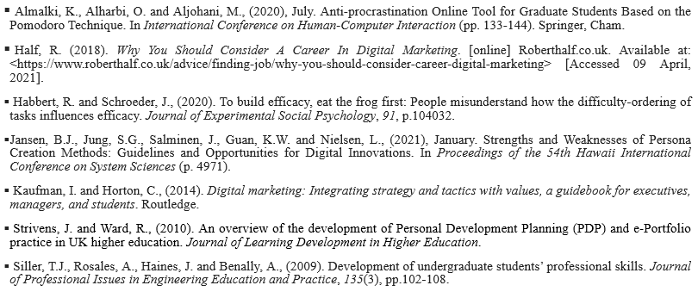
References

