Slide 1

Personal Development
OME Study Skills

Slide 2
What are we covering today?
Employability skills and competencies, professional presentation and self-promotion, e-Portfolio, choosing the right job and employers
Successful self-management e.g. time management, organising space and resources, positive attitude, emotional intelligence, managing change, stress management
Successful problem-solving e.g. action plans, solution-focused thinking, thinking outside the box, creative problem-solving techniques
People skills e.g. evaluating people skills, intelligence types, collaboration and team-working, leadership

Slide 3

Employability Skills

Slide 4
Top Employability Skills
Teamwork
Critical thinking and problem-solving
Communication skills
Self-management
Flexibility and adaptability
Initiative and self-direction
Digital skills
Resilience
Emotional intelligence
Innovation and creativity

Slide 5

Professional Self-Promotion
Self-promotion is presenting or networking yourself in a way that helps you achieve your professional goals
Effective self-promotion can help an employer to understand how your abilities can align with the company or position that you’re applying for.
Benefits can include:
  Differentiating yourself from other candidates
  Establish credibility in your industry
  Increase the chance of furthering your career in your current role
  Enable you to mentor and support team members

Slide 6
Different Types of Self-Promotion
Social Media
  Many people use social media, such as LinkedIn, to promote themselves professionally. Using keywords can help recruiters find you with the right job offers. Some people share their personal social accounts to show their online presence and demonstrate their key skills and qualities.
Personal Branding
  This involves marketing your skills to potential employers. Establishing goals and demonstrating that they align with the company can make you more employable. Personal branding requires a cohesive online and offline presence to be created.
Networking
  It's not what you know, it's who you know sometimes. Attending industry events and building and maintaining professional relationships can help people think of you when it comes to new and exciting opportunities
Self-Development
  Managers often appreciate proactive candidates who identify their own areas of improvement and work to better themselves. This will make you more likely to further your career in both your current and future positions

Slide 7
Successful Self-Promoting
How to self-promote…
Without being overbearing…
Identify your strengths
Communicate clearly
Utilise social media platforms
Create a personal brand
Network and collaborate
Seek opportunities to develop and showcase your skills
Be genuine
Build relationships
Promote others
Focus on providing value
Find balance

Slide 8

e-Portfolio
An e-Portfolio is an online space that allows you to do the following:
  Log, review and update your personal, professional and academic achievements
  Organise and structure your thoughts, ideas, goals and progress
  Clarify goals, reflect, problem-solve and find solutions to any life issues

Slide 9
Personal Development Plan (PDP)
PDP is a structured process that allows you to reflect on your learning, performance and/or achievement, and to plan for your personal, educational and professional development
Creating an e-Portfolio, you are organising your current achievements
Knowing where you are, this makes it easier for you to think about where you want to go
By creating and updating a PDP, you can clarify your goals, take responsibility for your personal and academic development and improve your professional employability

Slide 10
Engaging with the PDP Cycle
THINKING – where you are now, where do your interests lie, where are your strengths and weaknesses, what can you do to improve
PLANNING – where do you want to go, what skills and knowledge do you need to get you there, how might you acquire it
REFLECTION – review your achievements and decide on future areas for development
ACTION – set yourself specific goals and targets, monitor the process towards them

Slide 11
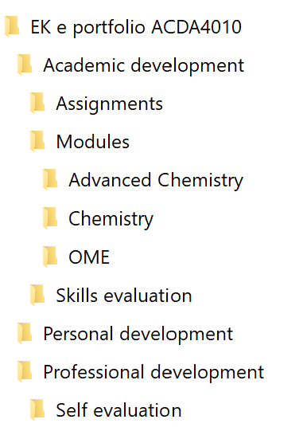
 Main folder
 Sub folder for development area
 Additional sub folder as category in development area
 Additional sub folder as category in development area
 Category sub folder to document specific area
 Category sub folder to document specific area
 Category sub folder to document specific area
 Additional sub folder as category in development area
 Sub folder for development area
 Sub folder for development area
 Additional sub folder as category in development area

Slide 12

Successful
Self-Management

Slide 13
Time Management
Planning
Prioritising
Create a schedule and follow it
Work your way back from key dates
Schedule important activities for when you have the most energy
Make sure you realistically give yourself enough time
Give yourself some flexibility
Planners, online calendars and Gantt charts can be very helpful
Very Important – do it now! Highest priority
Important – do it when you can
Needed but not important – do it when you have time
Not needed and not important – do it last, not the end of the world if it doesn’t get done. Lowest priority
Try to avoid procrastination and task displacement

Slide 14

Organising Space and Resources
Declutter! A tidy workspace will help to streamline productivity
Have a junk jar
Manage your documents – physically and digitally
Colourful and co-ordinating storage and labels in your workspace may be useful
Choose a desk layout that fits your flow
Reorganise before you leave

Slide 15
Positive Attitude – add a little AWE into your life!
Appreciate – consider what you do have, practicing appreciation has been shown to create positive moods and reduce depression
Wonder – take some time to look around and notice your environment whether in nature or the city, you may be amazed at what you can see
Empower – you make a difference in the world, you can help to empower someone

Slide 16
Emotional Intelligence
Perceiving
Detecting and deciphering emotions in faces, pictures, voices
Using
Harness emotions to facilitate activities such as thinking and problem solving
Understanding
Comprehending emotion language and appreciating complicated relationships between emotions
Managing
Regulating emotions and managing them to achieve goals

Slide 17
Emotional Intelligence in the Workplace
Better decision making and problem-solving skills
Keep cool under pressure
Conflict resolution skills
Greater empathy
Listen, reflect and respond to constructive criticism
Higher motivation and focus

Slide 18
Managing Change
Accept that change will happen
Look at the bigger picture
Work together as a team
Communication is key

Slide 19

Managing Stress
Eat, drink and sleep enough
Get active
Try meditation
Laugh more
Connect with other
Know when to seek help

Slide 20

Successful Problem-Solving

Slide 21
Action Plans
Set SMART Goals
Identify Tasks
Allocate Resources
Prioritise Tasks
Set Deadlines
Monitor and Revise

Slide 22
SMART Objectives
Specific
Measurable
Achievable
Relevant
Time-Bound

Slide 23
Solution-Focused Thinking
Problem-focused thinkers concentration on the specific problem at hand and why it emerges
Solution-focused thinkers consider all possible solutions to prevent the problem from occurring
Consider the Leaky Boat example:
  Problem-focused thinking would solve the problem by putting a plug in the hole
  Solution-focused thinking would ask questions such as how do we prevent the leak from happening again? If it does happen again, how do we reduce the impact?
Notes:
There are three types of people, those who focus on problems, those who focus on solutions and those who don’t care

Slide 24

Thinking Outside the Box
Why do professionals get stuck in a box?
  Fear of uncertainty
  Desire for traditional or conventional methods
  Comfort in a specific role or routine
Benefits of thinking outside the box:
  Drive improvement and innovation
  Promotes more effective communication
  Increases adaptability

Slide 25

Creative Problem-Solving Techniques
Brainstorming
Retrograde Analysis – work backwards from the ideal solution
Reverse Assumptions – can provoke unconventional thought patterns
5 why’s – asking why 5 times in a row explores the problem and validity of solutions in depth
Beginner’s Mindset – pretend you know nothing about the problem to create intuitive solutions
Notes:
Reverse assumptions example -

Slide 26

People Skills

Slide 27

Evaluating People Skills
What are people skills? Also known as soft skills, interpersonal skills or social skills, how we interact with people
Why are people skills important?
  Maintain workplace relationships
  Avoid miscommunication
  Gain support and avoid conflict
How can I improve my people skills?
  Control your emotions
  Be assertive
  Show empathy
Can I test my people skills?

Slide 28
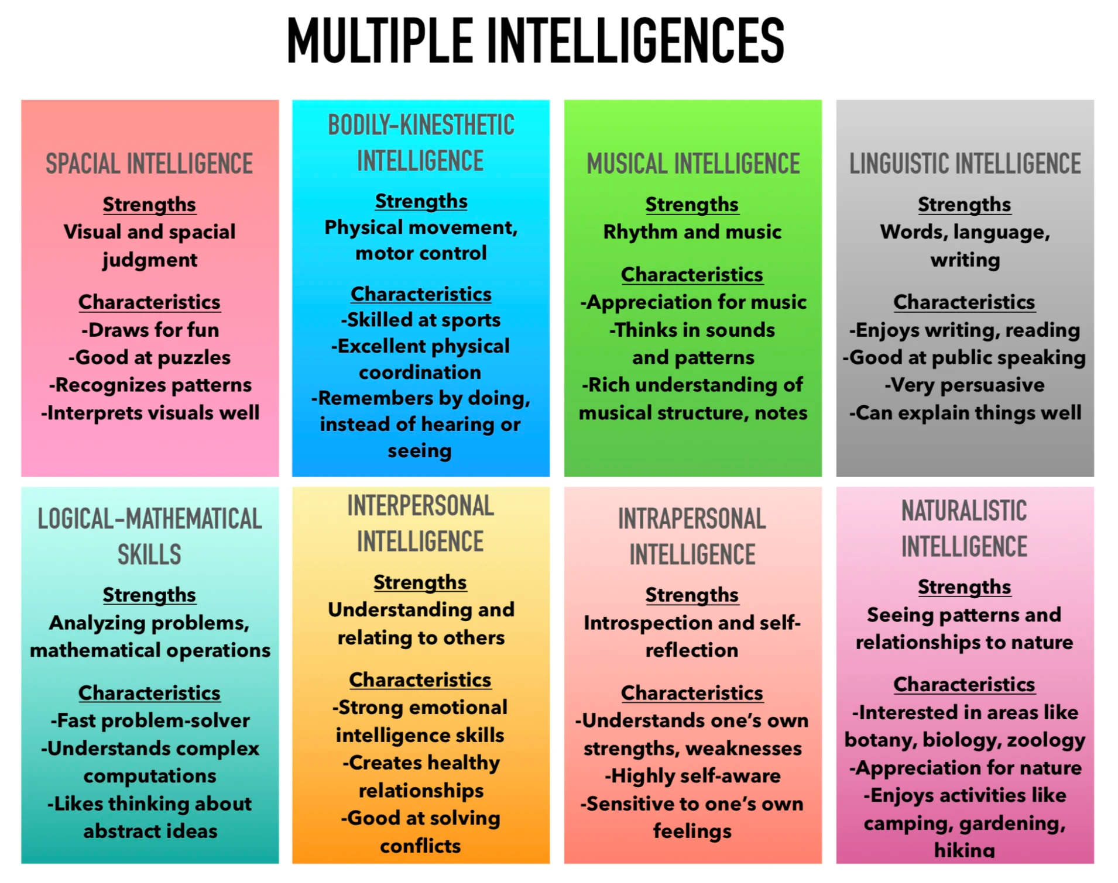
Intelligence Types

Slide 29
Collaboration and Teamwork
Benefits:
How can I improve?
Increased satisfaction at being part of something bigger
Bring together people with different skillsets
Maximise problem-solving
Enhances personal growth
Reduces risk of burnout
Know your goal
Clarify your role
Share enthusiasm
Positive mindset
Don’t fight for credit

Slide 30

Teamwork Tips
Collaborative tools such as Google Docs can support the team even when working remotely
Accepting differences – there will always be differing ideas and opinions in teams, always be respectful of what people bring to the table
Don’t micromanage – micromanagement is counterproductive and time-consuming, when people have a sense of responsibility and agency it removes the micromanagement needs
Start team traditions – this can be good fun and increase team bonding

Slide 31
Leadership Skills
Confidence
Vision
Transparency
Delagation
Humility

