Slide 1

Student name Bernarda Luisa Antonio Candido
Student number 2335282
BMHP6029
Psychopathological Classifications and Provisions Component
I confirm that I have not used any AI tools in the research and creation of this assignment. I confirm that I have not presented any AI generated materials as my own work. I confirm I have copies of my drafts, notes, and other resources I used, which I may be asked to provide in evidence

Slide 2

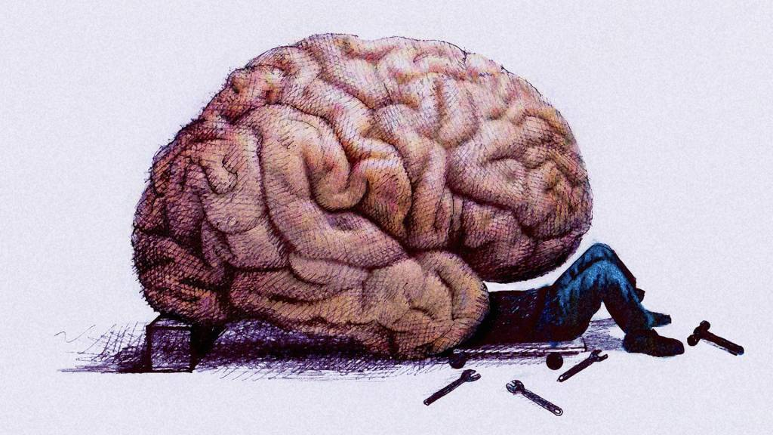
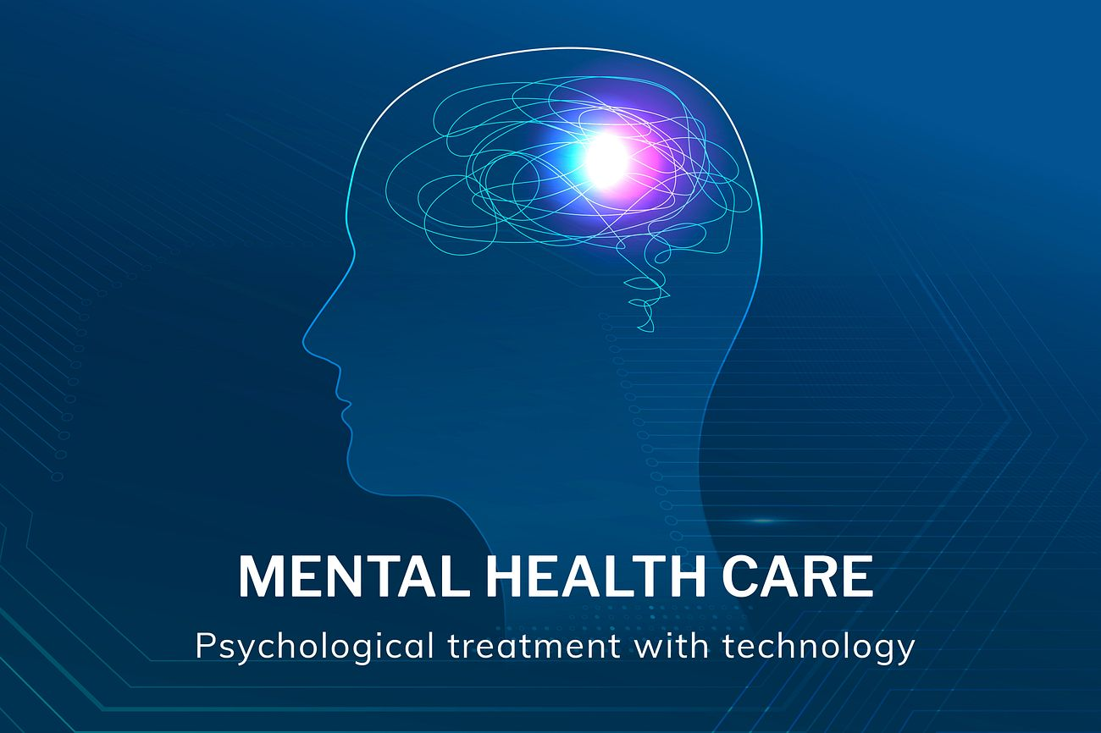


Anxiety Disorder
Obsessive-Compulsive Disorder (OCD)
Code 6B20
Introduction
Historical perspectives and treatments
Current services and treatments
Recommendations
Obsessive-Compulsive Disorder (OCD)
Obsessive-Compulsive Disorder (OCD) is a chronic mental health disorder characterised by persistent intrusive thoughts (obsessions) and repetitive behaviours or mental acts (compulsions) performed to reduce anxiety (American Psychiatric Association, 2022). OCD affects approximately 1–2% of the population and can significantly impair education, employment, relationships and quality of life (World Health Organization, 2022). This poster explores the historical and contemporary understanding of OCD, examines changes in attitudes, clinical practice and policy in England, and provides recommendations for future policy and practice.
Causes, Symptoms, Diagnosis
Causes
Current evidence supports a biopsychosocial model, suggesting OCD develops through interactions between:
Genetic susceptibility
Brain abnormalities affecting serotonin pathways
Psychological learning processes
Environmental stress and traumatic experiences (Fineberg et al., 2020).
Common Symptoms
Obsessions
Fear of contamination
Intrusive violent or sexual thoughts
Excessive doubts
Need for symmetry or order
Compulsions
Excessive hand washing
Repeated checking
Counting
Arranging objects
Seeking reassurance
Diagnosis
Diagnosis is based on clinical assessment using the ICD-11 diagnostic criteria. Symptoms must be time-consuming (typically more than one hour per day) or cause significant distress or impairment (American Psychiatric Association, 2022).
Historically, obsessive thoughts were often interpreted as signs of religious or moral weakness, resulting in misunderstanding and stigma (Porter, 2002). During the nineteenth and early twentieth centuries, OCD was viewed through psychoanalytic theories, with Freud suggesting obsessions reflected unconscious psychological conflict (Freud, 1909).
Contemporary understanding has shifted towards a neurobiological and biopsychosocial perspective supported by advances in neuroscience and psychological research. In England, the move from institutional care towards community-based mental health services, together with the introduction of evidence-based NICE guidance, has significantly improved treatment and patient outcomes.
How did medical professionals view OCD
Medical understanding of Obsessive-Compulsive Disorder (OCD) has changed considerably over time. In the late nineteenth and early twentieth centuries, many psychiatrists viewed OCD through a psychoanalytic perspective. Freud (1909) suggested that obsessive thoughts and compulsive behaviours arose from unconscious conflicts and unresolved childhood experiences. During this period, treatment focused mainly on psychoanalysis rather than evidence-based interventions.
From the mid-twentieth century onwards, advances in neuroscience and psychology led clinicians to recognise OCD as a neuropsychiatric disorder influenced by biological, psychological and environmental factors. Current practice in England follows a biopsychosocial model, with NICE recommending Cognitive Behavioural Therapy (CBT) with Exposure and Response Prevention (ERP) as the first-line treatment, alongside Selective Serotonin Reuptake Inhibitors (SSRIs) where appropriate (NICE, 2005; American Psychiatric Association, 2022). This shift reflects a move from theoretical explanations to evidence-based, person-centred care.
Increase investment in specialist OCD services.
Reduce NHS waiting times for CBT with ERP.
Improve early identification within schools and primary care.
Increase public awareness to reduce stigma.
Improve cultural competence within mental health services.
Expand digital CBT while maintaining face-to-face treatment options.
Continue workforce recruitment and specialist training.
The understanding of OCD has evolved from misconceptions and stigma to recognition as a complex mental health disorder requiring evidence-based intervention. In England, NICE guidance and NHS Talking Therapies have improved access to effective treatments, such as CBT with Exposure and Response Prevention (ERP) and, where appropriate, medication. However, delayed diagnosis, workforce shortages and inequalities in access continue to affect patient outcomes. Future policy should prioritise early intervention, equitable access and investment in specialist services to improve recovery and quality of life.
American Psychiatric Association (2022) Diagnostic and Statistical Manual of Mental Disorders. 5th edn., text revision. Washington, DC: American Psychiatric Association Publishing.
Engel, G.L. (1977) ‘The need for a new medical model: A challenge for biomedicine’, Science, 196(4286), pp. 129–136.
Fineberg, N.A., Hollander, E., Pallanti, S., Walitza, S., Grünblatt, E., Dell’Osso, B., Menchón, J.M., Zohar, J., Rodriguez, C.I., Menchon, J.M. and others (2020) ‘Clinical advances in obsessive-compulsive disorder: A position statement’, International Clinical Psychopharmacology, 35(4), pp. 173–193.
Freud, S. (1909) Notes Upon a Case of Obsessional Neurosis. London: Hogarth Press.
National Institute for Health and Care Excellence (2005) Obsessive-Compulsive Disorder and Body Dysmorphic Disorder: Treatment (CG31). Available at: https://www.nice.org.uk/guidance/cg31 (Accessed: 10 July 2026).
NHS England (2024) NHS Talking Therapies for Anxiety and Depression. Available at: https://www.england.nhs.uk/mental-health/adults/nhs-talking-therapies/ (Accessed: 30 July 2026).
Royal College of Psychiatrists (2023) Obsessive-Compulsive Disorder (OCD). Available at: https://www.rcpsych.ac.uk/mental-health/mental-illnesses-and-mental-health-problems/obsessive-compulsive-disorder-ocd (Accessed: 02 July 2026).
Porter, R. (2002) Madness: A Brief History. Oxford: Oxford University Press.
World Health Organization (2022) World Mental Health Report: Transforming Mental Health for All. Geneva: World Health Organization.
World Health Organization (2023) Mental disorders. Available at: https://www.who.int/news-room/fact-sheets/detail/mental-disorders (Accessed: 30 July 2026).
Psychological Treatment
Cognitive Behavioural Therapy (CBT)
Exposure and Response Prevention (ERP)
Guided self-help for mild symptoms
Medication
Selective Serotonin Reuptake Inhibitors (SSRIs)
Combined CBT and medication for moderate to severe OCD
NHS Services
People usually access treatment through:
General Practice (GP)
NHS Talking Therapies
Community Mental Health Teams
Specialist OCD services where required (NHS England, 2024).
Conclusions
References

