Slide 1
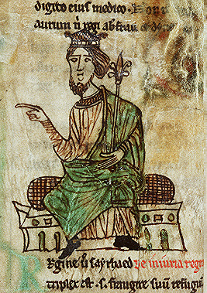
The Laws of Hywel Dda https://commons.wikimedia.org/wiki/File%3AHywel_Dda.jpg, National Library of Wales, MS Peniarth 28

Slide 2
Who was Hywel Dda? c. 880-950
Hywel Dda literally means ‘Hywel the Good’. He was the son of Cadell and grandson of Rhodri Mawr. He became king of Deheubarth (south Wales) and later ruled over most of Wales (including Powys and Gwynedd).
He had a younger brother called Clydog who died c. 920.
He married Elen of Dyfed and had a good relationship with Aethelstan of England.

Slide 3
Hywel Dda’s name became associated with the laws of Wales in the medieval period (cyfreithiau Hywel Dda) because many of the surviving law texts refer in their prologues to a conference he organised at Whitland and claim that he drew together legal experts and lawyers to put together a series of laws or make some attempt to codify the laws of Wales.
It is not known whether this actually took place and most of the elements that survive in the medieval prose legal texts are much later than tenth century.

Slide 4
Hywel Dda is referred to as King of the Britons in Annales Cambriae and the Annals of Ulster.
His reign was generally peaceful by contemporary standards.
He had three sons – Owain, Rhodri and Edwin.
Following Hywel’s death his kingdom was split and divided between his sons and the sons of Idwal Foel.
Cyfraith Hywel was different from English Common Law and Canon Law.

Slide 5
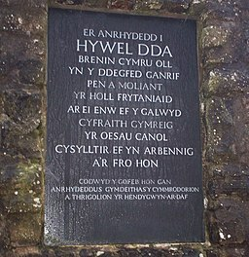
Hywel Dda gave his name to one of the National Health Authorities in Wales as well as the Hywel Dda Centre in Whitland ‘the only garden in Europe dedicated to the law’.
His name is also reflected in the Welsh Assembly Government’s legal chamber.
Image: welshbabe / Plaque, Hywel Dda Centre, Whitland / CC BY-SA 2.0

Slide 6
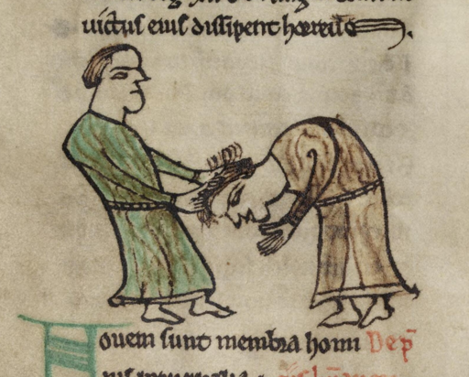
Medieval Welsh society was hierarchical and every person had a value according to their status.
The higher a person’s status, the higher the fine payable to the kin if the person was killed.
Galanas = life price
Sarhaed = injury price
The death penalty was only implemented in certain cases of theft; generally a fine was paid either to the victim or their kin.
Wales and Ireland shared these two basic concepts.
Image: NLW Peniarth MS 28, Hair Pulling. A Latin copy of the Laws of Hywel Dda, belongs to one of the National Library of Wales's foundation collections of manuscripts, the Peniarth Manuscripts.

Slide 7
The original meaning of galanas was ‘feud’, but it came to mean the fine given to prevent feuding between two families.
It indicated the fee payable if someone was killed and this varied according to the person’s status.
The different values placed on men are listed in the Iorwerth text and different fines are also levied on specific parts of the body.

Slide 8
Theft – taking by stealth – was a more serious crime than robbery – taking by force – and only the first form of theft was considered a capital offence. The idea behind this perhaps, according to Dafydd Jenkins, is that a thief acts in secret whereas a strong armed man could protect his belongings.
In England common law was born in the twelfth century when disorder had become intolerable. Punishment of the offender appears to have been more important to the state than compensating the victim.
Welsh law, on the other hand, focused on compensation.

Slide 9
There are more law texts extant than any other genre of medieval Welsh prose.
Morfydd Owen argues that two unifying features that made Wales a nation in the Middle Ages were the Welsh language and Welsh law.
The law texts were recorded in Welsh and Latin.
They are often divided into 3 categories:
The Book of Iorwerth (associated with Gwynedd)
The Book of Blegwryd (Dyfed)
The Book of Cyfnerth (Powys and the Marches)

Slide 10
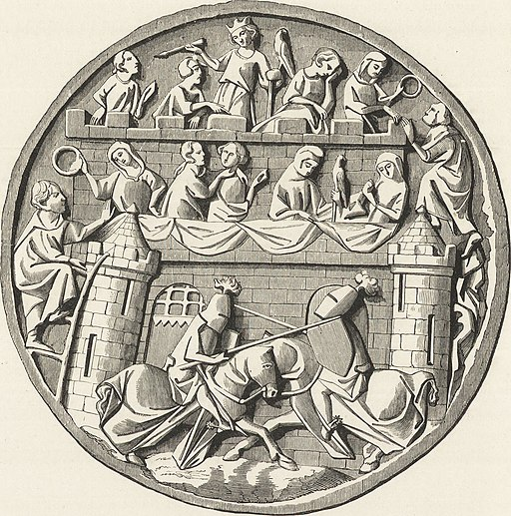
Bloodshed - there were specific rules relating to bloodshed. You could not prosecute unless the blood reached the ground – perhaps a survival in secularised form of the magical or sacral aspect of bloodshed – as in Biblical law and the idea that the earth is polluted by blood.
If a judge gave a punishment that was reversed on appeal, he would be punished himself and the laws say he would pay a heavy financial penalty and be disqualified from judging.
Image: Wikimedia commons The Prize of the Tournament. From a Looking-glass Lid in Carved Ivory. End of the Thirteenth Century

Slide 11
The laws are thought to have been the same throughout Wales although the names given to the different recensions give the impression that these suggest connections with particular regions.
Iorwerth ap Madog lived in Gwynedd in the thirteenth century and belonged to a line of professional educated people.
Other learned men associated with the law texts were poets and lawyers.
The word ‘ynad’ appears in the laws and although today this means Justice, it is thought to have meant a man well versed in the laws.

Slide 12
Tractates defining the different grades in society are regularly found in the law texts. These often list the different social and professional rankings, lament the short comings of these ranks and note that God ordained three social ranks – soldiers, priests and farmers.
A person’s rank was generally determined not by their job but the social status of their kin.

Slide 13
Rather than decide who was telling the truth a judge would need to request that the party which was most likely to know the truth ‘prove’ this with oaths. The oaths could be sworn by a number of witnesses who testified to particular facts. There were strict rules for the qualifications and disqualifications of witnesses, but the witnesses do not appear to have been cross examined.

Slide 14
Cyfraith y Gwragedd/The Welsh Law of Women
Marriage
In medieval Wales marriage was a sexual union.
morwyn -> gwraig maiden -> wife
According to the tractate known as Cyfraith y Gwragedd (The Welsh Law of Women), sexual intercourse rather than a religious ceremony marked this important rite de passage. The situation was the same in England where a ceremony could act as proof of the couple’s commitment to their sexual union. As Dafydd Jenkins (1980:86) states: ‘It must be remembered that neither ecclesiastical nor secular law in medieval England regarded a religious ceremony as essential to the validity of a marriage: the commitment of the parties to each other was what created the union, and a religious ceremony was of legal importance as providing notorious evidence of a commitment which might otherwise be very difficult to prove.’

Slide 15
In Wales nine different kinds of unions were officially recognised according to ‘Nau Kynywedi Teithiauc’ defined by T.M. Charles-Edwards as: ‘the nine lawful unions in the sense of nine processes by which a man and a woman were sexually united in the eyes of the law’. Amongst these one finds:
Priodas/marriage (the woman is given to the man by her family) this was the most respectable form of union (e.g. Branwen and Matholwch PKM2)

Slide 16
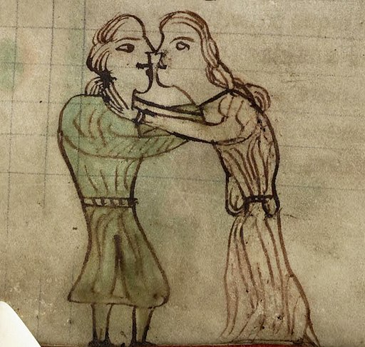
Llathlud/elopement – the girl decides to elope with the man of her choice or is kidnapped against her will. In this case the girl’s family do not choose her husband.
beichiogi twyll gwreic llwyn a pherth (secret pregnancy of bush and brake) – this was acknowledged as a legal union and the man was obliged to support his children financially.
Image: NLW Peniarth 28, Kissing Couple. From a Latin copy of the Laws of Hywel Dda, which belongs to one of the National Library of Wales's foundation collections of manuscripts, the Peniarth Manuscripts.

Slide 17
Llathlud/elopement – the girl decides to elope with the man of her choice or is kidnapped against her will. In this case the girl’s family do not choose her husband.
beichiogi twyll gwreic llwyn a pherth (secret pregnancy of bush and brake) – this was acknowledged as a legal union and the man was obliged to support his children financially.

Slide 18
T6yll uor6yn (twyll forwyn) – a maiden who has been tricked, i.e. raped. (In a different context this can also mean false virgin. See below.) Rape was considered to be a lawful union and the maiden became the rapist’s wife. However rape was also a punishable crime. (cf. the rape of Goewin in PKM4). If the girl was a virgin prior to the rape she was entitled to receive cowyll, agweddi, wynebwerth and dilysrwydd. Amobr was payable to her territorial lord. It was a crime to rape another man’s wife, and since this also insulted her husband, the rapist had to pay sarhaed (insult price).

Slide 19
Rape - Detailed compensation was payable for rape; According to Dafydd Jenkins: ‘since rape creates a marital union which is immediately terminated, all the payments which fall due on creation or termination are payable, in addition to the payments appropriate to the insults involved’ (p. xxix)

Slide 20
All young women were expected to be virgins on the night of their marriage. If it was discovered that the girl was not a virgin (twyllforwyn/ a false virgin), she was punished. The groom was entitled to invite the girl’s immediate family (cyfnesefiaid) into the bedroom and ask them to pledge that she was undefiled when she was given to the man in marriage. If the family were unwilling to do this, or if it was acknowledged that she was not a virgin, then the girl was publicly humiliated in front of the wedding guests (neithiorwyr): her night gown was cut off above her genitals and she was given a one-year-old steer with a greased tail. If the girl could hold on to the animal’s tail, she was allowed to keep it as her agweddi otherwise she lost all legal rights to financial settlements on separation from her ‘husband’. (cf. Arianrhod in PKM4 who is found to be a false virgin, but is not punished in this way).

Slide 21
Divorce – in the first seven years a fee known as agweddi would be payable; after seven years the woman would be entitled to half the movable goods that the couple owned. Detailed lists are provided in the Welsh law of women as to how the goods should be divided. Women were not supposed to own land and there is no mention that they were entitled to non movable goods i.e. property/the house!

Slide 22
Considerable detail relating to how their property should be split is given in the law texts (e.g. the woman had the top covers on the bed and the man could take the bedclothes upon which they had slept. However, if he remarried the clothes were given to his ex-wife.) According to Cyfraith y Gwragedd, women were not allowed to inherit land.

Slide 23
cowyll – (morning gift) made to the virgin bride by her husband, as payment for her virginity.
amobr – this was paid to the maiden’s territorial lord on the loss of her virginity (cf. ius primae noctis in England, i.e. the lord’s right to sleep with a virgin on her wedding night). Amobr does appear to have been extracted from the girl’s family and there are records of the amount of amobr paid annually in some parts of Wales. R. R. Davies suggests that the Marcher lords made a considerable amount of profit from amobr. It also appears to have been payable for sexual promiscuity (until the girl’s family officially declared that she was a common prostitute).
(Many other legal terms are defined by Dafydd Jenkins and Morfydd E. Owen (1980). See The Welsh Law of Women)

Slide 24
Murder, Injury and Insult
In the Middle Ages women were considered to be inferior to men and they had fewer legal rights. Women were not wholly independent, since their legal status was dependent upon the legal status of either their brothers or their husbands.
galanas (life price) – a fine payable for murder
galanas merch/ a female’s galanas = half her brother’s galanas (even after marriage) – usually defined as a certain number of cattle. This implies that the family’s loss was greater when they lost a son than when they lost a daughter.

Slide 25
Sarhaed (insult price)
sarhaed (insult price) – a fee payable for insulting another individual or causing physical harm – usually defined in terms of cattle and money. (cf. PKM2 Efnisien insults Matholwch and Bendigeidfran offers sarhaed as compensation).
sarhaed morwyn/a virgin’s sarhaed = half her brother’s sarhaed (before marriage)
sarhaed gwraig/a wife’s sarhaed = one third of her husband’s sarhaed (after marriage).

Slide 26
Bibliography
Cyfraith Hywel website http://www.cyfraith-hywel.org.uk/en/llyfryddiaeth-gweithiaumawr.php, accessed 23 November 2016
Helmholz, R.H., Marriage, Litigation in Medieval England (Cambridge: Cambridge University Press, 1974).
Jenkins, Dafydd (trans.) The Law of Hywel Dda (Llandysul: Gomer Press, 1986).
Jenkins, Dafydd and Owen, M.E. (eds), The Welsh Law of Women (Cardiff: University of Wales Press, 1980)
Owen, M. E. (ed.), The Welsh King and his Court, ed. M. E. Owen (Cardiff: University of Wales Press, 2000)
Pryce, Huw, Native Law and the Church in Medieval Wales (Oxford: Oxford University Press, 1985)
Sheehan, Michael M., Marriage, Family, and Law in Medieval Europe: Collected Studies (Cardiff: University of Wales Press, 1996).

